Slide 1


OOP with Java

Slide 2

K.Srivatsan - vatsan@gmail.com
IT Trainer Since 1991
Conducting Java Training Since 2004
About 60+ Corporate Clients

Slide 3
Objective
Describe the key features of Java technology
Write, compile, and run a simple Java application
Describe the function of the Java Virtual Machine
Define garbage collection

Slide 4
History of Java
Conceived as Programming language for embedded systems like microwave ovens, televisions etc
One of the first projects developed using Java
    personal hand-held remote control named Star 7.
The original language was called Oak
It was developed in the year 1991 at Sun Microsystems
Notes:
Java was conceived by a team of engineers in Sun Microsystems in 1991 as a part of a research project, which was led by James Gosling and Patrick Naughton. It took 18 months to develop the first working version. This language was initially called “Oak” but was renamed as “Java” in 1995.
Modeled after C++, the Java language was designed to be small, simple, and portable across platforms and operating systems, both at the source and at the binary level, which means that Java programs (applets and applications) can run on any machine that has the Java virtual machine installed.

Slide 5
Primary Goals of Java
Provides an easy-to-use language by:
  Avoiding many pitfalls of other languages
  Being object-oriented
  Enabling users to create streamlined and clear code
Provides an interpreted environment for:
  Improved speed of development
  Code portability
  Enables users to run more than one thread of activity
  Loads classes dynamically; that is, at the time they are actually needed
  Supports changing programs dynamically during runtime by loading classes from disparate sources

Slide 6
Features of Java
Features that fulfill the goals:
  The Java Virtual Machine (JVM)
  Garbage collection
  The Java Runtime Environment (JRE)
  JVM tool interface

Slide 7
The Java Virtual Machine
Executes instructions that a Java compiler generates.
A runtime environment, embedded in web browsers, servers, and operating systems
Imaginary machine that is implemented by emulating software on a real machine
Reads compiled byte codes that are platform-independent
Bytecode
  a special machine language that can be understood by the JVM independent of any particular computer hardware,
  Java Runtime Environment (JRE) is an implementation of the JVM”.
  “JVM becomes an instance of JRE at runtime”.
    A runtime instance of JVM will born when .class file starts its execution

Slide 8
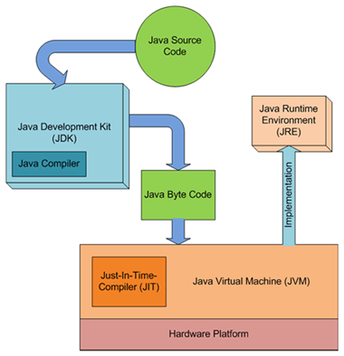
JDK,JVM and JRE

Slide 9
JVM Tasks
Loads code
  Loads all classes necessary for the execution of a program
  Maintains classes of the local file system in separate namespaces
Verifies code (Bytecode Verifier)
  The code adheres to the JVM specification.
  The code does not violate system integrity.
  The parameter types for all operational code are correct.
  No illegal data conversions have occurred.

Slide 10
Class Loader
Bootstrap Class Loader
  Responsible for loading classes from bootstrap classpath
  JAVA_HOME/jre/lib directory.
  Highest priority will be given to this loader.
Extension Class Loader
  This loader is child of Boorstrap class loader.
  It loads classes from JAVA_HOME/jre/lib/ext
  Can be specified by the java.ext.dirs system property.
Application Class Loader
  This loader is child of Extension class loader
  Responsible for loading classes from application level classpath.
  It uses Environment Variable which is mapped to java.class.path.

Slide 11
Runtime Data Area
Divided into five components
JVM uses them for different purposes.
Method Area
  This area is shared across all threads.
  All the class level information like class name, immediate parent class name, method information are stored here, including all static variables.
Heap Area
  All the objects and their corresponding information is stored in this area.
  shared across all threads, so data stored here are not thread safe.

Slide 12
Runtime Data Area
Stack Area
  Stack area is not shared resource.
  For each thread one stack will be created in this area.
  For each method call an entry will be created in record/stack frame.
  All the local variables will be stored in this region.
PC Registers
  Each thread will be having their separate PC register which is responsible of storing the current instruction being executed.
  Once the execution of current instruction is done, it will be updated with the next instruction to be executed.
Native Method Stack
  For every thread separate native stack will be created.
  Native stack holds all native method information.

Slide 13
Working of Class Loader
When JVM gets the request of loading a class, it first invokes loadClass() method of ClassLoader by passing the fully classified name of the class.
loadClass() method first checks whether the class is already loaded by calling findLoadedClass() method.
If the class is not loaded already, the request will be delegated to parent classloader to load the class.
If the parent classloader fails and if findBootstrapClass0() method also fails, the findClass() method is invoked to look for the classes in the file system.
If findClass() finds the class, then defineClass() method is invoked to convert bytecodes into a .class instance.

Slide 14
Garbage Collection
Garbage collector is responsible for cleaning the memory.
In other languages, de-allocation is the programmer’s responsibility.
A system-level thread to track memory allocation.
Garbage collection has the following characteristics:
  Checks for and frees memory no longer needed
  Is done automatically
  Can vary dramatically across JVM implementations
Can request JVM to run garbage collection by calling System.gc()

Slide 15
Execution Engine
Execution Engine is responsible for executing the bytecode line by line using the information stored in different memory location.
It is majorly divided into three major component.
Interpreter
  It interprets the bytecode line by line and it does it very fast, but executes very slow.
  The main disadvantage of interpreter is that if any method is called multiple times, every time a new interpretation is required.

Slide 16
Execution Engine
JIT Compiler
  Just In Time (JIT) compiler comes handy in overcoming the disadvantage of interpreter by increasing the efficiency.
  JIT uses a special component called Profiler to find out the repeated method calls. Once it finds the repeated method calls JIT uses the same native code which was interpreted in first method call every time, and makes sure that no re-interpretation is required.

Slide 17
Custom Class Loader
Custom classloaders are basically helpfull in loading classes from different sources other than local file system.
If we want to load a class from a FTP server, database or any other persistence store, in that case we have to extend the existing classloaders and give our own implementation accordingly.
For an example, Applets are mostly loaded from internet rather than local file system and AppletClassLoader is responsible for this loading operation.

Slide 18
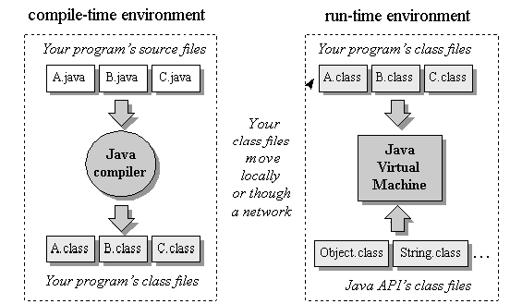
Compile time and Runtime Environment

Slide 19
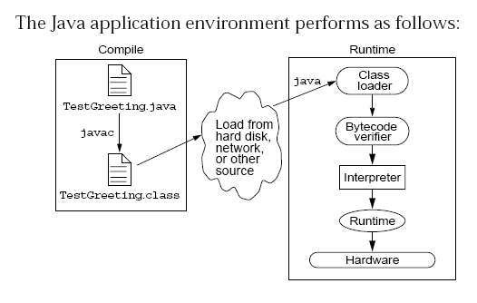
Java Run Time Environment

Slide 20
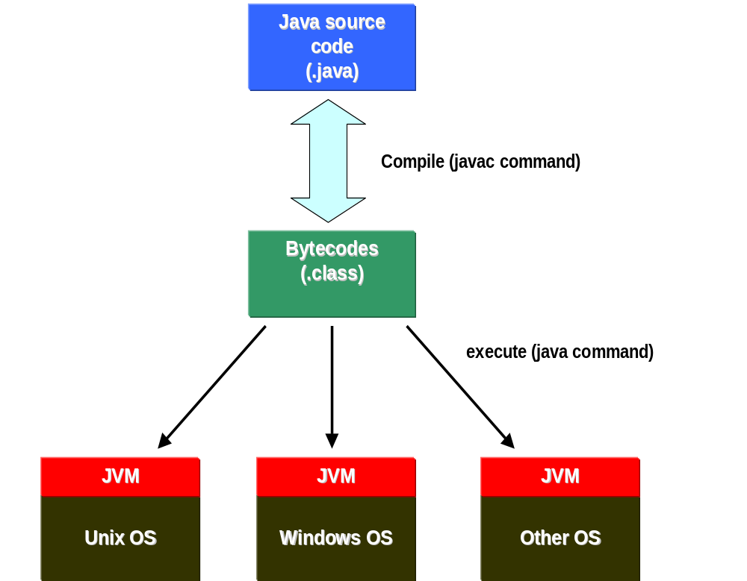

Slide 21
Integrated Development Environments
An IDE is the high-productivity tool
Used to edit, compile, and test programs, manage projects, debugging, building GUI interfaces, etc.
IDE provides extensive programming support for editing and project management,
The Popular IDE’s
  Eclipse
  NetBeans
  JDeveloper

Slide 22
Java language syntax

Slide 23
Objectives
Identify the basic parts of a Java program
Differentiate among Java literals, primitive data types,
variable types ,identifiers and operators
Develop a simple valid Java program using the concepts learned in this chapter

Slide 24
Program structure
A program in Java consists of one or more class definitions
One of these classes must define a method main(), which is where the program starts running
Java programs should always end with the .java extension.
There can be More than one Class Definition in a class ,but only one public class
Source Filenames should match the name of the public class.

Slide 25
Source File Layout
Basic syntax of a Java source file is:
[<package_declaration>]
<import_declaration>*
<class_declaration>+

Slide 26
Software Packages
Packages help manage large software systems.
Packages can contain classes and sub-packages.
package <top_pkg_name>[.<sub_pkg_name>]*;
Specify the package declaration at the beginning of the source file.
Only one package declaration per source file.
If no package is declared, then the class is placed into the default package.
Package names must be hierarchical and separated by dots.

Slide 27
The import Statement
import <pkg_name>[.<sub_pkg_name>]*.<class_name>;
import <pkg_name>[.<sub_pkg_name>]*.*;
import java.util.List;
import java.io.*;
import shipping.gui.reportscreens.*;
The import statement does the following:
  Precedes all class declarations
  Tells the compiler where to find classes

Slide 28
Example 1.1
  package com.training;
  public class Greetings {
  public String getMessage() {
  return "Welcome to Java Programming";
  }
  }

Slide 29
Example 1.1 (contd)
  package com.training;
  public class TestGreetings {
  public static void main(String[] args) {
  Greetings grtObj = new Greetings();
  System.out.println(grtObj.getMessage());
  }
  }

Slide 30
The System Class
Its part of the java.lang package
The classes in this package are available without the need for an import statement
This class contains several useful class fields and methods.
It can’t be Instantiated
It also Provides facilities for
  Standard Input
  Standard Output
  Error Output Streams
  Access to externally defined properties

Slide 31
Objectives
Define modeling concepts: abstraction, encapsulation,
Discuss why you can reuse Java technology application code
Define class, member, attribute, method, constructor, and package
Use the access modifiers private and public as appropriate for the guidelines of encapsulation
Invoke a method on a particular object
Use the Java technology application programming interface (API) online documentation

Slide 32
Abstraction
Functions – Write an algorithm once to be used in many situations
Objects – Group a related set of attributes and behaviors into a class
Frameworks and APIs – Large groups of objects that support a complex activity;
Frameworks can be used as is or be modified to extend the basic behavior

Slide 33
Classes as Blueprints for Objects
In manufacturing, a blueprint describes a device from which many physical devices are constructed.
In software, a class is a description of an object:
  A class describes the data that each object includes.
  A class describes the behaviors that each object exhibits.
In Java technology, classes support three key features OOP
  Encapsulation
  Inheritance
  Polymorphism

Slide 34
Declaring Java Technology Classes
Basic syntax of a Java class:
  <modifier>* class <class_name> {
  <attribute_declaration>*
  <constructor_declaration>*
  <method_declaration>*
  }
Define an attribute:
<modifier>* <type> <name> [ = <initial_value>];

Slide 35
Declaring Methods
Basic syntax of a method:
<modifier>* <return_type> <name> ( <argument>* ) {
<statement>*
}
  public int getWeight() {
  return weight;
  }
  public void setWeight(int newWeight) {
  if ( newWeight > 0 ) {
  weight = newWeight;
  }
  }

Slide 36
Accessing Object Members
The dot notation is: <object>.<member>
  used to access object members, including attributes and methods.
d.setWeight(42);
d.weight = 42; // only permissible if weight is public

Slide 37
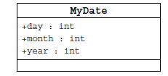
Information Hiding
Client code has direct access to internal data
(d refers to a MyDate object):
d.day = 32; // invalid day
d.month = 2; d.day = 30; // plausible but wrong
d.day = d.day + 1; // no check for wrap around

Slide 38
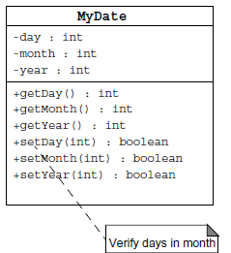
Encapsulation
Hides the implementation details of a class
Forces the user to use an interface to access data
Makes the code more maintainable

Slide 39
The Default Constructor
There is always at least one constructor in every class.
If the writer does not supply any constructors, the default constructor is present automatically:
The default constructor takes no arguments
The default constructor body is empty
The default enables you to create object instances with new Xxx()without having to write a constructor.
  [<modifier>] <class_name> ( <argument>* ) {
  <statement>*
  }

Slide 40
Classes
Top-level classes can be declared as
  public
    a public class is globally accessible.
    a single source file can have only one public class or interface
  abstract
    an abstract class cannot be instantiated
  final
    a final class cannot be subclassed
  Default
    With any Modifier
They can’t be declared as protected and private

Slide 41
Constructors
Have no return type
Have the same name as the class
If we don't’ put a constructor the compiler puts a default one
  The default constructor has the same access modifier as the class.
  The default constructor has no arguments.
  The default constructor is always a no-arg constructor, but a no-arg constructor is not necessarily the default constructor
  The default constructor includes a no-arg call to the super constructor (super()).
They are not inherited and hence they are not overridden
It can be Overloaded
It can have any of the Four Access Modifies
It cannot be synchronized
It can have throws clause

Slide 42
Instantiation with new
It is the process by which individual objects are created.
  Class objectReference = new Constructor();
Declaration
  Employee empObj;
Instantiation
  empObj = new Employee()
Declaration and Instantiation
  Employee empObj = new Employee()
  new operator allocates memory for an object.

Slide 43
Constructor Overloading
One constructor can call another overloaded constructor of the same class by using this keyword.
this() is used to call a constructor from another overloaded constructor in the same class
The call to this() can be used only in a constructor ,and must be the first statement in a constructor
A constructor can call its super class constructor by using the super keyword.
A constructor can have a call to super() or this() but never both

Slide 44
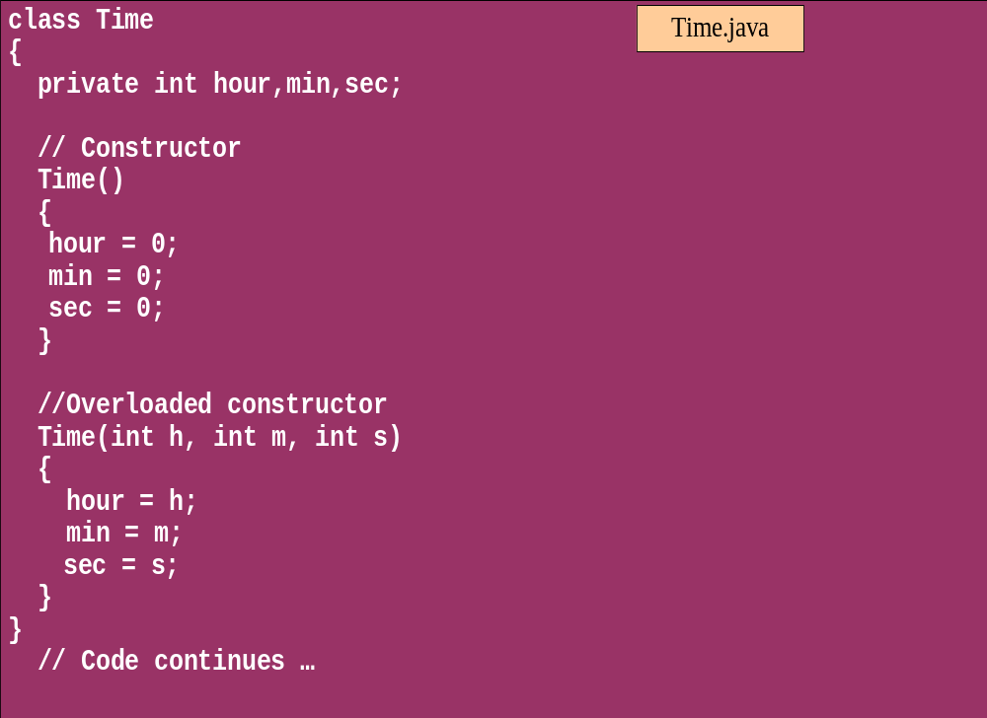
Overloaded Constructor

Slide 45
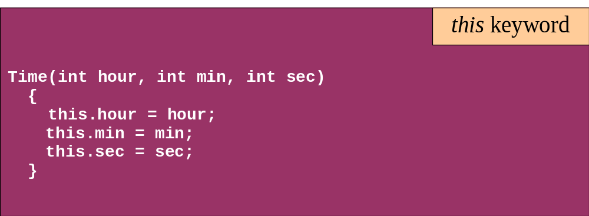
this keyword
Is a reference to the object from which the method was invoked

Slide 46
Comments
Java supports three forms of comments
  // single line comments
  /* multi
    line
    comment
    */
  /** a
    * Javadoc
    * comment
    */

Slide 47
Variables and Methods
A variable, which corresponds to an attribute, is a named memory location that can store a certain type of value.
Variable is a kind of special container that can only hold objects of a certain type.
Primitive type Variable
    Basic, built-in types that are part of the Java language
    Two basic categories
      boolean
      Numeric
        Integral - byte, short, int, long, char
        Floating point - float, double

Slide 48
Instance Variables and Methods
Variables and methods can be associated either with objects or their classes
An instance variable and instance method belongs to an object.
They can have any one of the four access levels
  Three access modifies – private, public , protected
They have a default value
A class variable (or class method) is a variable (or method) that is associated with the class itself.

Slide 49
Example for Variables
  public class VariableTypes {
  private int inst_empid;
  private static String cls_empName
  public void getData() { }
  public static void getSalary() { }
  public void showData(int a)
  {
  int localVariable ;
  }
  }
Instance Variable
Class Variable
Parameter Variable
Local Variable

Slide 50
Identifiers
Identifiers are used to name variables, methods, classes and interfaces
Identifiers
  start with an alphabetic character
  can contain letters, digits, or “_”
  are unlimited in length
Examples
  answer, total, last_total, relativePoint, gridElement, person, place, stack, queue

Slide 51
Local Variable needs to Be Initialized
  public class LocalVariable {
  private String name;
  public void display()
  {
  int age;
  System.out.println("Age"+age);
  System.out.println("Name"+name);
  }
Age Should be Initialized before Use

Slide 52
Instance Variable have Default Values
class Values
{
private int a;
private float b;
private String c;
public void display()
{
System.out.println("integer"+a);
System.out.println("float"+b);
System.out.println("String"+c);
}
public class DefaultVales {
public static void main(String[] args) {
Values v = new Values();
v.display();
}
}

Slide 53
Assignment of reference variables
int x = 7;
int y = x;
String s = “Hello”;
String t = s;
x
y
s
t
7
7
0x01234
0x01234
Hello

Slide 54
Pass-by-Value
The Java programming language only passes arguments by value for primitive data types.
When an object instance is passed as an argument to a method, the value of the argument is a reference to the object
The contents of the object can be changed in the called method, but the object reference is never changed
For primitives, you pass a copy of the actual value.
For references to objects, you pass a copy of the reference
You never pass the object. All objects are stored on the heap.
Notes:
The Java programming language only passes arguments by value.
When an object instance is passed as an argument to a method, the value of the argument is a reference to the object.
The contents of the object can be changed in the called method, but the object reference is never changed .

Slide 55

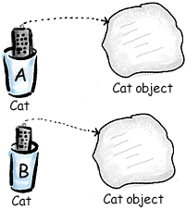
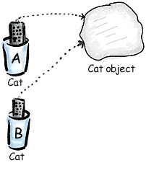
Pass By Value

Slide 56
Casting Primitive Types
Casting creates a new value and allows it to be treated as a different type than its source
JVM can implicitly promote from a narrower type to a wider type
To change to a narrow type explicit casting is required
Byte -> short -> int -> long -> float -> double

Slide 57
Casting Primitive Types
  public class PrimCasting {
  public static void main (String [] args){
  int x = 99;
  double y = 5.77;
  x = (int)y; //Casting
  System.out.println("x = "+ x);
  double y1 = x; //No Casting
  int i =42;
  byte bt;
  bt= (byte)i;
  System.out.println("The Short number"+ bt);
  }
  }

Slide 58
Wrapper Classes
Primitives have no associated methods
Wrapper Classes are used encapsulate primitives
They also provide some static utility methods to work on them
Primitive Type | Wrapper class
-boolean | Boolean
-byte | Byte
-char | Character
-double | Double
-float | Float
-int | Integer
-long | Long
short | Short

Slide 59
Wrapping Primitives
Wrapping a value
  int i = 288
  Integer iwrap = new Integer(i);
unWrapping a value
  int unwrapped = iwrap.intValue();
Methods In Wrapper Class
  parseXxx()
  xxxValue()
  valueOf()

Slide 60
Wrapper Class Method
Convert String to Numbers
public class ParsingStrings
{
public static void main(String args[])
{
int ino=Integer.parseInt(args[0]);
floatfno = Float.parseFloat(args[1]);
double dno = Double.parseDouble(args[2]);
Long lno = Long.parseLong(args[3]);
System.out.println("Integer value" +ino );
String strIno = Integer.toString(ino);
System.out.Println(“String Value”+strIno);
}
}

Slide 61
Auto Boxing
Java 5.0 provided autoboxing
Integer n = new Integer(123) Int m = n.intValue() m++; n=new Integer(m); System.out.println(n); | Integer n = new Integer(123); n++; System.out.println(n);

Slide 62
Auto Boxing
public class ABoxing {
  public void show(int a, float b)
  {
  System.out.println("Integer"+a*2);
  System.out.println("Float"+b*2);
  }
  public static void main(String[] args) {
  ABoxing abObj =new ABoxing ();
  Integer a = 10;
  Float b =20f;
  abObj.show(a,b);
  }
  }

Slide 63
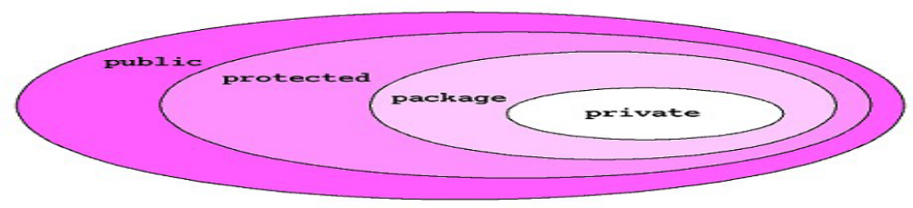
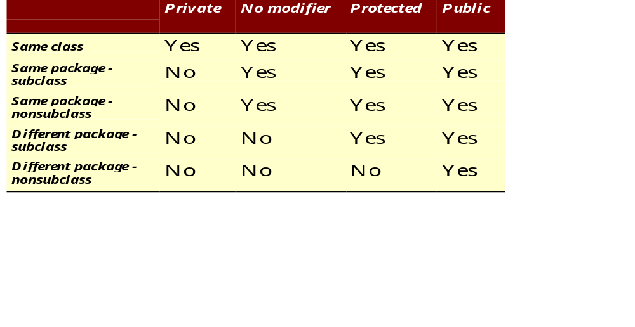
The 4 Access Levels and 3 Modifiers

Slide 64
Method Overloading
If two (or more) methods of a class have the same name but different signatures, then the method name is said to be overloaded.
The signature of a method consists of the name of the method and the number and types of formal parameters in particular order.
Method overloading is method name overloading.
Several methods that implement similar behavior but for different data types.
They are independent methods of a class and can call each other just like any other method.
A method can be overloaded in the same class or in a subclass.

Slide 65
Overloading Methods
Overloaded methods MUST change the argument list.
Overloaded methods CAN change the return type.
Overloaded methods CAN change the access modifier.
Overloaded methods CAN declare new or broader checked exceptions.

Slide 66
Overloading and AutoBoxing
public class Overloading {
public Integer add(Integer a , Integer b)
{
Integer c = a+b;
return c+100;
}
public int add(int a , int b)
{
return a+b;
}

Slide 67
Application
  public static void main(String[] args) {
  Overloading olObj = new Overloading();
  System.out.println(olObj.add(45, 55));
  }
  Output will be 100 and Not 200

Slide 68
Static Variables and Methods
A static method belongs to a class and not to its instance objects and hence they are shared between Objects
Static Methods can not be overridden
They can only call other static methods
They can access only static variables and not instance Variables
They cannot refer to this or super
Instance variable : 1 per instance and Static variable : 1 per class
Static final variables are constants
main( ) is defined to be a static method so as to be invoked directly

Slide 69
Static Method access only static
  public class StatClass {
  private int id;
  private static String name;
  private void instMethod()
  {
  staticMethod();
  System.out.println(id);
  System.out.println(name);
  }
  private static void staticMethod()
  {
  System.out.println(id);
  System.out.println(name);
  instMethod();
  }
  }
Can Access Static from Instance Method
Cannot Access Instance Variable From Static
Cannot Access Instance Method From Static

Slide 70
Q7. Can You Override a Static Method?
No, you can't. By definition, you can only override a method if its implementation is determined at runtime by the type of the actual instance (a process known as the dynamic method lookup). The static method implementation is determined at compile time using the type of the reference, so overriding would not make much sense anyway. Although you can add to subclass a static method with the exact same signature as in superclass, this is not technically overriding.

Slide 71
Static Import
  import java.util.*;
  import static java.lang.System.out;
  import static java.lang.System.in;
  public class StaticImport {
  public static void main(String[] args) {
  Scanner kb = new Scanner(in);
  out.print("Enter an integer ");
  int x = kb.nextInt();
  out.print("Enter a double ");
  double d = kb.nextDouble();
  out.println("The sum is " + (x+d));
  }
  }

Slide 72
java.util.Scanner Class
A simple text scanner which can parse primitive types and strings using regular expressions.
A Scanner breaks its input into tokens using a delimiter pattern, which by default matches whitespace.
The resulting tokens may then be converted into values of different types using the various next methods.
  Scanner sc = new Scanner(System.in);
  int i = sc.nextInt();

Slide 73
java.util.Scanner Class
  public void show()
  {
  Scanner sc = new Scanner(System.in);
  System.out.println("Enter The Number");
  int number = sc.nextInt();
  System.out.println("Enter the Name");
  String name = sc.next();
  System.out.println(number + ":"+name);
  }

Slide 74
java.util.Scanner Class
  public static void main(String[] args) {
  String line="Java,is,in,OOP,Language";
  Scanner sc1 = new Scanner(line);
  sc1.useDelimiter(",");
  while (sc1.hasNext())
  {
  System.out.println(sc1.next());
  }
  }

Slide 75
Flow Control

Slide 76
Objectives
Decision control structures (if, else, switch)
Repetition control structures (while, do-while, for)
Branching statements (break, continue, return)

Slide 77
Control Structures
To change the ordering of the statements in a program
Two types of Control Structures
decision control structures ,
  allows us to select specific sections of code to be executed
    if -- else , if – else if
    switch -- case
repetition control structures
  allows us to execute specific sections of the code a number of times
    while
    do -- while
    for

Slide 78
Decision Control Structures
Types:
  if-statement
  if-else-statement
  If-else if-statement
If Specifies that a statement or block of code will be executed if and only if a certain boolean statement is true.
      if( boolean_expression )
      statement;
    or
      if( boolean_expression ){
      statement1;
      statement2;
      }
boolean_expression : can be an expression or variable.

Slide 79
if-else statement
if( boolean_exp ){
Statement(s)
}
else {
Statement(s)
}
  if(boolean_exp1 )
  statement1;
  else if(boolean_exp2)
  statement2;
  else
  statement3;
For Comparison == used instead =
= being an assignment operator
equals Method Should Be Used for Objects comparison

Slide 80
switch-statement
Allows branching on multiple outcomes.
switch expression is an integer ,character expression or variable
case_selector1, case_selector2 and unique integer or character constants.
If none of the cases are satisfied, the optional default block if present is executed.
    switch( switch_expression ){
    case case_selector1:
    Statement(s);
    break;
    case case_selector2:
    Statement(s);
    break;
    default:
    statement1;
    }

Slide 81
switch-statement
When a switch is encountered,
  evaluates the switch_expression,
  jumps to the case whose selector matches the value of the expression.
  executes the statements in order from that point on until a break statement is encountered
  break statement stops executing statements in the subsequent cases, it will be last statement in a case.
  Used to make decisions based only on a single integer or character value.
  The value provided to each case statement must be unique

Slide 82
switch-statement
  public double CalculateDiscount(int pCode)
  {
  double discountPercentage=0.0d;
  switch(pCode)
  {
  case 1:
  discountPercentage=0.10d;
  break;
  case 2:
  discountPercentage=0.15d;
  break;
  case 3:
  discountPercentage=0.20d;
  break;
  default:
  discountPercentage=0.0;
  }
  return discountPercentage;
  }

Slide 83
Switch-Case in a Method
Can have Either Return or Break if present inside a Method, but should provide a default Value
    public String switchExample(int key) {
    switch (key) {
    case 1:
    return "Good Morning";
    case 2:
    return "Good AfterNoon";
    case 3:
    return "Good Evening";
    default:
    return "Good Night";
    }

Slide 84
Switch-Case Java 7.0
From In Java SE 7 and later, can use a String object in the switch statement's expression.
The String in the switch expression is compared with the expressions associated with each case label as if the String.equals method were being used.
Will Throw a Null pointer Expression if the expression is NULL
  String color = "red";
  switch (color) {
  case "red":
  System.out.println("Color is Red");
  break;
  default:
  System.out.println("Color not found");
  }

Slide 85
Repetition Control Structures
while-loop
  The statements inside the while loop are executed as long as the Boolean expression evaluates to true
do-while loop
  statements inside a do-while loop are executed several times as long as the condition is satisfied, the statements inside a do-while loop are executed at least once
Watch this
  while(boolean_expression){
  statement1;
  statement2;
  }
do{
statement1;
statement2;
}while(boolean_expression);

Slide 86
Loop and Branching
Same code a number of times.
for(Initialexpr;LoopCondition;StepExpr) {
  statement1;
  }
Branching statements allows to redirect the flow of program execution.
  break
  continue
  return.
System.exit() All program execution stops; the VM shuts down.

Slide 87
Arrays

Slide 88


Slide 89
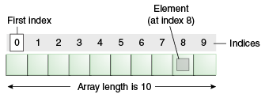
Introduction to Arrays
Array is one variable is used to store a list of data and manipulate
This type of variable is called an array.
It stores multiple data items of the same data type, in a contiguous block of memory, divided into a number of slots.
The new keyword to create an array object.
Need to tell the compiler how many elements will be stored in it.

Slide 90
Creating Arrays
There are three steps to creating an array,
declaring
  int[] k;
  float[] yt;
  String[] names;
allocating
  k = new int[3];
  yt = new float[7];
  names = new String[50];
initializing
  int[ ] k = {1, 2, 3};
  float[ ] yt = {0.0f, 1.2f, 3.4f, -9.87f, 65.4f, 0.0f, 567.9f};

Slide 91
Enhanced For Loop
The enhanced for loop, simplifies looping through an array or a collection.
Instead of having three components, the enhanced for has two.
for(data_type variable : array | collection){}
int [] a = {1,2,3,4};
for(int n : a)
System.out.print(n);.

Slide 92
Array Bounds
All array subscripts begin with 0 and ends with n-1
In order to get the number of elements in an array, can use the length field of an array.
The length field of an array returns the size of the array.
  int list [] = new int[10];
  for (int i = 0; i< list.length; i++)
  {
    System.out.println(list[i]);
    }
There is no array element arr[n]! This will result in an array-index-out-of bounds exception.
Notes:
Special care should be taken while accessing an array element, using the length variable of array objects. In the example shown above list.length gives 10, and if we try to access list[10], we will get an exception.

Slide 93
Multi Dimension Array
  public static void multiDimension()
  {
  int[][] values={
  {1,100,10},
  {2,200,20},
  {3,300,30},
  {4,400,40}
  };
  for(int i=0;i<4;i++)
  {
  for(int j=0;j<3;j++)
  {
  System.out.println(values[i][j]);
  }
  }

Slide 94
Array of Objects
public class ArrayofObject {
public void displaybooks(Book[] bks)
{
for(int i=0;i<bks.length;i++)
{
System.out.println("Book Number :="+bks[i].getBookno());
System.out.println("Book Name :="+bks[i].getBookname());
}
}
public static void main(String args[])
{
Book[] bk = new Book[2];
Book b1 = new Book(100,"java");
Book b2= new Book(101,"j2ee");
bk[0]=b1;
bk[1]=b2;
ArrayofObject ab= new ArrayofObject();
ab.displaybooks(bk);
}
}

Slide 95
Copying Arrays
System.arraycopy()
  can be used to efficiently copy data from one array into another:
public static void arraycopy(Object src, int srcPos, Object dest, int destPos, int length)
The two Object arguments
  the array to copy from and the array to copy to.
The three int arguments
  starting position in the source array,
  starting position in the destination array,
  number of array elements to copy.

Slide 96
INHERITANCE

Slide 97
Overview
  A class can inherit from another class
    Original class is the “superclass”
    New class is called the “subclass”
Inheritance is a fundamental OO concept
Superclass
Car
Subclasses
SportsCar
Taxi
PoliceCar

Slide 98
Example of Inheritance
  The Car class defines certain methods and variables
  Taxi extends Car, and can:
    Add new variables
    Add new methods
    Override methods of the Car class
Car
Taxi

Slide 99
Specifying Inheritance in Java
  Inheritance is achieved by specifying which superclass the subclass
  “extends”
Taxi inherits all the variables and methods of Car
public class Car {
…
}
public class Taxi extends Car {
…
}

Slide 100
What Does an Object Look Like?
A subclass inherits all the instance variables of its superclass
Car object
public class Car {
String regNum;
int engineSize; …
}
regNum
engineSize
Taxi object
public class Taxi extends Car {
private int cabNum; …
}
regNum
engineSize
cabNum

Slide 101
Default Initialization
  What happens when a subclass object is created?
  If no constructors are defined:
  No-arg constructor is called in superclass
    No-arg constructor called in subclass
Taxi object
regNum
engineSize
Taxi taxi1 = new Taxi();
cabNum

Slide 102
Nondefault Initialization
Specific initialization can be performed as follows:
public class Car {
Car(String r, int e) {
regNum = r;
engineSize = e;
} …
public class Taxi extends Car {
Taxi(String r, int e, int c) {
super(r, e);
cabNum = c;
} …
Use super() to call superclass constructor

Slide 103
Specifying Additional Methods
  The superclass defines methods that are applicable for all kinds of Car
  The subclass can specify additional methods that are specific to Taxis
public class Car {
public int getReg()…
public void changeOwner()…
…
public class Taxi extends Car {
public void renewCabLicense()…
public boolean isBooked()…
…

Slide 104
Overriding Superclass Methods
  A subclass inherits all the methods of its superclass
  The subclass can override a method with a specialized version, if it needs to:
public class Car {
public String details() {
return "Reg:" + getReg();
}
public class Taxi extends Car {
public String details() {
return "Reg:" + getReg() + cabNum;
}

Slide 105
Overriding
When a sub-class defines a
  “method with same method name, argument types, argument order and return type as a method in its super class, its called method overriding. “
Methods declared as final, static and private cannot be overridden.
An overriding method can be declared as final
The method can’t be less accessible
  Public => only public
  Protected => Both Public and Protected
  Default => default, public and protected

Slide 106
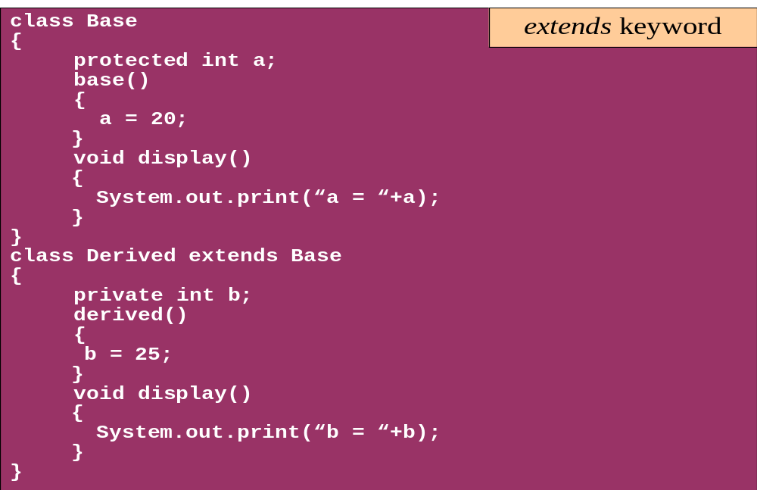
Overriding

Slide 107
Overriding with Compatible Return type
Arguments must be same and return type must be compatible
  class Base
  {
  private int i = 5;
  public Number getNumber()
  {
  return i;
  }
  }
  class Derived extends Base
  {
  @Override
  public Integer getNumber()
  {
  return new Integer(10);
  }
  }

Slide 108
Invoking Superclass Methods
  If a subclass overrides a method, it can still call the original superclass method
  Use super.method()to call a superclass method from the subclass
  Though keyword super is used to refer super class, method call super.super.method() is invalid.
public class Car {
public String details() {
return "Reg:" + getReg();
}
public class Taxi extends Car {
public String details() {
return super.details() + cabNum;
}

Slide 109
super keyword
The keyword super refers to the base class
  super( )
    invokes the base class constructor
    base class constructors are automatically invoked
  super.method( )
    invokes the specified method in the base class
  super.variable
    to access the specified variable in the base class
super must be the first statement in a constructor

Slide 110
Abstract Class
An abstract class is a shared superclass
  Provides a high-level partial implementation of some concept
  Cannot be instantiated
Use the abstract keyword to declare a class as abstract
Vehicle
Vehicle
Abstract superclass
Concrete subclasses
Car
Car
Truck

Slide 111
Defining Abstract Classes in Java
  Use the abstract keyword to declare a method as abstract
    Only provide the method signature
    Class must also be abstract
  Must be implemented by a concrete subclass
    Each concrete subclass can implement the method differently
public abstract class Vehicle {
private String regNum;
public String getRegNum()…
public abstract boolean isRoadWorthy();
}
public class Car
extends Vehicle{
private int numSeats;
public void fitRack()…
public class Truck
extends Vehicle{
private int axles;
public void setLoad()…

Slide 112
The Abstract Class-Super Class
Note
this
  public abstract class BankAccount {
  public abstract void deposit(float amount);
  public abstract void withdraw(float amount);
  public void sayHello() {
  System.out.println("Thanks-Come Again");
  }
  }

Slide 113
Child Class –Its alsoAbstract
  public abstract class Savingaccount extends BankAccount {
  public abstract void getClientdetails();
  }

Slide 114
The Concrete Class
  public class Supersavings extends Savingaccount {
  float balance,amount ;
  String custname;
  int accno;
  public void deposit(float amt)
  {
  balance+=amt;
  }
  public void withdraw(float amt)
  {
  balance-=amt;
  }
  public void getClientdetails()
  {
  System.out.println(custname);
  System.out.println(accno);
  System.out.println(amount);
  System.out.println(balance);
  }
  }

Slide 115
Interfaces & Polymorphism

Slide 116
Interfaces
  An interface is like a fully abstract class
    All of its methods are public and abstract
    No instance variables if present they are public static final
  An interface defines a set of methods that other classes can implement
    A class can implement many interfaces, but can extend only one class
  Can extend other interfaces and extend multiple interfaces
  Extends another sub interface inherits everything from super interface

Slide 117
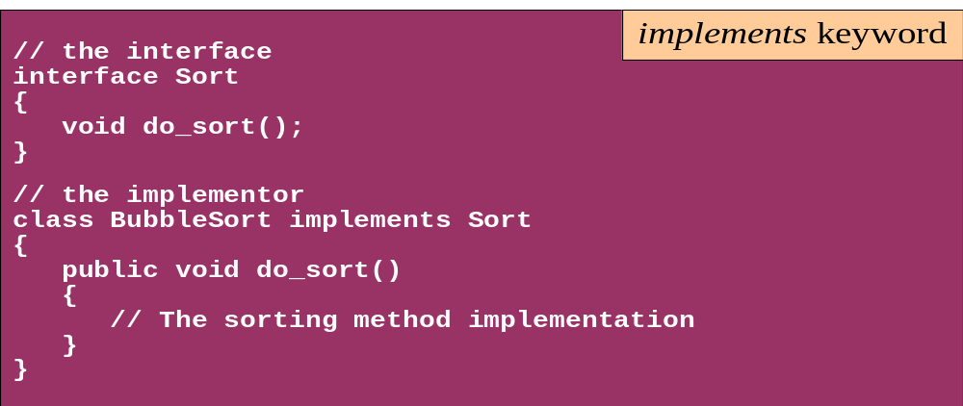
Interface
Interfaces define types in an abstract form
  An interface declaration allows the specification of a reference type without providing an implementation
  The class that implements the interface decides how to implement

Slide 118



Example of Interfaces
  Interfaces describe an aspect of behavior that different classes can support
  For example, any class that supports the “Steerable” interface can be steered:
Steerable
Not Steerable

Slide 119
Defining an Interface in Java
  Use interface keyword instead of class
public interface Steerable {
int maxTurn = 135;
void turnLeft(int deg);
void turnRight(int deg);
}

Slide 120
Implementing an Interface
public interface Steerable {
int maxTurn = 135;
void turnLeft(int deg);
void turnRight(int deg);
}
public class Car
extends Vehicle
implements Steerable {
public void turnLeft(int deg)
{…}
public void turnRight(int deg)
{…}

Slide 121
Partial Implementation of an Interface
Declare the class as abstract if the class does not implement all the methods of an interface
Implement the methods in the sub class level
Public abstract class Car
extends Vehicle
implements Steerable {
public void turnLeft(int deg)
{…}
}

Slide 122
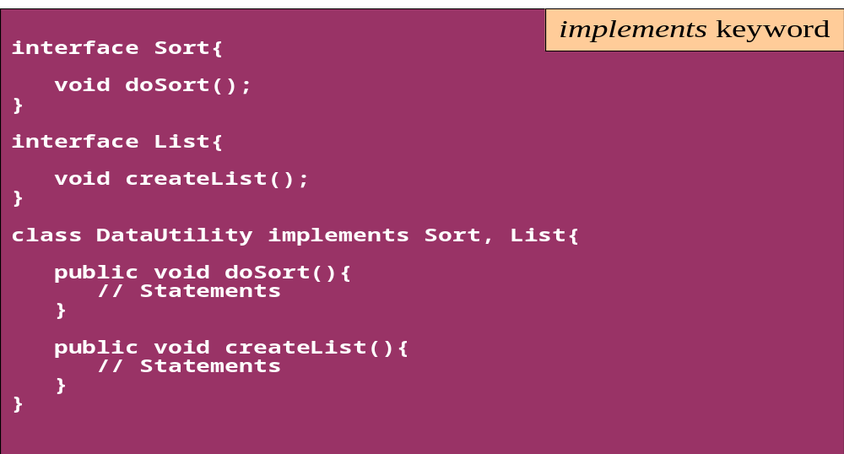
Interface
A single class can implement many interfaces

Slide 123
Using instanceof with Interfaces
  The instanceof operator can be used to check if an object implements an interface
  Downcasting can be used if necessary, to call methods defined in the interface
public void aMethod(Object obj) {
…
if (obj instanceof Steerable)
((Steerable)obj).turnLeft();
}

Slide 124
Extending an Interface
One Interface can extend another Interface
public interface Steerable {
int maxTurn = 135;
void turnLeft(int deg);
void turnRight(int deg);
}
public interface Navigator
extends Steerable {
void calcSpeed(int distance);
}

Slide 125
Polymorphism
This OO Principle allows the programmer to program abstractly
Objects of a subclass can be treated as objects of its superclass
The base class of a hierarchy is usually an abstract class or an Interface
  They define the common behavior (functionality)
Classes and Subclasses inherit this behavior and extend it according to their own properties by overriding the methods of the super class
Subclass objects can be treated as super class objects through references,
  But, super class objects are not subclass objects

Slide 126
Polymorphism
Allows for hierarchies to be highly extensible
New classes can be introduced and can still be processed without changing other parts of the program
Same method can do different things, depending on the class that implements it.
Method invoked is associated with OBJECT and not with reference.
Types of Polymorphism -
  Method Overloading.
  Method Overriding.

Slide 127
Polymorphism
  class SuperClass
  {
  int value = 100;
  void callMe()
  {
  System.out.println("I am in Super Class");
  }
  }
  class SubClass extends SuperClass
  {
  int value = 10;
  void callMe()
  {
  System.out.println("I am in Sub Class");
  }
  }

Slide 128
Polymorphism
This Object Reference is polymorphic
  public class TestDMD
  {
  public static void main(String s[])
  {
  SuperClass objSuperClass = new SubClass();
  objSuperClass.callMe();
  System.out.println(objSuperClass.value);
  }
  }
This means object variables are polymorphic , A variable of type Super Class can refer to an object of type Super class as well as subclass.

Slide 129
Substitution of Object References in Method Calls
A subclass object can be passed into any method that expects a superclass object
The method that got invoked, is the version that's present in the object type and NOT the reference type.
public static void main(String[] args) {
Taxi t = new Taxi("ABC123", 2000, 79);
displayDetails(t);
public static void displayDetails(Car c) {
System.out.println(c.details());
}
Notes:
The same object reference (that is, an object reference of the same reference type) is capable of behaving differently at runtime, depending on the object that it points to.

Slide 130
Dynamic Method Dispatch
Related Through Inheritance
superclass = subclass
  always valid
subclass=(subclass)superclass
  valid at compile time, checked at runtime. if is invalid then the exception ClassCastException is thrown.
subclass = superclass
  not valid at compile time, needs a cast
Unrelated Classes – Not Allowed
someClass = someUnrelatedClass
  not valid, won’t compile
somcClass = (someClass)someUnrelatedClass
  not valid, won’t compile

Slide 131
Dynamic Method Dispatch
subclass=
(subclass)superclass
Valid at both Compile ,RunTime
  class First
  {
  public void show()
  {
  System.out.println("ShowFirst");
  }
  }
  class Second extends First
  {
  public void show()
  {
  System.out.println("Show Second");
  }
  }
First fst = new Second();
Second sec = (Second)fst;
sec.show();
First fst2 = new First();
Second sec2 = (Second)fst2;
sec2.show();
subclass=
(subclass)superclass
Valid at Compile time exception at ,RunTime

Slide 132
FUNCTIONAL INTERFACES

Slide 133
Functional interface
An interface with only one method.
@FunctionalInterface
  Used to enforce the intent of the interface
  Existing interfaces are annotated with @FunctionalInterface
    Adding another method to the interface definition, will not be functional and compilation process will fail.
Used with lambda expressions.

Slide 134
Built-in Functional Interfaces
Earlier Versions of Java has several functional interfaces
  Prominent because of Lambda expressions
Existing functional interfaces
  Comparator
  Callable
  Runnable
  ActionListener
Collections API has been rewritten and new Stream API uses a lot of functional interfaces.
java.util.function
  Consumer, Supplier, Function and Predicate.

Slide 135

LAMBDAS

Slide 136
Functional Programming
Java always remained Object first language.
Functions are not important for Java.
  cannot live on their own in Java world.
JavaScript is one of the best example of an FP language.
There is no way of passing a method as argument or returning a method body
invList.forEach((inv)->{System.out.println(inv);});
Lambda expression adds that missing link of functional programming to Java.

Slide 137
Benefits of Lambda Expression
Fewer Lines of Code
  It reduced amount of code.
Sequential and Parallel Execution
  Support by passing behavior in methods
Higher Efficiency
  Utilizing Multicore CPU’s using Streams
Streams API
  Handling Collection of data much efficiently

Slide 138
Lambda Expressions
Anonymous
  It doesn’t have an explicit name like a method
Function
  Not associated with a particular class like a method
  Has a list of parameters, a body, a return type, and list of exceptions that can be thrown.
Passed around
  Can be passed as argument to a method or stored in a variable.
Concise
  No need to write a lot of boilerplate like anonymous classes.

Slide 139
Lambda Expressions
A lambda expression is composed of three parts.
  Argument List (int x, int y)
  Arrow Token ->
  Body x + y

Slide 140
Lambda – Argument List
Can have zero, one or more parameters.
  (int x, int y)
Parameters can be explicitly declared or it can be inferred
  (int a) is same as just (a)
Parameters are separated by commas.
  (a, b) or (int a, int b) or (String a, int b, float c)
Empty parentheses to represent an empty set
  () -> 42
It is not mandatory to use parentheses.
  a -> return a*a

Slide 141
Lambda Expression - Body
  The body of the lambda expressions can contain zero, one or more statements.
Lambdas may return a value.
The type of the return value will be inferred by compiler.
  Body is evaluated like a method body
  return statement returns control to the caller of the anonymous method.
The return statement is not required if the lambda body is just a one-liner.
If the return is an expression curly braces are required

Slide 142
Lambda with Built-in Functional Interface
    public static void main(String[] args) {
    Thread t1 =new Thread( () -> {
      for(int i=0;i<10;i++)
      {
      System.out.println("Hello World");
      }
    }
    );
  t1.start();
  }
    }

Slide 143
Functional Interface
  public interface InvoiceFactory {
  public Invoice createInvoice(long number, String name, double amount);
  }
  InvoiceFactory factory =
  (number,name,amount)->{return new Invoice(number,name,amount);};
  System.out.println(factory.createInvoice(101,"Ramesh",899.00));

Slide 144
Functional Interface
    interface Converter<T,R>{
    public R calculate(T frm);
    }
  public static void doConvert(Converter<Double,Double> conv,Double frm){
  System.out.println(conv.calculate(frm));
  }
  public static void main(String[] args) {
  Converter<Double,Double> currencyConverter = (val)->{return val * 45.0;};
  doConvert(currencyConverter, 100.00);
  Converter<Double,Double> farenToCel = (faren)->{return (faren-32) * 5/9;};
  doConvert(farenToCel, 84.00);
  }

Slide 145
Types of Lambda Expressions - Boolean
  public interface CheckSize{
  public boolean isEmpty(List<String> names);
  }
  public void booleanLambda(){
  List<String> nameList = HandleCustomers.getCustomerNames();
  CheckSize size=(list) -> list.isEmpty();
  System.out.println("Is Name List Empty :="+showSize.isNameEmpty(nameList));
  }

Slide 146
Scope in Lambda
Lambdas are allowed to capture static and instance variables
  But they are effectively final.
  Can also be explicitly declared final
Effectively Final.
  A n effectively final variable is one whose value does not change after it is first assigned.

Slide 147
Effectively Final
  @FunctionalInterface
  public interface EFConverter<T,R> {
  public R convertToString(T from);
  }
  int num = 1;
  EFConverter<Integer, String> stringConverter =
  (from) -> String.valueOf(from + num);
  String result = stringConverter.convertToString(new Integer(45));
  // num++;
  System.out.println(result.length());

Slide 148
When NOT to Use Lambda
Size
  The larger a lambda gets, the more difficult it makes it to follow the logic surrounding it.
Repetition
  It's better to create a named function for repeated logic, although it's okay to repeat very simple lambdas that are spread apart.
Nesting
  Nested lambdas are really, really hard to read.
Software is easily changed. Write both ways and see which is easier to read.

Slide 149
DEFAULT AND STATIC METHODS IN INTERFACES

Slide 150
Need for default Methods
When a interface has one or multiple implementations
Adding one or more methods to the interface
  All the implementations will be forced to implement them too.
  If not the design will break down.
Default interface methods allows to add new methods to an interface that are automatically available in the implementations.
  Thus, there’s no need to modify the implementing classes.
Backward compatibility is neatly preserved without having to refactor the implementers.

Slide 151
Default Method
Default methods are implicitly public
They are declared with the default keyword
They provide an implementation.
Default methods in interfaces helps to incrementally provide additional functionality to a given type without breaking down the implementing classes.
Can be used to provide additional functionality around an existing abstract method:

Slide 152
Default Interface Methods
  public interface Vehicle {
  String getBrand();
  String slowDown();
  default String turnAlarmOn() {
  return "Turning the vehicle alarm on.";
  }
  default String turnAlarmOff() {
  return "Turning the vehicle alarm off.";
  }
  }

Slide 153
Default Interface Methods
  public class Car implements Vehicle {
  private String brand;
  // constructors/getters
  @Override
  public String getBrand() {
  return brand;
  }
  @Override
  public String slowDown() {
  return "The car is slowing down.";
  }
  }

Slide 154
Default Interface Methods
  public static void main(String[] args) {
  Vehicle car = new Car("BMW");
  System.out.println(car.getBrand());
  System.out.println(car.slowDown());
  System.out.println(car.turnAlarmOn());
  System.out.println(car.turnAlarmOff());
  }

Slide 155
Accessing Default Interface Methods
Default method can be accessed from each instance including anonymous objects.
Default methods cannot be accessed from within lambda expressions.

Slide 156
Multiple Interface Inheritance Rules
Classes can implement multiple interfaces,
When a class implements several interfaces that define the same default methods.
  public interface Alarm {
  default String turnAlarmOn() {
  return "Turning the alarm on.";
  }
  default String turnAlarmOff() {
  return "Turning the alarm off.";
  }
  }
  public class Car implements Vehicle, Alarm {
  // ...
  }

Slide 157
Multiple Interface Inheritance Rules
There will be a conflict caused by multiple interface inheritance
Solved by explicitly providing an implementation for the methods:
  @Override
  public String turnAlarmOn() {
  // custom implementation
  }
  @Override
  public String turnAlarmOff() {
  // custom implementation
  }
  Can also have class use the default methods of one of the interfaces.

Slide 158
Multiple Interface Inheritance Rules
  The class can use the default methods defined within the Alarm interface:
  @Override
  public String turnAlarmOn() {
  return Vehicle.super.turnAlarmOn();
  }
  @Override
  public String turnAlarmOn() {
  return Alarm.super.turnAlarmOn();
  }

Slide 159
Multiple Interface Inheritance Rules
  Possible to make the Car class use both sets of default methods:
  @Override
  public String turnAlarmOn() {
  return Vehicle.super.turnAlarmOn() + " " + Alarm.super.turnAlarmOn();
  }
  @Override
  public String turnAlarmOff() {
  return Vehicle.super.turnAlarmOff() + " " + Alarm.super.turnAlarmOff();
  }

Slide 160
Static Interface Methods
static methods don’t belong to a particular object,
They are not part of the API of the classes implementing the interface
  Example : utility methods for null check, collection sorting etc
They have to be called by using the interface name preceding the method name.
  public interface Vehicle {
  // regular / default interface methods
  static int getHorsePower(int rpm, int torque) {
  return (rpm * torque) / 5252;
  }
  }

Slide 161
Static Interface Methods
Provide a mechanism that allows by putting together related methods in one single place without having to create an object.
  Can also be done with abstract classes.
Difference is that abstract classes can have constructors, state, and behavior.
Can group related utility methods, without having to create artificial utility classes that are simply placeholders for static methods.

Slide 162
Interface -Default and Static Methods
Default methods
  Allows adding new methods to existing interfaces without breaking the binary compatibility with the code written for older versions of those interfaces.
Difference between default methods and abstract methods
  Abstract methods are required to be implemented.
  Default methods are not.

Slide 163
Interface vs Abstract Class
A class may implement several interface
An interface cannot provide any code at all
Interfaces are often used to describe the peripheral abilities of a class, not its central identity,
A class may extend only one class
An abstract class can provide complete or partial code
An abstract class defines the core identity of its descendants.

Slide 164
Interface, Abstract Class,Subclass,Class
A plain class is designed when in doesn't pass the “is-a” test.
A Plain class is designed when its not extending any other class other than object class
Make a subclass , when it needs to extend a super class
Make a subclass, when it needs to override or add new behaviors
Make an abstract class , when there is a requirement for a kind of “template” for a group of subclasses, and there are some implementation in the class which the subclass can use .
Make an abstract class , to guarantee that nobody can make objects of that type.
Design an interface , to define a role that other classes can play, regardless of the inheritance tree,

Slide 165
final keyword
A final method or class is Java’s way of prohibiting inheritance and/or overriding
Final methods cannot be overridden by subclasses
All private methods are implicitly final
Final classes Cannot be extended and their methods are implicitly final
Can be applied to variables too
  The value of a final variable cannot be altered
  final int max_limit = 23
  final void method( )
  final class last_class

Slide 166
Object Class and Its Methods

Slide 167
Object Class
Every class in java extends class Object.
If a class doesn’t explicitly extend any class ,implicitly extends Object class
  boolean equals()
  int hashCode()
  String toString()
  Object.clone()

Slide 168
equals( ) method
The equals operator (==) can be used to test primitives
When its objects –
  it simply compares two object references to see if they refer to the same object, which is not the same as comparing the objects themselves.
The inherited equals( ) method can be used on the object
  It doesn't it does not compare fields
  It just returns the value of an == comparison on the two objects involved

Slide 169
Rules for an equals( ) method
It is reflexive:
    x.equals(x) must be true.
It is symmetrical:
    x.equals(y) must be true if and only if y.equals(x) is also true.
It is transitive:
    if x.equals(y) is true and y.equals(z) is true, then x.equals(z) must also be true.
It is repeatable:
    multiple calls on x.equals(y) return the same value (unless state values used in the comparison are changed, as by calling a set method).
It is cautious:
    x.equals(null) must return false rather than accidentally throwing a NullPointerException .

Slide 170
Overriding Equals Methods
  public boolean equals(Object otherObject)
  {
  // check objects are identical
  if(this==otherObject)
  return true ;
  //check for null
  if(otherObject==null)
  return false;
  // check for the class of the object
  if(getClass()!=otherObject.getClass())
  return false;
  // cast the object to the right type
  Exampleobject eobj = (Exampleobject)otherObject;
  //check the instance variables
  return customername.equals(eobj.customername)
  && orderno==(eobj.orderno);
  }

Slide 171
The hashCode( ) method
It returns an integer that should uniquely identify different objects.
A properly written hashCode( ) method will follow these rules:
It is repeatable:
  hashCode(x) must return the same int when called repeatedly, unless set methods have been called.
It is consistent with equality:
  if x.equals(y), then x.hashCode( ) must == y.hashCode( ).

Slide 172
Overriding HashCode
Acceptable Overriding but not Efficent
  public int hashCode()
  {
  return this.orderno + (7 * this. orderno);
  }
Violates Hashcode Rule
  public int hashCode()
  {
  int no = (int)Math.random()* 100 ;
  return this.orderno+no ;
  }

Slide 173
Object.clone( )
Need for cloning
  While method-calling ,the called method can modify the state of constructed object!
Cloning the input object before calling the method allows to pass a copy of the object, keeping the original safe.
The two steps to make a class cloneable:
  Override Object's clone( ) method.
  Implement the empty Cloneable interface
The Protected clone( ) method in Object throws CloneNotSupportedException .
Convention, the Cloned object should be obtained by calling super.clone.
it may be necessary to modify one or more fields of the object returned by super.clone before returning it

Slide 174
Clone Method
  public class Employee implements Cloneable {
  public Object clone()
  {
  try {
  return super.clone( );
  }
  catch (CloneNotSupportedException e )
  {
  e.printStackTrace();
  }
  }
  }
Note this

Slide 175
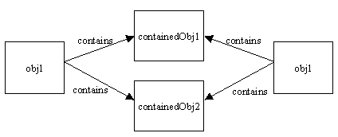
Shallow Clone
A shallow copy is performed on obj1, then it is copied but not its contained objects.

Slide 176
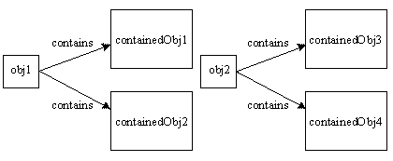
Deep Clone
A deep copy occurs when an object is copied along with the objects to which it refers.
If either of these contained objects themselves contain objects, then, in a deep copy, those objects are copied as well, and so on until the entire graph is traversed and copied.
Each object is responsible for cloning itself via its clone() method.

Slide 177
GC of Object
Objects become eligible for garbage collection
  Reference goes out of permanently
    void add()
    {
    Employee e = new Employee();
    }
  Reference assigned to another object
    Class EmpTest {
    Employee e = new Employee();
    void add()
    {
    e=new Employee();
    }

Slide 178
GC of Object
  The Reference is explicitly set to null
    Class EmpTest {
    Employee e = new Employee();
    void add()
    {
    e=null;
    }

Slide 179
Finalize Method()
  public class Book {
  String bookName;
  Book(String bookName)
  {
  this.bookName=bookName;
  }
  public String toString()
  {
  return this.bookName;
  }
  public void finalize()
  {
  System.out.println("Inside Finlize“+this);
  }

Slide 180
Finalize Method()
  public static void main(String[] args) {
  Book textbook = new Book("Java");
  System.out.println(textbook);
  textbook =new Book("J2EE");
  System.gc();
  System.out.println(textbook);
  textbook=null;
  System.gc();
  System.out.println(textbook);
  }

Slide 181
Math Class
The methods in the Math class don’t use any instance variable values
The Methods are “static” methods , and they don’t need to have an instance of the Math class
Some of the Methods in the class are
  Math.random() – returna double number between 0.0 to 1.0
  Math.abs() – absolute value of the argument
  Math.round() – returns int or long based on float,double rounded to nearest integer value
  Math.min() and Math.max() – maximum or minimum of two args
  Math.sqrt() – return the sqaure root of the given argument

Slide 182
Exception handling

Slide 183
Topics
Define exceptions
Use try, catch, and finally statements
Describe exception categories
Identify common exceptions
Develop programs to handle your own exceptions
Use assertions
Distinguish appropriate and inappropriate uses of assertions
Enable assertions at runtime

Slide 184
Exception Handling
java.lang.Object
java.lang.Throwable
java.lang.Error
java.lang.Exception
java.io.IOException
java.lang.RuntimeException
Notes:
The class Object is the root of the class hierarchy. Every class has Object as a superclass. All objects, including arrays, implement the methods of this class.
The Throwable class is the superclass of all errors and exceptions in the Java language. Only objects that are instances of this class (or of one of its subclasses) are thrown by the Java Virtual Machine or can be thrown by the Java throw statement. Similarly, only this class or one of its subclasses can be the argument type in a catch clause.
An Error is a subclass of Throwable that indicates serious problems that a reasonable application should not try to catch. Most such errors are abnormal conditions. The ThreadDeath error, though a "normal" condition, is also a subclass of Error because most applications should not try to catch it.
The class Exception and its subclasses are a form of Throwable that indicates conditions that a reasonable application might want to catch.
RuntimeException is the superclass of those exceptions that can be thrown during the normal operation of the Java Virtual Machine. A method is not required to declare in its throws clause any subclasses of RuntimeException that might be thrown during the execution of the method but not caught.
IOException signals that an I/O exception of some sort has occurred. This class is the general class of exceptions produced by failed or interrupted I/O operations.

Slide 185
Exceptions
Conditions that can readily occur in a correct program are checked exceptions.
These are represented by the Exception class.
Problems that reflect program bugs are unchecked exceptions.
Fatal situations are represented by the Error class.
Probable bugs are represented by the RuntimeException class.
The API documentation shows checked exceptions that can be thrown from a method

Slide 186
Checked and Unchecked
Checked exceptions include all subtypes of Exception, excluding classes that extend Runtime Exception.
Checked exceptions are subject to the handle or declare rule; any method that might throw a checked exception
  must either declare the exception using the throws keyword, or handle the exception with an appropriate try/catch.
Subtypes of Error or Runtime Exception are unchecked, so the compiler doesn’t enforce the handle or declare rule.

Slide 187
Handle or Declare Rule
Handle the exception by using the try-catch-finally block.
Declare that the code causes an exception by using the throws clause.
void trouble() throws IOException { ... }
void trouble() throws IOException, MyException { ... }
Other Principles
  You do not need to declare runtime exceptions or errors.
  You can choose to handle runtime exceptions

Slide 188
Catching Exceptions
  class DivByZero {
  public static void main(String args[]) {
  try {
  System.out.println(3/0);
  System.out.println(“Please print me.”);
  } catch (ArithmeticException exc) {
  //Division by zero is an ArithmeticException
  System.out.println(exc);
  }
  System.out.println(“After exception.”);
  }
  }

Slide 189
Catching Exception –Multiple Catch
  class MultipleCatch {
  public static void main(String args[]) {
  try {
  int den = Integer.parseInt(args[0]);
  System.out.println(3/den);
  }
  catch (ArithmeticException exc)
  {
  System.out.println(“Divisor was 0.”);
  }
  catch (ArrayIndexOutOfBoundsException exc2)
  {
  System.out.println(“Missing argument.”);
  }
  System.out.println(“After exception.”);
  }
}
}

Slide 190
Effective Exception Hierarchy
The exception classes are arranged in a hierarchy.
Catches for specific exceptions should always be written prior to the generic handler.
A generic handler for Exception would cover any missing situation.
  try
  {
  }
  catch (NumberFormatException e) {
  }
  catch (Exception ex2) {
  }
  try
  {
  }
  catch (Exception e1) {
  }
  catch(NumberFormatException e2) {
  }

Slide 191
Catching Exception –Nested Try’s
    public static void main(String args[]){
  try {
    int a = Integer.parseInt(args[0]);
    try {
    int b = Integer.parseInt(args[1]);
    System.out.println(a/b);
    }
    catch (ArithmeticException e1)
    {
    System.out.println("Div by zero error!");
    }
  }
  catch(ArrayIndexOutOfBoundsException e2)
  {
    System.out.println("Need 2 parameters!");
    }
    }
  }

Slide 192
Method Overriding and Exceptions
The overriding method can throw:
No exceptions
One or more of the exceptions thrown by the overridden method
One or more subclasses of the exceptions thrown by the overridden method
The overriding method cannot throw:
Additional exceptions not thrown by the overridden method
Superclasses of the exceptions thrown by the overridden method

Slide 193
Finally block
Its optional and will always be invoked,
  whether an exception in the corresponding try is thrown or not,
  whether a thrown exception is caught or not.
finally-will-always-be-called except if the JVM shuts down. When the try or catch blocks may call System.exit();
Block of code is always executed despite of different scenarios:
  Forced exit occurs using a return, a continue or a break statement
  Normal completion
  Caught exception thrown
  Exception was thrown and caught in the method
  Uncaught exception thrown
  Exception thrown was not specified in any catch block in the method

Slide 194
Finally Block
  public static String tryblkWithReturn(String data ) {
  try {
  int no = Integer.parseInt(data);
  }
  catch (NumberFormatException e) {
  System.out.println("Entering Catch Block");
  return "Hello";
  }
  finally {
  System.out.println("Inside finally");
  }
  System.out.println("I am back");
  return "Hi";
  }

Slide 195
Finally Block
  public static String tryblkWithNewException(String data ) throws Exception {
  try {
  int no = Integer.parseInt(data);
  }
  catch (NumberFormatException e) {
  System.out.println("Entering Catch Block");
  throw new Exception();
  }
  finally {
  System.out.println("Inside finally");
  }
  System.out.println("I am back");
  return "Hi“;
  }

Slide 196
Overriding –When Method Has Exceptions
Any exceptions declared in overriding method must be of the same type as those thrown by the super class, or a subclass of that type.
  class MyBase {
  public void method1() throws Exception
  { }
  public void method2() throws RuntimeException
  { }
  }
  class Sub extends MyBase
  {
  public void method1() throws Throwable {
  }
  public void method2() throws ArithmeticException {
  }
  }
This is compile Time Exception
This is Allowed

Slide 197
Throwing Exceptions
The throw Keyword
Java allows you to throw exceptions (generate exceptions)
  throw <exception object>
An exception you throw is an object
  You have to create an exception object in the same way you create any other object
Example:
  throw new ArithmeticException(“testing...”);

Slide 198
Throws Clause
A method is required to either catch or list all exceptions it might throw
  Except for Error or RuntimeException, or their subclasses
If a method may cause an exception to occur but does not catch it, then it must say so using the throws keyword
Applies to checked exceptions only
  <type> <methodName> (<parameterList>) throws <exceptionList>
  {
  <methodBody>
}

Slide 199
The try-with-resources Statement
A try statement that declares one or more resources.
A resource is an object that must be closed after the program is finished with it.
Ensures the resource is closed at the end of the statement.
Any object that implements java.lang.AutoCloseable, and java.io.Closeable, can be used as a resource.

Slide 200
The try-with-resources Statement
private static void printFile throws IOException {
try ( FileInputStream input = new FileInputStream("file.txt") )
{
int data = input.read();
while(data != -1)
  {
  System.out.print((char) data);
  data = input.read();
  }
}
}

Slide 201
Using Multiple Resources
Can use multiple resources and have them all automatically closed.
private static void printFile throws IOException {
  try (
  FileInputStream input = new FileInputStream("file.txt"); BufferedInputStream bufferedInput = new BufferedInputStream(input) )
  {
    int data = bufferedInput.read();
    while(data != -1){
    System.out.print((char) data);
    data = bufferedInput.read();
  } } }

Slide 202
Multiple Catch
  try {
  int val = Integer.parseInt(args[0]);
  double amount = val/0;
  System.out.println("Amount"+amount);
  } catch (ArrayIndexOutOfBoundsException | NumberFormatException e) {
  e.printStackTrace();
  }
  }

Slide 203
Multiple Catch
  try {
  } catch (RangeCheckException | RuntimeException e) {
  }
  try {
  } catch (RangeCheckException | Exception e) {
  }

Slide 204
Re-throw Exception
Exception of the Catch Parameter type is the one that is rethrown
To intercept all exceptions and rethrow them
  Can catch with super class Exception
  Declare method as throwing an Exception.
"imprecise rethrow“
  Throwing a general Exception type (instead of specific ones)

Slide 205
Re-Throw Exception
Java 7, can be more precise about the exception types being rethrown from a method.
This leads to improved checking for rethrown exceptions.
Can handle them a lot better at the calling side

Slide 206
Re-throw Exceptions
  public static void myExample() throws ParseException,IOException {
  try {
  new SimpleDateFormat("yyyyMMdd").parse("date");
  new FileReader("Abc.txt").read();
  } catch (Exception e) {
  throw e;
  }
  }

Slide 208
Custom AutoClosable Implementations
The AutoClosable interface only has a single method called close().
Any class that implements this interface can be used with the try-with-resources construct.
  public class MyAutoClosable implements AutoCloseable {
  public void doIt() {
  System.out.println("MyAutoClosable doing it!");
  }
  @Override
  public void close() throws Exception { System.out.println("MyAutoClosable closed!");
  } }

Slide 209
Auto Resource Management
close is the only method in AutoCloseable and it gets automatically invoked at runtime.
During initialization of multiple resources in ‘try’, if there is any issue then immediately in the reverse order those resources that are already initialized will be closed.
try-with-resources, can have catch and finally. They work as usual and no change in it.
In try-with-resources on exception, before going to catch the close statements will be executed.
While implementing AutoCloseable, best practice is to throw specific exception and not the highest level ‘Exception’ itself. This needs to highlighted because the signature of ‘close’ in AutoCloseable throws Exception.
By specification this close method is not required to be idempotent. But still, it is best practice to implement it as idempotent. That is, even if the close method is invoked multiple times, it should act as same.

Slide 210
Exception and Assertions
Exceptions handle unexpected situations – Illegal argument, network failure, or file not found
Assertions document and test programming assumptions – This can never be negative here
Assertion tests can be removed entirely from code at runtime, so the code is not slowed down at all.

Slide 211
Objects and Data Abstraction
  In many applications, data is more complicated than just a simple value
  An Employee
    The data here are actually:
      int empId – an integer of Employee Id
      double[] phoeNumber – an array of Phone Numbers
      double salary – the salary of employee
    Note that individually the data are just int or a double
      However, together they make up a Employee
    This is fundamental to object-oriented programming (OOP)

Slide 212
Objects and Data Abstraction
  Now consider operations that an Employee can do
    Note how that is stated – we are seeing what a Employee CAN DO rather than WHAT CAN BE DONE to it
    This is another fundamental idea of OOP – objects are ACTIVE rather than PASSIVE
Objects enable us to combine the data and operations of a type together into a single entity

Slide 213
Encapsulation and Data Abstraction
We do not need to know the implementation details of a data type in order to use it
  This includes the methods AND the actual data representation of the object
This concept is exemplified through objects
  We can think of an object as a container with data and operations inside
    We can see some of the data and some of the operations, but others are kept hidden from us
    The ones we can see give us the functionality of the objects

Slide 214
Lion’s close throws an exception, but where is it in the output? It got suppressed. That is the concept of try-with-resources.
If an exception is thrown in the try block, then the control will be transferred to catch. In between the jump to catch block the close() will be internally invoked for the registered resources.
Inside the close(), there is a possibility for an exception while closing the resource. If an exception is thrown (as given in Lion example), then it will be suppressed and the exception that is thrown in the try block (before calling close), will be exposed.
So how do we know about the suppressed exception? Here you go, use the Throwable.getSuppressed get the exceptions that are suppressed in try-with-resources.
If there are multiple resources to be closed and an exception is thrown during closing of one exception, irrespective of that all the resources will be closed.

Slide 215
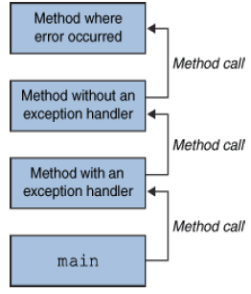
What Happens When an Exception
Occurs
When an exception occurs within a method,
  the method creates an exception object and hands it off to the runtime system - “throwing an exception”
  These Exception object contains information about the error, including its type and the state of the program when the error occurred
  The runtime system searches the call stack for a method that contains an exception handler

Slide 216
Assertions
Allow the programmer to find out if an assumption was met
  Example: month
Extension of comments wherein the assert statement informs the person reading the code that a particular condition should always be satisfied
Running the program informs you if assertions made are true or not
  If an assertion is not true, an AssertionError is thrown
User has the option to turn it off or on at runtime

Slide 217
What are Assertions
Allow the programmer to find out if an assumption was met
Extension of comments wherein the assert statement informs the person reading the code that a particular condition should always be satisfied
  Running the program informs you if assertions made are true or not
  If an assertion is not true, an AssertionError is thrown
User has the option to turn it off or on at runtime
assert <boolean_expression> ;
assert <boolean_expression> : <detail_expression> ;

Slide 218
Enabling or Disabling Assertions
Program with assertions may not work properly if used by clients not aware that assertions were used in the code
Compiling
  With assertion feature:
  javac –source 1.4 MyProgram.java
Without the assertion feature:
  javac MyProgram.java
Enabling assertions:
  Use the –enableassertions or –ea switch.
  java –enableassertions MyProgram

Slide 219
Assert Syntax
  class AgeAssert {
  public static void main(String args[]) {
  int age = Integer.parseInt(args[0]);
  assert(age>0);
  if (age >= 18) {
  System.out.println(“You're an adult! =)”);
  }
}
}

Slide 220
Use & Miss Use of Assertions
Use
  To validate Arguments of Private Method
  In Public Methods to check for cases that you know are never ever supposed to happen
Miss Use
  To validate Arguments of a Public Method
  To validate Command Line Arguments
  Don’t use Assertions that can cause side effect

Slide 221
Don’t Use assertion to validate Arguments of a Public Method
A public method has to be called from code that you don’t control for from code you have never seen,
public methods are interface to the outside word , that should guarantee that any constraints on the arguments will enforced by the method itself.
Assertions aren’t guaranteed to actually run , the enforcement won’t happen if assertions are not enabled ,
  Public void doStuff()
  {
  Assert (x>0)
  }
Same Principle applicable for command Line Arguments

Slide 222
Asserting in the Right Way
Use Assertions to validate Arguments of Private Method
  Private void doStuff()
  {
  Assert(x>0)
  }
Don’t use Assertions that can cause side effect
  public void doStuff()
  {
  Assert(modifythings());
  }
  public boolean modifythings()
  {
  y= x++;
  return true
  }

Slide 223
Asserting in the Right Way
Use , Even in Public Methods to check for cases that you know are never ever supposed to happen
Example in a case block that should never be reached , including a default switch statements as given
  Switch(x)
  {
  case 1: y-3;break;
  case 2: y=y-5;break;
  default
  Assert false;
  }

Slide 224
The Analysis and Design Phase
Analysis describes what the system needs to do:
Modeling the real-world, including actors and activities, objects, and behaviors
Design describes how the system does it:
Modeling the relationships and interactions between objects and actors in the system
Finding useful abstractions to help simplify the problem or solution

Slide 225
Abstraction
Functions – Write an algorithm once to be used in many situations
Objects – Group a related set of attributes and behaviors into a class
Frameworks and APIs – Large groups of objects that support a complex activity;
Frameworks can be used as is or be modified to extend the basic behavior

Slide 226
Classes as Blueprints for Objects
In manufacturing, a blueprint describes a device from which many physical devices are constructed.
In software, a class is a description of an object:
A class describes the data that each object includes.
A class describes the behaviors that each object exhibits.
In Java technology, classes support three key features OOP
  Encapsulation
  Inheritance
  Polymorphism

Slide 227
Declaring Java Technology Classes
Basic syntax of a Java class:
  <modifier>* class <class_name> {
  <attribute_declaration>*
  <constructor_declaration>*
  <method_declaration>*
  }

Slide 228
Declaring Attributes
Basic syntax of an attribute:
<modifier>* <type> <name> [ = <initial_value>];
public class Foo {
private int x;
private float y = 10000.0F;
private String name = "Bates Motel";
}

Slide 229
Declaring Methods
Basic syntax of a method:
<modifier>* <return_type> <name> ( <argument>* ) {
<statement>*
}
  public int getWeight() {
  return weight;
  }
  public void setWeight(int newWeight) {
  if ( newWeight > 0 ) {
  weight = newWeight;
  }
  }

Slide 230
Accessing Object Members
The dot notation is: <object>.<member>
  used to access object members, including attributes and methods.
d.setWeight(42);
d.weight = 42; // only permissible if weight is public

Slide 231
Information Hiding
Client code has direct access to internal data
(d refers to a MyDate object):
d.day = 32; // invalid day
d.month = 2; d.day = 30; // plausible but wrong
d.day = d.day + 1; // no check for wrap around

Slide 232
Encapsulation
Hides the implementation details of a class
Forces the user to use an interface to access data
Makes the code more maintainable

Slide 233
Objects and Data Abstraction
Consider the data
  In many applications, data is more complicated than just a simple value
  An Employee
    The data here are actually:
      int empId – an integer of Employee Id
      double[] phoeNumber – an array of Phone Numbers
      double salary – the salary of employee
    Note that individually the data are just int or a double
      However, together they make up a Employee
    This is fundamental to object-oriented programming (OOP)

Slide 234
Objects and Data Abstraction
Consider the operations
  Now consider operations that an Employee can do
    Note how that is stated – we are seeing what a Employee CAN DO rather than WHAT CAN BE DONE to it
    This is another fundamental idea of OOP – objects are ACTIVE rather than PASSIVE
Objects enable us to combine the data and operations of a type together into a single entity

Slide 235
Encapsulation and Data Abstraction
  We do not need to know the implementation details of a data type in order to use it
    This includes the methods AND the actual data representation of the object
  This concept is exemplified through objects
    We can think of an object as a container with data and operations inside
      We can see some of the data and some of the operations, but others are kept hidden from us
      The ones we can see give us the functionality of the objects

Slide 236
Continue
  public static void main(String[] args) {
  for(int i=0;i<=2;i++)
  {
  for(int j=0;j<=3;j++)
  {
  if(j % 2==0)
  continue;
  System.out.println("I ,"+i+",J "+j);
  }
  }
I ,0,J 1
I ,0,J 3
I ,1,J 1
I ,1,J 3
I ,2,J 1
I ,2,J 3

Slide 237
break
  public static void main(String[] args) {
  for(int i=0;i<=2;i++)
  {
  for(int j=0;j<=5;j++)
  {
  System.out.println(i+","+j);
  if(j==3)
  break;
  }
  }
0,0
0,1
0,2
0,3
1,0
1,1
1,2
1,3
2,0
2,1
2,2
2,3

Slide 238
Object.clone( )
Need for cloning
  While method-calling ,the called method can modify the state of constructed object!
Cloning the input object before calling the method allows to pass a copy of the object, keeping the original safe.
The two steps to make a class cloneable:
  Override Object's clone( ) method.
  Implement the empty Cloneable interface
The Protected clone( ) method in Object throws CloneNotSupportedException .
Convention, the Cloned object should be obtained by calling super.clone.
it may be necessary to modify one or more fields of the object returned by super.clone before returning it

Slide 239
Clone Method
  public class Employee implements Cloneable {
  public Object clone()
  {
  try {
  return super.clone( );
  }
  catch (CloneNotSupportedException e )
  {
  e.printStackTrace();
  }
  }
  }
Note this

Slide 240
Shallow Clone
A shallow copy is performed on obj1, then it is copied but not its contained objects.

Slide 241
Deep Clone
A deep copy occurs when an object is copied along with the objects to which it refers.
If either of these contained objects themselves contain objects, then, in a deep copy, those objects are copied as well, and so on until the entire graph is traversed and copied.
Each object is responsible for cloning itself via its clone() method.

Slide 242
err Field in the System Class
  public class Example_ErrField {
  public static void main(String[] args) {
  PrintStream prt;
  System.setErr(prt);
  try {
  prt = new PrintStream(new File("a.err"));
  }
  catch (FileNotFoundException e)
  {
  System.err.println("printed using Error Field");
  }
}
}

Slide 243
Redirecting Output
  public static void main(String[] args) {
  OutputStream outs = System.out;
  PrintStream dos = new PrintStream(outs);
  try {
  PrintStream ps =
  new PrintStream(
  new FileOutputStream("MyOutput.txt",true));
  System.setOut(ps);
  System.out.println("Hello World");
  ps.flush();
  System.out.close();
  System.setOut(dos);
  System.out.println("I am Back");
  }
  catch(FileNotFoundException e)
  {
  System.out.println("Inside Exception Block");
  } }

Slide 244
Enums
Previously, the standard way to represent an enumerated type was to use the
int Enum pattern:
public static final int WINTER = 0;
Not TypeSafe
  you could add seasons or pass an arbitrary season
No Namespace
  With other enum types
Uninformative printed values
Can not add methods to enum values

Slide 245
Enums
Enums are classes that extend java.lang.Enum.
Each declared value is an instance of the enum.
Enum values are public, static and final.
Enums can be compared with == or equals().
Enums are Comparable and Serializable
The Enum type can be declared with a constructor, and each enum constant is declared with parameters to be passed to the constructor.

Slide 246
Enums
enum Season{
WINTER, SPRING, SUMMER, FALL
}
Using the enum…
if (type == Season.WINTER)
System.out.println (…)

Slide 247
ENUM -Examples
  enum language {JAVA,J2EE,FORTRAN}
  public class Enum_Ex1 {
  enum dbprds {ORACLE,DB2,MYSQL}
  private dbprds database;
  private language prglang;
  public static void main(String[] args) {
  Enum_Ex1 myObj = new Enum_Ex1();
  myObj.database = dbprds.ORACLE;
  myObj.prglang = language.JAVA;
  System.out.println(myObj.database);
  System.out.println(myObj.prglang);
  }
  }

Slide 248
public class Enum_Ex2 {
flashDrive usbDrives;
enum flashDrive {SANDISK(1) ,SONY(2),PHILIPS(3);
private int size;
flashDrive(int size)
{
this.size=size;
}
public int getCap()
{
return this.size;
}
}
public static void main(String[] args) {
Enum_Ex2 myObj = new Enum_Ex2();
myObj.usbDrives = flashDrive.SANDISK;
System.out.println("Capacity :"+myObj.usbDrives.size+" Mb");
} }

Slide 249
  public class Enum_Ex5 {
  enum Servers {WEBLOGIC,WEBSPHERE,ORACLE,APACHE};
  public static void main(String[] args) {
  Servers myserver=Servers.WEBLOGIC;
  switch (myserver)
  {
  case WEBLOGIC:
  System.out.println("BEA");
  break;
  case WEBSPHERE:
  System.out.println("IBM");
  break;
  case APACHE:
  System.out.println("Open Source");
  break;
  }

Slide 250
  for(Servers s:Servers.values())
  {
  System.out.println(s);
  }
  myserver = Servers.APACHE;
  if(myserver==Servers.APACHE)
  {
  System.out.println("Good Choice for WEB Applications");
  }
  if(Servers.APACHE.equals(Servers.ORACLE))
  System.out.println("equals");
  else System.out.println("not equal");
  }
  }

Slide 252
Intro. to Object-Oriented Programming (OOP)
Object-Oriented Programming consists of 3 primary ideas:
  Data Abstraction and Encapsulation
    Operations on the data are considered to be part of the data type
    We can understand and use a data type without knowing all of its implementation details
      Neither how the data is represented nor how the operations are implemented
      We just need to know the interface (or method headers) – how to “communicate” with the object
      Compare to functional abstraction with methods

Slide 253
Intro. to OOP
  Inheritance
    Properties of a data type can be passed down to a sub-type – we can build new types from old ones
    We can build class hierarchies with many levels of inheritance
  Polymorphism
    Operations used with a variable are based on the class of the object being accessed, not the class of the variable
    Parent type and sub-type objects can be accessed in a consistent way

Slide 254
Objects and Data Abstraction
Consider primitive types
  Each variable represents a single, simple data value
  Any operations that we perform on the data are external to that data
  X + Y
X
10
+
Y
5

Slide 255
Objects and Data Abstraction
Consider the data
  In many applications, data is more complicated than just a simple value
  Ex: A Polygon – a sequence of connected points
    The data here are actually:
      int [] xpoints – an array of x-coordinates
      int [] ypoints – an array of y-coordinates
      int npoints – the number of points actually in the Polygon
    Note that individually the data are just ints
      However, together they make up a Polygon
    This is fundamental to object-oriented programming (OOP)

Slide 256
Objects and Data Abstraction
Consider the operations
  Now consider operations that a Polygon can do
    Note how that is stated – we are seeing what a Polygon CAN DO rather than WHAT CAN BE DONE to it
    This is another fundamental idea of OOP – objects are ACTIVE rather than PASSIVE
    Ex:
      void addPoint(int x, int y) – add a new point to Polygon
      boolean contains(double x, double y) – is point (x,y) within the boundaries of the Polygon
      void translate(int deltaX, int deltaY) – move all points in the Polygon by deltaX and deltaY

Slide 257
Objects and Data Abstraction
  These operations are actually (logically) PART of the Polygon itself
  int [] theXs = {0, 4, 4};
  int [] theYs = {0, 0, 2};
  int num = 2;
  Polygon P = new Polygon(theXs, theYs, num);
  P.addPoint(0, 2);
  if (P.contains(2, 1))
  System.out.println(“Inside P”);
  else
  System.out.println(“Outside P”);
  P.translate(2, 3);
    We are not passing the Polygon as an argument, we are calling the methods FROM the Polygon

Slide 258
Objects and Data Abstraction
  Objects enable us to combine the data and operations of a type together into a single entity
P
xpoints [0,4,4,0]
ypoints [0,0,2,2]
npoints 4
addPoint()
contains()
translate()
Thus, the operations are always implicitly acting on the object’s data
Ex: translate means translate the points that make up P

Slide 259
Objects and Data Abstraction
  For multiple objects of the same class, the operations act on the object specified
  int [] moreXs = {8, 11, 8};
  int [] moreYs = {0, 2, 4};
  Polygon P2 = new Polygon(moreXs, moreYs, 3);
P
P2
xpoints [0,4,4,0]
ypoints [0,0,2,2]
npoints 4
addPoint()
contains()
translate()
xpoints [8,11,8]]
ypoints [0,2,4]
npoints 3
addPoint()
contains()
translate()
Notes:
Consider P.translate(3,3) vs. P2.translate(3,3)
In both cases we are moving a Polygon 3 over and 3 down – the difference is which Polygon is being moved

Slide 260
Encapsulation and Data Abstraction
Recall that we previously discussed data abstraction
  We do not need to know the implementation details of a data type in order to use it
    This includes the methods AND the actual data representation of the object
  This concept is exemplified through objects
    We can think of an object as a container with data and operations inside
      We can see some of the data and some of the operations, but others are kept hidden from us
      The ones we can see give us the functionality of the objects

Slide 261
Encapsulation and Data Abstraction
As long as we know the method names, params and how to use them, we don’t need to know how the actual data is stored
  Note that I can use a Polygon without knowing how the data is stored OR how the methods are implemented
    I know it has points but I don’t know how they are stored
    Data Abstraction!
P
xpoints [0,4,4,0]
ypoints [0,0,2,2]
npoints 4
addPoint()
contains()
translate()

Slide 262
Composition & Inheritance
Sometimes we want to build a new class that is largely like one we already have
  Much of the functionality we need is already there, but some things need to be added or changed
We can achieve this in object-oriented languages using one of two ways
  Composition
  Inheritance

Slide 263
Composition
We include an object of the class whose functionality we need as a private instance variable in our own class
public class NewClass
{
private OldClass oldVar;
…
  Referred to as a “has a” relationship
  NewClass “has an” OldClass instance
We then write methods that wrap around similar methods of included class
public int foo(int arg)
{
return oldVar.foo(arg);
}
The new class then seems to provide the same functionality as the included class
In addition to any new functionality

Slide 264
Composition
This is ideal when an object of NewClass isn’t logically an object of OldClass
  Fails the “is a” test
This is scheme is used by the input and output stream classes of the java.io package
  Ex:
    DataOutputStream out = new DataOutputStream(new FileOutputStream(“file.out”));
  ‘out’ stores the passed in FileOutputStream as an instance variable
  A FileOutputStream isn’t necessarily a DataOutputStream, nor is a DataOutputStream necessarily a FileOutputStream
  Both are still output stream objects, though

Slide 265
Inheritance
Alternatively, our NewClass can directly “inherit” the properties of OldClass
  Just then need to add the new properties
Eliminates the need to redefine identical functionality in NewClass
  The OldClass public interface can be access directly by the user
Can still augment the inherited interface
Semantically defines a logical relationship between the two objects

Slide 266
Inheritance and “is a”
  We can understand this better by considering the “is a” idea
    A subclass object “is a” superclass object
    However, some extra instance variables and methods may have been added and some other methods may have been changed
  Note that “is a” is a one way operation
    Subclass “is a” superclass (specific "is a" general)
      With modifications / additions
    Superclass is NOT a subclass (general not "is a" specific
      Missing some properties
  Ex: Bird “is a” Animal

Slide 267
Inheritance and “is a”
Animal
is a
is a
is a
Bird
Human
Fish
  Bird, Human and Fish are all Animals
  However, an Animal is not necessarily a Bird, Human or Fish

Slide 268
Extending Classes
Inheritance in Java is implemented by extending a class
    public class NewClass extends OldClass
    {
    …
  We then continue the definition of NewClass as normal
  However, implicit in NewClass are all data and operations associated with OldClass
    Even though we don’t see them in the definition

Slide 269
Inheritance Example
As another example
  Compare MixedNumber class and MixedNumber2 class
  Both utilize the authors' RationalNumber class to do most of the "work"
  Both also have the same functionality, but MixedNumber uses composition and MixedNumber2 uses inheritance
    Note simplicity of MixedNumber2 methods
    Read over the comments carefully!
    See RationalNumber.java, MixedNumber.java and MixedNumber2.java

Slide 270
Java Class Hierarchy
In Java, class Object is the base class to all other classes
  If we do not explicitly say extends in a new class definition, it implicitly extends Object
  The tree of classes that extend from Object and all of its subclasses are is called the class hierarchy
  All classes eventually lead back up to Object
  This will enable consistent access of objects of different classes, as we shall see shortly

Slide 271
Polymorphism
Idea of polymorphism
  See internet definition:
    On Google type “definition polymorphism” and see the results
      This search works for many CS terms that you may be curious about
    http://www.wordiq.com/definition/Polymorphism_%28computer_science%29
  Generally, it allows us to mix methods and objects of different types in a consistent way

Slide 272
Method Overloading
  This is called ad hoc polymorphism, or method overloading
    In this case different methods within the same class or in a common hierarchy share the same name but have different method signatures (name + parameters)
      public static float max(float a, float b)
      public static float max(float a, float b, float c)
      public static int max(int a, int b)
    When a method is called, the call signature is matched to the correct method version
      Note: This is done during program COMPILATION

Slide 273
Method Overloading
    If an exact signature match is not possible, the one that is closest via “widening” of the values is used
      “Widening” means that values of “smaller” types are cast into values of “larger” types
        Ex: int to long int to float float to double
      Fewer widenings provides a "closer" match
    If two or more versions of the method are possible with the same amount of “widening”, the call is ambiguous, and a compilation error will result
  Note: This type of polymorphism is not necessarily object-oriented – can be done in non-object-oriented languages

Slide 274
Polymorphism
Subclassing Polymorphism
  Sometimes called “true polymorphism”
  Consists basically of two ideas:
  Method overriding
    A method defined in a superclass is redefined in a subclass with an identical method signature
    Since the signatures are identical, rather than overloading the method, it is instead overriding the method
      For subclass objects, the definition in the subclass replaces the version in the superclass

Slide 275
Polymorphism
  Dynamic (or late) binding
    The code executed for a method call is associated with the call during run-time
    The actual method executed is determined by the type of the object, not the type of the reference
  Allows superclass and subclass objects to be accessed in a regular, consistent way
    Array or collection of superclass references can be used to access a mixture of superclass and subclass objects
    This is very useful if we want access collections of mixed data types (ex: draw different graphical objects using the same draw() method call for each)

Slide 276



Polymorphism
Ex. Each subclass overrides the move() method in its own way
Animal [] A = new Animal[3];
A[0] = new Bird();
A[1] = new Person();
A[2] = new Fish();
for (int i = 0; i < A.length; i++)
A[i].move();
Animal
move()
move()
References are all the same, but objects are not
Method invoked is that associated with the OBJECT, NOT with the reference
move()

Slide 277
Composition or Inheritance
Caveats like those we just discussed arise often with Inheritance
Also, In heritance permanently associates a superclass with our class at compile time
  We can only inherit from a single class
  Composition allows our class the flexibility to wrap around different superclasses at run-time
Composition is generally preferred over Inheritance
We loose polymorphism and dynamic binding with Composition though
  In many cases, we need those capabilities
  We use abstract classes and Interfaces to help solve these problems

Slide 278
Creating And Running Executable Jar Files
Java .jar files are archive files, like .zip files, that can contain a collection of Java artifacts including class files, source code, supporting documentation, etc.
They can be executed by adding a manifest to the .jar file that specifies the name of the main application class.
Steps involved in Creating a Executable Jar files
  Create Java program/(s) and save the resulting .class files in the proper package structure
  Create a manifest file specifying the fully-qualified name of the main application class
  Use the jar command to create the .jar file

Slide 279
Create An Executable Jar File
In the Mainfest.mf File of the Project Add
  Manifest-Version: 1.0
  Main-Class: package_name.className
Jar Files are created using the command :
  jar cmf mainclass MyApp.jar
The Files can be executed by invoking java command with the -jar switch :
  java -jar MyApp.jar

