Slide 1



Slide 2
NODE JS

Slide 3
Introduction
Developed by Ryan Dahl in 2009
Writing JavaScript applications outside web browsers.
It is Open source, cross-platform runtime environment
Built on Google Chrome's JavaScript Engine (V8 Engine).
An event driven, non-blocking (asynchronous) I/O
  Cross-platform runtime environment for building highly scalable server-side applications

Slide 4
Introduction
Client-side JS makes heavy use of the DOM,with no access to files/databases
Server-side JS deals mostly in files/databases,
Provides a rich library of various JavaScript modules which simplifies the development of web applications
Node.js = Runtime Environment + JavaScript Library

Slide 5
NodeJs
Uses JavaScript to build entire server side application.
Can be used to build different types of applications
  command line application,
  web application,
  real-time chat application,
  REST API server etc.
  Creating an HTTP server , TCP server
  Online games
  MVC Applications

Slide 6
Installation
Download From : http://nodejs.org/#download
Check the Application Running
  Type “node” and enter
  Type ‘Hello From Node JS’
  The text gets printed shows node is installed correctly
Create a JS File
From the Command Prompt node xxx.js

Slide 7
Development Environment
Can be setup in Windows, Mac, Linux and Solaris.
The following tools/SDK help developing a Node.js application
  Node.js
  IDE (Integrated Development Environment) or TextEditor
  NPM (Node Package Manager)

Slide 8
NodeJS Console
Has virtual environment called REPL
  Read-Evaluate-Print-Loop.
started by invoking node on console
> "10 + 20"
> "Hello" + "World"
> var x = 10, y = 20;
> x + y
>function add(a, b){ return a+b; }
>add(4,5)
>console.log(‘\033c’);

Slide 9
Node.js Module:
Module are organized with single or multiple JavaScript files
  Reused throughout the Node.js application.
Node.js includes three types of modules:
  Core Modules
  Local Modules
  Third Party Modules

Slide 10
Core Module
Include bare minimum functionalities of Node.js.
Compiled into its binary distribution and load automatically when Node.js process starts.
  Need to import the core module to use it in application.
http :
  http module includes classes, methods and events to create Node.js http server.
Path
  path module includes methods to deal with file paths.
fs
  fs module includes classes, methods, and events to work with file I/O.
Util
  util module includes utility functions useful for programmers.

Slide 11
Creating Modules
Modules are loaded once, and after that they are cached by Node.
Unlike the browser, Node does not have a window global object, but instead has two others: globals and process.
  Should avoid adding properties on the two.
module.exports or exports to expose a function, object or variable as a module in Node.js.

Slide 12
Module – PaymentModule.js
  var bankModule ={};
  bankModule.simpleInterest=function(){
  return "SimpleInterest Calculation Invoked";
  }
  bankModule.compoundInterest=function(){
  return "Compound Intrest calculation Invoked";
  }
  module.exports = bankModule;

Slide 13
Application
  Loading the Local Module
  var module = require("./PaymentModule");
  console.log(module.simpleInterest());
  console.log(module.compoundInterest());

Slide 14
Modules
  module.js
  exports.calculate=function(){
  var amt = (5000 * 2 * 3)/100;
  return amt;
  }
  var funcRef = require('./module').calculate;
  console.log(funcRef());

Slide 15
Node.js Ecosystem
Node.js heavily relies on modules,
  require keyword loaded the local modules.
Libraries in Node.js are called packages and they can be installed by typing
  npm install “package_name”;
NPM (Node Package Manager) comes bundled with Node.js installation.
Modules can be installed globally or locally to a directory of Node application

Slide 16
Node Package Manager
NPM command line tool installs, updates or uninstalls packages
An online repository for open-source Node.js packages.
It has useful modules and many deveopers publishes to it
Popular package
  AngularJS, jQuery, Gulp, Bower etc.
Official website: https://www.npmjs.com

Slide 17
Npm install
Npm always installs the latest version
Can install specific version by defining it in package.json file in the local directory
-g or --global
  to install the package globally rather than locally.
  npm root –g : will show the path of global node modules
-f or --
  force npm to fetch remote resources even if a local copy exists on disk.

Slide 18
NPM Operations
Two Modes :
  global and local.
  Global mode : Performs operations which affect all the Node.js applications on the computer
  Local mode : Performs operations for the particular local directory which affects an application in that directory only.
C:\>npm install <package name>
npm install -g typescript
Global packages into <User>/local/lib/node_modulesfolder.
C:\MyNodeProj> npm install -g expressUpdate

Slide 19
Package.json
A JSON File and not a Object Literal
  Has a name and version fields. Required entries,
  package.json
  {
  "name": "file_upload", "version": "0.0.1", "dependencies": {
  "express": "^4.8.6",
  "ejs": "^1.0.0",“
  mysql": "^2.4.3"
  }}

Slide 20
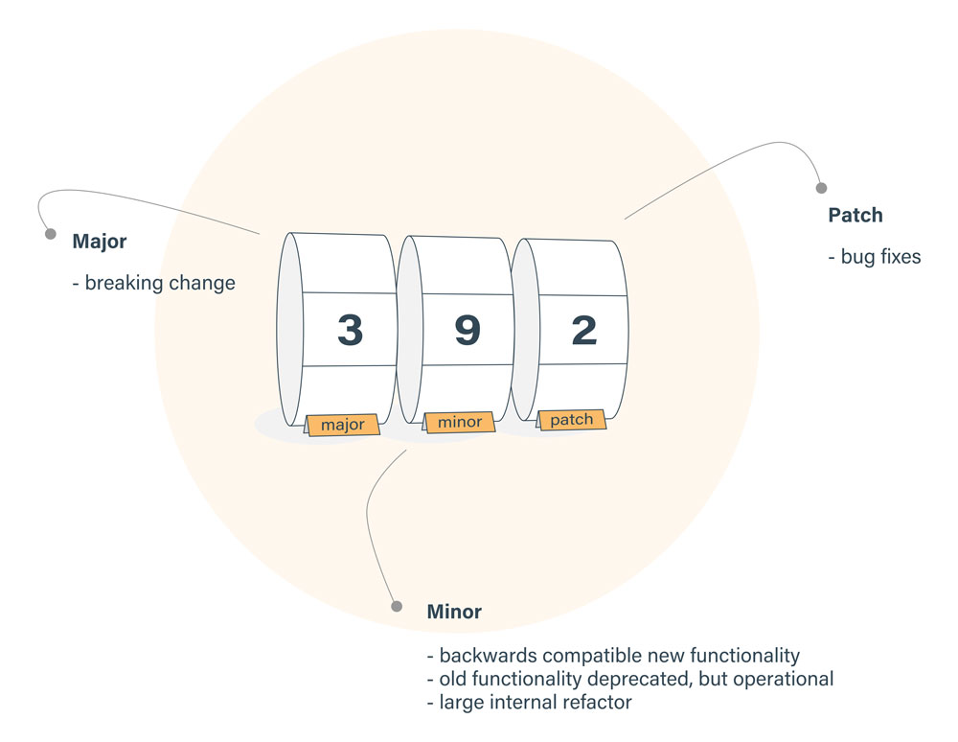
(^) Packages.json
Locks down the major version number,
  Leaves the minor and patch versions to be more flexible.
^2.2.3
  Any version that is greater than or equal to 2.2.3 and also less than 3.0.0.

Slide 21
(~) Packages.json
~2.3.1,
  Fixes both the major and minor version numbers
    Matching any patch number
  All versions greater than or equal to 2.3.1 and less than 2.4.0
1.*
  '*' would equate to any version
  Allow versions greater than or equal to 1.0.0 and less than 2.0.0.

Slide 22
Npm Install
Install takes optional flags which save or update the package version in package.json
-S, --save:
  Package will appear dependencies.
-D, --save-dev:
  Package will appear development Dependencies.
-O, --save-optional:
  Package will appear in optional Dependencies.

Slide 23
NPX – Node package executor
Available from npm version 5.2.0 onwards
Its typical use is to download and run packages temporally
  By default, it first checks if the package that is to be executed exists in the path
  If it does, it executes it;
  Else, means that the package has not been installed, so npx installs its latest version and then executes it;
npx -p @angular/cli@6.1.1
  p package

Slide 24
Node Frequently Used Commands
Install package globally and Locally
  npm install express –g // npm install express
Uninstall package globally and Locally
  npm uninstall express –g // npm uninstall express
List global and Local packages.
  npm ls –g // npm ls -l
  npm list -g --depth=0
Update global and Local packages.
  npm update –g // npm update
Search package
  npm search express

Slide 25
Node Frequently Used Commands
To show the package registry entry
  npm view bootstrap
List of the location of globally installed modules
  npm root –g
To use npm registry
  npm config set registry https://npm.fury.io/USERNAME/
  "npm config ls -l" to show all defaults.

Slide 26


Slide 27
TypeScript
Starts from the same syntax and semantics of JavaScript
  Its is a typed superset of JavaScript
Compiles to clean, simple JavaScript code which runs on any browser and Node.js,
Developers face Challenges with writing JavaScript:
  Difficulty in identifying mistakes at development time.
  Scoping issues
  Mismatched parameters
  Editors and IDEs that could Highlight a mistakes

Slide 28
Type Script and ES6
TypeScript offering over ES2015?
  Types
  Interfaces
Types and interfaces help identify problems early as we type .
Editors don’t have to guess
Brings the agreed upon features in the future ECMAScript spec to us today.
  Decorators,asyc/await

Slide 29
Basic Types
Supports much the same types in JavaScript
Boolean
  let isDone: boolean = false;
Number
  Numbers in TypeScript are floating point values.
  Supports decimal,hexadecimal binary and octal
  let decimal: number = 6;

Slide 30
String
Uses double quotes (") or single quotes (') to surround string data.
let color: string = "blue"; color = 'red';
Can also use template strings
  span multiple lines and have embedded expressions.
  Surrounded by the backtick/backquote (`) character,
  Embedded expressions of the form ${ expr }.
let fullName: string = `Ramesh Kumar`;
let age: number = 37;
let sentence: string = `Hello, my name is ${ fullName }.I'll be ${ age + 1 } years old next month.`

Slide 31
Array
Array types can be written in one of two ways.
Used with type of the elements followed by [] to denote an array of that element type:
let list: number[] = [1, 2, 3];
The second way uses a generic array type, Array<elemType>:
let list: Array<number> = [1, 2, 3];

Slide 32
Enum
Giving more friendly names to sets of numeric values.
By default, numbering starts at 0.
  can be changed manually
enum Color {Red, Green, Blue=4};
  let c: Color = Color.Green;
  console.log(c); // prints 1
  console.log(Color[4]); // prints Blue
enum StrColor {red="Red", green="Green", blue="Blue"};
console.log(StrColor.red);

Slide 33
Type Script Hello World
Install TypeScript
  $ npm install -g typescript
The TypeScript compiler performs local file transformations
JavaScript output closely matches the TypeScript input.
VS Code ships with a recent stable version of the TypeScript

Slide 34
Transpiling
The Typescript transpiler is invoked to obtain javascript code.
$ tsc person.ts
The *.ts extension designates a TypeScript file.
  The transpiler creates a new file called “person.js” with the javascript code.
$ tsc person.ts --target ES5
$ tsc person.ts --target ES6

Slide 35
Classes
Classes has three members:
  a property
  a constructor,
  methods
this.
  This denotes that it’s a member access.

Slide 36
Public , private , protected
Public by default
  Members are public by default.
  Can mark member public explicitly.
Private
  It cannot be accessed from outside of its containing class.
Protected
  Similar to private modifier
  Members declared protected can also be accessed by instances of deriving classes.

Slide 37
Classes
  class Person {
  public firstName: string;
  public lastName: string;
  private _fullName: string;
  constructor (firstName: string, lastName: string) {
  this.firstName = firstName;
  this.lastName = lastName;
  }
  get fullName(): string {
  return this.firstName +”:”+this.lastName;
  }
  }

Slide 38
Typing Functions
Can add types to each of the parameters in the function and return type.
TypeScript can also infer the return type out by looking at the return statements,
  Can leave it optionally l
function greeter(person :string) :string {
  return "Hello, " + person;
  }
  var user = "Ramesh";
  console.log(greeter(user));

Slide 39
Example
  class Startup {
  public static main(): number {
  console.log('Hello World');
  return 0;
  }
  }
  Startup.main();

Slide 40
Interfaces
Interfaces fill the role of naming types,
To define contracts within code as well as contracts with code outside of the project.
Don’t have to explicitly implements interface
  It’s only the shape that matters.
  Does not require that these properties come in any sort of order
  Properties in the interface are present in the required type.

Slide 41
Interfaces
Explicitly enforcing that a class meets a particular contract
Can describe methods in an interface that are implemented in the class
Interfaces can extend each other.
Can extend multiple interfaces, creating a combination of all of the interfaces.

Slide 42
Interface-example
  interface Person {
  firstName: string;
  lastName: string;
  }
  function greeter(person: Person) {
  return "Hello, " + person.firstName + " " + person.lastName;
  }
  var user = { firstName: "Magesh", lastName: "Kumar" };
  console.log(greeter(user));

Slide 43
Optional Properties
Not all properties of an interface may be required.
Interfaces with optional properties are denoted by a ? at the end of the property name in the declaration.
Can describe these possibly available properties
  still also preventing use of properties that are not part of the interface.

Slide 44
Optional Properties
  interface Passenger{passName:string,src:string,dest?:string,age
  :number,mode?:string};
  function BookBusTicket(client:Passenger):string{
  let status='Available';
  return status;
  }
  let busStatus = BookBusTicket({'passName':"ramesh",'age':45,"src":'chennai',"mode":'ac'});

Slide 45
Interfaces with Methods
  export interface Product{
  id:number;name:string;price:number;
  description:string;
  type:string;imageLink:string;
  }
  export interface ProductCart{
    cart:Product[];
    addProduct(prd:Product):number;
    showCart():Product[];
    emptyCart():void;
  }

Slide 46
Implementation
  import {Product,ProductCart} from './Product';
  class MyCart implements ProductCart{
  cart: Product[];
  constructor(){
  this.cart = [];
  };
  addProduct(prd: Product): number {
  this.cart.push(prd);
  return prd.id;
  };
  showCart(): Product[] {
  return this.cart;
  }
  emptyCart(): void {
  this.cart.length = 0;
  console.log(this.cart);
  }
  }

Slide 47
Application
  let cart = new MyCart();
  let iceCream: Product ={id:101,name:"icecream",price:45.00,
  description:"Cup Ice Cream",type:"desert",imageLink:"images/vannila"
  };
  let laddu: Product ={id:102,name:"Moti chur laddo",price:25.00,
  description:"Tradional Sweet",type:"desert",imageLink:"images/laddo"
  };
  cart.addProduct(iceCream);
  cart.addProduct(laddu);
  let prdList = cart.showCart();
  prdList.forEach((eachProduct)=>console.log(eachProduct))
  cart.emptyCart();

Slide 48
Tsconfig.json
tsc --init
  {
    "compilerOptions": {
    "target": "es5",
    "module": "commonjs",
    "sourceMap": true
    }
  }
Ctrl+Shift+B.
The Task Runner uses the config file, which instructs VS Code to use a specific executable with parameters

Slide 49


Slide 50
Angular
A platform that makes it easy to build applications with the web.
It combines declarative templates, dependency injection, end to end tooling
Integrated best practices to solve development challenges.
Empowers developers to build applications that live on the web, mobile, or the desktop
_x000b_

Slide 51
Version History
Angular 2 | 14th Sep 2016
Angular 4 | 23rd March 2017
Angular 5 | 11th Nov 2017
Angular 6 | 03rd May 2018

Slide 52
Angular1.X vs Angular 2
Angular 2 shares some concepts with its predecessor
  the special HTML templating syntax,
  directives/components to modify the DOM
Has Introduced better strategies and concepts to improve the performance
  By updating data binding concept.
Angular 1 may not be deprecated or will not lack support
  It will be there to stay
Angular 2 is Well designed and its is mobile oriented.
  Need for Iconic framework is minimized
  Component based without any controllers or scopes.

Slide 53
Angular 4
Released on March 23, 2017.
  Skipping 3 to avoid a confusion due to the misalignment of the router package's version which was already distributed as v3.3.0
  Angular 4 is backward compatible with Angular 2.
Smaller & Faster
  Angular applications becomes smaller and faster.
View Engine
  AOT generated code reduce the size of the generated code
  More complex the templates the higher the savings.
  Migrating to 4 reduced production bundles by hundreds of kilobytes.

Slide 54
What is New angular 4
Animation Package
  Animations is removed from @angular/core and into their own package.
  Added by importing @angular/platform-browser/animations.
Improved *ngIf
  Can now use an if/else style syntax
TypeScript 2.1 and 2.2 compatibility
  Updated to a more recent version of TypeScript.
  Improve the speed of ngc
  Better type checking in application.
Source Maps for Templates
  When there is an error caused by something in templates
  A Source Map is generated that give a meaningful context in terms of the original template.

Slide 55
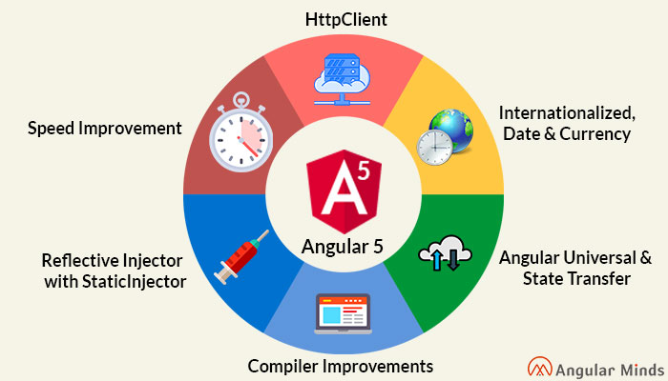
Angular 5

Slide 56
Single Page Application
HTML is a great declarative language for static documents.
  It does not contain much in the way of creating applications,
One "real" HTML page whose content can be changed in Javascript without having to download a new page.
  The new content is created programmatically using templates.
  Server sends an application engine along with the HTML page
The engine controls the entire application including processing, input, output, painting, and loading of the HTML pages.
Server is used when there is a need for new data or must perform secured operations such as authentication.

Slide 57
MVC on Client Side
Client side MVC
  MVC framework is built entirely on the client side.
  Server only delivers data to the application.
  The binding of the data to the models happens client side.
Need for client-side MVC
  operations are not only with HTML but with data on the page.
  when data is collection of JSON
  Process data, perform all required calculations, render HTML and put that into page.
  CRUD actions , over REST API.
  adding or deleting should not make page to reload
  can update page according to current data state.

Slide 58
Webpack Dev Server
The Webpack also comes with a development server.
Can be used run application as we are developing the application.
The Development server uses the Webpack’s watch mode.
Any changes made to our application are instantly updated.
Configured by using the webpack.config.js. Configuration file

Slide 59
Angular Development Environment
Installing Angular CLI
Done by using the following command.
    npm install -g @angular/cli
    ng -version
Creating the Project
  Created by executing the following command from the Prompt
  ng new “gettingstarted” --routing
  Creates a folder gettingstarted and copies all the required files and configuration settings.

Slide 60
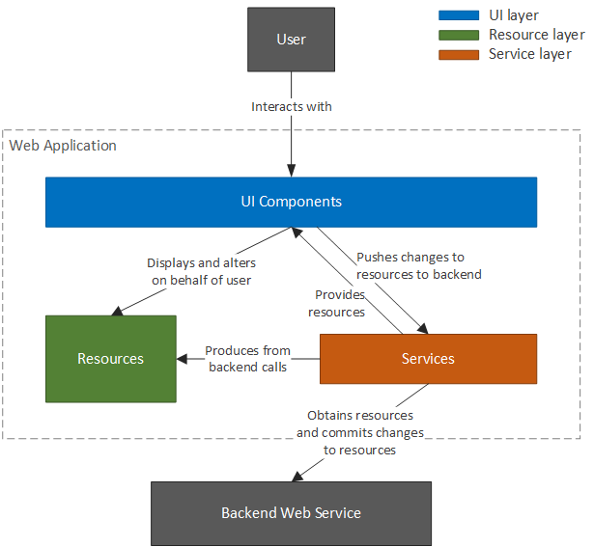
Angular Architecture

Slide 61
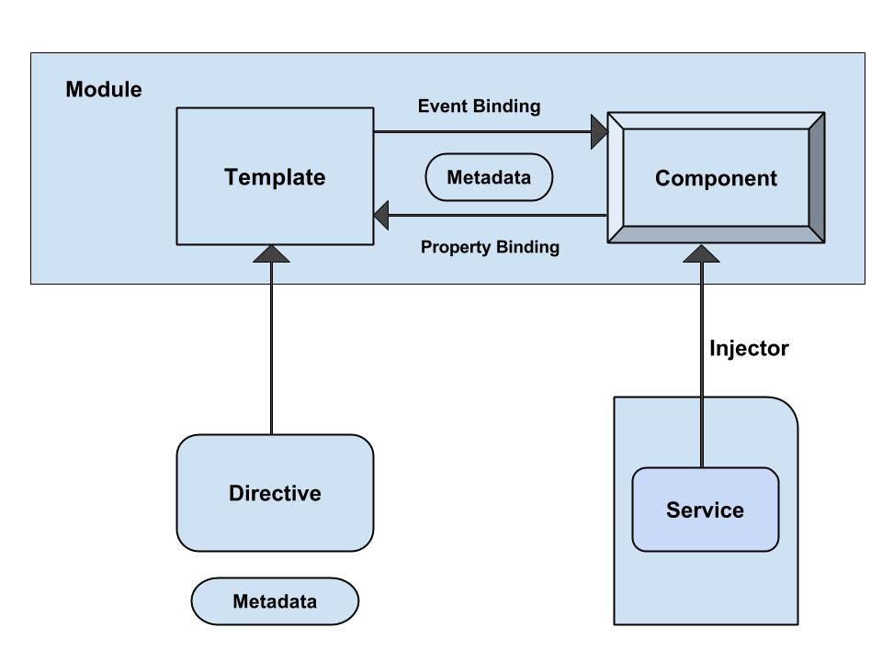
Angular - Architecture

Slide 62
Angular Application Folder structure
Creates a Sample Angular Application
It contains the subfolders e2e, node_modules and src.
It also contains the few configuration files
Angular.json
  This is the configuration file for Angular CLI
karma.conf.json
  The Configuration file karma test runner. Angular uses the Jasmine as the testing framework
protractor.conf.js
  The Configuration file for protractor end to end test runner.
tslint.json
  tslint is a static code analysis tool used in software development for checking Typescript code quality.

Slide 63
Packages.json
It also creates a packages.json which contains dependencies
  {
  "name": "quickstart",
  "version": "0.0.0",
  "scripts": {
  },
  "dependencies": {
  },
  "devDependencies": {
  }
  }

Slide 64
Packages.json
Script Section
  This Script section contains many of the most useful commands
  Ng,start,test etc
devDependencies Section
  This section contains the entries required for application development
  Typescript,karma,jasmine,protractor etc.,

Slide 65
Updating Package.json
Can also add in Project’s package.json and run update
  "dependencies": {
  "bootstrap": “^4.1.2”,
  "font-awesome": "^4.7.0"
  },
  npm install jquery@3.0.0 --save
  npm install popper.js@1.11.0 --save
@import "../node_modules/font-awesome/css/font-awesome.min.css";
  @import "../node_modules/bootstrap/dist/css/bootstrap.min.css";

Slide 66
Sample Application
app/app.component.ts
  where root component is defined
app/app.component.css
  where Css Styles are defined
app/app.component.html
  where HTML templates are defined
app/app.component.spec.ts
  where Test Specification are defined
app/app.module.ts
  - the entry Angular Module to be bootstrapped
index.html
  this is the page the component will be rendered in
app/main.ts
  - is the glue that combines the component and page together

Slide 67
@Component decorator
Components are decorated with @Component decorator.
Provides Metadata about component
It consists of three main parts
  @Component({
  selector: 'app-root',
  templateUrl: './app.component.html',
  styleUrls: ['./app.component.css']
  })

Slide 68
Export and Import Component
  import { Component } from '@angular/core';
  @Component({
  selector: 'app-root',
  templateUrl: './app.component.html',
  styleUrls: ['./app.component.css']
  })
  export class AppComponent {
  title = 'app';
  }

Slide 69
app/app.component.html
  <div style="text-align:center">
  <h1>
  Welcome to {{title}}!!
  </h1>
  </div>

Slide 70
app/app.module.ts
The Angular applications are organized as modules.
  application must have at least one module.
  root Module is loaded first
  Reference of root component type is passed as argument
  Its called as root module
Application routes declarations should be done here

Slide 71
NgModule
Modules are class decorated with the @NgModule
Decorator function which has one argument
  A metadata object with properties describing the module.
Some of its important properties are:
Bootstrap Array
Export Array
Import Array
Provider Array.

Slide 72
Modules
Bootstrap array
  Used to inform which components need to be loaded, so that its functionality can be accessed in the application.
Export array
  Used to export components, directives, and pipes which can then be used in other modules.
Import array
  Used to import the functionality from other modules.
Providers array
  Used to provide the services by the module

Slide 73
Modules
  import { NgModule } from '@angular/core';
  import { BrowserModule } from '@angular/platform-browser';
  import { CreditCardModule } from '../credit-card/credit-card.module';
  import { AppComponent } from './app.component';
  @NgModule({
  imports: [ BrowserModule, CreditCardModule ],
  declarations: [AppComponent],
  bootstrap: [AppComponent] })
  export class AppModule { }

Slide 74
Built in Modules
BrowserModule from @angular/platform-browser
  Used to run application in a browser.
CommonModule from @angular/common
  Used for directives - NgIf, NgFor and so on.
FormsModule from @angular/forms
  Used when to build template driven forms.
RouterModule from @angular/router
  Used for routing RouterLink, forRoot, and forChild.
HttpClientModule from @angular/common/http
  Used to initiate HTTP request and responses

Slide 75
app/main.ts
Makes angular to load the AppModule and controls the start up of the application
bootstrapModule method of platformBrowserDynamic library
  to bootstrap AppModule
  import { enableProdMode } from '@angular/core';
  import { platformBrowserDynamic } from '@angular/platform-browser-dynamic';
  import { environment } from './environments/environment';
  import { AppModule } from './app/app.module';
  if (environment.production) {
  enableProdMode();
  }
  platformBrowserDynamic().bootstrapModule(AppModule);

Slide 76
app.main.ts
platformBrowserDynamic library.
  Contains the functions required to bootstrap the angular application.
enableProdMode from @angular/core library.
  The Angular’s code by default runs in development mode.
  The development mode runs few assertions and checks
  helps in debugging the application.

Slide 77
index.html
  <html>
  <head>
  <link rel="icon" type="image/x-icon" href="favicon.ico">
  </head>
  <body>
  <app-root></app-root>
  </body>
  </html>
The selector “app-root”, defined in component metadata is used as HTML tag.
Angular scans the HTML page for <app-root>
  replaces the entire content with content of app.component.html

Slide 78
Running Angular Application
  npm start
  will run definitions of the start command of the scripts object in package.json file.
  Compiles the Angular application and invokes the Webpack development server.
  Watches project folder and if any changes are made it compiles the project again.
  Server listens on HTTP Port 4200.
  http://localhost:4200/
Can Change the Default Port using angular-cli.json
  "defaults": {
  "styleExt": "css",
  "component": {},
  "serve": {
  "port": 5200
  }
  }

Slide 79
Ng-serve
ng serve
  command launches the server,
  Watches files, and rebuilds the app
  serves an Angular project via a development server
Using the --open or -o option
  will automatically open browser on http://localhost:4200/.

Slide 80
The Component
Angular migrated from directives to components
  Directives that are always associated with a direct template.
They represent the view of the application.
Can have methods and properties, which supply logic to view.
Smart / Container components
  application-specific, higher-level, container components, with access to the application's domain model.
Dumb / Presentational components
  components responsible for UI rendering and/or behavior of specific entities passed in via component properties and events

Slide 81
Generating Components
ng generate or ng g
Ng generate component footer
ng g component my-new-component
ng g component feature/new-cmp
Creating a new component, generates the following files
  component.html (View)
  component.ts (Controller)
ng generate --help
  To View all available options Angular CLI.

Slide 82
Component Class
The basic building block of an UI
  An application is a tree of components.
Component decorator marks a class as an Angular component
A component must belong to an NgModule in order for it to be usable by another component or application.
Component Class has a constructor() to setup Dependency Injection
Components can control their runtime behavior by implementing various Life-Cycle hooks.

Slide 83
Configuring More than One Component
  Done in the app.module.ts
  import { AppComponent } from './app.component';
  import { HeaderComponent } from './app.headercomponent';
  @NgModule({
  declarations: [
  AppComponent,
  HeaderComponent,
  ],
  imports: [
  BrowserModule
  ],
  providers: [],
  bootstrap: [AppComponent,HeaderComponent]
  })
  export class AppModule { }

Slide 84
Header Component
  import { Component, OnInit } from '@angular/core';
  @Component({
  selector: 'app-header',
  templateUrl: './header.component.html',
  styleUrls: ['./header.component.css']
  })
  export class HeaderComponent implements OnInit {
  banner: string;
  constructor() {
  this.banner = 'assets/images/Banner.jpg';
  }
  ngOnInit() { }
  }

Slide 85
Data Binding - Interpolation
communication between a component and it’s Template
  {{ expression }} to render the bound value to the component’s template.
  To weave calculated strings into the text between
    HTML element tags and within attribute assignments.
  Replaces the name with the string value of the corresponding component property
  <img src={{banner}} class='banner' />

Slide 86
Index.html
  <!doctype html>
  <html lang="en">
  <head>
    <base href="/">
    <meta name="viewport" content="width=device-width, initial-scale=1">
    <link rel="icon" type="image/x-icon" href="favicon.ico">
  </head>
  <body>
      <app-header> </app-header>
      <app-root> </app-root>
  </body>
  </html>

Slide 87
TEMPLATES

Slide 88
Angular Templates
Templates mix native HTML with custom elements.
Inline Templates
  Specified directly in the component decorator
  Template literals with back-ticks allow multi-line strings.
  @Component({
  selector: 'inline-template',
  template: ` <h2>Inline Template</h2>
  <p> Multi-line inline template using back-ticks </p>`
  })
  export class InlineComponent {}

Slide 89
Angular Templates
External Templates
  Defined in a separate HTML file
  Referenced with templateUrl.
  Recommended to use if the template contains more than 3 lines.
  @Component({
  selector: 'external-template',
  templateUrl: 'app/templates/external-template.html'
  })
  export class ExternalComponent {}

Slide 90
Built-in Directives -ngFor
Part of core directive to build data presentation lists and tables
Takes an iteration expression
A loop variable defined using the keyword let
  <tr *ngFor="let medicine of medicineList">
    <td>{{medicine.medicineName}}</td>
    <td>{{medicine.price}}</td>
    <td>{{medicine.unit}}</td>
  </tr>
  <tr *ngFor="let medicine of medicineList let i=index">
  <td>{{i+1}}</td>
  </tr>

Slide 91
SERVICES

Slide 92
Dependency Injection
The ability to add functionality to components at runtime.
  Simplify dependency management in software components.
Done by reducing the amount of information a component needs to know about its dependencies,
  unit testing can be made easier and code is more likely to be flexible.

Slide 93
Services
A service is used when a common functionality needs to be provided to various modules.
  Eg: A database functionality that could be reused among various modules.
A separate class which has the injectable decorator
  ng g service my-new-service
Can also be added to the module to use the service as a provider in the @Component decorator.
Services are singleton objects.
Services are capable of returning the data in the form promises or observables.

Slide 94
@Injectable
@Injectable()
  Let know a class can be used with the dependency injector.
  Not strictly required if the class has other Angular decorators on it.
  Best practice is to decorate injectables with @Injectable(), as it is makes more sense to the reader.
providedIn: 'root‘
  Indicates that the root injector is responsible for creating an instance
  These are automatically made available to the entire application
  Don't need to be listed in any module.

Slide 95
*R*eactive E*x*tensions for *J*ava*S*cript
A stream in the RxJS represents values over time
  A library for composing asynchronous and event-based programs by using observable sequences.
Observable
  A function that produces a stream of values to an observer over time.
Observer
  Observer is the one which subscribes to an observable
  Read values coming from an observable.
  An observer has three callbacks that accept notifications coming from the observer,
    Next ,error,complete

Slide 96
RxJS
The create() method accepts a single argument subscribe function.
This subscribe function accepts an observer argument.
  import {Observable} from 'rxjs';
  ngOnInit(): void {
  const obs = Observable.create((observer: any) => {
    observer.next('Will be sent');
    observer.next('This too will be sent');
    observer.complete();
    observer.next('Will not be sent');
  });
  obs.subscribe((x: any) => console.log(x));
  }

Slide 97
HttpClient
Introduced in the Angular 4.3.
Available in package @angular/common/http
  To replace the older HttpModule.
The Response returned from the HttpClient is an observable
  Needs to be Subscribed.
  The response can be converted to desired object

Slide 98
Http Client Module
  import {HttpClientModule, HttpClient} from '@angular/common/http';
  @NgModule({
  declarations: [
  AppComponent,
  ],
  imports: [
  BrowserModule ,HttpClientModule],
  providers: [HttpClient],
  bootstrap: [AppComponent]
  })
  export class AppModule { }

Slide 99
HttpClient
get() :
  parses the JSON server response into the anonymous Object type.
  Can specify the type of response to make consuming the output easier and more obvious.
  this.http.get<Medicine[]>(this.baseURL)

Slide 100
Get Method
  @Injectable( { providedIn: 'root‘ }
  )
  export class MedicineApiService {
  constructor(private http: HttpClient) { }
  baseURL = 'http://localhost:3000/medicines';
  findAll(): Observable<Medicine[]> {
  return this.http.get<Medicine[]>(this.baseURL);
  }
  }

Slide 101
Subscribe()
.subscribe(success, failure, completed);
Success:
  Whenever observable returns a value.
  (response) => { this.repos=response; }
Failure:
  When observable is failed to generate the expected data or has encountered some other error.
  (error) => {this.errorMessage=error; this.loading=false; },
Completed:
  When the observables complete its task.
  () => {this.loading=false;})

Slide 102
Subscribing
  @Component({
  selector: 'app-crud',
  templateUrl: './crud.component.html',
  styleUrls: ['./crud.component.css']
  })
  export class CrudComponent implements OnInit {
  medList: Medicine[]
  constructor(private service: MedicineApiService) { }
  ngOnInit() {
  this.service.findAll()
  .subscribe(data => this.medList = data, err => console.log(err));
  }
  }

Slide 103
HttpResponse
Can provide observe option to specify return data type
  By default, observe is set to body.
  response which returns the full response
  events which returns the full event stream
  findAll(): Observable<HttpResponse<Object> {
  return this.http.get<Object>(this.baseURL, {observe: 'response'});
  }
  this.service.findAll().subscribe(resp => {
  this.weekEndTripList = <Weekendtrip[]> (resp.body);
  console.log(resp.status);
  console.log(resp.headers.get('content-type'));
  });

Slide 104
Using Promise
    findAllWithPromise(): Promise<Medicine[]> {
  return this.http.get<Medicine []>(this.baseURL).toPromise();
  }
Can use in the Component
this.service.findAllWithPromise().then(
res => this.medicineList = res ).catch(
err => console.log(err.error));

Slide 105
Post and Delete Method
  add(medicine): Observable<Medicine> {
  const headers =
  new HttpHeaders().set('content-type', 'application/json');
  return this.http.post<Medicine>(this.baseURL, medicine, {headers});
  }
  remove(codeNumber): Observable<Medicine> {
  return this.http.delete<Medicine>(this.baseURL + '/' + codeNumber);
  }

Slide 106
Delete Method
remove(loan: LoanCustomer): Observable<LoanCustomer> {
const headers =
new HttpHeaders().set('content-type', 'application/json');
return this.client.request<LoanCustomer>('Delete',
this.baseURL, { body: loan, headers});
}

Slide 107
Http with Authorization
import { HttpHeaders } from '@angular/common/http';
  const httpOptions = {
  headers: new HttpHeaders(
  {
  'Content-Type': 'application/json',
  'Authorization': 'Basic ' + btoa('username:password')
  }
  )
  };
return this.http.get<AObjects[]>(this.postsURL, httpOptions);

Slide 108
btoa()
Window.btoa()
  Encodes a string in base-64.
  Uses the "A-Z", "a-z", "0-9", "+", "/" and "=" characters to encode the string.
const url = 'http://localhost:8080/books';
const headers = new HttpHeaders({ Authorization: 'Basic ' + btoa('user:secret123') });
return this.http.get(url, { headers });
}

Slide 109
PROPERTY BINDING

Slide 110
Types of Property Binding
Element property binding
  works within HTML element
  binds a component property to a DOM property.
    <img [src]=" imageUrl ">
Component property binding
  works within component element
  binds parent component property into child component property.
  <app-child [info]=‘data’></app-child>
Directive property binding
  Works within HTML element with angular directives such as NgClass and NgStyle.
  Component property or any angular expression is bound to angular directive.

Slide 111
ELEMENT PROPERTY BINDING

Slide 112
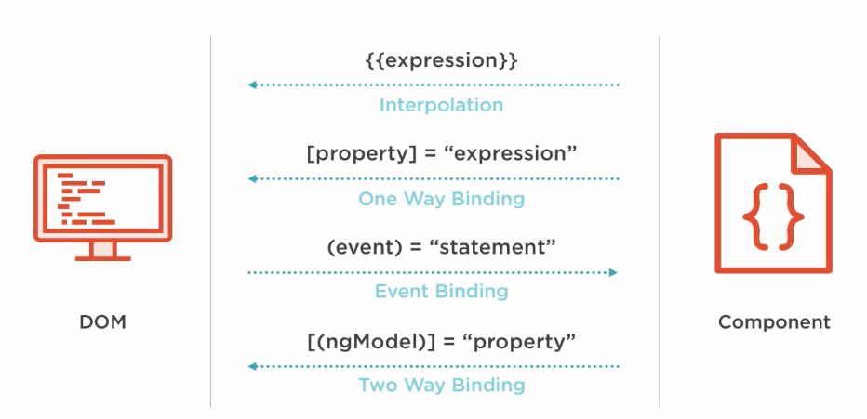
Element Property Binding

Slide 113
Property Binding
  A One way Binding
    from the component class, to the component’s template.
  sets an element property to a component property value.
  Can be Used for non-string data value.
Done by wrapping brackets around an element
  <img [src]=" imageUrl ">
  <button [disabled]='isDisabled'>Try Me</button> // in the template
  isDisabled: boolean = true; // in the component class

Slide 114
Event Binding
Event handler are is specified inside the template using ()
  Event handler is then coded in the class to process the event.
Can take the same property that is on the HTML element wrap it in parenthesis.
  template: `
  <h1>My First Angular App</h1>
  <img [src]="imageUrl" (click)='myMethod()'> `
      imageUrl =‘’assets/images/idly.jpg'
  myMethod() {
  console.log('Hello);
  }

Slide 115
Event Binding
Can also pass information about the event to the component class:
  ` <img src=“{{imageUrl}}" (click)='myMethod($event)'> `
  myMethod(event:any) {
  console.log(event);
  }

Slide 116
Two Way Binding
Combines the input and output binding into a single notation
Done by using a special directive called ngModel.
<input [(ngModel)]="name" >
  <input [ngModel]="name" (ngModelChange)="name=$event">
square braces [..] refers property binding.
circle braces (..) refers to the event binding.
  Together as [(..)] refers two way binding
This syntax is called Banana in a Box ([()]).

Slide 117
Two Way Binding- App Module
  import { FormsModule } from '@angular/forms';
  @NgModule({
  declarations: [
  AppComponent,
  ],
  imports: [
  BrowserModule,FormsModule
  ],
  providers: [],
  bootstrap: [AppComponent,ShowplacesComponent]
  })

Slide 118
Two Way Binding
  <div> <label>Name:</label>
  <input type="text" [(ngModel)]="name">
  <h1>Hello {{name}}!</h1> </div>
  export class AppModule {
  private name:string='World';
  }

Slide 119
DIRECTIVES

Slide 120
Directives
Used to attach behavior to DOM elements.
Built-in directives to the framework
  NgFor, NgIf, NgModel, NgClass
There are three kinds of directives:
Components
  @Component(): Is also a directive with a template.
Structural Directives
  Can change the DOM layout by adding and removing DOM elements
Attribute Directives
  doesn’t change the DOM but can change the appearance or behavior of an element such as NgStyle.

Slide 121
Attribute Directives
These directives change the appearance or behavior of a component.
They work in a way that is component agnostic and not bound to implementation details.
Example:
  ngClass and ngStyle work on any component or element.

Slide 122
NgStyle Directive
To modify a component or element's style attribute.
  @Component({
  selector: 'style-example',
  template: `
  <p [ngStyle]="{'background-color':messageStyle}">
  `
  })
  export class StyleExampleComponent {
  messageStyle:string='yellow';
  }

Slide 123
NgClass Directive
Directive changes the class attribute that is bound to the component or element it's attached
Binding a string
  Can bind a string directly to the attribute.
  @Component({
  selector: 'class-as-string',
  template: `
  <p [ngClass]='centerText'>Page Designed by Ramesh</p>
  `,
  Binding an Array : A list of applicable class names defined in css
  <p [ngClass]="['centerText','highLight']">Page Designed by Ramesh</p>

Slide 124
[ngClass] - Binding an object
Object can also be bound to the directive.
Template
  <button (click)='change()' class="fa fa-2x"
  [ngClass]="{'fa-toggle-up':showup,'fa-toggle-down':showdown}">
  </button>
  Component.ts
  showup =true;
  showdown =false;
  change(){
  this.showup = !this.showup;
  this.showdown = !this.showdown;
  }

Slide 125
Structural Directives
It’s a "syntactic sugar" for tasks that’s done Internally,
  * Means angular should create a template element
  Expression passed will be bound to the outer <ng-template>
  Template will be rendered related to variable passed to the directive
  It might add /remove/manipulate the host element and its descendants.
ngIf , ngFor , and ngSwitch .

Slide 126
Built-in Directives -ngFor
Part of core directive to build data presentation lists and tables
Takes an iteration expression
A loop variable defined using the keyword let
  <tr *ngFor="let medicine of medicineList">
    <td>{{medicine.medicineName}}</td>
    <td>{{medicine.price}}</td>
    <td>{{medicine.unit}}</td>
  </tr>
  <tr *ngFor="let medicine of medicineList let i=index">
  <td>{{i+1}}</td>
  </tr>

Slide 127
ngFor
ngFor also provides some other values that can be bound to:
  index - position of the current item in the iterable starting at 0
  first - true if the current item is the first item in the iterable
  last - true if the current item is the last item in the iterable
  even - true if the current index is an even number
  odd - true if the current index is an odd number
  *ngFor="let emp of employees;
  let even = even; let odd = odd"
  [ngClass]="{ odd: odd, even: even }"> {{emp.name}}

Slide 128
Built-in Directives –ngIf
*ngif="condition“
  <div>
  <button (click) =“clicked()”>Toggle</button>
    <div *ngIf=“show”>
    <p> see Image</p>
    </div>
  </div>
  export class AppComponent{
  show:boolean =true;
  Clicked (){
  this.show=!this.show;
  }
  }

Slide 129
ng-template directive
Represents an Angular template
Used for rendering HTML.
  Used by Built in Structural directives
  It gets loaded as part of parent view content.
The content of this tag will contain part of a template
  Which can be composed together with other templates
  Resulting in a final component template.

Slide 130
ngIf
<h2 *ngIf="condition">Hello {{name}}</h2>
<button (click)="condition = !condition">Click</button>
// When the above code is Rendered
  <ng-template [ngIf]=“condition">
  <h2 >Hello {{name}}</div>
  </ng-template>
  <!--bindings={
  "ng-reflect-ng-if": "true"
  }-->
  <h2 _ngcontent-c0="">Hello Angular5</h2>

Slide 131
*ngIf and Else
Can also declare else as conditions:
  template: `
  <h1>Greeting !</h1>
  <ul>
  <li *ngIf="myArr; else otherTmpl“>Hello World.</li>
  </ul>
  <ng-template #otherTmpl>Hello India</ng-template> `
Can also use then inside of expression
  template: `
  <h1>Greeting</h1>
  <div *ngIf="myArr; then tmpl1 else tmpl2"></div>
  <ng-template #tmpl1>Here</ng-template>
  <ng-template #tmpl2>Not here</ng-template> `,

Slide 132
NESTING COMPONENTS

Slide 133
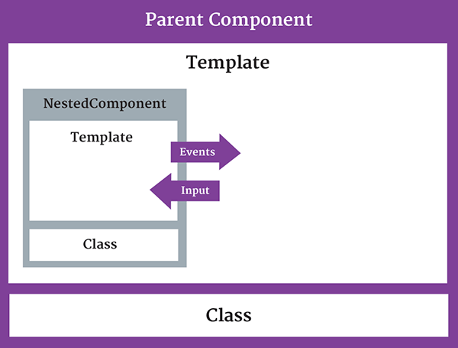
Nested Component
The component being used inside another component is known as the child component
  and the enclosing component is known as the parent component.

Slide 134
Nested Component -Child
  import { Component } from '@angular/core';
  @Component({
  selector: 'appchild',
  template: `<h2>Hi {{greetMessage}}</h2>` })
  export class AppChildComponent {
  greetMessage: string = "I am Child";
  }

Slide 135
Nested Component- Parent
  import {Component } from '@angular/core';
  import {AppChildComponent} from './appchild.component';
  @Component({
  selector: 'my-app',
  template: `<h1>Hello {{message}}</h1>
  <appchild></appchild> `,
  })
  export class AppComponent {
  message : string = "I am Parent";
  }

Slide 136
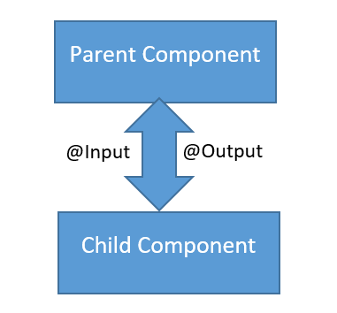
Communication Between Components
Can share data and information with another component by passing data or events.
Components can communicate to each other in different ways:
  Using @Input()
  Using @Output()
  Using Services
  Parent component calling ViewChild

Slide 137
PASSING DATA USING @INPUT
  To pass data into components from template and to dynamically configure them.
  Supports change tracking.
  Can NOT pass @Input() to a bootstraped component.
Binds a property within one component (child component) to receive a value from another component (parent component).
  One way communication from parent to child.
Component property should be annotated to act as input property.

Slide 138
Child Component
  import { Component,Input,Output,EventEmitter, OnInit } from '@angular/core';
  @Component({
  selector: 'review-food',
  templateUrl:'reviews.component.html',
  styleUrls: ['../food-items/food/food.component.css']
  })
  export class ReviewsComponent {
  @Input() reviewedby:string;
  details='Reviewed by 200 peoples';
  }

Slide 139
Parent Component-One Way Component Property Binding
  import { ReviewsComponent } from '../../reviews/reviews.component';
  @Component({
  selector: 'app-food',
  templateUrl: './food.component.html',
  styleUrls: ['./food.component.css'],
  })
  export class FoodComponent {
  reviewer:string = 'Zomoto';
  }
Reviwed by <review-food [reviewedby]='reviewer'></review-food>
Parent component sets the value of the child component’s property
Input Property as defined in Child
Bound property in Parent

Slide 140
@output
One way communication from child to parent component
Uses events
  binds a property of a component to send data from one component (child component) to calling component (parent component).
The child component exposes an EventEmitter property
  It emits events when something happens.
  The parent binds to that event property and reacts to those events.
The child's EventEmitter property is an output property,
  Its adorned with an @Output decoration
  @Output()
  sendMsgEvent = new EventEmitter<string>();
  sendMsgEvent will be custom event name.

Slide 141
Child Component
  import { Component,Input, Output,EventEmitter,OnInit } from '@angular/core';
  export class ChildComponent implements OnInit {
  @Input() childName: string;
  @Output() result: EventEmitter<String> = new EventEmitter<string>();
  constructor() { }
  ngOnInit() { }
  addData(){
  this.result.emit(this.childName + 'Added');
  }
  }
Property placeholder to receive from parent
Property To Parent

Slide 142
Emit
emit()
  emit a change to (change) listener in the parent
  Which will invoke the onchange($event) callback
  The data associated with the event will be given via the $event property.
Child-Component.html
  <p>
  <button (click)="addData()">Add Medicine</button>
  </p>

Slide 143
Parent-component.html
  <input type="text" name='user' [(ngModel)]='name'>
  <p>
  <app-child [childName] ={{name}} (result)="onChange($event)"></app-child>
  {{msg}}
  </p>
  childName : refers to @Input Property in to Child Component
  name : refers to property in the Parent Component
  Result : refers to @output Property in Child Component

Slide 144
Parent Compnent
  import { Component, OnInit, SimpleChanges } from '@angular/core';
  @Component({
  })
  export class ParentComponent implements OnInit {
  msg: string;
  name: string;
  constructor() { }
  ngOnInit() {
  }
  onChange(val) {
  this.msg = val;
  }
  }

Slide 145
Child Components
  export class GuestPhotosComponent implements OnInit {
  guestPhoto: string;
  constructor() {
  this.guestPhoto = 'assets/images/frntView.jpg';
  }
  }
  export class HotelPhotosComponent implements OnInit {
  hotelPhoto: string;
  constructor() {
  this.hotelPhoto = 'assets/images/rearView2.jpg';
  }
  }

Slide 146
Parent Template
  <app-guest-photos></app-guest-photos>
  <app-hotel-photos></app-hotel-photos>
    <img src={{gp}} alt='hello'>
    <img src={{hp}} alt='style'>

Slide 147
PIPES

Slide 148
Pipes
“Pipes transform displayed values within a template.”
  A pipe takes in data as input and transforms it to a desired output.
Used in any template.
Inside the interpolation expression, pipe operator ( | ) is used
Expression | pipeOperator[:pipeArguments]

Slide 149
Passing arguments
Can pass optional arguments to the pipe.
  Arguments are added to the pipe using a colon (:) sign followed by the value of the argument.
  Multiple arguments can be separated colon (:).
Date pipe accepts one optional argument called “format”.
  {{toDate | date:'medium'}}
  Nov 22, 2016, 10:04:10 PM
  Pipes can be chained together with useful combinations.
    {{ birthday | date:'fullDate' | uppercase}}

Slide 150
Built In Pipes
  DatePipe,
  UpperCasePipe, LowerCasePipe,
  CurrencyPipe,
  PercentPipe,
  JsonPipe,
Some of pipes not supported in New versions of Angular 2
  orderBy and filter
Can by achieved by using “custom pipes”.

Slide 151
Date Pipe
date_expression | date[:format]
format indicates which date/time components to include.
  'medium': equivalent to 'yMMMdjms' (e.g. Sep 3, 2010, 12:05:08 PM for en-US)
  'fullDate': equivalent to 'yMMMMEEEEd' (e.g. Friday, September 3, 2010 for en-US)
  'mediumDate': equivalent to 'yMMMd' (e.g. Sep 3, 2010 for en-US)
  'mediumTime': equivalent to 'jms' (e.g. 12:05:08 PM for en-US)
  'shortTime': equivalent to 'jm' (e.g. 12:05 PM for en-US)

Slide 152
Decimal Pipe
To format a number as decimal number according to locale rules.
It uses number keyword with pipe operator.
number_expression | number[:digitInfo]
number_expression:
  An angular expression that will give output a number.
number :
  A pipe keyword that is used with pipe operator.
digitInfo :
  Defines number format.
  {minIntegerDigits}.{minFractionDigits}-{maxFractionDigits}
  {{450.997 | number:'3.2-2'}} // 451.00
  {{450.992 | number:'3.2-2'}} // 450.99

Slide 153
Currency Pipe
currency [ : currencyCode [ : display [ : digitsInfo [ : locale ] ] ] ] }}
currencyCode is the ISO 4217 currency code,
  USD for the US dollar and EUR for the euro.
display
  code: Show the code (such as USD).
  symbol(default): Show the symbol (such as $)
  String: Use the given string value instead of a code or a symbol.
digitInfo
  <p> {{salary | currency:‘USD':'symbol':'4.2-2‘ : ‘fr’}}</p>

Slide 154
Percentage Pipe
Formats a number as a percentage according to locale rules.
number_expression | percent[:digitInfo]
number_expression:
  An angular expression that will give output a number.
percent :
  A pipe keyword that is used with pipe operator and it converts number into percent
digitInfo:
  defines a percentage format.
  {minIntegerDigits}.{minFractionDigits}-{maxFractionDigits}

