Slide 1
DOCKERS

Slide 2
Docker
Tool designed to create, deploy, and run applications
  Using containers.
Containers
  Used to package an application with all of the parts it needs
  Libraries and other dependencies, and ship it all out as one package.
Application will run on any other machine
  Even if the settings could differ from the machine used for writing and testing the code.

Slide 3
Need For Dockers
To benefit both developers and system administrators.
Part of many DevOps
Developers
  can focus on writing code without worrying about the system that it will ultimately be running on.
  Helps to get a head start by using one of thousands of programs already designed to run in a Docker container as a part of their application.
Operations
  Flexibility and reduces the number of systems needed because of its small footprint and lower overhead.

Slide 4
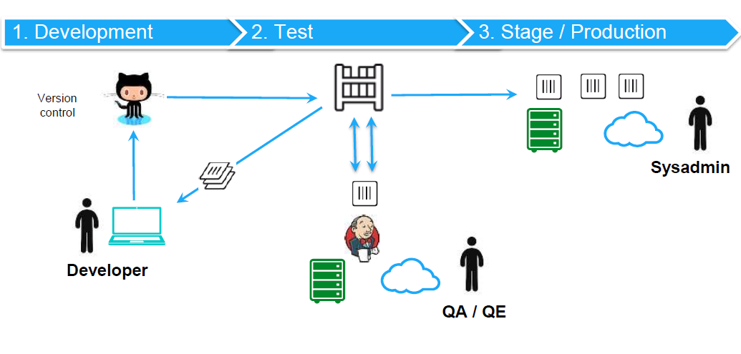
Continuous Integration and Delivery

Slide 5
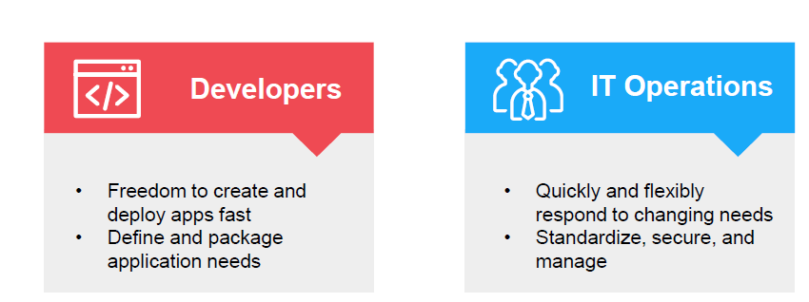
Tug of War Between Developers and Ops

Slide 6
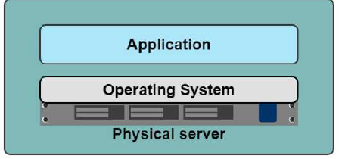
One application on one physical server

Slide 7
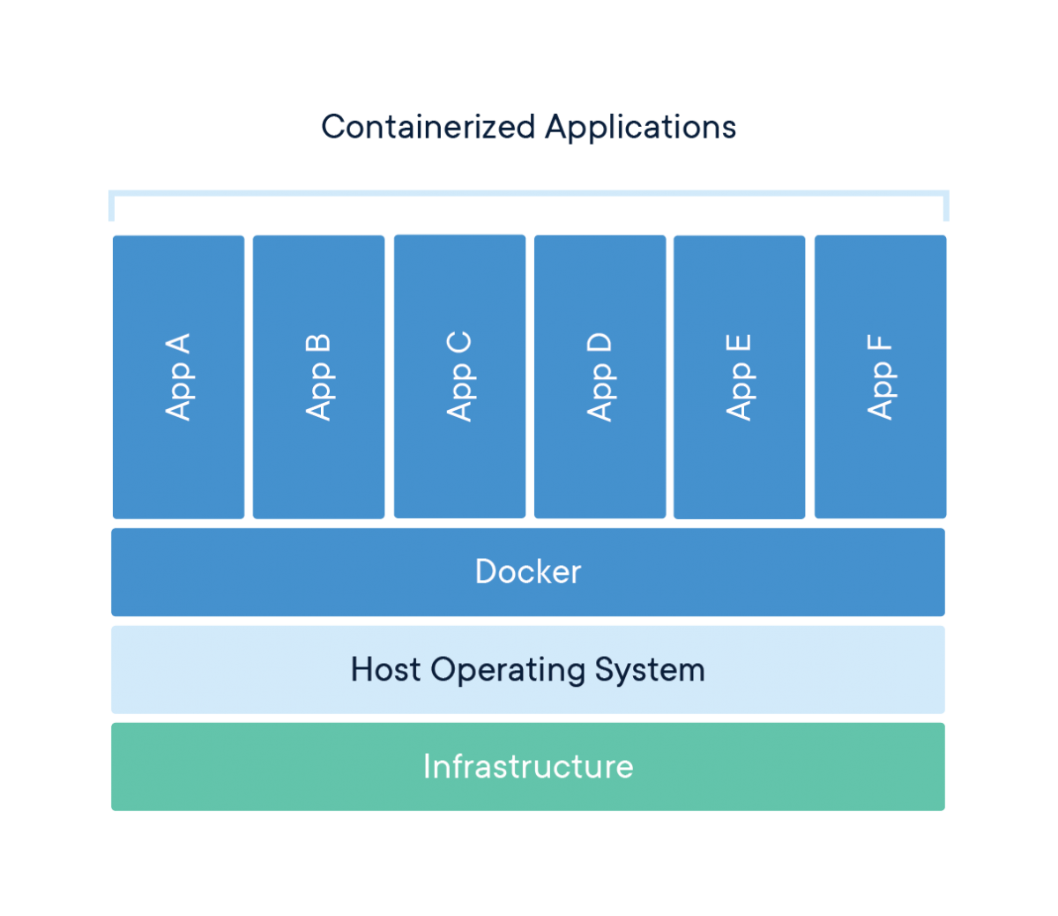
Containers

Slide 8
One application on one physical server
Slow deployment times
Huge costs
Wasted resources
Difficult to scale
Difficult to migrate
Vendor lock in

Slide 9
Container – Virtual Machine
Virtual Machine (VM)
  Runs virtually on a physical machine.
  Each VM has their own operating system , runtime libraries and installed apps.
  The size of a VM may take GB of space from the physical machine
  Consumes high resources of the physical machine
  Can be multiple VMs in a physical machine.

Slide 10
Container – Virtual Machine
Infrastructure
  represents the resources and software related to the physical machine.
  This includes the host’s machine operating system, runtime libraries and other resources.
Hypervisor
  Software that allows to run VM on host machine.
Host Machine & Guest Machine
  A computer on which a hypervisor runs one or more virtual machines is called a host machine
  Hypervisor is responsible for creating and maintaining VMs.
  Each virtual machine is called a guest machine.
  The virtual machines can access the host’s machine infrastructure and resources through the hypervisor.

Slide 11
Docker Containers
Docker containers run on top of the docker platform.
  Contains only the executable package of the application, libraries and dependent software/servers that are required to run the application.
They do not have separate OS installations running
Utilize the host machine’s OS.
  Size of the container may take relatively less spaces
Containers are considered as light weight with compared to VM.

Slide 12
Container and Image
Docker container is a running instance of an image.
  Can Use CLI commands to run, start, stop, move, or delete a container.
  Container is an isolated and secure application platform
  It can also share and access resources running in a different host or container.
Image is a read-only template with instructions for creating a Docker container.
Image is described in text file called a Dockerfile
  A simple, well-defined syntax.
An image does not have state and never changes.
Docker Engine
  Provides the core Docker technology that enables images and containers.

Slide 13
Installation
Installation method change time to time.
  Especially for windows and Mac.
docker for windows
docker toolbox -> docker desktop
Can check docker is installed by the following command
docker --version

Slide 14
Docker Hub
https://hub.docker.com/
A repository that contains the published docker images.
Can create docker image of application and publish it here for later use or someone else to use.
It also has official docker image of many popular application

Slide 15
Docker Container and Image
docker run <image-name> : docker run hello-world
docker:
  Docker engine used to run docker program.
run:
  Used to create and run a docker container.
hello-world:
  It is a image or name of an Image
  This image will be loaded into the container.

Slide 16
Running an Image from DockerHub
docker images hello-world
  List the named docker Image
docker images
  List the docker images on the machine
    Shows Repository,tag,size,created and imageId
docker images --format "{{.ID}}: {{.Repository}}"
  Command to run the image from the terminal

Slide 17
Running a Docker Image
  docker platform first check whether the requested image is already available in the local registry.
  If it is locally available, then it will run the local image.
  If the image is not available, then it will retrieve the image from the Docker Hub and run.

Slide 18
Dockerfile
A text file without any extension
Used To write the instruction to build new docker image
  Docker reads the instruction and builds images automatically
Will have commands to build a image.

Slide 19
DockerFile
FROM
  creates a layer from Docker image.
  FROM java:8
ARG <name>[=<default value>]
  Defines a variable that users can pass at build-time to the builder
  ARG JAR_FILE=target/firstExample.jar

Slide 20
DockerFile
ENTRYPOINT
  To configure a container that will run as an executable.
  ENTRYPOINT ["java","-jar","app.jar"]
WORKDIR
  Sets the working directory for any RUN, CMD, ENTRYPOINT, COPY and ADD instructions
  If the WORKDIR doesn’t exist, it will be created

Slide 21
DockerFile
FROM java:8
ARG JAR_FILE=target/firstExample.jar
WORKDIR /opt/app
COPY ${JAR_FILE} app.jar
ENTRYPOINT ["java","-jar","app.jar"]

Slide 22
Example
Create a Java Project
Change to Maven Project By selecting
  Project->RightClick->Configure ->Maven Project
Update the pom.xml file with “maven-jar” plugin
Can Optionally add build>finalName>secondExample
Add the Configuration ,manifest and main class
Create DockerFile in the context Path
Maven build the project mvn clean install

Slide 23
Build Docker Image
The docker build command builds Docker images from a Dockerfile
  Navigate to directory where DockerFile is present
docker build .
  Specifies that the PATH is .
  and so all the files in the local directory to Docker daemon
docker build --tag firstExample:1.0 .
  Can add a tag in the ‘name:tag’ format
docker run Image[:tag]
  Used to specify a version of an image to run
docker run firstexample:1.0

Slide 24
Maven Java Plugin
  <plugin>
  <groupId>org.apache.maven.plugins</groupId>
  <artifactId>maven-jar-plugin</artifactId>
  <version>3.2.0</version>
  <configuration>
  <archive>
  <manifest>
  <mainClass>com.training.Application</mainClass>
  </manifest>
  </archive>
  </configuration>
  </plugin>

Slide 25
Docker Commands
  docker info
  List system-wide information regarding the Docker installation,
  Including statistics and resources (CPU & memory) available
docker container ls
  List the containers on machine,
docker ps
    running containers will be displayed)
docker ps -a
    show all containers

Slide 26
Docker commands
docker rmi <image-id>
  Used to remove an image
  docker rmi -f <image-id>
    Force remove an image
docker start <container-id>
  Start the Stopped Container
docker stop <container-id>
  stop running container

Slide 27
Dockerize Spring Boot Application
Create a Spring Boot Application
Optionally Update the server.port =4040
Create the dockerFile in the context Path
Dockerfile
  FROM java:8
  ARG JAR_FILE=target/customer-service.jar
  WORKDIR /opt/app
  COPY ${JAR_FILE} app.jar
  ENTRYPOINT ["java","-jar","app.jar"]
  Can also use the mvn spring-boot:build-image goal

Slide 28
Docker run
docker run -it -p8080:4040 customer-service:1.0
Run a command in a new container
  Creates a writeable container layer over the specified image
  Then starts it using the specified command.
-p <port-on-host>:<port-on-container>
  publishes port 4040 in the container to port 8080 on the host.
-it
  Run a container interactively

Slide 29
Pushing to Docker Hub
Can push an image to Docker Hub
Local Image should be named using
  Docker Hub username and the repository name created through Docker Hub on the web.
Can add multiple images to a repository by adding a specific tag
  docs/base:testing
If it’s not specified, the tag defaults to latest.

Slide 30
Pushing a Image to DockerHub
Local Images can be named by one of these methods:
  While building
    using docker build -t <hub-user>/<repo-name>[:<tag>]
After Build
  By re-tagging an existing local image
  docker tag <existing-image> <hub-user>/<repo-name>[:<tag>]
docker tag spring-boot vatsank/vatsan-quick-start:1.0
docker push vatsank/vatsan-quick-start:1.0

Slide 31
KUBERNETES

Slide 32
Orchestration
Containers can create repeatable environments
  Dev, staging, and prod all looked and functioned the same way.
They were also light-weight ,drew resources from the host operating system.
However a Larger systems might consist of 100s or 1000+ containers
  Need to manage and do things like scheduling, load balancing, distribution and more.
Need to have orchestration ability for a system to handle all these container instances.
Here comes Kubernetes.

Slide 33
Kubernetes
An open-source system for automating deployment, scaling, and management of containerized applications.
It's Greek for Helmsman, the person who steers the ship.
  Logo looks like this, a steering wheel on a boat
Also called K8s
  K ubernete s, 8 characters in the middle are removed.

Slide 34
Installation
Installation
  A Hypervisor
  Kubectl (Kube control tool)
  Minikube
minikube start

Slide 35
Creating a Service
Pod is only accessible by its internal IP address within the Kubernetes cluster.
Need to expose the Pod as a Kubernetes Service.
kubectl expose deployment hello-node --type=LoadBalancer --port=8080
--type=LoadBalancer
  Indicates that the Service is exposed outside of the cluster
kubectl get services

Slide 36
kubectl
A command line program to interact with Clusters
  Also used to deploy and manage applications on Clusters.
Cluster
Has a a Master and multiple worker machines called Nodes.
Check installation of kubectl
  kubectl version

Slide 37
Kubectl commands
kubectl delete service hello-node
kubectl delete deployment hello-node
minikube stop
minikube delete

Slide 38
Kubectl Commands
kubectl get nodes
  Shows the Nodes available to do work.
kubectl get deployments
kubectl proxy
  This will expose the kubectl as an API that we can query with HTTP request. The result should look like:
kubectl get pods
  This will list all the pods you have, it should just be one pod at this point and look something like this

Slide 39
Pods
A Pod is the smallest deployable unit and consists of one or many containers,
Container and app is placed inside of a Pod.
Pods runs in a private isolated network that, although visible from other Pods and services, it cannot be accessed outside the network.
kubectl get pods
  List all the pods
  Can make a HTTP call pod

Slide 40
Kubernetes Deployment
kubectl run mykubernetes-springboot --image=demo/vatsan-quick-start:1.0 --port=8080
kubectl get deployments
kubectl get pods
kubectl expose deployment/spring-app --type="NodePort" --port 8080
kubectl describe services/spring-app
minikube ip
Open the browser with ip and invoke the uri

Slide 41
SPRING BOOT MYSQL

Slide 42
Docker MySql
Need to create two docker containers which should communicate with each other
Both of them should be started on same network.
MYSQL provides an image in dockerhub which can be run as container.
Should create a network name named network
  docker network create driver-mysql

Slide 43
Bridge Network
Docker Engine natively supports both bridge networks and overlay networks.
Bridge network
Limited to a single host running Docker Engine.
  docker network create driver-mysql
  docker network –d create driver-mysql
-d flag
  Docker to use the bridge driver for the new network.
  Its optional since bridge is the default value for this flag.
docker network ls

Slide 44
Bridge Network
Image provided by dockerhub to run as container.
Should specify following paramerters to run the container
  Name of the mysql container
  What should be the password for MYSQL
  Create the Database named testdb.
  Specify the network cabdriver-mysql on which this container should be created.
  Start the container in detached mode.
docker container run --name mysqldb --network cabdriver-mysql -e MYSQL_ROOT_PASSWORD=root -e MYSQL_DATABASE=testdb -d mysql:8.0

Slide 45
Bridge Network to Connect to MySQL
Check docker container is running by using logs by adding id
  docker container logs -f <id>
docker image build -t cabdriver-service .
docker container run --network cabdriver-mysql --name driver-jdbc-container -p 8080:8080 -d cabdriver-jdbc
docker container ls -a
docker container logs -f aaa

Slide 46
application.properties
spring.datasource.url=jdbc:mysql://mysqldb/testdb
spring.datasource.username=root
spring.datasource.password=root
spring.datasource.platform=mysql
spring.datasource.initialization-mode=always
spring.jpa.hibernate.ddl-auto=update
spring.jpa.hibernate.naming.physical-strategy=org.hibernate.boot.model.naming.PhysicalNamingStrategyStandardImpl
spring.application.name=driver-service

