Slide 1

REST WebService
Roy Thomas Fielding

Slide 2
HTTPS://TINYURL.COM/JAXRS-VATSAN

Slide 3
REST WebServices
An architectural style based on web-standards and the HTTP protocol.
First described by Roy Fielding in 2000.
Fast becoming defacto web services and almost replaced SOAP based web services
Increasingly important on JEE and other web development
  Easy to implement, its scalable, high performance,

Slide 4
REST Overview
Resource Oriented Architecture
  Data and functionality are considered resources
  Accessed using Uniform Resource Identifiers (URIs), typically links on the Web.
A resource is accessed via a common interface based on the HTTP standard methods.
A REST server provides access to the resources and a REST client which accesses and modify the REST resources.

Slide 5
Lightweight Web Services
REST is a lightweight alternative to Web Services and RPC.
REST services is:
  Platform-independent
  Language-independent
  Runs on top of HTTP Protocol
  Used in the Presence of firewalls too.
REST does not offer
  built-in security features
  encryption
  session management
These feature can be added by building on top of HTTP:

Slide 6
Resource Oriented Architectures
Involve loose-coupling between client and server, due to:
  Late binding to resource data
Successful use revolves around the cache-ability of resource data
  HTTP cache-control headers are used to specify resource to be cached.
Best for “linking and referring” across organization boundaries
Interaction are Stateless , new request should carry all the information required to complete
Must not rely on previous interactions with the same client.

Slide 7
Web Application & REST Service
An API that adheres to the principles of REST does not require the client to know anything about the structure of the API.
Server needs to provide whatever information the client needs to interact with the service.
The server specifies the location of the resource, and the required fields.
The browser doesn't know in advance where to submit the information, and it doesn't know in advance what to submit.

Slide 8
"Representational State Transfer? "
Resource
Client
http://www.boeing.com/aircraft/747
Fuel requirements
Maintenance schedule
...
Boeing747.html
  The Client references a Web resource using a URL.
  A representation of the resource is returned
  The representation places the client in a new state.
  When the client selects a hyperlink it accesses another resource.
  The client application transfers state with each resource representation.

Slide 9
The REST way of Designing the Web Services
HTTP GET request
URL 1
Parts
List
Response
(HTML/XML doc)
HTTP response
HTTP GET request
URL 2
Part
Data
Response
(HTML/XML doc)
Web Server
HTTP response
HTTP POST
PO
(HTML/XML)
URL 3
PO
URL to submitted PO
HTTP response

Slide 10
Examples of REST Web Services
Popular Real Life Example of REST Web services
Twitter API
Amazon.com
National Digital Forecast Database (NDFD)
Yahoo Weather Services
http://www.thomas-bayer.com/sqlrest/CUSTOMER/
http://www.thomas-bayer.com/sqlrest/CUSTOMER/2

Slide 11
JAX-RI - Implementation
To simplify development of RESTful Web services JAX-RS API has been designed.
Jersey RESTful Web Services framework is open source, production quality, framework for developing RESTful Web Services
Provides it’s own API that extend the JAX-RS toolkit with additional features and utilities to further simplify RESTful service and client development.
Download the Reference Implementation
  https://jersey.github.io/download.html

Slide 12
REST Request Methods
GET - Requests a specific representation of a resource
PUT - Creates or updates a resource with the supplied representation
DELETE - Deletes the specified resource
POST - Submits data to be processed by the identified resource

Slide 13
Java,REST and Jersey
Java defines standard REST support via JAX-RS
JAX-RS uses annotations to define the REST relevance of classes.
Use "web.xml“ register a servlet provided by Jersey and also define the path under which REST web application will be available.
http://your_domain:port/display-name/url-pattern/path_from_rest_class
This servlet which analyze the incoming HTTP request and select the correct class and method to respond to this request.
This selection is based on annotation in the class and methods.

Slide 14
Adding Archetype
  <dependency>
  <groupId>org.glassfish.jersey.archetypes</groupId>
  <artifactId>jersey-quickstart-webapp</artifactId>
  <version>2.16</version>
  </dependency>
  Create new maven project.
  Select add archetype
  Fill artifact Id and Group Id.

Slide 15
Adding Archetype
  <dependency>
  <groupId>org.glassfish.jersey.archetypes</groupId>
  <artifactId>jersey-quickstart-webapp</artifactId>
  <version>2.16</version>
  </dependency>
  Create new maven project.
  Select add archetype
  Fill artifact Id and Group Id.

Slide 16
Adding Archetype
  <dependency>
  <groupId>org.glassfish.jersey.archetypes</groupId>
  <artifactId>jersey-quickstart-webapp</artifactId>
  <version>2.32</version>
  </dependency>
  Create new maven project.
  Select add archetype
  Fill artifact Id and Group Id.

Slide 17
Adding Dependency to pom.xml
  <dependency>
  <groupId>org.glassfish.jersey.media</groupId>
  <artifactId>jersey-media-json-jackson</artifactId>
  </dependency>
  <dependency>
  <groupId>com.google.code.gson</groupId>
  <artifactId>gson</artifactId>
  <version>2.8.6</version>
  </dependency>

Slide 18
Jersy Servlet Dispatcher
In Servlet 2.5 environment Jersey Servlet container configured in web.xml
  <servlet>
  <servlet-name>Jersey REST Service</servlet-name>
  <servlet-class>org.glassfish.jersey.servlet.ServletContainer</servlet-class>
  <init-param>
  <param-name>jersey.config.server.provider.packages</param-name>
  <param-value>com.training,org.utils.providers</param-value>
  </init-param>
  <load-on-startup>1</load-on-startup>
  </servlet>
  <servlet-mapping>
  <servlet-name>Jersey REST Service</servlet-name>
  <url-pattern>/rest/*</url-pattern>
  </servlet-mapping>
JERSY 2.0 +

Slide 19
Jersy Servlet Dispatcher
In Servlet 3.0 environment Jersey Servlet container configured in Resource Config
  @ApplicationPath("/rest/*")
  public class MyApplication extends ResourceConfig {
  public MyApplication() {
  super();
  packages("com.example.demo");
  }
  }

Slide 20
Root Resource
Root resource classes are POJOs annotated with @Path
  Can also have one method annotated with @Path
The annotation's value is a relative URI path.
Resource methods
  Methods of a resource class annotated with a resource method designator.
  Method designator with annotation such as @GET, @PUT, @POST, @DELETE

Slide 21
Root Resource Classes
  package com.training;
  import javax.ws.rs.GET;
  import javax.ws.rs.Path;
  import javax.ws.rs.Produces;
  import javax.ws.rs.core.MediaType;
  @Path("myresource")
  public class QuickStart {
  @GET
  @Produces(MediaType.TEXT_PLAIN)
  public String greetMessage() {
  return "Welcome to RESTful WebService !";
  }
  }

Slide 22
Response Builder
Used to build Response instances that contain metadata instead of or in addition to an entity.
Obtained via static methods of the Response class,
public abstract Response build()
  Create a Response instance from the current ResponseBuilder.
  The builder is reset to a blank state equivalent to calling the ok method.

Slide 23
Send a JSON Response
import javax.json.Json;
import javax.json.JsonObject;
  @GET
  @Path("/quick")
  @Produces(MediaType.APPLICATION_JSON)
  public String getMessage(){
  JsonObject map = Json.createObjectBuilder().add("ram",40).build();
  return map.toString();
  }

Slide 24
@PathParam
Annotation is used to access Value of the variable on request method as a parameter
Binds the value of a path segment to a resource method parameter.
Used to inject values from the URL into a method parameter.
getCustomerById(@PathParam("customerId") int id)
Its invoked as
http://localhost:2020/RestExample/webapi/customer/101

Slide 25
Multiple @PathParam Annotation
  @GET
  @Path("{year}/{month}/{day}")
  public Response getDate(
  @PathParam("year") int year,
  @PathParam("month") int month,
  @PathParam("day") int day) {
  String date = year + "/" + month + "/" + day;
  return Response.status(200)
  .entity("getDate is called, year/month/day : " + date)
  .build();
  }

Slide 26
@QueryParam
Query parameters are extracted from the request URI
  Any java language types may be used as query parameters.
  Can also use Default Value annotation to avoid a null pointer exception if no query parameter is passed.
  @GET
  @Path("login/{zip}")
  public String login(@QueryParam("zip") String zip) {
  return "Id is " +id; }
  public String login( @DefaultValue("11111")
  @QueryParam("zip") String zip) {
  }

Slide 27
Difference between queryParam and PathPram
@QueryParam
  is used to access key/value pairs in the query string of the URI (the part after the ?).
  http://example.com?q=searchterm,
  use @QueryParam("q") to get the value of q.
@PathParam
  is used to match a part of the URI as a parameter.
  http://example.com/books/{bookid},
  use @PathParam("bookid") to get the id of a book.

Slide 28
@Produces Annotation
@Produces(MediaType.TEXT_PLAIN[, more-types])
  Used to specify the MIME media types or representations a resource can produce and send back to the client.
  Can be Applied Both at the Class and Method Level
Class level
  All the methods in a resource can produce the specified MIME types by default.
Method Level
  Overrides any @Produces annotations applied at the class level.
406 Not Acceptable
  Returned when methods matching MIME type is not found in a client request,

Slide 29
Server Response
A server response in REST is often an XML file; for example,
XML
  XML is easy to expand (clients should ignore unfamiliar fields) and is type-safe;
CSV (comma-separated values)
  CSV is more compact;
JSON (JavaScript Object Notation).
  Easy to parse in JavaScript clients and in other languages, too).
HTML
  Response is a human-readable document;

Slide 30
XML Response
  @GET
  @Path("{custId}")
  @Produces(value=MediaType.APPLICATION_XML)
  public Response getCustomer(@PathParam("custId") int custId)
  {
  Customer foundCustomer =custList.get(custId) ;
  return Response.status(200).entity(foundCustomer).build();
  }

Slide 31
The @Consumes Annotation
@Consumes(type[, more-types])
  used to specify which MIME media types of representations a resource can accept, or consume, from the client.
Class level
  All the response methods accept the specified MIME types by default.
Method level
  overrides @Consumes annotations applied at the class level.
HTTP 415 (“Unsupported Media Type”) .
  Returned when methods can not respond to the requested MIME type

Slide 32
Java Object as JSON Response
  @GET
  @Path("{customerId}")
  @Produces(MediaType.APPLICATION_JSON)
  public Response getCustomerById(@PathParam("customerId") int id) {
  Customer cust=null;
  try {
  cust = dao.findById(id);
  } catch (SQLException e) {
  e.printStackTrace();
  }
  return Response.status(200).entity(cust).build();
  }

Slide 33
POST Request with Form Parameter
  @POST
  @Path("/form")
  @Consumes(MediaType.APPLICATION_FORM_URLENCODED)
  @Produces(MediaType.APPLICATION_JSON)
  public Response addCustomerWithFormParam(
  @FormParam("customerId") int customerId,
  @FormParam("customerName") String customerName, @FormParam("mobileNumber") long mobileNumber ) {

Slide 34
POST Request with Form Parameter
  int rowAdded=0;
  Customer addedCustomer = new Customer(customerId, customerName, mobileNumber);
  try {
  rowAdded = dao.add(addedCustomer);
  } catch (SQLException e) {
  e.printStackTrace();
  }
  if(rowAdded !=1) {
  addedCustomer = null;
  }
  return Response.status(201).entity(addedCustomer).build();
  }

Slide 35
Post Request with JSON
  @POST
  @Consumes(MediaType.APPLICATION_JSON)
  @Produces(MediaType.APPLICATION_JSON)
  public Response addCustomer(Customer cust){
  int rowAdded=0;
  Customer addedCustomer = null;
  try {
  rowAdded = dao.add(cust);
  } catch (SQLException e) {
  e.printStackTrace();
  }
  if(rowAdded ==1) {
  addedCustomer = cust;
  }
  return Response.status(201).entity(addedCustomer).build();
  }

Slide 36
Delete Request
  @DELETE
  @Consumes(MediaType.APPLICATION_JSON)
  public Response removeCustomer(Customer cust){
  int rowDeleted=0;
  Customer deletedCustomer = null;
  try {
  rowDeleted =dao.remove(cust.getCustomerId());
  } catch (SQLException e) {
  e.printStackTrace();
  }
  if(rowDeleted ==1) {
  deletedCustomer = cust;
  }
  return Response.status(201).entity(deletedCustomer).build();
  }

Slide 37
Put Method
  @Path("updateItem/")
  @PUT
  public String update(@QueryParam("itemCode") int itemCode ){
  System.out.println("item Code"+itemCode);
  String message="One Item with Id "+"value"+itemCode+"updated";
  return message;
  }

Slide 38
Creating and configuring a Client instance
JAX-RS Client API
  Construction of a Client instance
  Need to create a WebTarget
  Request Invocation is built and invoked
  Can be chained in a single "flow" of invocations.
Client client = ClientBuilder.newClient();
  Contains several target(...) methods that allow for creation of WebTarget instance.
WebTarget webTarget = client.target("http://localhost:4040/rest");

Slide 39
Stand Alone Java Client
  public static void main(String[] args) {
  Client client = ClientBuilder.newClient();
  WebTarget target = client.target("http://localhost:2020/rest-quickstart/webapi/");
  String response = target.path("customer").request().get(String.class);
  System.out.println(response);
  }

Slide 40
Client
  public static void main(String[] args) {
  Client client = ClientBuilder.newClient();
  WebTarget target = client.target
  ("http://localhost:4040/REST_Examples/");
  System.out.println(target.path("jaxrs").
  path("simple/name").request().
  get(String.class));
  }

Slide 41
Post Client
  <form action="http://localhost:2020/rest-quickstart/webapi/customer/form" method="post">
  <label for="">Customer Id</label>
  <input type="text" name="customerId" id="customerId"/>
  <label for="customerName">customerName</label>
  <input type="text" name="customerName" id="customerName" />
  <label for="mobileNumber">MobileNumber</label>
  <input type="text" name="mobileNumber" id="mobileNumber" />
  <input type="submit" value="Add" id="addBtn">
  </form>

Slide 42
AJAX CLIENTS

Slide 43
Resource With Delete Method
  @DELETE
  @Path("/remove")
  public String remove(@QueryParam("key") String key){
  HashMap<String, String> names = new HashMap<String,String>();
  names.put("101", "Ramesh");
  names.put("102", "Suresh");
  names.put("101", "Magesh");
  return names.remove(key)+"Removed";
  }

Slide 44
Client Script
  <script type="text/javascript" src="scripts/jquery.js"></script>
  <script type="text/javascript">
  $(function(){
  $.ajax({
  type:'DELETE',
  url:'http://localhost:5050/RESTExample/rest/greet/remove?key=101',
  success:function(data){
  alert(data);
  }
  });
  });
  </script>

Slide 45
CROSS-ORIGIN RESOURCE SHARING

Slide 46
Cross-Origin Resource Sharing
Different origins
  https://api.mydomain.com and https://mydomain.com
  http://localhost:9000 and http://localhost:8080
For security reasons, browsers restrict cross-origin HTTP requests initiated from scripts.
Tells browsers to give a web application running at one origin, access to selected resources from a different origin.
A mechanism that uses additional HTTP headers

Slide 47
Cross-Origin Resource Sharing
A W3C spec that allows cross-domain communication from the browser.
A site aaa.com has some data that the site bbb.com wants to access.
  These requests wouldn’t be allowed under the browser’s same origin policy.
Supporting CORS requests, aaa.com can add a few special response headers that allows bbb.com to access the data.
Requires coordination between both the server and client.
Client-side developers are shielded from most of these details.

Slide 48
Http Request
  GET
  /cors HTTP/1.1
  Origin: http://api.bob.com
  Host: api.alice.com
  Accept-Language: en-US
  Connection: keep-alive
  User-Agent: Mozilla/5.0...
A valid CORS request *always* contains an Origin header.
It is added by the browser, and can not be controlled by the user.
The presence of the Origin header does not necessarily mean that the request is a cross-origin request.
Its Implemented by Different Browser in different ways

Slide 49
Setting CORS Headers
Access-Control-Allow-Origin
  specifies which domains can access a domain’s resources.
Access-Control-Allow-Credentials
  specifies whether or not the browser will send cookies with the request.
  Cookies will only be sent if the allow-credentials header is set to true.
Access-Control-Allow-Methods
  specifies which HTTP request methods (GET, PUT, DELETE, etc.) can be used to access resources.

Slide 50
Response Filter
Its invoked by the runtime after a response is generated by the JAX-RS resource method
Response filters can read/mutate aspects of the response e.g. HTTP headers)
Its provided as an implementation
  ContainerResponseFilter interface.
ContainerResponseContext is Injected into the filter method
Need to be annotated with the @Provider annotation to recognize it automatically.

Slide 51
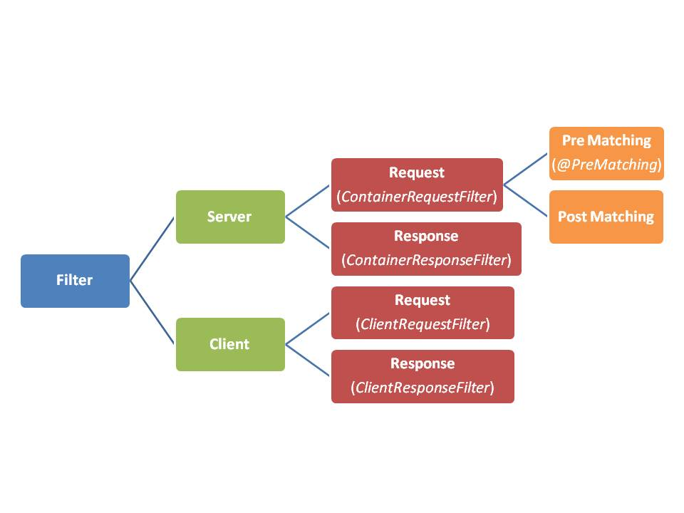
Filters

Slide 52
@Provider
A way of extending and customizing the JAX-RS runtime
Used to supply additional metadata,
Can supply HTTP headers or a different status code
Annotated classes are auto detected by the JAX-RS container
JAX-RS has a number of predefined providers
  mapping to and from XML,
  translating the most common exceptions
Can also create your own providers as needed.
Providers are not the same as resources
  Its in-between resources classes and the JAX-RS implementation.

Slide 53
Types of Providers
Entity Providers
  These providers control the mapping of data representations
  XML, JSON, CSV to their Java object equivalents.
Context Providers
  These providers control the context that resources can access via @ Context Annotations
Exception Providers
  These providers control the mapping of Java exceptions to a JAX-RS Response instance.

Slide 54
Filter
  @Provider
  public class ResponseFilter implements ContainerResponseFilter {
  @Override
  public void filter(ContainerRequestContext requestContext, ContainerResponseContext responseContext)
  throws IOException {
  responseContext.getHeaders().add("Access-Control-Allow-Origin", "*");
  responseContext.getHeaders().add("Access-Control-Allow-Credentials", "true");
  responseContext.getHeaders().add("Access-Control-Allow-Headers","origin, content-type, accept, authorization");
  responseContext.getHeaders().add("Access-Control-Allow-Methods", "GET,POST,DELETE,PUT");
  }
  }

Slide 55
Exception Mapping Providers
Providers map a checked or runtime exception to an instance of Response.
They implement ExceptionMapper<T>.
  @Provider
  public class ItemNotFound implements ExceptionMapper<ItemNotFoundException> { }

Slide 56
Custom Exception Class
  public class ItemNotFoundException extends RuntimeException {
  private String message;
  public ItemNotFoundException(String message) {
  super();
  this.message = message;
  }
  @Override
  public String getMessage() {
  return this.message;
  }
  }

Slide 57
Error Properties
  @XmlRootElement
  public class ErrorProperties {
  private String status;
  private String errorMessage;
  public ErrorProperties(){}
  public ErrorProperties(String statusFromOutside, String errorMessageFromOutside) {
  this.status = statusFromOutside;
  this.errorMessage = errorMessageFromOutside;
  }
  }

Slide 58
Provider
  @Provider
  public class ItemNotFound implements ExceptionMapper<ItemNotFoundException> {
  @Override
  public Response toResponse(ItemNotFoundException exception) {
  return Response.status(Status.NOT_FOUND).entity(new ErrorProperties("404", exception.getMessage())).type(MediaType.TEXT_XML).build();
  }
  }
  <init-param>
  <param-name>jersey.config.server.provider.packages</param-name>
  <param-value>com.training.execeptions</param-value>
  </init-param>

Slide 59
Throwing Exception
  @GET
  @Path("/getItem/{prdId}")
  public Response getItem(@PathParam("prdId") int id) {
  Product prd=null;
  if(id<100)
  {
  throw new ItemNotFoundException("Item Number should NOT be less 100 ");
  }
  else
  {
  prd = new Product(101,"LED TV",4500.00D);
  }
  return Response.status(200).entity(prd).build();
  }

Slide 60
Documenting REST Services: WSDL and WADL
WSDL -Web Services Description Language.
  Used to detail services offered by a SOAP server.
  Earlier Versions support Just GET and POST.
  REST services use all other HTTP verbs too
  WSDL was not considered as the right choice for documenting REST services.
WSDL -Web Services Description Language-Version 2.
  Supports all HTTP verbs
  Some people consider this as an acceptable method of documenting REST services.
WADL - Web Application Description Language.
  From Sun Microsystems and less Verbose.
  A lightweight, easier to understand and easier to write than WSDL.
  Doesn't have binding to SMTP servers
  May be sufficient for REST service

Slide 61
WADL
Jersey contains support for Web Application Description Language (WADL).
WADL is a XML description of a deployed RESTful web application.
It contains model of the deployed resources, their structure, supported media types, HTTP methods and so on. In a sense,
http://localhost:3030/RestJERSY/rest/application.wadl

Slide 62
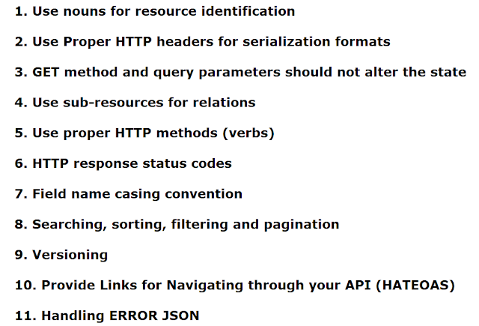
REST Best Practices

