Slide 1


Programming With Java

Slide 2

K.Srivatsan - vatsank@gmail.com
IT Trainer Since 1991
Conducting Java Training Since 2004
About 60+ Corporate Clients

Slide 3

Agenda
Java Introduction
Java Features
How Java Differs from other OO languages
Java and the World Wide Web
Java Environment
Build your first Java Program
Summary and Reference

Slide 4
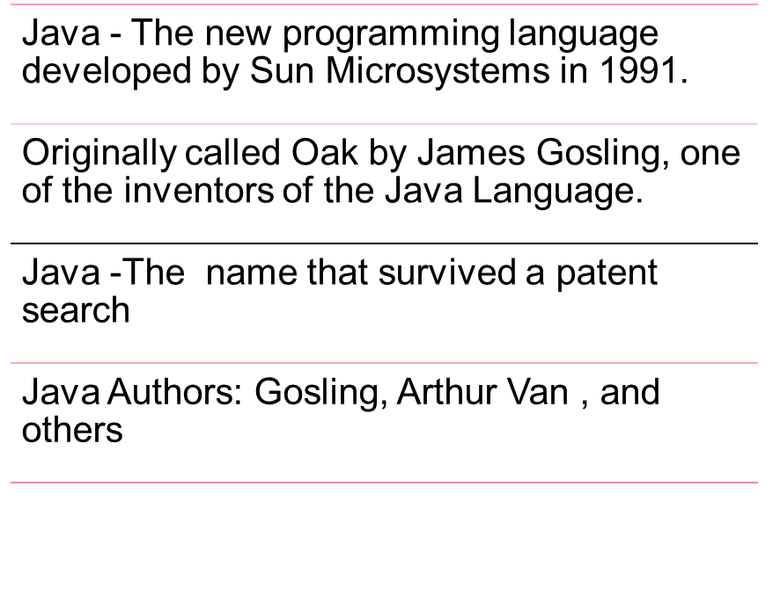
Java - An Introduction

Slide 5
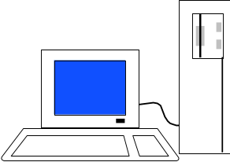
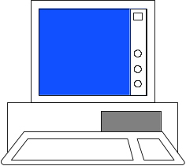
JAVA COMPILER
(translator)
JAVA BYTE CODE
(same for all platforms)
JAVA
(one for each different system)
Windows
Linux
Mac
Solaris

Slide 6
When to Use Java
Java is truly portable.
Software libraries and software components like web servers
Good Development environment
To Create Web Services or distributed applications
Good Database support
Networking support

Slide 7
When Not to Use Java
  Applications that are entirely bound by CPU time and need to be as fast as possible should be written in C++
  Applications where a virtual machine would not really work well.
    Database engines for database systems.
  Software that has to interface directly to the hardware (operating systems)
  Language processors that have to be fast (e.g., compilers)

Slide 8
Features of Java
Features that fulfill the goals:
  The Java Virtual Machine (JVM)
  Garbage collection
  The Java Runtime Environment (JRE)
  JVM tool interface

Slide 9
Program structure
A program in Java consists of one or more class definitions
One of these classes must define a method main(), which is where the program starts running
Java programs should always end with the .java extension.
There can be More than one Class Definition in a class ,but only one public class
Source Filenames should match the name of the public class.

Slide 10
Source File Layout
Basic syntax of a Java source file is:
[<package_declaration>]
<import_declaration>*
<class_declaration>+

Slide 11
Example 1.1
  package com.training;
  public class Greeting {
  public String getMessage() {
  return "Welcome to Java Programming";
  }
  }

Slide 12
Example 1.1 (contd)
  package com.training;
  public class TestGreetings {
  public static void main(String[] args) {
  Greetings grtObj = new Greetings();
  System.out.println(grtObj.getMessage());
  }
  }

Slide 13
Declaring Java Classes
Basic syntax of a Java class:
  <modifier>* class <class_name> {
  <attribute_declaration>*
  <constructor_declaration>*
  <method_declaration>*
  }
Define an attribute:
<modifier>* <type> <name> [ = <initial_value>];

Slide 14
Declaring Methods
Basic syntax of a method:
<modifier>* <return_type> <name> ( <argument>* ) {
<statement>*
}
  public int getWeight() {
  return weight;
  }
  public void setWeight(int newWeight) {
  if ( newWeight > 0 ) {
  weight = newWeight;
  }
  }

Slide 15
Accessing Object Members
The dot notation is: <object>.<member>
  used to access object members, including attributes and methods.
d.setWeight(42);
d.weight = 42; // only permissible if weight is public

Slide 16
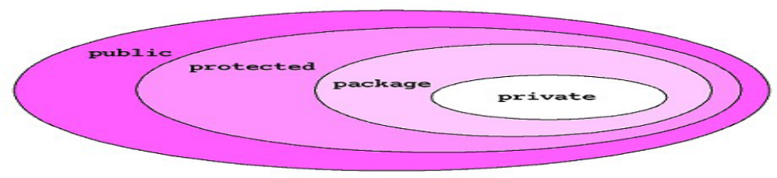
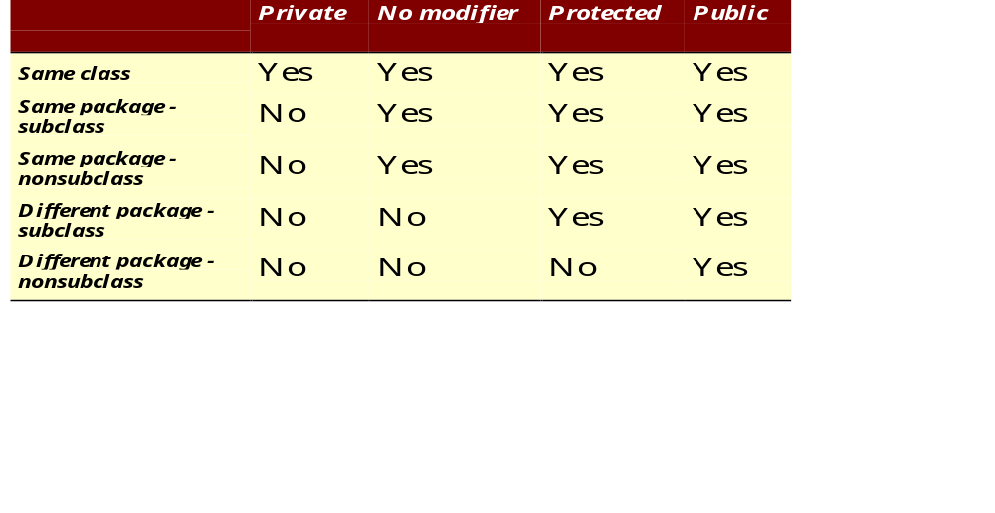
The 4 Access Levels and 3 Modifiers

Slide 17
Control Structures
To change the ordering of the statements in a program
Two types of Control Structures
decision control structures ,
  allows us to select specific sections of code to be executed
    if -- else , if – else if
    switch -- case
repetition control structures
  allows us to execute specific sections of the code a number of times
    while
    do -- while
    for

Slide 18
Switch-Case Java 7.0
From In Java SE 7 and later, can use a String object in the switch statement's expression.
The String in the switch expression is compared with the expressions associated with each case label as if the String.equals method were being used.
Will Throw a Null pointer Expression if the expression is NULL
  String color = "red";
  switch (color) {
  case "red":
  System.out.println("Color is Red");
  break;
  default:
  System.out.println("Color not found");
  }

Slide 19
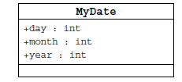
Information Hiding
Client code has direct access to internal data
(d refers to a MyDate object):
d.day = 32; // invalid day
d.month = 2; d.day = 30; // plausible but wrong
d.day = d.day + 1; // no check for wrap around

Slide 20
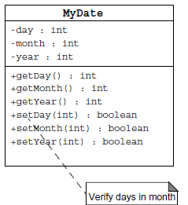
Encapsulation
Hides the implementation details of a class
Forces the user to use an interface to access data
Makes the code more maintainable

Slide 21
Classes
Top-level classes can be declared as
  public
    a public class is globally accessible.
    a single source file can have only one public class or interface
  abstract
    an abstract class cannot be instantiated
  final
    a final class cannot be subclassed
  Default
    With any Modifier
They can’t be declared as protected and private

Slide 22
Constructors
Have no return type
Have the same name as the class
If we don't’ put a constructor the compiler puts a default one
  The default constructor has the same access modifier as the class.
  The default constructor has no arguments.
  The default constructor is always a no-arg constructor, but a no-arg constructor is not necessarily the default constructor
  The default constructor includes a no-arg call to the super constructor (super()).
They are not inherited and hence they are not overridden
It can be Overloaded
It can have any of the Four Access Modifies
It cannot be synchronized
It can have throws clause

Slide 23
Constructor Overloading
One constructor can call another overloaded constructor of the same class by using this keyword.
this() is used to call a constructor from another overloaded constructor in the same class
The call to this() can be used only in a constructor ,and must be the first statement in a constructor
A constructor can call its super class constructor by using the super keyword.
A constructor can have a call to super() or this() but never both

Slide 24
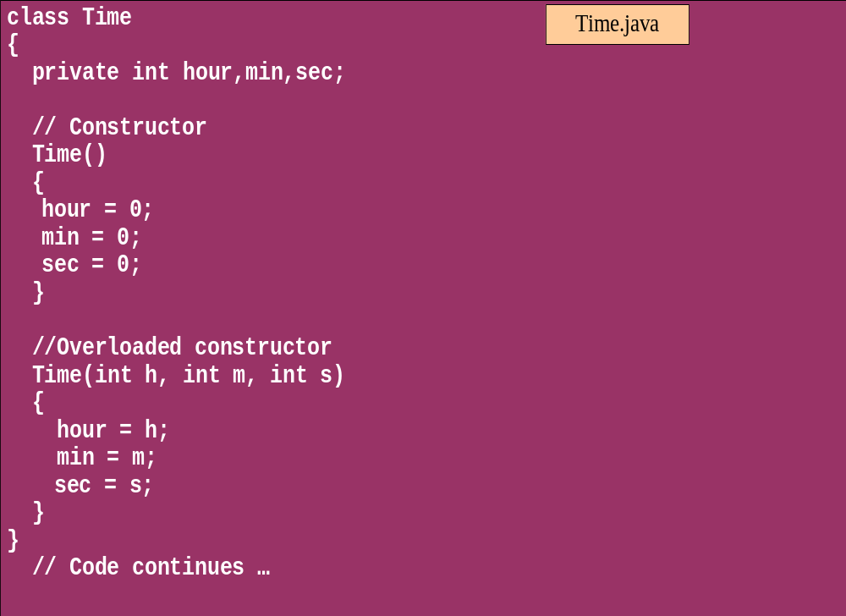
Overloaded Constructor

Slide 25
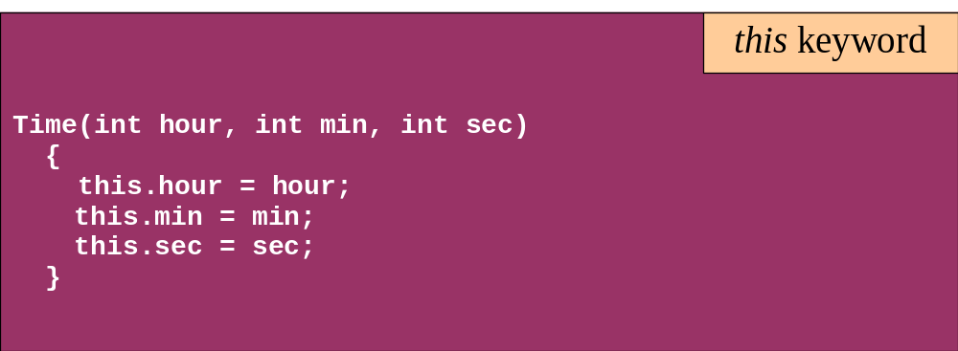
this keyword
Is a reference to the object from which the method was invoked

Slide 26
Comments
Java supports three forms of comments
  // single line comments
  /* multi
    line
    comment
    */
  /** a
    * Javadoc
    * comment
    */

Slide 27
Variables and Methods
A variable, which corresponds to an attribute, is a named memory location that can store a certain type of value.
Variable is a kind of special container that can only hold objects of a certain type.
Primitive type Variable
    Basic, built-in types that are part of the Java language
    Two basic categories
      boolean
      Numeric
        Integral - byte, short, int, long, char
        Floating point - float, double

Slide 28
Casting Primitive Types
Casting creates a new value and allows it to be treated as a different type than its source
JVM can implicitly promote from a narrower type to a wider type
To change to a narrow type explicit casting is required
Byte -> short -> int -> long -> float -> double

Slide 29
Casting Primitive Types
  public static void main (String [] args){
  int x = 99;
  double y = 5.77;
  x = (int)y; //Casting
  System.out.println("x = "+ x);
  double y1 = x; //No Casting
  int i =42;
  byte bt;
  bt= (byte)i;
  System.out.println("The Short number"+ bt);
  }

Slide 30
Wrapper Classes
Primitives have no associated methods
Wrapper Classes are used encapsulate primitives
They also provide some static utility methods to work on them
Primitive Type | Wrapper class
-boolean | Boolean
-byte | Byte
-char | Character
-double | Double
-float | Float
-int | Integer
-long | Long
short | Short

Slide 31
Wrapping Primitives
Wrapping a value
  int i = 288
  Integer iwrap = new Integer(i);
unWrapping a value
  int unwrapped = iwrap.intValue();
Methods In Wrapper Class
  parseXxx()
  xxxValue()
  valueOf()

Slide 32
Wrapper Class Method
Convert String to Numbers
public static void main(String args[])
{
int ino=Integer.parseInt(args[0]);
float fno = Float.parseFloat(args[1]);
double dno = Double.parseDouble(args[2]);
Long lno = Long.parseLong(args[3]);
System.out.println("Integer value" +ino );
String strIno = Integer.toString(ino);
System.out.Println(“String Value”+strIno);
}
}

Slide 33
Auto Boxing
Java 5.0 provided autoboxing
Integer n = new Integer(123) Int m = n.intValue() m++; n=new Integer(m); System.out.println(n); | Integer n = new Integer(123); n++; System.out.println(n);

Slide 34
Auto Boxing
public class ABoxing {
  public void show(int a, float b)
  {
  System.out.println("Integer"+a*2);
  System.out.println("Float"+b*2);
  }
  public static void main(String[] args) {
  ABoxing abObj =new ABoxing ();
  Integer a = 10;
  Float b =20f;
  abObj.show(a,b);
  }
  }

Slide 35
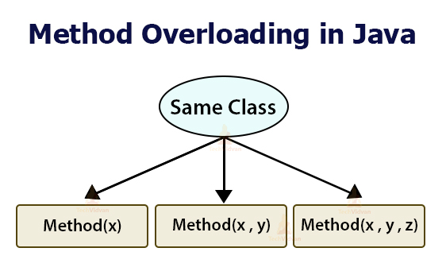

Slide 36
Method Overloading
Methods of a class have the same name but different signatures
  Similar behavior but for different data types.
Signature
  Name of the method and the number and types of formal parameters in particular order.
They are independent methods of a class
  Can call each other just like any other method.
A method can be overloaded in the same class or in a subclass.

Slide 37
Overloading Methods
Overloaded methods MUST change the argument list.
Overloaded methods CAN change the return type.
Overloaded methods CAN change the access modifier.
Overloaded methods CAN declare new or broader checked exceptions.

Slide 38
Static Variables and Methods
A static method belongs to a class and not to its instance objects and hence they are shared between Objects
Static Methods can not be overridden
They can only call other static methods
They can access only static variables and not instance Variables
They cannot refer to this or super
Instance variable : 1 per instance and Static variable : 1 per class
Static final variables are constants
main( ) is defined to be a static method so as to be invoked directly

Slide 39
Static Method access only static
  public class StatClass {
  private int id;
  private static String name;
  private void instMethod()
  {
  staticMethod();
  System.out.println(id);
  System.out.println(name);
  }
  private static void staticMethod()
  {
  System.out.println(id);
  System.out.println(name);
  instMethod();
  }
  }
Can Access Static from Instance Method
Cannot Access Instance Variable From Static
Cannot Access Instance Method From Static

Slide 40
Static Import
  import java.util.*;
  import static java.lang.System.out;
  import static java.lang.System.in;
  public class StaticImport {
  public static void main(String[] args) {
  Scanner kb = new Scanner(in);
  out.print("Enter an integer ");
  int x = kb.nextInt();
  out.print("Enter a double ");
  double d = kb.nextDouble();
  out.println("The sum is " + (x+d));
  }
  }

Slide 41
java.util.Scanner Class
A simple text scanner which can parse primitive types and strings using regular expressions.
A Scanner breaks its input into tokens using a delimiter pattern, which by default matches whitespace.
The resulting tokens may then be converted into values of different types using the various next methods.
  Scanner sc = new Scanner(System.in);
  int i = sc.nextInt();
  sc.close();

Slide 42
java.util.Scanner Class
  Scanner sc = new Scanner(System.in);
  System.out.println("Enter The Number");
  int number = sc.nextInt();
  System.out.println("Enter the Name");
  String name = sc.next();
  System.out.println(number + ":"+name);

Slide 43
java.util.Scanner Class
  public static void main(String[] args) {
  String line="Java,is,in,OOP,Language";
  Scanner sc1 = new Scanner(line);
  sc1.useDelimiter(",");
  while (sc1.hasNext())
  {
  System.out.println(sc1.next());
  }
  }

Slide 44
INHERITANCE

Slide 45
Overview
  A class can inherit from another class
    Original class is the “superclass”
    New class is called the “subclass”
Inheritance is a fundamental OO concept
Superclass
Car
Subclasses
SportsCar
Taxi
PoliceCar

Slide 46
Example of Inheritance
  The Car class defines certain methods and variables
  Taxi extends Car, and can:
    Add new variables
    Add new methods
    Override methods of the Car class
Car
Taxi

Slide 47
Specifying Inheritance in Java
  Inheritance is achieved by specifying which superclass the subclass
  “extends”
Taxi inherits all the variables and methods of Car
public class Car {
…
}
public class Taxi extends Car {
…
}

Slide 48
What Does an Object Look Like?
A subclass inherits all the instance variables of its superclass
Car object
public class Car {
String regNum;
int engineSize; …
}
regNum
engineSize
Taxi object
public class Taxi extends Car {
private int cabNum; …
}
regNum
engineSize
cabNum

Slide 49
Default Initialization
  What happens when a subclass object is created?
  If no constructors are defined:
  No-arg constructor is called in superclass
    No-arg constructor called in subclass
Taxi object
regNum
engineSize
Taxi taxi1 = new Taxi();
cabNum

Slide 50
Nondefault Initialization
Specific initialization can be performed as follows:
public class Car {
Car(String r, int e) {
regNum = r;
engineSize = e;
} …
public class Taxi extends Car {
Taxi(String r, int e, int c) {
super(r, e);
cabNum = c;
} …
Use super() to call superclass constructor

Slide 51
Specifying Additional Methods
  The superclass defines methods that are applicable for all kinds of Car
  The subclass can specify additional methods that are specific to Taxis
public class Car {
public int getReg()…
public void changeOwner()…
…
public class Taxi extends Car {
public void renewCabLicense()…
public boolean isBooked()…
…

Slide 52
Overriding Superclass Methods
  A subclass inherits all the methods of its superclass
  The subclass can override a method with a specialized version, if it needs to:
public class Car {
public String details() {
return "Reg:" + getReg();
}
public class Taxi extends Car {
public String details() {
return "Reg:" + getReg() + cabNum;
}

Slide 53
Overriding
When a sub-class defines a
  “method with same method name, argument types, argument order and return type as a method in its super class, its called method overriding. “
Methods declared as final, static and private cannot be overridden.
An overriding method can be declared as final
The method can’t be less accessible
  Public => only public
  Protected => Both Public and Protected
  Default => default, public and protected

Slide 54
Overriding with Compatible Return type
Arguments must be same and return type must be compatible
  class Base
  {
  private int i = 5;
  public Number getNumber()
  {
  return i;
  }
  }
  class Derived extends Base
  {
  @Override
  public Integer getNumber()
  {
  return new Integer(10);
  }
  }

Slide 55
Invoking Superclass Methods
  If a subclass overrides a method, it can still call the original superclass method
  Use super.method()to call a superclass method from the subclass
  Though keyword super is used to refer super class, method call super.super.method() is invalid.
public class Car {
public String details() {
return "Reg:" + getReg();
}
public class Taxi extends Car {
public String details() {
return super.details() + cabNum;
}

Slide 56
super keyword
The keyword super refers to the base class
  super( )
    invokes the base class constructor
    base class constructors are automatically invoked
  super.method( )
    invokes the specified method in the base class
  super.variable
    to access the specified variable in the base class
super must be the first statement in a constructor

Slide 57
Abstract Class
An abstract class is a shared superclass
  Provides a high-level partial implementation of some concept
  Cannot be instantiated
Use the abstract keyword to declare a class as abstract
Vehicle
Vehicle
Abstract superclass
Concrete subclasses
Car
Car
Truck

Slide 58
Defining Abstract Classes in Java
  Use the abstract keyword to declare a method as abstract
    Only provide the method signature
    Class must also be abstract
  Must be implemented by a concrete subclass
    Each concrete subclass can implement the method differently
public abstract class Vehicle {
private String regNum;
public String getRegNum()…
public abstract boolean isRoadWorthy();
}
public class Car
extends Vehicle{
private int numSeats;
public void fitRack()…
public class Truck
extends Vehicle{
private int axles;
public void setLoad()…

Slide 59
The Abstract Class-Super Class
Note
this
  public abstract class BankAccount {
  public abstract void deposit(double amount);
  public abstract void withdraw(double amount);
  public void sayHello() {
  System.out.println("Thanks-Come Again");
  }
  }

Slide 60
Child Class –Its alsoAbstract
  public abstract class Savingaccount extends BankAccount {
  public abstract void getDetails();
  }

Slide 61
The Concrete Class
  public class Supersavings extends Savingaccount {
  private double balance,amount ;
  private String custname;
  private int accno;
  public void deposit(double amt)
  {
  balance+=amt;
  }
  public void withdraw(double amt)
  {
  balance-=amt;
  }
  public void getDetails()
  {
  System.out.println(custname);
  System.out.println(accno);
  System.out.println(amount);
  System.out.println(balance);
  }
  }

Slide 62
Interfaces & Polymorphism

Slide 63
Interfaces
  An interface is like a fully abstract class
    All the methods are public and abstract- Till Java 8
      No instance variables if present they are public static final
  Defines a set of methods that other classes can implement
    A class can implement many interfaces,
      but can extend only one class
      can extend other interfaces and extend multiple interfaces

Slide 64
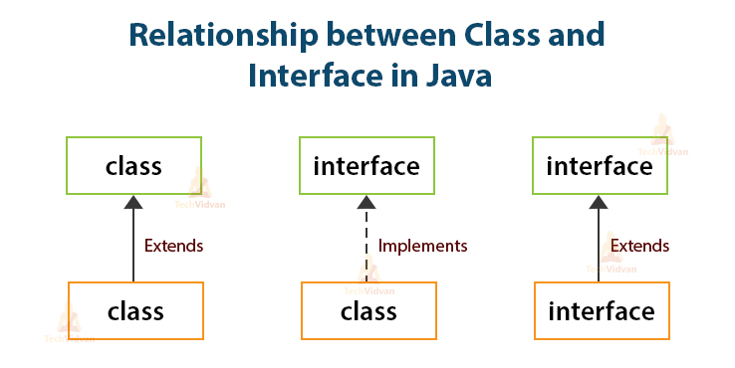

Slide 65



Example of Interfaces
  Interfaces describe an aspect of behavior that different classes can support
    Any class that supports the “Steerable” interface can be steered:
Steerable
Not Steerable

Slide 66
Interface
Interfaces define types in an abstract form
  Allows the specification of a reference type without providing an implementation
  The class that implements the interface decides how to implement
  Use interface keyword instead of class
  public interface Function {
  public double apply(double arg);
  }

Slide 67
Implement the Interface
  public class CurrencyConverter implements Function {
  @Override
  public double apply(double arg) {
  return arg * 45;
  }
  }
  Function usdToInr = new CurrencyConverter();
  System.out.println(usdToInr.apply(100));

Slide 68
Implementing an Interface
public interface Steerable {
int maxTurn = 135;
void turnLeft(int deg);
void turnRight(int deg);
}
public class Car
extends Vehicle
implements Steerable {
public void turnLeft(int deg)
{…}
public void turnRight(int deg)
{…}

Slide 69
Partial Implementation of an Interface
Declare the class as abstract if the class does not implement all the methods of an interface
Implement the methods in the sub class level
Public abstract class Car
extends Vehicle
implements Steerable {
public void turnLeft(int deg)
{…}
}

Slide 70
Using instanceof with Interfaces
  The instanceof operator can be used to check if an object implements an interface
  Downcasting can be used if necessary, to call methods defined in the interface
public void aMethod(Object obj) {
…
if (obj instanceof Steerable)
((Steerable)obj).turnLeft();
}

Slide 71
Extending an Interface
One Interface can extend another Interface
public interface Steerable {
int maxTurn = 135;
void turnLeft(int deg);
void turnRight(int deg);
}
public interface Navigator
extends Steerable {
void calcSpeed(int distance);
}

Slide 72
Polymorphism
This OO Principle allows the programmer to program abstractly
Objects of a subclass can be treated as objects of its superclass
The base class of a hierarchy is usually an abstract class or an Interface
  They define the common behavior (functionality)
Classes and Subclasses inherit this behavior and extend it according to their own properties by overriding the methods of the super class
Subclass objects can be treated as super class objects through references,
  But, super class objects are not subclass objects

Slide 73
Polymorphism
Allows for hierarchies to be highly extensible
New classes can be introduced and can still be processed without changing other parts of the program
Same method can do different things, depending on the class that implements it.
Method invoked is associated with OBJECT and not with reference.
Types of Polymorphism -
  Method Overloading.
  Method Overriding.

Slide 74
Polymorphism
  public interface Conditional {
  public boolean test();
  }

Slide 75
Implementation -One
  public class Professor implements Conditional {
  private String qualification;
  @Override
  public boolean test() {
  return this.qualification.equalsIgnoreCase("phd");
  }
  }

Slide 76
Implementation -Two
  public class Student implements Conditional {
  private double markScored;
  @Override
  public boolean test() {
  return this.markScored>90;
  }
  }

Slide 77
Polymorphism
  public static void print(Conditional poly) {
  System.out.println(poly.test());
  }
  public static void main(String[] args) {
  Student ramesh = new Student(101,"Ramesh",67);
  Professor prof = new Professor(201, "manish", "ece", "phd");
  print(ramesh);
  print(prof);
  }

Slide 78
Substitution of Object References in Method Calls
A subclass object can be passed into any method that expects a superclass object
The method that got invoked, is the version that's present in the object type and NOT the reference type.
public static void main(String[] args) {
Taxi t = new Taxi("ABC123", 2000, 79);
displayDetails(t);
public static void displayDetails(Car c) {
System.out.println(c.details());
}
Notes:
The same object reference (that is, an object reference of the same reference type) is capable of behaving differently at runtime, depending on the object that it points to.

Slide 79
Dynamic Method Dispatch
subclass=
(subclass)superclass
Valid at both Compile ,RunTime
  class First
  {
  public void show()
  {
  System.out.println("ShowFirst");
  }
  }
  class Second extends First
  {
  public void show()
  {
  System.out.println("Show Second");
  }
  }
First fst = new Second();
Second sec = (Second)fst;
sec.show();
First fst2 = new First();
Second sec2 = (Second)fst2;
sec2.show();
subclass=
(subclass)superclass
Valid at Compile time exception at ,RunTime

Slide 80
Dynamic Method Dispatch
Related Through Inheritance
superclass = subclass
  always valid
subclass = superclass
  not valid at compile time, needs a cast
subclass=(subclass)superclass
  valid at compile time, checked at runtime.
  if INVALID then ClassCastException is thrown.
Unrelated Classes – Not Allowed
someClass = someUnrelatedClass
  not valid, won’t compile
somcClass = (someClass)someUnrelatedClass
  not valid, won’t compile

Slide 81
Layered Architecture
Modern Applications are built using several components
  Each connected to one another, providing a specific functionality.
Components that perform similar functions are generally grouped into layers.
Components in a higher layer use the services of components in a lower layer.

Slide 82
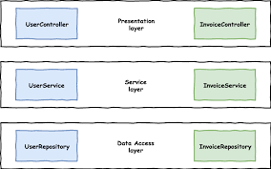
Layered Architecture

Slide 83
Exception handling

Slide 84
Exception Handling
An exception is a problem that arises during the execution of a program.
When an Exception occurs the normal flow of the program is disrupted and the program terminates abnormally, which is not recommended
  Exceptions are to be handled.

Slide 85
Exception Handling
java.lang.Object
java.lang.Throwable
java.lang.Error
java.lang.Exception
java.io.IOException
java.lang.RuntimeException
Notes:
The class Object is the root of the class hierarchy. Every class has Object as a superclass. All objects, including arrays, implement the methods of this class.
The Throwable class is the superclass of all errors and exceptions in the Java language. Only objects that are instances of this class (or of one of its subclasses) are thrown by the Java Virtual Machine or can be thrown by the Java throw statement. Similarly, only this class or one of its subclasses can be the argument type in a catch clause.
An Error is a subclass of Throwable that indicates serious problems that a reasonable application should not try to catch. Most such errors are abnormal conditions. The ThreadDeath error, though a "normal" condition, is also a subclass of Error because most applications should not try to catch it.
The class Exception and its subclasses are a form of Throwable that indicates conditions that a reasonable application might want to catch.
RuntimeException is the superclass of those exceptions that can be thrown during the normal operation of the Java Virtual Machine. A method is not required to declare in its throws clause any subclasses of RuntimeException that might be thrown during the execution of the method but not caught.
IOException signals that an I/O exception of some sort has occurred. This class is the general class of exceptions produced by failed or interrupted I/O operations.

Slide 86
Exceptions
checked exceptions
  Conditions that can readily occur in a correct program
  Includes all subtypes of Exception
  Excluding classes that extend Runtime Exception.
  Subject to the handle or declare rule
unchecked exceptions
  Problems that reflect program bugs
  Probable bugs are represented by the RuntimeException class.
  Compiler doesn’t enforce the handle or declare rule.
Error
  Fatal situations are represented by the Error class.

Slide 87
Handle or Declare Rule
Handle the exception by using the try-catch-finally block.
  try{
  // some code
  } catch(Exception e){
  }
Declare that the code causes an exception by using the throws clause.
  void trouble() throws IOException { ... }
  void trouble() throws IOException, MyException { ... }
Other Principles
  You do not need to declare runtime exceptions or errors.
  You can choose to handle runtime exceptions

Slide 88
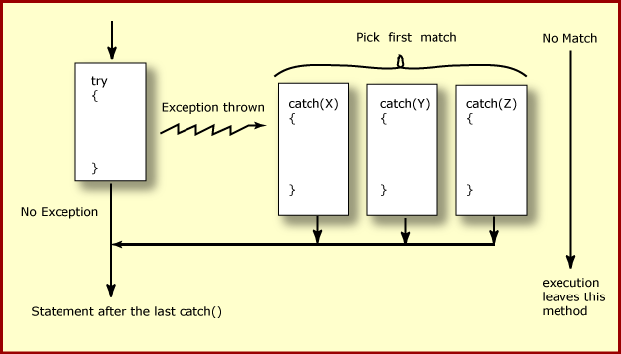
How try catch Work

Slide 89
Exception Handling
  try {
    Object value = "twenty";
    Integer number = (Integer) value;
  }
  catch ( ClassCastException ex ) {
  ex.printStackTrace();
  }
  System.out.println("Good-bye" );
  }

Slide 90
Nested Try Catch
  try {
  Object value = "twenty";
  Integer number = (Integer) value;
    try {
    String mark ="50";
    Integer.parseInt(mark);
    } catch (NumberFormatException e) {
    e.printStackTrace();
    }
  }
  catch ( ClassCastException ex ) {
  ex.printStackTrace();
  }

Slide 91
Catching Exception –Multiple Catch
  try {
  Object value = "twenty";
  Integer number = (Integer) value;
  String mark ="50";
  Integer.parseInt(mark);
  }
  catch ( ClassCastException ex ) {
  ex.printStackTrace();
  }
  catch (NumberFormatException e) {
  e.printStackTrace();
  }

Slide 92
Effective Exception Hierarchy
The exception classes are arranged in a hierarchy.
Catches for specific exceptions should always be written prior to the generic handler.
A generic handler for Exception would cover any missing situation.
  try
  {
  }
  catch (NumberFormatException e) {
  }
  catch (Exception ex2) {
  }
  try
  {
  }
  catch (Exception e1) {
  }
  catch(NumberFormatException e2) {
  }

Slide 93
Multiple Catch
  try {
  Object value = "twenty";
  Integer number = (Integer) value;
  String mark ="50";
  Integer.parseInt(mark);
  }
  catch ( ClassCastException| NumberFormatException ex ) {
  ex.printStackTrace();
  }

Slide 94
Multiple Catch
  try {
  } catch (RangeCheckException | RuntimeException e) {
  }
  try {
  } catch (RangeCheckException | Exception e) {
  }

Slide 95
Finally block
Its optional and will always be invoked,
  whether an exception in the corresponding try is thrown or not,
  whether a thrown exception is caught or not.
finally-will-always-be-called except if the JVM shuts down.
  When the try or catch blocks may call System.exit();
Finally Block is always executed despite of different scenarios:
  Forced exit occurs using a return, a continue or a break statement
  Normal completion
  Caught exception thrown
  Exception was thrown and caught in the method
  Uncaught exception thrown
  Exception thrown was not specified in any catch block in the method

Slide 96
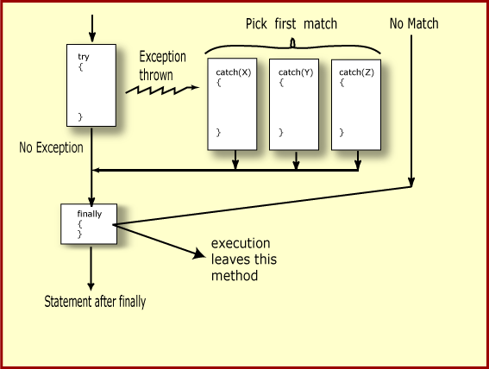
Finally Block

Slide 97
Finally Block
  public static String tryblkWithReturn(String data ) {
  try {
  int no = Integer.parseInt(data);
  }
  catch (NumberFormatException e) {
  System.out.println("Entering Catch Block");
  return "Hello";
  }
  finally {
  System.out.println("Inside finally");
  }
  System.out.println("I am back");
  return "Hi";
  }

Slide 98
Finally Block
  public static String tryblkWithNewException(String data ) throws Exception {
  try {
  int no = Integer.parseInt(data);
  }
  catch (NumberFormatException e) {
  System.out.println("Entering Catch Block");
  throw new Exception();
  }
  finally {
  System.out.println("Inside finally");
  }
  System.out.println("I am back");
  return "Hi“;
  }

Slide 99
Throws Clause
A method is required to either catch or list all exceptions it might throw
  Except for Error or RuntimeException, or their subclasses
If a method may cause an exception to occur but does not catch it, then it must say so using the throws keyword
Applies to checked exceptions only
  <type> <methodName> (<parameterList>) throws <exceptionList>
  {
  <methodBody>
}

Slide 100
The try-with-resources Statement
A try statement that declares one or more resources.
A resource is an object that must be closed after the program is finished with it.
Ensures the resource is closed at the end of the statement.
Any object that implements java.lang.AutoCloseable, and java.io.Closeable, can be used as a resource.

Slide 101
Exception Handling- Closing the Resource
  Scanner scan = new Scanner( System.in );
  int num ;
  System.out.print("Enter an integer: ");
  try {
  num = scan.nextInt();
  System.out.println("The square of " + num + " is " + num*num );
  }
  catch ( InputMismatchException ex ) {
    System.err.println("You entered bad data." );
    System.err.println("Run the program again." );
  }
  System.err.println("Good-bye" );
  scan.close();
  }

Slide 102
The try-with-resources Statement
  System.out.print("Enter an integer: ");
  try(Scanner scan = new Scanner( System.in )) {
  int num = scan.nextInt();
  System.out.println("square" + num + "is" + num*num );
  }
  catch ( InputMismatchException ex ) {
    System.err.println("You entered bad data." );
    System.err.println("Run the program again." );
  }
  System.out.println("Good-bye" );
  }

Slide 103
Throwing Exceptions
The throw Keyword
Java allows you to throw exceptions (generate exceptions)
  throw <exception object>
An exception you throw is an object
  You have to create an exception object in the same way you create any other object
Example:
  throw new ArithmeticException(“testing...”);

Slide 104
Re-throw Exception
Exception of the Catch Parameter type is the one that is rethrown
To intercept all exceptions and rethrow them
  Can catch with super class Exception
  Declare method as throwing an Exception.
"imprecise rethrow“
  Throwing a general Exception type (instead of specific ones)

Slide 105
Re-Throw Exception
Java 7, can be more precise about the exception types being rethrown from a method.
This leads to improved checking for rethrown exceptions.
Can handle them a lot better at the calling side

Slide 106
Re-throw Exceptions
  public static void myExample() throws ParseException,IOException {
  try {
  new SimpleDateFormat("yyyyMMdd").parse("date");
  new FileReader("Abc.txt").read();
  } catch (Exception e) {
  throw e;
  }
  }

Slide 107
Method Overriding and Exceptions
The overriding method can throw:
  No exceptions
  One or more of the exceptions thrown by the overridden method
  One or more subclasses of the exceptions thrown by the overridden method
The overriding method cannot throw:
  Additional exceptions not thrown by the overridden method
  Superclasses of the exceptions thrown by the overridden method

Slide 108
Overriding –When Method Has Exceptions
Any exceptions declared in overriding method must be of the same type as those thrown by the super class, or a subclass of that type.
  class MyBase {
  public void method1() throws Exception
  { }
  public void method2() throws RuntimeException
  { }
  }
  class Sub extends MyBase
  {
  public void method1() throws Throwable {
  }
  public void method2() throws ArithmeticException {
  }
  }
This is compile Time Exception
This is Allowed

Slide 109
User Defined Exception
User Defined Exception must be a child of Throwable.
To write a checked exception that is automatically enforced by the Handle or Declare Rule, need to extend the Exception class.
To write a runtime exception, need to extend the RuntimeException class.

Slide 110
User Defined Exception
  public class MyException extends Exception {
  private String message;
  private String errorCode;
  public MyException(String message, String errorCode) {
  super();
  this.message = message;
  this.errorCode = errorCode;
  }
  @Override
  public String getMessage() {
  return this.errorCode+"-"+this.message;
  }
  }

Slide 111
Files & IO

Slide 112
Overview
At its lowest level, all Java I/O involves a stream of bytes either entering or leaving memory
Packaged classes exist to make it easy for a program to read and write larger units of data.
Low-level stream class object are used to handle byte I/O
High-level stream class object will allow the program to read and write primitive data values and objects

Slide 113


File Classes
  Java views the data in files as a stream of bytes.
  A stream of bytes from which data are read is called an input stream.
  A stream of bytes to which data are written is called an output stream.
  Java provides classes for connecting to and manipulating data in a stream.
  The classes are defined in the package java.io and are organized in a large complex hierarchy.

Slide 114
Classes in I/O Package
File Reader
  Used to read characters from files
  The read() method of this class is used to read characters
  These are wrapped by BufferedReader to improve the performance
File Writer
  Used to write character to files
  The Write method() of this classes is used to write characters
  Wrapped by BufferedWriter to improve the performance

Slide 115
FileWriter
Constructors:
FileWriter(File file)
FileWriter(File file, boolean append)
FileWriter(String fileName)
FileWriter(String fileName, boolean append)
Same methods of Writer
public void write(int c)
All constructors and methods throw IOException

Slide 116
FileReader
Constructors:
FileReader(File file) throws FileNotFoundException
FileReader(String fileName) throws FileNotFoundException

Slide 117
Classes in I/O Package
BufferedReader
  Buffers give a temporary holding place to group until it reaches final place.
  It helps in efficent reading of files
  Reads a large amount of data from a file at once and keep that data in buffer
  Minimizes the number of times of file access.
  Provides a readLine() method , which reads a line of characters from the file
  BufferedReader in =
    new BufferedReader(new FileReader(“file.txt"));
BufferedWriter
  Provides a newLine() method , which that creates line separators automatically

Slide 118
Handling file input and output
PrintWriter
  Provides number of flexible and powerful methods to write data to files
  Methods like format(),printf() and append() are used to work with data
  print() or println() of this class take a single parameter of any data type
  PrintWriter wraps the FileWriter
  The resulting file can be read with a text editor or an input stream reader.

Slide 119
Write To File
public static void main(String args[]) {
try {
PrintWriter out = new PrintWriter(
new FileWriter("myAccount2.dat"));
out.println("srivatsan");
out.println("10099");
out.println(5000);
out.close();
}
catch (FileNotFoundException e){
}
catch (IOException e) {
}
}

Slide 120
Read From File
  public static void main(String[] args) {
  try {
  FileReader fr = new FileReader("TextFile.txt");
  BufferedReader br = new BufferedReader(fr);
  String line=null;
  try
  {
  while(( line=br.readLine()) !=null) {
  System.out.println(line); }
  }
  catch (IOException e) {
  e.printStackTrace();
  } }
  catch (FileNotFoundException e) {
  e.printStackTrace();
  }
  }

Slide 121
Serializing
Creating the sequence of bytes from an object and Recreating the object from the above generated bytes
Ability to read or write an object to a stream
  Process of "flattening" an object
Used to save object to some permanent storage
  Its state should be written in a serialized form to a file such that the object can be reconstructed at a later time from that file
Used to pass on to another object via the OutputStream class
  Can be sent over the network

Slide 122
To use serialization
Most Java classes are serializable
Classes need to implement the serializable interface.
  Serializable interface is marker interface
  Class should also provide a default constructor with no args
Objects of some system-level classes are not serializable
  Because the data they represent constantly changes
  Reconstructed object will contain different value anyway
A NotSerializableException is thrown if you try to serialize non-serializable objects

Slide 123
To use serialization
Only the object's data are preserved, Methods and constructors are not part of the serialized stream ,the class information is included
Marking a field with the transient keyword
  The transient keyword prevents the data from being serialized
  All non-transient fields are considered part of an object
Have access to the no-argument (or default) constructor of its first nonserializable superclass (or supersuperclass, supersupersuper class)
Serializability is inherited

Slide 124
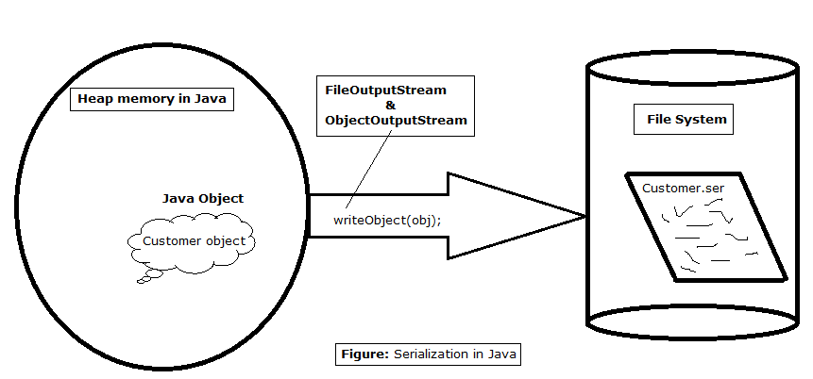
Serialization

Slide 125
Serialization
  public boolean writeObjectToFile(Professor prof,File file) {
  boolean result = false;
  try(ObjectOutputStream outStream = new ObjectOutputStream(new FileOutputStream(file))){
  outStream.writeObject(prof);
  result =true;
  }catch(IOException e) {
  e.printStackTrace();
  }
  return result;
  }

Slide 126
DeSerialization
  public Object readObjectFromFile(File file) {
  Object obj=null;
  try(ObjectInputStream inStream = new ObjectInputStream(new FileInputStream(file))){
  obj = inStream.readObject();
  }catch(ClassNotFoundException | IOException e) {
  e.printStackTrace();
  }
  return obj;
  }

Slide 127
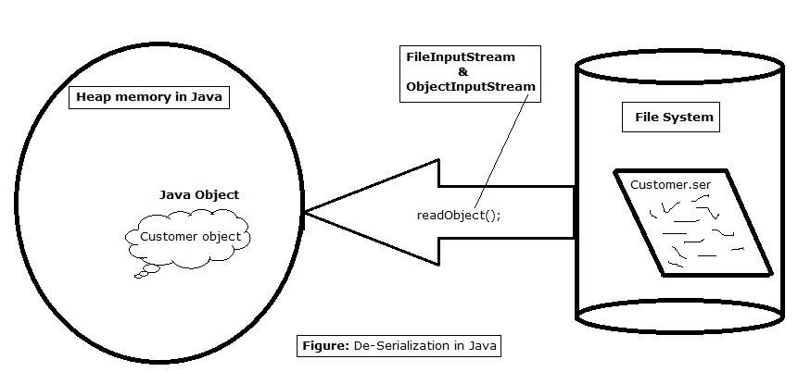
De Serialization

Slide 128
Multi Threads

Slide 129
Multi-threading in Java Platform
Java Application start with just one thread, called the main thread.
  This thread has the ability to create additional threads
When a new thread is started , a new stack materializes and methods called from that thread run in a call stack that’s separate from the main() call stack.
That second new call stack runs concurrently with the main thread
A thread of execution is an individual process (a “lightweight” process) that has its own call stack.
one thread per call stack—one call stack per thread.

Slide 130
Making a Thread
Done by extend the java.lang.Thread class
  To have specialized version of a thread class.
  That class can’t extend another class
Done By Implementing the Runnable interface
  Leaves class free to extend from some other class
  Define behavior that will be run by a separate thread.
  Thread Class is created with a Runnable argument.
  The Runnable object is the target of the thread.
    .

Slide 131
Making a Thread
A thread begins as an instance of java.lang.Thread.
public void run()
  Has the Code that needs to be run in a separate thread
  It can call other methods,
  The thread of execution begins with the call to this method

Slide 132
Example
  public class NumberService {
  public NumberService() {
  super();
  }
  public void sumNumbers(int countTo) {
  int count =0;
  for(int i=0;i<=countTo;i++) {
  count =count +i;
  }
  System.out.println( " Sum of Number upto" + countTo +"Is ="+count +"Done By"+Thread.currentThread().getName());
  }
  }

Slide 133
Implementing java.lang.Runnable
  public class NumberAddingService implements Runnable{
  private int countTo;
  private NumberService service;
  public NumberAddingService(int countTo,String name) {
  this.countTo = countTo;
  this.service = new NumberService();
  Thread t1 = new Thread(this,name);
  t1.start();
  }
  @Override
  public void run() {
  this.service.sumNumbers(countTo);
  }
  }

Slide 134
Starting a Thread
start()
  Creates a new thread and makes it runnable
  A new thread of execution starts (with a new call stack).
  The thread moves from the new state to the runnable state.
  When the thread gets a chance to execute, its target run() method will run.

Slide 135
Starting Multiple Thread
  public static void main(String[] args) {
  new NumberAddingService(50,"Fifty Count");
  new NumberAddingService(500,"Five Hundred Count");
  new NumberAddingService(5000,"Five Thousand Count");
  try {
  System.out.println("Enter the Number");
  int ch =System.in.read();
  System.out.println(ch);
  } catch (IOException e) {
  e.printStackTrace();
  }
  }

Slide 136
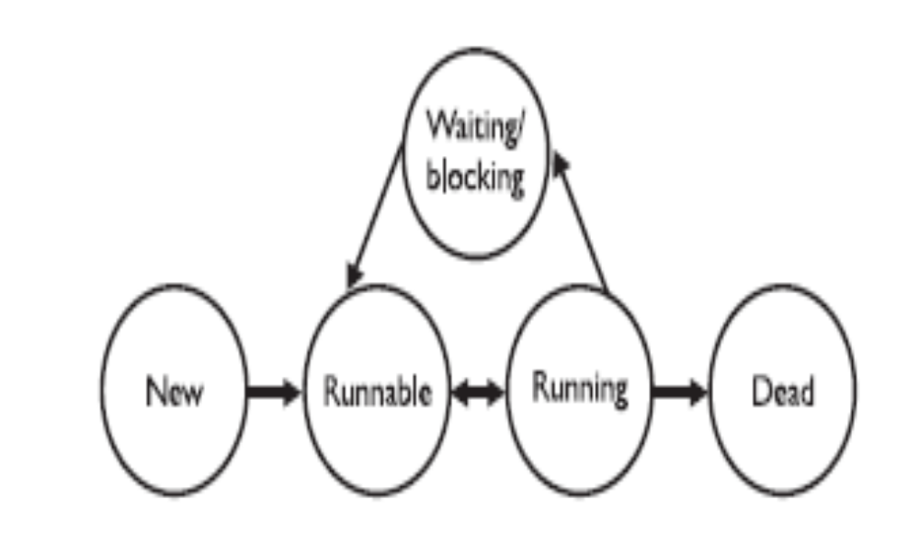
Thread States

Slide 137
Leave the running state
sleep()
Guaranteed to cause the current thread to stop executing
  Duration is specified in milli seconds
  It might be interrupted before its specified time
join()
Guaranteed to cause the current thread to stop executing until the thread it joins with the thread it calls wait on completes.
Leave the Running State:
Following scenarios
  The thread’s run() method completes..
  A thread can’t acquire the lock on the object whose method code it’s attempting to run

Slide 138
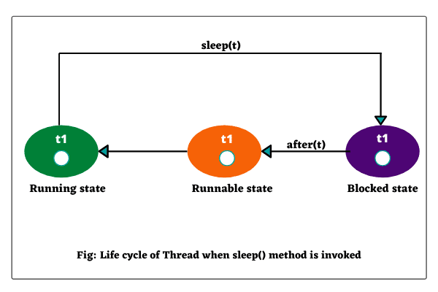
The sleep() method
Static method of Thread Class
Can be Placed anywhere in the Code
Throws a Checked Exception – Interrupted Exception
  try {
Thread.sleep(5*60*1000); // Sleep for 5 minutes
} catch (InterruptedException ex) { }

Slide 139
Synchronizing Code
Threads can share resources.
Sometimes it is desirable that only one thread at a time has access to a shared resource.
Achieved by using the keyword: synchronized, Only methods can be synchronized, not variables.
Protects access to code, not to data
  Make data members private
  Synchronize accessor methods
A lock can be associated with a shared resource. Threads gain access to a shared resource by first acquiring the lock associated with the resource.
one thread can hold the lock and thereby have access to the shared resource.

Slide 140
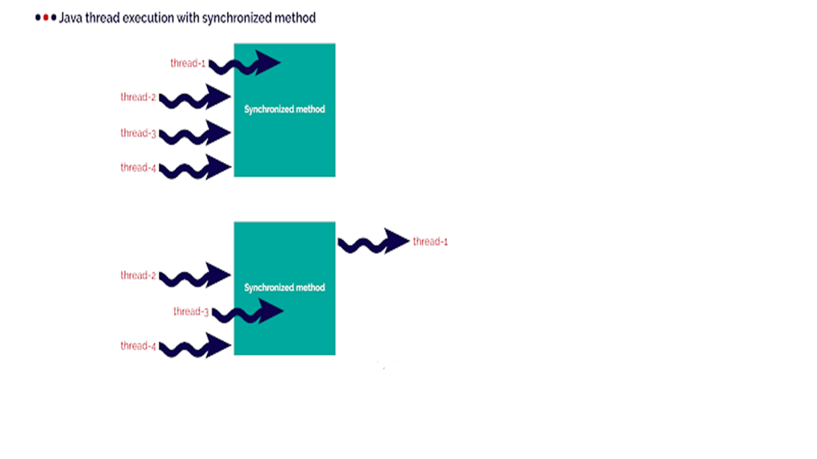
Synchronizing Code

Slide 141
Synchronizing Code
A class can have both synchronized and no synchronized methods.
If a class has both synchronized and nonsynchronized methods, multiple threads can still access the nonsynchronized methods of the class!
A thread can acquire more than one lock.
A thread can enter a synchronized method, thus acquiring a lock, and then immediately invoke a synchronized method on a different object, thus acquiring that lock as well.
As the stack unwinds, locks are released again.

Slide 142
Thread Synchronization
  class TwoStrings {
  synchronized static void print(String str1, String str2) {
  System.out.print(str1);
  try {
  Thread.sleep(500);
  } catch (InterruptedException ie)
  {
  ie.printStackTrace();
  }
  System.out.println(str2);
  }
  }

Slide 143
Thread Synchronization
  class PrintStringsThread implements Runnable {
  String str1, str2;
  PrintStringsThread(String str1, String str2) {
  this.str1 = str1;
  this.str2 = str2;
  Thread thread = new Thread(this);
  thread.start();
  }
  public void run() {
  TwoStrings.print(str1, str2);
  }
  }

Slide 144
Thread Synchronization
  public class Test {
  public static void main(String args[])
  {
  new PrintStringsThread("Hello ", "there.");
  new PrintStringsThread("How are ", "you?");
  new PrintStringsThread("Thank you ","very much!");
  new PrintStringsThread("Bye ","Bye!");
  }
  }
  Output- May be in Different Order
  Hello there
  How are you
  Thank you very much
  Bye,Bye

Slide 145
Cancelling the Future
  System.out.println("Task completed! Retrieving the result");
  String result;
  try {
  result = future.get();
  System.out.println(result);
  } catch (InterruptedException e) {
  e.printStackTrace();
  } catch (ExecutionException e) {
  e.printStackTrace();
  }
  executorService.shutdown();
  }
  }

Slide 146
Cancelling the Future
  if(!future.isCancelled()) {
  System.out.println("Task completed! Retrieving the result");
  String result = future.get();
  System.out.println(result);
  } else {
  System.out.println("Task was cancelled");
  }

