Slide 1


Programming With Java

Slide 2

K.Srivatsan - vatsank@gmail.com
IT Trainer Since 1991
Conducting Java Training Since 2004
About 60+ Corporate Clients

Slide 3
Day -1
Day 1 - Session -2
Java evolution
  Were is Java good to use
  Where not to use Java
  Core libraries (io, database, collections, Streams, Logging, Functions, annotations, lambdas)
  Data structures
  Functional programming
  Spring Frameworks
Day 1 - Session -2
  Java Debugging
  Program Documentation
  Software quality and basic of Unit testing
  Definition of Unit and technique to test Unit in isolation.
  Example of testing
  Introduce JUnit framework
  Hands on Exercise

Slide 4
Session -1
Day 1 - Session -2
Java evolution
  where is Java good to use
  where not to use Java
  Core libraries (io, database, collections, streams, logging, functions, annotations, lambdas)
  Data structures
  Functional programming
  Spring frameworks
Day 1 - Session -2
Java Debugging
Program Documentation
Software quality and basic of Unit testing
Definition of Unit and technique to test Unit in isolation.
Example of testing
Introduce JUnit framework
Hands on Exercise

Slide 5
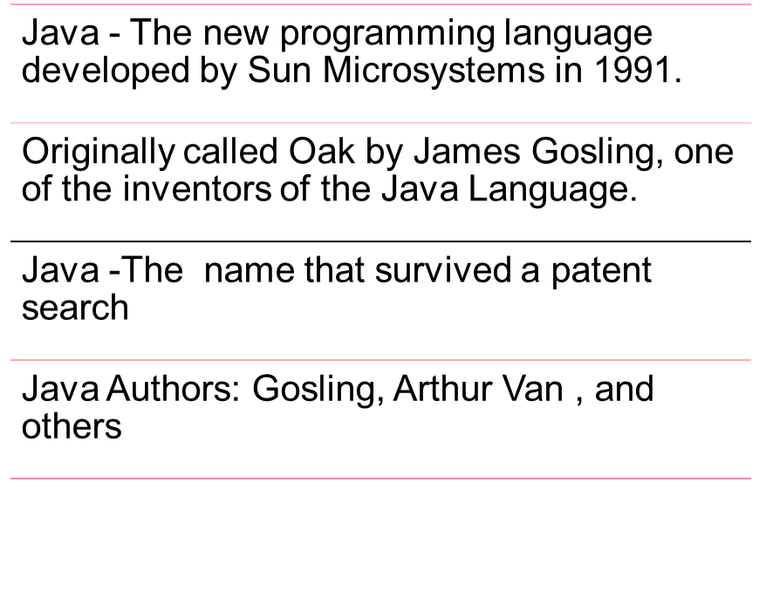
Java - An Introduction

Slide 6
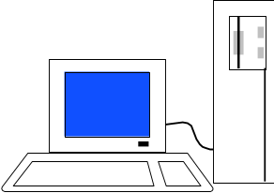
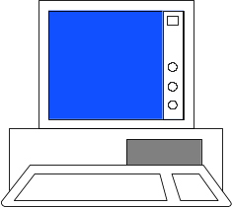
JAVA COMPILER
(translator)
JAVA BYTE CODE
(same for all platforms)
JAVA
(one for each different system)
Windows
Linux
Mac
Solaris

Slide 7
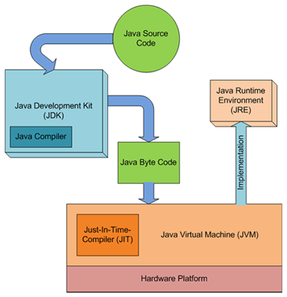
JDK,JVM and JRE

Slide 8
When to Use Java
Java is truly portable.
Software libraries and software components like web servers
Good Development environment
To Create Web Services or distributed applications
Good Database support
Networking support

Slide 9
When Not to Use Java
  Applications that are entirely bound by CPU time and need to be as fast as possible should be written in C++
  Applications where a virtual machine would not really work well.
    Database engines for database systems.
  Software that has to interface directly to the hardware (operating systems)
  Language processors that have to be fast (e.g., compilers)

Slide 10
Classes
Top-level classes can be declared as
  public
    a public class is globally accessible.
    a single source file can have only one public class or interface
  abstract
    an abstract class cannot be instantiated
  final
    a final class cannot be subclassed
  Default
    With any Modifier
They can’t be declared as protected and private

Slide 11
Source File Layout
Basic syntax of a Java source file is:
[<package_declaration>]
<import_declaration>*
<class_declaration>+

Slide 12
Declaring Java Technology Classes
Basic syntax of a Java class:
  <modifier>* class <class_name> {
  <attribute_declaration>*
  <constructor_declaration>*
  <method_declaration>*
  }
Define an attribute:
<modifier>* <type> <name> [ = <initial_value>];

Slide 13
Constructors
Have no return type
Have the same name as the class
If we don't’ put a Constructor the compiler puts a default one
It can have any of the Four Access Modifies
It can be overloaded.

Slide 14
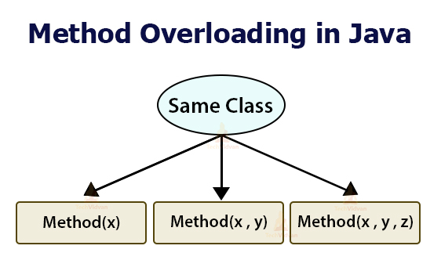

Slide 15
Overloading Methods
Overloaded methods MUST change the argument list.
Overloaded methods CAN change the return type.
Overloaded methods CAN change the access modifier.
Overloaded methods CAN declare new or broader checked exceptions.

Slide 16
Overview
  A class can inherit from another class
    Original class is the “superclass”
    New class is called the “subclass”
Inheritance is a fundamental OO concept
Superclass
Car
Subclasses
SportsCar
Taxi
PoliceCar

Slide 17
Overriding
When a sub-class defines a
  “method with same method name, argument types, argument order and return type as a method in its super class, its called method overriding. “
Methods declared as final, static and private cannot be overridden.
An overriding method can be declared as final
The method can’t be less accessible
  Public => only public
  Protected => Both Public and Protected
  Default => default, public and protected

Slide 18
Interfaces
  An interface is like a fully abstract class
    All the methods are public and abstract- Till Java 8
      No instance variables if present they are public static final
  Defines a set of methods that other classes can implement
    A class can implement many interfaces,
      but can extend only one class
      can extend other interfaces and extend multiple interfaces

Slide 19
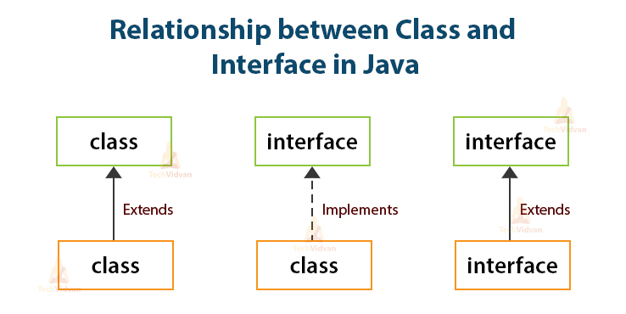

Slide 20
Exception handling

Slide 21
Exception Handling
java.lang.Object
java.lang.Throwable
java.lang.Error
java.lang.Exception
java.io.IOException
java.lang.RuntimeException
Notes:
The class Object is the root of the class hierarchy. Every class has Object as a superclass. All objects, including arrays, implement the methods of this class.
The Throwable class is the superclass of all errors and exceptions in the Java language. Only objects that are instances of this class (or of one of its subclasses) are thrown by the Java Virtual Machine or can be thrown by the Java throw statement. Similarly, only this class or one of its subclasses can be the argument type in a catch clause.
An Error is a subclass of Throwable that indicates serious problems that a reasonable application should not try to catch. Most such errors are abnormal conditions. The ThreadDeath error, though a "normal" condition, is also a subclass of Error because most applications should not try to catch it.
The class Exception and its subclasses are a form of Throwable that indicates conditions that a reasonable application might want to catch.
RuntimeException is the superclass of those exceptions that can be thrown during the normal operation of the Java Virtual Machine. A method is not required to declare in its throws clause any subclasses of RuntimeException that might be thrown during the execution of the method but not caught.
IOException signals that an I/O exception of some sort has occurred. This class is the general class of exceptions produced by failed or interrupted I/O operations.

Slide 22
Handle or Declare Rule
Handle the exception by using the try-catch-finally block.
  try{
  // some code
  } catch(Exception e){
  }
Declare that the code causes an exception by using the throws clause.
  void trouble() throws IOException { ... }
  void trouble() throws IOException, MyException { ... }
Other Principles
  You do not need to declare runtime exceptions or errors.
  You can choose to handle runtime exceptions

Slide 23
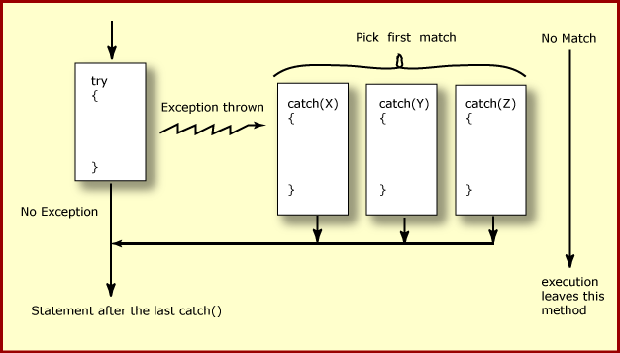
How try catch Work

Slide 24
Effective Exception Hierarchy
The exception classes are arranged in a hierarchy.
Catches for specific exceptions should always be written prior to the generic handler.
A generic handler for Exception would cover any missing situation.
  try
  {
  }
  catch (NumberFormatException e) {
  }
  catch (Exception ex2) {
  }
  try
  {
  }
  catch (Exception e1) {
  }
  catch(NumberFormatException e2) {
  }

Slide 25
Multiple Catch
  try {
  Object value = "twenty";
  Integer number = (Integer) value;
  String mark ="50";
  Integer.parseInt(mark);
  }
  catch ( ClassCastException| NumberFormatException ex ) {
  ex.printStackTrace();
  }

Slide 26
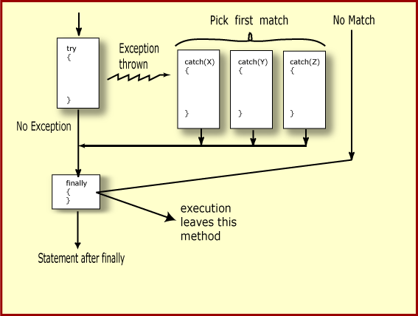
Finally Block

Slide 27
The try-with-resources Statement
A try statement that declares one or more resources.
A resource is an object that must be closed after the program is finished with it.
Ensures the resource is closed at the end of the statement.
Any object that implements java.lang.AutoCloseable, and java.io.Closeable, can be used as a resource.

Slide 28
The try-with-resources Statement
  System.out.print("Enter an integer: ");
  try(Scanner scan = new Scanner( System.in )) {
  int num = scan.nextInt();
  System.out.println("square" + num + "is" + num*num );
  }
  catch ( InputMismatchException ex ) {
    System.err.println("You entered bad data." );
    System.err.println("Run the program again." );
  }
  System.out.println("Good-bye" );
  }

Slide 29

Abstract Data Types
Abstract Data Types (aka ADTs) are descriptions of how a data type will work without implementation details
Java interfaces are a form of ADTs
  some implementation details start to creep in

Slide 30
Data Structures
A Data Structure is:
  an implementation of an abstract data type and
  "An organization of information, usually in computer memory", for better algorithm efficiency."
List Object
aList
5
size
myElements
0 1 2 3 4 5 6 7 8 9 10
A C E B A

Slide 31
Data Structure Concepts
Data Structures are containers:
  they hold other data
  arrays are a data structure
  ... so are lists
Other types of data structures:
  stack, queue, tree,
  binary search tree, hash table,
  dictionary or map, set, and on and on
Different types of data structures are optimized for certain types of operations

Slide 32
Core Operations
Data Structures will have 3 core operations
  a way to add things
  a way to remove things
  a way to access things
Details of these operations depend on the data structure
  Example: List, add at the end, access by location, remove by location
More operations added depending on what data structure is designed to do

Slide 33
Java Collection Framework
Provides tools to maintain data container of object
Is an alternative to the creation of custom data structures
Consists of interfaces and classes that implement interfaces within the java.util package
Collection is the root interface for most of the Java collections hierarchy

Slide 34
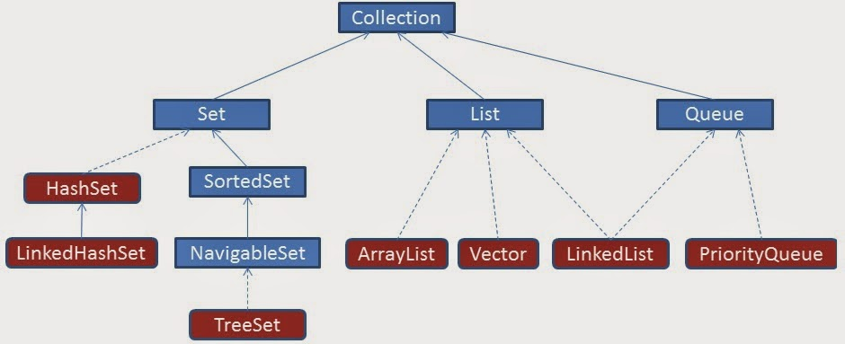
Collection Hierarchy

Slide 35
Collection categories
Ordered Collection
  The objects within the collection are maintained in a particular order or not
  When an object is added or removed from an ordered collection , the order is automatically maintained
Duplicate Elements
  Whether or not the collection allows duplicate objects
  Collection will automatically reject an attempt to add an object
Mapping of Key & Value
  Whether or not the collection maps a key to a particular object .
  This provides a means of quickly locating the object.
  Such collections do not allow duplicate objects

Slide 36
Class ArrayList
ArrayList()
Constructs an empty list with an initial capacity of ten.
ArrayList(Collection c)
Constructs a list containing the elements of the specified collection, in the order they are returned by the collection's iterator.
ArrayList(int initialCapacity)
Constructs an empty list with the specified initial capacity.

Slide 37
Generics
Introduced in Java 5.0
Can put any Object in to Collections, because they hold Just Objects
Type-safe Collections are created ,ensuring type-safety at compile time rather than run-time
Creating an Instance of Classes of Generic Type
  new ArrayList<Employee>
  ArrayList<Employee> mylist = new ArrayList<Employee>();

Slide 38
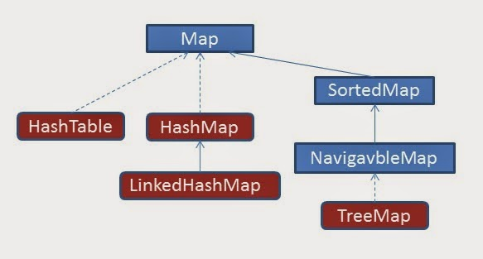
Collection Hierarchy- Map

Slide 39
Map
interface Map (does not extend Collection)
An object that maps keys to values
Ordering may be provided by implementation class, but not guaranteed
Methods to Add and Get Objects
  Object put( Object key, Object value)
  Object get( Object key)
Iterators for keys, values, (key, value) pairs

Slide 40
Map Implementations
Hash Map
  A hash table implementation of Map
  Supports null keys & values
  Not Ordered
Tree Map
  A balanced binary tree implementation
  Imposes an ordering on its elements based on comparable/compartor
Hash table
  Synchronized hash table implementation of Map interface.
  Doesn't support null keys and values

Slide 41
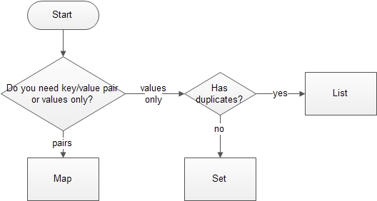
Deciding the Collection Interface

Slide 42
Files & IO

Slide 43
Overview
At its lowest level, all Java I/O involves a stream of bytes either entering or leaving memory
Packaged classes exist to make it easy for a program to read and write larger units of data.
Low-level stream class object are used to handle byte I/O
High-level stream class object will allow the program to read and write primitive data values and objects

Slide 44


File Classes
  Java views the data in files as a stream of bytes.
  A stream of bytes from which data are read is called an input stream.
  A stream of bytes to which data are written is called an output stream.
  Java provides classes for connecting to and manipulating data in a stream.
  The classes are defined in the package java.io and are organized in a large complex hierarchy.

Slide 45
Classes in I/O Package
File Reader
  Used to read characters from files
  The read() method of this class is used to read characters
  These are wrapped by BufferedReader to improve the performance
File Writer
  Used to write character to files
  The Write method() of this classes is used to write characters
  Wrapped by BufferedWriter to improve the performance

Slide 46
FileWriter
Constructors:
FileWriter(File file)
FileWriter(File file, boolean append)
FileWriter(String fileName)
FileWriter(String fileName, boolean append)
Same methods of Writer
public void write(int c)
All constructors and methods throw IOException

Slide 47
FileReader
Constructors:
FileReader(File file) throws FileNotFoundException
FileReader(String fileName) throws FileNotFoundException

Slide 48
Classes in I/O Package
BufferedReader
  Buffers give a temporary holding place to group until it reaches final place.
  It helps in efficent reading of files
  Reads a large amount of data from a file at once and keep that data in buffer
  Minimizes the number of times of file access.
  Provides a readLine() method , which reads a line of characters from the file
  BufferedReader in =
    new BufferedReader(new FileReader(“file.txt"));
BufferedWriter
  Provides a newLine() method , which that creates line separators automatically

Slide 49
Handling file input and output
PrintWriter
  Provides number of flexible and powerful methods to write data to files
  Methods like format(),printf() and append() are used to work with data
  print() or println() of this class take a single parameter of any data type
  PrintWriter wraps the FileWriter
  The resulting file can be read with a text editor or an input stream reader.

Slide 50
Write To File
public static void main(String args[]) {
try {
PrintWriter out = new PrintWriter(
new FileWriter("myAccount2.dat"));
out.println("srivatsan");
out.println("10099");
out.println(5000);
out.close();
}
catch (FileNotFoundException e){
}
catch (IOException e) {
}
}

Slide 51
Read From File
  public static void main(String[] args) {
  try {
  FileReader fr = new FileReader("TextFile.txt");
  BufferedReader br = new BufferedReader(fr);
  String line=null;
  try
  {
  while(( line=br.readLine()) !=null) {
  System.out.println(line); }
  }
  catch (IOException e) {
  e.printStackTrace();
  } }
  catch (FileNotFoundException e) {
  e.printStackTrace();
  }
  }

Slide 52
FUNCTIONAL INTERFACES

Slide 53
Functional interface
An interface with only one method.
  Adding another method to the interface definition, will not be functional and compilation process will fail.
@FunctionalInterface
  Used to enforce the intent of the interface
  Existing interfaces are annotated with @FunctionalInterface
These are used to leverage with lambda expressions.

Slide 54
Built-in Functional Interfaces
Earlier Versions of Java has several functional interfaces
  Prominent because of Lambda expressions
Existing functional interfaces
  Comparator
  Callable
  Runnable
  ActionListener
Collections API has been rewritten and new Stream API is introduced that uses a lot of functional interfaces.
java.util.function
  Consumer, Supplier, Function and Predicate.

Slide 55
Benefits of Lambda Expression
Fewer Lines of Code
  It reduced amount of code.
Sequential and Parallel Execution
  Support by passing behavior in methods
Higher Efficiency
  Utilizing Multicore CPU’s using Streams
Streams API
  Handling Collection of data much efficiently

Slide 56
Lambda Expressions
Lambda Expressions are:
Anonymous
  It doesn’t have an explicit name like a method
Function
  Not associated with a particular class like a method
  Has a list of parameters, a body, a return type, and list of exceptions that can be thrown.
Passed around
  Can be passed as argument to a method or stored in a variable.
Concise
  No need to write a lot of boilerplate like anonymous classes.

Slide 57
Lambda – Argument List
Can have zero, one or more parameters.
  (int x, int y)
Parameters can be explicitly declared or it can be inferred
  (int a) is same as just (a)
Parameters are separated by commas.
  (a, b) or (int a, int b) or (String a, int b, float c)
Empty parentheses to represent an empty set
  () -> 42
It is not mandatory to use parentheses.
  a -> return a*a

Slide 58
Lambda Expression - Body
  The body of the lambda expressions can contain zero, one or more statements.
Lambdas may return a value.
The type of the return value will be inferred by compiler.
  Body is evaluated like a method body
  return statement returns control to the caller of the anonymous method.
The return statement is not required if the lambda body is just a one-liner.
If the return is an expression curly braces are required

Slide 59
Functional Interface
    interface Converter<T,R>{
    public R calculate(T frm);
    }
  public static void doConvert(Converter<Double,Double> conv,Double frm){
  System.out.println(conv.calculate(frm));
  }
  public static void main(String[] args) {
  Converter<Double,Double> currencyConverter = (val)->{return val * 45.0;};
  doConvert(currencyConverter, 100.00);
  Converter<Double,Double> farenToCel = (faren)->{return (faren-32) * 5/9;};
  doConvert(farenToCel, 84.00);
  }

Slide 60
METHOD REFERENCES

Slide 61
Method References
Used to store a reference on the function
  But don't want to invoke it right away.
Lambda expressions are for passing parameter to an instance method
Points to existing methods by their names.
  Described using :: (double colon) symbol.
When Used With Lambdas expressions, creates a compact and concise code.

Slide 62
Method References
Method reference to an instance method of an object
  object::instanceMethod
  Method reference to a static method of a class
  Class::staticMethod
Method reference to a constructor
  Class::new

Slide 63
Method References
List names = new ArrayList();
  names.add("Mahesh");
  names.add("Suresh");
names.forEach((e)->System.out.println(e));
  Passes parameter as an argument to the println method
names.forEach(System.out::println);
  Can replace the pass-through lambda with a method reference.
  A method reference names the method to which the parameter is passed

Slide 64

Type -4 Native Protocol Pure Java Driver

Slide 65
Querying a Database With JDBC
Connect
Register the driver
Query
Connect to the database
Process
results
Close

Slide 66
Loading a Driver Programmatically:
forName()
    In the java.lang.Class class.
    Loads the JDBC driver and registers the driver with the driver manager.
Class.forName("oracle.jdbc.driver.OracleDriver");
Required before Java 6
  Not required after Java 6 and JDBC 4.0 API
Need to place the Product Specific JAR file with JDBC 4.X driver in class path.
  Java automatically detects the Driver class and loads it.

Slide 67
Connecting to a Database
    The DriverManager class provides the getConnection() method to create a Connection object.
    The getConnection()method has the form
    Connection getConnection (String <url>, String <username>, String <password>)
    JDBC uses a URL to identify the database connection.
jdbc:<subprotocol>:<subname>
jdbc:oracle:<driver>:@<database>

Slide 68
JDBC URLs with Oracle Drivers
Thin driver
jdbc:oracle:thin:@<host>:<port>:<SID>
Connection conn = DriverManager.getConnection
("jdbc:oracle:thin:@myhost:1521:orcl",
"scott", "tiger");
jdbc:microsoft:sqlserver:@10.161.3.94:1433:javatraining,sa,”L2USER;
Notes:
JDBC URLs with Oracle Drivers
For connecting to a database using one of the Oracle JDBC drivers, the basic structure of the JDBC URL is jdbc:<subprotocol>:<driver>:@<database>.
Thin Driver
<driver> is thin.
<database> is a string of the form <host>:<port>:<sid>. That is, it is the host name, TCP/IP port, and Oracle SID of the database to which you want to connect. For example: jdbc:oracle:thin:@eduhost:1521:ORCL
OCI Driver
<driver> is oci8 or oci7, depending on which OCI driver you are using.
<database> is a TNSNAMES entry from the tnsnames.ora file. For example: jdbc:oracle:oci8:@eduhost
Note: For the thin and OCI drivers, <database> can also use the SQL name-value pair syntax. For example:
(DESCRIPTION=(ADDRESS_LIST=(ADDRESS=(PROTOCOL=TCP)(HOST=<hostname>)
(PORT=<port>)))(CONNECT_DATA=(SID=<sid>))
Server-Side Driver
The server-side driver is for connecting within the server. You do not need a URL to do this; you can use the default connection. You will learn how to do this later in this lesson.

Slide 69
Data Base Connection Property
src/resources/DbConnection.properties
datasource.url=jdbc:mysql://localhost:3306/test
datasource.username=root
datasource.password=srivatsan
datasource.driverClassName=com.mysql.jdbc.Driver

Slide 70
Connection Utility
  public static Connection getMySqlConnection() {
  Connection con = null;
  try {
  String fileName = "resources/DbConnection.properties";
  Properties props=new Properties();
  InputStream inStream=
  DataBaseConnection.class.getClassLoader().
  getResourceAsStream(fileName);

Slide 71
Connection Utility
  props.load(inStream);
  con=DriverManager.getConnection(
  props.getProperty("datasource.url"),
  props.getProperty("datasource.username"),
  props.getProperty("datasource.password"));
  } catch (SQLException | IOException e) {
  e.printStackTrace();
  }
  return con;
  }

Slide 72
Statements - PreparedStatement
PreparedStatement extends the Statement interface.
Provides methods to bind various object types
Code becomes easy to understand:
Uses pre-compilation.
  As soon as the database gets a query, it will check the cache before pre-compiling the query.
Used for statements that is called more than once.
Suitable for DML queries like Insert,Update and Delete
Notes:
Prepared Statements
PreparedStatement is inherited from Statement; the difference is that a PreparedStatement holds precompiled SQL statements.
If you execute a Statement object many times, its SQL statement is compiled each time. PreparedStatement is more efficient because its SQL statement is compiled only once, when you first prepare the PreparedStatement. After that, each time you execute the SQL statement in the PreparedStatement, the SQL statement does not have to be recompiled.
Therefore, if you need to execute the same SQL statement several times within an application, it is more efficient to use PreparedStatement than Statement.
PreparedStatement Parameters
A PreparedStatement does not have to execute exactly the same query each time. You can specify parameters in the PreparedStatement SQL string and supply the actual values for these parameters when the statement is executed.
The following slide shows how to supply parameters and execute a PreparedStatement.

Slide 73
Statements - PreparedStatement
String sqlAdd = "insert into emp values(?,?,?)";
  PreparedStatement pstmt = con.prepareStatement(sqlAdd);
  pstmt.setInt(1, empid);
  pstmt.setString(2, empname);
  pstmt.setDouble(3, salary);
  int n = pstmt.executeUpdate();

Slide 74
Executing JDBC Statements
Can Use SQL statements to send requests to a database to retrieve results.
The Following methods are used to send static SQL statements to a database:
  ResultSet executeQuery(String str)
  int executeUpdate(String str)
  boolean execute(String str)

Slide 75
Dao Interface
  public interface DataAccess<T> {
  public boolean add(T t);
  public List<T> findAll();
  public boolean remove(T t);
  public int update(int key,T t);
  public T findById(int key);
  }

Slide 76
DAO Implementation
  public class InvoiceDaoImpl implements DataAccess<Invoice> {
  private Connection connection;
  public InvoiceService(Connection connection) {
  super();
  this.connection = connection;
  }

Slide 77
DAO Implementation
  public boolean add(Invoice t) {
  String sql = "insert into invoice values(?,?,?)";
  int rowAdded =0;
  try (PreparedStatement pstmt = connection.prepareStatement(sql)) {
  pstmt.setInt(1, t.getInvoiceNumber());
  pstmt.setString(2, t.getCustomerName());
  pstmt.setDouble(3, t.getAmount());
  rowAdded = pstmt.executeUpdate();
  } catch (SQLException e) {
  e.printStackTrace();
  }
  return rowAdded==1?true:false;
  }

Slide 78
DAO Implementation
  public List<Invoice> findAll() {
  String sql = "select * from invoice ";
  List<Invoice> invoiceList = new ArrayList<>();
  try (PreparedStatement pstmt = connection.prepareStatement(sql)) {
  ResultSet result = pstmt.executeQuery();
  while(result.next()) {
  int invoiceNumber =result.getInt("invoiceNumber");
  String customerName = result.getString("customerName");
  double amount = result.getDouble("amount");

Slide 79
DAO Implementation
  Invoice invoice = new Invoice(invoiceNumber, customerName, amount);
  invoiceList.add(invoice);
  }
  } catch (SQLException e) {
  e.printStackTrace();
  }
  return invoiceList;
  }

Slide 80
DAO Implementation
  public boolean remove(Invoice t) {
  String sql = "delete from invoice where invoiceNumber=?";
  int rowDeleted =0;
  try (PreparedStatement pstmt = connection.prepareStatement(sql)) {
  pstmt.setInt(1, t.getInvoiceNumber());
  rowDeleted = pstmt.executeUpdate();
  } catch (SQLException e) {
  e.printStackTrace();
  }
return rowDeleted==1?true:false;
}

Slide 81
DAO Implementation
  public void closeConnection() {
  try {
  this.connection.close();
  } catch (SQLException e) {
  e.printStackTrace();
  }
  }

Slide 82
DAO Implementation
  public Invoice findById(int key) {
  String sql = "select * from invoice where invoiceNumber=?";
  Invoice foundInvoice =null;
  try (PreparedStatement pstmt = connection.prepareStatement(sql)) {
  pstmt.setInt(1, key);
  ResultSet result = pstmt.executeQuery();

Slide 83
DAO Implementation
  if(result.next()) {
  int invoiceNumber =result.getInt("invoiceNumber");
  String customerName = result.getString("customerName");
  double amount = result.getDouble("amount");
  foundInvoice = new Invoice(invoiceNumber, customerName, amount);
  }
  } catch (SQLException e) {
  e.printStackTrace();
  }
  return foundInvoice;
}

Slide 84
ANNOTATIONS

Slide 85
Annotations
Adding META-DATA to the Java Elements.
Can be applied to several elements.
Tools will read and interpret the Annotations and add lot of functionalities
What Can be Annotated
  Class, Interface,
  Method, Constructor, Field,
  Method parameter
  Local Variable declaration

Slide 86
Annotations Use Cases
Used in EJB, Web Services and other Java Frame Works
  Replace or supplement descriptors with annotations
  Annotated Web Service implementation to generate Servlet binding, JAX-RPC interfaces, etc.
  JavaBeans, Logger utilities, Debugging classes, etc.
  Test methods
  AOP crosscuts

Slide 87
Simple Annotations
Override annotation:
  To Ensure the annotated method is used to override the method in the super class.
  The compiler will generate a error if there is improper Overriding.
Deprecated annotation:
  To warn when using the deprecated element of the program.
Suppresswarning annotation:
  To ensure that the compiler will shield the warning message in the annotated elements and also in all of its sub-elements

Slide 88
Defining Annotations
Start with the symbol @ followed by keyword interface and annotation name.
Method declaration should not throw any exception.
Method declaration should not contain any parameter.
Method using annotations should return a value or an collection of one of the types given below:
  String
  Primitive
  Enum
  Object

Slide 89
Example
  @interface MyAnnotation {
  String stringValue();
  int intValue();
  }
  public class MainClass {
  @MyAnnotation(stringValue = "Annotation Example", intValue = 100)
  public static void myMethod() {
  }
  }

Slide 90
META -Annotations
Target annotation:
  specifies the elements of a class to which annotation is to be applied.
@Target(ElementType.TYPE)
  applicable to any element of a class.
@Target(ElementType.FIELD)
  applicable to field or property.
@Target(ElementType.METHOD)
  applicable to method level annotation.

Slide 91
Retention Annotation
These annotation specify where and how long annotation with this types are to be retained.
RetentionPolicy.SOURCE:
  This type of annotation will be retained only at source level and the compiler will ignore them.
RetentionPolicy.CLASS:
  This type of annotation will be retained at the compile time the virtual machine (VM) will ignore them.
RetentionPolicy.RUNTIME:
  Virtual machine will retain the annotation of this type and they can be read only at run-time.

Slide 92
annotation processing
can happen on 3 levels
Introspections
  process runtime-visible annotations of their own program elements
  use reflection and read annotations with RUNTIME retention
Byte code analyzers
  process annotations in .class files
  e.g. stub generators
Source code analyzers
  process annotations in Java source code
  e.g. compilers, documentation generators, class browsers

Slide 93

INTRODUCTION TO SPRING BOOT

Slide 94
Introduction
Spring
  An application development framework and inversion of control container for Java
Spring Boot
  Makes it easy to create stand-alone, production-grade Spring Applications and expose them as services

Slide 95
Spring Framework
Light-weight comprehensive framework for building Java SE and Java EE applications
Java Bean-based configuration management,
Integration with persistence frameworks.
MVC web application framework
Aspect-oriented programming (AOP) framework
Publishing REST API’s

Slide 96

The Container

Slide 97
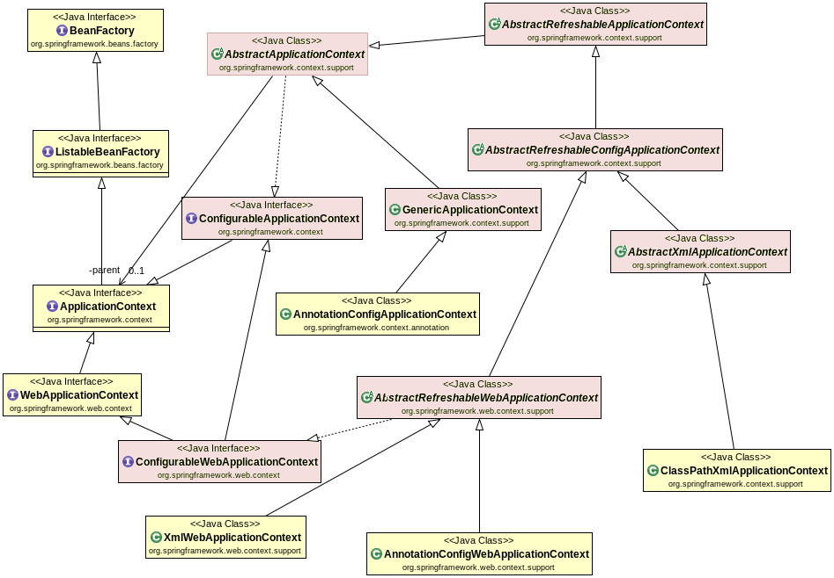
Container Hierarchy

Slide 98
Beans
A bean is an object that is instantiated, assembled, and otherwise managed by a Spring IoC container.
The “beans” are in the form of JavaBeans
  Present in a Named Package
  No Argument constructor
  getter and setter methods for the properties
  Can be controlled for scope, life cycle and callbacks.
Beans are singletons by default
Beans are Eagerly Initialized by default

Slide 99
Dependency Injection
Dependencies between the beans can be Injected by following ways
  Setter Injection
    uses setter method to set the value
  Constructor Injection
    Happens at the time of creating the object itself
  Field Injection (@Autowired at field)
    Uses reflection to set the values of private variables
  @Autowired
  private UserService userService;

Slide 100
Constructor Injection
Dependency can be one of the following
    Injected via a class constructor
    primitive and String-based values
    Dependent object (contained object)
    Collection values
  @Component
  public class UserController {
  private UserService userService;
  public UserController(UserService userService){
  this.userService = userService;
  } }

Slide 101
Setter Injection
Setter Injection
  Injected via setter methods
  Allows flexible initialization
  Requires Java Bean conventions to be followed
    Can add post initialization checking methods
  private UserService userService;
  @Autowired
  public void setUserService(UserService userService){
  this.userService = userService;
  }

Slide 102
REGISTERING BEANS

Slide 103
Configuration Meta Data
Instructs IoC Container to instantiate, configure, and assemble the objects
Can be done in XML format
  Supported from Spring 2.0
Can be done with Annotation
  Supported from Spring 2.5
Can be done with Just Java
  Supported from Spring 3.0

Slide 104
@ Component
@Component
  Spring can scan all the beans through auto scan if the class has this or similar annotation
The Registered Beans can be access by Its name
  The Name is first Character of the Class Name in lowercase
  ‘CustomerService’ to ‘customerService’.
CustomerService cust = (CustomerService)context.getBean("customerService");
@Component(“custService”)
  Can Customize the component name by passing a string value

Slide 105
@Bean
Method-level annotation in Class annotated @Configuration
Added to the public Method of the configuration class
  Methods should not be private or final
Method should return an object that should be registered as a Bean
Supports following attributes
  init-method
  destroy-method
  autowireCandidate
  name

Slide 106
Register Bean
Beans can also be registered with Java Based Configuration
  Done in the Java class with @Configuration Annotation
    This class acts as a source of Bean Definitions
  @Configuration
  public class EmployeeConfig {
  @Bean
  public Employee idOfTheBean(){
  return new Employee();
  }
  @Bean (name=“ram”) // bean Id overridden with name attribute
  public Employee employee(){
  return new Employee();
  }
  }

Slide 107
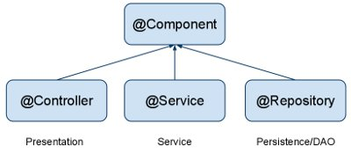
Auto Component Scan Types
@Component
  Indicates a auto scan component.
@Repository
  Indicates DAO component in the persistence layer.
@Service
  Indicates a Service component in the business layer.
@Controller
  Indicates a controller component in the presentation layer.

Slide 108
Constructor DI
  @Component
  @Data
  public class Invoice {
  private Customer customer;
  private Product product;
  @Autowired
  public Invoice(Customer customer, Product product) {
  super();
  this.customer = customer;
  this.product = product;
  }
  }

Slide 109
Setter DI
  @Autowired
  public void setCustomer(Customer customer) {
  this.customer = customer;
  }
  public Product getProduct() {
  return product;
  }
  @Autowired
  public void setProduct(Product product) {
  this.product = product;
  }
  public Invoice() {
  // TODO Auto-generated constructor stub
  }

Slide 110
Spring Boot
Extension of the Spring framework
  A faster and more efficient development
Eliminates the boilerplate configurations required for setting up a Spring application.
  Opinionated ‘starter’ dependencies to simplify build and application configuration
  Embedded server to avoid complexity in application deployment
  Metrics, Health check, and externalized configuration
  Automatic configuration whenever possible

Slide 111
Spring Boot Bootstrap
  @SpringBootApplication
  public class Application {
  public static void main(String[] args) {
  SpringApplication.run(Application.class, args);
  }
  }
Spring Boot can scan all the classes in the same package or sub packages of Main-class for components.
Equivalent to using @Configuration, @EnableAutoConfiguration, and @ComponentScan with their default attributes,

Slide 112
Spring Application
  public static void main(String[] args) {
  ConfigurableApplicationContext ctx = SpringApplication.run(BootIocApplication.class, args);
  Invoice invoice= ctx.getBean(Invoice.class);
  System.out.println(invoice);
  ctx.close();
  }

