Slide 1
REST SERVICE USING SPRING DATA JPA

Slide 2
REST Overview
REpresentational State Transfer
An architectural style of creating API's
  Makes it easier for systems to communicate with each other.
The implementation of the client and server can be done independently without each knowing about the other.
Different clients hit the same REST endpoints, perform the same actions, and receive the same responses.

Slide 3
REST Overview
Resource Oriented Architecture
  Data and functionality are considered resources
  Accessed using Uniform Resource Identifiers (URIs)
  Accessed Using HTTP standard methods.

Slide 4
Lightweight Web Services
REST is a lightweight alternative to Web Services and RPC.
REST services is:
  Platform-independent
  Language-independent
  Runs on top of HTTP Protocol
  Used in the Presence of firewalls too.
REST does not offer
  built-in security features
  encryption
  session management
These feature can be added by building on top of HTTP:

Slide 5
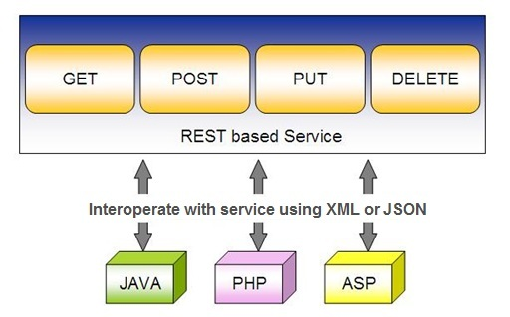
Spring RESTful Services
REST does not require the client to know anything about the structure of the API.
Server needs to provide whatever information the client needs to interact with the service.

Slide 6
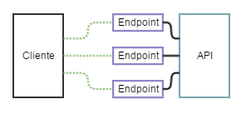
API and Endpoint

Slide 7
SPRING DATA REST WITH JPA

Slide 8
Spring RESTful Services
A RESTful architecture may expose multiple representations of a resource.
From Spring 4 @RestController annotation is added to controller
  A combination of @Controller and @ResponseBody
A Rest Controller method returns a domain object instead of a view.

Slide 9
REST Stereotypes
@RestController
  An implicit @ResponseBody is being added to the methods.
  Allows Spring to render the returned HttpEntity and its payload, directly to the response.
@GetMapping
  To map HTTP GET requests onto specific handler methods.
  Composed annotation for @RequestMapping(method = RequestMethod.GET).

Slide 10
REST Stereotypes
@PathVariable
  Indicates that the Method parameter should be bound to a URI template variable.
  @GetMapping("/members/{id}")
  public String getById(@PathVariable String id) { }
@PostMapping
  Combined shortcut for @RequestMapping(method = RequestMethod.POST).
  @PostMapping("/members“)
  public void addMember(@RequestBody Member member) { }

Slide 11
@Repository
There are three repository in Spring Data
CrudRepository
  Extends Repository
  provides CRUD functions
PagingAndSortingRepository
  Extends CrudRepository
  provides methods to do pagination and sort records
JpaRepository
  Extends PagingandSortingRepository
  Provides Methods such as flushing the persistence context and delete records in a batch
  Querying methods return List's instead of Iterable's

Slide 12
Creating Spring Data Application
  Create a repository interface and extend one of the repository interfaces provided by Spring Data.
  If required add custom query methods to the created repository interface
  Inject the repository interface to another component and use the implementation that is provided automatically by Spring.
Need NOT create an implementation class
  Spring will automatically create its implementation class at runtime.
The Repository class will be auto detected if suitably placed in the scan path

Slide 13
CrudRepository Interface
Extends Repository Interface and has the following Methods
  <S extends T> S save(S entity)
  <S extends T> Iterable<S> saveAll(Iterable<S> entities);
  Optional<T> findById(ID primaryKey)
  Iterable<T> findAll()
  void delete(T entity)
  long count()
  boolean existsById(ID id);

Slide 14
JpaRepository
Extends PagingAndSortingRepository
Can also optionally extend QueryByExampleExecutor
  List<T> findAllById(Iterable<ID> ids);
  <S extends T> S saveAndFlush(S entity);
  void deleteInBatch(Iterable<T> entities);
  void deleteAllInBatch();
  T getOne(ID id);
  void flush();

Slide 15
SAMPLE CODE-DEMO

Slide 16
Entity
  @Entity
  @Table(name = "demo_invoice")
  @Data
  @AllArgsConstructor
  @NoArgsConstructor
  @FieldDefaults(level = AccessLevel.PRIVATE)
  public class Invoice {
  @Id
  long id;
  String customerName;
  @DateTimeFormat(iso = DateTimeFormat.ISO.DATE)
  LocalDate invoiceDate;
  double amount;
  }

Slide 17
Repository
  @Repository
  public interface InvoiceRepository extends JpaRepository<Invoice, Long>{
  }

Slide 18
Service
  @Service
  public class InvoiceService {
  @Autowired
  private InvoiceRepository repo ;
  public List<Invoice> findAll(){
  return repo.findAll();
  }
  public Invoice findById(int id) {
  Optional<Invoice> optInvoice=repo.findById(id);
  return optInvoice.orElseThrow(() -> new
  RunTimeException(“Invoice not found"));
  }

Slide 19
Controller
  @RestController
  public class InvoiceController {
  @Autowired
  private InvoiceService service ;
  @GetMapping(path = "/api/v1/invoices")
  public List<Invoice> findAll() {
  List<Invoice> details = service.findAll();
  return details;
  }

Slide 20
@RequestBody
Used to map the HttpRequest body to a transfer or domain object
  Spring automatically deserializes the JSON into a Java type
  The type of @RequestBody annotation must correspond to the JSON sent from client-side
HttpMessageConverter
  Internally Used by Spring to perform Serialization/deserialization
@Valid
  To perform automatic validation by adding to method argument

Slide 21
Post and Put Mapping
  @PostMapping(path = "/api/v1/invoices")
  public Invoice add(@RequestBody Invoice entity
  ,HttpServletResponse response) {
  response.setStatus(201);
  return this.service.add(entity);
  }
@ResponseStatus(HttpStatus.CREATED)
  @PostMapping(path = "/api/v1/invoices")
  public Invoice add(@RequestBody Invoice entity) {
  return this.service.add(entity);
  }

Slide 22
ResponseEntity
Represents Complete HTTP response, gives more flexibility
  May be required in some special cases
  Can be used to send Status Code,Response Body,Location to the resource which was altered
  @GetMapping(path = "/api/v1/invoices")
  public ResponseEntity<Invoice> getInvoices() {
  HttpHeaders responseHeaders = new HttpHeaders();
  return ResponseEntity.ok().headers(responseHeaders).body(dao.findAll());
  }
  HttpStatus status = e != null ? HttpStatus.OK : HttpStatus.NOT_FOUND;
  return new ResponseEntity<Mono<Employee>>(e, status);

Slide 23
Put Mapping
@PutMapping(path = "/api/v1/invoice")
  public Invoice update(@RequestBody Invoice entity) {
  return this.service.add(entity);
  }
  @PatchMapping(path = "/api/v1/invoice")
  public ResponseEntity<String> updateAmount() {
  return ResponseEntity.status(HttpStatus.CREATED)
  .body("Updated Amount:="+this.service.updateAmount());
  }

Slide 24
Remove Method in Service
  public Invoice remove(Invoice entity) {
  Optional<Invoice> optional = Optional.empty();
  if(this.repository.existsById(entity.getId())) {
  this.repository.delete(entity);
  optional = Optional.of(entity);
  }
return optional;
}

Slide 25
Delete Mapping in Controller
  @DeleteMapping(path = "/api/v1/invoice")
  public ResponseEntity<Invoice> remove(@RequestBody Invoice entity) {
  Invoice invoice = this.service.removeInvoice(entity).orElseThrow(()-> new RuntimeException("Element NOT FOUND"));
  return ResponseEntity.ok().body(invoice);
  }

Slide 26
application.yml
  spring:
  datasource:
  url: jdbc:mysql://localhost:3306/test
  username: root
  password: srivatsan
  driver-class-name: com.mysql.cj.jdbc.Driver
  jpa:
  show-sql: true
  hibernate:
  ddl-auto: update
  naming:
  physical-strategy: org.hibernate.boot.model.naming.PhysicalNamingStrategyStandardImpl

Slide 27
application.yml
  application:
  name: invoice-service
  logging:
  level:
  org.hibernate.sql: debug
  org.hibernate.type.descriptor.sql.BasicBinder: trace
  management:
  endpoints:
  web:
  exposure:
  include:
  - "*"

Slide 28


Slide 29
INTRODUCTION TO MICRO SERVICES

Slide 30
Micro Services
Problems with Monolithic Application
What is Microservices
Advantages and disadvantages
When not to use Microservice
Use case for MicroServices

Slide 31
Monolith Application
A monolithic application is a single-tiered software application
  Has user interface and data access code combined into a single program from a single platform.
Its characteristics
  Doesn’t have Module but Modularized using object-based approach to be distributed across multiple computers
  Deployed together as a single deployment unit- EAR or WAR.
  Long Release Cycles
  Large Teams

Slide 32
Challenges to Monolith
  Large codebases become mess over the time
  Multiple teams working on single codebase become tedious
  Difficulty in Adapting to Device Explosion
  Scaling up certain parts of the application
  Technology updates/rewrites become complex and expensive tasks

Slide 33
Micro Services
An engineering approach focused on decomposing applications with well-defined interfaces - service contracts such as a JSON schema or WSDL
  Deployed independently as services and operated by small teams who own the entire lifecycle of the service.
  Each service handles a specific business domain (logging, auth, orders, customers)
  Each Service provides the implementation for user interface, business logic, and connection to database.
  Each Service can be scaled up Individually

Slide 34
Micro Service
  class UserApp() {
  User getUser() {
  // 1. auth user
  // 2. get user data
  // 3. log user actions
  }
  }
  class UserApp() {
  void authUser(User user) { ... }
  User getUserData() { ... }
  void logUserActions() { ... }
  }

Slide 35
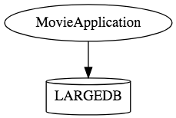
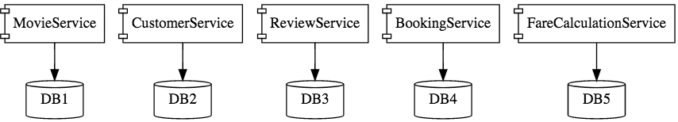
Micro Services

Slide 36
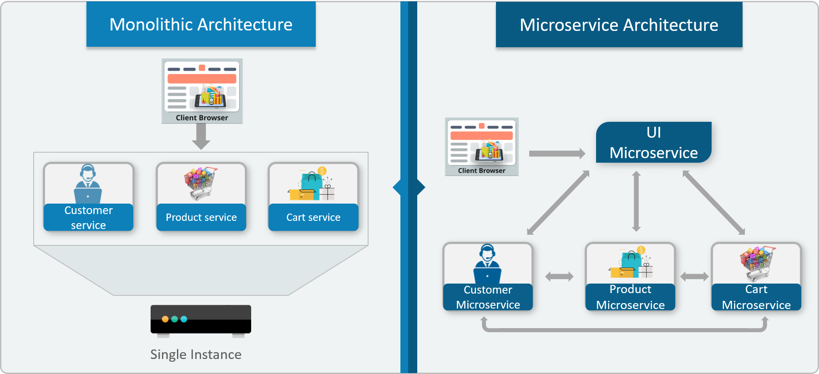

Monolithic vs Micro Service

Slide 37
Characteristics of Micro Service
Single-function
  Each and every service has a specific function, or responsibility.
  A service can do many tasks, but all of them are relevant to a single function.
Well-defined interfaces
  Services must provide an interface that defines to communicate with it.
  Defines a list of methods, and their inputs and outputs.
  JSON Schema or WSDL files

Slide 38
Characteristics of Micro Service
Independent
  Services doesn’t know about each other implementation.
  They can get tested, deployed, and maintained independently.
  Services may be implemented using different language stacks, and communicate with different databases.
    They can work together to complete a required operation.

Slide 39
Characteristics of Micro Service
Small Teams
  Split the work up and team across the services.
  Each team focuses on a specific service, they don’t need to know about internal workings of other teams.
  Teams can work efficiently, communicate easily,
  Each service can be deployed rapidly as soon as it’s ready.
Entire Lifecycle
  The team is responsible for the entire lifecycle of the service; from coding, testing, staging, deploying, debugging, maintaining.
  No separate team for coding, deployment. Etc

Slide 40
Characteristics of Micro Service
Minimizing Communication
  Only essential cross-team communication should be through the interface that each service provides.
  They all need to agree on the external interface, so that communication between services is clearly defined.
Cloud Enabled
  Dynamic Scaling

Slide 41
When Not to use Micro Services
Complexity is a key factor
  "...don't even consider microservices unless you have a system that's too complex to manage as a monolith...“ –Martin Fowler
If complexity isn't problem, microservices aren't the solution.
Micro service architecture also brings with it significant overhead
  Design
  Interoperability of services
  Management
  Use of system resources.

Slide 42
Challenges with Micro service
Development has some inherent complexities
Quick Setup needed
  Should be able to create micro services quickly.
Automation
  Smaller component build ,deployment, monitoring etc should automated
Visibility :
  Should be able to monitor and identify problems automatically.
  Need great visibility around all the components.
Debugging
  Centralized Logging and Dashboards are essential to debug problems.

Slide 43
Challenges with Micro service
Configuration Management
  Need to maintain configurations for hundreds of components across environments.
  Should Have Configuration Management solution
Dynamic Scale Up and Scale Down
  Applications should be easily scaled up and down
Pack of Cards :
  If a Service at the bottom of the call chain fails, it can have knock on effects on all other services.
  Services should be fault tolerant by Design.
Consistency
  Should have some decentralized governance around the languages, platforms, technology and tools used for implementing/deploying/monitoring

Slide 44
Solutions to Challenges
Spring Boot
  Enable building production ready applications quickly
  Provide non-functional features
  embedded servers (easy deployment with containers)
  metrics (monitoring)
  health checks (monitoring)
  externalized configuration

Slide 45
Solutions to Challenges
Spring Cloud
  Cloud solutions – From Spring and Open Sourced
Dynamic Scale Up and Down.
  Using a combination of Naming Server (Eureka)
  Client Side Load Balancing
  Feign (Easier REST Clients)
Visibility and Monitoring
  Zipkin Distributed Tracing
  API Gateway
Configuration Management
  Spring Cloud Config Server
Fault Tolerance
  Cloud Circuit Breaker

