Slide 1
Design Patterns

Slide 2
SOLID PRINCIPLE

Slide 3
SOLID Design Principle
S ->Single Responsibility Principle
  One class should have one and only one responsibility“
O -> Open Close Principle
  "Software components should be open for extension, but closed for modification“
L-> Liskov Substitution Principle
  "Derived types must be completely substitutable for their base types"
I ->Interface Segregation Principle
  "Clients should not be forced to implement unnecessary methods which they will not use“
D->Dependency Inversion Principle
  "Depend on abstractions, not on concretions"

Slide 4
Single Responsibility Principle (SRP)
There should not be more than one reason for a class to change
  a class should always handle single functionality.
One class at the most is responsible for doing one task or functionality among the whole set of responsibilities
And only when there is a change needed in that specific task or functionality should this class be changed.
Provides cohesiveness
  Attributes & behavior – are specific to that single functionality only
Class should be split into two If there are 2 reasons to change

Slide 5
Single Responsibility Principle (SRP)
  public class Item {
  private int itemNumber;
  private String itemName;
  private long ratePerUnit;
    public Item() {
    super();
  }
  }

Slide 6
Single Responsibility Principle (SRP)
  public class Customer {
  private String name;
  private int age;
  private long bill;
  private List<Item> listsOfItems;
  // Calculate bill should not be responsibility of customer
  public long calculateBill(long tax) {
  }
  //Report generation should not be responsibility of customer
  public void generateReport(String reportType)
  { }
  }
  There are two Responsibilities in the Customer Class.

Slide 7
Applying SRP
  public class BillCalculator {
  public long calculateBill(Customer customer,long tax) {
  }
  public class ReportGenerator {
  public void generateReport(Customer customer,String reportType) {
  }
  }

Slide 8
Open Closed Design Principle
Classes, methods or functions should be Open for extension (new functionality) and Closed for modification.
Prevents some-one from changing already tried and tested code.
New functionality should added by creating subclasses or methods, or by reusing existing code through delegation
New functionality should be tested and that's the goal of Open Closed Design principle.

Slide 9
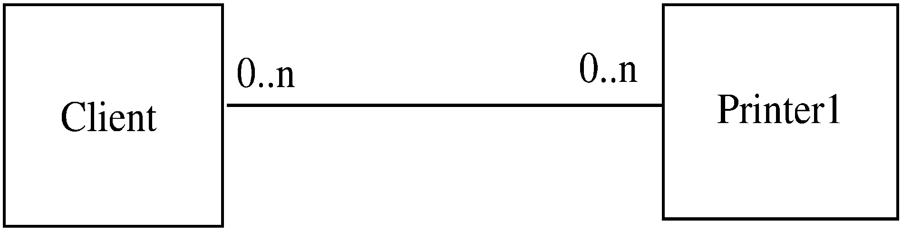
Example

Slide 10
Example..
Client directly calls methods on Printer1
If another printer is to be allowed
  A new class Printer2 will be created
  But the client will have to be changed if it wants to use Printer 2
Alternative approach
  Have Printer1 a subclass of a general Printer
  For modification, add another subclass Printer 2
  Client does not need to be changed

Slide 11
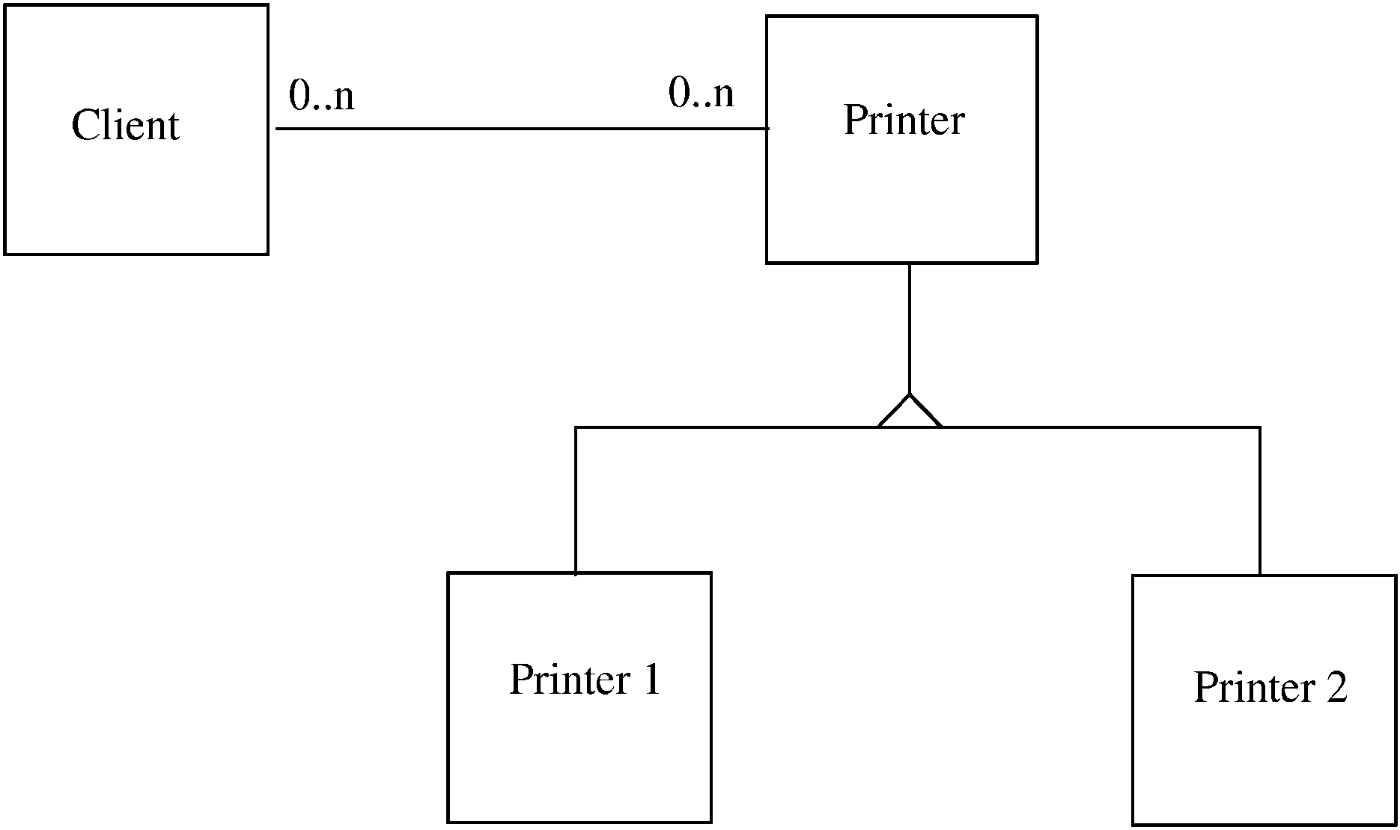
Example…

Slide 12
Liskov Substitution Principle (LSP)
If a program module is using a Base class, then the reference to the Base class can be replaced with a Derived class without affecting the functionality of the program module.
Classes are created in some class hierarchies, we extend some classes creating some derived classes.
Need to ensure that the new derived classes just extend without replacing the functionality of old classes.
Otherwise the new classes can produce undesired effects when they are used in existing program modules.

Slide 13
Liskov Substitution Principle (LSP)
  class Rectangle { }
  class Square extends Rectangle { }
  class LspTest {
  private static Rectangle getNewRectangle() {
  return new Square();
  }
  public static void main (String args[]) {
  Rectangle r = LspTest.getNewRectangle();
  r.setWidth(5);
  r.setHeight(10);
  System.out.println(r.getArea());
  } Area is 100 instead of 50.

Slide 14
Interface Segregation principle (ISP)
Interface Segregation Principle stats that, a client should not implement an interface, if it doesn't use that.
Instead of one fat interface many small interfaces are preferred based on groups of methods, each one serving one submodule.
This happens mostly when one interface contains more than one functionality, and client only need one functionality and not other.
Another benefit of this design principle in Java is, interface has disadvantage to implement all method before any class can use it so having single functionality means less method to implement.

Slide 15
Interface Segregation principle (ISP)
interface IWorker {
public void work();
public void eat(); }
class Worker implements IWorker{
public void work() { // ....working }
public void eat() { // ...... eating in lunch break }
}
class SuperWorker implements IWorker{
public void work() { //.... working much more }
public void eat() { //.... eating in lunch break }
}
class Manager {
IWorker worker;
public void setWorker(IWorker w) {
worker=w;
}
public void manage() {
worker.work();
} }
What Happens when a new Robot worker is introduced

Slide 16
Interface Segregation principle (ISP)
interface IWorkable { public void work(); }
interface IFeedable{ public void eat(); }
interface IWorker extends IFeedable, IWorkable {
}
class Worker implements IWorkable, IFeedable{
public void work() { // ....working }
public void eat() { //.... eating in launch break }
}
class Robot implements IWorkable{
public void work() {
// ....working
}
}

Slide 17
Dependency Injection or Inversion principle
High-level modules should not depend on low-level modules. Both should depend on abstractions.
Abstractions should not depend on details. Details should depend on abstractions.
Don't ask for dependency it will be provided to you by framework.
This has been very well implemented in Spring framework,
Any class which is injected by DI framework is easy to test with mock object and easier to maintain because object creation code is centralized in framework and client code is not littered with that.

Slide 18
Dependency Injection or Inversion principle
class Worker {
public void work() { // ....working }
}
class Manager {
Worker worker;
public void setWorker(Worker w) {
worker = w;
}
public void manage() {
worker.work();
}
}
class SuperWorker {
public void work() {
//.... working much more
}
}

Slide 19
Dependency Injection or Inversion principle
interface IWorker {
public void work();
}
class Worker implements IWorker{
public void work() { // ....working }
}
class SuperWorker implements IWorker{
public void work() { //.... working much more }
}
class Manager {
IWorker worker;
public void setWorker(IWorker w) {
worker = w;
}
public void manage() {
worker.work();
} }

Slide 20
Design Patterns
Design Patterns differ from Architectural Patterns in their scope,
  They are the outcome of a reusable solution to a general problem encountered in a particular context
  These are more localized, they have impact on a specific section of the code base,
  How to instantiate an object when we only know what type needs to be instantiated at run time - Factory Pattern
  How to make an object behave differently according to its state
    State machine, or a Strategy Pattern

Slide 21
DESIGN PATTERNS

Slide 22
Overview of Patterns
Is a proven solution to a problem in a given context.
Is first verified several times in the real-world systems to be actually called a pattern.
Promotes reuse of software concepts and technologies, which make you work faster and efficiently.
Establishes common terminology for problems.
Describes the circumstances, influences, and the resolution of a solution.
Facilitates design modifications, documentation, and understandability of a software system.

Slide 23
Types of GoF’s Design Patterns
Creational design patterns:
  Provide techniques for creating objects
  Create objects of the right class for a problem, generally when instances of several different classes are available.
Structural design patterns:
  Describe the composition of objects and their organization.
  To form larger structures from individual parts, of different classes.
Behavioral design patterns:
  Provide guidelines for enabling communication among objects of a given system.
  Describe interactions between objects.

Slide 24
CREATIONAL DESIGN PATTERN

Slide 25
Topics
Limitation of Constructor
Factory Method Pattern
Abstract Factory
Singleton Pattern

Slide 26
Creational Design Patterns
Deal with object creation mechanisms, trying to create objects in a manner suitable to the situation.
The basic form of object creation could result in design problems or added complexity to the design.
Creational design patterns solve this problem by somehow controlling this object creation.
Allows instances of classes to be created, without the need to identify the class type by having the subclass of the class create the objects.

Slide 27
Creational Patterns
Factory Method Pattern
  Define an interface for creating an object, but let subclasses decide which class to instantiate.
Abstract Factory Pattern
  Provide an interface for creating families of related or dependent
  objects without specifying their concrete classes.
Prototype Pattern
  Specify the kinds of objects to create using a prototypical instance, and create new objects by copying this prototype.
Builder Pattern
  Separate the construction of a complex object from its representation so that the same construction process can create different representations

Slide 28

FACTORY METHOD PATTERN

Slide 29
Introduction
Six Terms in the context of Factory Pattern
  Factory
  Creation method
  Static creation (or factory) method
  Simple factory
  Factory Method
  Abstract Factory

Slide 30
Factory
Factory stands for a function, method or class that supposed to be producing something.
  They produce files, records in databases, etc.
Factory can be used to represent any one of the following:
  a function or method that creates Object
  A Static method that calls a class constructor in a certain way
  One of the creational design patterns.

Slide 31
Creation method
"a method that creates objects."
Creation method is a wrapper around a constructor call.
It may have a name that better expresses its intentions.
It could even contain some particular logic that would return existing objects instead of creating new.

Slide 32
Creation method
  class Number{
  private value;
  public Number(int value) {
  this.value = value;
  }
  public function next() {
  return new Number (this.value + 1);
  }
  }

Slide 33
Static creation method
Constructors in most programming languages have to return new class instances.
  The static creation method is a workaround to this limitation.
A creation method declared as static.
It returns new objects and hence alternative constructor.
Static method can do one of the following
  Create a fresh instance by calling the constructor
  Can return an existing object from some cache.

Slide 34
Static Creation Method
  public class User {
  private String name;
  private String email;
  private long phone;
  public User(String name, String email, long phone) {
  this.name = name;
  this.email = email;
  this.phone = phone;
  }
  public static User load(int id) {
  User user = dao.find(id);
  return user;
  }
  }

Slide 35
Simple factory pattern
The Simple factory pattern describes a class that has one creation method with a large conditional that based on method parameters
  chooses which product class to instantiate and then return.
A simple factory is an intermediate step of introducing Factory Method or Abstract Factory patterns.
Simple factories usually don't have subclasses.
But after extracting subclasses from a simple factory, it starts to look like a classic factory method pattern.

Slide 36
simple factory
  class UserFactory {
  public static Object create(String type) {
  switch (type) {
  case "user":
  return new User();
  break;
  case "customer":
  return new Customer();
  default:
  throw new Exception("Wrong user type passed.");
  }
  }
  }

Slide 37
Factory Method Usage
Examples in JDK
  java.util.Calendar,
  ResourceBundle and NumberFormat getInstance() methods
  valueOf() method in wrapper classes like Boolean, Integer etc.

Slide 38
Factory Method
Intent
  Define an interface for creating an object, but let subclasses decide which class to instantiate.
  Factory Method lets a class defer instantiation to subclasses.
  Defining a "virtual" constructor.
  The new operator considered harmful.
Problem
  A framework needs to standardize the architectural model for a range of applications,
  but allow for individual applications to define their own domain objects and provide for their instantiation.

Slide 39
Solution
The Factory Method pattern suggests replacing direct object creation (using a new operator) with a call to a special "factory" method.
The constructor call should be moved inside that method.
Objects returned by factory methods are often referred to as "products.“
Can override the factory method in a subclass and change the class of an object that will be created.

Slide 40
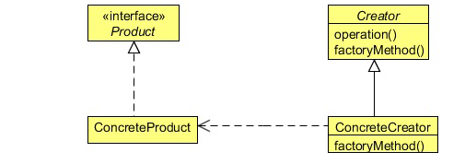
Factory Pattern

Slide 41
Pros and Cons
Pros
  Follows the Open/Closed Principle.
  Avoids tight coupling between concrete products and code that uses them.
  Simplifies code due to moving all creational code to one place.
  Simplifies adding new products to the program.
Cons
  Requires extra subclasses.

Slide 42
Factory Method
  package com.training.factory.example3;
  public interface CreditChek {
  public double creditLimit(long accountNumber);
  }
  public class CreditCheckOffline implements CreditChek {
  // Method Implemented
  }
  public class CreditChekOnline implements CreditChek {
  // Method Implemented
  }

Slide 43
Factory Method
  public class CreditCheckFactory {
  private String creditAgencyStatus ="online";
  public CreditChek createCreditCheck() {
    if(isAgencyUp())
    {
    return new CreditChekOnline();
    } else {
    return new CreditCheckOffline();
    }
  }
  public boolean isAgencyUp() {
    if(creditAgencyStatus.equals("online")) {
    return true;
    }
    else return false;
    }
    }

Slide 44
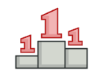
SINGLETON PATTERN

Slide 45
Singleton
Intent
  A pattern which ensure that a class has only one instance and provide a global access point to this instance.
Problem
Ensures that a class has only a single instance.
  The most common reason for this is to control some shared resource, for example, database.
Provides global access point to that instance.

Slide 46
Solution
All singleton implementations share two common steps:
  Making the default constructor private.
  Creating a static creation method that will act as a constructor.
Singleton keeps the single instance production code in one place—inside the creation method of a Singleton class.
Any client code that has access to Singleton class gets the access to its creation method as well
  gives us a global access point to the Singleton instance

Slide 47
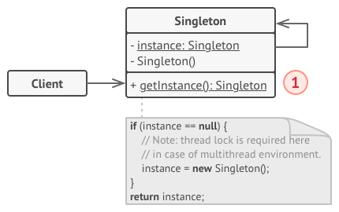

Slide 48
Singleton Pattern
Has Multiple Approach to implement
Use Cases
  Used for logging, driver objects, caching and thread pool.
  Used in other design patterns like Abstract Factory, Builder, Prototype, Facade etc.
  Singleton design pattern is used in core java classes
  java.lang.Runtime, java.awt.Desktop.
Common concept of different approaches of this Pattern
  private constructor to restrict instantiation from other classes.
  private static variable of the same class that is the only instance of the class.
  public static method that returns the instance of the class, this is the global access point for outer world

Slide 49
Eager Initialization
Pros
  The instance is created at the time of class loading
  easiest method to create a singleton class
  When the class is not using a lot of resources
Cons
  Instance is created even though client application might not be using it.
  Also this method doesn’t provide any options for exception handling.

Slide 50
Eager Initialization
  public class Singleton {
  private static final Singleton instance = new Singleton();
  private Singleton() { }
  public static getInstance(){
  return instance;
  }
  }

Slide 51
Lazy Initialization
Creates the instance in the global access method.
More suitable in single threaded environment
In a multithreaded systems
  If multiple threads are inside the if loop at the same time.
  It will destroy the singleton pattern and both threads will get the different instances of singleton class.

Slide 52
Lazy Initialization
  public class Singleton {
  private static Singleton instance;
  Private Singleton() { }
  public static Singleton getInstance(){
  if(instance == null){
  instance = new Singleton();
  }
  return instance;
  }
  }

Slide 53
Static block initialization
Similar to eager initialization
  Instance is created in the static block
  Static block has option for exception handling
  the instance is created even before it’s being used
  Not the best practice to use.

Slide 54
Static block initialization
  public class StaticBlockSingleton {
  private static StaticBlockSingleton instance;
  private StaticBlockSingleton(){}
  static{
  try{
  instance = new StaticBlockSingleton();
  }catch(Exception e){
  throw new RuntimeException("Exception occured in creating
  singleton instance");
  }
  }
  public static StaticBlockSingleton getInstance(){
  return instance;
  }
  }

Slide 55
Thread Safe Singleton
A thread-safe singleton class is created by making the global access method synchronized
  it reduces the performance because of cost associated with the synchronized method, although we need it only for the first few threads who might create the separate instances
To avoid this extra overhead every time, double checked locking principle is used.
In this approach, the synchronized block is used inside if condition with an additional check to ensure that only one instance of singleton class is created.

Slide 56
Thread Safe Singleton
  public class ThreadSafeSingleton {
  private static ThreadSafeSingleton instance;
  private ThreadSafeSingleton(){}
  public static synchronized ThreadSafeSingleton getInstance(){
  if(instance == null){
  instance = new ThreadSafeSingleton();
  }
  return instance;
  }
  }

Slide 57
Double checked locking
  public static ThreadSafeSingleton getInstanceUsingDoubleLocking(){
  if(instance == null){
  synchronized (ThreadSafeSingleton.class) {
  if(instance == null){
  instance = new ThreadSafeSingleton();
  }
  }
  }
  return instance;
  }

Slide 58
STRUCTURAL PATTERN

Slide 59
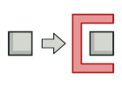
PROXY PATTERN

Slide 60
Proxy Pattern
  proxy pattern is used when we want to provide controlled access of a functionality.
used to represent a complex with a simpler one.
If creation of object is expensive, its creation can be postponed till the very need arises and till then, a simple object can represent it.
This simple object is called the “Proxy” for the complex object
The Proxy holds reference to the RealObject ,Clients interact with the realObject through the proxy .
Because both the proxy and RealObject implement the same interface .
The Proxy can be substituted where Subject can be requested

Slide 61
Proxy Pattern
The participants classes in the proxy pattern are:
Subject
  Interface implemented by the RealSubject and representing its services.
  The interface must be implemented by the proxy as well so that the proxy can be used in any location where the RealSubject can be used.
Proxy
  Maintains a reference that allows the Proxy to access the RealSubject.
  Implements the same interface implemented by the RealSubject so that the Proxy can be substituted for the RealSubject.
  Controls access to the RealSubject and may be responsible for its creation and deletion.
  Other responsibilities depend on the kind of proxy.
RealSubject - the real object that the proxy represents.

Slide 62
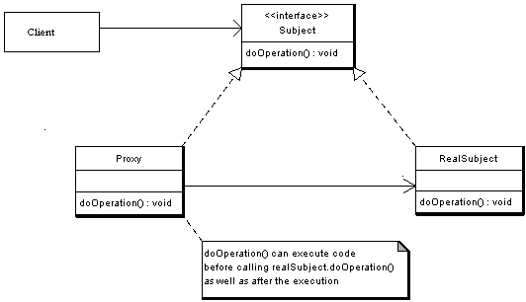

Slide 63
Proxy Pattern
public interface Subject {
public void request();
}
public class RealSubject implements Subject {
public void request() {
System.out.println("Hello From Real Subject");
}

Slide 64
The Proxy Class
  public class ProxySubject implements Subject {
  Subject sub;
  public void request() {
  sub = new RealSubject();
  sub.request();
  }
  }

Slide 65
Test the Proxy
  public class TestProxy {
  public void callProxy(Subject sub)
  {
  sub.request();
  }
  public static void main(String[] args) {
  ProxySubject pxySub = new ProxySubject();
  TestProxy tpxy = new TestProxy();
  tpxy.callProxy(pxySub);
  }

Slide 66
BEHAVIORAL PATTERN

Slide 67
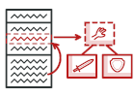
STRATEGY PATTERN

Slide 68
Strategy pattern
Intent
  Define a family of algorithms, encapsulate each one, and make them interchangeable.
  Strategy lets the algorithm vary independently from the clients that use it.
  Capture the abstraction in an interface, bury implementation details in derived classes
Also known as Policy Pattern.
Example :
Collections.sort() method that takes Comparator parameter.
Based on Comparators the Objects are getting sorted in different ways,

Slide 69
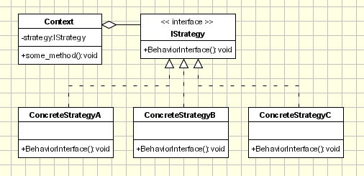
Strategy pattern

Slide 70
Strategy pattern Implementation
Strategy
  defines an interface common to all supported algorithms.
  Context
    Uses to call the algorithms defined by concrete strategy
    Contains the reference to a Strategy Object
  Concrete Strategy
    each concrete strategy implements an algorithm.
    If necessary, addition objects can be defined to pass data from context object to strategy.

Slide 71
Strategy and Concrete Strategy
Strategy
  public interface PaymentStrategy {
  public void pay(double amount);
  }
Concrete Strategy
  public class CardPayment implements PaymentStrategy {
  public void pay(double amount) {
  System.out.println("Received Payment through Card");
  }
}

Slide 72
Context
  public class Patient {
  private PaymentStrategy strategy;
  private double amount;
  public Patient(double amount) {
  super();
  this.amount = amount;
  }
  public PaymentStrategy getStrategy() {
  return strategy;
  }
  public void setStrategy(PaymentStrategy strategy) {
  this.strategy = strategy;
  }
  public void makePayment(){
  strategy.pay(4500);
  }
  }

Slide 73
Client
  public static void main(String[] args) {
  Patient p1 =new Patient(4500);
  Patient p2 =new Patient(3500);
  p1.setStrategy(new CashlessPayment());
  p1. makePayment();
  p2.setStrategy(new CardPayment());
  p2. makePayment();
  }

Slide 74
Client
  public class Client {
  public static void main(String[] args) {
  SelectionProcess company1 = new RamInfoSelection();
  company1.judgeCandidate();
  SelectionProcess company2 = new ShyamInfoSelection();
  company2.judgeCandidate();
  }
  }

