Slide 1

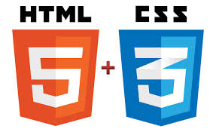
Tim Berners-Lee

Slide 2
UI Developer
Responsible to translate creative software design concepts and ideas into reality using front end technology
The task of a user experience designer is to design and create a software interfaces by prioritizing Users and business requirements over technology limitations and constraints.
  screens keyboards, sounds,
Knowledge Required
  HTML5
  JavaScript
  CSS/SCSS
  Ajax
  Advance Developers can hava React/Angular/Typescript

Slide 3
UX Designer
The user experience is how a user interacts with and experiences ease of use, and efficiency.
The sequence of actions they take as they interact with the interface
The thoughts and feelings that arise as they try to accomplish their task
The impressions they take away from the interaction
Create prototypes and wireframes.
  Conduct usability testing
Knowledge Required
  PhotoShop
  Wireframe Tools
  Animation Tools
  Creative Background

Slide 4
Modern UI Technologies
HTML
Javascript / Typescript
CSS
WebPack and Bundling
Ajax and Async Programming

Slide 5
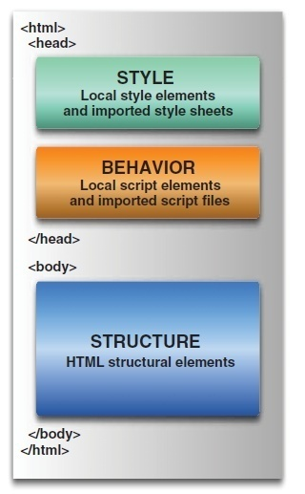
Web page

Slide 6
What is HTML
Hypertext Markup Language.
Based on the Standard Generalized Markup Language (SGML)
Defines a set of common styles for web pages:
  headings, paragraphs, lists, and tables.
  defines character styles such as boldface
These styles are indicated inside HTML documents using tags.
  <h1>Hello World</h1>
HTML element encompasses opening tag, closing tag, content

Slide 7
Evolution of HTML
Tim Berners-Lee made major contribution in Creating HTML in 1989
He Founded the W3C , refined and updated HTML with HTML4 in 1997.,
Growing need for richer Web content
  audio, video and interactivity ,Plug-in applications such as Flash
Web Hypertext Application Technology Working Group (WHATWG) in 2004,
  Created with the involvement of Apple, the Mozilla Foundation and Opera
In 2006 WHATWG developed the new standard named HTML5
  released in 2008, web browsers have increasingly incorporated the new standard

Slide 8
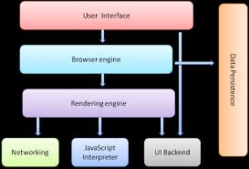
Browser Structure

Slide 9

Rendering Engine
By default, display only HTML, XML and image.
Beyond above things, we need extension/Add-on/Plug-ins
Also called as Layout Engine
Rendering Engine
  Chrome and Opera : Blink
  Chrome (iPhone) & Safari : WebKit
  Firefox : Gecko
  IE : Trident

Slide 10
What is HTML5?
Latest standard for HTML.
Designed to replace both HTML 4, XHTML, HTML DOM Level 2.
Designed to deliver rich content without the need for additional plugins.
Animation to graphics, music to movies, and can also be used to build complicated web applications.
Cross-platform.
It is designed to work with PC, or a Tablet, a Smartphone, or a Smart TV.

Slide 11
Page Simplification
HTML5 has made some simplifications to the page:
The new doctype is simply: <!DOCTYPE HTML>.
  The doctype is specified to ensure that browsers render the page in standards mode; the statement is case-insensitive.
The character set is simply declared with:
<meta charset="UTF-8">.
  This tells the browser to use the UTF-8 character encoding, ensuring that the browser won't display characters as gibberish.
The type attribute is no longer required on <style> and <script> tags.
  The default types are CSS and ECMAScript, respectively.

Slide 12
Structuring HTML
HTML defines page's overall structure
  <html>
  <head>
  <body>
These tags don't affect what the page looks like when it's displayed;
Helps the tools that interpret or filter HTML files.
Meta Tags
  View Port :
    Added to Ensure rendering and Touch Zooming
  X-UA-Compatible
    To choose the version of Internet Explorer the page should be rendered as IE7,IE8 or Edge
  Initial-Scale
    The initial zoom level for the page when its opened in browser

Slide 13
Basic HTML
<!DOCTYPE html>
<html lang="en">
<head>
<meta charset="UTF-8">
<meta http-equiv="X-UA-Compatible" content="IE=edge">
<meta name="viewport" content="width=device-width, initial- scale=1.0">
<title>Document</title>
</head>
  <body>
  <header>
  <h1> HTML 5 and CSS 3</h1>
  </header>
  </body>
  </html>

Slide 14
HTML Global Attributes
Global attributes may be specified on all HTML elements
Class
  Specifies one or more classnames for an element (refers to a class in a style sheet)
Id
  Specifies a unique id for an element
Style
  Specifies an inline CSS style for an element
Accesskey
  specifies a shortcut key to activate/focus an element
Tabindex
  Specifies the tabbing order of an element
Title
  Specifies extra information about an element

Slide 15
<link>
TO link document to other resources.
The destination of the link(s) is given by the href attribute
The types of link indicated (the relationships) are given by the value of the rel attribute
The possible supported tokens are icon, stylesheet.
  Should only include the tokens from this list that the user agent implements the processing model for.

Slide 16
Headings
Headings are used to add titles to sections of a page
. HTML defines six levels of headings.
  <h1>Installing Your Safety Lock</h1>
The numbers indicate heading levels (H1 through H6).
They're displayed in larger or bolder text, are centered or underlined, or are capitalized so that they stand out from regular text.

Slide 17
Paragraphs
<p> tag was used to indicate the end of a paragraph and not the beginning.
Multiple <P>'s do not create blank lines
Use <BR> for blank line
Fully-specified text uses <P> and </P> ,but </P> is optional

Slide 18
List Tags- Unordered List
List tags begin and end the entire list.
This will create a list with bullets next to the list items.
The is <ul> ... </ul>.
To set off each item in list, the <li> tag, followed by text, then close each list item with the </li> tag.
<ul type=“disc”>
<li>I am item one</li>
<li>I am item two</li>
</ul>
The type attribute to specify the type of bullets to be used in the list.
  disc, circle, square

Slide 19
List Tags- Ordered List
Ordered List
Created using <ol></ol>,
<ol>
<li>Item 1</li>
<li>Item 2</li>
<li>Item 3</li>
</ol>
Ordered List can also be specified with type , to use uppercase Roman numerals,
<ol type="I">
<li>Roman I</li>
<li>Roman II</li>
</ol>
“1” , “A”,”a”,”I” are the possible value for the type

Slide 20
Comments
Comments in HTML pages to describe the page itself or to provide some kind of indication of the status of the page.
Text in comments is ignored when the HTML file is parsed;
Comments don't ever show up on screen
  <!-- This is a comment -->

Slide 21
Creating Links
<a href="http://www.someplace.com">Display Text</a>
“a” stands for anchor, and the href="" is asking for a location to link to. The </a> is the closing tag.
The text between the tags is what will show up on your Web page as a link.
"local url".
  Any file for which the to create a local url link , the file should be in the same directory as the page you are editing.
  <a href="linking.htm">Linking to Other Pages</a>

Slide 22
Horizontal Rules & Line Break
The <hr> tag, which has no closing tag in HTML and no text associated with it, creates a horizontal line on the page.
Rule lines are used to visually separate sections of a web pagejust before headings,
  To separate body text from a list of items.
Line Break
The <br> tag breaks a line of text at the point where it appears.
When a web browser encounters a <br> tag, it restarts the text after the tag at the left margin

Slide 23
Physical Character Style
    <H1>Physical Character Styles</H1>
    <B>Bold</B><BR>
    <I>Italic</I><BR>
    <U>Underlined</U><BR>
    Subscripts: f<SUB>0</SUB> + f<SUB>1</SUB><BR>
    Superscripts: x<SUP>2</SUP> + y<SUP>2</SUP><BR>
    <SMALL>Smaller</SMALL><BR>
    <BIG>Bigger</BIG><BR>
    <STRIKE>Strike Through</STRIKE><BR>

Slide 24
Inline Images in HTML: The <img> Tag
Inline images are placed in HTML documents using the <img> tag.
Adding Alternative Text to Images
When client cannot present then there is graceful degradation
  Providing an alternative version or making the user aware of shortcomings of a product as a safety measure to ensure that the product is usable
<img src="myimage.gif" alt=“picture of a cat" />

Slide 25
Images and Links
Image can serve as a link
Add an <img> tag inside a link tag (<a>), that image serves as a link itself:
<a href="index.html"><img src="uparrow.gif" alt="Up" /></a>
Both an image and text in the link tag, they become links to the same page:
<a href="index.html">
  <img src="uparrow.gif" alt="Up" />Up to Index</a>

Slide 26
<A> Anchors (HyperLinks)
Link to an absolute URL:
  If you get spam, contact
  <A HREF="htttp:www.microsoft.com“>Microsoft </A> to report the problem.
Link to a relative URL:
  See these <A HREF="#references"> references </A>
  concerning our fine products.
Link to a section within a URL:
  Amazon provided a <A HREF="www.amazon.com/#reference">
  reference for our company. </A>

Slide 27
Naming a Section
You can link to another part of the same web page by adding an id attribute to almost any HTML tag, and then link to it by adding a pound sign (#) at the beginning of where the destination url goes
Clicking on the link will take you to the HTML element with that id.
<p id="part16">
Part 16
HTML Made Easy
</p>
<a href=“#part16”>software Required</a>

Slide 28
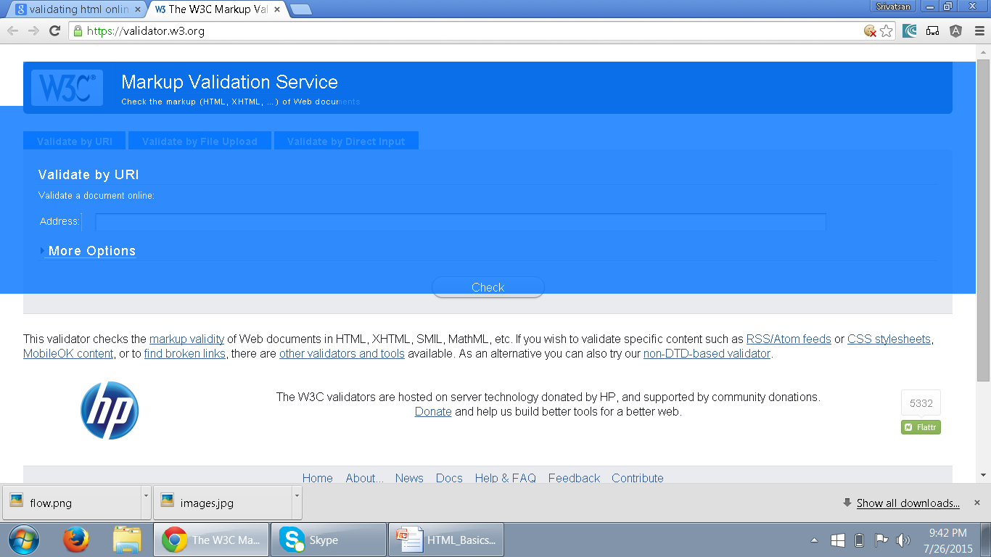
Validating HTML
The validator service checks the markup validity of Web documents in HTML, XHTML, SMIL, MathML, etc
https://validator.w3.org/
.

Slide 29
Cascading StyleSheets (CSS)
The Goal of HTML was to create content for a web page.
  CSS is a W3C Specification
From HTML 4.0
  Only CSS is used for all formatting
  It can also be added from a separate external .css file.

Slide 30
CSS Usage
Specify point size and font of text;
Set margins within a web page;
Create a distinctive style for individual web pages or sets of web pages;
Format style to one element of a web page or to a numerous pages;
Control color of different elements of a web page;

Slide 31
Style Rule
A Style Rule is composed of two parts: a selector and a declaration.
TH {color: red;}.
The Selector indicates the element to which the rule is applied.
The Declaration determines the property values of a selector.
  Property specifies a characteristic
    color, font-family, position
  Value expresses specification of a property
    RED for color, 12 pt for font-size
    {color: red;}
Selector
Declaration
Value
Property

Slide 32
External Style Sheet
Can also expressed in an external Style Sheet
    Used to apply styles to number of pages
External Style Sheet has a .css extension.
<link rel="stylesheet" type="text/css" href=“my_style.css" />
href:
  URL Specifies the location of the linked document
rel
  Specifies the relationship between the current document and the linked document
  Author,Icon,external,Help,search,sidebar,stylesheet

Slide 33
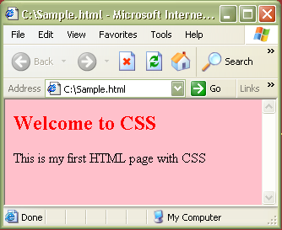
CSS – External StyleSheet Example
<html>
<link rel="stylesheet" type="text/css" href=“my_style.css" />
<h2> Welcome to CSS </h2>
<body> This is my first HTML page with CSS </body>
</html>
Sample.html
Path to the .css file
h2 {color:red}
body {background-color:pink}
my_style.css
Output:

Slide 34
CSS – Internal StyleSheet
Included in the head section of HTML page
    <style> tag is used to hold the values for formatting
Can contain <type> attribute with a value “text/css”
Style that can be applied to a page that needs a unique format.

Slide 35
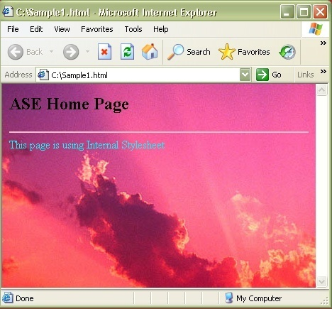
CSS – Internal StyleSheet Example
<html>
<head>
<style type="text/css">
hr{color:pink}
body {background- image:url(‘images\Sunset.jpg')}
</style>
</head>
<hr>
<body>
<h2> Home Page</h2>
<p>This page is using Internal Stylesheet</p>
</body>
</html>

Slide 36
CSS – Inline StyleSheet
    style attribute is used in the relevant tag.
    style attribute can contain any CSS property.
    <html>
    <p style="color:blue">This is a example of inline stylesheet</p>
    </html>

Slide 37
Working with Tables

Slide 38
<table> - Element
To tabulate data in columns and rows as in a spreadsheet
Used for displaying tabular data.
Its inappropriate to use tables for layout.
  <table>
  <tr>
  <th>Name</th>
  <th>ID</th>
  </tr>
  <tr>
  <td>Ramesh</td>
  <td>10000</td>
  </tr>
  </table>

Slide 39
Table
Two Elements are used to create data within each row
<th>...</th>
  Used for heading cells.
  Browsers center the contents
  text is rendered in the boldface.
<td>...</td>
  Used to render table data.

Slide 40
Basic Styling With CSS
Width
  Can be applied to individual cells <th> or <td>
  width attribute in cells can be pixel or a percentage
  Useful when multiple columns of identical widths, regardless of their contents
border-collapse
  To specify whether a table's borders are separated
  cells can have distinct borders from each other
  Adjacent cells can share borders.
  border-collapse: collapse;
  border-collapse: separate;

Slide 41
Padding
Padding :
  sets the padding area on all four sides of an element.
  A shorthand that sets all individual paddings at once:
  padding-top, padding-right, padding-bottom, and padding-left.
  Can be used to defines the amount of space between the edges of the cells and the content inside a cell.
one value : Same padding to all four sides.
two values : top and bottom, left and right.
three values : top, left and right, bottom.
four values : top, right, bottom, and left

Slide 42
Basic Styling With CSS
border
  A shorthand property for setting following property values
  Any value that is not specified is set to its corresponding initial value.
  border-width,
  border-style,
  border-color.
border: 1px;
border: 2px dotted;
border: medium dashed green;

Slide 43
Basic Styling
  table{
  border: 2px solid blue;
  border-collapse:collapse;
  }
  th,tr,td{
  border: 2px solid blue;
  }
  td{
  padding:0px 10px 0px 10px;
  width: 30px;
  }

Slide 44
Head and Body
<thead>
  Can semantically indicate that the first row was the header of the table.
  must appear after any <caption> element
  Must appear before any <tbody>, <tfoot> and <tr> element
<tfoot>
  defines a set of rows summarizing the columns of the table.
  Can be used as a child of a <table> element, after any <caption>, and <thead>
  Can be used before any <tbody> and <tr> elements.
.

Slide 45
colSpan and rowSpan
Create a cell that spans multiple rows or columns
  Can be added to both <th> or <td>
The data within that cell then fills the entire width or length of the combined cells
rowspan
  similar to colspan,
  it will span across rows rather than columns.

Slide 46
Table Example
  <table>
  <caption>Conference Schedule</caption>
  <thead>
  <tr>
    <th>Item Number</th>
    <th>Item Name</th>
    <th>Quantity</th>
    <th>Rate</th>
    <th>Amount</th>
  </tr>
  </thead>

Slide 47
Table Example
  <tbody>
  <tr>
    <td>101</td>
    <td>Cake</td>
    <td>1</td>
    <td>200</td>
    <td>200</td>
  </tr>
  </tbody>
  <tfoot>
        <tr>
        <td colspan="4">Total</td>
        <td>200</td>
        </tr>
  </tfoot>
  </table>

Slide 48
Basic Styling
  table{
  border: 2px solid blue;
  border-collapse: collapse;
  margin: auto;
  }
  thead {
  background-color: grey;
  }
  tfoot {
  background-color: lightgray;
  }
  caption{
  font-style: 'Arial';
  }
  tr,td {
  border: 2px solid blue;
  text-align: center;
  }

Slide 49
Semantic markup
HTML is oriented towards design
  element in it should have well-structured content.
Semantic markup :
  self-describing and uses the correct HTML elements for the correct job.
  <div id="heading" style="font-size:300%; padding: 10px;">
  My heading
  </div>
Its not heading in terms of meaning or purpose.

Slide 50
Advantage of Semantic Markup
Search engine optimization
  keywords in headings have more weight,
Accessibility
  screen readers use heading elements as navigational signposts
Development
  it is a lot trickier to target elements with styles and scripts when you don't use proper semantic elements
Lightweight
  removing all those nested <divs> and other spaghetti code.
This makes file sizes smaller and coding easier.

Slide 51
Structural Elements
Elements that are replacements for the common ad hoc semantics applied using class and id attributes
Header
  Header content for a page or a section of page
Footer
  footer content for a page or a section of the page
Section
  A section in a web page
Article
  Independent article content
Aside
  Related content or pull quotes
nav
  Navigational aids

Slide 52
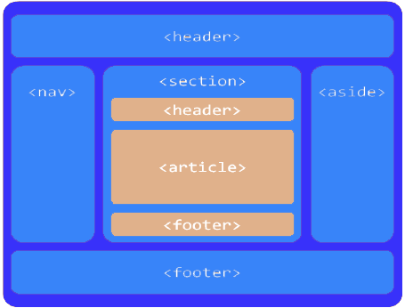
Page Layout

Slide 53
Example
  <div id="main">
  <div id="primary">
  <article>
  </article>
  </div>
  <div id="content">
  <article>
  <aside></aside>
  </article>
  </div>
  </div>

Slide 54
<nav> Element
The nav element stands for Navigation.
  “A section of a page that links to other pages or to parts within the page: a section with navigation links.”
Usage is not limited to only the primary navigation, typically at the top of the web page.
Can also be used on any part of the page that also acts as a navigator,

Slide 55
Example
  <body>
  <div id="wrapper">
  <header>
  <h1>HTML5 Document Structure Example</h1>
  <nav id="navigation">
  <ul id="nav-list">
  </ul>
  </nav>
  </header>

Slide 56
HTML
FORM HANDLING

Slide 57
New Global Attributes
Contenteditable
  Whether the contents of the element is editable or not
  Values can be true or false
draggable
  whether the element is draggable.
  Values can be true or false
hidden
  Specifies that the element represents an element that is not yet, or is no longer, relevant.
  Value can be "hidden" or empty string
spellcheck
    Elements contents are subject to spell checking and grammar checking.
  Values can be true or false

Slide 58
Using the <form> Tag
To accept input from a user, input fields are placed inside a <form> tag.
Its purpose is to indicate where and how the user's input should be sent.
The two most commonly used attributes of the <form> tag are
  Action
  method.
Both of these attributes are optional.
  <form action="someaction" method="get or post">
  </form>
Action specifies the URL to which the form is submitted.

Slide 59
Creating Form Controls with the <input> Tag
Text Boxes
These tags allows the user to enter a single line of text.
<input type="text" name="yourname" size="25" maxlength="60" />
The type=" "
  specifies the type of input we want from the user, the type is "text".
The name=" "
  attribute is name of the line of text to be recognized when the form is submitted

Slide 60
label
Defines a label for an <input> element.
Usability improvement for mouse users, because if the user clicks on the text within the <label> element, it toggles the control.
The for attribute of the <label> tag should be equal to the id attribute of the related element to bind them together.
  <label for="email">EMAIL-ID</label>
  <input type="email" value="" name="emailid" size="30" placeholder="Enter a valid email address“ id=“email”>

Slide 61
Creating Password Controls
The password and text field types are identical in every way except that the data entered in a password field is masked
  <p>
  Enter your password:
  <input type="password" name="userpassword" size="8" maxlength="8" />
  </p>

Slide 62
Text Areas
used to create text area where lines of text could be inserted
<textarea name="comments" rows="5" cols="30"></textarea>
The name=" “
  assigns a name to the textarea,
The rows=" "
  To specify how many vertical rows the textarea will take up on the page.
The cols=" "
  To specify the horizontal width of the textarea in characters.

Slide 63
Radio Buttons
<input type="radio" name="foodchoice" value="pizza" />
This will create little button for people to click on to highlight it:
The name=" "
  To name the section of choices.,If its group all the button share the same value
The value=" “
  To assign the value of the individual button when it is selected.
  This is going to be the text sent back as the user's choice

Slide 64
Checkboxes
  <input type="checkbox" name="foodchoice" value="pizza" />
A little square is displayed instead of small circle
type="checkbox"
  tells the browser to display the little box.
name=" "
  allows to give the section of choices a name,
value=" "
  allows to give the individual checkbox its value

Slide 65
Drop-Down Menus
They are created with the <select> tag:
  <select name="bestcolor">
  <option selected="selected">blue</option>
  <option>red</option>
  <option>black</option>
  <option>green</option>
  <option>polka dots!</option>
  </select>
<option selected="selected">
  To specify which option will be displayed as the default value on the screen.
<option>
  To add another choice to the list.

Slide 66
Creating Submit Buttons
Submit buttons are used to indicate that the user is finished filling out the form.
Submit button is displayed with the text “Submit Query. “
value attribute used enter custom label,
  <input type="submit" value="Send Form Data" />
Creating Reset Buttons
Reset buttons set all the form controls to their default values.
  <input type="reset" value="Clear Form" />

Slide 67
Creating Generic Buttons
<input type="button" name="verify" value="verify" onclick="verifydata()" />
Button can be created such a way it runs a function when clicked
Label for the Button is provided with the value attribute
Unlike Submit buttons, regular buttons don't submit the form when they're clicked.

Slide 68
Hidden Form Fields
Hidden form fields are used when you want to embed data in a page that shouldn't be seen or modified by the user.
The name and value pair associated with a hidden form field will be submitted along with the rest of the contents
<input type="hidden" name="id" value="1402" />
Hidden form fields are generally used when data identifying the user needs to be included in a form.

Slide 69
Search
Provides a search field—a one-line text input control for entering one or more search terms.
The difference is primarily stylistic:
Browsers have added the ability to clear the input with the click of a mouse, by providing an x icon once text is entered into the field.

Slide 70
Email Addresses
Used for specifying one or more email addresses.
It supports the Boolean multiple attribute, allowing for multiple, comma-separated email addresses.
<input type="email" id="email" name="email“ multiple=“multiple”>
The change becomes apparent if you’re using an iOS device.
When you focus on the email field, the iPhone, iPad, and iPod will all display a keyboard optimized for email entry (with a shortcut key for the @ symbol),

Slide 71
Dates and Times
There are several new date and time input types,
  date, datetime, datetime-local, month, time, and week.
date
  This comprises the date (year, month, and day), but no time; for example, 2004-06-24.
month
  Only includes the year and month; for example, January 2015.
week
  This covers the year and week number (from 1 to 52); for example, Week 3 2015

Slide 72
The required Attribute
The Boolean required attribute tells the browser to submit the form if the field in question is filled out correctly.
The focus will move to the first invalid form element.
Default error messages are shown on the page
<input type="text" title="First Name should not be blank" name="firstName“ required="required“ />

Slide 73
Place Holder Attribute
To show a short hint inside the form element, space permitting,
Text disappears when the field gains focus, and reappears on blur if no data was entered
  <label for="url">My website is located at:</label>
  <input type="text" id="url" name="url“
  placeholder="http://example.com">
  </li>
Can also be Styled with CSS
input::-webkit-input-placeholder { color: #ccc; }

Slide 74
The disabled Attribute
Can be used with any form control except the output element
If set on a fieldset apply to all the contained form elements
They aren’t submitted along with the form to the server side
<button disabled="disabled">Register</button>

Slide 75
The readonly Attribute
Similar to the disabled attribute: it makes it impossible for the user to edit the form field.
Unlike disabled, however, the field can receive focus, and its value is submitted with the form.
Used to let the user know that we are collecting this data without allowing them to change it:
  <label for="about">Article Title</label>
  <input type="text" name="about" id="about" readonly=“readOnly”/>

Slide 76
The multiple Attribute
Used to indicate that multiple values can be entered in a form control.
In HTML5, apart from Select it can be added to email and file input
Can include several comma-separated email addresses.
<input type="email" name="email" multiple="multiple" />

Slide 77
formaction
Similar to action attribute of <form> element.
used to send the data through the URL,
overrides the action attribute of the form element.
Can be used with submit and image
  <input type="submit“
  formaction="demo_admin.php"
  value="submit as Admin“>
<input type="submit" formmethod="post" formaction="demo_post.php">

Slide 78
CSS and CSS3

Slide 79
Style Classes
Created to control which elements of a given type should use a style rule.
  In the style sheet, the selector defines the class name, which is preceded by a period.
  In the HTML, the tag includes the class attribute and specifies the value of the class name
A class name should be descriptive of the purpose (such as nav, news, footer, and so on) rather than being descriptive of the presentation (such as redText).
a.anchorStyle { text-decoration : none }
<a class="anchorStyle" href="somepage.html">Link text</a>

Slide 80
Style Classes
Style classes can also be “generic,” i.e. not tied to a specific element type.
  .mytag {
  font-size: 23px;
  background: gray;
  }
  .urtag
  {
  font-size: 32px;
  background: fuchsia;
  }

Slide 81
Using the CSS
  <head>
  <link href="MyFirstCss.css" type="text/css" rel="stylesheet">
  </head>
  <body>
  <div class="mytag">
  <p> Using Div Tag in CSS</p>
  <div class="urtag">
  <p> Using Second Tag in the list</p>
  </div>
  </div>

Slide 82
Cascading Rule
If two equally specific rules can apply to the same element, the one that comes last in the style sheet is used.
Thus, in the example below, a:hover must follow a:link and a:visited in order to have effect, since a link can be both visited (or not) and hovering.
The order of the first two doesn’t matter since they are mutually exclusive.
a:link { color : red }
a:visited { color : green }
a:hover { color : yellow }

Slide 83
Css class definition
<div class="general-div">some stuff</div>
<div class="general-div special">some stuff</div>
<div class="general-div">some stuff</div>
<div class="extra-div">some stuff</div>
<div class="extra-div special">some stuff</div>
.general-div {width: 300px; height: 300px; border: 1px solid #000;}
.extra-div {width: 200px; height: 200px; border: 1px solid #666;}
.general-div.special {background-color: red;}
.extra-div.special {background-color: blue;}
.general-div with .special class to have red background,
extra-div with .special class to have a blue background.

Slide 84
Block-Level Elements
A block level element in HTML create a “block” or “box”.
Browsers typically display the block-level element with a new line.
Block level elements may contain inline elements and other block-level elements.
The block level elements create “larger” structure than inline elements.

Slide 85
List of Block-Level Elements
<address> Contact information | <figcaption> (HTML5) Figure caption | <ol> Ordered list
<article>(HTML5) Article content | <figure>(HTML5) Groups media content with a caption | <output>(HTML5) Form output
<aside>(HTML5) Aside content | <footer>(HTML5) Section or page footer | <p> Paragraph
<audio>(HTML5) Audio player | <form> Input form | <pre> Preformatted text
<blockquote> Long (“block”) quotation | <h1><h2><h3><h4><h5><h6> Heading levels 1 - 6 | <section>(HTML5) Section of the page
<canvas>(HTML5) Drawing canvas | <header>(HTML5) Section or page header. | <table> Table.
<dd> Definition description | <hgroup>(HTML5) Groups header information | <tfoot> Table footer
<div> Document division | <hr> Horizontal rule (dividing line) | <ul> Unordered list
<dl> Definition list | <fieldset> Field set label | <video>(HTML5) Video player

Slide 86


Inline Elements
.norm {
color:red;
}
.big {
color:blue;
font-weight:bold;
}
.italicText {
color:green;
font-style:italic;
}
#row1 {
padding:10px;
border:solid 1px #000;
}
<div id="row1" >
<span class="norm">This is small text and </span>
<span class="big">this is big</span>
<span class="italicText"> I am Italic</span>
</div>

Slide 87
CSS Display properties
Display
  The display property configures how and if an element is displayed.
An element configured with:
  display:none ;
    will not be displayed
    and does not occupy any space
    used when configuring styles to print a web page
  display:block ;
    will be rendered as a block element – a line break above and below (even if it is actually an inline element, such as an anchor tag).
  display:inline;
    The element will be rendered as an inline element – no line break above and below (even if it is actually a block element – such as a <li>).

Slide 88
Changing How an Element is Displayed
Changing an inline element to a block element, or vice versa, can be useful for making the page look a specific way, and still follow web standards.
The following example displays <li> elements as inline elements:
Example
li {
display: inline;
}
Example
span {
display: block;
}

Slide 89
COMMENTS IN CSS
<style>
/*
p {
font-family: sans-serif;
font-size: 15pt;
}
*/
</style>

Slide 90
SELECTORS

Slide 91
CSS Selectors
Selectors are at the heart of CSS.
CSS allowed the matching of elements by type, class, and/or id.
CSS2.1 added pseudo-elements, pseudo-classes, and combinators.
With CSS3, we can target almost any element on the page with a wide range of selectors.

Slide 92
Universal Selector
* {
margin: 0;
padding: 0;
}
The star symbol will target every single element on the page.
Used to zero out the margins and padding.
It adds too much weight on the browser

Slide 93
Select by Id
#container {
width: 960px;
margin: auto;
}
Prefixing the hash symbol to a selector allows us to target by id.
Most common usage
id selectors are rigid and don't allow for reuse.
Can use a pseudo-class.

Slide 94
Class Selector
.error {
color: red;
}
This is a class selector.
The difference between ids and classes is that, with the latter, you can target multiple elements.
Use classes when you want your styling to apply to a group of elements.

Slide 95
Selector Grouping
Can be grouped using a comma (,) separator.
Any element that matches either of the selectors in the group:
td, th { ⋮ declarations }
  Similar to the logical OR operator,
  but it’s important to remember that each selector in a group is autonomous.
#foo td, th { ⋮ declarations }
#foo td { ⋮ declarations } th { ⋮ declarations }

Slide 96
Compound Selectors
Compound selectors are more specific than simple selectors.
For instance, if a style sheet defines both
p { color : red }
div p { color : blue }
Then for a <p> tag that is inside a <div> element, the second rule would apply.

Slide 97
Attribute Selector
a[title] {
color: green;
}
Select the anchor tags that have a title attribute.
a[href=“Welcome.html] {
color: green;
}
* appear somewhere in the attribute's value.
^ for Beginning of the String
$ is used for end of the String

Slide 98
Attribute selectors
Attribute selectors selects elements based upon the attributes present in the HTML Tags and their value.
  IMG[src="small.gif"] {
  border: 1px solid #000;
  }
  will work for
  <img src=“small.gif” />

Slide 99
Adjacent Selector
ul + p {
color: red;
}
This is referred to as an adjacent selector.
It will select only the element that is immediately preceded by the former element.
In this case, only the first paragraph after each ul will have red text.

Slide 100
CSS Pseudo-classes
selector:pseudo-class { property: value }
:link
:visited } Link (A tag) related pseudo classes
:hover
:active
:after
:before
:first-child
:focus
:first-letter
:first-line
:lang

Slide 101
CSS-Pseudo classes
Pseudo classes are used to include special effects to some selectors.
Syntax : selector:pseudo-class {property:value}
For example: a:link {color:#00FF00}
CSS classes can be used with pseudo-classes.
Syntax: selector.class:pseudo-class {property:value}
For example: a.red:visited {color:#FF0000}
<a class="red" href=“c:\css_syntax.html">CSS Syntax</a>

Slide 102
CSS-Pseudo classes
Some of the pseudo classes are
  :active Adds a style to an activated element
  :first-child Adds a style to the first element that is the included in another element
  :focus Adds a style to an element that has keyboard input focus
  :hover Adds a style to an element when mouse moves over it
  :lang Adds a style to an element with the specific lang attribute
  :link Adds a style to an unvisited link
  :visited Adds a style to a visited link

Slide 103
Pseudo Class
input[type=radio]:checked {
border: 1px solid black;
}
A user interface element that has been checked
div:hover {
background: #e3e3e3;
}
a:link { color : red }
a:visited { color : green }
a:hover { color: yellow }

Slide 104
CSS3 Psuedo Classes
:last-child
matches an element that’s the last child element of its parent element
:first-of-type
matches the first child element of the specified element type
:last-of-type
matches the last child element of the specified element type
:only-of-type
matches an element that’s the only child element of its type
:root
matches the element that’s the root element of the document
:enabled
matches user interface elements that are enabled
:disabled
matches user interface elements that are disabled

Slide 105
CSS3 Psuedo Classes
:nth-child(N)
matches elements on the basis of their positions within a parent element’s list of child elements
:nth-last-child(N)
matches elements on the basis of their positions within a parent element’s list of child elements
:nth-of-type(N)
matches elements on the basis of their positions within a parent element’s list of child elements of the same type
:nth-last-of-type(N)
matches elements on the basis of their positions within a parent element’s list of child elements of the same type

Slide 106
pseudo Element
CSS classes can also be used with pseudo-elements:
selector.class::pseudo-element {
property:value;
}
:first-letter
represents the first character of the first line of text within an element
:first-line
represents the first formatted line of text
:before
specifies content to be inserted before another element
:after
specifies content to be inserted after another element
::selection
represents a part of the document that’s been highlighted by the user

Slide 107
pseudo Element
P::first-line {
font-weight: bold;
font-size: 1.2em;
}
We can use pseudo elements (designated by ::) to style fragments
Used to target first line, or the first letter.
Applied to block level elements in order to take effect.
P::first-letter {
float: left;
font-size: 2em;
padding-right: 2px;
}

Slide 108
Pseudo-elements
p { text-indent: 1em }
p.initial { text-indent: 0 }
p.initial:first-line { text-transform: uppercase }
p.initial:first-letter { font-size: 24pt }
This indents all normal paragraphs.
A paragraph that is declared with class="initial" is not indented, and its first line appears in all capital letters, with an extra-large first letter.

Slide 109
Box Model
Every block element in CSS is effectively inside a box, and can have margins, padding and borders applied to it.
Box widths can be specified in absolute values (e.g. px) or in relative values,
The root (or top-most) element’s containing box is effectively the browser window.
The main idea is that every element’s layout is composed of:
  the actual element’s content area.
  a border around the element.
  a padding between the content and the border (inside the border)
  a margin between the border and other content (outside the border)

Slide 110
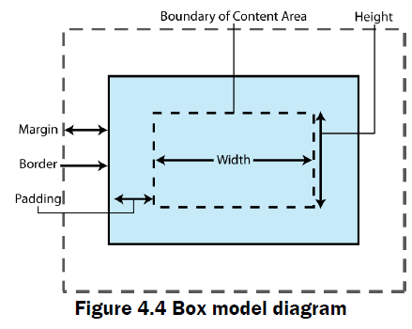

Slide 111
CSS PROPERTIES

Slide 112
Categories of CSS properties
Color
Border
Margin and Padding
Positioning and layout handling related.
Background related properties.
Font and text related
Lists related.
Table related.

Slide 113
color
<p style=“color: red;” >
This text will be written in red.
</p>
Output:
This text will be written in red.
Possible values:
any color name in any valid format.

Slide 114
CSS Colors
Colors in CSS can be specified by the following popular three methods:
Hexadecimal colors
RGB colors
Predefined/Cross-browser color names

Slide 115
Hexadecimal Colors
Supported in all major browsers.
Specified with: #RRGGBB, where the RR (red), GG (green) and BB (blue)
Hexadecimal integers specify the components of the color.
All values must be between 00 and FF.
#0000ff : rendered as blue
  component is set to its highest value (ff) and the others are set to 00.

Slide 116
RGB Colors
Supported in all major browsers.
Specified with: rgb(red, green, blue).
Each parameter (red, green, and blue) defines the intensity of the color
  integer between 0 and 255 or a percentage value (from 0% to 100%).
rgb(0,0,255) rendered as blue
  blue parameter is set to its highest value (255) and the others are set to 0.

Slide 117
Margins & Padding
Margins
  Define the space around elements outside the border
  can have negative values in order to deliberately overlap content
  will affect the position of background elements (graphics and/or colors) in relation to the edges of the containing block element
  can be defined independently on top, right, bottom and left, or all-at-once using CSS shorthand

Slide 118
Margins & Padding
Padding
  Defines the space around elements inside the border;
  i.e between the border and the content itself
  cannot have negative values
  DO NOT affect the position of background elements
  Can be defined independently on top, right, bottom and left, or all-at-once using CSS shorthand

Slide 119
CSS Margins
You can set following margin properties of an element:
  The margin-bottom property specify the bottom margin of an element.
  The margin-top property specify the top margin of an element.
  The margin-left property specify the left margin of an element.
  The margin-right property specify the right margin of an element.
  The margin shorthand property for setting margin properties in one declaration.

Slide 120
margin
<div style=“margin: 20px;”>
This is a paragraph with a specified margin from all sides.</div>
<div style=“margin-top: 10px;”>
This is a paragraph with a specified top margin.</div>

Slide 121
Margin property
<style>
p {margin: 15px; }
all four margins will be 15px
p {margin: 10px 5px; }
top and bottom margin will be 10px, left and right
will be 2% of the total width of doc.
p {margin: 10px 8px 20px 15px; }
top margin will be 10px, right margin will be 2%, bottom
margin will be -10px, left margin will be set by the browser
</style>

Slide 122
CSS Padding
Padding property allows you to specify how much space should appear between the content of an element and its border :
  The padding-bottom property specify the bottom padding of an element.
  The padding-top property specify the top padding of an element.
  The padding-left property specify the left padding of an element.
  The padding-right property specify the right padding of an element.
  The padding shorthand property serves as the preceding properties.

Slide 123
padding
<p style=“padding-bottom: 15px; border-width: 1px solid black;”>
This is a paragraph with a specified bottom padding.</p>
<p style=“padding-top: 15px; border-width: 1px solid black;”>
This is a paragraph with a specified top padding.</p>
<p style=“padding: 15px; border-width: 1px solid black;”>
This is a paragraph with a specified right padding.</p>

Slide 124
CSS Positioning
Relies on CSS properties rather than tables to design a Web page.
  A growing trend is to configure pages using CSS
The technology is for this is called “table-less layout” or CSS-P for CSS Positioning
Even Web sites with so-called “table-less” layouts may include tables to present info in a tabular manner to facilitate design of a small portion of the page.

Slide 125
CSS Positioning
Normal flow causes the browser to render the elements in the order they appear in the HTML/XHTML source code.
Using CSS for page layout the location of elements can be changed.
Cross browser-support positioning is more reliable when the <div> element is used for positioning.

Slide 126
Relative Positioning
Keeps elements in the general flow on the page and offsets them by the specified top, left, right or bottom value of the document area in the browser window
  Use to slightly change the location of an element in relation to where it would otherwise appear in normal flow (for example the left side of the browser window)
  h1 {
  background-color:#cccccc;
  padding:5px;
  color: #000000;
  }
  #myContent {
  position: relative;
  left:30px;
  }

Slide 127
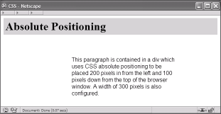
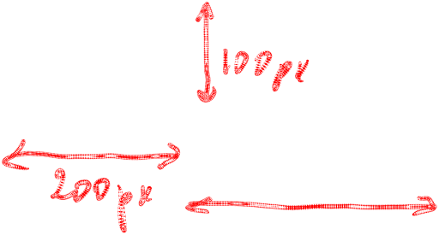
Absolute Positioning
Absolute
  Use to precisely specify the location of an element in the browser window
  Elements rendered outside of normal flow
  h1 { background-color:#cccccc;
  padding:5px;
  color: #000000;
  }
  #content {position: absolute;
  left:200; //from the left margin
  top:100; //down from the top of the browser window
  font-family:Arial,sans-serif;
  width:300;
  }

Slide 128
CSS Font Properties
You can set following font properties of an element:
  The font-family property is used to change the face of a font.
  The font-style property is used to make a font italic or oblique.
  The font-variant property is used to create a small-caps effect.
  The font-weight property is used to increase or decrease how bold or light a font appears.
  The font-size property is used to increase or decrease the size of a font.

Slide 129
Generic Font Family
These are the generic name values for the font-family property, followed by an example of each that the browser might select from the user’s system fonts:
Generic font-family Names | Example
serif | Times New Roman
sans-serif | Arial
cursive | Zapf-Chancery
fantasy | Western
monospace | Courier

Slide 130
font-style
<p style="font-style: italic;">
This text will be rendered in italic style. </p>
Possible Values:
normal, italic, oblique(more slanted than normal)
<p style="font-size: 20pt;">
This font size is 20 pixels.
</p>
Possible values:
px, small, xx-small, x-small, medium, large, x-large, xx-large or in %

Slide 131
font-weight
<p style="font-weight: bold;">
This font is bold.
</p>
Possible values:
normal, bold, bolder, lighter, 100, 200, 300, 400, 500, 600, 700, 800, 900
<p style="font-variant: small-caps;">
This text will be rendered in small caps. </p>
Possible values:
normal, small-caps

Slide 132
@font-face
Can specify online fonts to display text
Provide their own fonts
Eliminates the need to depend on the limited number of fonts users have installed on their computers.
  <style type="text/css" media="screen, print">
  @font-face {
  font-family: "Bitstream Vera Serif Bold";
  src: url("https://mdn.mozillademos.org/files/2468/VeraSeBd.ttf");
  }
  body { font-family: "Bitstream Vera Serif Bold", serif }
  </style>

Slide 133
@font-face
  @font-face {
    font-family: MyHelvetica;
    src: local("Helvetica Neue Bold"), local("HelveticaNeue-Bold"),
    url(MgOpenModernaBold.ttf);
    font-weight: bold;
  }

Slide 134
CSS Text Formatting
You can set following text properties of an element:
  The color property is used to set the color of a text.
  The letter-spacing property is used to add or subtract space between the letters.
  The word-spacing property is used to add or subtract space between the words.
  The text-indent property is used to indent the text of a paragraph.
  The text-align property is used to align the text of a document.

Slide 135
CSS Text Formatting
  The text-decoration property is used to underline, overline and strikethrough text.
  The text-transform property is used to capitalize text or convert text to uppercase or lowercase letters.
  The text-shadow property is used to set the text shadow around a text.
  The white-space property is used to control the flow and formatting of text.

Slide 136
letter-spacing
<p style=“letter-spacing: 5px;” >
This text is having space between letters.
</p>
Possible values:
normal or a number.
<p style=“word-spacing: 5px;” >
This text is having space between words.
</p>
Possible values:
normal or a number.

Slide 137
text-indent
The text-indent property is used to indent only the first line of text within an element.
The default value for this property is 0.
It only applies to block-level elements
<p style=“text-indent: 1cm;” >
This text will have first line indent by 1cm.
and this line will remain at its actual position.
</p>
Possible values:
% or a number.
.

Slide 138
text-decoration
<p style=“text-decoration: underline;” >
This will be underline.
</p>
Possible values:
none, underline, overline, line-through, blink
<p style=“text-transform: uppercase;” >
This will be in uppercase.
</p>
Possible values:
none, capitalize, uppercase, lowercase

Slide 139
CSS Borders
You can set following border properties of an element:
  The border-color property is used to set the color of the border.
  The border-style property is used to set the style of border.
  The border-width property is used to set .
  The border property is used to set the width, style and color of the border in one declaration.

Slide 140
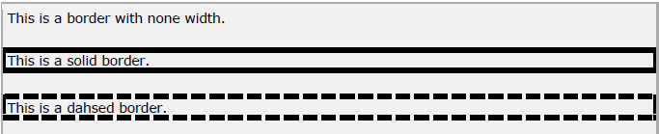
border-style
<p style=“border-style: none”>
This is a border with none width.</p>
<p style=“border-style: solid”>
This is a solid border.</p>
<p style=“border-style: dashed”>
This is a dashed border.</p>
Output:
Possible values:
none, solid, dashed, double, groove, ridge, inset, outset

Slide 141
border-color
<style>
p.example1 {
border-style: solid;
border-bottom-color: #009900;
border-top-color: #FF0000;
border-left-color: #330000;
border-right-color: #0000CC;
}
</style>
<p class=“example1”>
This example is showing all borders in different colors.
</p>
Output:
Possible values:
any color with valid format

Slide 142
border-color
<style>
p.example1 {
border-style: solid;
border-color: #FF0000;
}
</style>
<p class=“example1”>
This example is showing all borders in same color.
</p>
Output:
Possible values:
any color with valid format

Slide 143
border-width
<p style=“border-width: 4px; border-style: solid;”>
This is a solid border whose width is 4px.</p>
Output:
Possible values:
length in px, pt or cm or it should be thin, medium or thick.

Slide 144
You can individually change the width of the bottom, top, left and right borders of an element. Using the following properties:
  border-bottom-width changes the width of bottom border.
  border-top-width changes the width of top border.
  border-left-width changes the width of left border.
  border-right-width changes the width of right border.

Slide 145
border-width
<style>
p.example1 {
border-style: solid;
border-bottom-width: 6pt;
border-top-width: 6pt;
border-left-width: 4pt;
border-right-width: 4pt;
}
</style>
<p class=“example1”>
This example is showing all borders in different widths.
</p>
Output:
Possible values:
any color with valid format
This example is showing all borders in different widths.

Slide 146
border
<p style=“border: 4px solid red;”>
This example is showing shorthand property for border.</p>
Output:

Slide 147
CSS
Module -4

Slide 148
RESPONSIVE WEB DESIGN

Slide 149
Introduction
The practice of building a website suitable to work on every device and every screen size
Focused around providing an intuitive and gratifying experience for everyone.
Desktop computer and cell phone users alike all benefit from responsive websites.

Slide 150
Responsive vs. Adaptive vs. Mobile
Responsive and adaptive web design are closely related, and often transposed as one in the same.
Responsive
  to react quickly and positively to any change,
  Changes continually and fluidly change based on viewport width
  Adaptive
  to be easily modified for a new purpose or situation,
  may show elements, resize text/images, reflow elements as resolution changes
A combination of the two is ideal
Mobile : build a separate website commonly on a new domain solely for mobile users.

Slide 151
Responsive Web Design
Fluid, flexible layout
  Uses relative sizing of grids, not fixed
  Based on columns that can be reflowed
  Allows grid layout to adjust to viewport size
Media queries
  Target media types and media features
  Tests for max/min width & height on viewport and device, device orientation, aspect radio, resolution
Responsive images
  Relative widths (CSS) or dynamic replacement (JS)

Slide 152
FLUID LAYOUT

Slide 153
Fluid Layout
Responsive design can be done by fluid grid.
Huge number of screen resolutions present in today’s market
They care carefully designed in terms of proportions.
  When a layout is squeezed onto a tiny mobile device or stretched across a huge screen, all of the elements in the layout will resize their widths in relation to one another.
Created by making a mockup in a pixel based imaged editor, like Photoshop.
Page element is measured by the full width of the page.

Slide 154
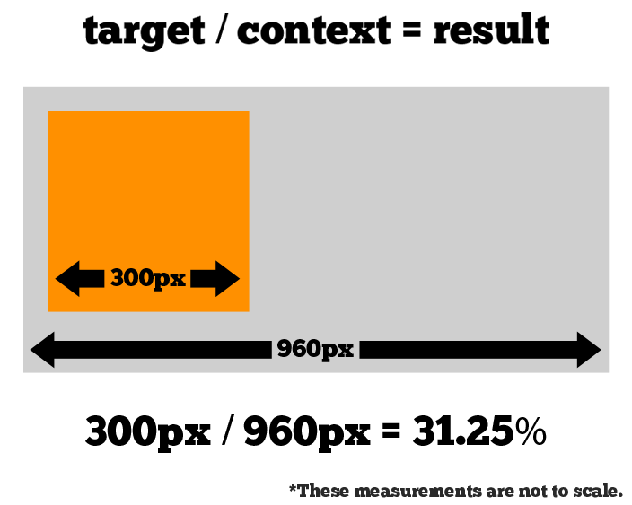
Fluid Layout
When the Computed values has some floating point value with many numbers after the decimal, don’t round the value!

Slide 155
Fluid Grid Layout
Fluid grids are a very important part of creating a responsive design
Constraints with Fluid Grid
  When the width of the browser becomes too narrow, the design can start to severely break down.
a complex three-column layout isn’t going to work very well on a small mobile phone.
Responsive design has taken care of this problem by using media queries.

Slide 156
View Port
The viewport is the user's visible area of a web page.
It varies with the device
  Smaller on a mobile phone than on a computer screen.
Set in the Head Section of the HTML Page
  <meta name="viewport" content="">
Content
  Can enter a set comma delimited values
  For mobile design can specify the viewport width:
Width
  The width property controls the size of the viewport.
  <meta name="viewport" content="width=320">

Slide 157
View Port
<meta name="viewport" content="width=device-width">
  For flexible layouts viewport width is based on the device
<meta name="viewport" content="initial-scale=1">
  To make sure layout will be displayed as intended its set with a zoom level.
  It will ensure that upon opening layout will be displayed properly at 1:1 scale.
  No zooming will be applied.

Slide 158
View Port
<meta name="viewport" content="maximum-scale=1">
  Prevent any zooming by the user:
  Used If there is a genuine need for preventing zooming
<meta name="viewport" content="width=device-width, initial-scale=1“>
Can combine the values together which can act as default
Initial-Scale to 1
  initial page zoom level , on the page load
  Can disable zoom completely with use scale= false

Slide 159
@View Port
At-rules are special instructions for the CSS parser.
They are invoked by an at-keyword preceded by an "@" sign.
Specifies the size, zoom factor, and orientation of the viewport.
  @viewport{
  zoom: 1.0;
  width: device-width;
  }
  @viewport{
  zoom: 1.0;
  width: extend-to-zoom;
  }

Slide 160
MEDIA QUERIES

Slide 161
Media Queries
A way of specifying different styles for individual browser and device circumstances, the width of the viewport or device orientation
Can apply uniquely targeted styles
Common media types include
  all, screen, print, tv, and braille.
  default the media type to screen.

Slide 162
Inserting Media Queries
Can be inserted in HTML pages in the following ways:
Inserted into a <link> element which refers to a CSS style sheet.
<link rel="stylesheet" href="mycss.css" media="only screen and (max-width: 1200px)">
Inserted before an @import CSS instruction in CSS style sheet.
@import url('my-other-css.css') only screen and (max-width: 1200px);
Inserted inside a CSS style sheet.
@media only screen and (max-width: 1200px) { /* css rules */ }

Slide 163
Media Query Syntax
Media queries follow this syntax:
[logic] [media] [and (condition)] [and (condition)] ...
[logic]
Only:
  The media query only matches a certain media type
Not
  The media query matches all other than a certain media type

Slide 164
Media Query Syntax
Height
  Specifies the height of the browser window this media query matches.
min-height
  Specifies the minimum browser window height this media query matches.
max-height
  Specifies the maximum browser window height this media query matches.

Slide 165
Media Query Syntax
Width
  Specifies the width of the browser window this media query matches.
min-width
  Specifies the minimum browser window width this media query matches.
max-width
  Specifies the maximum browser window width this media query matches.
Most commonly used features include min-width and max-width.

Slide 166
Media Query Syntax
[media]
  computer screens.
  Both on desktop computers, laptops, tablets, smart phones and TVs.
Projection
  Matches projection devices such as projectors.
Print
  Matches when a user clicks "print" for the page.

Slide 167
Media Query Syntax
[and (condition)]
  blocks set conditions for the screen.
  can use it inside condition block
Two Group of Conditions:
  related to the width and height of the browser window,
  related to the width and height of the physical device screen.
On a desktop computer, the browser window width may change if the browser is resized by the user,
Device width mostly does not change.
On a mobile device the browser window width and device width are typically the same
  if the user changes orientation of the device, the device width becomes device height and vice versa.

Slide 168
Example
Browser Width Equal or less than 600 px
@media only screen and (max-width: 600px) {
body { background-color: #ffffff; } }
@media only screen and (min-width: 601px) and (max-width: 1200px) {
body { background-color: #ff0000; } }
@media only screen and (min-width: 1201px) {
body { background-color: #0000ff; } } </style>

Slide 169
Logical Operators in Media Queries
@media all and (min-width: 800px) and (max-width: 1024px) {...}
not logical operator
  negates the query, specifying any query but the one identified.
@media not screen {...}
@media only screen and (orientation: portrait) {...}
Height & Width Media Features
  @media all and (min-width: 320px) and (max-width: 780px) {...}

Slide 170
Media Queries
Aspect Ratio Media Features
Specifies the width/height pixel ratio of the targeted rendering area or output device.
The value for the aspect ratio feature consist of two positive integers separated by a forward slash.
The first integer identifies the width in pixels while the second integer identifies the height in pixels.
@media all and (min-device-aspect-ratio: 16/9) {...}

Slide 171
Resolution Media Feature
Specifies the resolution of the output device in pixel density, also known as dots per inch or DPI.
Accepts the min and max prefixes.
will accept dots per pixel (1.3dppx), dots per centimeter (118dpcm), and other length based resolution values.
@media print and (min-resolution: 300dpi) {...}
Other Media Features
Can identify available output colors with use of the color,color-index, and monochrome features,

Slide 172
Identifying Breakpoints
A breakpoint is the media query values that will mark the transition to a new class of devices. You need a minimum of 3 breakpoints — one for each type of device (mobile, tablet, and desktop).
Can write media query breakpoints around common viewport sizes as determined by different device resolutions
When building a responsive website it should adjust to an array of different viewport sizes, regardless of the device.
Breakpoints should only be introduced when a website starts to break, look weird, or the experience is being hampered.

Slide 173
Break Points
@media only screen and (min-width: 768px) {
/* tablets and desktop */ }
@media only screen and (max-width: 767px) { /* phones */ }
@media only screen and (max-width: 767px) and (orientation: portrait) { /* portrait phones */ }
@media only screen and (min-width: 1176px){
/* Large size Monitor */
}
@media (min-width: 400px) and (min-height: 600px) {
/* 400px wide and 600px tall */
}

Slide 174
Print Media with Style Element
  @media print {
  img {
  display:none
  }
  body {
  Font-size:10pt;
  color: black;
  }
  }
  @media screen {
  img {
  width:100px;
  height:100px;
  }
  }

