Slide 1
UI AND FORMS

Slide 2
Creating Forms with React
Similar to HTML forms, Standard HTML Forms will work
But HTML form elements keep some internal state
  Its convenient to have a JavaScript function to handle the submission
  It should have access to the data that the user entered into the form.

Slide 3
Form components
Don’t have to reach to an input field's native DOM element to read its value
Whatever the user types will be reflected on the component state itself.
  Done by Using an onChange event handler.
Every time a change event is fired, component state associated with the input is updated
  Properties of components are updated with useState Hook

Slide 4
Custom Hooks
Created by importing useState hook from "react".
They are like component but returns values instead of JSX.
  It’s a JavaScript function whose name starts with ”use”
Custom Hooks are used to extract component logic into reusable functions.
Custom Hook doesn’t need to have a specific signature.
  Can have any arguments, and return type.

Slide 5
Custom Hook
  import { useState } from "react";
  import Book from './model/Book';
  export const useForm = (callback: any, initialState:{}) => {
  const [values, setValues] = useState(initialState);
  const onChange = (event: React.ChangeEvent<HTMLInputElement>)
  => {
  setValues({ ...values, [event.target.name]: event.target.value });
  };

Slide 6
Custom Hook
  const onSubmit = (event: React.FormEvent<HTMLFormElement>) => {
  event.preventDefault();
  callback();
  };
  return {
  onChange,
  onSubmit,
  values,
  };
  }

Slide 7
Form Handling
  function AddBook() {
  const initialState:Book = {
  id: 0,
  bookName: "",
  author:'',
  price:0
  };
  const { onChange, onSubmit, values } = useForm(
  loginUserCallback,
  initialState
  );
  function loginUserCallback() {
  console.log(values); // post to Backend
  }

Slide 8
Form Handling
return (
<form onSubmit={onSubmit}>
<div>
<input name='id’ id='bookId’ type='text'
placeholder='Book Id’ onChange={onChange} required />
<input name='bookName’ id='bookName’ type='text'
placeholder='Book Name’ onChange={onChange}
required/>
<button type='submit'>Login</button>
</div>
</form>
); }
export default AddBook;

Slide 9
REDUX

Slide 10
What is Redux
Redux is a library for front end development
Data flows through the components.
  Unidirectional Data flows from parent to child components
  Data is organized and controlled better.
  Application’s state is contained in specific stores
  The rest of the components remain loosely coupled.
  Makes application more flexible leading to increased efficiency.
  Can Manage both data-state and UI-state

Slide 11
Principles Of Redux
State is read-only:
  The only way to change the state is to trigger an action.
  An action is a plain JS object describing the change.
  Just like the state is the minimal representation of data, the action is the minimal representation of the change to that data.
  An action must have a type property (conventionally a String constant).
  All the changes are centralized and occur one by one in a strict order.

Slide 12
Principles Of Redux
Changes are made with pure functions:
  In order to specify how the state tree is transformed by actions, you need pure functions.
  Pure functions are those whose return values depend solely on the values of their arguments.
  Reducers are just pure functions that take the previous state and an action and return the next state.
  You can have a single reducer in your application and as it grows, you can split it off into smaller reducers.
  These smaller reducers will then manage specific parts of the state tree.

Slide 13
Principles Of Redux
Redux follows three fundamental principles:
Single source of truth:
  The state of the entire application is stored in an object/ state tree within a single store.
  The single state tree makes it easier to keep track of the changes over time and debug or inspect the application.
  For a faster development cycle, it helps to persist the application’s state in development.

Slide 14
Redux
Redux provides a “store”
  Place keep the application state together.
Components can “dispatch” state changes to the store
  Not directly to the other components.
Components that need the updates about the state changes
  “subscribe” to the store.
Initiating component does not have to worry about the list of components needing the state change
  It simply dispatch the change to the store.

Slide 15
Environment Setup
npx create-react-app my-app --template typescript
cd my--app
npm install redux react-redux

Slide 16
Components Of Redux
Redux has four components.
  Action
  Reducer
  Store
  View

Slide 17
Redux Application
Create the types
Create the action creators
Create a reducer
Create a store
Create the components

Slide 18
ACTION

Slide 19
Action and Action Creator
  Action Types
    An action type is a string that describes the type of an action.
Action
  Plain JavaScript objects
  Main source of information
  An action is like a message dispatched to central Redux store.
Action Creator
  A function that creates and returns an action.

Slide 20
Action Creator
  export function addArticle(article: IArticle) {
  const action: ArticleAction = {
  type: actionTypes.ADD_ARTICLE,
  article:article
  }
  return action;
  }

Slide 21
Action Creator
  export function removeArticle(article: IArticle) {
  const action: ArticleAction = {
  type: "REMOVE_ARTICLE",
  article:article
  }
  return action;
  }

Slide 22
REDUCER

Slide 23
Reducer
  Take “state” from Redux “action” object
  Returns a new “state” to be stored back in Redux.
Calculates the next state depending on the action type.
  should return at least the initial state when no action type matches.
  When the action type matches a valid clause, the reducer calculates the next state and returns a new object.

Slide 24
Reducer
  const initialState: ArticleState = {
  articles: [
  {
  id: 1,
  title: "post 1",
  body:
  "Java Script",
  }]
  }

Slide 25
Reducer
  const reducer = (
  state: ArticleState = initialState, action: ArticleAction ): ArticleState => {
  switch (action.type) {
  case actionTypes.ADD_ARTICLE:
  const newArticle: IArticle = {
  id: Math.random(),
  title: action.article.title,
  body: action.article.body,
  }
  return {
  ...state,
  articles: state.articles.concat(newArticle), //Using Spread
  }

Slide 26
Reducer
  case actionTypes.REMOVE_ARTICLE:
  const updatedArticles: IArticle[] = state.articles.filter(
  article => article.id !== action.article.id
  )
  return {
  ...state,
  articles: updatedArticles,
  }
  }
  return state
  }
  export default reducer

Slide 27
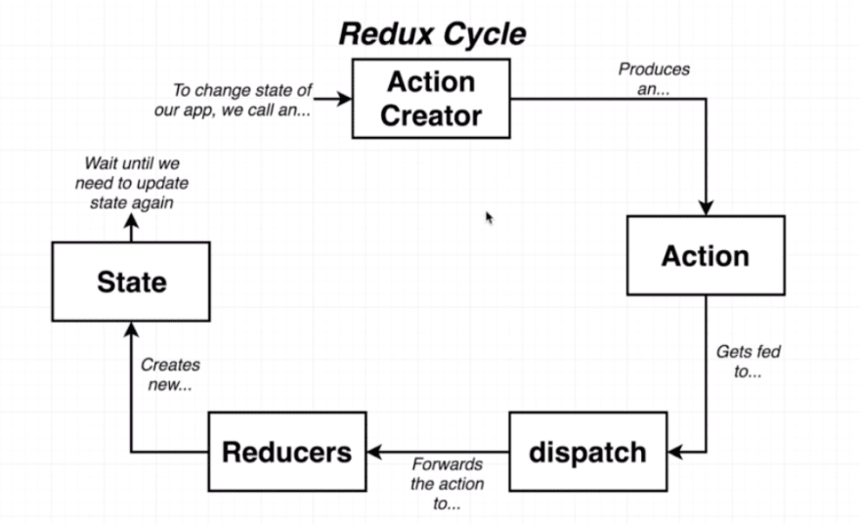
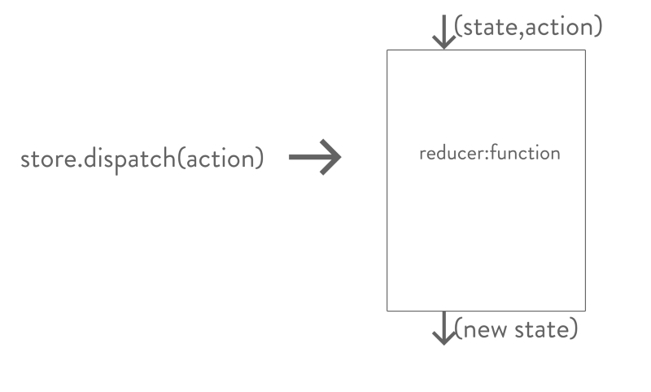
Redux Cycle

Slide 28
STORE

Slide 29
Redux Store -Methods
State of the whole application lives inside the store.
  Created by wrapping up the state.
Redux store exposes a simple API for managing the state.
getState()
  for accessing the current state of the application
Dispatch()
  for dispatching an action
Subscribe()
  for listening on state changes

Slide 30
Redux Store -Methods
createStore()
  to create a store
  takes a reducer as the first argument
  Can also pass initial state
import reducer from "./reducer";
import { createStore } from "redux";
const store = createStore(reducer);
  store.subscribe(()=>{console.log('redux action called')})
  export default store;

Slide 31
Provider
An high order component coming from react-redux.
It gets the store as a prop.
Wraps up React application and makes it aware of the entire Redux’s store.
  React must get state and actions by accessing the store
  ReactDOM.render(
  <Provider store={store}>
  <App/>
  </Provider>,document.getElementById("root"));

Slide 32
Component
  import * as React from "react"
  import { IArticle } from "../types"
  type Props = {
  saveArticle: (article: IArticle | any) => void
  }
  export const AddArticle: React.FC<Props> = ({ saveArticle }) => {
  const [article, setArticle] = React.useState<IArticle | {}>()
  const handleArticleData = (e: React.FormEvent<HTMLInputElement>) => {
  setArticle({
  ...article,
  [e.currentTarget.id]: e.currentTarget.value,
  })
  }

Slide 33
React Hooks
useSelector
  const result: any = useSelector(selector: Function, equalityFn?: Function)
Allows To extract data from the Redux store state, using a selector function.
The selector will be called with the entire Redux store state as its only argument.
The selector will be run whenever the function component renders
Will also subscribe to the Redux store, and run selector whenever an action is dispatched.

Slide 34
useDispatch()
  const saveArticle = React.useCallback(
  (article: IArticle) => dispatch(addArticle(article)),
  [dispatch]
  )
This hook returns a reference to the dispatch function from the Redux store.
Can be used to dispatch actions as needed.
useCallBack()
  Returns a memoized callback.
  The arguments form a key that is already present in the map
  It will invoke the call callback with the corresponding value from the map.
  If not present, then call the function with the same set of arguments, except for the callback.

Slide 35
Component
  const addNewArticle = (e: React.FormEvent) => {
  e.preventDefault()
  saveArticle(article)
  }
  return (
  <form onSubmit={addNewArticle} className="Add-article">
  <input type="text“ id="title“ placeholder="Title"
  onChange={handleArticleData} />
  <input type="text“ id="body“ placeholder="Description"
  onChange={handleArticleData} />
  <button disabled={article === undefined ? true : false}>
  Add article
  </button>
  </form>
  )
  }

Slide 36
Component
  const App: React.FC = () => {
  const articles: readonly IArticle[] =
  useSelector(
  (state: ArticleState) => state.articles,
  shallowEqual
  )
  const dispatch: Dispatch<any> = useDispatch()
  const saveArticle = React.useCallback(
  (article: IArticle) => dispatch(addArticle(article)),
  [dispatch]
  )

Slide 37
Component
  return (
  <main>
  <h1>My Articles</h1>
  <AddArticle saveArticle={saveArticle} />
  {articles.map((article: IArticle) => (
  <Article key={article.id}
  article={article} removeArticle={removeArticle} />
  ))}
  </main>
  )
  }
  export default App

Slide 38
Component
import { Dispatch } from "redux"
import { useDispatch } from "react-redux"
import { IArticle } from "../types"
interface Props{
article: IArticle
removeArticle: (article: IArticle) => void
}

Slide 39
Component
  export const Article: React.FC<Props> = ({ article, removeArticle }) => {
  const dispatch: Dispatch<any> = useDispatch()
  const deleteArticle = React.useCallback(
  (article: IArticle) => dispatch(removeArticle(article)),
  [dispatch, removeArticle]
  )
  return (
  <div className="Article">
  <div>
  <h1>{article.title}</h1>
  <p>{article.body}</p>
  </div>
  <button onClick={() => deleteArticle(article)}>Delete</button>
  </div> ) }

Slide 40
CONTEXT API

Slide 41
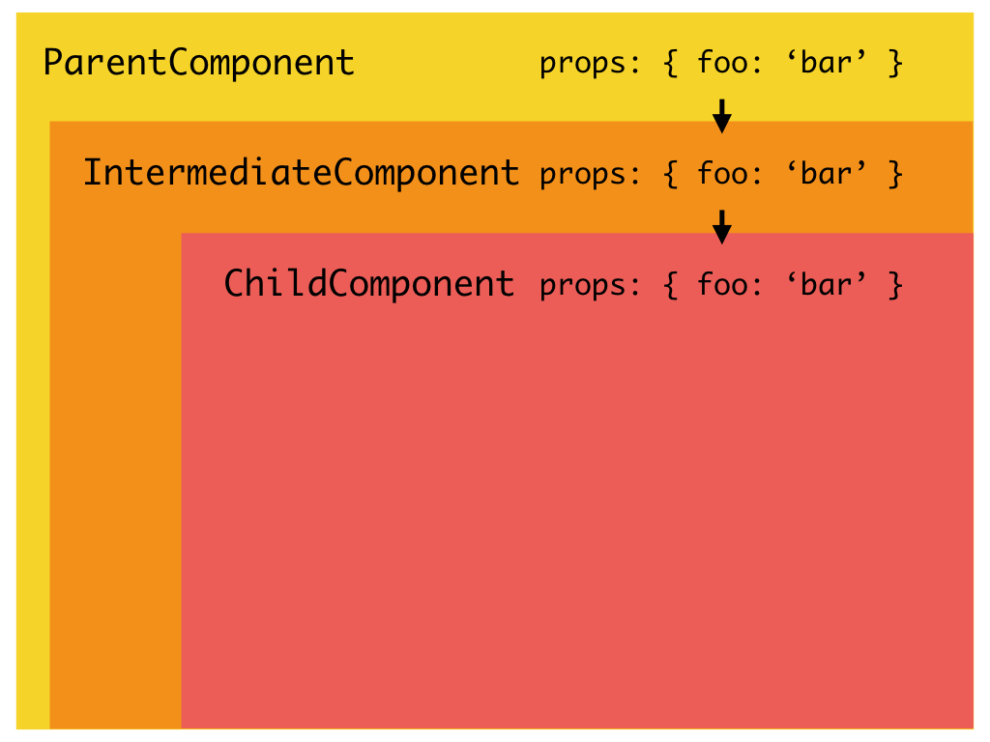
Context API

Slide 42
Introduction
Introduced from React 16.3
  A way to pass data through the component tree without having to pass props down manually at every level
Can set a state that can be seen globally to the entire application.
A context provider (<Provider />) to define the data to be sending around
A context consumer (<Consumer />) that grabs that data and uses it where called.
  Declare the state once, and then use via the context consumer

Slide 43
Context API
React.createContext
  Used to create the context Object
  const MyContext = React.createContext(defaultValue);
Can read the current context value from a closest matching Provider
defaultValue
  used when the component does not have the matching Provider above it in the tree.
  Helpful for testing components in the isolation without wrapping them.

Slide 44
Context Provider
<MyContext.Provider value={/* some value */}>
Every Context object comes with the Provider React component
  Accepts the value prop to be passed to the consuming components that are the descendants of this Provider.
  One Provider can be connected to the many consumers.
  Providers can be nested to override the values deeper within a tree.
  It can wrap around all components that share state.

Slide 45
Context Consumer
It is the React component that subscribes to the context changes.
  receives a current context value and returns the React node.
  The value argument passed to a function will be equal to a value prop of the closest Provider for this context above in the tree.
If there are no Providers for the context
  Will have the defaultValue that was passed to createContext().
  <MyContext.Consumer>
  render something based on the context value
  </MyContext.Consumer>

Slide 46
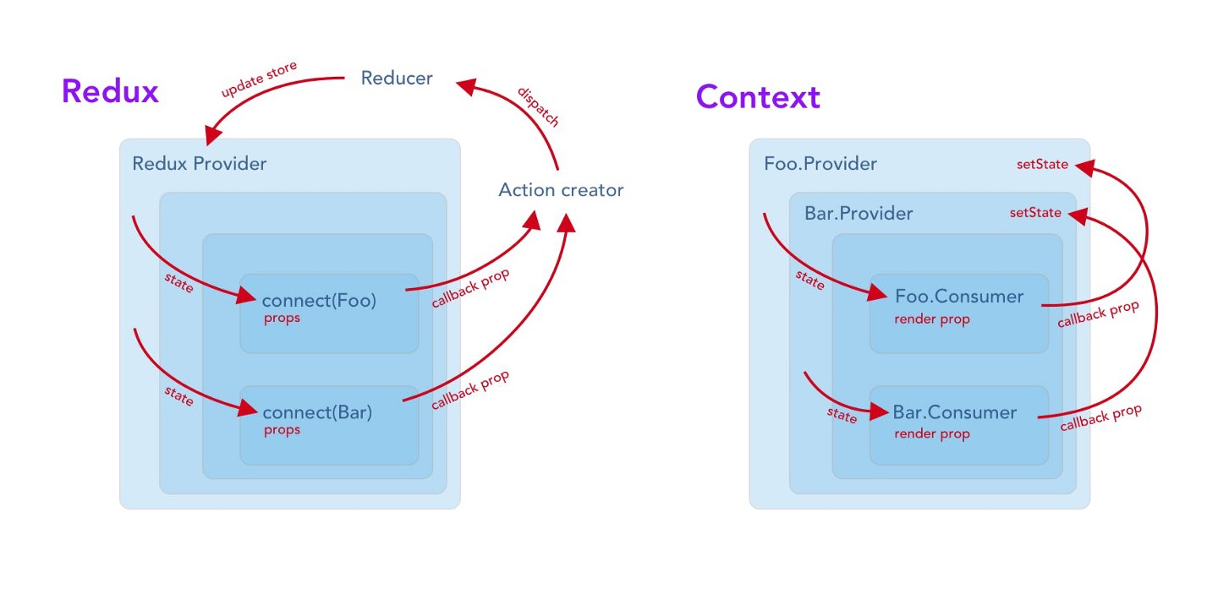
When to Use Context API
Used for simple prop drilling solution that can scale
  Use Redux for applications that have multiple (and more complex) states, reducers, etc,

Slide 47
Context API - Provider
  export const AppContext = React.createContext({
name: 'Ramesh From Context'
  });

Slide 48
Application
  const App = () => {
  return <AppContext.Provider value={ {
  name: 'Ramesh'
  } }>
  <Header/>
  </AppContext.Provider>
  }

Slide 49
Context API Consumer
  const Header = () => {
  return <AppContext.Consumer>
  {
  (name) => {
  return <h1>Logged in!{name}</h1>
  }
  }
  </AppContext.Consumer>
  }
  export default Header;

Slide 50
TESTING – JEST

Slide 51
React Testing Library
Jest will take care of running tests and handling assertions
React Testing Library provides testing utilities.
There are several practices that the React Testing Library promotes:
  Avoid testing internal component state
  Testing how a component renders

Slide 52
Configuration
Starting with an existing React and TypeScript project
Can add the dependencies for Jest and React Testing Library
Testing utilities or imported from @testing-library/react:

Slide 53
Render
render helps render components and returns find helper methods.
fireEvent
  is for simulating events on DOM elements.
waitForElement
  is useful when waiting for UI changes to occur.
Tests are executed with one of the following
  Npm run test
  npm run test:watch

Slide 54
React Testing Library
Provides way to find elements using helpers.
Elements can be selected not only by the text they contain.
findByTestId
  To find elements by their data-testid attribute value.
toHaveFormValues
  A matcher to more easily assert if the form values are what we expect
ByLabelText,
  Element by a given text in label or aria-label
ByRole
  Find by aria role;
ByTestId
  Find by data-testid attribute.

Slide 55
Testing Event Handling
fireEvent
  Utility to modify the form's state.
  Callbacks on the props is mocked to ensure that the value we expect for each interaction.
  Used to simulate a form event (Click,Change) on the inputs
  Then it can be used to assert that the right value was passed to the prop callback.

Slide 56
Type
  export default interface GreetingsProps {
  name: string;
  onGreeting: (message: string) => void;
  };

Slide 57
Component Under Test
  export const Greetings = ({
  name, onGreeting }: GreetingsProps) => {
  return (
  <div>
  <p>Hello {name}!</p>
  <button
  type="button"
  onClick={() =>
  onGreeting(`Hello ${name}!`)}> Send</button>
  </div>
  );
  };

Slide 58
Test Case
  import { fireEvent, render, screen } from "@testing-library/react";
  import userEvent from "@testing-library/user-event";
  import { Greetings } from "./GreetingComponent";
  describe("when rendered with `OnGeeting` prop", () => {
  it("should render the send button", () => {
  render(
  <Greetings name="Test Name“ onGreeting={() => {}} />
  );
  expect(
  screen.getByRole("button")
  ).toBeInTheDocument();
  });
  });

Slide 59
Test Case
  describe("when the button is pressed", () => {
  it("should call the `onGreeting` callback", () => {
  const onGreetingMock = jest.fn();
  render(
  <Greetings name="Test Name“
  onGreeting={onGreetingMock} />
  );
  fireEvent.click(screen.getByRole("button"));
  expect(onGreetingMock).toHaveBeenCalledWith(
  "Hello Test Name!");
  });
  });

Slide 60
Micro Frontends
Micro services to the frontend.
Feature-rich and powerful Single page application is build with , micro service architecture.
Frontend layer, often developed by a separate team, grows and gets more difficult to maintain.
  Resulting in a Frontend Monolith.
Micro Frontends is to think about a web app as a composition of features which are owned by independent teams.

Slide 61
Micro Frontends
Each team has a distinct area of business or mission it cares about and specialises in.
A team is cross functional and develops its features end-to-end, from database to user interface.
Micro Frontends Frameworks
  1. Bit
  2. Webpack 5 and Module Federation ·
  3. Single SPA
  4. Systemjs
  5. Piral

