Slide 1
ENTITY GRAPH

Slide 2
N+1 SELECT
Happens when ORM executes one SQL query to retrieve the main entity from a parent-child relationship
    Does one more SQL query for each child object.
    As the associated entities increases, the more queries will be executed.
    Will impact the performance of application.
How to Avoid
  Can use lazy fetching mechanism
  But it affects all retrieve calls and does not give the flexibility for different fetch types.

Slide 3
Entity Graphs
Introduced in JPA 2.1
  A template for a particular Persistence query or operation.
Entities can be fetched eagerly from the database in a single select statement
  Improving the performance of the application.
  Fetching specific of objects.
Loads in one select query and avoids fetching association with more SELECT queries.

Slide 4
@EntityGraph
Entity graphs allows to Solves the N+1 problem
It provides multiple fetch plans for different purposes.
Annotation takes a type parameter with 2 values:
@EntityGraph(attributePaths = {"user","city"},type = EntityGraph.EntityGraphType.LOAD)
attributPaths
  The paths of attributes of this EntityGraph to use, empty by default.
  To fetch the associated entities included in attributePaths
  Can refer to direct properties of the entity
  Uses EntityGraphType specified, FETCH, or LOAD.

Slide 5
@EntityGraph -Type
There are two types of entityGraphs, Fetch and Load
FETCH:
  It is the default graph type.
  Attributes that are specified are treated as FetchType.EAGER
  Attributes that are not specified are treated as FetchType.LAZY.
LOAD:
  Attributes that are specified are treated as FetchType.EAGER
  Attributes that are not specified are treated to their specified or default FetchType.

Slide 6
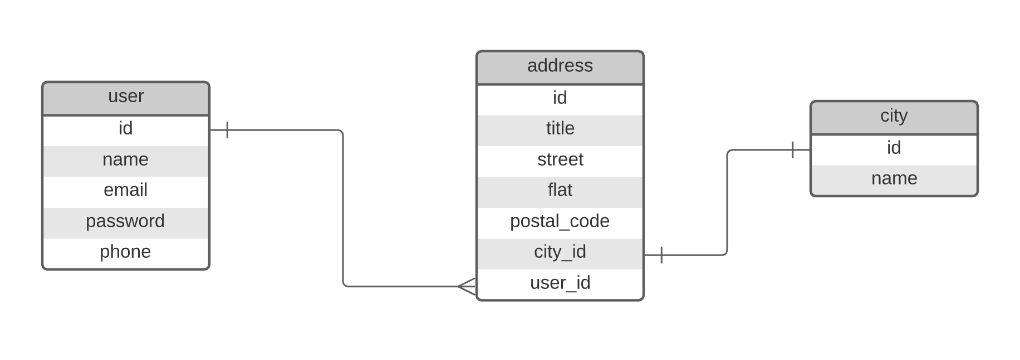
Tables

Slide 7
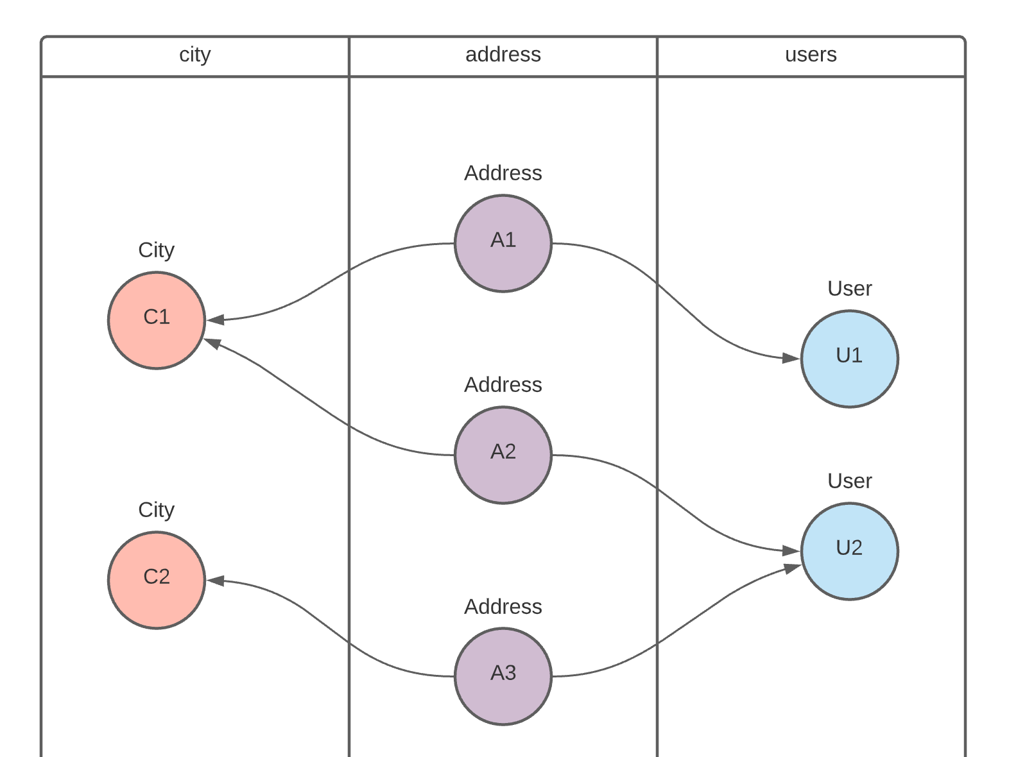
Table Design

Slide 8
Entity -City
  @Entity
  @Table(name = "city_2022")
  public class City {
  public City(String name) {
  super();
  this.name = name;
  }
  @Id
  @GeneratedValue(strategy = GenerationType.AUTO)
  private Long id;
  private String name;
  private int code;
  }

Slide 9
Entity - User
  @Entity
  @Table(name = "users_2022")
  public class User {
  @Id
  @GeneratedValue(strategy = GenerationType.AUTO)
  private Long id;
  private String name;
  private String email;
  private String password;
  private String phone;
  }

Slide 10
Address- Entity
  @Entity
  @Table(name = "address_2022")
  public class Address {
  @Id
  @GeneratedValue(strategy = GenerationType.AUTO)
  private Long id;
  private String title;
  private String street;
  private String flat;
  private String postalCode;

Slide 11
Address Entity
  @OneToOne(cascade = CascadeType.ALL)
  @JoinColumn(name = "city_id")
  private City city;
  @ManyToOne(cascade = CascadeType.ALL)
  @JoinColumn(name = "user_id")
  private User user;
  }

Slide 12
Repository
  public interface AddressRepository extends JpaRepository<Address, Integer> {
  }

Slide 13
N+1 SELECT
To query and return Both User and City Generates N+1 Queries
select id ,city_id,flat ,postal_code,street,titleuser_id as from address_2022
  select id,code,name from city_2022 where .id=?
  select id,code,name from city_2022 where .id=?
  select id,code,name from city_2022 where .id=?
  select .id ,email,name ,password ,phone from
  users_2022 where .id=?
  select .id ,email,name ,password ,phone from users_2022 where .id=?
  select .id ,email,name ,password ,phone from users_2022 where .id=?
  select .id ,email,name ,password ,phone from users_2022 where .id=?

Slide 14
Repository
  To query and return Both User and City with a Single Query
  @EntityGraph(attributePaths = {"user","city"},type = EntityGraph.EntityGraphType.LOAD)
  List<Address> findAll();
- Invoking findAll() Method Abridged Version of Generated Select Query
  select a.id, u.id ,c.id ,a.city_id, a.flat, u.name,c.code , …
  from address_2022 a
  left outer join users_2022 u on a.id=u.id
  left outer join city_2022 c on a.city_id=c.id

Slide 15
Repository
  public interface AddressRepository extends JpaRepository<Address, Integer> {
  List<Address> findByCityId(Long id);
  // Will Fetch Only city from the Address excluding User
  @EntityGraph(attributePaths = {“city"},type = EntityGraph.EntityGraphType.Fetch)
  Optional<Address> findById(Long id);
  }
City and Id refer to the props in Address Class

Slide 16
Application
  AddressRepository repo = ctx.getBean(AddressRepository.class);
  City chennai = new City("South chennai");
  User deepak = new User("Deepak", "deep@abc.com", "i223@88", "6383483");
  Address address1 = new Address("Mr", "gandhi street", "pavithra", "117", chennai, deepak);
  repo.save(address1);
  System.out.println("Find City:"+repo.findByCityId(18L));

Slide 17
REST SERVICE USING SPRING DATA JPA

Slide 18
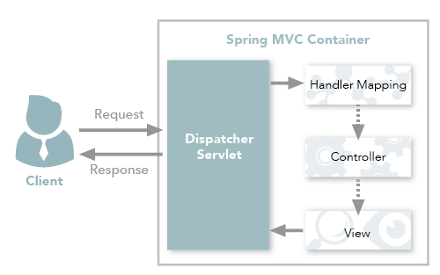
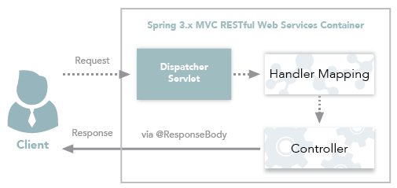
Spring MVC and Spring REST

Slide 19
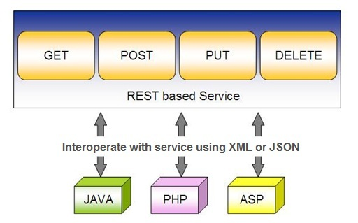
Spring RESTful Services
REST does not require the client to know anything about the structure of the API.
Server needs to provide whatever information the client needs to interact with the service.

Slide 20
Using appropriate Request Methods
GET :
  Should not update anything.
  Should be idempotent (same result in multiple calls).
  Possible Return Codes 200 (OK) + 404 (NOT FOUND) +400 (BAD REQUEST)
POST :
  Should create new resource.
  Ideally return JSON with link to newly created resource.
  Same return codes as get possible.
  In addition : Return code 201 (CREATED) is possible.

Slide 21
Using appropriate Request Methods
PUT :
  Update a known resource. ex: update client details.
  Possible Return Codes : 200(OK)
DELETE :
  Used to delete a resource.
  Possible Return Codes : 200(OK) or a 204 - no content

Slide 22
Application Programming Interface
Application Programming Interface
  Set of definitions and protocols that allow one application to communicate with another application.
APIs can be exposed through local files (such as a JAR file in a Java program, .H file in C/C++ programs, etc.)
  Two local applications can communicate with each other.
  May not require a network as the two applications are communicating within a single device.

Slide 23
Need for API
Automation
  Automation accelerates API testing, Increases efficiency.
  API glues the digital world with its dynamic nature, but it also allows companies to become more agile by automating workflows.
Integration
  Integration of platforms and applications can be done using API to leverage seamless communication.
  Movement of data, facilitating companies to automate workflows and improve workplace collaboration.

Slide 24
Need for API
Efficiency
  Efficiency increases with decreasing human intervention.
  Providing API access prevents duplication of content,
  Greater flexibility for companies to spend time in quality innovation.
Security
  Security is an additional benefit because API supplements an extra layer of protection between your data and server.
  Can strengthen their security by using tokens, signatures, and transport layer security (TLS) encryption.

Slide 25
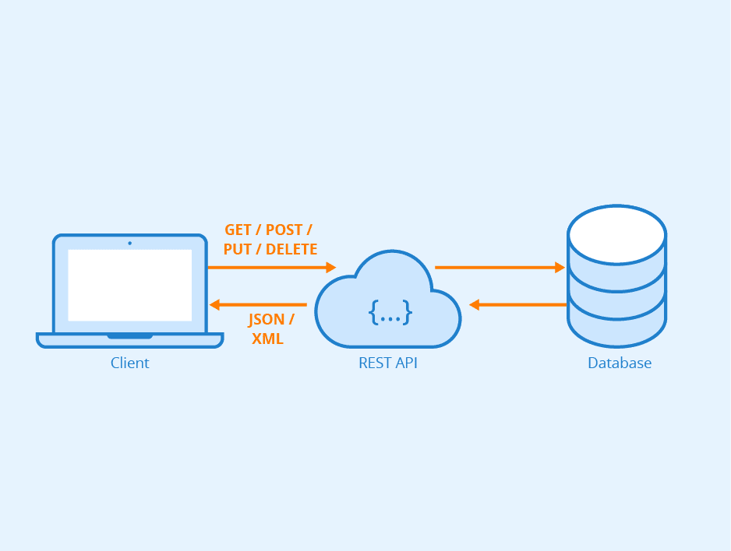
Rest API

Slide 26
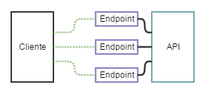
API and Endpoint

Slide 27
REST API
REST APIs are a standardized architecture abides by the following rules:
Statelessness:
  Systems aligning with the REST paradigm are bound to become stateless.
Cacheable:
  Cache helps servers to mitigate some constraints of statelessness.
  Caching enhances the performance on the client-side but also scales significant results on the server-side.

Slide 28
REST API
Decoupled:
  Client and server applications are decoupled from each other.
  Client application just need to know URI of the requested resource.
Layered:
  A Layered system makes a REST architecture scalable.
  Neither Client nor Server identifies its communication with end applications or an intermediary.

Slide 29
SPRING DATA REST WITH JPA

Slide 30
Spring RESTful Services
A RESTful architecture may expose multiple representations of a resource.
From Spring 4 @RestController annotation is added to controller
  A combination of @Controller and @ResponseBody
A Rest Controller method returns a domain object instead of a view.

Slide 31
REST Stereotypes
@RestController
  An implicit @ResponseBody is being added to the methods.
  Allows Spring to render the returned HttpEntity and its payload, directly to the response.
@GetMapping
  To map HTTP GET requests onto specific handler methods.
  Composed annotation for @RequestMapping(method = RequestMethod.GET).

Slide 32
REST Stereotypes
@PathVariable
  Indicates that the Method parameter should be bound to a URI template variable.
  @GetMapping("/members/{id}")
  public String getById(@PathVariable String id) { }
@PostMapping
  Combined shortcut for @RequestMapping(method = RequestMethod.POST).
  @PostMapping("/members“)
  public void addMember(@RequestBody Member member) { }

Slide 33
@RequestBody
Used to map the HttpRequest body to a transfer or domain object
  Spring automatically deserializes the JSON into a Java type
  The type of @RequestBody annotation must correspond to the JSON sent from client-side
HttpMessageConverter
  Internally Used by Spring to perform Serialization/deserialization

Slide 34
Response Entity
Represents Complete HTTP response
  Can be used to send Status Code,Response Body,Location to the resource which was altered
  @PostMapping(“/invoices)
  public ResponseEntity<Object> addInfo(@RequestBody Invoice entity){
  URI location=
  ServletUriComponentsBuilder
  .fromCurrentRequest()
  .path("/{id}")
  .buildAndExpand(entity.getId())
  .toUri();
  return ResponseEntity.created(location).body(entity);
  }

Slide 35
SAMPLE CODE-DEMO

Slide 36
Entity
  @Entity
  @Table(name = "demo_invoice")
  @Data
  @AllArgsConstructor
  @NoArgsConstructor
  @FieldDefaults(level = AccessLevel.PRIVATE)
  public class Invoice {
  @Id
  long id;
  String customerName;
  @DateTimeFormat(iso = DateTimeFormat.ISO.DATE)
  LocalDate invoiceDate;
  double amount;
  }

Slide 37
Repository
  @Repository
  public interface InvoiceRepository extends JpaRepository<Invoice, Long>{
  }

Slide 38
Service
  @Service
  public class InvoiceService {
  @Autowired
  private InvoiceRepository repo ;
  public List<Invoice> findAll(){
  return repo.findAll();
  }
  public Invoice findById(int id) {
  Optional<Invoice> optInvoice=repo.findById(id);
  return optInvoice.orElseThrow(() -> new
  RunTimeException(“Invoice not found"));
  }

Slide 39
Controller
  @RestController
  public class InvoiceController {
  @Autowired
  private InvoiceService service ;
  @GetMapping(path = "/api/v1/invoices")
  public List<Invoice> findAll() {
  List<Invoice> details = service.findAll();
  return details;
  }

Slide 40
@RequestBody
Used to map the HttpRequest body to a transfer or domain object
  Spring automatically deserializes the JSON into a Java type
  The type of @RequestBody annotation must correspond to the JSON sent from client-side
HttpMessageConverter
  Internally Used by Spring to perform Serialization/deserialization
@Valid
  To perform automatic validation by adding to method argument

Slide 41
Remove Method in Service
  public Invoice remove(Invoice entity) {
  Optional<Invoice> optional = Optional.empty();
  if(this.repository.existsById(entity.getId())) {
  this.repository.delete(entity);
  optional = Optional.of(entity);
  }
return optional;
}

Slide 42
Delete Mapping in Controller
  @DeleteMapping(path = "/api/v1/invoice")
  public ResponseEntity<Invoice> remove(@RequestBody Invoice entity) {
  Invoice invoice = this.service.removeInvoice(entity).orElseThrow(()-> new RuntimeException("Element NOT FOUND"));
  return ResponseEntity.ok().body(invoice);
  }

Slide 43
@RestControllerAdvice
Used for Exception handling in Rest API’s
Used to handle exceptions across the whole application
Like an interceptor of exceptions thrown by methods annotated with @RequestMapping or one of the shortcuts.
It’s a combination of @ContollerAdvice and @ResponseBody.
@ExceptionHandler
  Annotation for handling exceptions in specific handler classes and/or handler methods.

Slide 44
@RestControllerAdvice
  @RestControllerAdvice
  public class ErrorHandler {
  @ExceptionHandler(value = Exception.class)
  public ErrorDetails handleAllExceptions(Exception ex, WebRequest request){
  return new ErrorDetails(LocalDateTime.now(),
  ex.getMessage(), request.getDescription(false));
  }
  }
  request.getDescription(false):
  Whether to include client-specific information like session id and user name

Slide 45
application.yml
  spring:
  datasource:
  url: jdbc:mysql://localhost:3306/test
  username: root
  password: srivatsan
  driver-class-name: com.mysql.cj.jdbc.Driver
  jpa:
  show-sql: true
  hibernate:
  ddl-auto: update

Slide 46
application.yml
  logging:
  level:
  org.hibernate.sql: debug
  org.hibernate.type.descriptor.sql.BasicBinder: trace

Slide 47
QUERY DSL

Slide 48
Query DSL
Domain Specific Language
  Extension of a programming language to address a domain.
  Enhancing Java to be better suited at creating and working with JPA queries.
  A Powerful, flexible and customizable based on JPA entity
  Framework checks the validity of queries when application starts up
  Have been in use in scripted language

Slide 49
@Query
Used to write the more flexible query to fetch data.
Supports both JPQL and native SQL queries.
By default will be using JPQL to execute the queries.
  Using normal SQL queries, would get the query syntax error exceptions.
Can use native SQL queries by setting nativeQuery flag to true.
  Pagination and dynamic sorting for native queries are not supported in spring data jpa.

Slide 50
@Query
Used to write the more flexible query to fetch data.
Supports both JPQL and native SQL queries.
By default will be using JPQL to execute the queries.
  Using normal SQL queries, would get the query syntax error exceptions.
Can use native SQL queries by setting nativeQuery flag to true.
  Pagination and dynamic sorting for native queries are not supported in spring data jpa.

Slide 51
@Modifying
@Query
  Can also be used for queries that add, change, or remove records in database.
@Modifying
  Indicates a query method should be considered as modifying query as that changes the way it needs to be executed.
  Not applied on custom implementation methods or queries derived from the method name
  Those methods already have control over the underlying data access APIs or specify if they are modifying by their name.

Slide 52
@Modifying
Method annotated with @Modifying also requires @Transactional
By default, CRUD methods on repository instances are transactional.
  For read operations, the transaction configuration readOnly flag is set to true.
  For other operations are configured with a plain @Transactional
  We need to add @Transactional annotation with required attribute values.

Slide 53
@Query - Example
  @Repository
  public interface TourGuideRepository extends JpaRepository<TouristGuide, Integer> {
  public TouristGuide findByFirstName(String name);
  @Query(value = "SELECT * FROM tourguides WHERE first_name = :firstName", nativeQuery = true)
  List<TouristGuide> findGuideByFirstName(@Param("firstName") String firstName);

Slide 54
@Query - Example
  @Query("FROM TouristGuide WHERE firstName = :firstName AND lastName = :lastName")
  List<TouristGuide> findByFirstAndLastName(@Param("firstName") String firstName, @Param("lastName") String lastName);
  @Query("UPDATE TouristGuide SET firstName = :prefix || firstName")
  @Modifying
  @Transactional
  void updatePrefix(@Param("prefix") String prefix);
  }

Slide 55
DOCUMENTING REST API

Slide 56
Documentation
Essential part of building REST APIs
Open Api Documentation
  Standard, programming language-agnostic interface description for REST APIs,
  Allows both humans and computers to discover and understand the capabilities of a service
  No need to access source code,
  Can add additional documentation, or inspect network traffic

Slide 57
Spring Documentation
  A tool that simplifies the generation and maintenance of API docs
  Based on the OpenAPI 3 specification, for Spring Boot 1.x and 2.x applications.
  Required dependency are added to pom.xml:
  <dependency>
  <groupId>org.springdoc</groupId>
  <artifactId>springdoc-openapi-ui</artifactId>
  <version>1.3.0</version>
  </dependency>

Slide 58
View the Documentation
Can be viewed after executing the application
Its rendered in the browser in JSON format by default.
Default Path : http://localhost:8080/v3/api-docs/
Can be Customised using application.properties file:
  springdoc.api-docs.path=/api-docs
Custom Path : http://localhost:8080/api-docs/

Slide 59
Swagger
  springdoc-openapi is integrated with Swagger UI
  Access from the folowing URL
  http://localhost:8080/swagger-ui.html
Can be customized using application.properties
  springdoc.swagger-ui.path=/swagger-ui-custom.html

Slide 60
Custom Configuration
  Documenting at the Class Level
  @SpringBootApplication
  @OpenAPIDefinition( info = @Info(title = “Invoice Service")
  )
  Can also Document at the Method Level
  @Operation(description = "Method to Add Invoice")
  Can also Document at the Model Class
  Using JSR 303 Annotations

Slide 61
Best practices
Use Nouns for Resource Identification
Use Proper Http Headers for Serialization formats
Get Method and Query Parameter should not alter the state
Always use plurals when you name resources.
Use Appropriate Http Response Status Codes
Field Name casing Conventions
Provide Searching, Sorting and Pagination
Use Versioning of API
Provide Links for Navigating through API – Hateos
Handle Error Properly
Using DTO to Handle the Request and Response

Slide 62
SPRING REST CLIENT-REST TEMPLATE

Slide 63
Consuming REST with REST Template
REST web service can be comsumed programmatically.
Spring convenient template class is called RestTemplate.
  one-line that can bind the data to custom domain types.
It leverages the same marshallers that the server uses.
Can use JAXB marshaller,as well as JSON marshaller

Slide 64
Rest Template
Rest Template is used to create applications that consume REST
Its Autowired to the controller class.
exchange()
  Returns ResponseEntity containing an object mapped from the response body
  Can Communicate with any HTTP Method
  Takes the following arguments
    URL,
    HttpMethod,
    Return type for Exchange() method.

Slide 65
Rest Template
  getForObject(url, java.lang.Class<T>)
    Retrieve a representation by doing a GET on the specified URL.
    Class<T> is the response class Type
getForEntity(url, java.lang.Class<T>)
  Retrieve a representation by doing a GET on the URL
  Class<T> is the response class Type

Slide 66
Rest Template
headForHeaders() :
  Retrieves all headers
delete()
  Deletes the resources at the given URL.
put()
  Creates the new resource for the given URL.
postForEntity():
  Creates a news resource using HTTP POST method.

Slide 67
Rest Template -Exchange
  HttpHeaders headers = new HttpHeaders();
  headers.setAccept(Arrays.asList(MediaType.APPLICATION_JSON));
  HttpEntity <String> entity = new HttpEntity<String>(headers);
  restTemplate.exchange(" http://localhost:8080/products",
  HttpMethod.GET, entity, String.class).getBody();

Slide 68
getForObject
  @Autowired
  RestTemplate restTemplate;
  String obj =
  restTemplate.getForObject("http://localhost:4040/person/all", String.class);
  System.out.println(obj);

Slide 69
PostForObject
Used to create a new Resource
postForObject()
  Returns the Resource itself.
RestTemplate restTemplate = new RestTemplate();
HttpEntity<Book> request = new HttpEntity<>(new Book(“Java"));
Book bk = restTemplate.postForObject(url, request,Book.class);

Slide 70
Post For Entity
  HttpHeaders headers = new HttpHeaders();
  headers.setContentType(MediaType.APPLICATION_JSON);
  Map<String, Object> map = new HashMap<>();
  map.put("rollNumber", 210);
  map.put("studentName", "Yash");
  map.put("markScored", 88);
  HttpEntity<Map<String, Object>> entity = new HttpEntity<>(map, headers);

Slide 71
Post For Entity
  ResponseEntity<String> response2 = template.postForEntity("http://localhost:4040/api/v1/students", entity, String.class);
  System.out.println(response2.getBody());
  System.out.println("Status Code:="+ response2.getStatusCodeValue());
  System.out.println("Location:="+response2.getHeaders().get("location"));

Slide 72
Put
  RestTemplate restTemplate = new RestTemplate();
  String url = "http://localhost:8080/spring-rest/data/putdata/{id}/{name}";
  Map<String, String> map = new HashMap<String, String>();
  map.put("id", "100"); map.put("name", "Ram");
  Address address = new Address(“Tiurpur,”TN");
  restTemplate.put(url, address, map);

Slide 73
Delete
Used to remove an existing Resource
  String url = "http://localhost:8080/spring-rest/data/delete/{name}/{village}";
  Map<String, String> map = new HashMap<String, String>();
  map.put("name", "Mahesh");
  map.put("village", “Madipakkam");
  restTemplate.delete(url, map);

Slide 74
PAGING AND SORTING

Slide 75
PagingAndSortingRepository
findAll(Pageable pageable)
    Pageable object with following properties
      Page size
      Current page number
      Sorting
      findAll(Sort sort)
        Sort Object with the Property on Which the sorting is to be done
        Sort.by(propName)

Slide 76
Entity
@Data
@AllArgsConstructor
@NoArgsConstructor
@Entity
@Table(name = "STATEDOCTOR")
public class Doctor {
@Id
private int doctorCode;
private String doctorName;
private String specialization;
private long handPhone;
private String location;
private String qualification;
}

Slide 77
Repository
@Repository
public interface DoctorRepository extends PagingAndSortingRepository<Doctor,Integer> {
Iterable<Doctor> findAll(Sort sort);
Page<Doctor> findAll(Pageable pageable);
}

Slide 78
Service
@Service
public class DoctorService {
@Autowired
private DoctorRepository repo;
public Iterable<Doctor> findAll(String propName){
Sort sortBy = Sort.by (propName);
return this.repo.findAll (sortBy);
}

Slide 79
Service
public List<Doctor> findByPage(int page, int size, String propName){
Pageable paging =
PageRequest.of(page,size,Sort.by(propName).ascending ());
Page<Doctor> pagedResult = repo.findAll(paging);
if(pagedResult.hasContent()) {
return pagedResult.getContent();
} else {
return new ArrayList<Doctor> ();
}
}
}

Slide 80
Rest Controller
@RestController
public class DoctorController {
@Autowired
private DoctorService service;
@GetMapping("/doctor/sort/{prop}")
public Iterable<Doctor> findAll(@PathVariable("prop") String prop){
return this.service.findAll (prop);
}

Slide 81
Rest Controller
@GetMapping("/doctor/paging/{page}/{size}/{propName}")
public List<Doctor> findByPage(@PathVariable("page") int page, @PathVariable("size") int size, @PathVariable("propName") String propName){
return this.service.findByPage (page,size,propName);
}
}

Slide 82
SPRING SECURITY

Slide 83
Spring Security
Highly customizable authentication and access-control framework.
Focuses on providing both authentication and authorization
“Authentication”
  The process of establishing a user, device or some other system which can perform an action in the application
“Authorization”
  The process of deciding whether a principal is allowed to perform an action within the application.
  authorization is done after authentication process.
  Once the user is authenticated they may have one or more “roles”

Slide 84
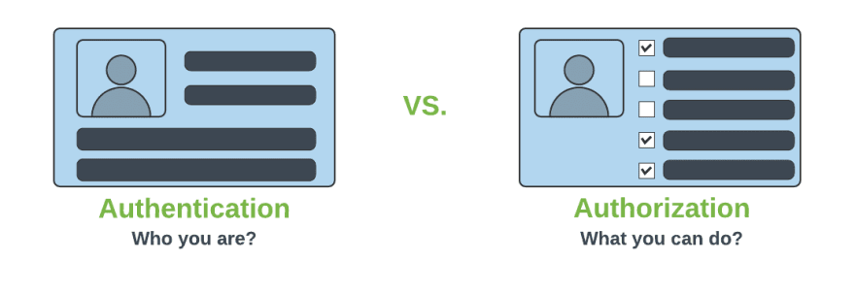
Authentication & Authorization

Slide 85
@EnableWebSecurity
Can be Added to the Class annotated with @Configuration or @SpringApplication
  Can Create a Class of of type WebSecurityConfigurerAdapter
  Spring finds bean with @Configuration and automatically apply Security

Slide 86
WebSecurityConfigurerAdapter
A base class for creating a WebSecurityConfigurer instance.
Can do customization by overriding methods
configure(HttpSecurity)
  Defines the mapping of secured URLs or path that will determine if the user can access specific pages.
configure(AuthenticationManagerBuilder).
  Defines how the security will handle the retrieval of user information commonly in the database.

Slide 87
configure(HttpSecurity)
HttpSecurity
  Provides a Method authoriseRequests()
authorizeRequests()
  To Define custom requirements for URLs
  Can add multiple children to this method.
  The matchers are considered in the order they were declared.
  http.authorizeRequests()
  .anyRequest().authenticated()
  .and().httpBasic();

Slide 88
configure(AuthenticationManagerBuilder).
AuthenticationManagerBuilder
  Used to create an Authentication Manager
Authentication Manager
  Used to authenticate the passed Authentication object,
  Allows building in memory authentication
  Can also use LDAP authentication
  Can also use JDBC based authentication,

Slide 89
Security Config
  @Configuration
  public class SecurityConfig extends WebSecurityConfigurerAdapter {
  @AutoWire
  BcryptaPasswordEncoder encoder;
  @Override
  protected void configure(HttpSecurity http) throws Exception {
  http.authorizeRequests().antMatchers("/first").authenticated().and().httpBasic();
  }
  @Override
  protected void configure(AuthenticationManagerBuilder auth) throws Exception {
  auth.inMemoryAuthentication().withUser("ramesh").password(encoder.encode("ramesh")).roles("USER");
  }

Slide 90
Controller
  @RestController
  public class ProjectController {
  @GetMapping("/first")
  public String getSecuredMessage(Principal user) {
  return "Welcome to Secured Page"+user.getName();
  }
  @GetMapping("/second")
  public String getUnSecuredMessage() {
  return "Welcome to UN-Secured Page";
  }
  }

Slide 91
Sql Statements
  CREATE TABLE users( `username` varchar(50) NOT NULL, `password` varchar(200) NOT NULL, `enabled` tinyint(1) NOT NULL, PRIMARY KEY (`username`))
  CREATE TABLE authorities ( `username` varchar(50) NOT NULL, `authority` varchar(50) NOT NULL, KEY `fk_authorities_users` (`username`), CONSTRAINT `fk_authorities_users` FOREIGN KEY (`username`) REFERENCES `users` (`username`))

Slide 92
SQL Statements
  insert into users (username, password,enabled) values ('india','$2a$10$P.9MaemE6x38wnZer4qauO8Dl9pixQEZ27.yEQglTtyjdmJBRtTFS',true);
  insert into authorities (username, authority) values ('india', 'ROLE_USER');
  insert into test.users (username, password, enabled) values ('nepal','$2a10$t4kkrerTgJlcvTj7QresWuBqAsnxVxMxaJ6UzlXCaP/HSdDraO5QC',true);
  insert into authorities (username, authority) values ('nepal', 'ROLE_ADMIN');

Slide 93
Application.properties
  spring.datasource.url=jdbc:mysql://localhost:3306/test
  spring.datasource.username=root
  spring.datasource.password=srivatsan
  spring.datasource.driver-class-name=com.mysql.cj.jdbc.Driver

Slide 94
Pass Word Encoder
  public static void main(String[] args) {
  BCryptPasswordEncoder encoder = new BCryptPasswordEncoder();
  String encoded = encoder.encode("india");
  System.out.println(encoded);
  encoded = encoder.encode("nepal");
  System.out.println(encoded);
  }

Slide 95
Security Config
  @Configuration
  public class SecurityConfiguration extends WebSecurityConfigurerAdapter {
  @Autowired
  private DataSource dataSource;
  @Bean
  public BCryptPasswordEncoder encoder() {
  return new BCryptPasswordEncoder();
  }

Slide 96
Security Config
  @Override
  public void configure(AuthenticationManagerBuilder auth) throws Exception{
  auth.jdbcAuthentication()
  .dataSource(dataSource)
  .usersByUsernameQuery(
  "SELECT username, password, enabled from users where username = ?")
  .authoritiesByUsernameQuery(
  "SELECT u.username, a.authority " +
  "FROM authorities a, users u " +
  "WHERE u.username = ? " +
  "AND u.username = a.username"
  )
  .passwordEncoder(new BCryptPasswordEncoder());
  }

Slide 97
Using Rest Template-With Security
  @Bean
  public BasicAuthenticationInterceptor interceptor() {
  return new BasicAuthenticationInterceptor("india", "india");
  }
  @Bean
  public RestTemplate template() {
  RestTemplate template = new RestTemplate();
  template.getInterceptors().add(interceptor());
  return template;
  }

Slide 98
Using Rest Template-With Security
  @Bean
  public HttpHeaders headers() {
  HttpHeaders headers = new HttpHeaders();
  headers.setAccept(Arrays.asList(MediaType.APPLICATION_JSON));
  return headers;
  }
  @Bean
  public HttpEntity entity() {
  HttpEntity <String> entity = new HttpEntity<String>(headers());
  return entity;
  }

Slide 99
Using Rest Template-With Security
  public String useGetAll() {
  return this.template.exchange(url,HttpMethod.GET,entity,String.class).getBody();
  }

Slide 100
SPRING AOP

Slide 101
Aspect Oriented Programming
It’s a Programming technique that promotes separation of concerns within a software system
It is not a replacement for Object Oriented Programming.
AOP is another way of organizing Program Structure
An aspect of a program which affect (crosscut) other concerns.
Cross Cutting Concerns
  Transaction management
  Security
  Auditing
  Event handling

Slide 102
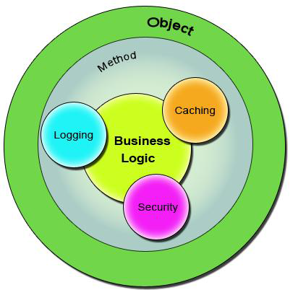
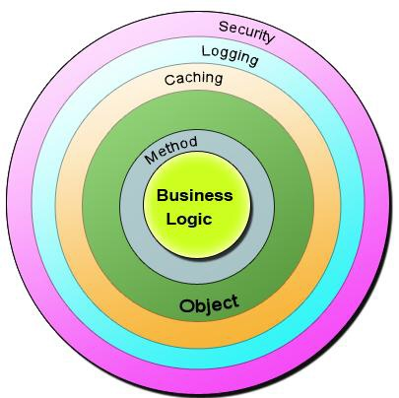
Bean in Spring container

Slide 103
Sample Code
  public class Account {
  public long deposit(long depositAmount){
  newAmount = existingAccount + depositAccount;
  currentAmount = newAmount;
  return currentAmount;
  }
  public long withdraw(long withdrawalAmount){
  if (withdrawalAmount <= currentAmount){
  currentAmount = currentAmount – withdrawalAmount;
  }
  return currentAmount;
  }
  }

Slide 104
The Challenge ?
Requirment -1
  Add security to the Account class - only users with BankAdmin privilege is allowed to do the operations.
Requirement-2
  Account class is to provide some kind of Logging
Requirement-3
Account class need to provide Transaction Management Facility.
New requirements forces the methods and the logic to change a lot which is against the Software Design.
The code has to undergo the Software Development Lifecycle of Development, Testing, Bug Fixing, Development, Testing,

Slide 105
The Solution !
public void deposit(){
// Transaction Management
// Logging
// Checking for the Privileged User
// Actual Deposit Logic comes here
}
public void withdraw(){
// Transaction Management
// Logging
// Checking for the Privileged User
// Actual Withdraw Logic comes here
}
The above logic that cross-cuts or overlaps the existing business logic as Concerns or Cross-Cutting Concerns.
These cross-cutting concerns from the application code can be modularized as different entities.

Slide 106
AOP Terminologies-Aspect
An Aspect is a functionality or a feature that cross-cuts over objects.
Logging and Transaction Management are the aspects.
public void businessOperation(BusinessData data)
{
// Logging logger.info("Business Method Called");
// Transaction Management Begin transaction.begin();
// Do the original business operation here transaction.end();
}

Slide 107
AOP Terminologies-Joint Point
Join Points defines the various Execution Points where an Aspect can be applied.
In Spring AOP, a join point always represents a method execution.
  public void someBusinessOperation(BusinessData data){
  //Method Start - > Possible aspect code here like logging.
  try{
  // Original Business Logic here.
  } catch(Exception exception) {
  // Exception -> Aspect code here when some exception is raised. }
  finally{
  // Finally -> Even possible to have aspect code at this point too.
  }
  // Method End -> Aspect code here in the end of a method.
  }

Slide 108
AOP Terminologies-JoinPoints
Points in the execution of the program
  Start of the Method,
  End of the Method,
  Exception Block,
  Finally Block
In these points an Aspect can be made to execute.
These Execution Points embedding Aspects are called Join Points.
An Aspect need not be applied to all the possible Join Points.

Slide 109
AOP Terminologies-Pointcut
Join Points refer to the Logical Points wherein a particular Aspect or a Set of Aspects can be applied.
A Pointcut or a Pointcut Definition will exactly tell on which Join Points the Aspects will be applied.
pointcut method_start_end_pointcut(){
// This point cut applies the aspects, logging and transaction, before the beginning and the end of the method.
}
pointcut catch_and_finally_pointcut(){
// This point cut applies the aspects, logging and transaction, in the catch block (whenever an exception raises) and the finally block.
}

Slide 110
Advice
Advice is the code that implements the Aspect.
Aspect defines the functionality in a more abstract manner.
Advice provides a Concrete code Implementation for the Aspect.
Creating Advices in Spring
Spring provides support only for Method Aspect and not for Field Aspect

Slide 111
Advices
  Before advice :@Before
  Executes before a join point,
  Does not have the ability to prevent execution flow proceeding to the join point (unless it throws an exception).
After returning advice : @AfterReturning
  Executed after a join point completes normally:
After throwing advice : @AfterThrowing
  Executed if a method exits by throwing an exception.
  After advice :@After
  Executed when normal or exceptional return by which a join point exits
  Around advice : @Around
  Advice that surrounds a join point

Slide 112

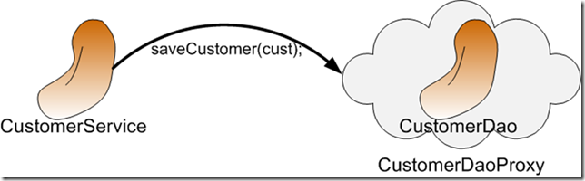
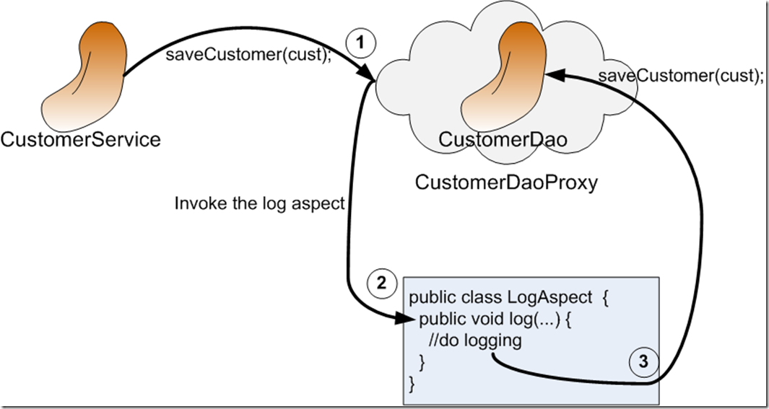
AOP Proxy Mechanism

Slide 113
Using Auto Proxy
Can create proxies automatically for selected bean definitions.
Built on Spring "bean post processor" infrastructure,
Need for ProxyFactoryBean is eliminated
  @Configuration
  @EnableAspectJAutoProxy
  public class AppConfig { }

Slide 114
Format of an execution expression
execution(
  modifiers-pattern
  returning-type-pattern
  declaring-type-pattern
  name-pattern(param-pattern)
  throws-pattern
)
execution(public * *(..)) or within(com.xyz.service.*)
execution – for matching method execution join points

Slide 115
Declaring a pointcut
execution(public * *(..))
the execution of any public method:
execution(* set*(..)) -
the execution of any methods beginning with "set":
execution(* com.xyz.service.AccountService.*(..))
the execution of any method defined by the named interface:
execution(* com.xyz.service.*.*(..))
the execution of any method defined in the service package:

Slide 116
Currency Converter
  public class CurrencyConverter implements MyInterface {
  public double dollorToRupess(double dlrAmt) {
  return dlrAmt * 49.0d;
  }
  public double dollorToEuro(String dlrAmt)
  {
  double val =Double.parseDouble(dlrAmt);
  return val * 70.00d;
  }

Slide 117
@Around Advice
@Aspect
public class MyAroundAdvice {
@Around("execution(* com.training.CurrencyConverter.*(..))")
public Object aroundLog(ProceedingJoinPoint pjp) throws Throwable {
System.out.println("Called Before Method Invocation");
Object ret =pjp.proceed();
System.out.println("I am Around ");
return ret;
}
}

Slide 118
After returning advice
  @Aspect
  public class BankAspect {
  @AfterReturning( pointcut="execution(* get*(..))",
  returning="retVal")
  public void logAfter(JoinPoint joinPoint, Object retVal) {
  //to do something
  }
  }

Slide 119
Before advice
  @Aspect
  public class BankAspect {
  @Pointcut("execution(public * * (..))")
  public void anyPublicMethod() {}
  @Before("anyPublicMethod()")
  public void logBefore(JoinPoint joinPoint) {
  //to do something
  }
  }

Slide 120
After throwing advice
  @Aspect
  public class BankAspect {
  @AfterThrowing(
  pointcut = "execution(* bank..*ServiceImpl.add*(..))",
  throwing = "exception")
  public void afterThrowing(Exception exception) {
  //to do something
  }
  }

Slide 121
CACHING IN SPRING BOOT

Slide 122
Caching
Caching is a part of temporary memory -RAM
  To store data for future reference.
  Between the application and persistence database.
  Stores the recently used data to reduce the number of database hits as much as possible.
  Data access from memory is always faster in comparison to fetching data from the database.
Cache Declaration
  It identifies the methods that need to be cached.
Cache Configuration
  The backing cache where the data is stored and read from.

Slide 123
Which Data To Cache
Data That should be cached
  Data that do not change frequently.
  The frequently used read query in which results does not change in each call, at least for a period.

Slide 124
Caching With Spring
Spring Framework provides caching in a Spring Application
The cache abstraction is a mechanism that allows consistent use of various caching methods with minimal impact on the code.
The Spring abstraction layer can use cache independently of the cache provider.
Supports the Caching Providers
  EhCache
  Hazelcast
  Couchbase
  Redis
  Simple

Slide 125
Hazelcast IMDG
Open-source distributed in-memory object store supporting a wide variety of data structures.
  An in-memory data grid.
Used to store data in RAM, spread and replicate
it across cluster of machines and perform computations on it.
  Replication gives resilience to failures of cluster members.
  Many instances are joined automatically to form the grid.
Can be Used with cloud-native applications and microservices.
The grid is a collection of embedded instances of Hazelcast runtime.

Slide 126
Cache Dependency
Spring Boot finds a cache provider on the classpath
  It finds a default configuration for this provider.
  <dependency>
  <groupId>org.springframework.boot</groupId>
  <artifactId>spring-boot-starter-cache</artifactId>
  </dependency>
  <dependency>
  <groupId>com.hazelcast</groupId>
  <artifactId>hazelcast-spring</artifactId>
  </dependency>
  <dependency>
  <groupId>com.hazelcast</groupId>
  <artifactId>hazelcast</artifactId>
  </dependency>

Slide 127
Configure HazelCast
@EnableCaching
  Will start the search for a Cache Manger bean to configure the cache provider.

Slide 128
@Cacheable
@Cacheable can be applied to @Service,@Controller
It is a method level annotation, starts the cache support.
  Takes two attributes value and key
  Stores using the key-value
Cache will search for the value by the key.
If the value is found in the cache, and the method will not be executed.

Slide 129
@Cacheable
Value:
  To specify the name of cache and is required, Multiple cache names can be supplied by using a String array
Key
  This is the key with which objects will be cached. SpEL expression is used
  @Cacheable(value="posts", key="#postId")
  public Post findById(Integer postId) { }
Can apply a condition by using the condition attribute.
  @Cacheable(value="student", condition="#name.length<20")
  public Student findStudent(String name) { }

Slide 130
@CacheEvict
Used for removing stale or unused data from the cache, since cache can grow quite large and may be holding unused data.
  Can be applied on delete and update methods
Deletes the data from the cache.
  Can define the key that is used to identify the cache item that should be deleted.
  Can delete all entries from the cache
  @CacheEvict(value = "emp", allEntries=true)

Slide 131
@CachePut
It is used when to update the cache without interfering the method execution.
  Method will always execute, and its result will be placed into the cache.
@Cacheable , skips the method execution
@CachePut runs the method and put the result into the cache.
@CacheEvict when you're deleting an object.
  @CachePut(value = "cars", key = "#car.id")
  public Car update(Car car) {

Slide 132
Example
  @Cacheable(cacheNames = "driver",key = "#id")
  public Optional<Driver> findById(long id) {
  return this.repo.findById(id);
  }
  @CachePut()
  public Driver update(Driver entity) {
  return this.repo.save(entity);
  }
  @CacheEvict(value="driver", key = "#entity.id")
  public void delete(Driver entity) {
  this.repo.delete(entity);
  }

