Slide 1
Working With SQL
Has extensive support for working with SQL databases
  Direct JDBC access using JdbcTemplate
  Database handling made easy
  Allows to clean-up the resources automatically
  Converts the standard JDBC SQLExceptions into RuntimeExceptions.
  vendor specific error messages into better understandable error messages.

Slide 2
Spring JDBC
Spring Task
  Connection Management
  Statement Management
  ResultSet Management
  Transaction Management
  Exception Handling
Developer Task
  SQL
  Row Data Retrieval
  Parameter Setting

Slide 3
Spring JDBC – Template pattern
Defines the skeleton of an algorithm in an operation, deferring some steps to subclasses.
Template Method lets subclasses redefine certain steps of an algorithm without letting them to change the algorithms structure.
Add the JdbcTemplate as Dependency

Slide 4
Spring JDBC Template
Has many helpful methods for performing CRUD operations
execute(String sql)
  To Issue a single SQL execute, typically a DDL statement.
queryForList(String sql, Object[] args)
  Query given SQL to create a prepared statement from SQL and a list of arguments to bind to the query, expecting a result list.
update(String sql)
  Issue a single SQL update operation (such as an insert, update or delete statement).

Slide 5
Bean Property Row Mapper
BeanPropertyRowMapper implements RowMapper
  Converts a row into a new instance of the specified mapped target class.
  Class must be a top-level class and it must have a default or no-arg constructor.
  Column values are mapped based on matching the column name as obtained from result set meta-data to public setters for the corresponding properties.
  The names are matched either directly or by transforming a name separating the parts with underscores to the same name using "camel" case.

Slide 6
Data Base Connection Properties
application.properties
spring.datasource.url=jdbc:mysql://localhost:3306/test
spring.datasource.username=root
spring.datasource.password=srivatsan
spring.datasource.driverClassName=com.mysql.cj.jdbc.Driver

Slide 7
Repsository
  public interface CrudRepository {
    int save(Student entity);
    int update(Student entity);
    Student findById(Long id);
    int deleteById(Long id);
    List<Student> findAll();
  }

Slide 8
Repository Implementation
  @Repository
  public class StudentRepository implements CrudRepository {
  @Autowired
  private JdbcTemplate jdbcTemplate;
public List<Student> findAll() {
return jdbcTemplate.query("SELECT * from Student",
BeanPropertyRowMapper.newInstance(Student.class));
}

Slide 9
Find By Id
  public Student findById(Long id) {
  try {
  return jdbcTemplate
  .queryForObject(
  "SELECT * FROM Student WHERE rollNumber=?",
  BeanPropertyRowMapper.newInstance(Student.class), id);
  }
  catch (IncorrectResultSizeDataAccessException e) {
  return null;
  }
  }

Slide 10
Insert
  public int save(Student entity) {
  return jdbcTemplate
  .update(
  "INSERT INTO Student VALUES(?,?,?)",
  new Object[] { entity.getRollNumber(),entity.getStudentName(),entity.getMarkScored() });
  }

Slide 11
Update
  public int update(Student entity) {
  return jdbcTemplate
  .update(
  "UPDATE Student SET studentname=?, markScored=?WHERE rollNumber=?",
  new Object[] { entity.getStudentName(),entity.getMarkScored(), entity.getRollNumber() });
  }

Slide 12
Delete
  public int deleteById(Long id) {
  return jdbcTemplate.update("DELETE FROM Student WHERE rollNumber=?", id);
  }

Slide 13
SPRING BOOT MVC

Slide 14
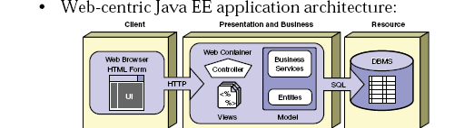
SPRING BOOT MVC

Slide 15
Client calls a program
server returns the Response
Client
(Browser)
WEB
server
html
dB

Slide 16
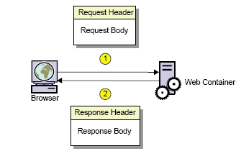
Request and Response

Slide 17
Spring MVC
Web application framework that takes advantage of design principles of Spring framework
Flexible and extensible via component’s
Simplified form handling through its parameter binding
Can do validation and error handling

Slide 18
MVC Architecture
Controller
  Designed around a DispatcherServlet
Model
  Can use any object as a command or form object.
  Data binding is highly flexible.
View
  View resolution is extremely flexible.
  View name resolution is configurable
  Can use properties file to configure views

Slide 19
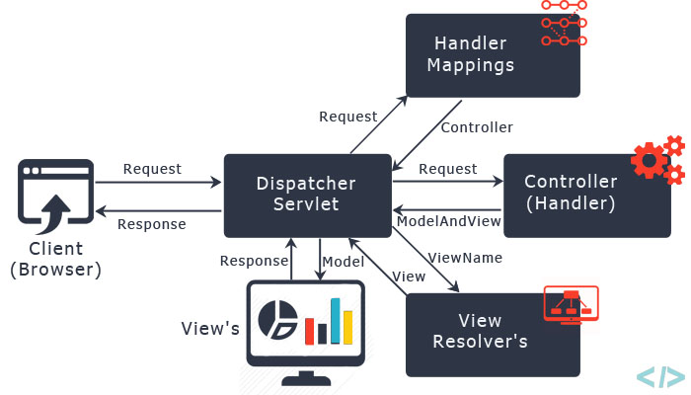
The requesting processing workflow

Slide 20
@RequestMapping
Used to map URLs onto a class or a particular method.
Class-level annotation maps a specific request path or pattern to a controller
Method-level annotations are used to narrow the primary mapping
  HTTP "GET"/"POST“ methods.

Slide 21
First Example
  @Controller
  @RequestMapping("/welcome")
  public class WelcomeController {
  @RequestMapping(value = "/greet",method = RequestMethod.GET)
  @ResponseBody
  public String message() {
  return "Spring MVC";
  }
  }
  http://localhost:8080/welcome/greet

Slide 22
Introduction to JSP Technology
JSP pages, by virtue of the separate placement of the static and dynamic content, facilitates both Web developers and the Web designer to work independently.
Facilitates the segregation of the work profiles of a Web designer and a Web developer.
  A Web designer can design and formulate the layout for a Web page by using HTML.
  A Web developer, working independently, can use Java code and other JSP specific tags to code the business logic.

Slide 23
Jsp Scripting
Scriptlets
  Java code placed inside JSP Page
  <%
  out.println("Hello From Jsp");
  %>

Slide 24
Controller
  @Controller
  public class WelcomeController {
  @RequestMapping("/welcome")
  public String showLoginPage() {
  return "welcome";
  }
  }

Slide 25
View Resolver
InternalResourceViewResolver
  Used to map the logical view names to view files
  spring.mvc.view.prefix=/WEB-INF/pages/
  spring.mvc.view.suffix=.jsp

Slide 26
Welcome.jsp
  src/main/webapp/WEB-INF/pages
  <%@ page language="java" contentType="text/html; charset=ISO-8859-1"
  pageEncoding="ISO-8859-1"%>
  <!DOCTYPE html>
  <html>
  <head>
  <meta charset="ISO-8859-1">
  </head>
  <body>
  <h2>MVC Configured Successfully</h2>
  </body>
  </html>

Slide 27
Dependency Required
Update the pom.xml with following Dependencies
The Entries can be picked from the Effective Pom.
  <dependency>
  <groupId>org.apache.tomcat.embed</groupId>
  <artifactId>tomcat-embed-jasper</artifactId>
  </dependency>
  <dependency>
  <groupId>javax.servlet</groupId>
  <artifactId>jstl</artifactId>
  </dependency>

Slide 28
ModelAndView object
Encapsulates both model and view that is to be used to render model
Model is represented as a java.util.Map
Objects can be added to without name:
  addObject(String, Object) – added with explicit name
  addObject(Object) – added using name generation (Convention over Configuration)
View is represented by String or View object

Slide 29
Controller
  @Controller
  public class FirstController {
  @RequestMapping("/first")
  public ModelAndView execute()
  {
  String message = "Welcome to Spring!";
  return new ModelAndView("Success", “msg",message);
  }
  }

Slide 30
@ModelAttribute
When Used as method parameter, maps a model attribute to the specific, annotated method parameter
The controller gets a reference to the object holding the data entered in the form.
When used at method level provides reference data for the model
The @ModelAttribute annotated methods are executed before the chosen @RequestMapping annotated handler method.
This helps in pre-populating the implicit model with specific attributes,

Slide 31
Model
A map object used to store attribute value pairs
It's created before invoking a handler method if the method has an argument type Model.
  Stores attribute values to render dynamic views such as JSP.
addAttribute(String name, Object obj)
  Used to map attribute names to object as attribute vales.
  public String init(Model model) {
  model.addAttribute("majHeading", "Jeevan Blood Bank");
  return "index";
  }

Slide 32
Model
  @Data
  @AllArgsConstructor
  @NoArgsConstructor
  @ToString
  public class TripDetail {
  private long tripId;
  private String destination;
  private double amount;
  }

Slide 33
Controller
  @Controller
  public class TripController {
  @Autowired
  TripDetail detail;
  @GetMapping("/")
  public String init() {
  return "index";
  }

Slide 34
Controller
    @GetMapping("/addTrip")
    public String initForm(Model model) {
    model.addAttribute("command",detail);
    return "addTripDetails";
    }
    @PostMapping("/addTrip")
    public String onSubmit(@ModelAttribute("data") TripDetail details) {
    System.out.println(details);
    return "success";
    }
    }

Slide 35
Using Spring's form tag library
Spring's form tag library gives the tags access to the command object and reference data of the controller
The form tag library comes bundled in spring-webmvc.jar.
The library descriptor is called spring-form.tld.
<%@ taglib prefix="form" uri="http://www.springframework.org/tags/form" %>
A Form tag puts the command object in the PageContext

Slide 36
View
  <form:form action="/addTrip" method="post“ modelAttribute=“command”>
  <form:form action="/addTrip" method="post">
  <form:input path="tripId"/>
  <form:input path="destination"/>
  <form:input path="amount"/>
  <input type="submit" value="Add">
  </form:form>
From Spring 5.0

Slide 37
@RequestParam
Use to bind request parameters to a method parameter in the controller.
  @RequestMapping ("/find")
  public String get ( @RequestParam ("custId") int id, Model model) {
  Customer cust =dao.findByCustomerId(id);
  model.addAttribute("foundCustomer",cust);
  return "Display";
  }

Slide 38
Spring Validation
JSR-303 Bean Validation API is used by Spring.
The standardized validation constraint declaration and metadata
Annotate domain model properties with declarative validation constraints and the runtime enforces them.
Can define own custom constraints.
To trigger validation of a @Controller input, Input arguments are annotated with @Valid
Using Hibernate Validator in the classpath, Spring will detect it and automatically support across all Controllers

Slide 39
Maven Dependency
  <dependency>
  <groupId>javax.validation</groupId>
  <artifactId>validation-api</artifactId>
  <version>2.0.0.Final</version>
  </dependency>
  <dependency>
  <groupId>org.hibernate</groupId>
  <artifactId>hibernate-validator</artifactId>
  <version>5.4.0.Final</version>
  </dependency>

Slide 40
Inbuilt Validation
@NotNull:
  Field must not be null.
@NotBlank:
  A string field must not be the empty string
  Must have at least one character).
@Min and @Max:
  Numerical field is only valid when it’s value is above or below a certain value.

Slide 41
Inbuilt Validation
@Pattern:
  String field is only valid when it matches a certain regular expression.
  @Pattern(regexp="[0-9]*")
@Email:
  String field must be a valid email address.
@Past, @Future
  Value must be a Date in the future or in the past

Slide 42
Inbuilt Validation
@Length(min=, max=)
  Validates that the annotated character sequence is between min and max included.
@Range(min=, max=)
  Checks whether the annotated value lies between (inclusive) the specified minimum and maximum
@DecimalMax
  The field value must be a decimal value lower than or equal to the number in the value element

Slide 43
Model
  public class BloodDonor {
  private int id;
  @Length(min = 3,max = 8)
  private String name;
  @DateTimeFormat(pattern = "yyyy-MM-dd")
  private LocalDate dateOfBirth;
  private String bloodGroup;
  }

Slide 44
@Valid
@Valid
  Spring does the validation
  No need to create a validator object ourselves.
  Need to tell Spring that we want to have a certain object validated.
Mostly Done on the POST and PUT requests
  These methods take JSON payload within the request body.
  Spring automatically maps the incoming JSON to a Java object.
  To check if the incoming Java object meets requirements.
@Valid annotation in a controller checks and validates .

Slide 45
Binding Result
Spring’s object that holds the result of the validation and binding and contains errors that may have occurred.
The BindingResult must come right after the model object that is validated
  Spring automatically picks up validation annotations
  Spring then invokes the validator and puts any errors in the BindingResult
  Adds the BindingResult to the view model.

Slide 46
Controller - @Valid annotation
  @RequestMapping(“/donors")
  public String initAddDonorForm(Model model) {
  model.addAttribute("command",donor);
  return "addDonor";
  }
  @PostMapping(path="/donors")
  public String greetingSubmit(@Valid @ModelAttribute("command") BloodDonor donor, BindingResult result) {
  if(result.hasErrors()) {
  return "addDonor";
  } else {
  return "result";
  }
  }

Slide 47
Validation Input Jsp Page
  <<form:form method="post" action=" donors" >
  ID: <form:input path=“id" />
  <form:errors path=“id" />
  Name : <form:input path=“name" />
  <form:errors path=“name" />
  <input type="submit" value="Submit" />

