Slide 1


Slide 2
Amazon Web Service
Known as AWS, is a subsidiary of Amazon.com
It Offers cloud-computing services at very affordable rates
  Used by small scale companies to big enterprises
  Provides servers and other IT infrastructure
  Can instantly spin up hundreds or thousands of servers and deliver results faster.
  Need to pay only for what is being used with no up-front expenses and no long-term commitments

Slide 3
Cloud Computing
Using remote servers on the internet to store, manage and process data rather than a local server or personal computer.
Clouds can be categorized into three types:
Public
  Managed by an organization which is open to use by the general public
    Amazon Web Services,Microsoft Azure,IBM Cloud.
Private
  Virtualizes and shares IT infrastructure within a single organization
    HPE,DELL EMC,Vmware
Hybrid
  A mix of a public and a private cloud
    AWS Outposts, Azure Stack, Azure Arc, Google Anthos and VMware Cloud on AWS.

Slide 4
Cloud Computing
SaaS (Software as a Service)
  It allows companies to use software without having to purchase them
  Reduces the expenditure of the company drastically
    Since they are already installed on the cloud server they can be quickly deployed and therefore saves time.
  Many of them run directly through web browser
  Example : Dropbox, Salesforce, Cisco WebEx, GoToMeeting

Slide 5
Advantages of Cloud Computing
Cost-Efficient
  Using cloud computing, only pay for the amount that’s used
Reliability
  A cloud computing platform provides much more managed, reliable and consistent service than an in-house IT infrastructure.
Unlimited Storage
  Cloud computing provides almost unlimited storage capacity
  Can access as much or as little as we need.
Backup & Recovery
  Storing data in the cloud, backing it up and restoring the same is relatively easier than storing it on a physical device.
  The cloud service providers also have enough technology to recover our data, so there is the convenience of recovering our data anytime.
Easy Access to Information
  Can access account from anywhere in the world

Slide 6
Cloud Computing
PaaS (Platform as a Service)
  It allows developers to build applications, collaborate on projects without having to purchase or maintain infrastructure.
  Delivers a framework for developers that they can build upon and use to create customized applications.
  All servers, storage, and networking can be managed by the enterprise or a third-party provider while the developers can maintain management of the applications.
  Example : AWS Elastic Beanstalk, Windows Azure, Heroku

Slide 7
Cloud Computing
IaaS (Infrastructure as a Service)
  It allows companies to rent servers, storage space, etc. from a cloud provider.
  Businesses can purchase resources on-demand and as-needed instead of having to buy hardware outright.
Example :
  DigitalOcean, ,Google Compute Engine (GCE),Amazon Web Services (AWS)
AWS, is a mixture of SaaS ,PaaS and IaaS

Slide 8
Key benefits of AWS
it is the most mature cloud platform
it supports the greatest number of SDK languages
the community support is larger than any other cloud platform

Slide 9
AWS Services
Compute
  It is used to process data on the cloud by making use of powerful processors which serve multiple instances at a time.
Storage and Content Delivery
  The storage as the name suggests, is used to store data in the cloud, this data can be stored anywhere but content delivery on the other hand is used to cache data nearer to the user so as to provide low latency.
Database
  The database domain is used to provide reliable relational and non relational database instances managed by AWS.

Slide 10
AWS Service
Networking
  It includes services which provide a variety of networking features such as security, faster access etc.
Management Tools
  It includes services which can be used to manage and monitor your AWS instances.
Security and Identity
  It includes services for user authentication or limiting access to a certain set of audience on your AWS resources.
Application Services
  It includes simple services like notifications, emailing and queuing.

Slide 11
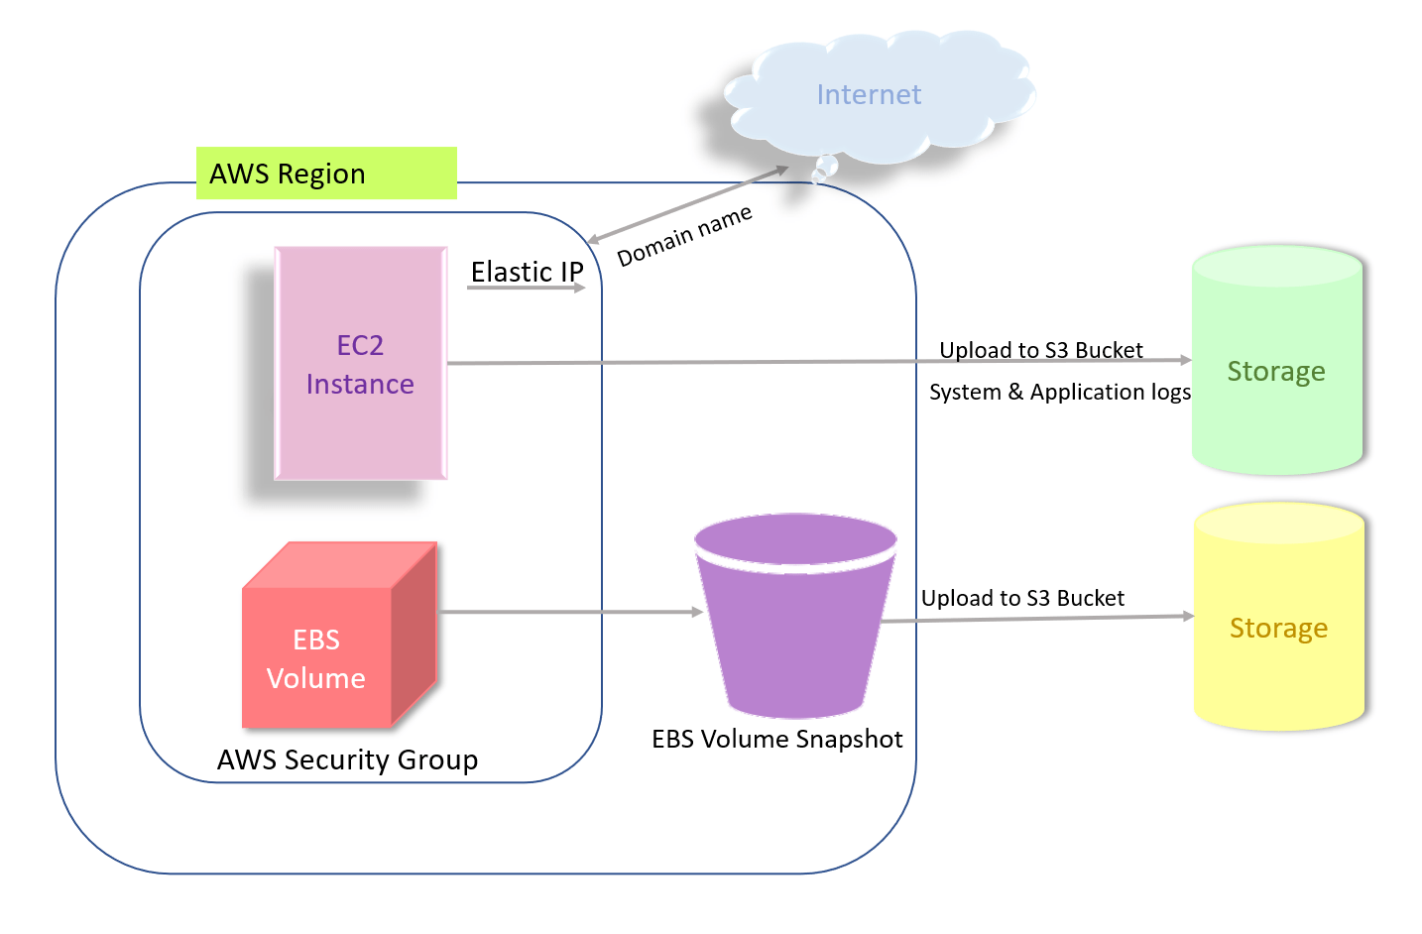
AWS Architecture

Slide 12
ELASTIC COMPUTE CLOUD-EC2

Slide 13
Elastic Compute Cloud
EC2 is short for Elastic Compute Cloud.
It is a service which provides with a virtual server called an instance.
With EC2, can set up and configure the OS and install applications on this instance.
EC2 instances can be resized, and the number of instances scaled up or down as per our requirement.

Slide 14
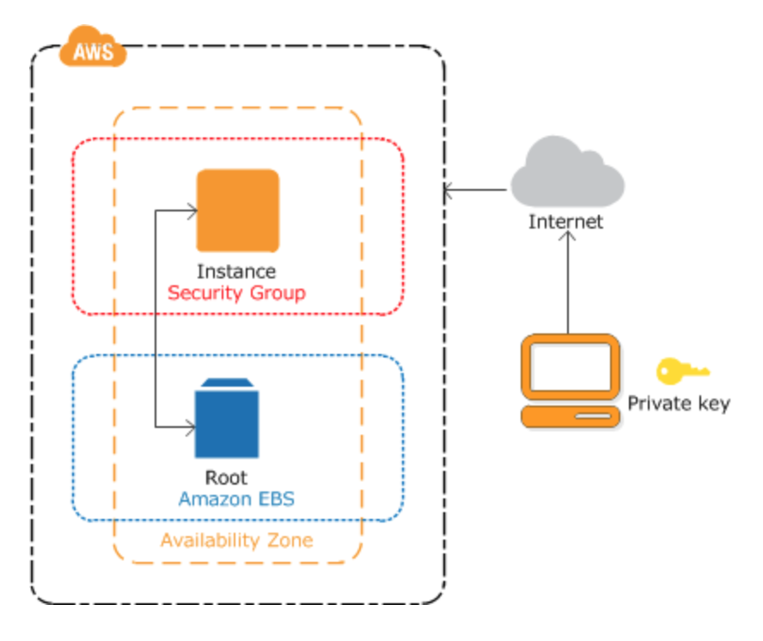
EC2 Instance

Slide 15
EC2 Instance
Instance is an Amazon Elastic Block Storage backed instance,
  i.e., root is an EBS volume.
EBS provides persistent block storage volumes for use to the instance.
  Protects instance from component failure
  High availability and durability
  Consistent and low-latency performance
  Scale usage up or down within minutes

Slide 16
EC2 Instance
Can be created by using the Admin Console
Instance Creation involved three main steps
  Launch an Instance
  Connect to your Instance
  Terminate your Instance
Connecting to the instance
  Through the browser
  Through a standalone SSH client

Slide 17
AWS - Management Console
A web application for managing Amazon Web Services.
AWS Management Console consists of list of various services to choose from.
It also provides all information related to our account like billing.
This console provides an inbuilt user interface to perform AWS tasks like working with Amazon S3 buckets, launching and connecting to Amazon EC2 instances

Slide 18
SIMPLE STORAGE SERVICE-S3

Slide 19
Simple Storage Service (S3)
Storage service for large-capacity, low-cost across multiple geographical regions.
Provides Secure, Durable and Highly Scalable object storage.
Object
  Fundamental entity in S3
  Consists of data, key and metadata.
  Can store any kind of data, in any format
Uses the bucket to store and retrieve data at any time from anywhere on any device.

Slide 20
Buckets
Data in S3 is organized in the form of buckets.
Bucket is a logical unit of storage in S3.
A Bucket contains objects which contain the data and metadata.
Before adding any data in S3 the user must create a bucket which will be used to store objects.

Slide 21
Amazon RDS
Amazon Relational Database Service
  A fully-managed Relational Database cloud service,
  Facilitates the deployment and maintenance of relational databases in the cloud.
Features of Amazon RDS
  Scalable
  Automatic backups
  Software patching
  Management Console,
  Command Line Interface.

Slide 22
Amazon RDS
Supports an array of database engines to store and organize data.
Amazon RDS is not itself a database; it is a service used to manage relational databases.
Supports six types of database engines
  Amazon Aurora
  RDS for MariaDB
  RDS for MySQL
  RDS for Oracle Database
  RDS for PostgreSQL
  RDS for SQL Server

Slide 23
RDS Benefits
Ease of use.
  Admins don't need to learn specific database management tools.
  They also can manage multiple database instances using the management console.
  RDS is compatible with database engines that users may already be familiar with, such as MySQL and Oracle
  Automates manual backup and recovery processes.
Cost-effectiveness.
  Customers only pay for what they use.
  Time spent maintaining instances is reduced,
    because maintenance tasks, such as backups and patching, are automated.

Slide 24
ELASTIC BEAN STALK

Slide 25
Elastic Bean Stalk
A platform within AWS that is used for deploying and scaling web applications.
  Reference to the fairy tale Jack and the Beanstalk.
It’s like a Pre-configured EC2 server
Platform as a service (PaaS)
Takes application code and deploys it while provisioning the supporting architecture and compute resources required for the code to run

Slide 26
Features of Elastic Bean
Stalk
To quickly deploy and manage applications in the AWS Cloud
Reduces management complexity without restricting choice or control.
Once the application is uploaded automatically handles the following details
    Capacity provisioning,
    load balancing,
    scaling,
    application health monitoring.
Supports applications developed in Go, Java, .NET, Node.js, PHP, Python, and Ruby.

Slide 27
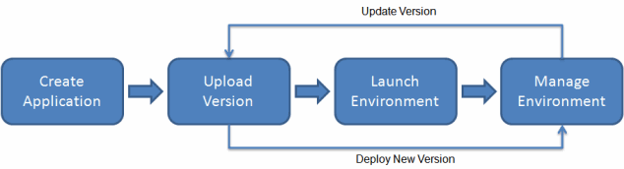
Working with Elastic Bean Stalk
Can use Elastic Beanstalk console
Eb Command Line Interface ,a high-level CLI designed specifically for Elastic Beanstalk.

Slide 28
Elastic Bean Stalk
Application
  A logical collection of Elastic Beanstalk components,
  environments, versions, and environment configurations.
  Application is conceptually like a folder.
Environment
  Collection of AWS resources running an application version.
  Each environment runs only one application version at a time,
  Elastic Beanstalk provisions the resources needed to run the application version specified.

Slide 29
Elastic Bean Stalk
Environment tier
Designates the type of application that the environment runs
  An application that serves HTTP requests runs in a web server environment tier.
  Amazon Simple Queue Service (Amazon SQS) queue runs in a worker environment tier.
Platform
  Combination of an operating system, programming language runtime, web server, application server, and Elastic Beanstalk components.
  Provides a variety of platforms on which applications can be built
  Platforms for different programming languages, application servers, and Docker containers

