Slide 1
Files & IO

Slide 2
Overview
At its lowest level, all Java I/O involves a stream of bytes either entering or leaving memory
Packaged classes exist to make it easy for a program to read and write larger units of data.
Low-level stream class object are used to handle byte I/O
High-level stream class object will allow the program to read and write primitive data values and objects

Slide 3


File Classes
  Java views the data in files as a stream of bytes.
  A stream of bytes from which data are read is called an input stream.
  A stream of bytes to which data are written is called an output stream.
  Java provides classes for connecting to and manipulating data in a stream.
  The classes are defined in the package java.io and are organized in a large complex hierarchy.

Slide 4
File Class
This is an abstract representation file and directory pathnames
  Not used to read and write data
  Used for searching and deleting of files, creating directories and working with path and making directories
  has methods for getting file/directory info.
  cannot be used to read or write to a file.
To make a File object, there are three commonly used constructors File
  File file1 = new File("C:\\Data\\myFile.dat");
  public File(String directory, String filename)

Slide 5
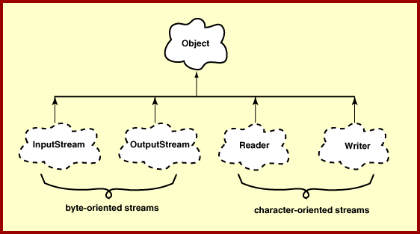
Hirearchy of IO Package

Slide 6
FileWriter
Used to write character to files
The Write method() of this classes is used to write characters
Wrapped by BufferedWriter to improve the performance
FileWriter(File file)
FileWriter(File file, boolean append)
All constructors and methods throw IOException

Slide 7
Print Writer
PrintWriter wraps the FileWriter
Has flexible and powerful methods to write data to files
format(),printf() and append() are used to work with data
print() or println() take a single parameter of any data type

Slide 8
FileReader
Used to read characters from files
The read() method of this class is used to read characters
These are wrapped by BufferedReader to improve the performance
Constructors:
FileReader(File file) throws FileNotFoundException
FileReader(String fileName) throws FileNotFoundException

Slide 9
Buffering
BufferedReader
  Buffers give a temporary holding place to group until it reaches final place.
  It helps in efficent reading of files
  Reads a large amount of data from a file at once and keep that data in buffer
  Minimizes the number of times of file access.
  Provides a readLine() method , which reads a line of characters from the file
  BufferedReader in =
    new BufferedReader(new FileReader(“file.txt"));
BufferedWriter
  Provides a newLine() method , which that creates line separators automatically

Slide 10
Write To File
  public boolean writeToTextFile(Professor prof,File file) {
  boolean result = false;
  try (PrintWriter writer = new PrintWriter(new FileWriter(file,true))){
  writer.println(prof);
  result =true;
  } catch (IOException e) {
  e.printStackTrace();
  }
  return result;
  }

Slide 11
Read From File
  public Professor[] readFromTextFile(File file) {
  Professor[] list = new Professor[4];
  String line =null;
  try(BufferedReader reader = new BufferedReader(new FileReader(file))){
  int i = 0;

Slide 12
Read From File
    while( (line = reader.readLine())!=null) {
    String[] values = line.split(",");
    Professor prof = new Professor(Integer.parseInt(values[0]),
    values[1],values[2], values[3]);
    list[i]= prof;
    i++;
    }
    }catch(IOException e) {
    e.printStackTrace();
    }
    return list;
    }

Slide 13
Serializing
Creating the sequence of bytes from an object and Recreating the object from the above generated bytes
Ability to read or write an object to a stream
  Process of "flattening" an object
Used to save object to some permanent storage
  Its state should be written in a serialized form to a file such that the object can be reconstructed at a later time from that file
Used to pass on to another object via the OutputStream class
  Can be sent over the network

Slide 14
To use serialization
Most Java classes are serializable
Classes need to implement the serializable interface.
  Serializable interface is marker interface
  Class should also provide a default constructor with no args
Objects of some system-level classes are not serializable
  Because the data they represent constantly changes
  Reconstructed object will contain different value anyway
A NotSerializableException is thrown if you try to serialize non-serializable objects

Slide 15
To use serialization
Only the object's data are preserved, Methods and constructors are not part of the serialized stream ,the class information is included
Marking a field with the transient keyword
  The transient keyword prevents the data from being serialized
  All non-transient fields are considered part of an object
Have access to the no-argument (or default) constructor of its first nonserializable superclass (or supersuperclass, supersupersuper class)
Serializability is inherited

Slide 16
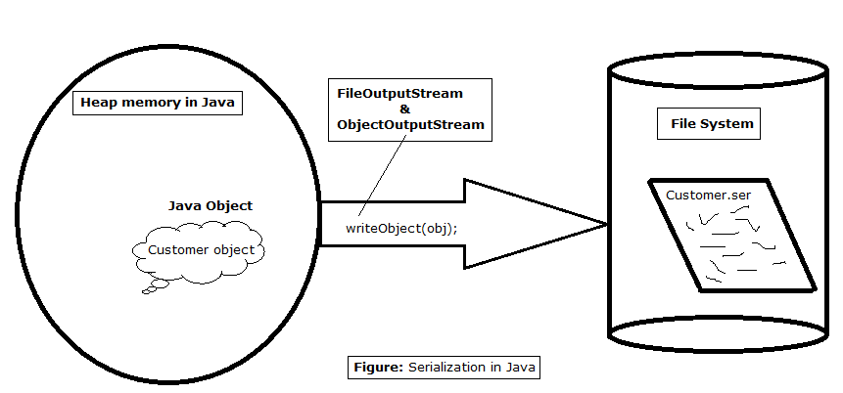
Serialization

Slide 17
Serialization
  public boolean writeObjectToFile(Professor prof,File file) {
  boolean result = false;
  try(ObjectOutputStream outStream = new ObjectOutputStream(new FileOutputStream(file))){
  outStream.writeObject(prof);
  result =true;
  }catch(IOException e) {
  e.printStackTrace();
  }
  return result;
  }

Slide 18
DeSerialization
  public Object readObjectFromFile(File file) {
  Object obj=null;
  try(ObjectInputStream inStream = new ObjectInputStream(new FileInputStream(file))){
  obj = inStream.readObject();
  }catch(ClassNotFoundException | IOException e) {
  e.printStackTrace();
  }
  return obj;
  }

Slide 19
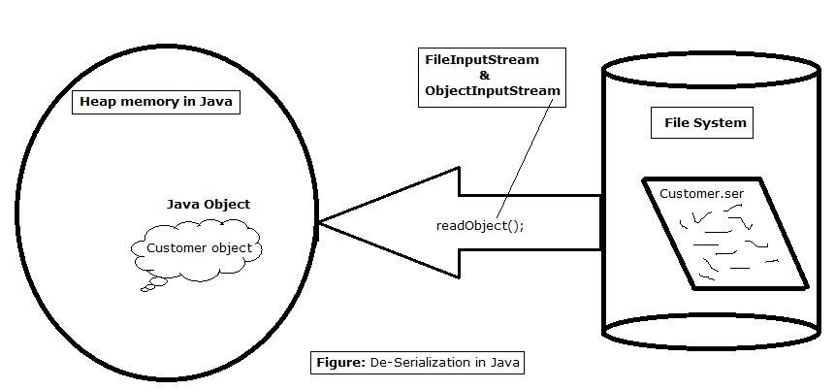
De Serialization

