Slide 1

Continuous Integration

Slide 2
Topics
Continuous Integration.
Jenkins - an Introduction.
Installing and Configuring Jenkins.
Creating a job with Jenkins.

Slide 3
Continuous Integration
A development practice
  developers are required to commit changes to source code in a shared repository several times a day.
  Every commit is then built ,this allows the teams to detect problems early.
Has following benefits to software development:
  Catch issues fast and nip them in the bud.
  Everyone can see what’s happening.
  Automate the build.
  Leads to Continuous Deployment to deliver software more rapidly.

Slide 4
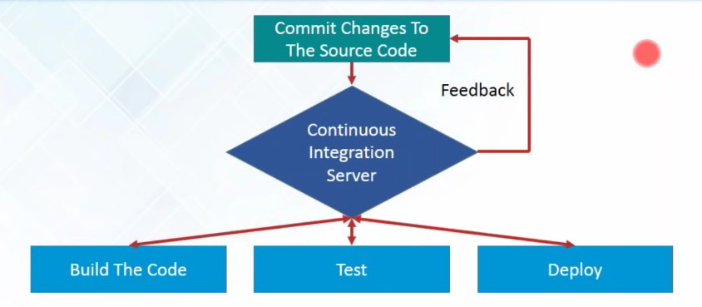
What is Continuous Integration...

Slide 5
What is Continuous Integration
In a large project with many developers, commits are made many times during a day. With each commit code is built and tested.
  If the test is passed, build is tested for deployment.
  If deployment is a success, the code is pushed to production.
  This commit, build, test, and deploy is a continuous process and hence the name continuous integration/deployment.

Slide 6
Continuous Integration tools
Used to host, monitor, compile and test code, or code changes,
Continuous Integration Server
  Jenkins, Bamboo, CruiseControl, TeamCity, and others
Source Control Tool
  CVS, SVN, GIT, Mercurial, Perforce, ClearCase and others
Build tool
  Make, ANT, Maven, Ivy, Gradle, and others
Automation testing framework
  Selenium,, TestComplete, UFT, and others

Slide 7
Jenkins
Leading open source continuous integration tool.
  Builds and tests software continuously
  Monitors the execution and status of remote jobs
  Easier for team members and users to regularly obtain the latest stable code.
Continuous Integration is done by the help of Plugins.
  It provides support for over 1000 Plugins .

Slide 8
Advantages of using Jenkins
  Jenkins is being managed by the community which is very open.
  Created by a developer for developers.
  As technology grows, so does Jenkins.
  Has many plugins published in its plugins database.
  With plugins, Jenkins becomes even more powerful and feature rich.
  Jenkins also supports cloud-based architecture

Slide 9
Installing Jenkins
java -jar jenkins.war --httpPort=9090
Jenkins runs on Java, need latest version of Java Development Kit
  Java –jar Jenkins.war
  Java –jar Jenkins.war –httpPort=9090
Can be downloaded from https://jenkins.io/download/
  Should select the required platform.
  Unzip the downloaded package.
After completing the Jenkins installation process, a browser tab will pop-up asking for the initial Administrator password.
To access Jenkins, : http://localhost:8080

Slide 10
Installing Jenkins
The initial Administrator password should be found under the Jenkins installation path
initialAdminPassword
  A file with the above can be found under C:\Program Files (x86)\Jenkins\secrets.
Customize Jenkins
  Can customize with "Install suggested plugins button"
  Jenkins will retrieve and install the essential plugins
After suggested plugins were installed
Use "Create First Admin User" panel to create users

Slide 11
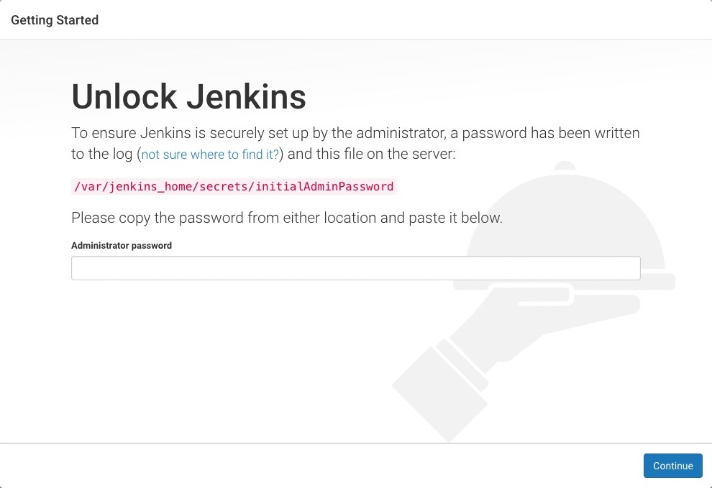
Unlocking Jenkins
Need to unlock Jenkins instance on first access
  Should Enter an automatically-generated password.

Slide 12
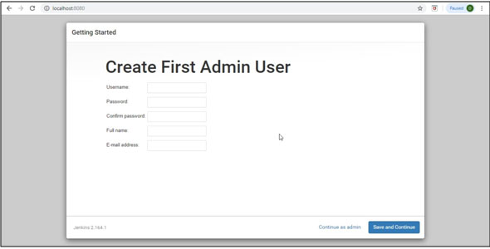
Creating Admin User

Slide 13
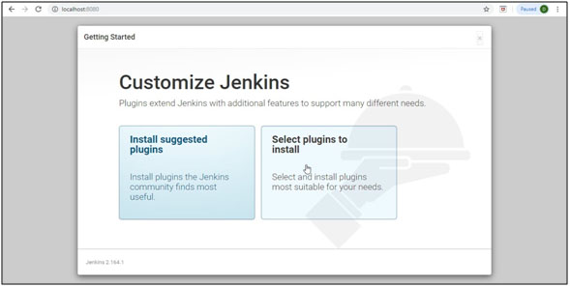
Customize Jenkins

Slide 14
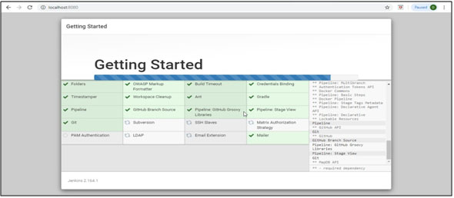
Customize Jenkins

Slide 15
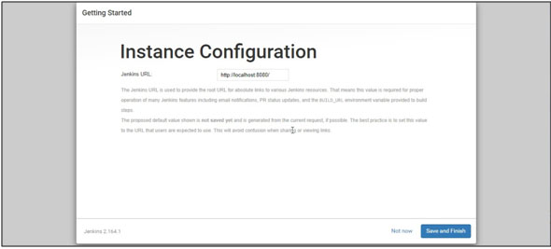
Instance Configurtion

Slide 16
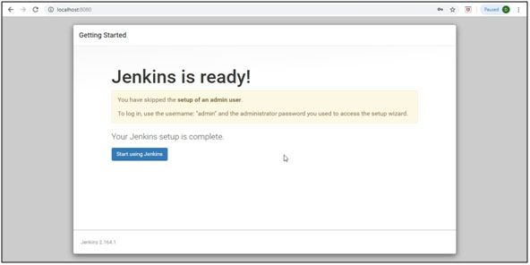
Jenkins Ready

Slide 17
Jenkins Dash Board
Jenkins dashboard is primary control point for interacting with Jenkins.
It includes controls for creating and running builds, inspecting build output, working with credentials and configuring Jenkins.
Can create Jenkins jobs from the Dash Board

Slide 18
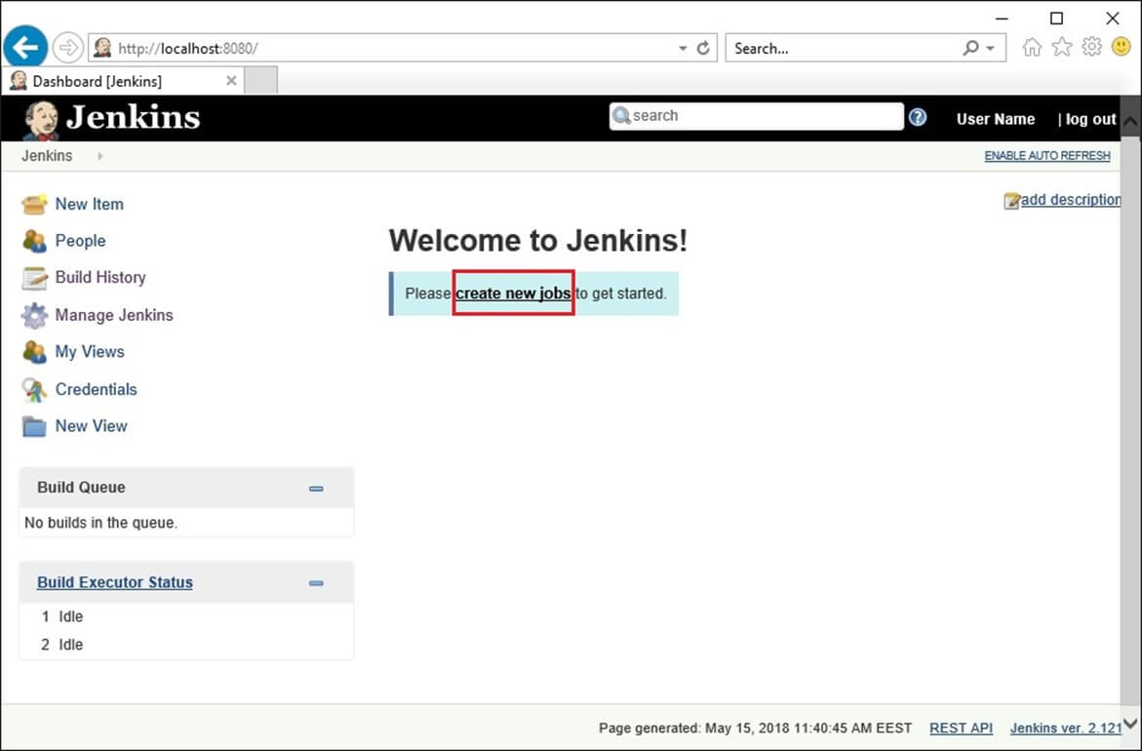
New Job

Slide 19
Simple Project
Begin by clicking the “New Item” link in the Jenkins dashboard.
Enter a name for the new project and select “Freestyle project”
Opens project configuration page
  Can define various aspects of the build.
Select the “Build” section.
Choose “Add build step” button and add a step to “Execute window based command”.
In the “Command” box, enter a command that displays output and Save”
  echo “Hello world”
From the project page click the “Build now” link.

Slide 20
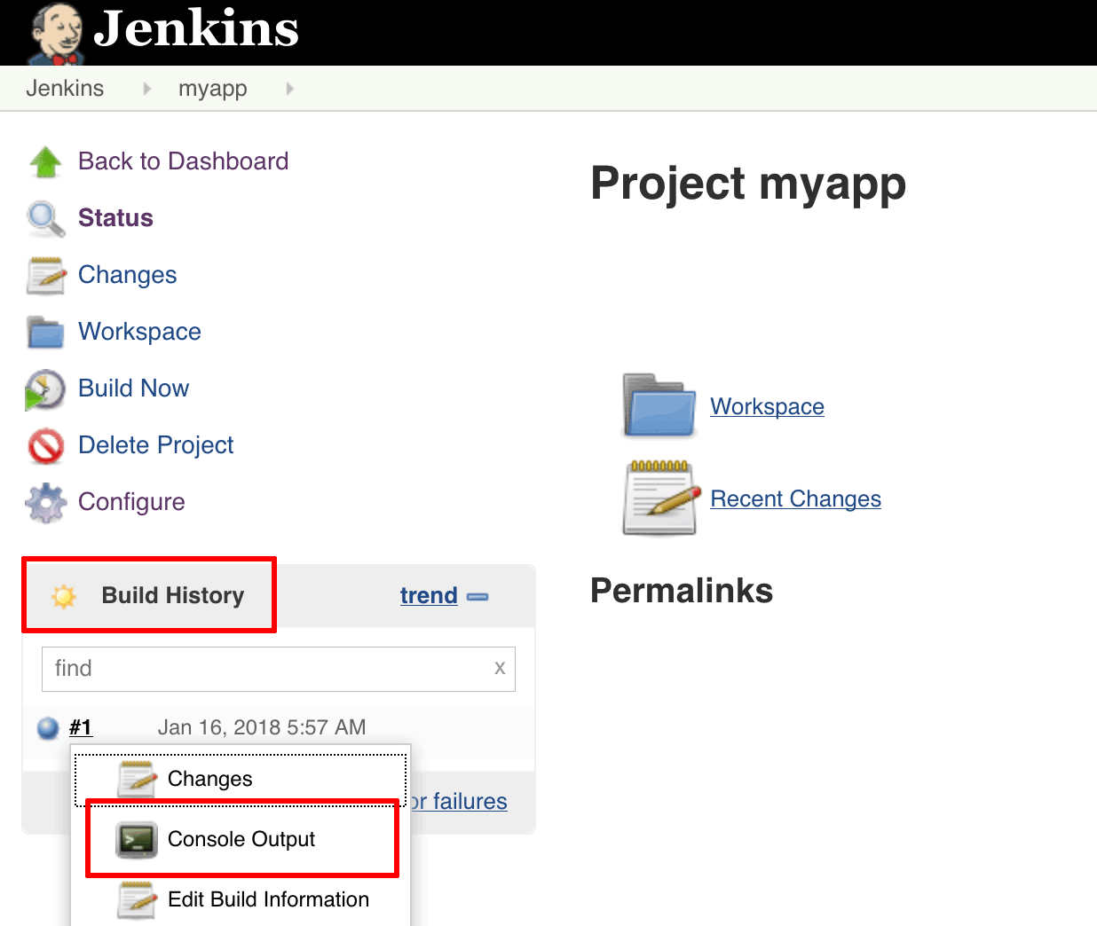
Building with Jenkins
Jenkins will build the project.
The “Build History” panel in the bottom left corner of the page will show you the status of the build
Blue indicates success, red indicates failure

Slide 21
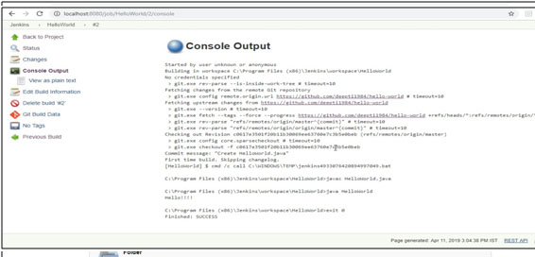

Slide 22
Jenkins Build Jobs
Freestyle job:
  General-purpose build jobs with maximum flexibility and multiple configuration options.
  Can be used for any project type.
  Easy to Set up
Maven Project:
  Specially designed for Maven projects.
  Can use the POM files and project structures
  Gathers information from the POM file to minimize the setup work for your project.

Slide 23
Jenkins Plugins
The default version of Jenkins comes with a limited set of features.
To integrate with version control tools like Git, need to install plugins.
Also Need to add tools and plugins for Maven, Docker etc
Jenkins May install these suggested plugins at the beginning itself.
  Can also add it later

Slide 24
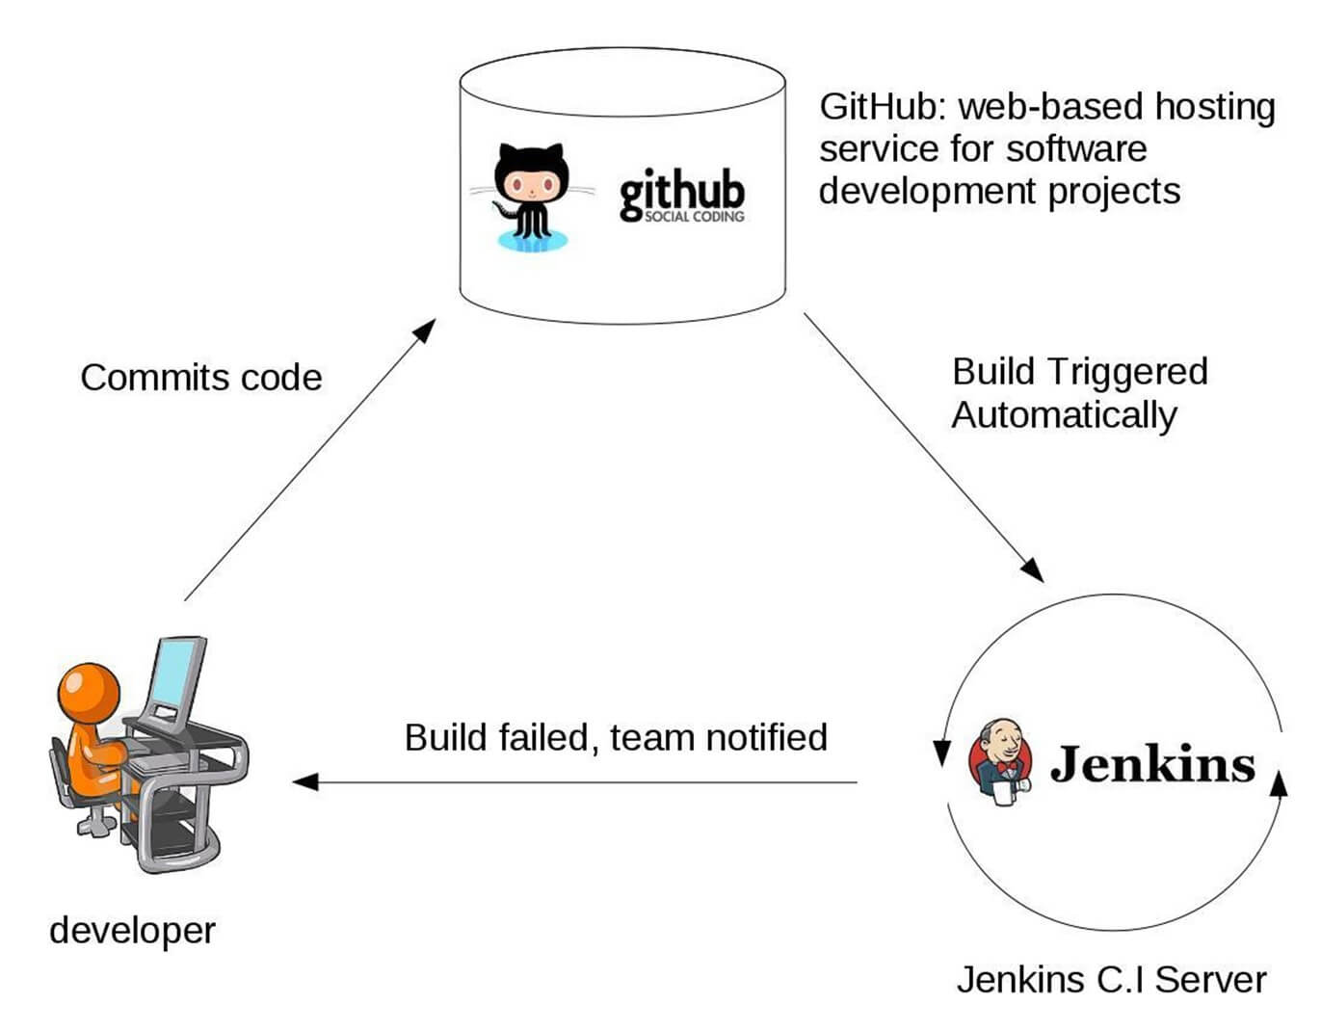
Working of Jenkins

Slide 25
Setting up Jenkins and Maven
Download Maven from Apache Maven.
Extract the files to the relevant application folder.
Navigate to the Jenkins dashboard
Select Manage Jenkins
Select ‘Configure System’
In the Configure system screen, scroll down to Maven section
  Select ‘Add Maven’ button.
Uncheck the ‘Install automatically’ option.
Add name for the setting and the location of the M2_HOME.
Click on the ‘Save’ button at the end of the screen.

Slide 26
Build A Maven Project from GitHub
Can Build project stored in an external SCM, such as GitHub.
From the dashboard. Select the project
Choose the “Configure” button for the project.
In the project configuration page,
  Choose “Source Code Management” section,
  Choose “Git” as the option
  Enter the clone URL for your GitHub repository.

Slide 27
Build A Project From GitHub
From the project configuration page select “Build” section
  Add a new build step to “Invoke top-level Maven targets”.
  In the “Maven Version” field, select the name of the Maven installation just created.
  In the “Goals” field, specify the Maven goals as “clean package”.
Head back to the project page and click the “Build now” link.
Jenkins should clone GitHub repository and build it with Maven.
Once the build is complete, select the “Console Output” menu item to access detailed build information.

Slide 28
Jenkins Build
Status of the build is indicated in two ways, by a weather icon and by a colored ball.
  The weather icon shows you a record of multiple builds in one image.
  The sun represents that builds were successful.
  The color of the ball gives us the status of that build,
  Red shows failure.

Slide 29
BUILD TRIGGER

Slide 30
Build Trigger
Trigger
  Execute a job on an event occurrence.
  This event is called a trigger.
  Has list of build triggers

Slide 31
List of Build Triggers
Trigger build remotely:
  The job is usually triggered by accessing a specified URL. This is convenient for scripts. With the URL, one needs to mention the authorization token as well.
Build after other projects are built:
  As it reads, we need to mention the list of other projects, once those projects are built then the present job is executed.
Build periodically:
  The build is triggered based on the mentioned time. A cron has to be mentioned here.
Poll SCM:
  Configure Jenkins to poll the SCM for ant pushes or commits and then trigger the jobs.

Slide 32
Polling the SCM
Click on the “Configure” of the job created in the Jenkins dashboard.
Click on build triggers in the configure settings and select the Poll SCM.
Enter the desired cron to poll the SCM. Here we have given * * * * which means the Jenkins polls the SCM every minute.

Slide 33
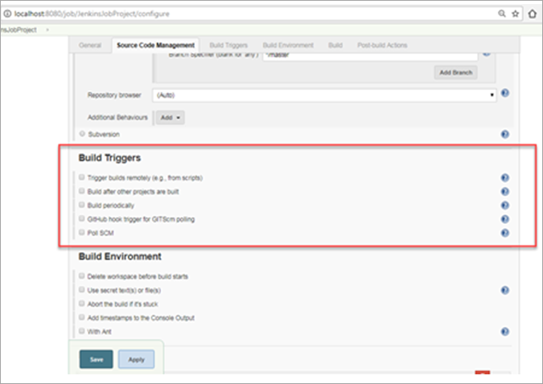
Build Triggers

Slide 34
CRON
CRON contains 5 places for each time entry
Minute (0-59)
  tells at what minute of the hour the Job should build.
Hour (0-23 With 0 is the midnight)
  tells at what hour the job should build in the 24-hour clock.
Day of the month (1-31)
  - tells on which day of the month your job should build. e.g. 23rd of each month.
Month (1-12)
  tells the month when your job should build. You can number or name the month as well I.e. April, May etc.
Day of the week (0-7 With 0 or 7 both being Sunday)
  tells the day of the week when you want to build your job. It can also be a number or name like Mon etc.

Slide 35
CRON
Every day at 6 in the morning
  0 18 * * *
After every 20 minutes
  *0/20 * * * *
After every 4 hours
  0 */4 * * *
This will run every Saturday (6) and Sunday (7) at 5 pm (17).
  0 17 * * 6,7
To schedule your build every 5 minutes, this will do the job :
  */5 * * * *
To the job every 5min past every hour(5th Minute of every Hour)
  5 * * * *

Slide 36
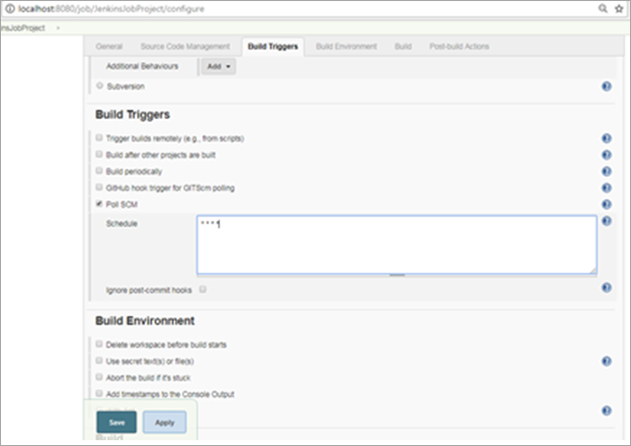
Adding CRON

Slide 37
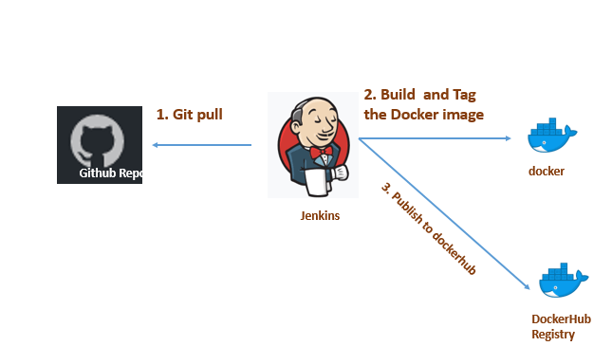
Jenkins –GIT Maven Docker Build

Slide 38
Docker Plugin
Configure Jenkins Server With Docker Plugin
Select Jenkins Dashboard –> Manage Jenkins –> Manage Plugins.
From the Available tab, search for “Docker”
Add the following pluggins
  Cloud bees docker
  Docker-pipeline
  Docker-pluggin
  Docker-buildstep

Slide 39
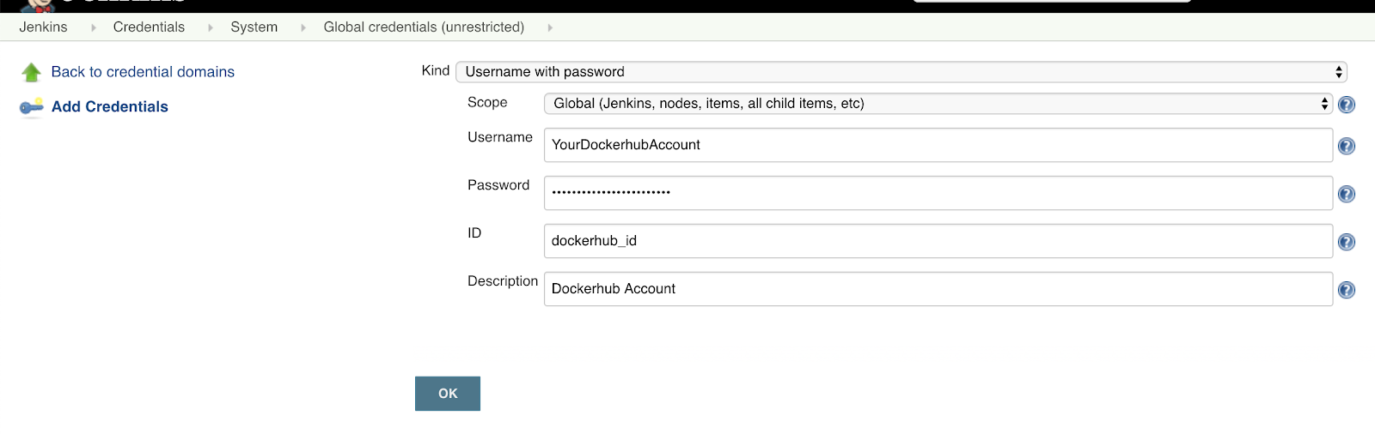
Docker Credentials
Need to create a new credential Docker Hub account details.
Select Credentials → Global → Add credentials
  Fill out the form with your username and password.

Slide 40
Docker
Create a Project with Dockerfile
Commit to the github repository
Select freestyle/maven Build project
Check build publish option in build section
Click on configure add build set/docker build
Set Repository name username/jarname
Registry credentials
Select the build goal as docker build and publish
Add the repo name vatsank/example
Add the repo credentials
Save
Build the project

Slide 41
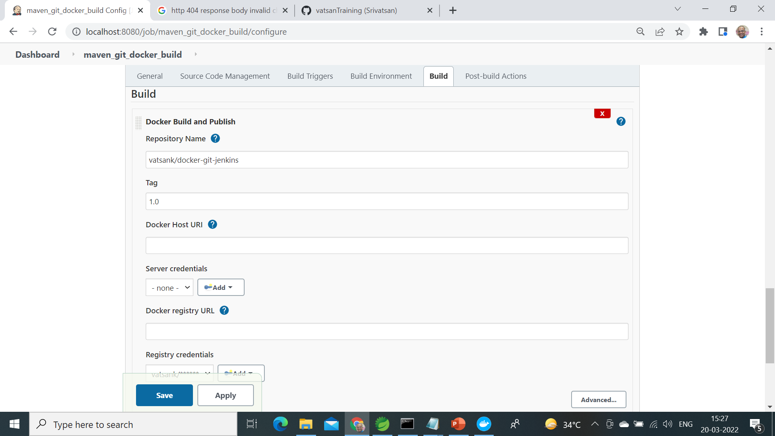

Slide 42
JENKINS PIPELINE

Slide 43
Jenkins Pipeline
Pipeline is a series of interlinked events or jobs.
Its a combination of plugins that support the integration and implementation of continuous delivery pipelines
It contains a group of states called build, deploy, test and release.
  Every state has its events, which work in a sequence called a continuous delivery pipeline.
Every job or event has some sort of dependency on at least one or more events.
  These events are interlinked with each other.

Slide 44
Why Use Jenkins Pipeline
Pipelines are robust.
  Can run multiple jobs, and even use pipelines in a loop.
  If server undergoes an unforeseen restart, the pipeline will be automatically resumed.
  Can pause the pipeline process and make it wait to resume until there is an input from the user.
  The scripted pipeline is stored in Jenkins webUI as a Jenkins file.
  The end-to-end scripted pipeline script is written in Groovy.

Slide 45
Creating a Pipe Line
From the Jenkins home select “New Item”
Give a name, select “Pipeline” and click ok.
Scroll down to the Pipeline section, enter the pipeline code in the script section and save it.
Click “Build Now” and wait for the build to start.
While the job starts Can view each stage executing

Slide 46
Simple Pipe Line
  pipeline {
  agent any
  stages {
  stage('build') {
  steps {
  echo 'build phase called'
  }
  }
  stage('test') {
  steps {
  echo 'test phase called'
  }
  }

Slide 47
Simple Pipe Line
  stage('deploy') {
  steps {
  echo 'deploy phase called'
  }
  }
  }
  }

Slide 48
Pipe Line Block
Pipeline code should be wrapped inside the pipeline block.
  pipeline {
  ---<All Pipeline blocks go here>---
  }
Tools Block
  Can refer to the tools configured in the Jenkins Global tool configuration.
  tools {
  maven 'maven3'
  }

Slide 49
Pipe Line Block
Stages:
  Stages block contains multiple stages.
  stages {
  ---<All Pipeline Stages Go Here>---
  }
Stage Block:
  A stage is a subset of stages.
  Each stage has a steps block.
Steps Block:
  In each steps block can define a set of operations to perform.

Slide 50
SCM Pipe Line
  pipeline {
  agent any
  tools {
  maven "M2_HOME"
  }
  stages {
  stage('Build') {
  steps {
  git 'https://github.com/vatsanTraining/docker-git-jenkins.git'
  dir('docker-git-jenkins'){
  bat "mvn package"
  }
  }

Slide 51
SCM Pipe Line
  post {
  success {
  archiveArtifacts 'docker-git-jenkins/target/*.jar'
  }
  }
  }
  }
  }

