Slide 1
Tortoise Subversion (SVN)

Slide 2
What is version control?
Version management allows to control and monitor changes to files
  What changes were made?
  Revert to pervious versions
  When were changes made
  What code was present in different releases
Earliest tools were around 1972 (SCCS)
Older tools – RCS, CVS, Microsoft Source Safe, PVCS Version Manager, etc…
Current tools – Subversion, Mercurial, Git, Bazaar

Slide 3
We will use subversion (svn)
it’s popular
It’s well supported
  IDEs - Netbeans, Eclipse
  Numerous GUI tools
  Works with xp-dev.com (which we’ll use)
  Git/Mercurial are distributed (more peer-to-peer)

Slide 4
Install TortoiseSVN
System requirements
  TortoiseSVN runs on Windows eithr 32-bit and 64-bit flavours.
Installation
  https://tortoisesvn.net/downloads.html
  TortoiseSVN comes with an easy to use installer.
  Double click on the installer file and follow the instructions.
  The installer will take care of the rest. Don't forget to reboot after installation.
  Need Administrator privileges to install TortoiseSVN.

Slide 5
Basic Concepts
Repository
  Subversion uses a central database which contains all version-controlled files with their complete history.
  This database is referred to as the repository.
  The repository normally lives on a file server running the Subversion server program, which supplies content to Subversion clients (like TortoiseSVN) on request.

Slide 6
Creating a Repository
Can use Subversion's local repository feature
  In real projects a repository is set up somewhere in a Subversion server to control it.
First create a new empty directory
Now right click on the new folder and from the context menu
  choose TortoiseSVN => Create Repository here
  The repository is then created inside the folder
  Its ready to use.
  Its created with a default internal folder structure
    Done by clicking the Create folder structure button.

Slide 7
Importing a Project
Created Repository will be empty
Select a Folder with the files in Explorer and right click on it
  Select TortoiseSVN => Import... which brings up a dialog
A Subversion repository is referred to by URL, which allows to specify a repository anywhere on the Internet.
Point to local repository which has a URL of file:///c:/svn_repos/
Click on OK and the folder is added to repository

Slide 8
Project Layout in Repository
Projects are organized as a good practice in the trunk/branch/tags layout
  Each one makes a clear distinction of the codes contained
Trunk
  To store current release code – only!
  The trunk should always be stable and compilable.
Tags
  These are used to provide a snapshot of the code at a specific point in project’s history
Branches
  Useful for working on significant changes, variations of code etc
  Used for working without disrupting the stable code in the trunk.

Slide 9
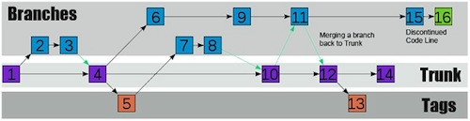
Working of Subversion

Slide 10
Working Copy
Every developer has his own working copy on his local PC.
  Can pull down the latest version from the repository
  work on it locally without affecting others code
  can commit the changes made to the repository.
Working copy does not contain the history of the project
  It keeps a copy of the files as they exist in the repository before starting making changes.
  It is a way to check exactly what changes have been made.

Slide 11
Checking out a Working Copy
Working copy is for day-to-day work.
Importing a folder does not automatically turn that folder into a working copy.
Checkout
  Creating a fresh working copy is Checkout.
Create that folder, then right click on it
  select TortoiseSVN =>Checkout....
  Enter the URL to checkout, in this case file:///c:/svn_repos/
Development folder is then populated with files from the repository.
TortoiseSVN's status icons with green state indicates that the file is unchanged from the version in the repository.

Slide 12
"import" and "checkout"
They are opposites.
"Import"
  is to bring something completely outside of version control into SVN.
  Once something is under SVN control,
  "commit" - new modifications
  "checkout" - already committed.
Can "export" some or all project into a "clean directory".
The source exported is not under version control.
"import into" and "export out of" SVN.
"commit" and "checkout" that's already under SVN control.

Slide 13
Making Changes
Can Start editing files in the working copy
  Icon overlays on these files have now changed to red
  indicating that changes have been made locally.
Right click on one of the changed files
select TortoiseSVN =>Diff.
  TortoiseSVN’s file compare tool starts, showing exactly which lines have changed.
select TortoiseSVN => Commit.
  The commit dialog lists the changed files, each with a checkbox.
  Enter up a message to describe what the change is all about and
  click on OK.

Slide 14
Adding More Files
Right click on the folder and TortoiseSVN => Add.
The Add dialog shows all unversioned files
  Can select the ones to add.
Can also addg files would be to right click on the file itself
  select TortoiseSVN => Add.

Slide 15
Viewing the Project History
Log dialog.
  Shows a list of all the commits made to a file or folder
  Shows the detailed commit messages entered
Undoing Changes
  Can undo changes that are made before its committed
  TortoiseSVN => Revert
  This discards and reverts to the earlier committed version

Slide 16
VERSION CONTROL CONCEPTS

Slide 17
The Repository
repository, is a central store of data.
The repository stores information in the form of a filesystem tree
  a typical hierarchy of files and directories.
Any number of clients connect to the repository, and then read or write to these files.
By writing data, a client makes the information available to others;
By reading data, the client receives information from others.

Slide 18
Client/Server System
The repository remembers every change ever written to it
  Change to every file, and even changes to the directory tree itself,
  Addition, deletion, and rearrangement of files and directories.
Client always reads latest version of the filesystem tree.
Client can also view previous states of the filesystem.

Slide 19
Versioning Models
Version control systems must solve the same Problem:
  How will the system allow users to share information,
    but prevent them from accidentally stepping on each other's feet?
It's all too easy for users to accidentally overwrite each other's changes in the repository.

Slide 20
Problem of File-Sharing
Two users editing the same repository file at the same time.
lock-modify-unlock
  The repository allows only one person to change a file at a time.
  If she tries to lock the file, the repository will deny the request.
  Can read the file and wait for other to finish his changes and release his lock.
After One unlocks the file, his turn is over, and now Other One can take her turn by locking and editing.

Slide 21
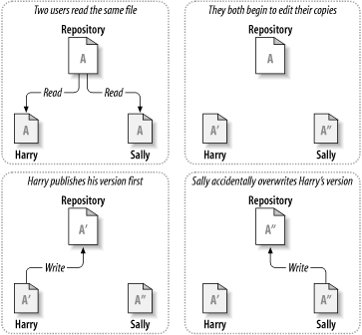
Problem of File Sharing

Slide 22
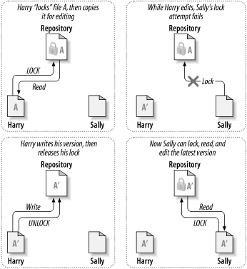
Lock and Modify Solution

Slide 23
The Copy-Modify-Merge Solution
copy-modify-merge
Each user's client reads the repository and creates a personal working copy of the file or project.
Users then work in parallel, modifying their private copies.
Finally, the private copies are merged together into a new, final version.
The version control system often assists with the merging,
  but ultimately a human being is responsible for making it happen correctly.

Slide 24
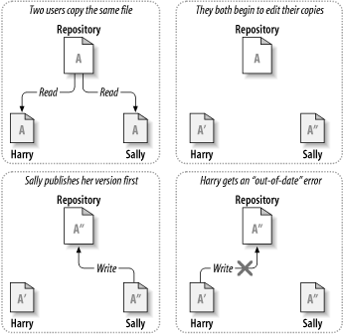
Copy and Merge Solution -1

Slide 25
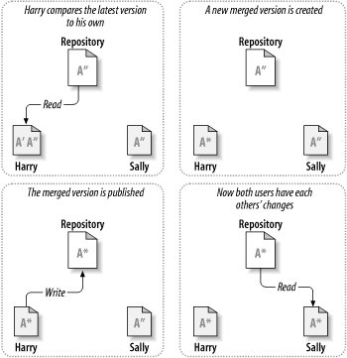
Copy and Merge Solution -Continued

Slide 26
Copy and Merge Solution
Conflict
When One user asks his client to merge the latest repository changes into his working copy
His copy of file A is somehow flagged as being in a state of conflict: he'll be able to see both sets of conflicting changes, and manually choose between them.
Software can't automatically resolve conflicts;
  only humans are capable of understanding and making the necessary intelligent choices.
  The User has to manually resolve the overlapping changes he can safely save the merged file back to the repository.
Subversion uses the copy-modify-merge solution by default

Slide 27
Working Copies
Working copy is an ordinary directory tree on local system, containing a collection of files.
  Can edit these files
  Subversion will never incorporate other people's changes, nor make your own changes available to others, until you explicitly tell it to do so.
  A working copy also contains some extra files, created and maintained by Subversion, to help it carry out these commands.
  Working copy contains a subdirectory named .svn
  Get a working copy, user must check out some subtree of the repository.
  It creates a private copy of the project for you.

Slide 28
The Repository's Filesystem
Committing
  The act of publishing your changes checking in
  changes to the repository.
Subversion only modifies working copies at the user's request.
For other users to bring project up to date,
  Ask Subversion to update working copy
  Done by using the Subversion update command.
Update
  Will incorporate changes into other users working copy
  As well as any others that have been committed since she checked it out.
Subversion uses the information in the .svn directory, to decide which files need to be brought up to date.

Slide 29
Repository URLs
Subversion repositories can be accessed through many different methods - on local disk, or through various network protocols.
  A repository location, however, is always a URL.
For the local machine, the hostname portion of the URL is required to be either absent or localhost.
Local paths normally appear with three slashes, file:///path/to/repos.

Slide 30
Revisions
A svn commit operation can publish changes to any number of files and directories as a single atomic transaction.
Each time the repository accepts a commit, this creates a new state of the filesystem tree, called a revision.
Each revision is assigned a unique natural number, one greater than the number of the previous revision.
The initial revision of a freshly created repository is numbered zero, and consists of nothing but an empty root directory.
Another way to think about it is that revision N represents the state of the repository

