Slide 1
RABBIT MQ

Slide 2
Need for Messaging systems
Loose coupling between modules
Queuing data for later delivery
Asynchronous processing
Reliable load balancing
Producer
Data
Consumer

Slide 3
Rabbit MQ
Rabbit Technologies started as a joint venture
  between LShift and CohesiveFT in 2007
Acquired in April 2010 by SpringSource, a division of VMWare.
  Became part of GoPivotal in May 2013
Client Libraries available for all major languages

Slide 4
Rabbit MQ
RabbitMQ is open source MessagingBroker software
  Message Oriented Middleware
  Server written in Erlang
  Implements Advanced Message Queuing Protocol

Slide 5
AMQP
Advanced Message Queuing Protocol
  An open standard protocol for implementing Message Oriented Middleware).
  Enables conforming client applications to communicate with conforming messaging middleware brokers.
Brokers and Their Role
  Receive messages from applications that publish
  Route to an applications that process them
  Publishers, consumers and the broker can all reside on different machines.

Slide 6
Need for AMQP
JMS API
  Messaging systems that will work only in Java-based applications.
  It does not support other languages.
AMQP
  AMQP supports interoperability between heterogeneous platforms and messaging brokers.
  Can be developed in any language (Java, C++, C#)
  Communication with each other by using AMQP based message brokers.

Slide 7
Erlang
Programming language used to build massively scalable real-time systems with requirements on high availability.
  Used in telecoms, banking, e-commerce, computer telephony and instant messaging.
Can be downloaded from
  https://www.erlang.org/downloads
Launch the Erlang shell:
1> enter 6 * 7.
q(). to quit.

Slide 8
Rabbit MQ
Can be downloaded and Installed from the official website
  https://www.rabbitmq.com/install-windows.html
Open the command window with administration privilege
  run as administrator
Navigate RabbitMQ Server\rabbitmq_server-3.9.13\sbin
Invoke rabbitmq-service start

Slide 9
Rabbit MQ
Open browser and navigate to http://localhost:15672/
  Will redirect to RabbitMQ Dashboard
In the Login page enter the default username and password
  guest
Can create new user and password
rabbitmqctl add_user test test

Slide 10
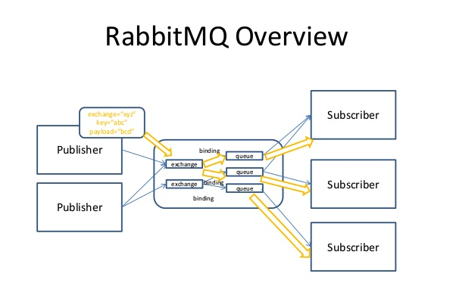
RabbitMQ Overview

Slide 11
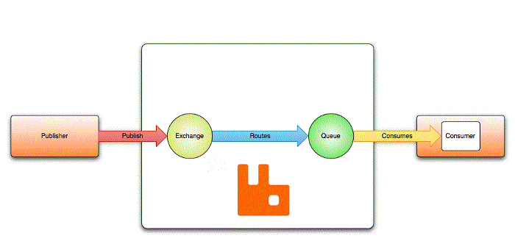
AMQP Entities.
Message
Exchange
Queue
Binding

Slide 12
AMQP Entities.
Messages
  Published to exchanges
Exchanges
Producers sends messages to an exchange.
  Not directly published to a queue.
Exchanges are message routing agents, defined by the virtual host within RabbitMQ.
Exchange is responsible for routing the messages
  Will route to different queues with the help of header attributes, bindings, and routing keys.

Slide 13
AMQP Entities.
Bindings are rules that exchanges use
  To route messages to queues.
  To instruct an exchange E to route messages to a queue Q,
  Q has to be bound to E.
  Bindings may have an optional routing key attribute used by some exchange types.
  The purpose of the routing key is to select certain messages published to an exchange to be routed to the bound queue.
  Routing key acts like a filter.

Slide 14
AMQP Entities.
Store messages that are consumed by applications.
Queues share some properties with exchanges
  Has Additional properties:
    Name
    Durable (the queue will survive a broker restart)
Before a queue can be used it has to be declared.
Declaring a queue will cause it to be created if it does not already exist.

Slide 15
AMQP Entities.
routing key
  A message attribute the exchange looks at when deciding how to route the message to queues
  It’s a String of characters
  Exchange Type decides strategy for routing messages to bounded queues
Broker
  Either deliver messages to consumers subscribed to queues,
  Consumers may fetch/pull messages from queues on demand.

Slide 16
Analogy
Queue is like a in Chennai
Exchange is like Chennai airport
Bindings are routes from Airport to destination.
There can be zero or many ways to reach it

Slide 17
RabbitMQ message flow
The producer publishes a message to the exchange.
  The exchange receives the message and routes the message.
  Binding must be set up between the queue and the exchange.
    Bindings to queues from the exchange.
    Exchange routes the message into the queues.
  The messages stay in the queue until they are handled by a consumer.
  The consumer handles the message.

Slide 18
SPRING AMQP

Slide 19
Spring RabbitMQ
Spring Provides AMQP API to integrate AMQP Message brokers with Spring applications
Popular AMQP protocol implemented Message brokers
  Apache Active MQ server
  Spring Rabbit MQ server
By default, Spring AMQP uses localhost to connect to RabbitMQ.
Spring can load the configuration details from properties file

Slide 20
Dependency
  <dependency>
  <groupId>org.springframework.amqp</groupId>
  <artifactId>spring-rabbit</artifactId>
  </dependency>

Slide 21
Spring AMQP
Exchange
  The Exchange interface represents an AMQP Exchange,
Queue
  The Queue class represents the component from which a message consumer receives messages.
Binding
  A Binding class to represent Binding and its connections.
  new Binding(someQueue, someDirectExchange, "foo.bar");
  new Binding(someQueue, someTopicExchange, "foo.*");
  new Binding(someQueue, someFanoutExchange);

Slide 22
AMQP Template
Rabbit Template
  Spring AMQP provides a “template” that plays a central role.
  The interface that defines the main operations to send and receive.
Sending Messages
  Convert a Java object to an Amqp Message and send it to a t exchange with routing key.
  Has many overloaded methods
  template.convertAndSend(DirectExchangeConfig.EXCHANGE, DirectExchangeConfig.ROUTING_KEY, order);

Slide 23
@RabbitListerner
Receiver class is annotated with @RabbitListener
The Name of the queue is passed
  @RabbitListener(queues = DirectExchangeConfig.ROUTING_KEY)
  public void consumeMessageFromQueue(Order order) {
  System.out.println("Message recieved from queue : " + order);
  }

Slide 24
Exchange
Exchanges control the routing of messages to queues.
Each type defines a specific routing algorithm to determine which bound queues a published message should be routed to.
Direct
  Messages would only be routed when there is queue bonded with Routing Key
Fanout
  Messages would be routed to all queues bounded irrespective of routing key
Topic
  We can use regular expressions for routing key

Slide 25
DIRECT EXCHANGE

Slide 26
Direct Exchange
Delivers messages to queues based on the message routing key.
  route the message to a single queue.
Ideal for the unicast routing of messages
A queue binds to the exchange with a routing key K
  Routing key is set by the producer as a message header
When a new message with routing key R arrives at the direct exchange, the exchange routes it to the queue if K = R
  queues whose binding key exactly matches with the routing key

Slide 27
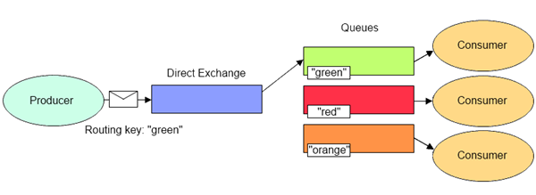
Direct Exchange

Slide 28
Direct Exchange Configuration
  @Configuration
  public class DirectExchangeConfig {
  public static final String EXCHANGE = "direct_exchange";
  public static final String ROUTING_KEY = "restaurant_order";
  @Bean
  public Queue directConfigQueue() {
  return new Queue(ROUTING_KEY, false);
  }

Slide 29
Direct Exchange Configuration
  @Bean
  public DirectExchange direct() {
  return new DirectExchange(EXCHANGE);
  }
  @Bean
  public Binding bindingDirect(DirectExchange direct, Queue directConfigQueue) {
  return BindingBuilder.bind(directConfigQueue).to(direct).with(ROUTING_KEY);
  }
  }

Slide 30
Direct Exchange Publisher
  @RestController
  public class DirectExchangePublisher {
  @Autowired
  private RabbitTemplate template;
  PostMapping(value = "/direct/{restaurantName}")
  public String producer(@RequestBody Order order,@PathVariable String restaurantName) {
  template.convertAndSend(DirectExchangeConfig.EXCHANGE, DirectExchangeConfig.ROUTING_KEY, order);
  return "Message Successfully sent using Direct Exchange";
  }
  }

Slide 31
Message Converter Configuration
  @Bean
  public MessageConverter converter() {
  return new Jackson2JsonMessageConverter();
  }
  @Bean
  public AmqpTemplate template(ConnectionFactory connectionFactory) {
  final RabbitTemplate rabbitTemplate = new RabbitTemplate(connectionFactory);
  rabbitTemplate.setMessageConverter(converter());
  return rabbitTemplate;
  }

Slide 32
Direct Exchange Consumer
  @Component
  public class DirectExchangeUser {
  @RabbitListener(queues = DirectExchangeConfig.ROUTING_KEY)
  public void consumeMessageFromQueue(Order order) {
  System.out.println("Message recieved from queue : " + order);
  }
  }

Slide 33
FANOUT EXCHANGE

Slide 34
Fan Out Exchange
Routes messages to all the queues that are bound to it
  The routing key is ignored.
If N queues are bound to a fanout exchange,
  when a new message is published to that exchange
  a copy of the message is delivered to all N queues.
Ideal for the broadcast routing of messages.
Delivers a copy of message to every queue bound to it

Slide 35
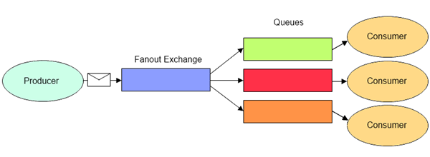
Fan out Exchange Routing

Slide 36
Fanout Exchange Configuration
  public static final String QUEUE_NAME_1 = "restaurant.fanout.q1";
  public static final String QUEUE_NAME_2 = "restaurant.fanout.q2";
  public static final String EXCHANGE_NAME = "fanout.exchange";
  @Bean
  public Queue fanoutQueue1() {
  return new Queue(QUEUE_NAME_1, false);
  }
  @Bean
  public Queue fanoutQueue2() {
  return new Queue(QUEUE_NAME_2, false);
  }

Slide 37
Fanout Exchange Configuration
@Bean
public FanoutExchange fanout() {
return new FanoutExchange(EXCHANGE_NAME);
}
@Bean
public Binding binding1(FanoutExchange fanout, Queue fanoutQueue1) {
return BindingBuilder.bind(fanoutQueue1).to(fanout);
}
@Bean
public Binding binding2(FanoutExchange fanout, Queue fanoutQueue2) {
return BindingBuilder.bind(fanoutQueue2).to(fanout);
}

Slide 38
Fanout Configuration
  @PostMapping(value = "/fan/{restaurantName}")
  public String producer(@RequestBody Order order,@PathVariable String restaurantName) {
  String routingKey = "";
  template.convertAndSend(FanoutExchangeConfig.EXCHANGE_NAME,routingKey, order);
  return "Message Successfully sent using Fan out Exchange";
  }

Slide 39
Fanout Configuration
  @RabbitListener(queues = "restaurant.fanout.q1")
  public void consumeMessageFromQueue1(Order order) {
  System.out.println("Message recieved In ONE queue : " + order);
  }
  @RabbitListener(queues = "restaurant.fanout.q2")
  public void consumeMessageFromQueue2(Order order) {
  System.out.println("Message recieved In SECOND queue : " + order);
  }

Slide 40
TOPIC EXCHANGE

Slide 41
Topic Exchange
Route messages to one or many queues
  based on matching between a message routing key and the pattern that was used to bind a queue to an exchange.
Used to implement various publish/subscribe pattern variations.
Used for the multicast routing of messages.
Involves multiple consumers/applications that selectively choose which type of messages they want to receive

Slide 42
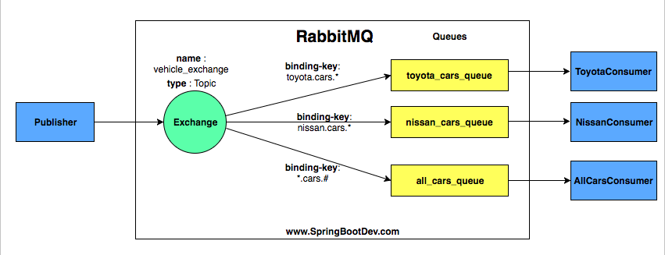
Topic Exchange
Regular Expression as Routing Key
* Denotes one Word
# Denotes one or more word

Slide 43
Topic exchange
Routing-key with wildcards is supported, it is not mandatory
Routing key is a list of words separated with . Character
  taxi.eco.small and taxi.eco.large
Can use * symbol to match any word at a specific position
  taxi.*.large.
Can use # matching of zero or more words,
  taxi.eco.# ,
  which will match all routing keys starting with taxi.eco .
    "*.breakfast.*” = anything that is breakfast
    "*.*.roti“ = anything but it should be roti
    "south.#” = anything that is South

Slide 44
Topic Exchange Configuration
public static final String QUEUE = "orders_queue";
public static final String EXCHANGE = "demo_exchange";
public static final String ROUTING_KEY = "orders_routingKey";
@Bean
public Queue queue() {
return new Queue(QUEUE); }
@Bean
public TopicExchange exchange() {
return new TopicExchange(EXCHANGE);
}
@Bean
public Binding binding(Queue queue, TopicExchange exchange) {
return BindingBuilder.bind(queue).to(exchange).with(ROUTING_KEY);
}

Slide 45
Topic Exchange Configuration
  @PostMapping("/{restaurantName}")
  public String bookOrder(@RequestBody Order order, @PathVariable String restaurantName) {
  order.setOrderId(UUID.randomUUID().toString());
  OrderStatus orderStatus = new OrderStatus(order, "PROCESS", "order placed succesfully in " + restaurantName);
  template.convertAndSend(TopciExchangeConfig.EXCHANGE, TopciExchangeConfig.ROUTING_KEY, orderStatus);
  return "Success !!";
  }

Slide 46
Topic Exchange Configuration
  @RabbitListener(queues = TopciExchangeConfig.QUEUE)
  public void consumeMessageFromQueue(OrderStatus orderStatus) {
  System.out.println("Message recieved from queue : " + orderStatus);
  }

