Slide 1

INTRODUCTION TO SPRING BOOT

Slide 2

Spring Framework
Rod Johnson

Slide 3
Introduction
Spring
  An application development framework and inversion of control container for Java
Spring Boot
  Makes it easy to create stand-alone, production-grade Spring Applications and expose them as services

Slide 4
Spring Framework
Light-weight comprehensive framework for building Java SE and Java EE applications
Created by Rod Johnson
Uses Inversion-of-Control principles
  specifically using the Dependency Injection technique

Slide 5
Key Features
Java Bean-based configuration management,
Integration with persistence frameworks.
MVC web application framework
Aspect-oriented programming (AOP) framework
Publishing REST API’s

Slide 6
IOC CONTAINER

Slide 7
Dependency Injection
A pattern of injecting a class’s dependencies at runtime.
  Achieved by defining the dependencies and then injecting in a concrete class
Can swap in different implementations without having to modify the main class.
Promotes high cohesion by promoting the Single Responsibility Principle (SRP) and low coupling.

Slide 8
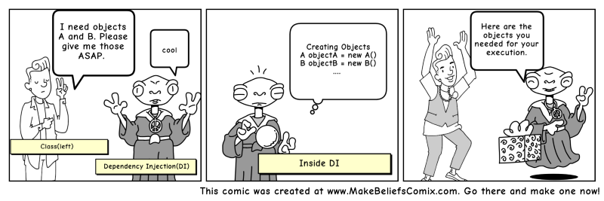

Slide 9
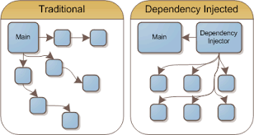
Dependency Injection

Slide 10
Dependency Inversion Principle
public class Messaging {
MessageService service;
public void sendMssage(){
service.sendMessage();
} }
public interface MessageService {
public String sendMessage();
}
public class Email implements MessageService {
public String sendMessage() { }
}
High-level modules should not depend on low-level modules.
Both should depend on abstractions.
High Level Module
Abstraction
Low Level Module

Slide 11
Dependency Inversion Principle
  High level modules should not depend upon low level modules.
  Low and High Modules should depend upon abstractions.
  Low modules should NOT define a interface that Higher Level module depend on
  Higher Level Module should define an interface that lower level module must implement
This gives the flexibility at the cost of increased effort.

Slide 12
Inversion of Control Container(IoC)
A container that supports Dependency Injection.
No Need to create objects but describe how they should be created.
Describe which services are needed by which components by configuration file.
Objects are given their dependencies at creation time by the IoC
IoC - inversion of responsibility with regard to how an object obtains references to collaborating objects.

Slide 13

The Container

Slide 14
Beans
A bean is an object that is instantiated, assembled, and otherwise managed by a Spring IoC container.
The “beans” are in the form of JavaBeans
  Present in a Named Package
  No Argument constructor
  getter and setter methods for the properties
  Can be controlled for scope, life cycle and callbacks.
Beans are singletons by default
Properties of the beans may be simple values or references to other beans

Slide 15
Container
org.springframework.beans.factory.BeanFactory is the representation of the Spring IoC container
  containing and managing beans,
  instantiating or sourcing application objects
  configuring such objects
  assembling the dependencies between objects.
Beans, and the dependencies among them, are reflected in the configuration metadata used by a container
ApplicationContext
  Sub Interface of BeanFactory
  There are many Implementations of the ApplicationContext

Slide 16
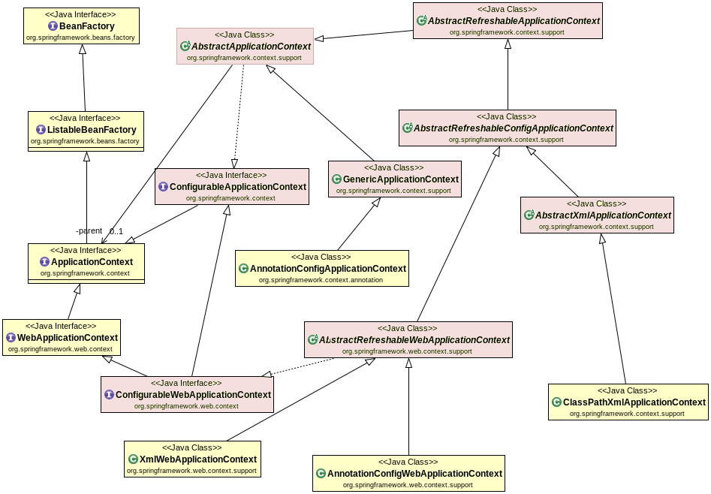
Container Hierarchy

Slide 17
Configuration Meta Data
Instructs IoC Container to instantiate, configure, and assemble the objects
Can be done in XML format
  Supported from Spring 2.0
Can be done with Annotation
  Supported from Spring 2.5
Can be done with Just Java
  Supported from Spring 3.0

Slide 18
DEPENDENCY INJECTION

Slide 19
Dependency Injection
Dependencies between the beans can be Injected by following ways
  Setter Injection (Using Setter Methods)
  Constructor Injection (Using the Constructors)
  Field Injection (@Autowired at field)

Slide 20
Setter Injection
All dependencies injected via setter methods
Allows flexible initialization
Requires Java Bean conventions to be followed
  If Required can add post initialization checking methods

Slide 21
Constructor Dependency Injection
Container invokes a class constructor with a number of arguments, each representing a dependency on the other class
Dependency can be one of the following
  primitive and String-based values
  Dependent object (contained object)
  Collection values

Slide 22
Constructor-based or setter-based DI?
Constructor arguments for mandatory dependencies
  Object becomes less amenable to reconfiguration and re-injection.
Setters for optional dependencies.
  Legacy class may not expose any setter methods

Slide 23
REGISTERING BEANS

Slide 24
@ Component
@Component
  Spring can scan all the beans through auto scan if the class has this or similar annotation
The Registered Beans can be access by Its name
  The Name is first Character of the Class Name in lowercase
  ‘CustomerService’ to ‘customerService’.
CustomerService cust = (CustomerService)context.getBean("customerService");
@Component(“custService”)
  Can Customize the component name by passing a string value

Slide 25
@Bean
Method-level annotation in Class annotated @Configuration
Added to the public Method of the configuration class
  Methods should not be private or final
Method should return an object that should be registered as a Bean
Supports following attributes
  init-method
  destroy-method
  autowireCandidate
  name

Slide 26
Register Bean
Beans can also be registered with Java Based Configuration
  Done in the Java class with @Configuration Annotation
    This class acts as a source of Bean Definitions
  @Configuration
  public class EmployeeConfig {
  @Bean
  public Employee idOfTheBean(){
  return new Employee();
  }
  @Bean (name=“ram”) // bean Id overridden with name attribute
  public Employee employee(){
  return new Employee();
  }
  }

Slide 27
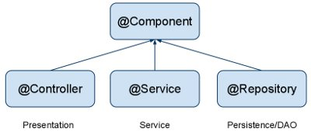
Auto Component Scan Types
@Component
  Indicates a auto scan component.
@Repository
  Indicates DAO component in the persistence layer.
@Service
  Indicates a Service component in the business layer.
@Controller
  Indicates a controller component in the presentation layer.

Slide 28
Auto Wiring of Bean
@Autowired :
  Used to auto wire bean on the setter method, constructor or a field.
  It uses auto wire bean by matching data type.
  @Autowired(required =false)
  Exception will be thrown when matching bean is not found
  required attribute is used to disable this checking
  Will leave the property unset.
@Qualifier
  Used to control which bean should be autowired on a field.
  If there are two similar beans, can specify the bean name to wire

Slide 29
Customer Bean
  @Data
  @NoArgsConstructor
  @AllArgsConstructor
  @FieldDefaults(level = AccessLevel.PRIVATE)
  public class Customer {
  private int customerId;
  private String customerName;
  }

Slide 30
Product Bean
  @Data
  @NoArgsConstructor
  @AllArgsConstructor
  @FieldDefaults(level = AccessLevel.PRIVATE)
  public class Product {
  private int productId;
  private String productName;
  }

Slide 31
Registering The Beans
  @Bean
  public Customer customer() {
  return new Customer(101,"Ramesh");
  }
  @Bean
  public Product tv() {
  return new Product(101,"LED Tv");
  }

Slide 32
Constructor DI
  @Component
  @Data
  public class Invoice {
  private Customer customer;
  private Product product;
  @Autowired
  public Invoice(Customer customer, Product product) {
  super();
  this.customer = customer;
  this.product = product;
  }
  }

Slide 33
Setter DI
  @Autowired
  public void setCustomer(Customer customer) {
  this.customer = customer;
  }
  public Product getProduct() {
  return product;
  }
  @Autowired
  public void setProduct(Product product) {
  this.product = product;
  }
  public Invoice() {
  // TODO Auto-generated constructor stub
  }

Slide 34
Bean Dependencies
Bean-annotated method can have an arbitrary number of parameters
  Each Parameter describe the dependencies required to build that bean.
  @Bean()
  public Catalog catalog() {
  return new Catalog(101,"Classical Menu",address());
  }
  @Bean
  public Address address() {
  return new Address("Gandhi Street","behru Nagar","chennai",600040);
  }

Slide 35
Spring Boot
Extension of the Spring framework
  A faster and more efficient development
Eliminates the boilerplate configurations required for setting up a Spring application.
  Opinionated ‘starter’ dependencies to simplify build and application configuration
  Embedded server to avoid complexity in application deployment
  Metrics, Health check, and externalized configuration
  Automatic configuration whenever possible

Slide 36
Spring Initializr
https://start.spring.io/
  A web-based UI tool provided by the Pivotal
  Used to generate the structure of the Spring Boot Project.
  Can configure the list of dependencies
  Package downloaded as Jar or War file
  Import as a Maven Project into STS

Slide 37
Spring Boot Starters
Set of convenient dependency descriptors
Eliminates the need to hunt through sample code
No need to copy-paste loads of dependency descriptors.
Contains lot of the dependencies that are required to get a project up and running
Also has support of managed transitive dependencies.

Slide 38
Creating a Spring Boot Project
In the Eclipse IDE Right-click in the package explorer and select New -> Spring Starter Project
A screen opens with some details which can be changed or can accept the default values for a simple project
The entry point of a Spring Boot application is the class which is annotated with @SpringBootApplication:
Uses this class with public static void main entry-point to launch an embedded web server.

Slide 39
Spring Boot Bootstrap
  @SpringBootApplication
  public class Application {
  public static void main(String[] args) {
  SpringApplication.run(Application.class, args);
  }
  }
  @SpringBootApplication
  Equivalent to using following with their default attributes
    @Configuration,
    @EnableAutoConfiguration,
    @ComponentScan

Slide 40
Spring Application
  public static void main(String[] args) {
  ConfigurableApplicationContext ctx = SpringApplication.run(BootIocApplication.class, args);
  Tour lankaTour = ctx.getBean("lanka",Tour.class);
  System.out.println(lankaTour);
  System.out.println(ctx.getBean("thailand",Tour.class));
  ctx.close();
  }

Slide 41
@Primary
Used to give higher preference to a bean, when there are multiple beans of same type.
Used on any class directly or indirectly annotated with @Component or on methods annotated with @Bean
If a bean has @Autowired without any @Qualifier
  Multiple beans of the type exist
  Candidate bean marked @Primary will be chosen
@Qualifier should be used in conjunction with @Autowired always.
@Primary should be used in conjunction with @Bean

Slide 42
@Primary
  @Bean
  @Primary
  public Service myService() {
  return new Service();
  }
  @Bean
  public Service backupService() {
  return new Service();
  }
  getBean(Service.class) will return the primary bean

Slide 43
Life Cycle Methods
  @Component
  public class Invoice {
  @PostConstruct
  public void myInit()
  {
  System.out.println("Inside init Method");
  }
  @PreDestroy
  public void myDestroy()
  {
  System.out.println("Inside Destroy Method");
  }
  }

Slide 44
Life Cycle Java Based Configuration
  public class Employee {
  public void start() { // Initialization Work }
  public void close() {
  // Destruction Work
  }
  }
  @Bean(initMethod="start",destroyMethod="close")
  public Employee myBean() {
  return new Employee(employee_Id,employee_Name);
  }

Slide 45
SPRING BEAN SCOPES

Slide 46

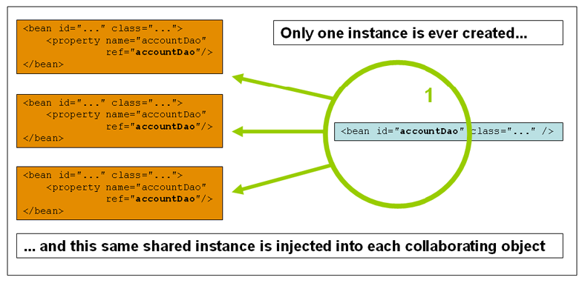
Singleton

Slide 47
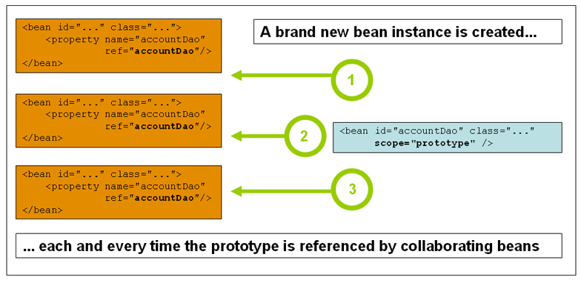
Prototype Scope

Slide 48
Bean Scope
The Bean Scope for Standard Java SE Beans are singleton:
@Scope(scopeName=ConfigurableBeanFactory.SCOPE_SINGLETON)
  Scopes a single bean definition to a single object instance per Spring IoC container, per container and per bean.
  Single instance will be stored in a cache and all subsequent requests and references will result in cached object being returned.
@Scope(value=ConfigurableBeanFactory.SCOPE_PROTOTYPE)

Slide 49
Bean Scope
The Bean Score for Standard Java SE Beans are singleton:
Scopes a single bean definition to a single object instance per Spring IoC container, per container and per bean.
prototype:
  Prototype results in the creation of a new bean instance every time a request for that specific bean is made
  Can change the Scope by
@Scope(value=ConfigurableBeanFactory.SCOPE_PROTOTYPE)

Slide 50
Test the Scopes
  DiscountService service = ctx.getBean(DiscountService.class);
  DiscountNotification protoBean;
  protoBean = service.getDiscount("april");
  log.info("Discount :="+protoBean.showDiscount());
  protoBean = service.getDiscount("may");
  log.info("Discount :="+protoBean.showDiscount());

Slide 51
Test the Scopes
  DiscountService service = ctx.getBean(DiscountService.class);
  DiscountNotification protoBean;
  protoBean = service.getDiscount("april");
  log.info("Discount :="+protoBean.showDiscount());
  protoBean = service.getDiscount("may");
  log.info("Discount :="+protoBean.showDiscount());

Slide 52
Profiles
A way to segregate parts of application configuration and make it only available in certain environments.
Used to control two things:
  Influence the application properties
  Which beans are loaded into the application context.
@Profile
  Used to Create profiles .
  Can be attached to an @Configuration Class
    Can also be attached to @Bean Factory Method.

Slide 53
Profiles- Contd
  public static void main(String[] args) {
  ConfigurableApplicationContextctx=SpringApplication.run(UsingProfilesApplication.class, args);
  System.out.println(“Using Profiles”);
  }

Slide 54
Application.yml
  spring:
  config:
  activate:
  on-profile:
  - dev
  server:
  port: 6060
  logging:
  level:
  '[org.springframework.boot]': trace
  --- => (Three Hypens)

Slide 55
Application.yml
  spring:
  config:
  activate:
  on-profile:
  - prod
  server:
  port: 6065
  logging:
  level:
  '[org.springframework.boot]': info

