Slide 1
Java Persistence API
Notes:
Hibernate 3.0 features - http://blog.hibernate.org/cgi-bin/blosxom.cgi/2005/02/28
A blog on the EJB 3.0 Hibernate Fallacy
http://www.jroller.com/comments/mkeith/Weblog/the_ejb_3_0_hibernate

Slide 2
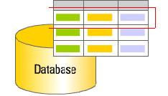
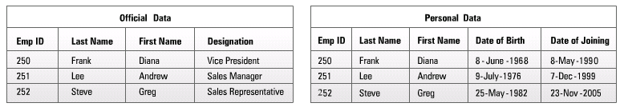
Introduction
An Entity
Bean
Instance

Slide 3
Object –Data Tier Relationship
Object Tier Element | Data Tier Element
Entity Class | Database Table
Field of Entity Class | Database table Column
Entity Instance | Database table row

Slide 4
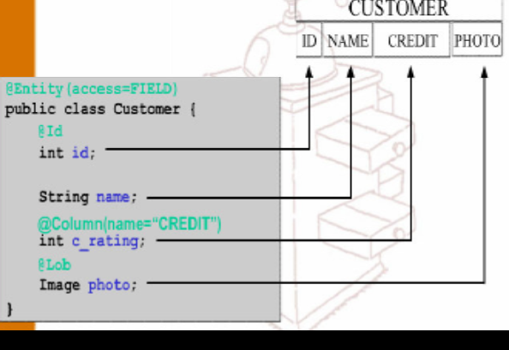
Simple Mapping

Slide 5
Entity Class
@Entity
@Table(name="book")
public class Book {
@Id
@coloum(“booknumber”)
private Long bookNumber;
@column(“bookname”)
private String bookName;
@column(“price”)
private double price;
}

Slide 6
Hikari
Hikari connection pool helps in configuration of Data source and connection pools
Spring Boot selects HikariDataSource by default
Some of the Properties of Connection Pools
connectionTimeout
  The amount of time that a client will wait for a connection from connection pool.
  Time is measured in millisecond
  spring.datasource.hikari.connection-timeout=20000

Slide 7
Hikari Properties
minimumIdle
  The number of idle connections that is maintained in connection pool.
  spring.datasource.hikari.minimum-idle=5
maximumPoolSize
  The maximum pool size.
  spring.datasource.hikari.maximum-pool-size=12
idleTimeout
  The maximum amount of time in milliseconds that a connection is allowed to sit idle in connection pool.
  spring.datasource.hikari.idle-timeout=300000

Slide 8
Hikari Properties
maxLifetime
  Maximum life time in milliseconds of a connection in pool after it is closed.
  spring.datasource.hikari.max-lifetime=1200000
autoCommit
  autoCommit configures the default auto-commit behavior of connections returned from pool.
  Default value is true
  spring.datasource.hikari.auto-commit=true

Slide 9
Primary Key Generation
@Generated Value
  Used to automatically generate the primary key value
  Applied to a Primary key property
  Provides for the specification of generation strategies for the values of primary keys.
  @Id
  @GeneratedValue(strategy = GenerationType.IDENTITY)
  private int rollNumber;
  @Id
  @SequenceGenerator(name="seq",sequenceName="oracle_seq")
  @GeneratedValue(strategy=GenerationType.SEQUENCE, generator="seq")
  private int rollNumber;

Slide 10
Primary Key Generation
Different primary key generation strategies
  Added to the Primary Key property
AUTO
  Selects the generation strategy based on the used dialect,
IDENTITY
  Relies on an auto-incremented database column to generate the primary key,
SEQUENCE
  Requests the primary key value from a database sequence,
TABLE
  Uses a database table to simulate a sequence.

Slide 11
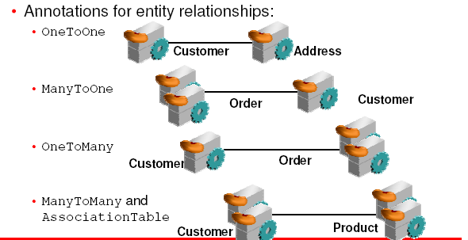
Mapping Relationship Between Entities

Slide 12
JPA Relationships
Relationships can be either unidirectional or bidirectional.
Defining the direction of the relationship between entities has no impact on the database mapping.
  It only defines the directions in domain model.
Bidirectional relationship requires
  The owning side
  inverse or the referencing side

Slide 13
ONE TO MANY RELATIONS

Slide 14
Fetch Types
Depends on the cardinality of the relationship.
FetchType.EAGER
  Fetch immediately
  To get all elements of a relationship when selecting the root entity.
FetchType.LAZY.
  fetch when needed
  The elements of a relationship are fetched only when its requested for

Slide 15
Fetch type
Default Fetch type in case of the below annotations.
  @OneToOne –EAGER.
  @OneToMany –LAZY.
  @ManyToOne –EAGER.
  @ManyToMany –LAZY.

Slide 16
@JoinColumn
Used to specify the column used for joining an entity association
  Indicates that this entity is the owner of the relationship
Name :
  The name of the foreign key column.
Referenced column
  The name of the column referenced by this foreign key column.
  @JoinColumn(name = "patient_ref" , referencedColumnName = "doctorId")

Slide 17
@OneToMany
Defines a many-valued association with one-to-many multiplicity.
  Unidirectional One-to-Many association using a foreign key mapping
targetEntity
  The entity class that is the target of the association.
cascade
  The operations that must be cascaded to the target of the association.
fetch
  Whether the association should be lazily loaded or must be eagerly fetched.
  @OneToMany(targetEntity =Patient.class,
  cascade = CascadeType.ALL,
  fetch=FetchType.EAGER)

Slide 18
Entity -1
  @Data
  @NoArgsConstructor
  @FieldDefaults(level = AccessLevel.PRIVATE)
  @AllArgsConstructor
  @Entity
  @Table(name = "patient")
  public class Patient {
  @Id
  int patientId;
  String patientName;
  String caseHistory;
}

Slide 19
Entity 2
  @Entity
  @Table(name = "doctor")
  public class Doctor {
  @Id
  int doctorId;
  String doctorName;
  @OneToMany(targetEntity =Patient.class,
  cascade = CascadeType.ALL,
  fetch=FetchType.EAGER)
  @JoinColumn(name = "patient_ref" , referencedColumnName = "doctorId")
  @JsonIgnore
  Set<Patient> patientList;
  }

Slide 20
Repositories
  @Repository
  public interface DoctorRepository extends JpaRepository<Doctor, Integer> { }

Slide 21
Service
  @Service
  public class DoctorService {
  @Autowired
  Set<Patient> patientList;
  @Autowired
  Doctor doctor;
  public Doctor createDoctor(){
  doctor.setDoctorId(800);
  doctor.setDoctorName("Rajesh Kanna");
  doctor.setPatientList(this.patientList);
  return this.doctor;
  }
}

Slide 22
Main Method
  DoctorRepository repo= ctx.getBean(DoctorRepository.class);
  DoctorService service = ctx.getBean(DoctorService.class);
  Doctor doctor = service.createDoctor();
  Doctor added= repo.save(doctor);
  System.out.println(added);

Slide 23
ONE TO ONE

Slide 24
@Entity
@Table(name = "company")
public class Company {
@Id
@Column(name = "id")
private int id;
@Column(name = "companyname")
private String companyName;
@OneToOne(cascade = CascadeType.ALL)
@JoinColumn(name = "vendor_ref")
private Vendor vendor;
}

Slide 25
@Entity
@Table(name = "vendor")
public class Vendor {
@Id
@Column(name = "vendorid")
private int vendorid;
@Column(name = "vendorname")
private String vendorName;
@Column(name = "phonenumber")
private long mobileNumber;
}

Slide 26
@Autowired
Vendor vendor;
@Autowired
Company company;
public Company createCompany(){
this.company.setCompanyName("Sharechart Inc");
this.company.setId(4959);
this.company.setVendor(vendor);
return this.company;
}

Slide 27
JPA INHERITANCE-ASSOCIATION

Slide 28
Mapping Inheritance
Joined Subclass
  The root of the class hierarchy is represented by a table.
  Each subclass is represented by a separate table that contains the columns that are specific to the subclass as well as the column that represent the subclass’s primary key.
  If the subclass table has primary key column, it serves as a foreign key to the primary key of the superclass table.
Single Table for Each Class Hierarchy
  All the classes in a hierarchy are mapped to a single table.
  The table has a column that serves as a discriminator column.

Slide 29
Using Single Table
@Entity
@Table(name="USERS")
@Inheritance(strategy=InheritanceType.SINGLE)
@DiscriminatorColumn(name="USER_TYPE",
discriminatorType=DiscriminatorType.STRING,
length=1)
public class User { }
@Entity
@DiscriminatorValue(value="S")
public class Seller extends User{ ..}

Slide 30
JPA Inheritance
  @FieldDefaults(level = AccessLevel.PRIVATE)
  @AllArgsConstructor()
  @NoArgsConstructor
  @Data
  @Entity
  @Table(name="catalog")
  @Inheritance(strategy = InheritanceType.JOINED)
  public class Catalog {
  @Id
  int id;
  String description;
  LocalDate releaseDate;
  }

Slide 31
JPA Inheritance
  @FieldDefaults(level = AccessLevel.PRIVATE)
  @AllArgsConstructor
  @Entity
  @NoArgsConstructor
  @Table(name="corpcatalog")
  @PrimaryKeyJoinColumn(name=“id")
  public class CorpCatalog extends Catalog {
  private double discount;
  public CorpCatalog(int id, String description, LocalDate releaseDate, double discount) {
  super(id, description, releaseDate);
  this.discount = discount;
  }
  }

Slide 32
Inheritance
  @Repository
  public interface CatalogRepository<T extends Catalog>
  extends JpaRepository<T,Integer> {
  Catalog findByDescription(String desc);
  }

