Slide 1

Java Script
Brenden Eich

Slide 2
Topics
Introduction
Events and Event Handling
JavaScript Functions
JavaScipt Objects
Validation
Cookies

Slide 3
INTRODUCTION
Module -1

Slide 4
Java Script
It’s a scripting language, to design interactive web page
it is interpreted by the browser engine while the page is loaded.
  HTML, gives structure to the web pages
  CSS, controls the appearance of web pages
  JavaScript gives the behavior for the page.
Created by Brendan Eich at Netscape and was first introduced in December 1995 under the name of LiveScript.
Its official name is ECMAScript,

Slide 5
Scripts vs. programs
A scripting language is a simple, interpreted programming language
  scripts are embedded as plain text, interpreted by application
  simpler execution model: don't need compiler or development environment
  saves bandwidth: source code is downloaded, not compiled executable
  platform-independence: code interpreted by any script-enabled browser
  but: slower than compiled code, not as powerful/full-featured

Slide 6
Common scripting tasks
adding dynamic features to Web pages
  validation of form data
  image rollovers
  time-sensitive or random page elements
  handling cookies
defining programs with Web interfaces
  utilize buttons, text boxes, clickable images, prompts, frames
limitations of client-side scripting
  since script code is embedded in the page, viewable to the world
  for security reasons, scripts are limited in
  since designed to run on any machine platform, scripts do not contain platform specific commands

Slide 7
Features of JavaScript
Syntax similar to C++ and Java
Loosely typed
Object-based language
  Programming Tool for interactive HTML pages
  Interpreted Language
  Saves time as validation is done on Client side
  Event-Driven Programming
  Detects Client browser, hence platform independent

Slide 8


JavaScript Execution
Other files
Server side code
HTML files
HTML file
JavaScript
Request
Web Server
Response
Client
Script executes locally and interacts with the browser
Server side code executes on the server and sends the response
So JavaScripts on client side executes faster than server-side code.

Slide 9
Placeholders for scripts within HTML
Inside head
  only declarations. Declarations could for variables or functions.
  No standalone executable statements must appear
Inside the body
  any statements can appear
  standalone executable statements inside the body are interpreted in place where it appears.
Along with the event handler
  Script expression can be written as a value when an event like button click happens.

Slide 10
Script Execution – Head Section
Scripts, placed in the head section will be executed
  When they are called or
  When an event is triggered.
  <html>
  <head>
  <script type=“text/javascript">
  some statements
  </script>
  </head>
  </html>
Advantage →
The script will be loaded before anyone uses it.

Slide 11
Scripts Execution - Body Section
A script to be executed while the page is being loaded is placed in the body section.
  <html>
  <head> </head>
  <body>
    <script type=“javascript">
    some statements
    </script>
  </body>
  </html>
Advantage →  The script generates the content of the page.

Slide 12
In lining of JavaScript
  <html>
  <head>
  <title>Example</title>
  </head>
  <body>
  <input type="button" value="Click"
  onclick="javascript:alert('Wrong Button Clicked')"/>
  </body>
  </html>

Slide 13
Calling Java Script From .js Files
Creating a Separate Java Script File
  function display {
  document.writeln("Hello From Java Script");
  }
Create a HTML File to invoke the same
  <script type="javascript" src="First.js"></script>
  <FORM >
  <INPUT TYPE="BUTTON" NAME="b1" VALUE="What\'s your name" onClick=“display()">
  </FORM>

Slide 14
VARIABLES AND CONSTANTS
Module 3

Slide 15
What is a Variable?
Information is stored in variables.
It’s value can be change during the execution of script.
It can be referenced by its name to see its value or to change its value.
Datatype supported – Variant.
Variant can store any type of data.

Slide 16
JavaScript data types & variables
JavaScript has only three primitive data types
  strings
  Numbers
  Booleans
variable names are sequences of letters, digits, and underscores: start with a letter
variables names are case-sensitive

Slide 17
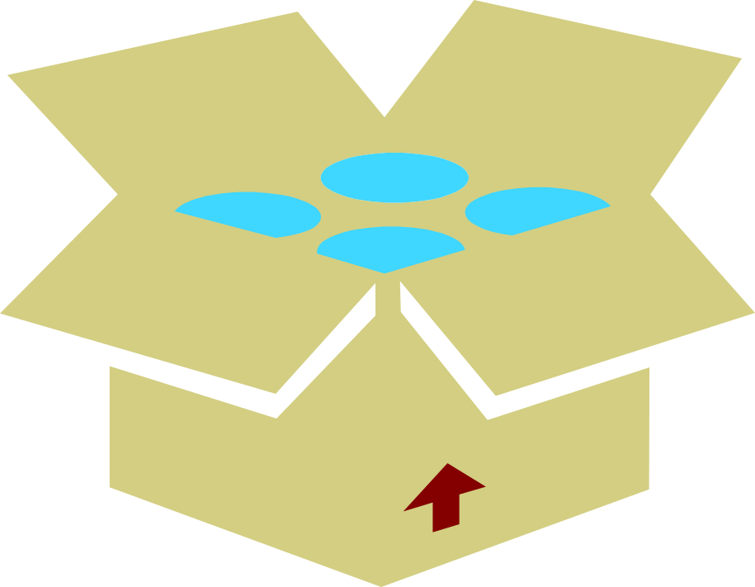
Variant
Integer
Float
Boolean
Char
Variant

Slide 18
Declaring Variables
There are two ways of declaring a variable.
  Implicit Declaration
  Explicit Declaration
Implicit Declaration –
Declare variables by using its name directly in the script.
For example : name=“Tom”
Explicit declaration - Using ‘var’ keyword
For example : var name
name=“Tom”

Slide 19
=== and !==
alert("34"==34); Returns true
alert("34"===34); Returns false
  alert(true===1); returns false
  The ( = ) operator is used to assign or give a value to a variable. It is not a sign for equality.
( == ) compares only values, ( === ) compares both values and data type.

Slide 20
Control statements
Same as in C++ or Java
  if else
  for
  for..in
  while
  do .. while
  switch

Slide 21
EVENTS
Module 2

Slide 22
Java Script Events
Events are occurrences taking place in the context of the interactions between web server, web browser, and web user.
Every element on a web page has certain events which can trigger invocation of event handlers
Attributes are inserted into HTML tags to define events and event handlers
  A mouse click
  A web page or an image loading
  Mouse over a hot spot on the web page
  Selecting an input box in an HTML form
  Submitting an HTML form
  A keystroke

Slide 23
Event Handling
Common events dealt in JavaScript are:
onLoad :triggered by the browser as the new web page content is loaded
onClick;
onSubmit (triggered by the user submitting a form);
onFocus / onBlur (triggered by a user as, for example, she clicks in a textbox or clicks away from a textbox respectively);
onMouseOver / onMouseOut (triggered by the user moving the mouse over or away from an HTML element respectively).

Slide 24
onload
  <SCRIPT type=“text/JavaScript">
  function Hello()
  {
  alert("Welcome to My Page");
  }
  </SCRIPT>
  <body onLoad="Hello()“ >

Slide 25
JAVA SCRIPT FUNCTIONS
Module 4

Slide 26
Functions
JavaScript has a great many built-in functions like write(), alert(), getElementById(), random(), floor(), and several others.
JavaScript also gives you the option to craft your own functions.
A function is a way of packaging your JavaScript commands so you can easily reuse them every time you need the same piece of functionality implemented in your website.
This suggests that there are 2 distinct phases to a function:
The phase where the function is declared (created);
The phase where the function is called (used).

Slide 27
Function
A function can be defined inside <head> , <body> or in a external file and can be called from anywhere after it has been read.
Syntax
  function functionname(var1,var2,...,varX)
  {
  //some code
  }
Functions can be invoked by name of function()
  Function can take arguments (or parameters).
  Can have return statement too.

Slide 28
Functions
  <body>
  <script type="text/javascript”>
  function display(x)
  {
    if(x==null)
    x="Greetings";
    alert(x) ;
  }
  function display1(){
  alert("Greet") ;
  }
  </script>
  </body>

Slide 29
Calling a function
The above function can be called as
  display();
  display(“hello”);
  Or display with any number of arguments
  function display(x){
  if(x==null)
  x=“Greetings”;
  alert(x) ;
  }
You can also pass values to a function that does not take any arguments!

Slide 30
Scope of variable in functions
A variable can have local or global scope on the basis of whether it's declared inside or outside a function block..
Variable having local scope is declared inside a function
  means that it's visible, or accessible, only within the function in which it lives.
  It is created and destroyed every time the function is executed
Variable having global scope is declared outside a function definition
  it's accessible, modifiable , anywhere in the script..
JavaScript does not support block scope except in the special case of block-scoped variables.

Slide 31
Local and Global Variable
All the variables that are not explicitly declared are global.
Local variables are created using var inside the function
  variable without var, defined inside a function global
  gloTotal =0.0;
  function sum(){
    gloY=20;
    var localX=10;
    total=x+y;
  }
  function display(){
    sum();
    alert(total);
    alert(y);
    alert(“Error”+x);
  }

Slide 32
Named function
var Greet=function(person,greeting){
var text=greeting+”-”+person};
Console.log(text);
;
}
Greet(“ram”,”Hello’)

Slide 33
Function that returns value
Function that Retuns Value
  function fun1(){
  return "Hello";
  }
Function with Parameter
  function fun2(name){
  return "Hello :"+name;
  }

Slide 34
Function as arguments
Passing functions as arguments is an externly common idiom in Javascript frameworks like jQuery
  function fun4(myfunc){
  var funRef=myfunc();
  console.log("Function as arguments"+ funRef);
  }
  fun4( function(){
  return "I am from Annon function"}
  );

Slide 35
JAVA SCRIPT OBJECTS
Module 5

Slide 36
Java Script Object
Everything in JavaScript is an object.
Document object
  used to print JavaScript messages on the web page;
Math object,
  To generate random numbers and round off decimals;
Date object
  used to retrieve the current date.
HTML elements like the button object used to manipulate its value attribute;

Slide 37
Properties and Methods
JavaScript script interacts with its object-modelled data by properties and methods.
Properties are values associated with an object.
  HTML element object has a value property and an innerHTML property, that you used to add new mark-up to the web page.
Methods represent what an object can do, its behavior, and are very much like functions.

Slide 38
Objects
Javascript use the object.property and object.method syntax to interact with JavaScript objects.
use the random() method of the Math object Math.random();
use the write() method of the document object document.write();
use the length property of the string object myStringText.length;

Slide 39
Array
Can be created by using new Array()
  var colors = new Array();
  colors[0] = "green"; colors[1] = "red";
Can Use constructor
  var colors = new Array("green", "red");
Shortcut way of creating Array
  var colors = ["green", "red"];
The index position of an item inside an array starts at 0.

Slide 40
Using Arrays
  <script type="text/javascript">
  function show()
  {
  var names = new Array("Ramesh","Suresh","Ganesh“);
  for(i =0;i<3;i++)
  {
  document.writeln(names[i]);
  }
  }
  </script>
  <body>
  <script language="JavaScript">
  show();
  </script>
  </body>

Slide 41
Iteration of Array
var colors = ["green", "red", "yellow", "orange", "blue"];
for (idxPos in colors) {
document.write(colors[idxPos] + "<br />"); }
Sorting an Array
var colors = ["green", "red", "yellow", "orange", "blue"];
var ascendingColors = colors.sort();

Slide 42
Push()
Push()
  adding an item to the end of an array,
var colors = ["green", "red", "yellow", "orange", "blue"];
colors.push("pink");
unshift()
  to add new items to the start index position of an array.
    colors.unshift(“magenta",”violet");
  Magenta,violet, green", "red", "yellow", "orange", "blue"

Slide 43
Window Object -Alert boxes
An alert box is a small window that pops up with a yellow warning sign and a (usually) important message.
With JavaScript we can either show a message to the user either before a page loads or in response to a user action.
  alert (“Welcome to the Test Site!”);

Slide 44
Confirm Boxes
Confirm box
User will have to click either "OK" or "Cancel" to proceed
  <form>
  <input type = ''button" value = “submit" onClick = "confirm(‘are u Sure to submit ' ) ; " >
  </form>
The onClick event handler means that when click on the button, a confirm box pops up.

Slide 45
Message input boxes
Prompt box
User will have to click either "OK" or "Cancel" to proceed after entering an input value
prompt("sometext","defaultvalue")
  var yourname = prompt('Type your name here');
  document.writeln("<center>Welcome, "+ yourname+"</center>");

Slide 46
String Object
Length
  contains the number of characters (including spaces) in the text value of a string.
toUpperCase()
  The toUpperCase() method of the string object turns the text value of a string into, uppercase letters.
  toLowerCase() does the opposite: it turns the text value of a string into lowercase letters.

Slide 47
Date Object
var today = new Date();
var date = new Date(1000);
you pass a millisecond argument that starts at 1970/01/01: //new Date(milliseconds)
var date = new Date("10 November, 2011");
date.toLocaleDateString();

Slide 48
Date Object
getDate() to extract the day of the month
document.write(myDate.getDate());
document.write(myTime.getTime());
Setdate()
var myDate = new Date();
mySetDate = myDate.setFullYear(2011, 9, 31);
date var mySetDay = myDate.getDay(mySetDate);

Slide 49
JAVASCRIPT CUSTOM OBJECTS
Module 9

Slide 50
Custom Objects
Also called prototype-based object oriented language
  Objects are associative arrays
  functions as object constructors and methods
  prototypes instead of classes for inheritance.
  Can be dynamically typed
  Properties and methods can be added dynamically.

Slide 51
Java Script Object
Objects can be created by invoking the built-in constructor of the Object class using new Operator
Can use the shorthand object literal syntax, using curly braces:
  var myObject={};.
Initially empty with no properties or methods
  personObj=new Object();
Can Add properties to it
  personObj.name=“Ramesh";
Can Add an anonymous function to the personObj
  personObj.tellYourage=function(){
  alert(“This age is ” + this.age);
  }

Slide 52
Creating Objects
  function show(){
  var userDefObject= {
  greet:function(name) {
  alert('hello'+name);
  },
  name:'suresh'
  };
  userDefObject.greet('ganesh');
  console.log(userDefObject.name);
  }

Slide 53
Objects with Function Approach
function Animal(){
this.name="cat";
this.getInfo = function(){
return this.name;
}
}
var anim = new Animal();
alert(anim.name);
alert(anim.getInfo());

Slide 54
BLOCK SCOPING

Slide 55
Using let
Allows to scope variables at the block level (the nearest curly brackets).
  function gradeRating(product){
  var grade ="Excellent"
  if(product.rating >3 && product.rating <=4){
  let grade ="Average";
  console.log(grade)
  }
  console.log(grade)
  }
  const tv = new Product(101, "Sony Tv", 'images/sony.jpg', 4.2);
  Output : =>// Excellent

Slide 56
Constant
Const is the new ES6 keyword
  like Java's final
The const declaration creates a read-only reference to a value
  It does not mean the value it holds is immutable,
  Means variable identifier cannot be reassigned.
const PI = 3.141593 PI > 3.0
  const AGE = 13;
  AGE = 20; // Error!

Slide 57
Arrow Functions
Arrow functions are, as the name suggests, functions defined with a new syntax that uses an “arrow” (=>).
  They doesn’t require function keyword, return keyword and curly brackets.
More expressive closure syntax.
  No this, super, arguments
  Cannot be called with new ,throws an error
  No prototype
  No duplicate named parameters

Slide 58
Arrow Functions
There are a variety of syntaxes available in arrow functions.
  var sum = function(num1, num2) {
  return num1 + num2;
  };
  var sum = (num1, num2) => num1 + num2;
  var sum= (num1, num2) => { return num1 + num2; };

Slide 59
Arrow Functions
  genericConverter(funcRef,arg) {
  console.log(funcRef(arg));
  }
  let tempConv = (faren) => {
  return (faren - 32) * (5 / 9)
  }
  genericConverter(tempConv, 45);
  let inrToUsd = (inr) => { return inr * 65 };
  conv.genericConverter(inrToUsd, 650)

Slide 60
Spread
Has … (three dots) notation.
Creating a New data Structure from existing One
Spreading of elements of an “iterable” collection into both literal elements and individual function parameters.
  function sum(a, b, c) {
  return a + b + c;
  }
  var args = [1, 2, 3];
  console.log(sum(…args)); // 6

Slide 61
Spread
  function sum(a, b, c) {
  return a + b + c;
  }
  var args = [1, 2];
  console.log(sum(…args, 3)); // 6

Slide 62
Spread Example
  let firstList = ['ram','shyam'];
  let secondList = ['gaurav','gautam'];
  let spread = [...firstList,...secondList];
  console.log(spread);
  Output will be
    ['ram', 'shyam‘ 'gaurav', 'gautam' ]
  It WILL NOT BE
    [ [ 'ram', 'shyam' ], [ 'gaurav', 'gautam' ] ]

Slide 63
Spread Example
  const x = null;
  const y = {id: 1, name: 'ram'};
  const z = {...x, ...y};
  console.log(z); => Output : { id: 1, name: 'ram' }
  const x = {age:45};
  const y = {id: 1, name: 'ram'};
  const z = {...x, ...y};
  console.log(z); => { age: 45, id: 1, name: 'ram' }

Slide 64
Spread Example
Supply Default Value
  const y = {id: 1, name: 'ram'};
  const z = {...y, location:'chennai'};
  console.log(z)
  { id: 1, name: 'ram', location: 'chennai' }
  Array of Values
  const scores =[90,45,89];
  const y = {id: 1, name: 'ram'};
  const z = {...y, marks:[...scores]};
  console.log(z);
  { id: 1, name: 'ram', marks: [ 90, 45, 89 ] }

Slide 65
Destructuring
It breaks an array into its elements
  Keeping the original array unchanged.
  Taking an Existing Data Structure and extracting values from it
This process maps the same variable names for values.
let [ firstColor, secondColor ] = [ "red", "green", "blue" ];
  0 1 = 0 1 2
  firstColor = red
  SecondColor = green
  console.log(firstColor); // "red"
  console.log(secondColor); // "green"

Slide 66
Destructuring
Using array destructuring assignment, to swap variables
  let a = 1, b = 2;
  [ a, b ] = [ b, a ];
  console.log(a); // 2
  console.log(b); // 1
The destructuring happens on the temporary array, which has the values of b and a copied into its first and second positions.
The effect is that the variables have swapped values.

Slide 67
Object Destructuring
Uses an object literal on the left side of an assignment operation.
Operates on the named properties that are available in objects.
  var donar = {name: "Ramesh", location: "Chennai", group: "bpos"};
  var {name,group} = donar;
  var {name,group} = = {name: "Ramesh", location:
  "Chennai", group: "bpos"}; ;
  console.log(name);
  console.log(group);

Slide 68
De structuring
Using a new Variable Name
  var donar = {name: "Ramesh", location: "Chennai", group: "bpos"};
  var {name: donarName, group: bloodGroup} = donar;
  console.log(donarName);
  console.log(bloodGroup);

Slide 69
Using Default Values
Default values can also be used in object de structuring
  var donar = {name: "Ramesh", location: "Chennai", group: "bpos"};
  var {name,group,lastDonated='12-10-2018'} = donar;
  console.log(name);
  console.log(group);
  console.log(lastDonated) // 12-10-2018

Slide 70
Rest in Object De structuring
The rest syntax can also be used to pick up property keys that are not already picked up by the destructuring pattern.
  keys and their values are copied onto a new object.
  var donar = {name: "Ramesh", location: "Chennai", group: "bpos"};
  var {name,...otherDetails} = donar;
  console.log(name);
  console.log(otherDetails); //{ location: 'Chennai', group: 'bpos' }

