Slide 1

jQuery
John Resig

Slide 2
History of jQuery
The First Stable version of jQuery v1.0 was released in 2006 by a team headed by John Resig
Can be downloaded from the https://releases.jquery.com/
Minified Version :
compressed version with whitespaces and comments stripped out, shorter variable names to preserve bandwidth.
Can use normal jquery.js version for Debugging purpose

Slide 3
Adding JQuery
Local System
Can add using <script> by downloading the minified version
<script type="text/javascript" src="path/to/jquery.min.js">
Adding Jquery with Google CDN
<script src=https://code.jquery.com/jquery-3.7.1.js> </script>

Slide 4
The jQuery Function
$() function returns an object containing an array of the DOM elements
Wraps the collected elements with extended functionality
Made ready for another action.,
Takes selector as the argument
$(selector)
Or
jQuery(selector)
$ is an alias for the jQuery() function

Slide 5
First JQUERY-Anonymous Functions
<head>
<script type="text/javascript" src="js/jquery.js"></script>
<script type="text/javascript" >
$(document).ready(function() {
$("#msgId").html("<b>Hello From JQuery<b>");
});
</script>
</head>
<body>
<div id="msgId"></div>
</body>

Slide 6
Selection
2

Slide 7
Basic Selectors
Basic jQuery selectors work the same as CSS selectors:
$(“*”) - // Selectors return a pseudo-array of jQuery elements
Selectors start with $(), representing the global jQuery function
It can take following arguments
Tag Name: Represents a tag name available in the DOM.
Tag ID: Represents a tag available with the given ID in the DOM.
Tag Class : Represents a tag available with the given class in the DOM.
If more than one element has the same id only the first matched element in the DOM will be returned

Slide 8
Basic Selectors
<p id="id1">Java</p>
<p id="id2" class="style1">JEE</p>
<div>Spring</div>
=$("#id1").text();
$(".style1").text();
=$(“div“).text();

Slide 9
Form Selectors
:input -> Input, textarea, select, and button elements
:enabled -> Form elements that are enabled
:disabled -> Form elements that are disabled
:checked -> Radio buttons or checkboxes that are checked
:selected -> Option elements that are selected
$(":checkbox")implies $("*:checkbox")).
var retVal =$("input:text#txtFld1").val();
var retVal=$("input:radio[name=rad]:checked").val();

Slide 10
Event Handling

Slide 11
Event Handling
The event handling methods are core functions in jQuery.
Event handlers are method that are called when "something happens" in HTML.
The term "triggered (or "fired") by an event" is often used.
.click( handler(eventObject) )
$("button").click(function(){ $("p").hide(); });
$('div').click(handler).keydown(handler);

Slide 12
On Method
.on( events [, selector ] [, data ], handler(eventObject) )
Introduced with jQuery 1.7,
Its combination of bind, live method.
$( "#members li a" ).on( "click", function( e ) {} );
$( document ).on( "click", "#members li a", function( e ) {} );

Slide 13
On Method
$(function(){
$(document.body).on('mouseover',"#tab tr", function(){
$(this).addClass("selected");
}) .on('mouseout',"#tab tr", function(){$(this).removeClass("selected")});
$('#add').click(function(){
$('#tab').append('<tr><td>1</td><td>Jquery</td></tr>');
});
});

Slide 14
Dom Manipulation

Slide 15
Creating Elements
There are two ways to create elements in jQuery:
A string with HTML markup as argument to the jQuery function:
$("<p>Hi there!</p>") : creates a New Paragraph
var menuli1 = $('<li class="menu-li1">About Us</li>');
A string with HTML markup and a JavaScript object as the second argument, can be text, event callbacks and other HTML attributes.
var menuli1 = $('<li/>', { 'class': 'menu-li1',
'text': ‘About Us'
});

Slide 16
Inserting Elements
Create elements can be insert elements into a page.
Elements can be inserted:
Before an existing element
After an existing element
Inside a container element, at its beginning
Inside a container element, at its end
Two approaches to each method of inserting elements into a page:
Place the selected element(s) relative to another element
Place an element relative to the selected element(s)

Slide 17
Inserting an Element Before Another Element
.insertBefore()
$(‘<ol><li>Chennai</li></ol>').insertBefore('#place_list1');
.before()
$("#place_list1 :eq(2)").before("<li>Orissa<li>");
.before():
the selector expression preceding the method is the container before which the content is inserted.
.insertBefore()
the content precedes the method, either as a selector expression or as markup created on the fly, and it is inserted before the target container.

Slide 18
Inserting an Element as the Last Child of a Parent
.append() : As the Last Child
newRow= "<tr><td>F105</td><td>jQuery</td></tr>";
$("table").append(newRow);
.appendTo()
newRow=$("<li/>").html("Noida");
newRow.appendTo("#place_list1");
$( '<p>', {
html: 'Hello!',
'class': 'greet'
});

Slide 19
Jquery –ajax interaction

Slide 20
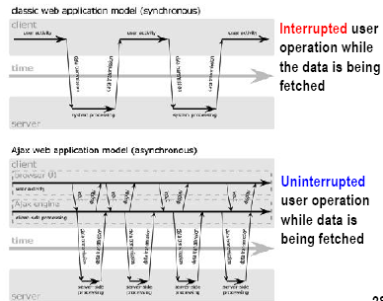
Notes:
I assume some of you have seen this picture before. This picture
compares the user interaction models of conventional web
application in the top half of the slide against AJAX-fied web
application in the bottom part of the slide.
On the top, it is how a user interaction occurs when conventional
web application is used. Here a user has to stop and wait until a
response is received. What this means is that data fetching activity
interrupts the user operation.
The bottom picture shows how a user interaction occurs for AJAX
application. In this model, a user keeps operating since the data
fetching occurs in the background.

Slide 21
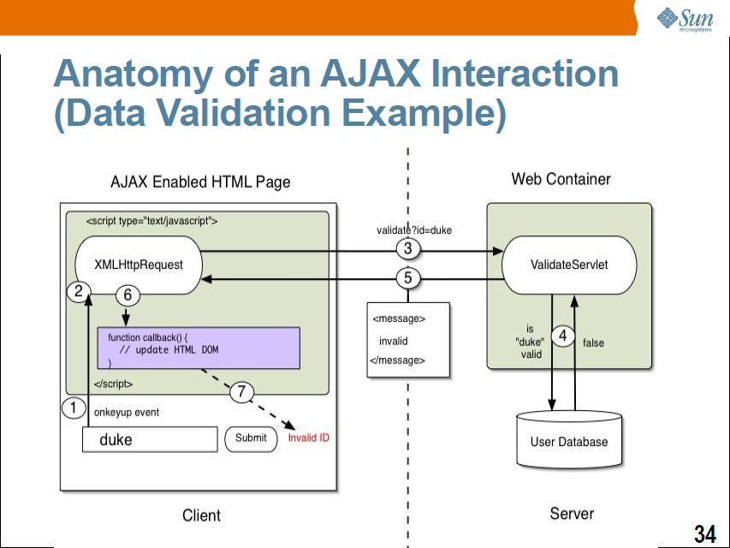
Ajax Interaction

Slide 22
XMLHttpRequest
JavaScript object
Adopted by modern browsers
Mozilla™, Firefox, Safari, and Opera
Communicates with a server via standard HTTP GET/POST
XMLHttpRequest object works in the background for performing asynchronous communication with the backend server
Does not interrupt user operation
Notes:
Now let's talk about XMLHttpRequest a bit. It is a JavaScript object,
which means it gets created within a JavaScript code.
The XMLHttpRequest JavaScript object is supported in most modern
browsers.
It is the AJAX engine that performs the HTTP request/response
interaction with the backend web application in asynchronous
fashion.

Slide 23
Server-Side AJAX Request Processing
Server programming model remains the same
It receives standard HTTP GETs/POSTs
Can use Servlet, JSP, JSF, ...
With minor constraints
More frequent and finer-grained requests from client
Response content type can be
text/xml
text/plain
text/json
text/javascript
Notes:
Now, how does server side web application handle the AJAX
interaction with the browser? Well as far as Server side code is
concerned, it is just another HTTP request that comes in. The server
side does not even know the browser is sending the HTTP request
in asynchronous fashion and it should not.
What this means is that the server side web application can use any
server side technology of its choice such as servlet, JSP, JSF,
Struts, or whatever.
The server side application however has minor constraints. First, it is
possible the client might send more frequent and finer grained
requests. The response type can be text/xml, text/plain, text/json, or
text/javascript.

Slide 24
$.ajax() – Façade Pattern
provides a simpler abstracted interface to a larger (potentially more complex) body of code.
Facades for handling DOM manipulation, animation,cross-browser Ajax.
The following are facades for jQuery's $.ajax():
$.get( url, data, callback, dataType );
$.post( url, data, callback, dataType );
$.getJSON( url, data, callback );
$.getScript( url, callback );
These facades are actually facades in their own right, hiding a great deal of complexity behind the scenes.

Slide 25
Get and Post Method
userName = $("#txtFld1").val();
$.get("/Simple/getCustomerDetails",
{ "name": userName }, function (data) {
$("#d1").html(data);
});
public String getCustomerDetails(String name) {
String result = "Invalid";
int val=String.Compare(name, "Ramesh");
if(val==0) {
result = "valid"; }
return result;
}

Slide 26
$.ajax()
Powerful and straightforward way of creating ajax request
It takes an configuration object that has the all instructions required
Has the ability to specify success and failure callback
Configuration object can be defined separately makes it easier to write and reuse the code
$.ajax(url[, options])
$.ajax([options])

Slide 27
$.ajax()
$("#submit").click(function(event){
event.preventDefault();
var postData = $("#frm").serialize();
$.ajax( {
type:'POST',
data:postData,
url:'ValidateServlet',
success:function(resp, textStatus, jqXHR){
$("#msg").text(resp);
},
error:function(jqXHR, textStatus, errorThrown){
console.log(errorThrown);
}
}
);

Slide 28
Core Ajax
var value = $(this).val();
var options = {
type: 'GET',
url: '/Simple/coreAjax',
data: { city: value },
dataType: 'html',
error: function (xhr, textStatus, errorThrown) {
alert('An error occurred! ' + errorThrown);
alert('text status! ' + textStatus);
},
success: function (resp, textStatus) {
$('#d3').text(resp);
}
}
$.ajax(options);

Slide 29
JSON Syntax Rules
JSON syntax is a subset of the JavaScript object notation syntax:
Data is in name/value pairs
Data is separated by commas
Curly braces hold objects
Square brackets hold arrays
JSON Name/Value Pairs
JSON data is written as name/value pairs.
A name/value pair consists of a field name (in double quotes), followed by a colon, followed by a value:
{"age":29,"name":"Ramesh","books":["Java","JEE","Spring"]}

Slide 30
Working With Json Data
Names.json
{
"book1": "Head First Java",
"book2": "Thinking in Java",
"book3": "Effective Java"
}
$.getJSON('Names.json', function(data) {
$.each(data,function(key,val){
$("#disDiv").append("<li/>",val);
});

Slide 31
Ajax with JSON Data
$.ajax({
type:'GET',
url:'JsonServlet',
success:function(resp){
$.each(resp,function(key,value){
$("#msg").append(key + ":"+value);
});
},
error:function(jqXHR, textStatus, errorThrown){
console.log(errorThrown);
}
});

Slide 32
JSON Response
HashMap<String, Integer> nameList = new HashMap<String,Integer>();
nameList.put("Ramesh",500);
nameList.put("Rakesh",600);
ObjectMapper mapper = new ObjectMapper();
ObjectWriter writer= mapper.writerWithDefaultPrettyPrinter();
String jsonResult = writer.writeValueAsString(nameList);
response.setContentType("application/json");
out.println(jsonResult);

Slide 33
Working with JSON Data
var user = {
name: $("#txtFld1").val(),
email: $("#txtFld2").val(),
}
$.ajax({
type: 'POST',
url: 'Home/sendJson',
data: user,
dataType:'json',
success: function (data) {
alert(data);
$("#msg").html(data.name);
}
});

