Slide 1


OOP with Java

Slide 2

K.Srivatsan - vatsank@gmail.com
IT Trainer Since 1991
Conducting Java Training Since 2004
About 60+ Corporate Clients

Slide 3
Primary Goals of Java
Provides an easy-to-use language by:
  Avoiding many pitfalls of other languages
  Being object-oriented
  Enabling users to create streamlined and clear code

Slide 4
Primary Goals of Java
Provides an interpreted environment for:
  Improved speed of development
  Code portability
  Enables users to run more than one thread of activity
  Loads classes dynamically when they are required
  Supports changing programs dynamically during runtime by loading classes from disparate sources

Slide 5
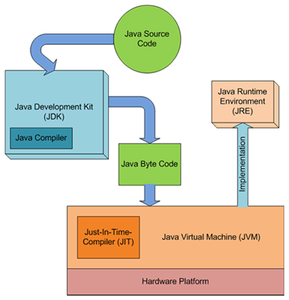
JDK,JVM and JRE

Slide 6
Integrated Development Environments
An IDE is the high-productivity tool
Used to edit, compile, and test programs, manage projects, debugging, building GUI interfaces, etc.
IDE provides extensive programming support for editing and project management,
The Popular IDE’s
  Eclipse
  NetBeans
  JDeveloper

Slide 7
Java language syntax

Slide 8
Program structure
A program in Java consists of one or more class definitions
One of these classes must define a method main(), which is where the program starts running
Java programs should always end with the .java extension.
There can be More than one Class Definition in a class ,but only one public class
Source Filenames should match the name of the public class.

Slide 9
Source File Layout
Basic syntax of a Java source file is:
[<package_declaration>]
<import_declaration>*
<class_declaration>+

Slide 10
Example 1.1
  package com.training;
  public class Greeting {
  public String getMessage() {
  return "Welcome to Java Programming";
  }
  }

Slide 11
Example 1.1 (contd)
  package com.training;
  public class TestGreeting {
  public static void main(String[] args) {
  Greeting grtObj = new Greeting();
  System.out.println(grtObj.getMessage());
  }
  }

Slide 12
Classes as Blueprints for Objects
In manufacturing, a blueprint describes a device from which many physical devices are constructed.
In software, a class is a description of an object:
  A class describes the data that each object includes.
  A class describes the behaviors that each object exhibits.
In Java technology, classes support three key features OOP
  Encapsulation
  Inheritance
  Polymorphism

Slide 13
Declaring Java Technology Classes
Basic syntax of a Java class:
  <modifier>* class <class_name> {
  <attribute_declaration>*
  <constructor_declaration>*
  <method_declaration>*
  }
Define an attribute:
<modifier>* <type> <name> [ = <initial_value>];

Slide 14
Declaring Methods
Basic syntax of a method:
<modifier>* <return_type> <name> ( <argument>* ) {
<statement>*
}
  public int getWeight() {
  return weight;
  }
  public void setWeight(int newWeight) {
  if ( newWeight > 0 ) {
  weight = newWeight;
  }
  }

Slide 15
Accessing Object Members
The dot notation is: <object>.<member>
  used to access object members, including attributes and methods.
d.setWeight(42);
d.weight = 42; // only permissible if weight is public

Slide 16
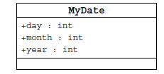
Information Hiding
Client code has direct access to internal data
(d refers to a MyDate object):
d.day = 32; // invalid day
d.month = 2; d.day = 30; // plausible but wrong
d.day = d.day + 1; // no check for wrap around

Slide 17
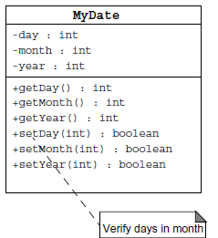
Encapsulation
Hides the implementation details of a class
Forces the user to use an interface to access data
Makes the code more maintainable

Slide 18
Classes
Top-level classes can be declared as
  public
    a public class is globally accessible.
    a single source file can have only one public class or interface
  abstract
    an abstract class cannot be instantiated
  final
    a final class cannot be subclassed
  Default
    With any Modifier
They can’t be declared as protected and private

Slide 19
Constructors
Have no return type
Have the same name as the class
If we don't’ put a constructor the compiler puts a default one
  The default constructor has the same access modifier as the class.
  The default constructor has no arguments.
  The default constructor is always a no-arg constructor, but a no-arg constructor is not necessarily the default constructor
  The default constructor includes a no-arg call to the super constructor (super()).
They are not inherited and hence they are not overridden
It can be Overloaded
It can have any of the Four Access Modifies
It cannot be synchronized
It can have throws clause

Slide 20
Instantiation with new
It is the process by which individual objects are created.
  Class objectReference = new Constructor();
Declaration
  Employee empObj;
Instantiation
  empObj = new Employee()
Declaration and Instantiation
  Employee empObj = new Employee()
  new operator allocates memory for an object.

Slide 21
Comments
Java supports three forms of comments
  // single line comments
  /* multi
    line
    comment
    */
  /** a
    * Javadoc
    * comment
    */

Slide 22
Example for Variables
  public class VariableTypes {
  private int inst_empid;
  private static String cls_empName
  public void getData() { }
  public static void getSalary() { }
  public void showData(int a)
  {
  int localVariable ;
  }
  }
Instance Variable
Class Variable
Parameter Variable
Local Variable

Slide 23
Wrapper Classes
Primitives have no associated methods
Wrapper Classes are used encapsulate primitives
They also provide some static utility methods to work on them
Primitive Type | Wrapper class
-boolean | Boolean
-byte | Byte
-char | Character
-double | Double
-float | Float
-int | Integer
-long | Long
short | Short

Slide 24
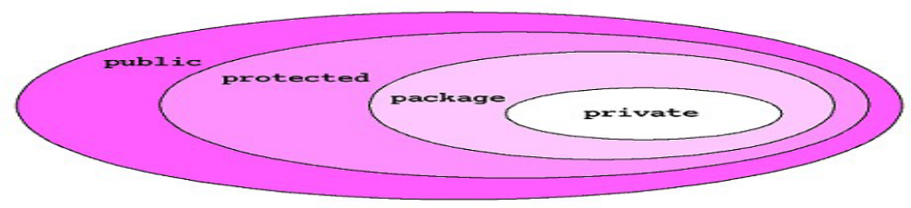
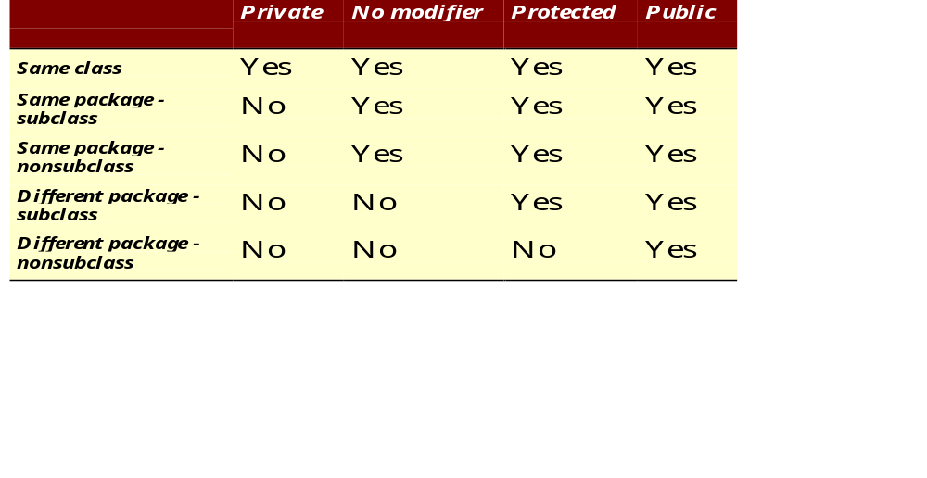
The 4 Access Levels and 3 Modifiers

Slide 25
Method Overloading
If two (or more) methods of a class have the same name but different signatures, then the method name is said to be overloaded.
The signature of a method consists of the name of the method and the number and types of formal parameters in particular order.
Method overloading is method name overloading.
Several methods that implement similar behavior but for different data types.
They are independent methods of a class and can call each other just like any other method.
A method can be overloaded in the same class or in a subclass.

Slide 26
Overloading Methods
Overloaded methods MUST change the argument list.
Overloaded methods CAN change the return type.
Overloaded methods CAN change the access modifier.
Overloaded methods CAN declare new or broader checked exceptions.

Slide 27
INHERITANCE

Slide 28
Overview
  A class can inherit from another class
    Original class is the “superclass”
    New class is called the “subclass”
Inheritance is a fundamental OO concept
Superclass
Car
Subclasses
SportsCar
Taxi
PoliceCar

Slide 29
Example of Inheritance
  The Car class defines certain methods and variables
  Taxi extends Car, and can:
    Add new variables
    Add new methods
    Override methods of the Car class
Car
Taxi

Slide 30
Specifying Inheritance in Java
  Inheritance is achieved by specifying which superclass the subclass
  “extends”
Taxi inherits all the variables and methods of Car
public class Car {
…
}
public class Taxi extends Car {
…
}

Slide 31
What Does an Object Look Like?
A subclass inherits all the instance variables of its superclass
Car object
public class Car {
String regNum;
int engineSize; …
}
regNum
engineSize
Taxi object
public class Taxi extends Car {
private int cabNum; …
}
regNum
engineSize
cabNum

Slide 32
Default Initialization
  What happens when a subclass object is created?
  If no constructors are defined:
  No-arg constructor is called in superclass
    No-arg constructor called in subclass
Taxi object
regNum
engineSize
Taxi taxi1 = new Taxi();
cabNum

Slide 33
Nondefault Initialization
Specific initialization can be performed as follows:
public class Car {
Car(String r, int e) {
regNum = r;
engineSize = e;
} …
public class Taxi extends Car {
Taxi(String r, int e, int c) {
super(r, e);
cabNum = c;
} …
Use super() to call superclass constructor

Slide 34
Specifying Additional Methods
  The superclass defines methods that are applicable for all kinds of Car
  The subclass can specify additional methods that are specific to Taxis
public class Car {
public int getReg()…
public void changeOwner()…
…
public class Taxi extends Car {
public void renewCabLicense()…
public boolean isBooked()…
…

Slide 35
Overriding Superclass Methods
  A subclass inherits all the methods of its superclass
  The subclass can override a method with a specialized version, if it needs to:
public class Car {
public String details() {
return "Reg:" + getReg();
}
public class Taxi extends Car {
public String details() {
return "Reg:" + getReg() + cabNum;
}

Slide 36
Overriding
When a sub-class defines a
  “method with same method name, argument types, argument order and return type as a method in its super class, its called method overriding. “
Methods declared as final, static and private cannot be overridden.
An overriding method can be declared as final
The method can’t be less accessible
  Public => only public
  Protected => Both Public and Protected
  Default => default, public and protected

Slide 37
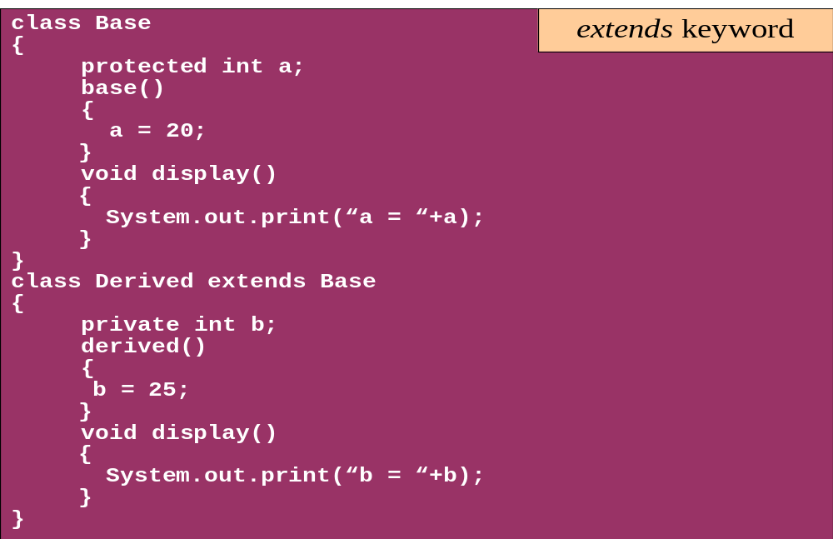
Overriding

Slide 38
Overriding with Compatible Return type
Arguments must be same and return type must be compatible
  class Base
  {
  private int i = 5;
  public Number getNumber()
  {
  return i;
  }
  }
  class Derived extends Base
  {
  @Override
  public Integer getNumber()
  {
  return new Integer(10);
  }
  }

Slide 39
Invoking Superclass Methods
  If a subclass overrides a method, it can still call the original superclass method
  Use super.method()to call a superclass method from the subclass
  Though keyword super is used to refer super class, method call super.super.method() is invalid.
public class Car {
public String details() {
return "Reg:" + getReg();
}
public class Taxi extends Car {
public String details() {
return super.details() + cabNum;
}

Slide 40
super keyword
The keyword super refers to the base class
  super( )
    invokes the base class constructor
    base class constructors are automatically invoked
  super.method( )
    invokes the specified method in the base class
  super.variable
    to access the specified variable in the base class
super must be the first statement in a constructor

Slide 41
Abstract Class
An abstract class is a shared superclass
  Provides a high-level partial implementation of some concept
  Cannot be instantiated
Use the abstract keyword to declare a class as abstract
Vehicle
Vehicle
Abstract superclass
Concrete subclasses
Car
Car
Truck

Slide 42
Defining Abstract Classes in Java
  Use the abstract keyword to declare a method as abstract
    Only provide the method signature
    Class must also be abstract
  Must be implemented by a concrete subclass
    Each concrete subclass can implement the method differently
public abstract class Vehicle {
private String regNum;
public String getRegNum()…
public abstract boolean isRoadWorthy();
}
public class Car
extends Vehicle{
private int numSeats;
public void fitRack()…
public class Truck
extends Vehicle{
private int axles;
public void setLoad()…

Slide 43
The Abstract Class-Super Class
Note
this
  public abstract class BankAccount {
  public abstract void deposit(double amount);
  public abstract void withdraw(double amount);
  public void sayHello() {
  System.out.println("Thanks-Come Again");
  }
  }

Slide 44
Child Class –Its alsoAbstract
  public abstract class Savingaccount extends BankAccount {
  public abstract void getClientdetails();
  }

Slide 45
The Concrete Class
  public class Supersavings extends Savingaccount {
  private double balance;
  private double amount ;
  private String custname;
  private int accno;
  public void deposit(double amount)
  {
  balance+=amt;
  }
  public void withdraw(double amount)
  {
  balance-=amt;
  }
  public void getClientdetails()
  {
  System.out.println(custname);
  System.out.println(accno);
  System.out.println(amount);
  System.out.println(balance);
  }
  }

Slide 46
Interfaces & Polymorphism

Slide 47
Interfaces
  An interface is like a fully abstract class
    All of its methods are public and abstract
    No instance variables if present they are public static final
  An interface defines a set of methods that other classes can implement
    A class can implement many interfaces, but can extend only one class
  Can extend other interfaces and extend multiple interfaces
  Extends another sub interface inherits everything from super interface

Slide 48
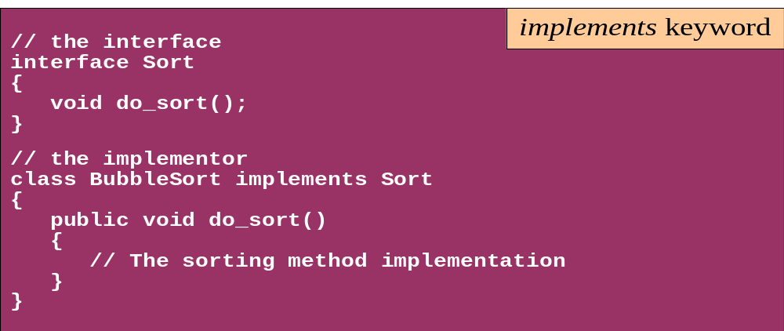
Interface
Interfaces define types in an abstract form
  An interface declaration allows the specification of a reference type without providing an implementation
  The class that implements the interface decides how to implement

Slide 49



Example of Interfaces
  Interfaces describe an aspect of behavior that different classes can support
  For example, any class that supports the “Steerable” interface can be steered:
Steerable
Not Steerable

Slide 50
Defining an Interface in Java
  Use interface keyword instead of class
public interface Steerable {
int maxTurn = 135;
void turnLeft(int deg);
void turnRight(int deg);
}

Slide 51
Implementing an Interface
public interface Steerable {
int maxTurn = 135;
void turnLeft(int deg);
void turnRight(int deg);
}
public class Car
extends Vehicle
implements Steerable {
public void turnLeft(int deg)
{…}
public void turnRight(int deg)
{…}

Slide 52
Partial Implementation of an Interface
Declare the class as abstract if the class does not implement all the methods of an interface
Implement the methods in the sub class level
Public abstract class Car
extends Vehicle
implements Steerable {
public void turnLeft(int deg)
{…}
}

Slide 53
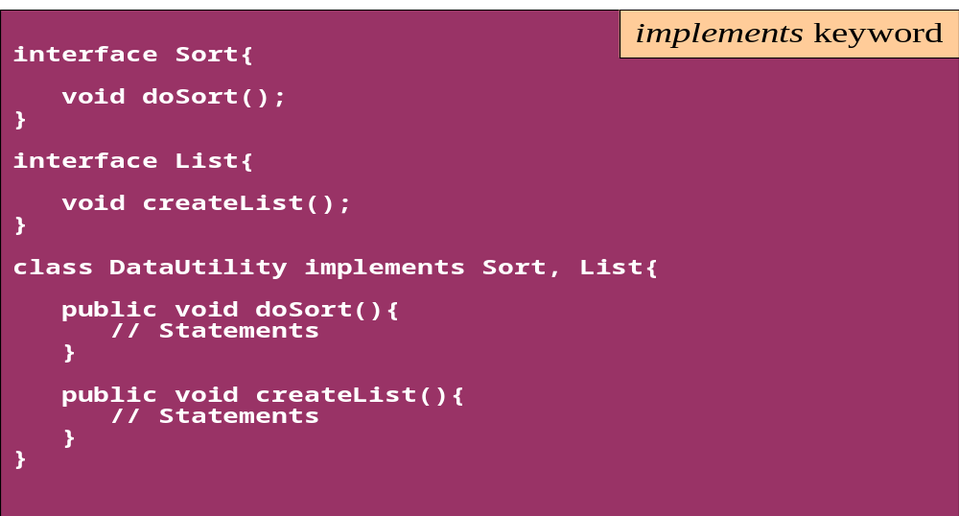
Interface
A single class can implement many interfaces

Slide 54
Extending an Interface
One Interface can extend another Interface
public interface Steerable {
int maxTurn = 135;
void turnLeft(int deg);
void turnRight(int deg);
}
public interface Navigator
extends Steerable {
void calcSpeed(int distance);
}

Slide 55
Polymorphism
This OO Principle allows the programmer to program abstractly
Objects of a subclass can be treated as objects of its superclass
The base class of a hierarchy is usually an abstract class or an Interface
  They define the common behavior (functionality)
Classes and Subclasses inherit this behavior and extend it according to their own properties by overriding the methods of the super class
Subclass objects can be treated as super class objects through references,
  But, super class objects are not subclass objects

Slide 56
Polymorphism
Allows for hierarchies to be highly extensible
New classes can be introduced and can still be processed without changing other parts of the program
Same method can do different things, depending on the class that implements it.
Method invoked is associated with OBJECT and not with reference.
Types of Polymorphism -
  Method Overloading.
  Method Overriding.

Slide 57
Interface, Abstract Class,Subclass,Class
A plain class is designed when in doesn't pass the “is-a” test.
A Plain class is designed when its not extending any other class other than object class
Make a subclass , when it needs to extend a super class
Make a subclass, when it needs to override or add new behaviors
Make an abstract class , when there is a requirement for a kind of “template” for a group of subclasses, and there are some implementation in the class which the subclass can use .
Make an abstract class , to guarantee that nobody can make objects of that type.
Design an interface , to define a role that other classes can play, regardless of the inheritance tree,

Slide 58
Exception handling

Slide 59
Topics
Define exceptions
Use try, catch, and finally statements
Describe exception categories
Identify common exceptions
Develop programs to handle your own exceptions
Use assertions
Distinguish appropriate and inappropriate uses of assertions
Enable assertions at runtime

Slide 60
Exception Handling
java.lang.Object
java.lang.Throwable
java.lang.Error
java.lang.Exception
java.io.IOException
java.lang.RuntimeException
Notes:
The class Object is the root of the class hierarchy. Every class has Object as a superclass. All objects, including arrays, implement the methods of this class.
The Throwable class is the superclass of all errors and exceptions in the Java language. Only objects that are instances of this class (or of one of its subclasses) are thrown by the Java Virtual Machine or can be thrown by the Java throw statement. Similarly, only this class or one of its subclasses can be the argument type in a catch clause.
An Error is a subclass of Throwable that indicates serious problems that a reasonable application should not try to catch. Most such errors are abnormal conditions. The ThreadDeath error, though a "normal" condition, is also a subclass of Error because most applications should not try to catch it.
The class Exception and its subclasses are a form of Throwable that indicates conditions that a reasonable application might want to catch.
RuntimeException is the superclass of those exceptions that can be thrown during the normal operation of the Java Virtual Machine. A method is not required to declare in its throws clause any subclasses of RuntimeException that might be thrown during the execution of the method but not caught.
IOException signals that an I/O exception of some sort has occurred. This class is the general class of exceptions produced by failed or interrupted I/O operations.

Slide 61
Exceptions
Conditions that can readily occur in a correct program are checked exceptions.
These are represented by the Exception class.
Problems that reflect program bugs are unchecked exceptions.
Fatal situations are represented by the Error class.
Probable bugs are represented by the RuntimeException class.
The API documentation shows checked exceptions that can be thrown from a method

Slide 62
Checked and Unchecked
Checked exceptions include all subtypes of Exception, excluding classes that extend Runtime Exception.
Checked exceptions are subject to the handle or declare rule; any method that might throw a checked exception
  must either declare the exception using the throws keyword, or handle the exception with an appropriate try/catch.
Subtypes of Error or Runtime Exception are unchecked, so the compiler doesn’t enforce the handle or declare rule.

Slide 63
Handle or Declare Rule
Handle the exception by using the try-catch-finally block.
Declare that the code causes an exception by using the throws clause.
void trouble() throws IOException { ... }
void trouble() throws IOException, MyException { ... }
Other Principles
  You do not need to declare runtime exceptions or errors.
  You can choose to handle runtime exceptions

Slide 64
Catching Exceptions
  class DivByZero {
  public static void main(String args[]) {
  try {
  System.out.println(3/0);
  System.out.println(“Please print me.”);
  } catch (ArithmeticException exc) {
  //Division by zero is an ArithmeticException
  System.out.println(exc);
  }
  System.out.println(“After exception.”);
  }
  }

Slide 65
Catching Exception –Multiple Catch
  class MultipleCatch {
  public static void main(String args[]) {
  try {
  int den = Integer.parseInt(args[0]);
  System.out.println(3/den);
  }
  catch (ArithmeticException exc)
  {
  System.out.println(“Divisor was 0.”);
  }
  catch (ArrayIndexOutOfBoundsException exc2)
  {
  System.out.println(“Missing argument.”);
  }
  System.out.println(“After exception.”);
  }
}
}

Slide 66
Effective Exception Hierarchy
The exception classes are arranged in a hierarchy.
Catches for specific exceptions should always be written prior to the generic handler.
A generic handler for Exception would cover any missing situation.
  try
  {
  }
  catch (NumberFormatException e) {
  }
  catch (Exception ex2) {
  }
  try
  {
  }
  catch (Exception e1) {
  }
  catch(NumberFormatException e2) {
  }

Slide 67
Catching Exception –Nested Try’s
    public static void main(String args[]){
  try {
    int a = Integer.parseInt(args[0]);
    try {
    int b = Integer.parseInt(args[1]);
    System.out.println(a/b);
    }
    catch (ArithmeticException e1)
    {
    System.out.println("Div by zero error!");
    }
  }
  catch(ArrayIndexOutOfBoundsException e2)
  {
    System.out.println("Need 2 parameters!");
    }
    }
  }

Slide 68
Finally block
Its optional and will always be invoked,
  whether an exception in the corresponding try is thrown or not,
  whether a thrown exception is caught or not.
finally-will-always-be-called except if the JVM shuts down. When the try or catch blocks may call System.exit();
Block of code is always executed despite of different scenarios:
  Forced exit occurs using a return, a continue or a break statement
  Normal completion
  Caught exception thrown
  Exception was thrown and caught in the method
  Uncaught exception thrown
  Exception thrown was not specified in any catch block in the method

Slide 69
Finally Block
  public static String tryblkWithReturn(String data ) {
  try {
  int no = Integer.parseInt(data);
  }
  catch (NumberFormatException e) {
  System.out.println("Entering Catch Block");
  return "Hello";
  }
  finally {
  System.out.println("Inside finally");
  }
  System.out.println("I am back");
  return "Hi";
  }

Slide 70
Finally Block
  public static String tryblkWithNewException(String data ) throws Exception {
  try {
  int no = Integer.parseInt(data);
  }
  catch (NumberFormatException e) {
  System.out.println("Entering Catch Block");
  throw new Exception();
  }
  finally {
  System.out.println("Inside finally");
  }
  System.out.println("I am back");
  return "Hi“;
  }

Slide 71
Overriding –When Method Has Exceptions
Any exceptions declared in overriding method must be of the same type as those thrown by the super class, or a subclass of that type.
  class MyBase {
  public void method1() throws Exception
  { }
  public void method2() throws RuntimeException
  { }
  }
  class Sub extends MyBase
  {
  public void method1() throws Throwable {
  }
  public void method2() throws ArithmeticException {
  }
  }
This is compile Time Exception
This is Allowed

Slide 72
Throwing Exceptions
The throw Keyword
Java allows you to throw exceptions (generate exceptions)
  throw <exception object>
An exception you throw is an object
  You have to create an exception object in the same way you create any other object
Example:
  throw new ArithmeticException(“testing...”);

Slide 73
Throws Clause
A method is required to either catch or list all exceptions it might throw
  Except for Error or RuntimeException, or their subclasses
If a method may cause an exception to occur but does not catch it, then it must say so using the throws keyword
Applies to checked exceptions only
  <type> <methodName> (<parameterList>) throws <exceptionList>
  {
  <methodBody>
}

Slide 74
The try-with-resources Statement
A try statement that declares one or more resources.
A resource is an object that must be closed after the program is finished with it.
Ensures the resource is closed at the end of the statement.
Any object that implements java.lang.AutoCloseable, and java.io.Closeable, can be used as a resource.

Slide 75
The try-with-resources Statement
private static void printFile throws IOException {
try ( FileInputStream input = new FileInputStream("file.txt") )
{
int data = input.read();
while(data != -1)
  {
  System.out.print((char) data);
  data = input.read();
  }
}
}

Slide 76
Using Multiple Resources
Can use multiple resources and have them all automatically closed.
private static void printFile throws IOException {
  try (
  FileInputStream input = new FileInputStream("file.txt"); BufferedInputStream bufferedInput = new BufferedInputStream(input) )
  {
    int data = bufferedInput.read();
    while(data != -1){
    System.out.print((char) data);
    data = bufferedInput.read();
  } } }

Slide 77
Multiple Catch
  try {
  int val = Integer.parseInt(args[0]);
  double amount = val/0;
  System.out.println("Amount"+amount);
  } catch (ArrayIndexOutOfBoundsException | NumberFormatException e) {
  e.printStackTrace();
  }
  }

Slide 78
Multiple Catch
  try {
  } catch (RangeCheckException | RuntimeException e) {
  }
  try {
  } catch (RangeCheckException | Exception e) {
  }

Slide 79
Re-throw Exception
Exception of the Catch Parameter type is the one that is rethrown
To intercept all exceptions and rethrow them
  Can catch with super class Exception
  Declare method as throwing an Exception.
"imprecise rethrow“
  Throwing a general Exception type (instead of specific ones)

Slide 80
Re-Throw Exception
Java 7, can be more precise about the exception types being rethrown from a method.
This leads to improved checking for rethrown exceptions.
Can handle them a lot better at the calling side

