Slide 1
REST SERVICE USING SPRING DATA JPA

Slide 2
Lightweight Web Services
REST is a lightweight alternative to Web Services and RPC.
REST services is:
  Platform-independent
  Language-independent
  Runs on top of HTTP Protocol
  Used in the Presence of firewalls too.
REST does not offer
  built-in security features
  encryption
  session management
These feature can be added by building on top of HTTP:

Slide 3
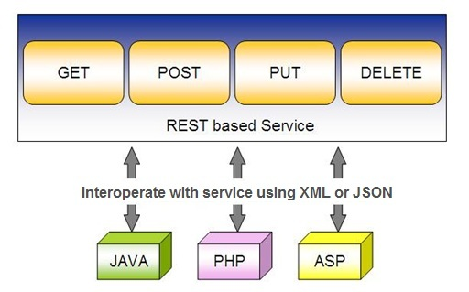
Spring RESTful Services
REST does not require the client to know anything about the structure of the API.
Server needs to provide whatever information the client needs to interact with the service.

Slide 4
Richardson Maturity Model
Level 0 :
  Expose SOAP web services in REST style.
  Expose action based services
  (http://server/getPosts, http://server/deletePosts, http://server/doThis, http://server/doThat etc) using REST.
Level 1
  Expose Resources with proper URI’s (using nouns).
  Ex: http://server/accounts, http://server/accounts/10.
  However, HTTP Methods are not used.

Slide 5
Richardson Maturity Model
Level 2
  Resources use proper URI’s + HTTP Methods.
  To update an account PUT and create a POST
Level 3
  HATEOAS- Hypermedia As The Engine Of Application State
  Need to give the required response to the client
  Also need to give the next possible actions that he can perform
When requesting information about a facebook user,
REST service can return user details along with information about how to get his recent posts, how to get his recent comments and how to retrieve his friend’s list.

Slide 6
Using appropriate Request Methods
GET :
  Should not update anything.
  Should be idempotent (same result in multiple calls).
  Possible Return Codes 200 (OK) + 404 (NOT FOUND) +400 (BAD REQUEST)
POST :
  Should create new resource.
  Ideally return JSON with link to newly created resource.
  Same return codes as get possible.
  In addition : Return code 201 (CREATED) is possible.

Slide 7
Using appropriate Request Methods
PUT :
  Update a known resource. ex: update client details.
  Possible Return Codes : 200(OK)
DELETE :
  Used to delete a resource.
  Possible Return Codes : 200(OK) or a 204 - no content

Slide 8
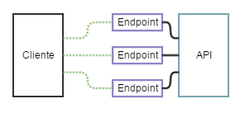
API and Endpoint

Slide 9
SPRING DATA REST WITH JPA

Slide 10
Spring RESTful Services
A RESTful architecture may expose multiple representations of a resource.
From Spring 4 @RestController annotation is added to controller
  A combination of @Controller and @ResponseBody
A Rest Controller method returns a domain object instead of a view.

Slide 11
REST Stereotypes
@RestController
  An implicit @ResponseBody is being added to the methods.
  Allows Spring to render the returned HttpEntity and its payload, directly to the response.
@GetMapping
  To map HTTP GET requests onto specific handler methods.
  Composed annotation for @RequestMapping(method = RequestMethod.GET).

Slide 12
REST Stereotypes
@PathVariable
  Indicates that the Method parameter should be bound to a URI template variable.
  @GetMapping("/members/{id}")
  public String getById(@PathVariable String id) { }
@PostMapping
  Combined shortcut for @RequestMapping(method = RequestMethod.POST).
  @PostMapping("/members“)
  public void addMember(@RequestBody Member member) { }

Slide 13
@Repository
There are three repository in Spring Data
CrudRepository
  Extends Repository
  provides CRUD functions
PagingAndSortingRepository
  Extends CrudRepository
  provides methods to do pagination and sort records
JpaRepository
  Extends PagingandSortingRepository
  Provides Methods such as flushing the persistence context and delete records in a batch
  Querying methods return List's instead of Iterable's

Slide 14
Creating Spring Data Application
  Create a repository interface and extend one of the repository interfaces provided by Spring Data.
  If required add custom query methods to the created repository interface
  Inject the repository interface to another component and use the implementation that is provided automatically by Spring.
Need NOT create an implementation class
  Spring will automatically create its implementation class at runtime.
The Repository class will be auto detected if suitably placed in the scan path

Slide 15
CrudRepository Interface
Extends Repository Interface and has the following Methods
  <S extends T> S save(S entity)
  <S extends T> Iterable<S> saveAll(Iterable<S> entities);
  Optional<T> findById(ID primaryKey)
  Iterable<T> findAll()
  void delete(T entity)
  long count()
  boolean existsById(ID id);

Slide 16
PagingAndSortingRepository
  Extends CrudRepository Interface and has the following Methods
findAll(Pageable pageable)
    Pageable object with following properties
      Page size
      Current page number
      Sorting
      findAll(Sort sort)
        Sort Object with the Property on Which the sorting is to be done
        Sort.by(propName)

Slide 17
JpaRepository
Extends PagingAndSortingRepository
Can also optionally extend QueryByExampleExecutor
  List<T> findAllById(Iterable<ID> ids);
  <S extends T> S saveAndFlush(S entity);
  void deleteInBatch(Iterable<T> entities);
  void deleteAllInBatch();
  T getOne(ID id);
  void flush();

Slide 18
SAMPLE CODE-DEMO

Slide 19
Entity
  @Entity
  @Table(name = "demo_invoice")
  @Data
  @AllArgsConstructor
  @NoArgsConstructor
  @FieldDefaults(level = AccessLevel.PRIVATE)
  public class Invoice {
  @Id
  long id;
  String customerName;
  @DateTimeFormat(iso = DateTimeFormat.ISO.DATE)
  LocalDate invoiceDate;
  double amount;
  }

Slide 20
Repository
  @Repository
  public interface InvoiceRepository extends JpaRepository<Invoice, Long>{
  }

Slide 21
Service
  @Service
  public class InvoiceService {
  @Autowired
  private InvoiceRepository repo ;
  public List<Invoice> findAll(){
  return repo.findAll();
  }
  public Invoice findById(int id) {
  Optional<Invoice> optInvoice=repo.findById(id);
  return optInvoice.orElseThrow(() -> new
  RunTimeException(“Invoice not found"));
  }

Slide 22
Controller
  @RestController
  public class InvoiceController {
  @Autowired
  private InvoiceService service ;
  @GetMapping(path = "/api/v1/invoices")
  public List<Invoice> findAll() {
  List<Invoice> details = service.findAll();
  return details;
  }

Slide 23
@RequestBody
Used to map the HttpRequest body to a transfer or domain object
  Spring automatically deserializes the JSON into a Java type
  The type of @RequestBody annotation must correspond to the JSON sent from client-side
HttpMessageConverter
  Internally Used by Spring to perform Serialization/deserialization
@Valid
  To perform automatic validation by adding to method argument

Slide 24
Post and Put Mapping
  @PostMapping(path = "/api/v1/invoices")
  public Invoice add(@RequestBody Invoice entity
  ,HttpServletResponse response) {
  response.setStatus(201);
  return this.service.add(entity);
  }
@ResponseStatus(HttpStatus.CREATED)
  @PostMapping(path = "/api/v1/invoices")
  public Invoice add(@RequestBody Invoice entity) {
  return this.service.add(entity);
  }

Slide 25
ResponseEntity
Represents Complete HTTP response, gives more flexibility
  May be required in some special cases
  Can be used to send Status Code,Response Body,Location to the resource which was altered
  @GetMapping(path = "/api/v1/invoices")
  public ResponseEntity<Invoice> getInvoices() {
  HttpHeaders responseHeaders = new HttpHeaders();
  return ResponseEntity.ok().headers(responseHeaders).body(dao.findAll());
  }

Slide 26
Put Mapping
@PutMapping(path = "/api/v1/invoice")
  public Invoice update(@RequestBody Invoice entity) {
  return this.service.add(entity);
  }
  @PatchMapping(path = "/api/v1/invoice")
  public ResponseEntity<String> updateAmount() {
  return ResponseEntity.status(HttpStatus.CREATED)
  .body("Updated Amount:="+this.service.updateAmount());
  }

Slide 27
Remove Method in Service
  public Invoice remove(Invoice entity) {
  Optional<Invoice> optional = Optional.empty();
  if(this.repository.existsById(entity.getId())) {
  this.repository.delete(entity);
  optional = Optional.of(entity);
  }
return optional;
}

Slide 28
Delete Mapping in Controller
  @DeleteMapping(path = "/api/v1/invoice")
  public ResponseEntity<Invoice> remove(@RequestBody Invoice entity) {
  Invoice invoice = this.service.removeInvoice(entity).orElseThrow(()-> new RuntimeException("Element NOT FOUND"));
  return ResponseEntity.ok().body(invoice);
  }

Slide 29
@RestControllerAdvice
Used for Exception handling in Rest API’s
Used to handle exceptions across the whole application
Like an interceptor of exceptions thrown by methods annotated with @RequestMapping or one of the shortcuts.
It’s a combination of @ContollerAdvice and @ResponseBody.
@ExceptionHandler
  Annotation for handling exceptions in specific handler classes and/or handler methods.

Slide 30
@RestControllerAdvice
  @RestControllerAdvice
  public class ErrorHandler {
  @ExceptionHandler(value = Exception.class)
  public ErrorDetails handleAllExceptions(Exception ex, WebRequest request){
  return new ErrorDetails(LocalDateTime.now(),
  ex.getMessage(), request.getDescription(false));
  }
  }
  request.getDescription(false):
  Whether to include client-specific information like session id and user name

Slide 31
application.yml
  spring:
  datasource:
  url: jdbc:mysql://localhost:3306/test
  username: root
  password: srivatsan
  driver-class-name: com.mysql.cj.jdbc.Driver
  jpa:
  show-sql: true
  hibernate:
  ddl-auto: update
  naming:
  physical-strategy: org.hibernate.boot.model.naming.PhysicalNamingStrategyStandardImpl

Slide 32
application.yml
  logging:
  level:
  org.hibernate.sql: debug
  org.hibernate.type.descriptor.sql.BasicBinder: trace

Slide 33
QUERY DSL

Slide 34
Query DSL
Domain Specific Language
  Extension of a programming language to address a domain.
  Enhancing Java to be better suited at creating and working with JPA queries.
  A Powerful, flexible and customizable based on JPA entity
  Framework checks the validity of queries when application starts up
  Have been in use in scripted language

Slide 35
Query Method Syntax
Methods are defined in JPA repository that Spring Data JPA will auto-implement
  The query parser will look for methods that start with find, query, read, count, or get.
Prefixes can be enhanced with other keywords until it gets to the B-Y, or By, of the method name.
findByAgeLike(Integer age);

Slide 36
Query Method Syntax
findByAgeLike(Integer age);
find
  Method starts with find so that the query parser understands that it needs to implement this query contract.
By
  Following the find keyword,
  Signaling that the criteria information will be coming next in the method name.
Age
  Matches the attribute name age JPA entity, and age is of data type Integer.

Slide 37
Query Method Syntax
findByAgeLike(Integer age);
Like
  final keyword tells the implementation to create a Like query
  Need to pass variable that the query implementation should use as the actual filter criteria.
  It's of type Integer because data type of age in entity is of type Integer.

Slide 38
Custom Repository Methods
Can add custom methods to the interface
Methods are Derived by two main parts separated by the find By keyword
Equality Condition Keywords
  List findByNameEquals(String name);
  List findByNameIsNot(String name);
Similarity Condition Keywords
  List findByNameStartingWith(String prefix);
  List findByNameContaining(String infix);

Slide 39
Custom Repository Methods
  Comparison Condition Keywords
  List findByAgeLessThan(Integer age);
  List findByAgeLessThanEqual(Integer age);
  List findByAgeGreaterThan(Integer age);
Multiple Condition Expressions
  List findByNameOrBirthDate(String name, ZonedDateTime birthDate);
  List findByNameOrBirthDateAndActive(String name, ZonedDateTime birthDate, Boolean active);
Sorting the Results
  List findByNameOrderByName(String name);
  List findByNameOrderByNameAsc(String name);

Slide 40
Custom Repository Methods
findByStartDateBetween
findByStartDateAfter
findByAgeOrderByLastnameDesc.
To Return Just the two properties Name and email
  public interface ProjectNameAndEmail {
  String getName();
  String getEmail();
  }
  List<ProjectNameAndEmail> findAllById(int id);

Slide 41
@Query
Used to write the more flexible query to fetch data.
Supports both JPQL and native SQL queries.
By default will be using JPQL to execute the queries.
  Using normal SQL queries, would get the query syntax error exceptions.
Can use native SQL queries by setting nativeQuery flag to true.
  Pagination and dynamic sorting for native queries are not supported in spring data jpa.

Slide 42
@Query
Used to write the more flexible query to fetch data.
Supports both JPQL and native SQL queries.
By default will be using JPQL to execute the queries.
  Using normal SQL queries, would get the query syntax error exceptions.
Can use native SQL queries by setting nativeQuery flag to true.
  Pagination and dynamic sorting for native queries are not supported in spring data jpa.

Slide 43
@Modifying
@Query
  Can also be used for queries that add, change, or remove records in database.
@Modifying
  Indicates a query method should be considered as modifying query as that changes the way it needs to be executed.
  Not applied on custom implementation methods or queries derived from the method name
  Those methods already have control over the underlying data access APIs or specify if they are modifying by their name.

Slide 44
@Modifying
Method annotated with @Modifying also requires @Transactional
By default, CRUD methods on repository instances are transactional.
  For read operations, the transaction configuration readOnly flag is set to true.
  For other operations are configured with a plain @Transactional
  We need to add @Transactional annotation with required attribute values.

Slide 45
@Query - Example
  @Repository
  public interface TourGuideRepository extends JpaRepository<TouristGuide, Integer> {
  public TouristGuide findByFirstName(String name);
  @Query(value = "SELECT * FROM tourguides WHERE first_name = :firstName", nativeQuery = true)
  List<TouristGuide> findGuideByFirstName(@Param("firstName") String firstName);

Slide 46
@Query - Example
  @Query("FROM TouristGuide WHERE firstName = :firstName AND lastName = :lastName")
  List<TouristGuide> findByFirstAndLastName(@Param("firstName") String firstName, @Param("lastName") String lastName);
  @Query("UPDATE TouristGuide SET firstName = :prefix || firstName")
  @Modifying
  @Transactional
  void updatePrefix(@Param("prefix") String prefix);
  }

Slide 47
Application.yml
  server:
  port: 2525
  spring:
  datasource:
  username: root
  password: srivatsan
  driver-class-name: com.mysql.cj.jdbc.Driver
  url: jdbc:mysql://localhost:3306/test
  jpa:
  hibernate:
  ddl-auto: update
  naming:
  physical-strategy: org.hibernate.boot.model.naming.PhysicalNamingStrategyStandardImpl
  show-sql: true

Slide 48
DOCUMENTING REST API

Slide 49
Documentation
Essential part of building REST APIs
Open Api Documentation
  Standard, programming language-agnostic interface description for REST APIs,
  Allows both humans and computers to discover and understand the capabilities of a service
  No need to access source code,
  Can add additional documentation, or inspect network traffic

Slide 50
Spring Documentation
  A tool that simplifies the generation and maintenance of API docs
  Based on the OpenAPI 3 specification, for Spring Boot 1.x and 2.x applications.
  Required dependency are added to pom.xml:
  <dependency>
  <groupId>org.springdoc</groupId>
  <artifactId>springdoc-openapi-ui</artifactId>
  <version>1.3.0</version>
  </dependency>

Slide 51
View the Documentation
Can be viewed after executing the application
Its rendered in the browser in JSON format by default.
Default Path : http://localhost:8080/v3/api-docs/
Can be Customised using application.properties file:
  springdoc.api-docs.path=/api-docs
Custom Path : http://localhost:8080/api-docs/

Slide 52
Swagger
  springdoc-openapi is integrated with Swagger UI
  Access from the folowing URL
  http://localhost:8080/swagger-ui.html
Can be customized using application.properties
  springdoc.swagger-ui.path=/swagger-ui-custom.html

Slide 53
Custom Configuration
  Documenting at the Class Level
  @SpringBootApplication
  @OpenAPIDefinition( info = @Info(title = “Invoice Service")
  )
  Can also Document at the Method Level
  @Operation(description = "Method to Add Invoice")
  Can also Document at the Model Class
  Using JSR 303 Annotations

Slide 54
Best practices
Use Nouns for Resource Identification
Use Proper Http Headers for Serialization formats
Get Method and Query Parameter should not alter the state
Always use plurals when you name resources.
Use Appropriate Http Response Status Codes
Field Name casing Conventions
Provide Searching, Sorting and Pagination
Use Versioning of API
Provide Links for Navigating through API – Hateos
Handle Error Properly
Using DTO to Handle the Request and Response

Slide 55
REACTIVE SPRING

Slide 56
Introduction
A programming paradigm that promotes
  asynchronous, non-blocking, event-driven approach to data processing.
Thread per request model to more requests with few number of threads
  Prevent threads from blocking while waiting for I/O operations to complete

Slide 57
Subscription
Subscription made by the subscriber
With the publisher
  To fetch data.
  public interface Subscription {
  public void request(long n);
  public void cancel();
  }

Slide 58
Subscriber
Represents the consumer of the stream data.
  public interface Subscriber<T> {
  public void onSubscribe(Subscription s);
  public void onNext(T t);
  public void onError(Throwable t);
  public void onComplete();
  }

Slide 59
Publisher
Represents the data source
  database, external service, etc.
  public interface Publisher<T> {
  public void subscribe(Subscriber<? super T> s);
  }

Slide 60
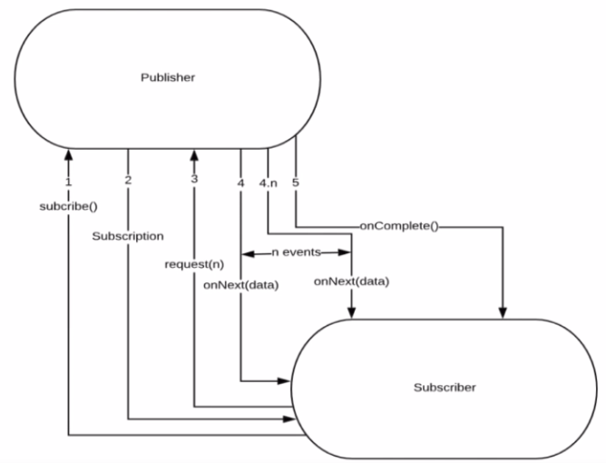
Flow Between Publisher and Subscriber

Slide 61
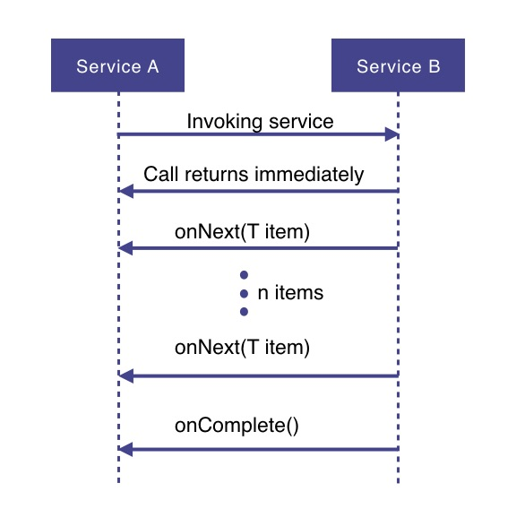
How Does it Work

Slide 62
How Does it Work
Service A wants to retrieve some data from service B.
Service A will make a request to service B which returns immediately
  Non-blocking and asynchronous.
Data requested will be made available to service A as a data stream,
  Service B will publish an onNext-event for each data item one by one.
When all the data has been published
  onComplete event is fired
In case of an error, an onError event would be published
  Items would not be emitted.

Slide 63
PROJECT REACTOR

Slide 64
PROJECT REACTOR
Spring Framework supports reactive programming since version 5.
  That support is build on top of Project Reactor.
WebFlux, Spring's reactive-stack web framework, requires Reactor as a core dependency.
Suited for Microservices Architecture
Offers backpressure-ready network engines for HTTP (including Websockets), TCP, and UDP.
Built and maintained by Pivotal
Recommended Library to work with Spring Boot
Runs on Java 8 and above.

Slide 65
PROJECT REACTOR
Spring Framework supports reactive programming since version 5.
  That support is build on top of Project Reactor.
WebFlux, Spring's reactive-stack web framework, requires Reactor as a core dependency.
Suited for Microservices Architecture
Offers backpressure-ready network engines for HTTP (including Websockets), TCP, and UDP.
Built and maintained by Pivotal
Recommended Library to work with Spring Boot
Runs on Java 8 and above.

Slide 66
Setting up a Project
Spring Boot application using Spring Initializr.
  Add Spring Reactive Web as dependecy
The spring-boot-starter-webflux dependency is added
  It will bring in the reactor-core dependency.
  The reactor-test has been added as a dependency.
Spring Webflux
  A reactive-stack web framework
  Runs on Netty, and Servlet 3.1+ containers.

Slide 67
Types of Publishers
Spring Webflux uses two Publishers
Mono
  To publish 0..1 element
  Mono is like the Optional type provided in Java 8.
  Mono to return a single object or VOid
Flux
  To publish 0..N element.
  Used to return lists.

Slide 68
Flux and Mono
They are both terminated either by a completion signal or an error
They call a downstream Subscriber's onNext, onComplete and onError methods.
Both provide a set of operators to support transformations, filtering, and error handling.

Slide 69
Creating Flux
Just (T... data)
  Overloaded method
  Create a new Flux that will only emit a single element then onComplete.
  Returns a new Flux
Flux<String> fluxColors = Flux.just("red", "green", "blue");
fluxColors.subscribe(System.out::println);

Slide 70
Mono
Emits at most one item and then optionally terminates with an onComplete signal or an onError signal.
  Mono noData = Mono.empty();
  Mono data = Mono.just(“ramesh”);

Slide 71
Mono and Flux
  public Mono<Book> bestBook(){
  Mono<Book> bestBook = Mono.just(bookList.get(1));
  return bestBook;
  }
  public Mono<Book> betterBook(){
  Mono<Book> betterBook = Mono.just(bookList.get(0));
  return betterBook;
  }
  public Flux<Book> fluxFromMono(){
  return Flux.concat(bestBook(),betterBook());
  }

Slide 72
SPRING WEBCLIENT

Slide 73
WebClient
Introduced from Spring 5
  Its a non-blocking client with support for Reactive Streams.
  It’s a replacement for RestTemplate .
  Its more functional and is fully reactive.
  It's included in the spring-boot-starter-weblux dependency

Slide 74
Web Client
  @Bean
  WebClient.Builder builder() {
  return WebClient.builder();
  }
  @Bean
  WebClient client(WebClient.Builder builderRef) {
  return builderRef.build();
  }

Slide 75
Http Methods
get()
  indicates that we are making a GET request.
  We know that the response will be a single object, so we're using a Mono as explained before.
  client.get()
  Client.post()

Slide 76
Rest Client - Controller
  @RestController
  public class ClientController {
  @Autowired
  private WebClient client;
  @GetMapping(path = "/hotels")
  public Flux<String> getAllHotels(){
  return client.get()
  .uri("http://localhost:7075/api/v1/hotels")
  .retrieve()
  .bodyToFlux(String.class);
  }
  }

Slide 77
Rest Client - Controller
  @PostMapping(path = "/hotels")
  public Mono<HotelDto> create(@RequestBody HotelDto dto)
  {
  return client.post()
  .uri(" http://localhost:7075/api/v1/hotels")
  .body(Mono.just(dto), HotelDto.class)
  .retrieve()
  .bodyToMono(HotelDto.class);
  }

Slide 78
Rest Client - Controller
  @DeleteMapping(path = "/hotels/{id}")
  public Mono<Void> removeHotelById(@PathVariable("id") int id){
  return client.delete()
  .uri(" http://localhost:7075/api/v1/hotels/{id}" ,id)
  .retrieve()
  .bodyToMono(Void.class);
  }
  }

Slide 79
Rest Client - Controller
  @GetMapping(path = "/hotels/{id}")
  public Mono<String> getHotelById(@PathVariable("id") int id){
  return client.get()
  .uri(" http://localhost:7075/api/v1/hotels /{id}",id)
  .retrieve()
  .bodyToMono(String.class);
  }

