Slide 1
DOCKER

Slide 2
Docker
Tool designed to create, deploy, and run applications
  Using containers.
Containers
  Used to package an application with all the parts it needs
  Libraries and other dependencies and ship it all out as one package.
Application will run on any other machine
  Even if the settings could differ from the machine used for writing and testing the code.

Slide 3
Need For Dockers
To benefit both developers and system administrators.
Part of many DevOps
Developers
  can focus on writing code without worrying about the system that it will ultimately be running on.
  Helps to get a head start by using one of thousands of programs already designed to run in a Docker container as a part of their application.
Operations
  Flexibility and reduces the number of systems needed because of its small footprint and lower overhead.

Slide 4
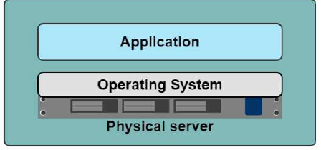
One application on one physical server

Slide 5
One application on one physical server
Slow deployment times
Huge costs
Wasted resources
Difficult to scale
Difficult to migrate
Vendor lock in

Slide 6
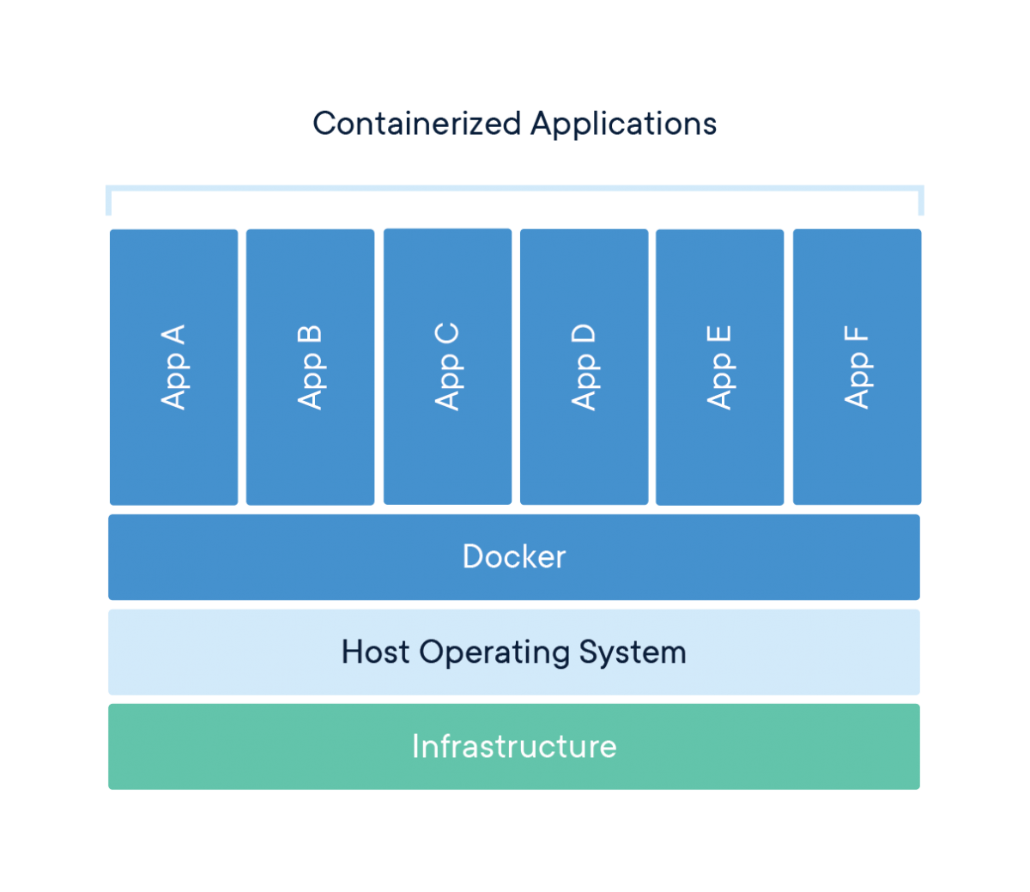
Containers

Slide 7
Virtual Machine
Virtual Machine (VM)
  Runs virtually on a physical machine.
  Each VM has their own operating system , runtime libraries and installed apps.
  The size of a VM may take GB of space from the physical machine
  Consumes high resources of the physical machine
  Can be multiple VMs in a physical machine.

Slide 8
Container – Virtual Machine
Infrastructure
  represents the resources and software related to the physical machine.
  This includes the host’s machine operating system, runtime libraries and other resources.
Hypervisor
  Software that allows to run VM on host machine.
Host Machine & Guest Machine
  A computer on which a hypervisor runs one or more virtual machines is called a host machine
  Hypervisor is responsible for creating and maintaining VMs.
  Each virtual machine is called a guest machine.
  The virtual machines can access the host’s machine infrastructure and resources through the hypervisor.

Slide 9
Docker Containers
Docker containers run on top of the docker platform.
  Contains only the executable package of the application, libraries and dependent software/servers that are required to run the application.
They do not have separate OS installations running
Utilize the host machine’s OS.
  Size of the container may take relatively less spaces
Containers are considered as light weight with compared to VM.

Slide 10
Container and Image
Docker container is a running instance of an image.
  Can Use CLI commands to run, start, stop, move, or delete a container.
  Container is an isolated and secure application platform
  It can also share and access resources running in a different host or container.
Image is a read-only template with instructions for creating a Docker container.
Image is described in text file called a Dockerfile
  A simple, well-defined syntax.
An image does not have state and never changes.
Docker Engine
  Provides the core Docker technology that enables images and containers.

Slide 11
Installation
Installation method change time to time.
  Especially for windows and Mac.
Docker desktop for Windows
  Available for free download
  Windows 10 Professional
  Windows Enterprise 64-bit
  Windows 10 Home 64-bit with WSL 2.
Can check docker is installed by the following command
docker --version

Slide 12
Docker Hub
https://hub.docker.com/
A repository that contains the published docker images.
Can create docker image of application and publish it here for later use or someone else to use.
It also has official docker image of many popular application

Slide 13
Docker Container and Image
docker run <image-name> : docker run hello-world
docker:
  Docker engine used to run docker program.
run:
  Used to create and run a docker container.
hello-world:
  It is a image or name of an Image
  This image will be loaded into the container.

Slide 14
Running an Image from DockerHub
docker images hello-world
  List the named docker Image
docker images
  List the docker images on the machine
    Shows Repository,tag,size,created and imageId
docker images --format "{{.ID}}: {{.Repository}}"
  Command to run the image from the terminal

Slide 15
Running a Docker Image
  Docker platform first check whether the requested image is already available in the local registry.
  If it is locally available, then it will run the local image.
  If the image is not available, then it will retrieve the image from the Docker Hub and run.

Slide 16
Dockerfile
A text file without any extension
Used To write the instruction to build new docker image
  Docker reads the instruction and builds images automatically
Will have commands to build a image.

Slide 17
DockerFile
FROM
  creates a layer from Docker image.
  FROM java:8
ARG <name>[=<default value>]
  Defines a variable that users can pass at build-time to the builder
  ARG JAR_FILE=target/firstExample.jar

Slide 18
DockerFile
ENTRYPOINT
  To configure a container that will run as an executable.
  ENTRYPOINT ["java","-jar","app.jar"]
WORKDIR
  Sets the working directory for any RUN, CMD, ENTRYPOINT, COPY and ADD instructions
  If the WORKDIR doesn’t exist, it will be created

Slide 19
Dockerfile
  FROM java:8
  ARG JAR_FILE=target/firstExample.jar
  WORKDIR /opt/app
  COPY ${JAR_FILE} app.jar
  ENTRYPOINT ["java","-jar","app.jar"]

Slide 20
Docker Core Java Project
Create a Maven Project
choose maven-archetype-quickstart
Update the pom.xml file
Can Optionally add build>finalName>customer-service
Add the Configuration ,archieve,manifest and main class
Create Dockerfile in the context Path
Update the Dockerfile with build entries
Maven build the project mvn clean package

Slide 21
Maven Java Plugin
  <plugin>
  <groupId>org.apache.maven.plugins</groupId>
  <artifactId>maven-jar-plugin</artifactId>
  <version>3.2.0</version>
  <configuration>
  <archive>
  <manifest>
  <mainClass>com.training.Application</mainClass>
  </manifest>
  </archive>
  </configuration>
  </plugin>

Slide 22
Build Docker Image
The docker build command builds Docker images from a Dockerfile
  Navigate to directory where DockerFile is present
docker build .
  Specifies that the PATH is .
  and so all the files in the local directory to Docker daemon
docker build --tag firstexample:1.0 .
  Can add a tag in the ‘name:tag’ format
docker run Image[:tag] =>docker run firstexample:1.0
  Used to specify a version of an image to run
docker rmi -f <imageId>

Slide 23
Docker Commands
  docker info
  List system-wide information regarding the Docker installation,
  Including statistics and resources (CPU & memory) available
docker container ls
  List the containers on machine,
docker ps
    running containers will be displayed)
docker ps -a
    show all containers

Slide 24
Docker commands
docker rmi <image-id>
  Used to remove an image
  docker rmi -f <image-id>
    Force remove an image
docker start <container-id>
  Start the Stopped Container
docker stop <container-id>
  stop running container

Slide 25
Dockerize Spring Boot Application
Create a Spring Boot Application
Optionally Update the server.port =4040
Create the dockerFile in the context Path
Dockerfile
  FROM java:8
  ARG JAR_FILE=target/customer-service.jar
  WORKDIR /opt/app
  COPY ${JAR_FILE} app.jar
  ENTRYPOINT ["java","-jar","app.jar"]
  Can also use the mvn spring-boot:build-image goal

Slide 26
Docker run
docker run -it -p8080:4040 customer-service:1.0
  4040: => from server.port in application.properties
  8080 -> any port which is not in use
Run a command in a new container
  Creates a writeable container layer over the specified image
  Then starts it using the specified command.
-p <port-on-host>:<port-on-container>
  publishes port 4040 in the container to port 8080 on the host.
-it
  Run a container interactively

Slide 27
Pushing to Docker Hub
Can push an image to Docker Hub
Local Image should be named using
  Docker Hub username and the repository name created through Docker Hub on the web.
Can add multiple images to a repository by adding a specific tag
  docs/base:testing
If it’s not specified, the tag defaults to latest.

Slide 28
Pushing Image to DockerHub
Local Images can be named by one of these methods:
  While building
    using docker build -t <hub-user>/<repo-name>[:<tag>]
After Build
  By re-tagging an existing local image
  docker tag <existing-image> <hub-user>/<repo-name>[:<tag>]
docker tag spring-boot vatsank/vatsan-quick-start:1.0
docker push vatsank/vatsan-quick-start:1.0

Slide 29
SPRING BOOT MYSQL

Slide 30
DOCKER COMPOSE

Slide 31
Dockerize Dependent Applications
Docker commands and Dockerfiles are suitable for creating individual containers.
Docker Compose
  Comes with an own build-file in YAML format
  Used for managing multiple containers.
    To start or stop a composite of services in one command,
    To Merge the logging output of multiple services together

Slide 32
Dockerfile
  FROM java:8
  WORKDIR /app
  COPY . /app
  EXPOSE 8080
  ADD ./target/user-service.jar user-service.jar
  ENTRYPOINT ["java","-jar","user-service.jar"]

Slide 33
docker-compose.yml
  version: '3'
  services:
  mysql-docker-container:
  image: mysql:latest
  environment:
  - MYSQL_ROOT_PASSWORD=root123
  - MYSQL_DATABASE=spring_app_db
  - MYSQL_USER=app_user
  - MYSQL_PASSWORD=test123
  volumes:
  - /data/mysql

Slide 34
docker-compose.yml
  spring-boot-jpa-app:
  image: spring-boot-jpa-image
  build:
  context: ./
  dockerfile: Dockerfile
  depends_on:
  - mysql-docker-container
  ports:
  - 8087:8080
  volumes:
  - /data/spring-boot-app

Slide 35
application.yml
  spring.datasource.url = jdbc:mysql://mysql-docker-container:3306/spring_app_db?allowPublicKeyRetrieval=true&useSSL=false
  spring.datasource.username = app_user
  spring.datasource.password = test123
  spring.jpa.properties.hibernate.dialect = org.hibernate.dialect.MySQL5Dialect
  spring.jpa.hibernate.ddl-auto = update

Slide 36
Docker-compose Commands
version:
  Specifies which format version should be used.
    Mandatory field.
services:
  Each object in this key defines a service,
  Like a container.
    Mandatory section
build:
  Specifies the location of our Dockerfile
  “.” represents the directory where the docker-compose.yml file is located.

Slide 37
Docker-compose Commands
image:
  The Name it be given to the image when build-features are used.
  It will be searching for this image in the library or remote-registry
depends_on:
  Used to inform Docker to start a service only, if the listed services have started successfully.
restart:
    always restarts containers that exit with zero ( success ) exit code.
  ports:
    Used to map the container’s ports to the host machine.

Slide 38
Docker-compose Commands
docker-compose up
  to start up a container
docker-compose down
  To take down container
docker-compose build
  To rebuild discarding old images with the newer one
docker-compose ps:
  This command list all the containers in the current docker-compose file. They can then either be running or stopped.

Slide 39
DOCKER WITH GRADLE AND MONGODB

Slide 40
Example
Create a Spring Boot Starter Project with Gradle
settings.gradle
  Give a concise name for the Project
version = '1.0’
  Give a Concise Version number in build.gradle
Add the Required Code in the Java Project
Create DockerFile in the context Path
Run the Docker Task => bootJar
A jar File will be created in the bin/libs folder of the project
Right Click on the project => showIn=> System Explorer
  Can see the Jar File Created

Slide 41
docker-compose.yml
  version: "3.7"
  services:
  api_service:
  build: .
  restart: always
  ports:
  - 8080:8080
  depends_on:
  - mongo_db
  mongo_db:
  image: "mongo:4.4.3"
  restart: always
  ports:
  - 27017:27017

Slide 42
application.yml
  spring:
  data:
  mongodb:
  host: mongo_db

