Slide 1
SPRING BOOT MVC

Slide 2
Spring MVC
Web application framework that takes advantage of design principles of Spring framework
Flexible and extensible via component’s
Simplified form handling through its parameter binding
Can do validation and error handling

Slide 3
MVC Architecture
Controller
  Designed around a DispatcherServlet
Model
  Can use any object as a command or form object.
  Data binding is highly flexible.
View
  View resolution is extremely flexible.
  View name resolution is configurable
  Can use properties file to configure views

Slide 4
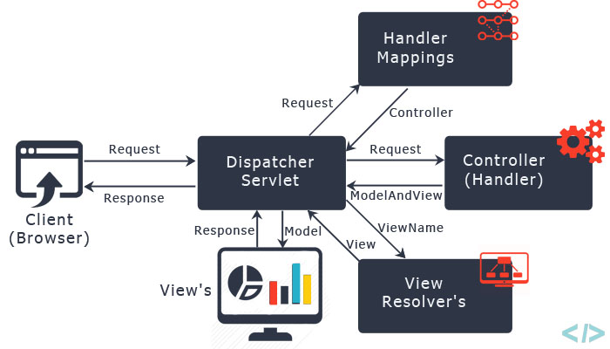
The requesting processing workflow

Slide 5
@RequestMapping
Used to map URLs onto a class or a particular method.
Class-level annotation maps a specific request path or pattern to a controller
Method-level annotations are used to narrow the primary mapping
  HTTP "GET"/"POST“ methods.
  @Controller
  @RequestMapping("/api")
  public class SecondController {
  }

Slide 6
@RequestMapping
  @Controller
  @RequestMapping("/api")
  public class SecondController {
  @RequestMapping(value=“/third” method = RequestMethod.GET)
  public String addUser()
  {
  return "Third";
  }
  }
  http://localhost:8080/springmvc/api/third

Slide 7
Model
A map object used to store attribute value pairs
Its created before invoking a handler method if the method has an argument type Model.
  Stores attribute values to render dynamic views such as JSP.
addAttribute(String name, Object obj)
  Used to map attribute names to object as attribute vales.
  public String init(Model model) {
  model.addAttribute("majHeading", "Jeevan Blood Bank");
  return "index";
  }

Slide 8
Controller
  @Controller
  public class WelcomeController {
  @RequestMapping("/welcome")
  public String showLoginPage() {
  return "welcome";
  }
  }

Slide 9
View Resolver
InternalResourceViewResolver
  Used to map the logical view names to view files
  spring.mvc.view.prefix=/WEB-INF/pages/
  spring.mvc.view.suffix=.jsp

Slide 10
Welcome.jsp
  src/main/webapp/WEB-INF/pages
  <%@ page language="java" contentType="text/html; charset=ISO-8859-1"
  pageEncoding="ISO-8859-1"%>
  <!DOCTYPE html>
  <html>
  <head>
  <meta charset="ISO-8859-1">
  </head>
  <body>
  <h2>MVC Configured Successfully</h2>
  </body>
  </html>

Slide 11
Dependency Required
Update the pom.xml with following Dependencies
The Entries can be picked from the Effective Pom.
  <dependency>
  <groupId>org.apache.tomcat.embed</groupId>
  <artifactId>tomcat-embed-jasper</artifactId>
  </dependency>
  <dependency>
  <groupId>javax.servlet</groupId>
  <artifactId>jstl</artifactId>
  </dependency>

Slide 12
ModelAndView object
Encapsulates both model and view that is to be used to render model
Model is represented as a java.util.Map
Objects can be added to without name:
  addObject(String, Object) – added with explicit name
  addObject(Object) – added using name generation (Convention over Configuration)
View is represented by String or View object
Analogous to Struts Action

Slide 13
Controller
  @Controller
  public class FirstController {
  @RequestMapping("/first")
  public ModelAndView execute()
  {
  String message = "Welcome to Spring!";
  return new ModelAndView("Success", “msg",message);
  }
  }

Slide 14
Controller-Model and View
  @Controller
  public class SecondController {
  @RequestMapping("/second")
  public ModelAndView getMessage() {
  ModelAndView mdl=new ModelAndView();
  mdl.setViewName("Second");
  mdl.addObject("msg","Hello India");
  return mdl;
  } }

Slide 15
@RequestParam
Use to bind request parameters to a method parameter in the controller.
  @RequestMapping ("/find")
  public String get ( @RequestParam ("custId") int id, Model model) {
  Customer cust =dao.findByCustomerId(id);
  System.out.println("Inside GET Method"+ cust);
  model.addAttribute("foundCustomer",cust);
  return "Display";
  }
Can also do return new ModelAndView("redirect:RedirectPage.htm");

Slide 16
@ModelAttribute
When Used as method parameter, maps a model attribute to the specific, annotated method parameter
The controller gets a reference to the object holding the data entered in the form.
When used at method level provides reference data for the model
The @ModelAttribute annotated methods are executed before the chosen @RequestMapping annotated handler method.
This helps in pre-populating the implicit model with specific attributes,

Slide 17
Model
  @Data
  @AllArgsConstructor
  @NoArgsConstructor
  @ToString
  public class TripDetail {
  private long tripId;
  private String source;
  private String destination;
  private double amount;
  }

Slide 18
Controller
  @Controller
  public class TripController {
  @Autowired
  TripDetail detail;
  @GetMapping("/")
  public String init() {
  return "index";
  }
  @ModelAttribute("location")
  public String[] loadPlaces() {
  return new String[]{"Bessy Beach","Mahabs","Mayajal"};
  }

Slide 19
Controller
    @GetMapping("/addTrip")
    public String initForm(Model model) {
    model.addAttribute("command",detail);
    return "addTripDetails";
    }
    @PostMapping("/addTrip")
    public String onSubmit(@ModelAttribute("data") TripDetail details) {
    System.out.println(details);
    return "success";
    }
    }

Slide 20
Using Spring's form tag library
Spring's form tag library gives the tags access to the command object and reference data of the controller
The form tag library comes bundled in spring-webmvc.jar.
The library descriptor is called spring-form.tld.
<%@ taglib prefix="form" uri="http://www.springframework.org/tags/form" %>
A Form tag puts the command object in the PageContext

Slide 21
View
  <form:form action="/addTrip" method="post">
  <form:input path="tripId"/>
  <form:select path="source" items="${location}">
  </form:select>
  <form:input path="destination"/>
  <form:input path="amount"/>
  <input type="submit" value="Add">
  </form:form>

Slide 22
Spring Validation
JSR-303 Bean Validation API is used by Spring.
The standardized validation constraint declaration and metadata
Annotate domain model properties with declarative validation constraints and the runtime enforces them.
Can define own custom constraints.
To trigger validation of a @Controller input, Input arguments are annotated with @Valid
Using Hibernate Validator in the classpath, Spring will detect it and automatically support across all Controllers

Slide 23
Maven Dependency
  <dependency>
  <groupId>javax.validation</groupId>
  <artifactId>validation-api</artifactId>
  <version>2.0.0.Final</version>
  </dependency>
  <dependency>
  <groupId>org.hibernate</groupId>
  <artifactId>hibernate-validator</artifactId>
  <version>5.4.0.Final</version>
  </dependency>

Slide 24
Hibernate inbuilt Validation
@AssertFalse
@AssertTrue
@Email
@Length
@Range

Slide 25
Model
  public class BloodDonor {
  private int id;
  @Length(min = 3,max = 8)
  private String name;
  @DateTimeFormat(pattern = "yyyy-MM-dd")
  private LocalDate dateOfBirth;
  private String bloodGroup;
  }

Slide 26
Controller - @Valid annotation
  @RequestMapping(“/donors")
  public String initAddDonorForm(Model model) {
  model.addAttribute("command",donor);
  return "addDonor";
  }
  @PostMapping(path="/donors")
  public String greetingSubmit(@Valid @ModelAttribute("command") BloodDonor donor, BindingResult result) {
  if(result.hasErrors()) {
  return "addDonor";
  } else {
  return "result";
  }
  }

Slide 27
Validation Input Jsp Page
  <<form:form method="post" action=" donors" >
  ID: <form:input path=“id" />
  <form:errors path=“id" />
  Name : <form:input path=“name" />
  <form:errors path=“name" />
  <input type="submit" value="Submit" />

