Slide 1
Files & IO

Slide 2
Overview
At its lowest level, all Java I/O involves a stream of bytes either entering or leaving memory
Packaged classes exist to make it easy for a program to read and write larger units of data.
Low-level stream class object are used to handle byte I/O
High-level stream class object will allow the program to read and write primitive data values and objects

Slide 3


File Classes
  Java views the data in files as a stream of bytes.
  A stream of bytes from which data are read is called an input stream.
  A stream of bytes to which data are written is called an output stream.
  Java provides classes for connecting to and manipulating data in a stream.
  The classes are defined in the package java.io and are organized in a large complex hierarchy.

Slide 4
File Class
This is an abstract representation file and directory pathnames
  Not used to read and write data
  Used for searching and deleting of files, creating directories and working with path and making directories
  has methods for getting file/directory info.
  cannot be used to read or write to a file.
To make a File object, there are three commonly used constructors File
  File file1 = new File("C:\\Data\\myFile.dat");
  public File(String directory, String filename)

Slide 5
File Class
The static File[] listRoots( )
  returns an array containing the roots of the filesystem as File objects:
public boolean exists( )
  returns true if the file named in this file object's path field exists or false if it doesn't:
Public boolean isFile( )
public boolean isDirectory( )
public boolean canRead( )
  The canRead( ) method indicates whether the program can read from the file.
public boolean canWrite( )
  The canWrite( ) method indicates whether the program can write into the file referred to by this File object.

Slide 6
File Class
To Make a New Directory
  File dir = new File(“JavaIO”);
  dir.mkdir();
public boolean createNewFile( ) throws IOException
  checks to see whether the file exists and creates the file if it doesn't already exist.
  It returns true if the file was created and false if it wasn't created, either because it couldn't be created or because the file already existed.
  File f = new File("output.dat");
  boolean success = f.createNewFile( );
  if (success) { //... } else { //...

Slide 7
Deleting and renaming files
public boolean renameTo(File destination)
The renameTo( ) method changes the name of a file:
  File src = new File("src.txt");
  File dst = new File("dst.txt");
  src.renameTo(dst);
public boolean delete( )
  The delete( ) method removes files from the filesystem permanently:
  This method returns true if the file existed and was deleted.

Slide 8
Listing Directories and Files
public String[] list( )
  returns an array of strings containing the names of each file in the directory referred to by the File object:
public File[] listFiles( )
  The two list( ) methods return arrays of strings.

Slide 9
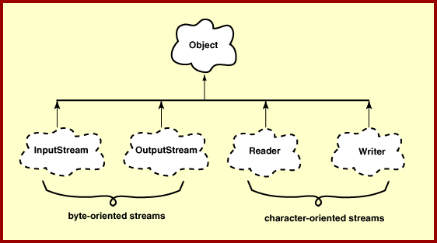
Hirearchy of IO Package

Slide 10
Java IO Package
Streams are byte-oriented or character-oriented.
Each type has input streams and output streams.
Byte-oriented streams.
  Use for general-purpose input and output.
  Data may be primitive data types or raw bytes.
Character-oriented streams.
  Specialized for character data.
  Transforms data from/to 16 bit Java char used inside programs to UTF format used externally.

Slide 11
Serializing
Creating the sequence of bytes from an object and Recreating the object from the above generated bytes
Ability to read or write an object to a stream
  Process of "flattening" an object
Used to save object to some permanent storage
  Its state should be written in a serialized form to a file such that the object can be reconstructed at a later time from that file
Used to pass on to another object via the OutputStream class
  Can be sent over the network

Slide 12
To use serialization
Most Java classes are serializable
Classes need to implement the serializable interface.
  Serializable interface is marker interface
  Class should also provide a default constructor with no args
Objects of some system-level classes are not serializable
  Because the data they represent constantly changes
  Reconstructed object will contain different value anyway
A NotSerializableException is thrown if you try to serialize non-serializable objects

Slide 13
To use serialization
Only the object's data are preserved, Methods and constructors are not part of the serialized stream ,the class information is included
Marking a field with the transient keyword
  The transient keyword prevents the data from being serialized
  All non-transient fields are considered part of an object
Have access to the no-argument (or default) constructor of its first nonserializable superclass (or supersuperclass, supersupersuper class)
Serializability is inherited

Slide 14
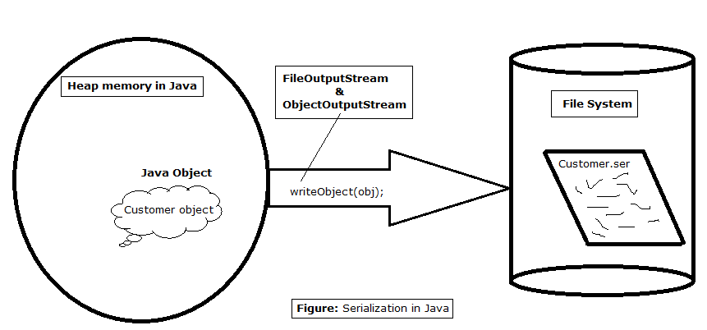
Serialization

Slide 15
Serialization
  public boolean writeObjectToFile(Professor prof,File file) {
  boolean result = false;
  try(ObjectOutputStream outStream = new ObjectOutputStream(new FileOutputStream(file))){
  outStream.writeObject(prof);
  result =true;
  }catch(IOException e) {
  e.printStackTrace();
  }
  return result;
  }

Slide 16
DeSerialization
  public Object readObjectFromFile(File file) {
  Object obj=null;
  try(ObjectInputStream inStream = new ObjectInputStream(new FileInputStream(file))){
  obj = inStream.readObject();
  }catch(ClassNotFoundException | IOException e) {
  e.printStackTrace();
  }
  return obj;
  }

Slide 17
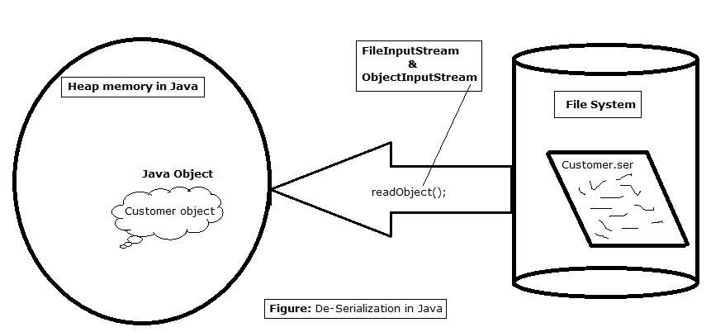
De Serialization

Slide 18
FileWriter
Used to write character to files
The Write method() of this classes is used to write characters
Wrapped by BufferedWriter to improve the performance
FileWriter(File file)
FileWriter(File file, boolean append)
All constructors and methods throw IOException

Slide 19
Print Writer
PrintWriter wraps the FileWriter
Has flexible and powerful methods to write data to files
format(),printf() and append() are used to work with data
print() or println() take a single parameter of any data type

Slide 20
FileReader
Used to read characters from files
The read() method of this class is used to read characters
These are wrapped by BufferedReader to improve the performance
Constructors:
FileReader(File file) throws FileNotFoundException
FileReader(String fileName) throws FileNotFoundException

Slide 21
Buffering
BufferedReader
  Buffers give a temporary holding place to group until it reaches final place.
  It helps in efficent reading of files
  Reads a large amount of data from a file at once and keep that data in buffer
  Minimizes the number of times of file access.
  Provides a readLine() method , which reads a line of characters from the file
  BufferedReader in =
    new BufferedReader(new FileReader(“file.txt"));
BufferedWriter
  Provides a newLine() method , which that creates line separators automatically

Slide 22
Write To File
  public boolean writeToTextFile(Professor prof,File file) {
  boolean result = false;
  try (PrintWriter writer = new PrintWriter(new FileWriter(file,true))){
  writer.println(prof);
  result =true;
  } catch (IOException e) {
  e.printStackTrace();
  }
  return result;
  }

Slide 23
Read From File
  public Professor[] readFromTextFile(File file) {
  Professor[] list = new Professor[4];
  String line =null;
  try(BufferedReader reader = new BufferedReader(new FileReader(file))){
  int i = 0;

Slide 24
Read From File
    while( (line = reader.readLine())!=null) {
    String[] values = line.split(",");
    Professor prof = new Professor(Integer.parseInt(values[0]),
    values[1],values[2], values[3]);
    list[i]= prof;
    i++;
    }
    }catch(IOException e) {
    e.printStackTrace();
    }
    return list;
    }

Slide 25
NON BLOCKING IO –NIO2

Slide 26
NIO
Used to manage the time consuming I/O activities
  Filling and draining buffers back into the operating system
  NIO makes I/O faster than traditional I/O.
    Since it uses the Buffers and Channels
NIO.2 API
  Introduced in Java 7 as a replacement for the java.io.File class.
  Provides a flexible, and intuitive API for use with files.

Slide 27
Blocking and Non-Blocking IO
Blocking I/O
  Waits for the data while writing or reading before returning.
Non blocking I/O
  Does not wait for the data to be read or write before returning.
  The thread can go on and do something else in a mean time.

Slide 28
IO and NIO
IO
  It is based on the Blocking I/O operation
  It is Stream-oriented
  Doesn’t have Channels and selectors
NIO
  It is based on the Non-blocking I/O operation
  It is Buffer-oriented
  Has Channels and Selectors

Slide 29
Buffers and Channels
Buffers
  Data is handled with buffers.
  Both read and write are directly done into a buffer.
  Provides a mechanism to store a fixed amount of primitive data elements using an in-memory container.

Slide 30
Channels
A medium that transports the data efficiently between the entity and byte buffers.
It reads the data from an entity and places it inside buffer blocks for consumption.
Acts as gateway to access the I/O mechanism.
Has one-to-one relationship with operating system file descriptor for providing the platform independence operational feature.

Slide 31
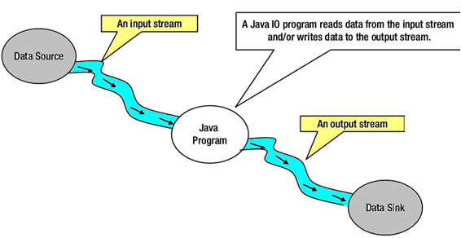
Stream Oriented

Slide 32
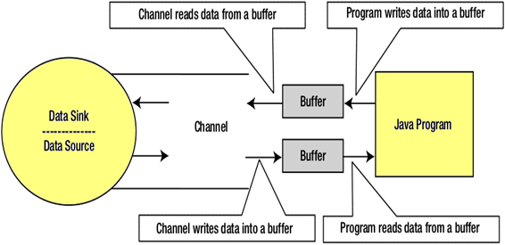
Buffer Oriented

Slide 33
Stream Oriented vs. Buffer Oriented
Stream Oriented
  Need to read one or more bytes at a time from a stream.
  It uses streams for transferring the data between a data source/sink and a java program.
    Streams can only be used for one-way data transfer.
  The I/O operation using this approach is slow.
Buffer Oriented
  Data is read into a buffer from which it is further processed using a channel.
  Works with the channel and buffer for I/O operation.
    A channel provides a two-way data transfer facility.
  Instead of reading the data byte for byte
    Data is first read into a Buffer, and then processed

Slide 34
Creating a NIO Path
Path object is a hierarchical representation of the path on a system to the file or directory.
Can create a Path Object using Paths factory class.
Paths.get()
  Used to obtain a reference to a file or directory.
  Accepts either a string, or a sequence of strings
  Path p1 = Paths.get(“demo/sample.txt");
  Path p2 = Paths.get("/home/demo");

Slide 35
Reading and Writing Large Files
Files.newBufferedReader()
  Used to read a large file
  Used to obtain an instance of BufferedReader
  Then read the file line by line using a BufferedReader.
  Can read the full content of a file into an array.
Files.readAllLines()
  Utility method that reads all the lines of a file and returns a List<String> containing each line.
  It internally uses BufferedReader to read the file.

Slide 36
Write To File
  public boolean writeToFile(String fileName,List<Doctor> doctorList) throws IOException {
  boolean status = false;
  Path path = Paths.get(fileName);
  try(BufferedWriter writer =
  Files.newBufferedWriter(path, StandardOpenOption.CREATE,StandardOpenOption.APPEND))
  {
  for(Doctor eachDoctor :doctorList) {
  writer.write(eachDoctor.toString());
  writer.newLine();
  }
  status = true;
  }
  return status;
  }

Slide 37
Reading files with the NIO API
  public Doctor[] readFromFile(String fileName) throws IOException {
  Path path = Paths.get(fileName);
  Doctor[] list = new Doctor[6];
  try(BufferedReader reader =
  Files.newBufferedReader(path)) {
  String currentLine =null;

Slide 38
Reading files with the NIO API
  int i=0;
  while((currentLine=reader.readLine())!=null) {
  String[] values = currentLine.split(",");
  Doctor doc = new Doctor(Integer.parseInt(values[0]),values[1]);
  list[i] = doc;
  i++;
  }
  }
  return list;
  }

Slide 39
Using NIO API with readAllLines()
Files.readAllLines()
  read the contents of a file and return them as an ordered list of strings.
  Path path = Paths.get(“details.txt");
  try{
  List contents = Files.readAllLines(path);
  for(String content:contents){
  System.out.println(content);
  }
  }catch(IOException ex){
  ex.printStackTrace();
  }

Slide 40
Create Stream Using NIO
  try {
  List<CreditCard> list =
  Files.lines(Paths.get("card-data.txt"))
  .skip(1).map(line ->line.split(","))
  .map(values ->
  new CreditCard(Integer.parseInt(values[0]),values[1],Double.parseDouble(values[2])))
  .collect(Collectors.toList());
  list.forEach(System.out::println);
  } catch (IOException e) {
  e.printStackTrace();
  }

Slide 41
Threads

Slide 42
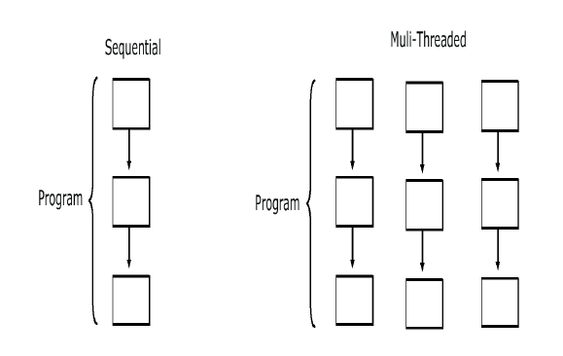
Why threads
Need to handle concurrent processes
Definition
  Single sequential flow of control within a program
Threads are like a processes executed by a program
Example:
  Operating System
  HotJava web browser

Slide 43
Multi-threading in Java Platform
Java Application start with just one thread, called the main thread.
  This thread has the ability to create additional threads
When a new thread is started , a new stack materializes and methods called from that thread run in a call stack that’s separate from the main() call stack.
That second new call stack runs concurrently with the main thread
A thread of execution is an individual process (a “lightweight” process) that has its own call stack.
one thread per call stack—one call stack per thread.

Slide 44
The Main Thread
Every java program has at least one thread called main thread
Thread.currentThread().getName()
  Returns the name current thread
  setName() is used to set the name for the thread

Slide 45
Making a Thread
Done by extend the java.lang.Thread class
  To have specialized version of a thread class.
  That class can’t extend another class
Done By Implementing the Runnable interface
  Leaves class free to extend from some other class
  Define behavior that will be run by a separate thread.
  Thread Class is created with a Runnable argument.
  The Runnable object is the target of the thread.
    .

Slide 46
Making a Thread
A thread begins as an instance of java.lang.Thread.
public void run()
  Has the Code that needs to be run in a separate thread
  It can call other methods,
  The thread of execution begins with the call to this method

Slide 47
Example
  public class NumberService {
  public NumberService() {
  super();
  }
  public void sumNumbers(int countTo) {
  int count =0;
  for(int i=0;i<=countTo;i++) {
  count =count +i;
  }
  System.out.println( " Sum of Number upto" + countTo +"Is ="+count +"Done By"+Thread.currentThread().getName());
  }
  }

Slide 48
Implementing java.lang.Runnable
  public class NumberAddingService implements Runnable{
  private int countTo;
  private NumberService service;
  public NumberAddingService(int countTo,String name) {
  this.countTo = countTo;
  this.service = new NumberService();
  Thread t1 = new Thread(this,name);
  t1.start();
  }
  @Override
  public void run() {
  this.service.sumNumbers(countTo);
  }
  }

Slide 49
Starting a Thread
start()
  Creates a new thread and makes it runnable
  A new thread of execution starts (with a new call stack).
  The thread moves from the new state to the runnable state.
  When the thread gets a chance to execute, its target run() method will run.

Slide 50
Starting Multiple Thread
  public static void main(String[] args) {
  new NumberAddingService(50,"Fifty Count");
  new NumberAddingService(500,"Five Hundred Count");
  new NumberAddingService(5000,"Five Thousand Count");
  try {
  System.out.println("Enter the Number");
  int ch =System.in.read();
  System.out.println(ch);
  } catch (IOException e) {
  e.printStackTrace();
  }
  }

Slide 51
The Thread Scheduler
The thread scheduler is the part of the JVM
Any thread in the runnable state can be chosen by the scheduler to be the one and only running thread.
java.lang.Thread Class
  public static void sleep(long millis) throws InterruptedException
  public final void join()
java.lang.Object Class
  public final void wait()
  public final void notify()
  public final void notifyAll()

Slide 52
Thread States
New
  When the Thread has been instantiated
    The start() method has not been invoked on the thread.
  It is a live Thread object, but not yet a thread of execution.
  At this point, the thread is considered not alive.
Runnable
  The state a thread is in when it’s eligible to run,
  Scheduler has not selected it to be the running thread.
  A thread first enters the runnable state when the start() method is invoked
  A thread can also return to the runnable state after either running or coming back from a blocked, waiting, or sleeping state.
  When the thread is in the runnable state, it is considered alive.

Slide 53
Thread States
Running
  This is the state a thread is in when the thread scheduler selects it from the runnable pool to be the currently executing process.
  A thread can transition out of a running state for several reasons, including because “the thread scheduler felt like it.”
Waiting/blocked/sleeping
  The thread is still alive, but is currently not eligible to run.
  A thread may be blocked waiting for a resource
  A thread may be sleeping because the thread’s run code tells it to sleep for some period of time
  waiting, because the thread’s run code causes it to wait

Slide 54
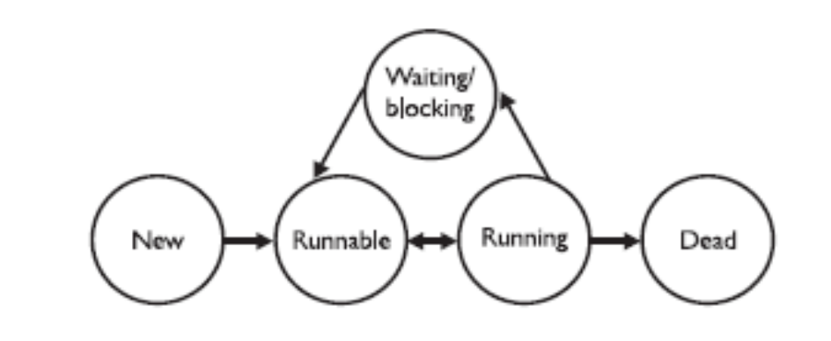
Thread States
Dead
A thread is considered dead when its run() method completes.
It may still be a viable Thread object, but it is no longer a separate thread of execution. Once a thread is dead, it can never be brought back to life
A runtime exception will be thrown

Slide 55
Leave the running state
sleep()
Guaranteed to cause the current thread to stop executing
  Duration is specified in milli seconds
  It might be interrupted before its specified time
join()
Guaranteed to cause the current thread to stop executing until the thread it joins with the thread it calls wait on completes.
Leave the Running State:
Following scenarios
  The thread’s run() method completes..
  A thread can’t acquire the lock on the object whose method code it’s attempting to run

Slide 56
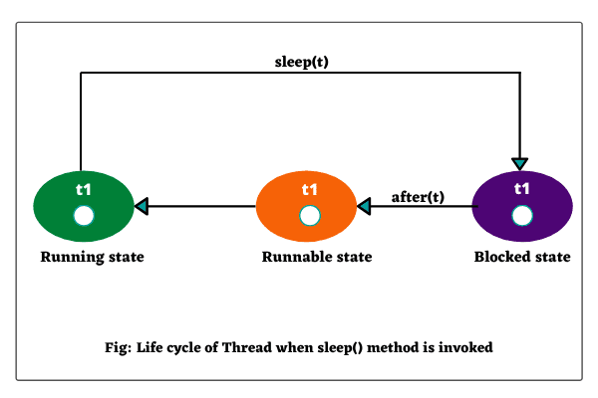
The sleep() method
Static method of Thread Class
Can be Placed anywhere in the Code
Throws a Checked Exception – Interrupted Exception
  try {
Thread.sleep(5*60*1000); // Sleep for 5 minutes
} catch (InterruptedException ex) { }

Slide 57
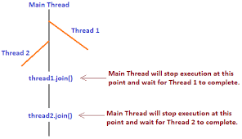
The Join() Method
The non-static join() method of class Thread lets one thread “join onto the end” of another thread.
The thread class join method waits until a thread is finished executing or waiting for a thread to die before returning .

Slide 58
Joining Thread
  public class TaskForJoin implements Runnable {
  public void run() {
  System.out.println("Reading");
  try {
  System.in.read( );
  } catch (java.io.IOException ex) {
  }
  System.out.println("Thread Finished.");
  }
  }

Slide 59
Joining Thread
  public class ParentThread {
  public static void main(String[] args) {
  System.out.println("Starting");
  TaskForJoin task = new TaskForJoin();
  Thread t = new Thread(task);
  t.start( );
  System.out.println("Joining");

Slide 60
Joining Thread
    try {
    t.join( );
    } catch (InterruptedException ex) {
    ex.printStackTrace();
    }
    System.out.println("Main Finished.");
    }
    }

Slide 61
Synchronizing Code
Threads can share resources.
Sometimes it is desirable that only one thread at a time has access to a shared resource.
Achieved by using the keyword: synchronized, Only methods can be synchronized, not variables.
Protects access to code, not to data
  Make data members private
  Synchronize accessor methods
A lock can be associated with a shared resource. Threads gain access to a shared resource by first acquiring the lock associated with the resource.
one thread can hold the lock and thereby have access to the shared resource.

Slide 62
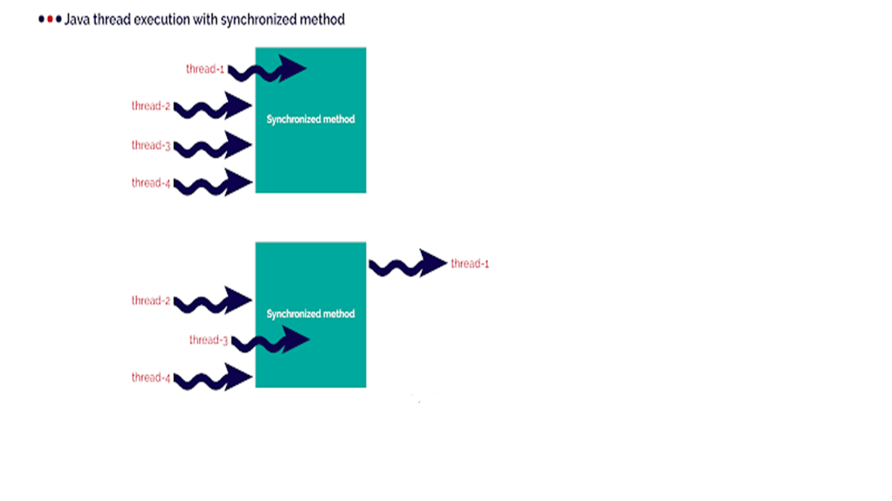
Synchronizing Code

Slide 63
Synchronizing Code
A class can have both synchronized and no synchronized methods.
If a class has both synchronized and nonsynchronized methods, multiple threads can still access the nonsynchronized methods of the class!
A thread can acquire more than one lock.
A thread can enter a synchronized method, thus acquiring a lock, and then immediately invoke a synchronized method on a different object, thus acquiring that lock as well.
As the stack unwinds, locks are released again.

Slide 64
Thread Synchronization
  class TwoStrings {
  synchronized static void print(String str1, String str2) {
  System.out.print(str1);
  try {
  Thread.sleep(500);
  } catch (InterruptedException ie)
  {
  ie.printStackTrace();
  }
  System.out.println(str2);
  }
  }

Slide 65
Thread Synchronization
  class PrintStringsThread implements Runnable {
  String str1, str2;
  PrintStringsThread(String str1, String str2) {
  this.str1 = str1;
  this.str2 = str2;
  Thread thread = new Thread(this);
  thread.start();
  }
  public void run() {
  TwoStrings.print(str1, str2);
  }
  }

Slide 66
Thread Synchronization
  public class Test {
  public static void main(String args[])
  {
  new PrintStringsThread("Hello ", "there.");
  new PrintStringsThread("How are ", "you?");
  new PrintStringsThread("Thank you ","very much!");
  new PrintStringsThread("Bye ","Bye!");
  }
  }
  Output- May be in Different Order
  Hello there
  How are you
  Thank you very much
  Bye,Bye

Slide 67
Thread Interaction
The java.lang.Object class has three methods—wait(), notify(), and notifyAll()—that help threads communicate
wait(), notify(), and notifyAll() must be called from within a synchronized context!
If many threads are waiting on the same object, only one will be chosen (in no guaranteed order) to proceed with its execution.
If there are no threads waiting, then no particular action is taken

Slide 68
notifyAll()
This notifies all waiting threads and they start competing to get the lock. As the lock is used and released by each thread, all of them will get into action without a need for further notification.
Object can have many threads waiting on it, and using notify() will affect only one of them.
Which one exactly is not specified and depends on the JVM implementation,
never rely on a particular thread In cases in which there might be a lot more waiting, the best way to do this is by using notifyAll().

Slide 69
Notify -Example
  class BankAccount {
  private double balance=2000;
  public synchronized double deposit(double amount){
  balance=balance+amount;
  notify();
  return balance;
  }

Slide 70
Notify -Example
public synchronized double withdraw(double amount)
{
if(balance <amount) {
System.out.println("In sufficent Balance ");
try {
wait();
} catch (InterruptedException e) {
e.printStackTrace();
}
}
balance =balance-amount;
return balance;
}

Slide 71
Notify -Example
  public static void main(String[] args) {
  final BankAccount bk1 =new BankAccount();
  Thread t1=new Thread(){
  public void run(){
  bk1.withdraw(4000);
  } };
  t1.start();
  Thread t2=new Thread(){
  public void run(){
  bk1.deposit(3000);
  }
  };
  t2.start();
  }

Slide 72
Notify and notifyAll()
notify
Object can have many threads waiting on it, and using notify() will affect only one of them.
  Which one exactly is not specified and depends on the JVM implementation,
  The thread that receives notification may not able to proceed and starts waiting again application cannot progress further.
  May result in deadlock if the thread which calls notify() goes into waiting for state after sending a notification because then there is no active thread to notify all waiting threads.
notifyAll()
  A better option than notify()
  It sends a notification to all the threads.
  If one is not able to proceed, there is still some more threads to do the job

Slide 73

Notify and notifyAll()

Slide 74
Notify -Example
  class BankAccount {
  private double balance=2000;
  public synchronized double deposit(double amount){
  balance=balance+amount;
  notify();
  return balance;
  }

Slide 75
Notify -Example
public synchronized double withdraw(double amount)
{
if(balance <amount) {
System.out.println("In sufficent Balance ");
try {
wait();
} catch (InterruptedException e) {
e.printStackTrace();
}
}
balance =balance-amount;
return balance;
}

Slide 76
Notify -Example
  public static void main(String[] args) {
  final BankAccount bk1 =new BankAccount();
  Thread t1=new Thread(){
  public void run(){
  bk1.withdraw(4000);
  } };
  t1.start();
  Thread t2=new Thread(){
  public void run(){
  bk1.deposit(3000);
  }
  };
  t2.start();
  }

Slide 77
EXECUTOR FRAMEWORK

Slide 78
Executor Framework
Released with the JDK 5 as part of java.util.concurrent package
Helps to decouple a command submission from command execution.
Thread Creation
  Has methods for creating a pool of threads to run tasks concurrently.
Task submission and execution
  Has methods for submitting tasks for execution in the thread pool
  Can submit a task to be executed or schedule them to be executed later
  Can also make them execute periodically.

Slide 79
Executors framework
Executors
  Provides Factory methods to create Thread Pools of worker threads.
  Tasks are submitted for execution.
  Schedules and executes the submitted tasks
  Return the results from the thread pool.
ExecutorService
  A sub interface of Executor
  Has methods to manage lifecycle of threads
  Used for running the submitted tasks
  Has methods that produce a Future to get a result from an asynchronous computation.

Slide 80
Executor Service
Has methods to start and terminate thread.
  execute()
  Used for threads which are Runnable
  submit()
  Used for Callable threads.
shutdown()
  Stops accepting new tasks, waits for previously submitted tasks to execute,
  Then terminates the executor.
shutdownNow()
  Interrupts the running task and shuts down the executor immediately.

Slide 81
Thread Pool
A pool of worker threads
  Executors use thread pools to execute tasks.
  Executors Utility class provides different methods to create thread pool.
Need for Thread Pool
  Creating a new thread for a new task leads to overhead of thread creation and tear-down.
    Managing thread life-cycle adds to the execution time.
  New thread for each process without any throttling leads to the creation of many threads.
    They occupy memory and cause wastage of resources.

Slide 82

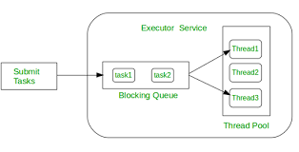
Working of Executors

Slide 83
Types of Executors –Single Thread Executor
newSingleThreadExecutor()
  Executor has only a single thread.
  Used to execute tasks in a sequential manner.
  When the submitted task is in execution
    The new task will wait in a queue until the thread is free to execute it.
    If the thread dies due to an exception while executing a task, a new thread is created to replace the old thread and the subsequent tasks are executed in the new one.
  ExecutorService executorService =
  Executors.newSingleThreadExecutor()

Slide 84
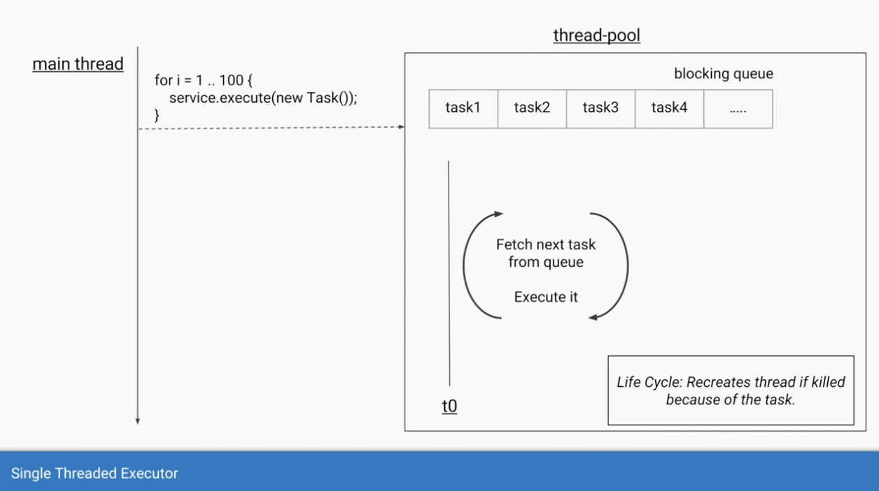
Single Threaded Executor

Slide 85
Task
  public class PrintNames {
  public synchronized static void print(String str1,String str2) {
  System.out.println(str1);
  try {
  Thread.sleep(200);
  } catch (InterruptedException e) {
  e.printStackTrace();
  }
  System.out.println(str2);
  }
  }

Slide 86
Runnable
  public class ExecutorPrintService implements Runnable {
  private String str1;
  private String str2;
  public ExecutorPrintService(String str1, String str2) {
  super();
  this.str1 = str1;
  this.str2 = str2;
  }
  @Override
  public void run() {
  PrintNames.print(str1, str2);
  }
  }

Slide 87
Submit to Executor
  public static void main(String[] args) {
  ExecutorService executor = Executors.newSingleThreadExecutor();
  ExecutorPrintService tasks[] = {
  new ExecutorPrintService("Idly","sambar"),
  new ExecutorPrintService("Parantha","achar"),
  new ExecutorPrintService("pizza","coke")};
  for(int i=0;i<tasks.length;i++) {
  executor.submit(tasks[i]);
  }
  executor.shutdown();
  }

Slide 88
Runnable Task
  public class NameManager implements Runnable {
  private List<String> list;
  private List<String> nameToAdd ;
  public NameManager(List<String> list,String ... names) {
  this.list = list;
  this.nameToAdd = Arrays.asList(names);
  }
  public List<String> getList() {
  return list;
  }
  @Override
  public void run() {
  this.list.addAll(nameToAdd);
  }
  }

Slide 89
Single Thread Executor
    ExecutorService service = Executors.newSingleThreadExecutor();
  List<String> list = new ArrayList<>();
  NameManager task1 =new NameManager(list,"Ram",“Vijay",”Vicky");
  NameManager task2 =new NameManager(list,"Vidya","vani","Rani");
  service.submit(task1);
  service.submit(task2);
  task1.getList().forEach(System.out::println);
  service.shutdown();

Slide 90
Executors.newFixedThreadPool
  Create a thread pool of fixed size,
  Executor service picks one of the available threads from the pool and executes the task on that thread.
  Makes sure that the pool always has the specified number of threads running.
  If any thread dies it is replaced by a new thread immediately.
  If all the threads are busy , the new tasks will wait for their turn in a queue.

Slide 91
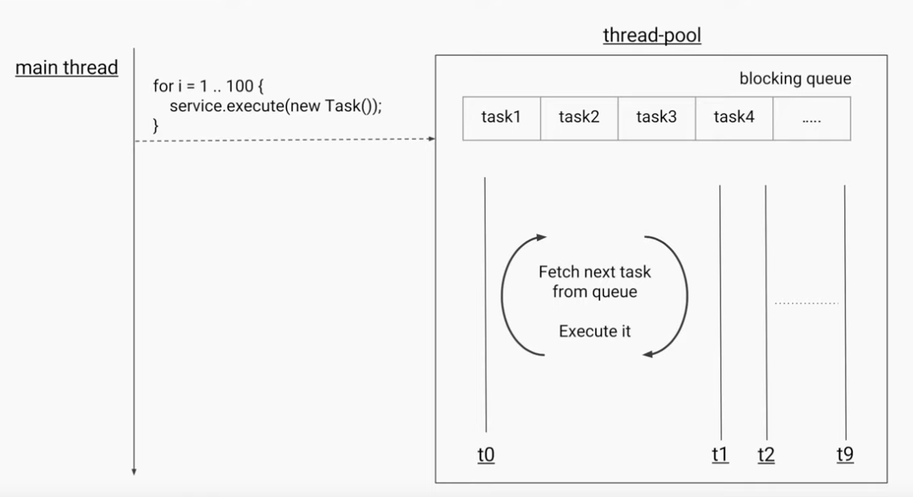
Fixed Thread Pool

Slide 92
Submit to Executor
  public static void main(String[] args) {
int poolSize = Runtime.getRuntime().availableProcessors();
  ExecutorService executor = Executors.newFixedThreadPool(poolSize);
  ExecutorPrintService tasks[] = {
  new ExecutorPrintService("Idly","sambar"),
  new ExecutorPrintService("Parantha","achar"),
  new ExecutorPrintService("pizza","coke")};
  for(int i=0;i<tasks.length;i++) {
  executor.submit(tasks[i]);
  }
  executor.shutdown();
  }

Slide 93
Size of the Fixed Thread Pool
Decided based on the use-case of the java program.
It also depends on number of CPU cores
CPU Bound
  Tasks which involves mathematical calculations.
  Ideal size is same as number of CPU cores.
IO Bound
  Tasks which involve communication to other application through network calls like database, web services
  Ideal size depends on the wait time of the IO task.
  More number of threads can be used to ensure maximum CPU utilization.

Slide 94
SingleThreadExecutor vs FixedThreadPool
Similarity
  Returns ExecutorService
  If thread terminates, new thread will be created.
Difference
  newSingleThreadExecutor()
    can never increase its thread pool size more than one.
  newFixedThreadPool(1)
    (1) stands for the number of threads in the pool
    can increase its thread pool size more than one at run time
  Done by setCorePoolSize() of the class ThreadPoolExecutor.

Slide 95
Difference between execute and submit
execute
  Starts the task
  Used for fire and forget calls
  Throws un-handled Exception.
    submit
  returns a Future object to manage the task.
  Can be Used to submit a Callable
  Callable can return a value
  Hides un-handled Exception in framework itself.
  Can Wait for the Callable task to finish executing
  Can get the return value on completion , with get.

Slide 96
CALLABLE

Slide 97
Callable
Similar to Runnable
Can be used with an executor service for execution.
A functional Interface with one Method
call()
  Method contains the code that is executed by a thread.
  Can return a result and throws a checked exception.

Slide 98
Callable With Executor
submit()
  submits the task for execution by a thread.
  returns a java.util.concurrent.Future
A task submitted to the executor
  Submitted task must implement Callable.
  Whenever the task execution is completed, it is set to Future object by the executor.

Slide 99
Future
Future
  Object returned by the executor.
  The result of the task submitted for execution to an executor
  Its like a promise made to the caller by the executor.
  Future.isDone
  Returns a boolean value true if the task completed.

Slide 100
Future.get()
Future.get()
  Waits for the computation to complete, and then retrieves its result.
  This method is used to get the result of the submitted task when its completed
get(long timeout, TimeUnit unit)
  Throws a TimeoutException if the result is not returned in the stipulated timeframe.
  The caller can handle this exception and continue with the further execution of the program.

Slide 101
Cancelling a Future
Future.cancel(boolean mayInterruptIfRunning)
  Used to cancel a future
  returns true if it is cancelled successfully, otherwise, it returns false.
mayInterruptIfRunning.
  True
    the thread that is currently executing the task will be interrupted
  False
    in-progress tasks will be allowed to complete.
Future.isCancelled()
  To check if a task is cancelled or not.

Slide 102
Callable Example
public class Task implements Callable<String> {
private String message;
public Task(String message) {
this.message = message;
}
@Override
public String call() throws Exception {
return "Hello " + message + "!";
}
}

Slide 103
Callable Example
public class ExecutorExample {
public static void main(String[] args) {
Task task = new Task("World");
ExecutorService executorService = Executors.newFixedThreadPool(4);
Future<String> result = executorService.submit(task);
try {
System.out.println(result.get());
} catch (InterruptedException | ExecutionException e) {
System.out.println("Error occured while executing the submitted task");
e.printStackTrace();
}
executorService.shutdown();
}
}

Slide 104
Callable Example
  public class FactorialCalculator implements Callable<Integer> {
  private Integer number;
  public FactorialCalculator(Integer number) {
  this.number = number; }
  @Override
  public Integer call() throws Exception {
  int result = 1;
  if ((number == 0) || (number == 1)) {
  result = 1;
  } else {
  for (int i = 2; i <= number; i++) {
  result *= i;
  TimeUnit.MILLISECONDS.sleep(20);
  }
  }
  return result;
  } }

Slide 105
Callable Example
  ExecutorService executor = Executors.newFixedThreadPool(2);
  FactorialCalculator calculator = new FactorialCalculator(5);
  try {
  Future<Integer> task = executor.submit(calculator);
  System.out.println("Future result is - " + " - " + task.get() + "; And Task done is " + task.isDone());
  }
  catch ( ExecutionException | InterruptedException e)
  {
  e.printStackTrace();
  }
  executor.shutdown ();

Slide 106
Cancelling the Future
  public static void main(String[] args) {
  ExecutorService executorService = Executors.newSingleThreadExecutor();
  long startTime = System.nanoTime();
  Future<String> future = executorService.submit(() -> {
  Thread.sleep(2000); return "Hello from Callable"; });
  while(!future.isDone()) {
  System.out.println("Task is still not done...");
  try {
  Thread.sleep(200);
  double elapsedTimeInSec = (System.nanoTime() - startTime)/1000000000.0;
  if(elapsedTimeInSec > 1) {
  future.cancel(true);
  }
  } catch (InterruptedException e) {
  e.printStackTrace(); }

Slide 107
Cancelling the Future
  System.out.println("Task completed! Retrieving the result");
  String result;
  try {
  result = future.get();
  System.out.println(result);
  } catch (InterruptedException e) {
  e.printStackTrace();
  } catch (ExecutionException e) {
  e.printStackTrace();
  }
  executorService.shutdown();
  }
  }

Slide 108
Cancelling the Future
  if(!future.isCancelled()) {
  System.out.println("Task completed! Retrieving the result");
  String result = future.get();
  System.out.println(result);
  } else {
  System.out.println("Task was cancelled");
  }

