Slide 1
DevOps

Slide 2
Devops
'DevOps' is a combination of two words 'development' and 'operations.‘
A set of practices designed to overcome the gap between development, QA and Operations
  Done by effective communication and collaboration, incorporating continuous integration process with automated deployment.
It helps to increase an organization’s speed to deliver applications and services.

Slide 3
Need for DevOps
The development and operation team worked in complete isolation.
Testing and Deployment were isolated activities done after design-build.
  Hence they consumed more time than actual build cycles.
  Manual code deployment leads to human errors in production
  Coding & operation teams have their separate timelines and are not in synch causing further delays.

Slide 4
Life Cycle
Development
  Software Development takes place constantly.
  The entire development process is separated into small development cycles.
  Helps to speed up software development and delivery process.
Testing
  QA team use tools like Selenium to identify and fix bugs in the new piece of code.

Slide 5
Life Cycle
Integration
  New functionality is integrated with the prevailing code,
  Testing takes place.
  Continuous development with integration and testing.
Deployment
  Deployment process takes place continuously.
  It is performed in such a manner that any changes made any time in the code, should not affect the functioning of high traffic application.
Monitoring
  Operation team will take care of the inappropriate system behavior or bugs which are found in production.

Slide 6
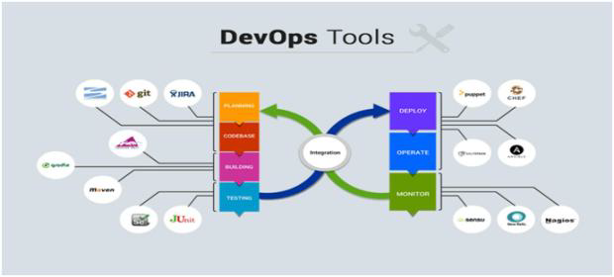
Life Cycle

Slide 7
Popular Tool for DevOps Automation
Git
  Version Control System tool
Jenkins
  Continuous Integration tool
Selenium
  Continuous Testing tool
Puppet, Chef, Ansible
  Configuration Management and Deployment tools
Nagios
  Continuous Monitoring tool
Docker
  Containerization tool

Slide 8
Working of Tools
Developers develop the code and this source code is managed by Version Control System tools like Git etc.
Developers send this code to the Git repository and any changes made in the code is committed to this Repository.
Jenkins pulls this code from the repository using the Git plugin and builds it using tools like Ant or Maven.

Slide 9
Working of Tools
Configuration management tools like puppet deploys & provisions testing environment and then Jenkins releases this code on the test environment on which testing is done using tools like selenium.
Once the code is tested, Jenkins send it for deployment on the production server (even production server is provisioned & maintained by tools like puppet).
After deployment It is continuously monitored by tools like Nagios.
Docker containers provides testing environment to test the build features

Slide 10
DevOps Principles
Customer-Centric Action
  DevOps team must take customer-centric action
  Invest in products and services.
End-To-End Responsibility
  DevOps team need to provide performance support until they become end-of-life.
  This enhances the level of responsibility and the quality of the products engineered.
Continuous Improvement
  DevOps culture focuses on continuous improvement to minimize waste.
  It continuously speeds up the improvement of product or services offered.

Slide 11
DevOps Principles
Automate everything
  Automation is a vital principle of DevOps process.
  Both software development and infrastructure
Work as one team
  In the DevOps culture role of the designer, developer, and tester are already defined.
  All they needed to do is work as one team with complete collaboration.
Monitor and test everything
  It is very important for DevOps team to have a robust monitoring and testing procedures.

Slide 12
GIT
Configuration Management

Slide 13
Topics
Basics of Software Configuration Management
Basics of Version Control System
  Centralized version control system
  Distributed/Decentralized version control system
How to install, configure and create repository
Working copy and check out
Review, Commit & Update
How to merge code and avoid conflict

Slide 14
Software Configuration Management
Multiple people have to work on software that is changing
More than one version of the software has to be supported:
    Released systems
    Custom configured systems (different functionality)
    System(s) under development
    Software on different machines & operating systems
Need for coordination
Software Configuration Management
  manages evolving software systems
  controls the costs involved in making changes to a system.

Slide 15
All Software Has Multiple Versions
Different releases of a product
Variations for different platforms
    Hardware and software
Versions within a development cycle
    Test release with debugging code
    Alpha, beta of final release
Every time when the program is edited

Slide 16
Version Control
Version control tracks multiple versions
In particular, allows
  old versions to be recovered
  multiple versions to exist simultaneously
  can recreate project history
Can revert a file or project to a previous version, track modifications and modifying individuals, and compare changes.

Slide 17
Centralized Version Control
A single server storing all changes and file versions
Can be accessed by various clients.
Knowledge of team members activities with certain files
Administrators can control privileges.

Slide 18
GIT
Git is a Distributed Version Control System that stores data in a file system made up of snapshots.
Creates a snapshot of the file and stores a reference to it.
When changes are saved its called commit
If the file has not changed, stores a reference to the already-stored identical version of it.

Slide 19
History of Git
Git traces its roots to the open source software project Linux kernel.
Linus Torvalds, the chief architect of the Linux kernel, began creating Git.
Since its inception in 2005, Git has become one of the most utilized Version Control Systems in the world.

Slide 20
Local Operations
Git mostly relies on local operations because most necessary information can be found in local resources.
Projects history resides on the local disk, eliminating the need to fetch history information from the server
Can continue work on a project even when not online or on a VPN.

Slide 21
GIT-Features
Tracking Changes
  Every single change applied to any file or directory is tracked by Git.
States
  Files in Git can reside in three main states: committed, modified and staged.
  Committed
    Data is securely stored in a local database
  Modified
    File has been changed but not committed to the database
  Staged
    Flagged a file changed version to be committed in the next snapshot

Slide 22
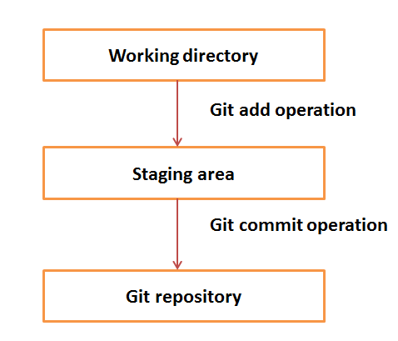
Working Directory and Staging Area

Slide 23
Download GIT
Git can be installed by downloading
Git Website
http://git-scm.com/download/win
GitHub
Install Git as part of the GitHub for Windows install.
http://windows.github.com

Slide 24
Initial Customization
Identity Setting
Can set the user name and email address, to be used for every Git commit.
To SET
  git config --global user.name “Ramesh Kumar"
  git config --global user.email ram@abc.com
To View
  git config --global user.name
  git config --global user.email

Slide 25
Default Text Editor
Git will use the gitPad has the text Editor
  Can configure a different text editor
$ git config --global core.editor wordpad
Check Settings
  git config --list command.
Getting Help
  git help command
  git command –help

Slide 26
Setting up a Git Repository
To import an existing project or directory into Git,
Switch to the target project directory
$ cd test
  Use the git init command
Can start tracking repository files, and initial commit

Slide 27
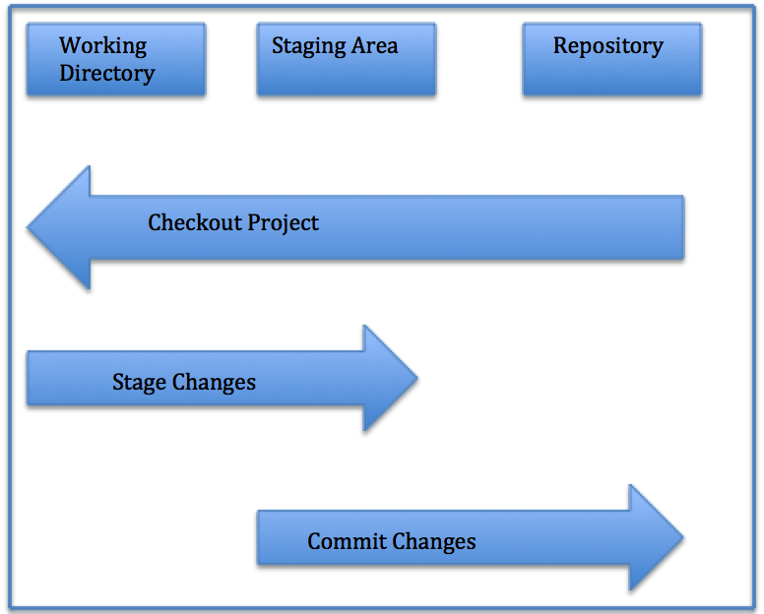
Local Repository Structure
The local Git repository has three components:
Working Directory: The actual files reside here.
Index: The area used for staging
Head: Points to the most recent commit

Slide 28
Saving Changes
All files in a checked out (or working) copy of a project file are either in a tracked or untracked state.
Tracked
  Files can be modified, unmodified, or staged; they were part of the most recent file snapshot.
Untracked
  Untracked files were not in the last snapshot and do not currently reside in the staging area.
  After cloning a repository, files have tracked status and are unmodified because they have been checked out but not edited.

Slide 29
Check File Status
To determine the state of files,
$ git status
Gives information of branch and state of working directory

Slide 30
Tracking and Staging a New File
  files are tracked and staged for committing.
Single File
  git add filename
All Files
  $ git add
$ git status

Slide 31
Committing a File
should commit the changes and record commit message:
  $ git commit –m made change x,y,z
Committing All Changes
  $ git commit -a*

Slide 32
GitHUB
GitHub is a is the largest existing host for Git repositories and is used by millions of developers worldwide.
A high percentage of Git repositories reside on GitHub, and this resource is used by many open source projects.
Can set up a free user account.
Done by visiting https://github.com.

Slide 33
GITHUB - General Workflow
GitHub collaboration workflow revolves around Pull Requests.
  Create a topic branch from master.
  Commit changes for the project.
  Push the topic branch to the GitHub project.
  Open a Pull Request.
  Confer with team and perform additional commits, if applicable.
  The project owner closes or merges the Pull Request.

Slide 34
Repositories
Remote
  Versions of a project residing online or on a network.
  Teams can use remote repositories to push information to and pull data from.
Cloned Repositories
    Versions of a project residing in local machine.
Seeing Your Remotes
  git remote -v,
  you can view all the remote
  git remote -v remote1

Slide 35
Pushing Changes
To push changes to a remote repository.
$ git push origin master
pushes changes from the local master branch to the remote repository named origin
For cloned repositories,
  Git will automatically give the name origin  to the server from which you cloned and the name master to your local repository.
However, names can be changed by the user.

Slide 36
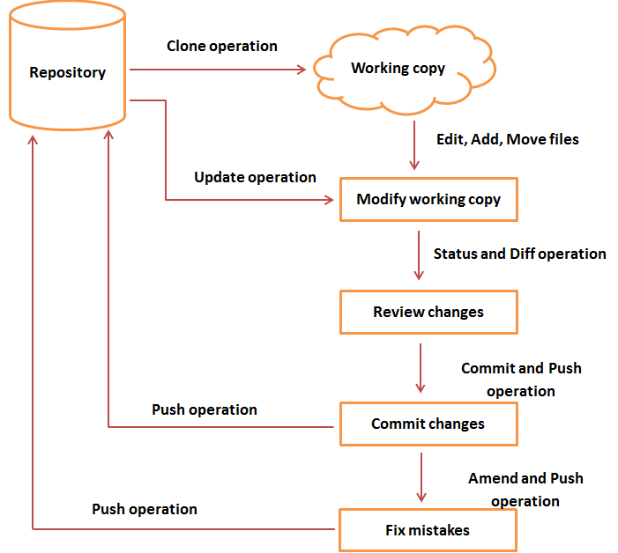
Git Life Cycle

Slide 37
Fetching
Fetching entails pulling data you don t have from a remote project.
git fetch [remote-name]
Cloned Repositories
  git fetch origin
  to pull down any new changes that were pushed to the server since you cloned or last fetched from it.
git fetch solely pulls new data to a local repository;
it does not merge changes with or modify your local work.

Slide 38
Pushing
To push your changes upstream for sharing,
  git push [remote-name][branch-name]
$ git push origin master
  pushes committed changes from local master branch upstream to the origin server.

Slide 39
Cloning
To create a copy of an existing Git repository from a particular server
$ git clone https://github.com/test
  Copies all versions of all files for a project.
  creation of a directory called test,
  Has copies of all versions of all files for the specified project.
  automatically checks out or retrieves for editing a copy of the newest version of the project.
$ git clone https://github.com/test mydirectory
  It create a copy of the target repository in a directory named mydirectory

Slide 40
Cloning
After the clone,
git fetch : will update all the remote-tracking branches,
git pull
  Will update all the remote tracking branches
  In addition merge the remote master branch into the current master branch,

Slide 41
Branching
Branches of a central repository are created
Collaborators are able to work on a project simultaneously via multiple branches, without affecting this main repository.
A collaborator can create a branch, work on it and save commit snapshots within it,
Can switch between various branches, and merge changes.

Slide 42
Branching
A Git branch is basically a movable pointer that always points to the most recent commit, or snapshot.
Git uses the default local branch name master, which can be changed.
Just because the default name is master does not imply that it is higher in importance or has more functionality than other branches.
The head is a special pointer which indicates which branch you are currently working within.

Slide 43
creating a New Branch
$ git branch test
Switching Branches
To switch to another branch,
$ git checkout test
This command moves the HEAD pointer to the test branch
If you make a commit while on the test branch, only this branch will point to the most recent commit.
The master branch will still point at the commit it was pointing to when you checked out to the test branch.

Slide 44
Create a Branch and Checkout
To simultaneously create a new branch and switch to it,
  $ git checkout -b test2
Creates a new branch test2  and switches you to it.
List Branches
    $ git branch
Deleting Branches
  $ git branch -d test

Slide 45
Merging
To merge changes from one branch into your current one
Current branch pointer moves forward to the most recent commit for the branch being merged in
$ git checkout master
$ git merge test
  merges in changes from test branch

Slide 46
Merge Conflicts
When the two files being merged both have changes in identical sections of a file,
Git will not be able to complete the merge cleanly.
These conflicts must be dealt with manually.
Portions of files with unresolved merge conflicts will be labeled unmerged
You can easily locate areas of merge conflict via Git conflict resolution markers,

Slide 47
Merge Conflicts
My name is
<<<<<<< HEAD
Jane
======= Mary >>>>>>>
branch-test Here,
HEAD indicates the branch you checked out before running the merge command.
The content above the ======= resides within this branch,
while everything below it is within the test branch.
git add command on fixed files to mark them as resolved.
$ git status will show the merge resolved

Slide 48

Continuous Integration

Slide 49
Topics
Continuous Integration.
Jenkins - an Introduction.
Installing and Configuring Jenkins.
Creating a job with Jenkins.

Slide 50
Continuous Integration
A development practice
  developers are required to commit changes to source code in a shared repository several times a day.
  Every commit is then built ,this allows the teams to detect problems early.
Has following benefits to software development:
  Catch issues fast and nip them in the bud.
  Everyone can see what’s happening.
  Automate the build.
  Leads to Continuous Deployment to deliver software more rapidly.

Slide 51
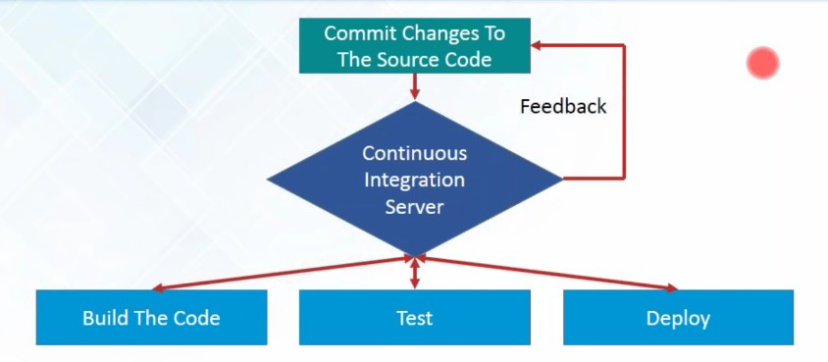
What is Continuous Integration...

Slide 52
What is Continuous Integration
In a large project with many developers, commits are made many times during a day. With each commit code is built and tested.
  If the test is passed, build is tested for deployment.
  If deployment is a success, the code is pushed to production.
  This commit, build, test, and deploy is a continuous process and hence the name continuous integration/deployment.

Slide 53
Continuous Integration tools
Used to host, monitor, compile and test code, or code changes,
Continuous Integration Server
  Jenkins, Bamboo, CruiseControl, TeamCity, and others
Source Control Tool
  CVS, SVN, GIT, Mercurial, Perforce, ClearCase and others
Build tool
  Make, ANT, Maven, Ivy, Gradle, and others
Automation testing framework
  Selenium,, TestComplete, UFT, and others

Slide 54
Jenkins
Leading open source continuous integration tool.
  Builds and tests software continuously
  Monitors the execution and status of remote jobs
  Easier for team members and users to regularly obtain the latest stable code.
Continuous Integration is done by the help of Plugins.
  It provides support for over 1000 Plugins .

Slide 55
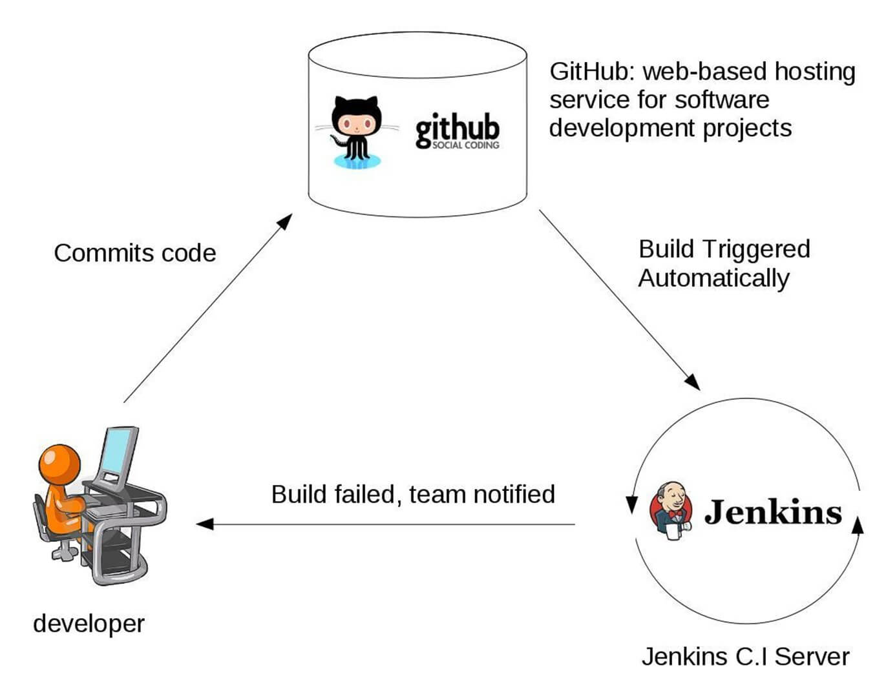
Working of Jenkins

Slide 56
Advantages of using Jenkins
  Jenkins is being managed by the community which is very open.
  Created by a developer for developers.
  As technology grows, so does Jenkins.
  Has many plugins published in its plugins database.
  With plugins, Jenkins becomes even more powerful and feature rich.
  Jenkins also supports cloud-based architecture

Slide 57
Installing Jenkins
Jenkins runs on Java, need latest version of Java Development Kit
Can be downloaded from https://jenkins.io/download/
  Should select the required platform.
Unzip the downloaded package.
Double-click on unzipped jenkins.msi and complete installation process with default options
After completing the Jenkins installation process, a browser tab will pop-up asking for the initial Administrator password.
To access Jenkins, : http://localhost:8080

Slide 58
Installing Jenkins
The initial Administrator password should be found under the Jenkins installation path
initialAdminPassword
  A file with the above can be found under C:\Program Files (x86)\Jenkins\secrets.
Customize Jenkins
  Can customize with "Install suggested plugins button"
  Jenkins will retrieve and install the essential plugins
After suggested plugins were installed
Use "Create First Admin User" panel to create users

Slide 59
Installing Jenkins War File
Can be downloaded from https://jenkins.io/download/
The Jenkins Web application ARchive (WAR) file can be started from the command line like this:
Download the latest stable Jenkins WAR file to an appropriate directory on your machine.
Open up a terminal/command prompt window to the download directory.
Run the command java -jar jenkins.war.
Browse to http://localhost:8080 and wait until the Unlock Jenkins page appears.

Slide 60
Jenkins Dash Board
Jenkins dashboard is primary control point for interacting with Jenkins.
It includes controls for creating and running builds, inspecting build output, working with credentials and configuring Jenkins.
Can create Jenkins jobs from the Dash Board

Slide 61
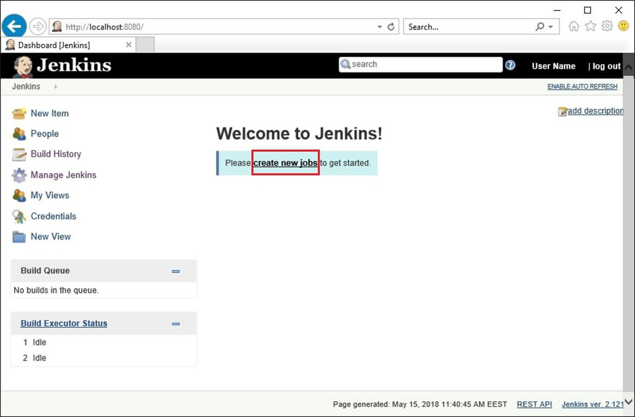
New Job

Slide 62
Simple Project
Begin by clicking the “New Item” link in the Jenkins dashboard.
Enter a name for the new project and select “Freestyle project”
Opens project configuration page
  Can define various aspects of the build.
Select the “Build” section.
Choose “Add build step” button and add a step to “Execute window batch command”.
IFrom the project page click the “Build now” link.

Slide 63
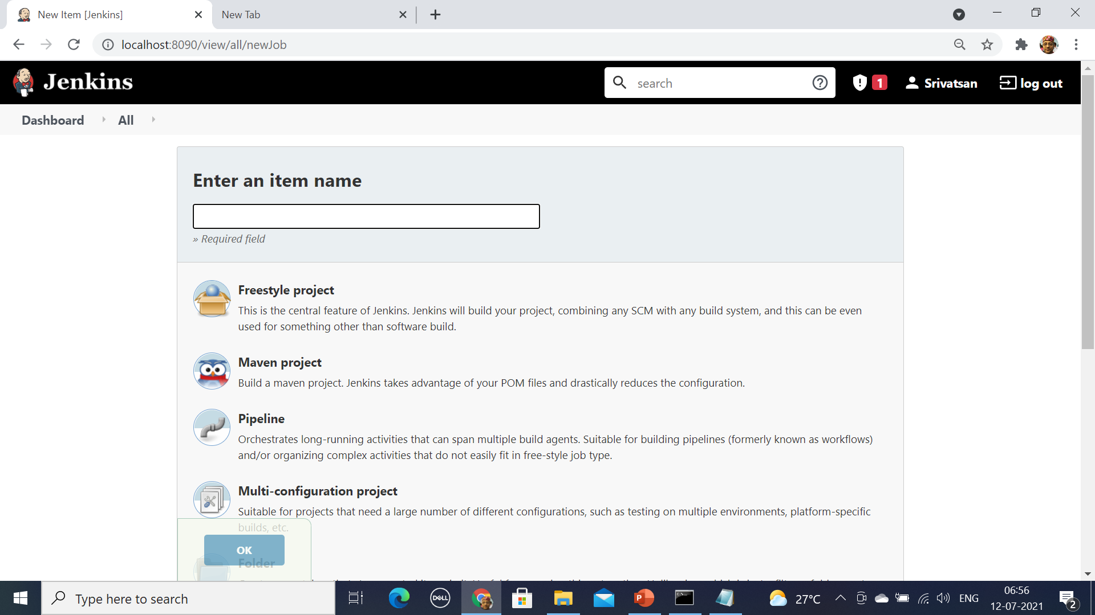
Jenkins Project Creation

Slide 64
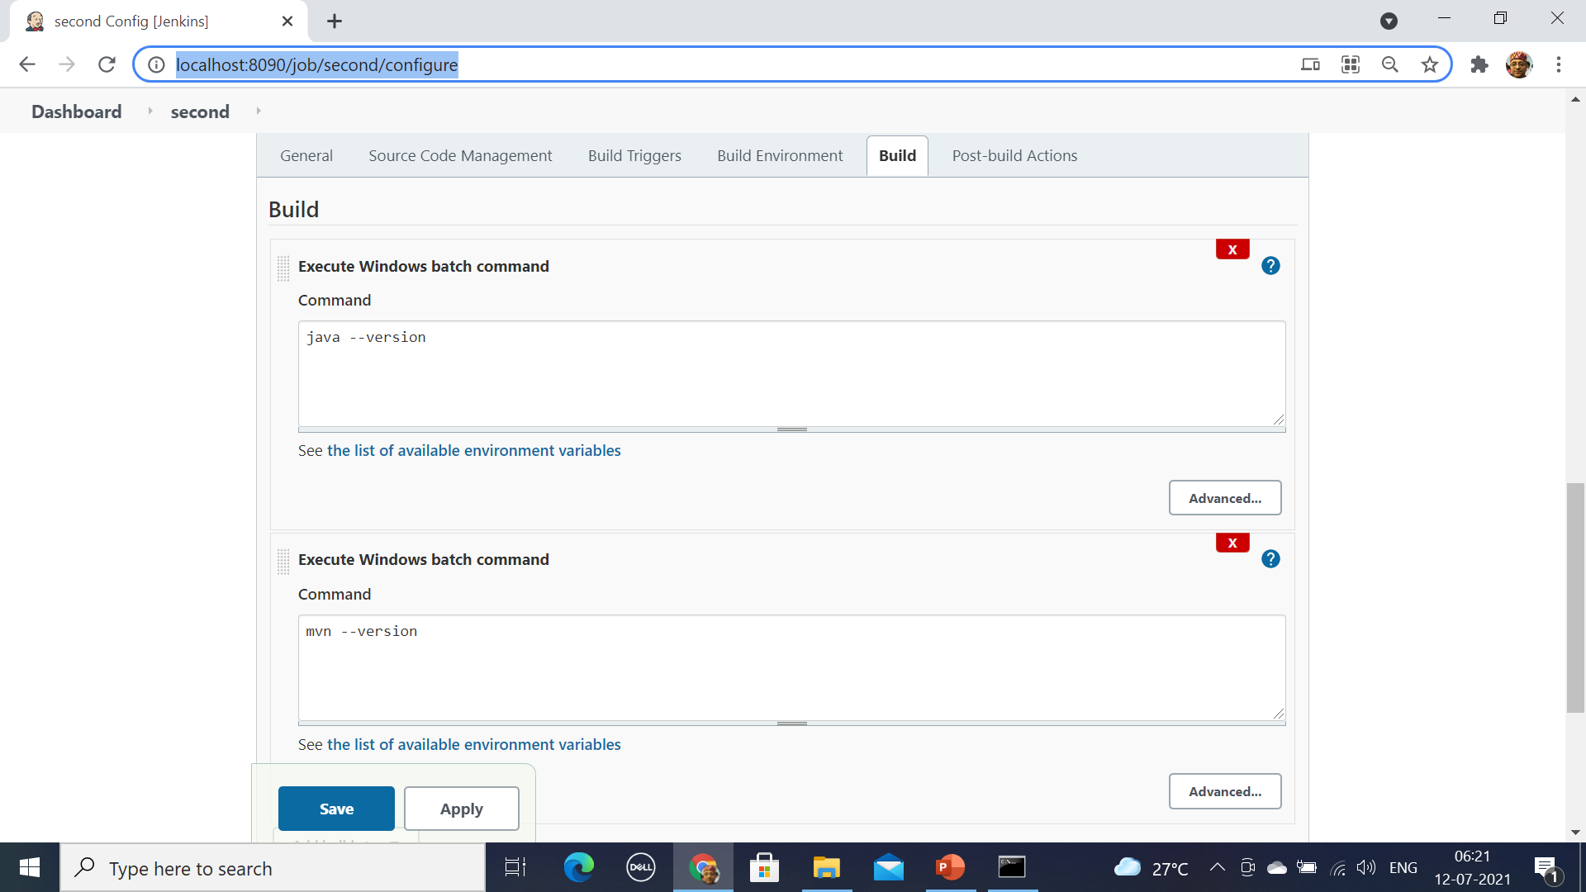
Simple Batch Command

Slide 65
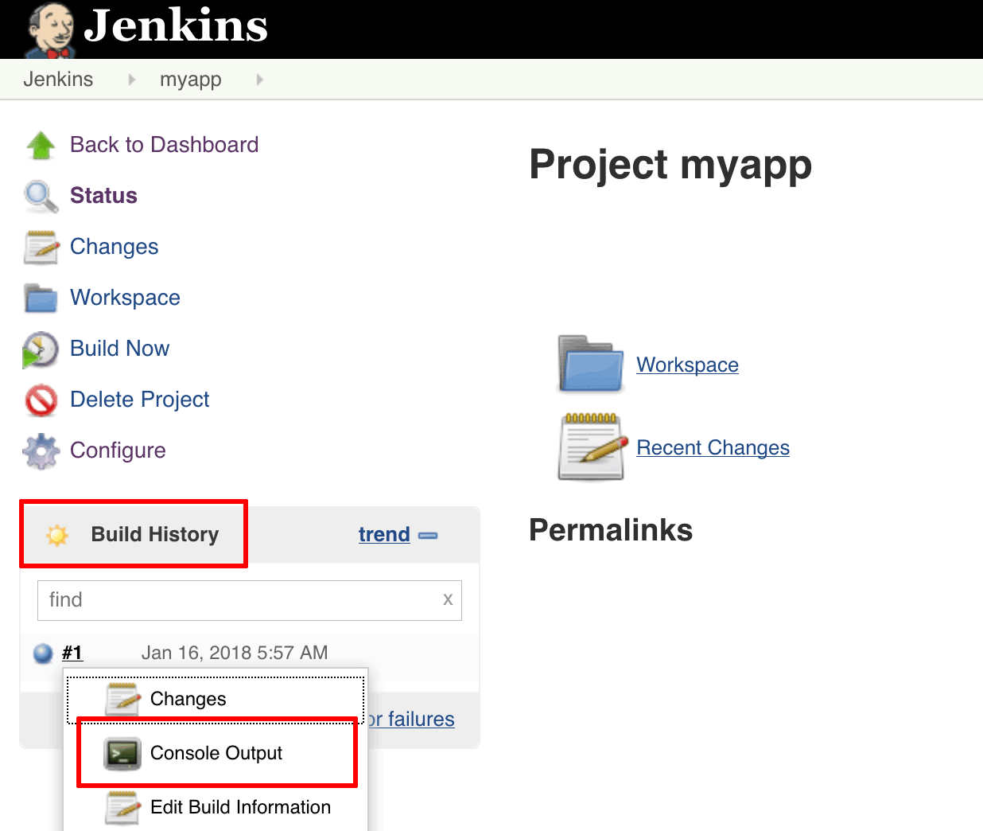
Building with Jenkins
Jenkins will be building the project.
The “Build History” panel in the bottom left corner of the page will show you the status of the build
Blue indicates success, red indicates failure

Slide 66
Build A Project from GitHub
Can Build project stored in an external SCM, such as GitHub.
From the dashboard. Select the project
Choose the “Configure” button for the project.
In the project configuration page,
  Choose “Source Code Management” section,
  Choose “Git” as the option
  Enter the clone URL for your GitHub repository.
From dashboard, choose “Manage Jenkins
  Select Global Tool Configuration” option.
  Find the “Maven” section and click the “Add Maven” button.
  Enter a name for the new Maven installation or add maven home

Slide 67
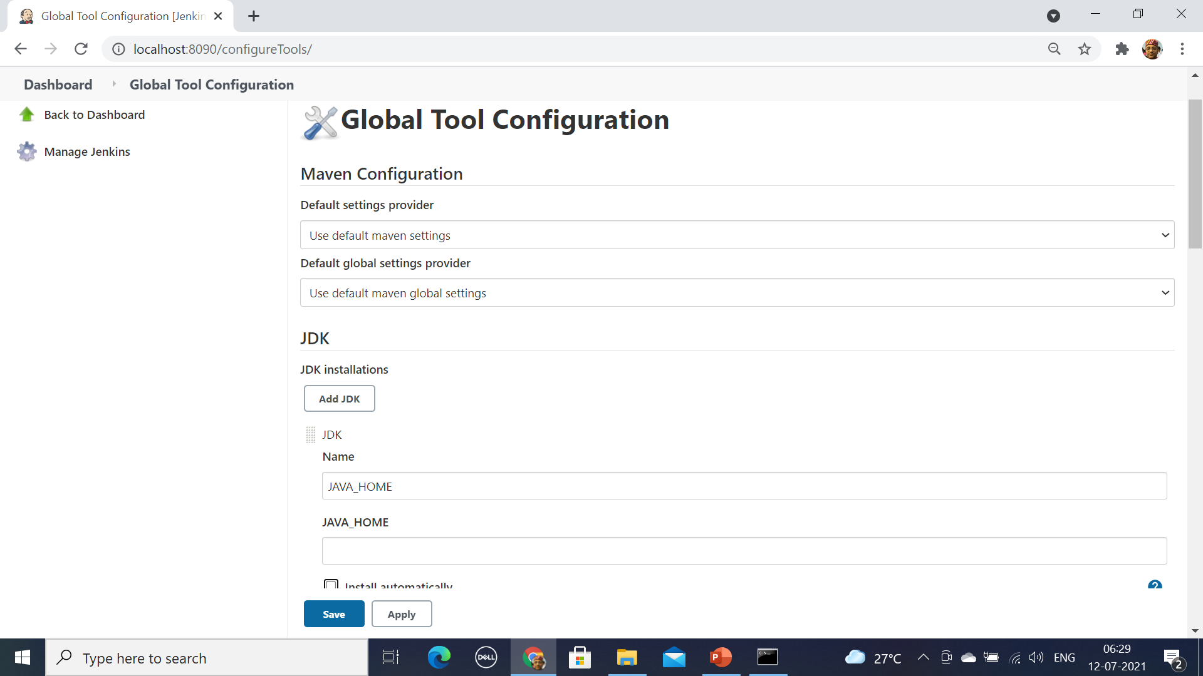
Manage Jenkins

Slide 68
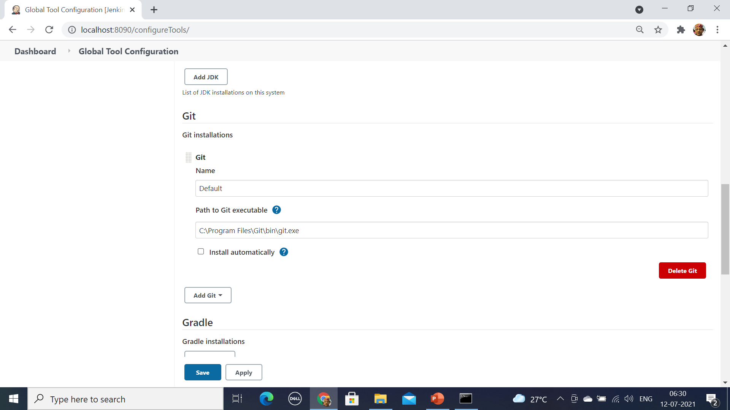
Manage Jenkins

Slide 69
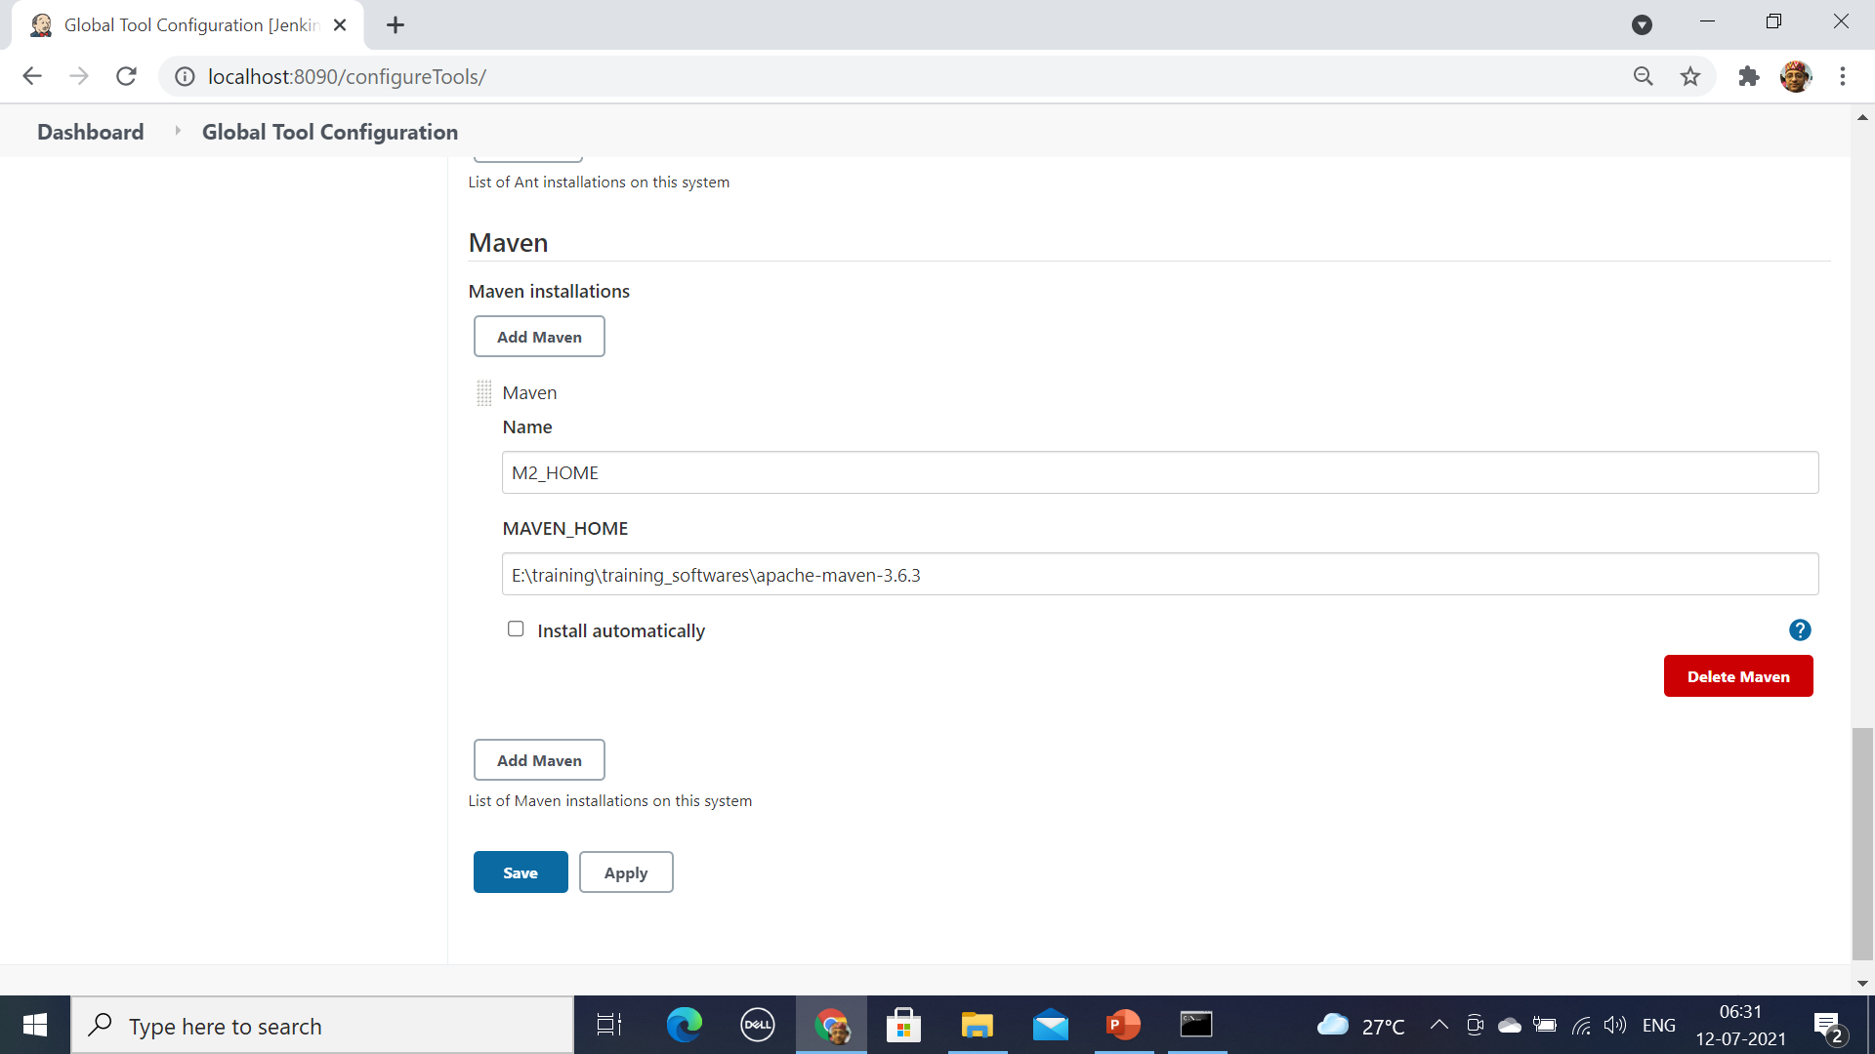
Manage Jenkins

Slide 70
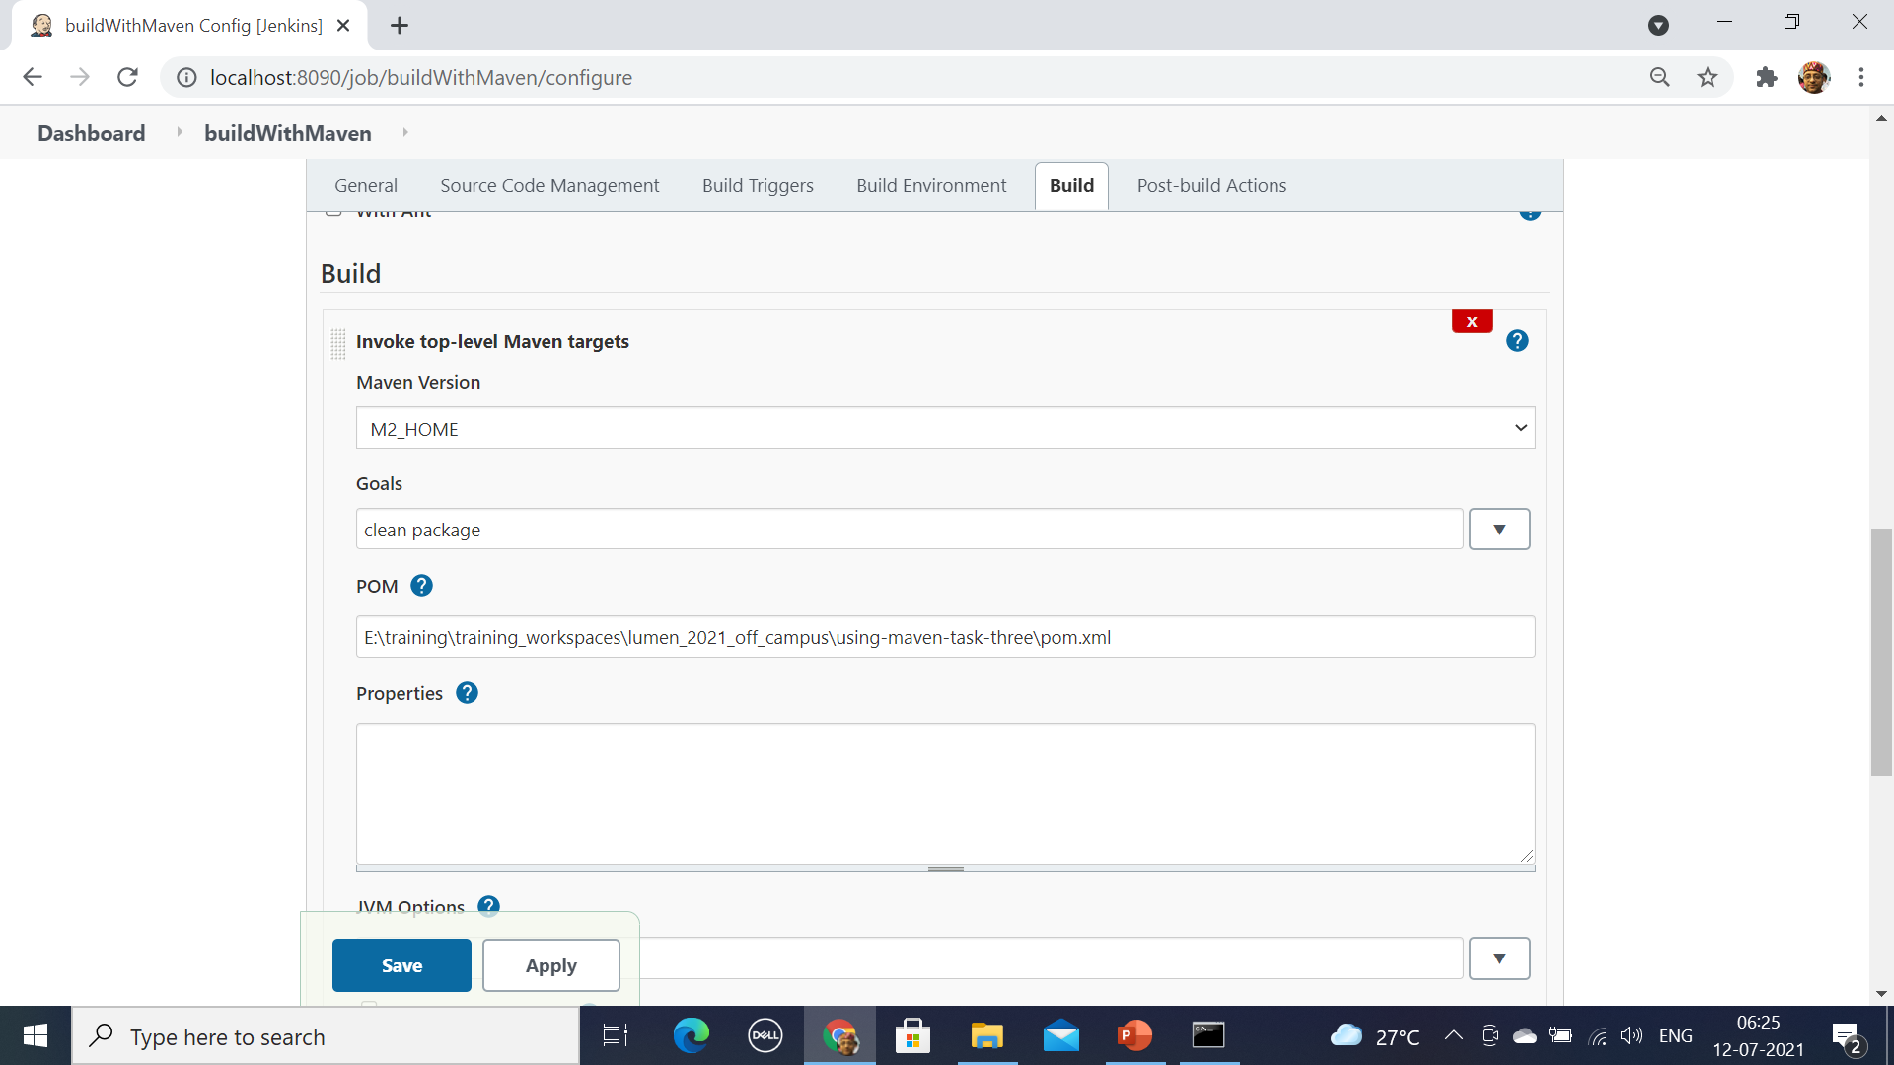
Building With Maven

Slide 71
Build A Project From GitHub
From the project configuration page select “Build” section
  Add a new build step to “Invoke top-level Maven targets”.
  In the “Maven Version” field, select the name of the Maven installation just created.
  In the “Goals” field, specify the Maven goals as “clean package”.
Head back to the project page and click the “Build now” link.
Jenkins should clone GitHub repository and build it with Maven.
Once the build is complete, select the “Console Output” menu item to access detailed build information.

Slide 72
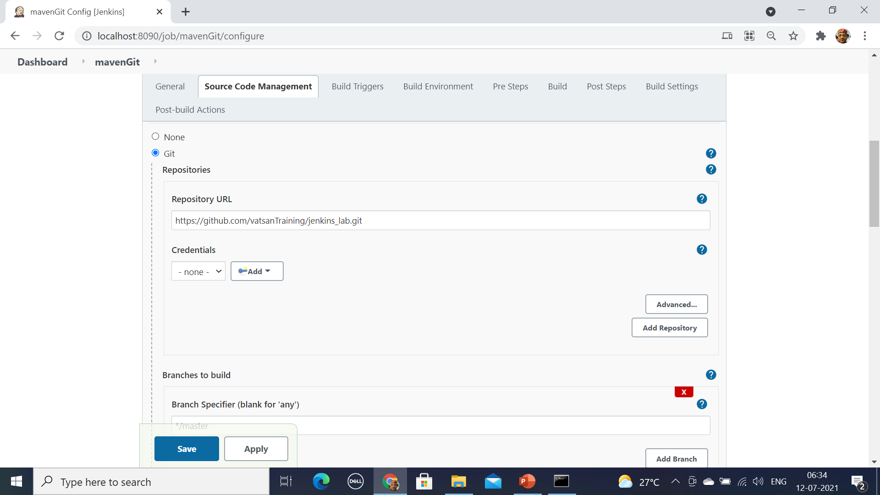

Slide 73
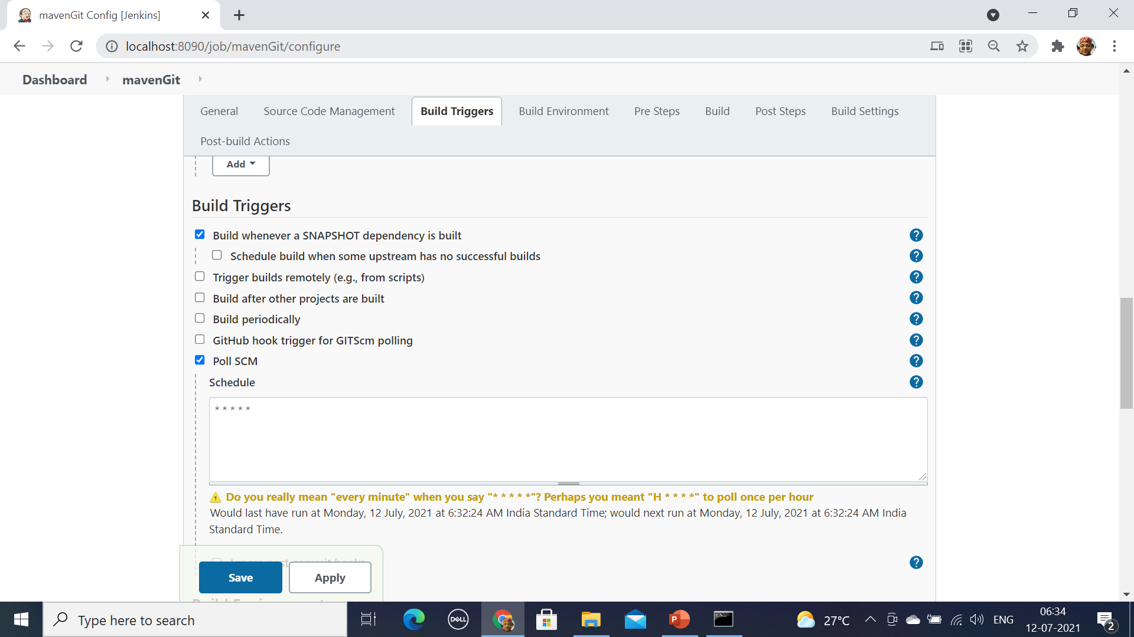

Slide 74
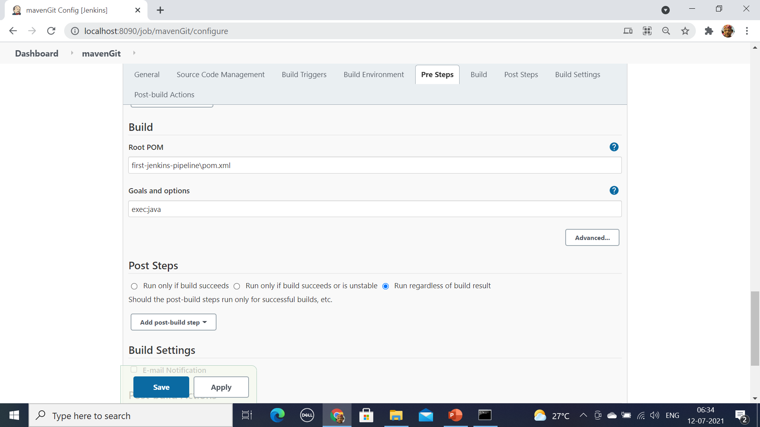

Slide 75
Pipeline
Jenkins Pipeline is a suite of plugins which supports implementing and integrating continuous delivery pipelines into Jenkins.
Automated process for getting software from version control right through to your users and customers.
Every change to software goes through a complex process on its way to being released.
This process involves building the software in a reliable and repeatable manner, as well as progressing the built software (called a "build") through multiple stages of testing and deployment.

Slide 76
Pipeline
Pipeline provides an extensible set of tools for modeling simple-to-complex delivery pipelines "as code" via the Pipeline domain-specific language (DSL) syntax.
The definition of a Jenkins Pipeline is written into a text file Jenkinsfile
  It can be committed to a project’s source control repository.
Agent
  A machine, or container, which connects to a Jenkins controller and executes tasks when directed by the controller.

Slide 77
Pipeline Script
  agent any
  stages {
  stage('build') {
  steps {
  echo 'build phase called'
  }
  }
  stage('test') {
  steps {
  echo 'test phase called'
  }
  }

Slide 78
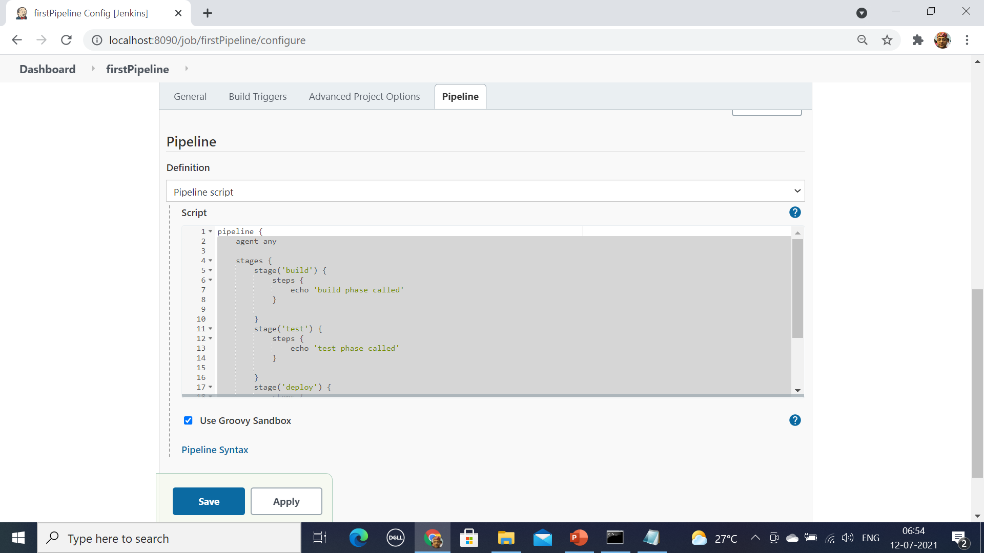
Pipeline Script

Slide 79
Pipeline Script
  pipeline {
  agent any
  tools { maven "M2_HOME" }
  stages {
  stage('Build') {
  steps {
  git 'https://github.com/vatsanTraining/jenkins_lab.git'
  dir('first-jenkins-pipeline’){
  bat 'mvn -Dmaven.test.failure.ignore=true clean package'
  } }
  post {
  success {
  archiveArtifacts 'first-jenkins-pipeline/target/*.jar'
  }
  }
  }
  }}

