Slide 1
STREAMS

Slide 2
Streams
An Interface defined in java.util.stream package.
Streams are a sequence of elements from a source that supports aggregate operations.
  filter, map, reduce, find, match, sort.
  Operations can be executed in series or in parallel.
The source can be a Collection, IO Operation or Arrays
Java collections has methods that return Stream.
  These Methods are added as default methods.

Slide 3
Characteristics of Streams
Not related to InputStreams, OutputStreams, etc.
These are NOT data structures
  Wrappers around Collection that carry values from a source through a pipeline of operations.
More powerful, faster and more memory efficient than Lists
Designed for lambdas
Employ lazy evaluation
Streams are parallelizable

Slide 4
Collections vs Streams
Collections are in-memory data structures which hold elements within it.
  Each element in the collection is computed before it actually becomes a part of that collection.
  On the other hand Streams are data computed on-demand basis.
Streams are lazily constructed Collections, where the values are computed when user demands for it.
Collections are eagerly computed values

Slide 5
Streams
The Streams also support Pipelining and Internal Iterations.
Streams operations returns Streams only.
  Helps creating chain of various stream operations.
  This is called as pipelining.
The pipelined operations looks similar to a sql query.
In Java, we traditionally use for loops or iterators to iterate through the collections.
  These iterations are called as external iterations and they are clearly visible in the code.
Java 8 Stream uses internal Iterations which are not visible in the code

Slide 6
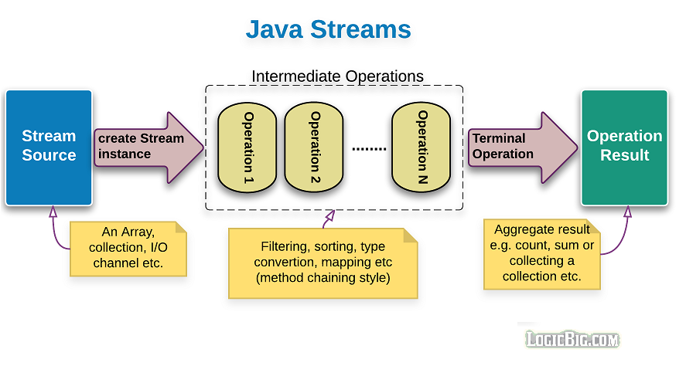
Structure of Java 8 Stream Operations
The three important components to make it work.
  A source
  one or more intermediate operations
  A terminal operation.
The three are pipelined in a sequence to make a stream work.

Slide 7
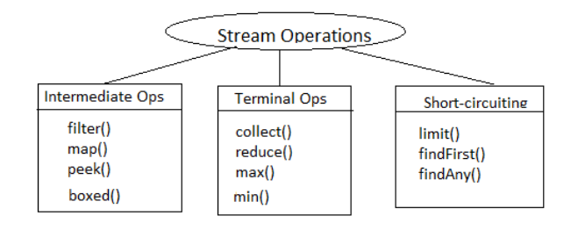
Stream Operations

Slide 8
Operation Categories
Two types of Operations
  Intermediate operations
  Terminal Operations.
Intermediate operations
  intermediate operations are lazy.
    They will not be invoked until the terminal operation is invoked.
    Streams become accessible when intermediate operations were called.
  Return streams can pipeline of operations.
    map, filter, and limit

Slide 9
Operation Categories
The terminal operations
  Used at the end of a pipeline
  They close the stream in some meaningful way.
  Eagerly executed
  Collects the results of stream operations
  Can be collected like lists, integers or simply nothing.
Stream become inaccessible when a terminal operation is called
  Will trigger the IllegalStateException which is a RuntimeException
Example : collect() ,count() ,forEach(), min() ,max()

Slide 10
INTERMEDIATE OPERATIONS

Slide 11
Types of Intermediate Operations
Intermediate operations can be classified into Stateful and Stateless
Stateful Operations
  Operations which maintain information from a previous invocation internally
  It can be used again in a future invocation of the method
  State storage can become huge for instances of infinite streams
  Can potentially affect performance of the whole system.
  Example : distinct() , sorted()

Slide 12
Stateless Intermediate Operations:
  Operations do not store any state across passes.
  Improves the performance of these operations
  Stream operation can be in parallel
    No information to shared, no need for order
  Example : filter(), map(), findAny()

Slide 13
Filter()
Takes predicate as an argument
Applies to the whole stream and returns a filtered stream
  Containing elements which match the Predicate.
  List<Customer> filteredList= customerList.stream().filter((Customer cust ) -> cust.getCustomerId() >200).collect(toList());
  System.out.println("After applying filter method");
  filteredList.forEach(System.out::println);

Slide 14
Map()
Takes an instance of Function <T, R> as parameter
Converts the type of elements in the stream from the current type T to the new type R.
Returns as output a stream of type R or Stream<R>
  List<Customer> customerList = HandleCustomers.getCustomers();
  List<Long> phoneBook = customerList.stream().
  map((eachCust)->eachCust.getPhoneNumber()).collect(toList());
  phoneBook.forEach(System.out::println);

Slide 15
Distinct()
  returns a stream instance which has all elements unique/distinct.
  The uniqueness is determined by the equals & hashcode
  List<Long> custIds= customerList.stream().map(e -> e.getCustomerId()).distinct().collect(toList());

Slide 16
Sorted
sorted()
  Sorts the elements using natural ordering.
  The element class must implement Comparable interface.
  List<Customer> sortedList = customerList.stream().sorted().collect(toList());
sorted(Comparator<? super T> comparator)
  Sorted using an instance of Comparator using lambda expression.
Comparator.comparing
  A static function that accepts a sort key Function
  Returns a Comparator for the type which contains the sort key:

Slide 17
Sorted
Comparator.comparing
  List<Customer> slist = customerList.stream().sorted(Comparator.comparing(Customer::getCustomerId)).collect(toList());
reversed()
  To reverse the natural ordering Comparator
  List<Customer> revrseList = customerList.stream().sorted(Comparator.reverseOrder()).collect(toList());
thenComparing()
  To set up lexicographical ordering of values by provisioning multiple sort keys in a particular sequence.

Slide 18
TERMINAL OPERATIONS

Slide 19
Stream Reduction
count(), max(), min(), sum()
  Predefined Terminal Operation implementation.
  Used to aggregate a stream to a type or to a primitive
Can create a custom Stream’s reduction mechanism by using two methods
reduce()
collect()

Slide 20
Max , Min ,Count
count()
  returns the count of elements of a stream.
max()
  returns the maximum element of a stream according to the provided Comparator.
min()
  returns the minimum element of a stream according to the provided Comparator.

Slide 21
Min
  List<Product> catalog = new ArrayList<>();
  Comparator<Product> priceComparator = Comparator.comparing(Product::getRatePerUnit);
  String itemType="TV";
  Optional<Product> minresult = catalog.stream().
  filter((Product prod ) -> prod.getProductName().equalsIgnoreCase(itemType)).
  min(priceComparator);
  double leastPriced=0;
  if(minresult.isPresent())
  {
  leastPriced= minresult.get().getRatePerUnit();
  }

Slide 22
Max
  Optional<Product> maxresult= catalog.stream().
  filter((Product prod ) -> prod.getProductName().equalsIgnoreCase(itemType)).
  max(priceComparator);
  double highPriced=0;
  if(maxresult.isPresent())
  {
  highPriced= maxresult.get().getRatePerUnit();
  }
  System.out.println("Highest Priced :="+itemType + highPriced);

Slide 23
Count()
  long countresult= catalog.stream().
  filter((Product prod ) -> prod.getProductName().equalsIgnoreCase(itemType)).count();
  System.out.println(countresult);

Slide 24
collect()
A terminal operation
It accepts an argument of the type Collector
  Specifies the mechanism of reduction.
Predefined collectors for most common operations.
Accessed with the help of the Collectors type.
Collectors.toList()
  Used for collecting all Stream elements into a List instance.
  Can have more control with toCollection instead.
Collectors.toSet()
  Used for collecting all Stream elements into a Set instance.

Slide 25
collect()
Collectors.toCollection()
  To use a custom implementation
  List<String> result = givenList.stream()
  .collect(toCollection(LinkedList::new))
Collectors.toMap()
  Used to collect Stream elements into a Map instance.
  Map<Long, String> map = customerList.stream()
  .collect(Collectors.toMap(Customer::getPhoneNumber, Customer::getCustomerName));
  map.forEach((x, y) -> System.out.println("Key: " + x +", value: "+ y));

