Slide 1
REST SERVICE USING SPRING DATA JPA

Slide 2
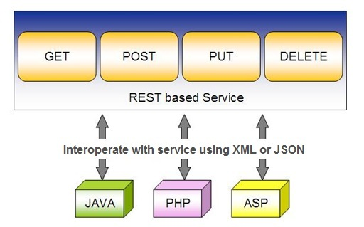
Spring RESTful Services
REST does not require the client to know anything about the structure of the API.
Server needs to provide whatever information the client needs to interact with the service.

Slide 3
Using appropriate Request Methods
GET :
  Should not update anything.
  Should be idempotent (same result in multiple calls).
  Possible Return Codes 200 (OK) + 404 (NOT FOUND) +400 (BAD REQUEST)
POST :
  Should create new resource.
  Ideally return JSON with link to newly created resource.
  Same return codes as get possible.
  In addition : Return code 201 (CREATED) is possible.

Slide 4
Using appropriate Request Methods
PUT :
  Update a known resource. ex: update client details.
  Possible Return Codes : 200(OK)
DELETE :
  Used to delete a resource.
  Possible Return Codes : 200(OK) or a 204 - no content

Slide 5
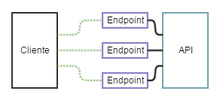
API and Endpoint

Slide 6
SPRING DATA REST WITH JPA

Slide 7
Spring RESTful Services
A RESTful architecture may expose multiple representations of a resource.
From Spring 4 @RestController annotation is added to controller
  A combination of @Controller and @ResponseBody
A Rest Controller method returns a domain object instead of a view.

Slide 8
REST Stereotypes
@RestController
  An implicit @ResponseBody is being added to the methods.
  Allows Spring to render the returned HttpEntity and its payload, directly to the response.
@GetMapping
  To map HTTP GET requests onto specific handler methods.
  Composed annotation for @RequestMapping(method = RequestMethod.GET).

Slide 9
REST Stereotypes
@PathVariable
  Indicates that the Method parameter should be bound to a URI template variable.
  @GetMapping("/members/{id}")
  public String getById(@PathVariable String id) { }
@PostMapping
  Combined shortcut for @RequestMapping(method = RequestMethod.POST).
  @PostMapping("/members“)
  public void addMember(@RequestBody Member member) { }

Slide 10
@Repository
There are three repository in Spring Data
CrudRepository
  Extends Repository
  provides CRUD functions
PagingAndSortingRepository
  Extends CrudRepository
  provides methods to do pagination and sort records
JpaRepository
  Extends PagingandSortingRepository
  Provides Methods such as flushing the persistence context and delete records in a batch
  Querying methods return List's instead of Iterable's

Slide 11
Creating Spring Data Application
  Create a repository interface and extend one of the repository interfaces provided by Spring Data.
  If required add custom query methods to the created repository interface
  Inject the repository interface to another component and use the implementation that is provided automatically by Spring.
Need NOT create an implementation class
  Spring will automatically create its implementation class at runtime.
The Repository class will be auto detected if suitably placed in the scan path

Slide 12
CrudRepository Interface
Extends Repository Interface and has the following Methods
  <S extends T> S save(S entity)
  <S extends T> Iterable<S> saveAll(Iterable<S> entities);
  Optional<T> findById(ID primaryKey)
  Iterable<T> findAll()
  void delete(T entity)
  long count()
  boolean existsById(ID id);

Slide 13
PagingAndSortingRepository
  Extends CrudRepository Interface and has the following Methods
findAll(Pageable pageable)
    Pageable object with following properties
      Page size
      Current page number
      Sorting
      findAll(Sort sort)
        Sort Object with the Property on Which the sorting is to be done
        Sort.by(propName)

Slide 14
JpaRepository
Extends PagingAndSortingRepository
Can also optionally extend QueryByExampleExecutor
  List<T> findAllById(Iterable<ID> ids);
  <S extends T> S saveAndFlush(S entity);
  void deleteInBatch(Iterable<T> entities);
  void deleteAllInBatch();
  T getOne(ID id);
  void flush();

Slide 15
SAMPLE CODE-DEMO

Slide 16
Entity
  @Entity
  @Table(name = "demo_invoice")
  @Data
  @AllArgsConstructor
  @NoArgsConstructor
  @FieldDefaults(level = AccessLevel.PRIVATE)
  public class Invoice {
  @Id
  long id;
  String customerName;
  @DateTimeFormat(iso = DateTimeFormat.ISO.DATE)
  LocalDate invoiceDate;
  double amount;
  }

Slide 17
Repository
  @Repository
  public interface InvoiceRepository extends JpaRepository<Invoice, Long>{
  }

Slide 18
Service
  @Service
  public class InvoiceService {
  @Autowired
  private InvoiceRepository repo ;
  public List<Invoice> findAll(){
  return repo.findAll();
  }
  public Invoice findById(int id) {
  Optional<Invoice> optInvoice=repo.findById(id);
  return optInvoice.orElseThrow(() -> new
  RunTimeException(“Invoice not found"));
  }

Slide 19
Controller
  @RestController
  public class InvoiceController {
  @Autowired
  private InvoiceService service ;
  @GetMapping(path = "/api/v1/invoices")
  public List<Invoice> findAll() {
  List<Invoice> details = service.findAll();
  return details;
  }

Slide 20
@RequestBody
Used to map the HttpRequest body to a transfer or domain object
  Spring automatically deserializes the JSON into a Java type
  The type of @RequestBody annotation must correspond to the JSON sent from client-side
HttpMessageConverter
  Internally Used by Spring to perform Serialization/deserialization
@Valid
  To perform automatic validation by adding to method argument

Slide 21
Post and Put Mapping
  @PostMapping(path = "/api/v1/invoices")
  public Invoice add(@RequestBody Invoice entity
  ,HttpServletResponse response) {
  response.setStatus(201);
  return this.service.add(entity);
  }
@ResponseStatus(HttpStatus.CREATED)
  @PostMapping(path = "/api/v1/invoices")
  public Invoice add(@RequestBody Invoice entity) {
  return this.service.add(entity);
  }

Slide 22
ResponseEntity
Represents Complete HTTP response, gives more flexibility
  May be required in some special cases
  Can be used to send Status Code,Response Body,Location to the resource which was altered
  @GetMapping(path = "/api/v1/invoices")
  public ResponseEntity<Invoice> getInvoices() {
  HttpHeaders responseHeaders = new HttpHeaders();
  return ResponseEntity.ok().headers(responseHeaders).body(dao.findAll());
  }

Slide 23
Put Mapping
@PutMapping(path = "/api/v1/invoice")
  public Invoice update(@RequestBody Invoice entity) {
  return this.service.add(entity);
  }
  @PatchMapping(path = "/api/v1/invoice")
  public ResponseEntity<String> updateAmount() {
  return ResponseEntity.status(HttpStatus.CREATED)
  .body("Updated Amount:="+this.service.updateAmount());
  }

Slide 24
Remove Method in Service
  public Invoice remove(Invoice entity) {
  Optional<Invoice> optional = Optional.empty();
  if(this.repository.existsById(entity.getId())) {
  this.repository.delete(entity);
  optional = Optional.of(entity);
  }
return optional;
}

Slide 25
Delete Mapping in Controller
  @DeleteMapping(path = "/api/v1/invoice")
  public ResponseEntity<Invoice> remove(@RequestBody Invoice entity) {
  Invoice invoice = this.service.removeInvoice(entity).orElseThrow(()-> new RuntimeException("Element NOT FOUND"));
  return ResponseEntity.ok().body(invoice);
  }

Slide 26
@RestControllerAdvice
Used for Exception handling in Rest API’s
Used to handle exceptions across the whole application
Like an interceptor of exceptions thrown by methods annotated with @RequestMapping or one of the shortcuts.
It’s a combination of @ContollerAdvice and @ResponseBody.
@ExceptionHandler
  Annotation for handling exceptions in specific handler classes and/or handler methods.

Slide 27
@RestControllerAdvice
  @RestControllerAdvice
  public class ErrorHandler {
  @ExceptionHandler(value = Exception.class)
  public ErrorDetails handleAllExceptions(Exception ex, WebRequest request){
  return new ErrorDetails(LocalDateTime.now(),
  ex.getMessage(), request.getDescription(false));
  }
  }
  request.getDescription(false):
  Whether to include client-specific information like session id and user name

Slide 28
application.yml
  spring:
  datasource:
  url: jdbc:mysql://localhost:3306/test
  username: root
  password: srivatsan
  driver-class-name: com.mysql.cj.jdbc.Driver
  jpa:
  show-sql: true
  hibernate:
  ddl-auto: update
  naming:
  physical-strategy: org.hibernate.boot.model.naming.PhysicalNamingStrategyStandardImpl

Slide 29
application.yml
  logging:
  level:
  org.hibernate.sql: debug
  org.hibernate.type.descriptor.sql.BasicBinder: trace

Slide 30
QUERY DSL

Slide 31
Query DSL
Domain Specific Language
  Extension of a programming language to address a domain.
  Enhancing Java to be better suited at creating and working with JPA queries.
  A Powerful, flexible and customizable based on JPA entity
  Framework checks the validity of queries when application starts up
  Have been in use in scripted language

Slide 32
Query Method Syntax
Methods are defined in JPA repository that Spring Data JPA will auto-implement
  The query parser will look for methods that start with find, query, read, count, or get.
Prefixes can be enhanced with other keywords until it gets to the B-Y, or By, of the method name.
findByAgeLike(Integer age);

Slide 33
Query Method Syntax
findByAgeLike(Integer age);
find
  Method starts with find so that the query parser understands that it needs to implement this query contract.
By
  Following the find keyword,
  Signaling that the criteria information will be coming next in the method name.
Age
  Matches the attribute name age JPA entity, and age is of data type Integer.

Slide 34
Query Method Syntax
findByAgeLike(Integer age);
Like
  final keyword tells the implementation to create a Like query
  Need to pass variable that the query implementation should use as the actual filter criteria.
  It's of type Integer because data type of age in entity is of type Integer.

Slide 35
Custom Repository Methods
Can add custom methods to the interface
Methods are Derived by two main parts separated by the find By keyword
Equality Condition Keywords
  List findByNameEquals(String name);
  List findByNameIsNot(String name);
Similarity Condition Keywords
  List findByNameStartingWith(String prefix);
  List findByNameContaining(String infix);

Slide 36
Custom Repository Methods
  Comparison Condition Keywords
  List findByAgeLessThan(Integer age);
  List findByAgeLessThanEqual(Integer age);
  List findByAgeGreaterThan(Integer age);
Multiple Condition Expressions
  List findByNameOrBirthDate(String name, ZonedDateTime birthDate);
  List findByNameOrBirthDateAndActive(String name, ZonedDateTime birthDate, Boolean active);
Sorting the Results
  List findByNameOrderByName(String name);
  List findByNameOrderByNameAsc(String name);

Slide 37
Custom Repository Methods
findByStartDateBetween
findByStartDateAfter
findByAgeOrderByLastnameDesc.
To Return Just the two properties Name and email
  public interface ProjectNameAndEmail {
  String getName();
  String getEmail();
  }
  List<ProjectNameAndEmail> findAllById(int id);

Slide 38
@Query
Used to write the more flexible query to fetch data.
Supports both JPQL and native SQL queries.
By default will be using JPQL to execute the queries.
  Using normal SQL queries, would get the query syntax error exceptions.
Can use native SQL queries by setting nativeQuery flag to true.
  Pagination and dynamic sorting for native queries are not supported in spring data jpa.

Slide 39
@Query
Used to write the more flexible query to fetch data.
Supports both JPQL and native SQL queries.
By default will be using JPQL to execute the queries.
  Using normal SQL queries, would get the query syntax error exceptions.
Can use native SQL queries by setting nativeQuery flag to true.
  Pagination and dynamic sorting for native queries are not supported in spring data jpa.

Slide 40
@Modifying
@Query
  Can also be used for queries that add, change, or remove records in database.
@Modifying
  Indicates a query method should be considered as modifying query as that changes the way it needs to be executed.
  Not applied on custom implementation methods or queries derived from the method name
  Those methods already have control over the underlying data access APIs or specify if they are modifying by their name.

Slide 41
@Modifying
Method annotated with @Modifying also requires @Transactional
By default, CRUD methods on repository instances are transactional.
  For read operations, the transaction configuration readOnly flag is set to true.
  For other operations are configured with a plain @Transactional
  We need to add @Transactional annotation with required attribute values.

Slide 42
@Query - Example
  @Repository
  public interface TourGuideRepository extends JpaRepository<TouristGuide, Integer> {
  public TouristGuide findByFirstName(String name);
  @Query(value = "SELECT * FROM tourguides WHERE first_name = :firstName", nativeQuery = true)
  List<TouristGuide> findGuideByFirstName(@Param("firstName") String firstName);

Slide 43
@Query - Example
  @Query("FROM TouristGuide WHERE firstName = :firstName AND lastName = :lastName")
  List<TouristGuide> findByFirstAndLastName(@Param("firstName") String firstName, @Param("lastName") String lastName);
  @Query("UPDATE TouristGuide SET firstName = :prefix || firstName")
  @Modifying
  @Transactional
  void updatePrefix(@Param("prefix") String prefix);
  }

Slide 44
Application.yml
  server:
  port: 2525
  spring:
  datasource:
  username: root
  password: srivatsan
  driver-class-name: com.mysql.cj.jdbc.Driver
  url: jdbc:mysql://localhost:3306/test
  jpa:
  hibernate:
  ddl-auto: update
  naming:
  physical-strategy: org.hibernate.boot.model.naming.PhysicalNamingStrategyStandardImpl
  show-sql: true

Slide 45
DOCUMENTING REST API

Slide 46
Documentation
Essential part of building REST APIs
Open Api Documentation
  Standard, programming language-agnostic interface description for REST APIs,
  Allows both humans and computers to discover and understand the capabilities of a service
  No need to access source code,
  Can add additional documentation, or inspect network traffic

Slide 47
Spring Documentation
  A tool that simplifies the generation and maintenance of API docs
  Based on the OpenAPI 3 specification, for Spring Boot 1.x and 2.x applications.
  Required dependency are added to pom.xml:
  <dependency>
  <groupId>org.springdoc</groupId>
  <artifactId>springdoc-openapi-ui</artifactId>
  <version>1.3.0</version>
  </dependency>

Slide 48
View the Documentation
Can be viewed after executing the application
Its rendered in the browser in JSON format by default.
Default Path : http://localhost:8080/v3/api-docs/
Can be Customised using application.properties file:
  springdoc.api-docs.path=/api-docs
Custom Path : http://localhost:8080/api-docs/

Slide 49
Swagger
  springdoc-openapi is integrated with Swagger UI
  Access from the folowing URL
  http://localhost:8080/swagger-ui.html
Can be customized using application.properties
  springdoc.swagger-ui.path=/swagger-ui-custom.html

Slide 50
Custom Configuration
  Documenting at the Class Level
  @SpringBootApplication
  @OpenAPIDefinition( info = @Info(title = “Invoice Service")
  )
  Can also Document at the Method Level
  @Operation(description = "Method to Add Invoice")
  Can also Document at the Model Class
  Using JSR 303 Annotations

Slide 51
Best practices
Use Nouns for Resource Identification
Use Proper Http Headers for Serialization formats
Get Method and Query Parameter should not alter the state
Always use plurals when you name resources.
Use Appropriate Http Response Status Codes
Field Name casing Conventions
Provide Searching, Sorting and Pagination
Use Versioning of API
Provide Links for Navigating through API – Hateos
Handle Error Properly
Using DTO to Handle the Request and Response

Slide 52
REACTIVE SPRING

Slide 53
Introduction
A programming paradigm that promotes
  asynchronous, non-blocking, event-driven approach to data processing.
Thread per request model to more requests with few number of threads
  Prevent threads from blocking while waiting for I/O operations to complete

Slide 54
Subscription
Subscription made by the subscriber
With the publisher
  To fetch data.
  public interface Subscription {
  public void request(long n);
  public void cancel();
  }

Slide 55
Subscriber
Represents the consumer of the stream data.
  public interface Subscriber<T> {
  public void onSubscribe(Subscription s);
  public void onNext(T t);
  public void onError(Throwable t);
  public void onComplete();
  }

Slide 56
Publisher
Represents the data source
  database, external service, etc.
  public interface Publisher<T> {
  public void subscribe(Subscriber<? super T> s);
  }

Slide 57
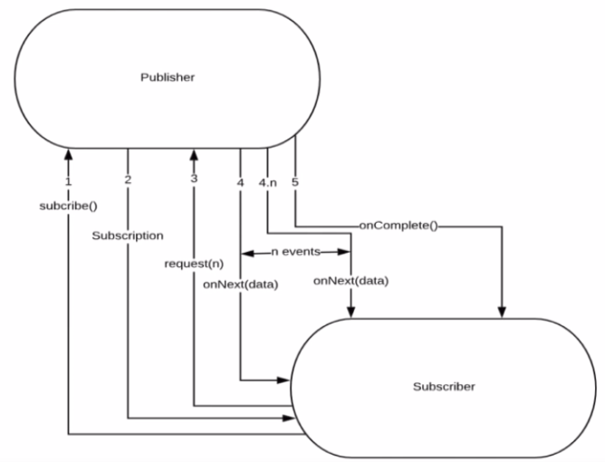
Flow Between Publisher and Subscriber

Slide 58
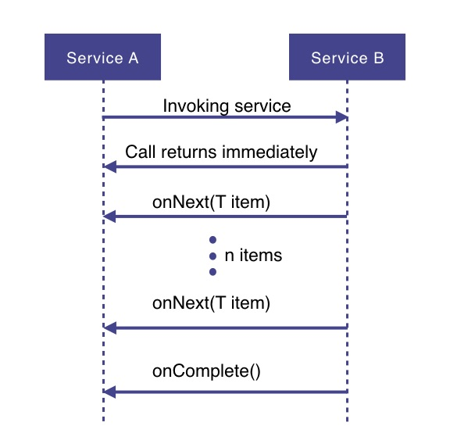
How Does it Work

Slide 59
How Does it Work
Service A wants to retrieve some data from service B.
Service A will make a request to service B which returns immediately
  Non-blocking and asynchronous.
Data requested will be made available to service A as a data stream,
  Service B will publish an onNext-event for each data item one by one.
When all the data has been published
  onComplete event is fired
In case of an error, an onError event would be published
  Items would not be emitted.

Slide 60
PROJECT REACTOR

Slide 61
PROJECT REACTOR
Spring Framework supports reactive programming since version 5.
  That support is build on top of Project Reactor.
WebFlux, Spring's reactive-stack web framework, requires Reactor as a core dependency.
Suited for Microservices Architecture
Offers backpressure-ready network engines for HTTP (including Websockets), TCP, and UDP.
Built and maintained by Pivotal
Recommended Library to work with Spring Boot
Runs on Java 8 and above.

Slide 62
PROJECT REACTOR
Spring Framework supports reactive programming since version 5.
  That support is build on top of Project Reactor.
WebFlux, Spring's reactive-stack web framework, requires Reactor as a core dependency.
Suited for Microservices Architecture
Offers backpressure-ready network engines for HTTP (including Websockets), TCP, and UDP.
Built and maintained by Pivotal
Recommended Library to work with Spring Boot
Runs on Java 8 and above.

Slide 63
Setting up a Project
Spring Boot application using Spring Initializr.
  Add Spring Reactive Web as dependecy
The spring-boot-starter-webflux dependency is added
  It will bring in the reactor-core dependency.
  The reactor-test has been added as a dependency.
Spring Webflux
  A reactive-stack web framework
  Runs on Netty, and Servlet 3.1+ containers.

Slide 64
Types of Publishers
Spring Webflux uses two Publishers
Mono
  To publish 0..1 element
  Mono is like the Optional type provided in Java 8.
  Mono to return a single object or VOid
Flux
  To publish 0..N element.
  Used to return lists.

Slide 65
Flux and Mono
They are both terminated either by a completion signal or an error
They call a downstream Subscriber's onNext, onComplete and onError methods.
Both provide a set of operators to support transformations, filtering, and error handling.

Slide 66
Creating Flux
Just (T... data)
  Overloaded method
  Create a new Flux that will only emit a single element then onComplete.
  Returns a new Flux
Flux<String> fluxColors = Flux.just("red", "green", "blue");
fluxColors.subscribe(System.out::println);

Slide 67
Mono
Emits at most one item and then optionally terminates with an onComplete signal or an onError signal.
  Mono noData = Mono.empty();
  Mono data = Mono.just(“ramesh”);

Slide 68
Mono and Flux
  public Mono<Book> bestBook(){
  Mono<Book> bestBook = Mono.just(bookList.get(1));
  return bestBook;
  }
  public Mono<Book> betterBook(){
  Mono<Book> betterBook = Mono.just(bookList.get(0));
  return betterBook;
  }
  public Flux<Book> fluxFromMono(){
  return Flux.concat(bestBook(),betterBook());
  }

Slide 69
SPRING WEBCLIENT

Slide 70
WebClient
Introduced from Spring 5
  Its a non-blocking client with support for Reactive Streams.
  It’s a replacement for RestTemplate .
  Its more functional and is fully reactive.
  It's included in the spring-boot-starter-weblux dependency

Slide 71
Web Client
  @Bean
  WebClient.Builder builder() {
  return WebClient.builder();
  }
  @Bean
  WebClient client(WebClient.Builder builderRef) {
  return builderRef.build();
  }

Slide 72
Http Methods
get()
  indicates that we are making a GET request.
  We know that the response will be a single object, so we're using a Mono as explained before.
  client.get()
  Client.post()

Slide 73
Rest Client - Controller
  @RestController
  public class ClientController {
  @Autowired
  private WebClient client;
  @GetMapping(path = "/hotels")
  public Flux<String> getAllHotels(){
  return client.get()
  .uri("http://localhost:7075/api/v1/hotels")
  .retrieve()
  .bodyToFlux(String.class);
  }
  }

Slide 74
Rest Client - Controller
  @PostMapping(path = "/hotels")
  public Mono<HotelDto> create(@RequestBody HotelDto dto)
  {
  return client.post()
  .uri(" http://localhost:7075/api/v1/hotels")
  .body(Mono.just(dto), HotelDto.class)
  .retrieve()
  .bodyToMono(HotelDto.class);
  }

Slide 75
Rest Client - Controller
  @DeleteMapping(path = "/hotels/{id}")
  public Mono<Void> removeHotelById(@PathVariable("id") int id){
  return client.delete()
  .uri(" http://localhost:7075/api/v1/hotels/{id}" ,id)
  .retrieve()
  .bodyToMono(Void.class);
  }
  }

Slide 76
Rest Client - Controller
  @GetMapping(path = "/hotels/{id}")
  public Mono<String> getHotelById(@PathVariable("id") int id){
  return client.get()
  .uri(" http://localhost:7075/api/v1/hotels /{id}",id)
  .retrieve()
  .bodyToMono(String.class);
  }

Slide 77
SPRING SECURITY

Slide 78
Spring Security
Highly customizable authentication and access-control framework.
Focuses on providing both authentication and authorization
“Authentication”
  The process of establishing a user, device or some other system
“Authorization”
  The process of deciding whether a principal is allowed to perform an action within the application.
Authorization is done after authentication process.
  Authenticated user may have one or more “roles”

Slide 79
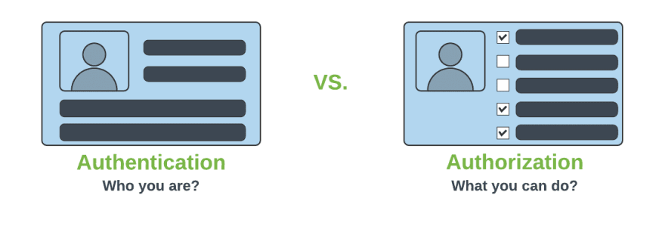
Authentication & Authorization

Slide 80
@EnableWebSecurity
Can be Added to the Class annotated with @Configuration or @SpringApplication
  Create a Class of type WebSecurityConfigurerAdapter
  Spring finds bean with @Configuration and automatically apply Security

Slide 81
Spring Security Modules
  <dependency>
    <groupId>org.springframework.boot</groupId>
    <artifactId>spring-boot-starter-security</artifactId>
  </dependency>
  <dependency>
    <groupId>org.springframework.security</groupId>
    <artifactId>spring-security-test</artifactId>
    <scope>test</scope>
  </dependency>

Slide 82
WebSecurityConfigurerAdapter
A base class for creating a WebSecurityConfigurer instance.
Can do customization by overriding methods
configure(HttpSecurity)
  Defines the mapping of secured URLs or path that will determine if the user can access specific pages.
configure(AuthenticationManagerBuilder).
  Defines how the security will handle the retrieval of user information commonly in the database.

Slide 83
configure(HttpSecurity)
HttpSecurity
  Provides a Method authoriseRequests()
authorizeRequests()
  To Define custom requirements for URLs
  Can add multiple children to this method.
  The matchers are considered in the order they were declared.
  http.authorizeRequests()
  .anyRequest().authenticated()
  .and().httpBasic();

Slide 84
configure(HttpSecurity)
public HttpSecurity antMatcher​(java.lang.String antPattern)
  Used to configure to be invoked when matching the provided ant pattern.
antPattern
  the Ant Pattern to match on (i.e. "/admin/**")
formLogin()
  Specifies to support form-based authentication.
  If loginPage(String) is not specified a default login page will be generated.
httpBasic()
  Configures HTTP Basic authentication.

Slide 85
configure(AuthenticationManagerBuilder).
AuthenticationManagerBuilder
  Used to create an Authentication Manager
Authentication Manager
  Used to authenticate the passed Authentication object,
  Allows building in memory authentication
  Can also use JDBC based authentication,

Slide 86
Form Login
  @Configuration
  public class SecurityConfig extends WebSecurityConfigurerAdapter {
  @Override
  protected void configure(HttpSecurity http) throws Exception {
  http.authorizeRequests().antMatchers("/first").authenticated().and().formLogin();
  }
  @Override
  protected void configure(AuthenticationManagerBuilder auth) throws Exception {
  auth.inMemoryAuthentication().withUser("ramesh").password("{noop}ramesh").roles("USER");
  }

Slide 87
Controller
  @RestController
  public class ProjectController {
  @GetMapping("/first")
  public String getSecuredMessage(Principal user) {
  return "Welcome to Secured Page"+user.getName();
  }
  @GetMapping("/second")
  public String getUnSecuredMessage() {
  return "Welcome to UN-Secured Page";
  }
  }

Slide 88
Sample Security Config
  http.authorizeRequests()
  .antMatchers("/","/*.html","/h2/**")
  .permitAll().
  antMatchers("/first")
  .authenticated().and()
  .httpBasic().and()
  .csrf().
  disable();

Slide 89
Method Level Security
Spring Security supports authorization semantics at the method level.
Service layer can be secured by which roles are able to execute a particular method – and test it using dedicated method-level security test support.

Slide 90
Method Level Security
  @Configuration
  @EnableGlobalMethodSecurity(jsr250Enabled = true)
  public class SecurityConfig extends WebSecurityConfigurerAdapter {
  protected void configure(HttpSecurity http) throws Exception {
  // required configurations
  }
  protected void configure(AuthenticationManagerBuilder auth) throws Exception {
  // required configurations
  }
  }

Slide 91
Method Security
@RolesAllowed
  is a standard annotation
  @PermitAll
  public String anonymously() {
  return "Hello, World!"; }
  @RolesAllowed({"ROLE_ADMIN"})
  public String hasRole() {
  return "Hello, World!";
  }

Slide 92
Basic Authentication With WebClient
  @Autowired
  WebClient client;
  @GetMapping(path = "/client")
  public Flux<String> getOrders(){
  return client.get().uri("http://localhost:8080/orders/pending")
  .headers(headers -> headers.setBasicAuth("chennai","chennai"))
  .retrieve()
  .onStatus(HttpStatus::is5xxServerError, clientResponse ->
  Mono.error(new RuntimeException()))
  .bodyToFlux(String.class);
  }

