Slide 1
DevOps

Slide 2
Devops
'DevOps' is a combination of two words 'development' and 'operations.‘
A set of practices designed to overcome the gap between development, QA and Operations
  Done by effective communication and collaboration, incorporating continuous integration process with automated deployment.
It helps to increase an organization’s speed to deliver applications and services.

Slide 3
Need for DevOps
The development and operation team worked in complete isolation.
Testing and Deployment were isolated activities done after design-build.
  Hence they consumed more time than actual build cycles.
  Manual code deployment leads to human errors in production
  Coding & operation teams have their separate timelines and are not in synch causing further delays.

Slide 4
Life Cycle
Development
  Software Development takes place constantly.
  The entire development process is separated into small development cycles.
  Helps to speed up software development and delivery process.
Testing
  QA team use tools like Selenium to identify and fix bugs in the new piece of code.

Slide 5
Life Cycle
Integration
  New functionality is integrated with the prevailing code,
  Testing takes place.
  Continuous development with integration and testing.
Deployment
  Deployment process takes place continuously.
  It is performed in such a manner that any changes made any time in the code, should not affect the functioning of high traffic application.
Monitoring
  Operation team will take care of the inappropriate system behavior or bugs which are found in production.

Slide 6
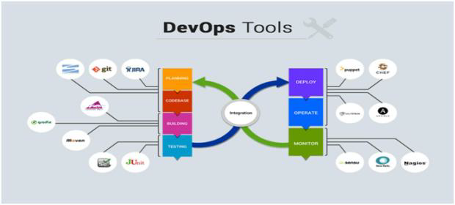
Life Cycle

Slide 7
Popular Tool for DevOps Automation
Git
  Version Control System tool
Jenkins
  Continuous Integration tool
Selenium
  Continuous Testing tool
Puppet, Chef, Ansible
  Configuration Management and Deployment tools
Nagios
  Continuous Monitoring tool
Docker
  Containerization tool

Slide 8
Working of Tools
Developers develop the code and this source code is managed by Version Control System tools like Git etc.
Developers send this code to the Git repository and any changes made in the code is committed to this Repository.
Jenkins pulls this code from the repository using the Git plugin and builds it using tools like Ant or Maven.

Slide 9
Working of Tools
Configuration management tools like puppet deploys & provisions testing environment and then Jenkins releases this code on the test environment on which testing is done using tools like selenium.
Once the code is tested, Jenkins send it for deployment on the production server (even production server is provisioned & maintained by tools like puppet).
After deployment It is continuously monitored by tools like Nagios.
Docker containers provides testing environment to test the build features

Slide 10
DevOps Principles
Customer-Centric Action
  DevOps team must take customer-centric action
  Invest in products and services.
End-To-End Responsibility
  DevOps team need to provide performance support until they become end-of-life.
  This enhances the level of responsibility and the quality of the products engineered.
Continuous Improvement
  DevOps culture focuses on continuous improvement to minimize waste.
  It continuously speeds up the improvement of product or services offered.

Slide 11
DevOps Principles
Automate everything
  Automation is a vital principle of DevOps process.
  Both software development and infrastructure
Work as one team
  In the DevOps culture role of the designer, developer, and tester are already defined.
  All they needed to do is work as one team with complete collaboration.
Monitor and test everything
  It is very important for DevOps team to have a robust monitoring and testing procedures.

Slide 12
GIT
Configuration Management

Slide 13
Topics
Basics of Software Configuration Management
Basics of Version Control System
  Centralized version control system
  Distributed/Decentralized version control system
How to install, configure and create repository
Working copy and check out
Review, Commit & Update
How to merge code and avoid conflict

Slide 14
Software Configuration Management
Multiple people have to work on software that is changing
More than one version of the software has to be supported:
    Released systems
    Custom configured systems (different functionality)
    System(s) under development
    Software on different machines & operating systems
Need for coordination
Software Configuration Management
  manages evolving software systems
  controls the costs involved in making changes to a system.

Slide 15
All Software Has Multiple Versions
Different releases of a product
Variations for different platforms
    Hardware and software
Versions within a development cycle
    Test release with debugging code
    Alpha, beta of final release
Every time when the program is edited

Slide 16
Version Control
Version control tracks multiple versions
In particular, allows
  old versions to be recovered
  multiple versions to exist simultaneously
  can recreate project history
Can revert a file or project to a previous version, track modifications and modifying individuals, and compare changes.

Slide 17
Centralized Version Control
A single server storing all changes and file versions
Can be accessed by various clients.
Knowledge of team members activities with certain files
Administrators can control privileges.

Slide 18
GIT
Git is a Distributed Version Control System that stores data in a file system made up of snapshots.
Creates a snapshot of the file and stores a reference to it.
When changes are saved its called commit
If the file has not changed, stores a reference to the already-stored identical version of it.

Slide 19
History of Git
Git traces its roots to the open source software project Linux kernel.
Linus Torvalds, the chief architect of the Linux kernel, began creating Git.
Since its inception in 2005, Git has become one of the most utilized Version Control Systems in the world.

Slide 20
Local Operations
Git mostly relies on local operations because most necessary information can be found in local resources.
Projects history resides on the local disk, eliminating the need to fetch history information from the server
Can continue work on a project even when not online or on a VPN.

Slide 21
GIT-Features
Tracking Changes
  Every single change applied to any file or directory is tracked by Git.
States
  Files in Git can reside in three main states: committed, modified and staged.
  Committed
    Data is securely stored in a local database
  Modified
    File has been changed but not committed to the database
  Staged
    Flagged a file changed version to be committed in the next snapshot

Slide 22
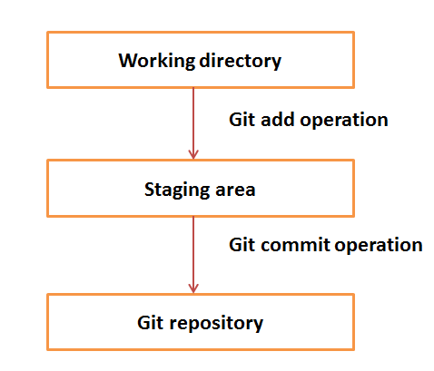
Working Directory and Staging Area

Slide 23
Download GIT
Git can be installed by downloading
Git Website
http://git-scm.com/download/win
GitHub
Install Git as part of the GitHub for Windows install.
http://windows.github.com

Slide 24
Eclipse GIT
Git commands like staging, commit, merge, rebase, pull and push, can be performed from IDE’s
IDE distributions from Eclipse already contain support for Git.
  No additional installation is required.
Identity Setting
Can set the user name and email address, to be used for every Git commit.
  Select the Window->Preferences->Version Control> Git-> Configuration -> user Settings .
    Add the user.name as key and give the value
    Add user.email key and give the value

Slide 25
Setting up a Git Repository
Can Create a new local Git repository via the Eclipse IDE.
  By Convention Git repositories should be outside the Eclipse workspace.
    It helps in separating Git repository from any additional meta-data which Eclipse might create. By default,
Open the Git Repositories view
  Window-> Show View-> Other->Git-> Git Repositories
Using the toolbar, select the Create a new Git repository
  By convention, this directory is a subdirectory in the git folder of the users home directory.

Slide 26
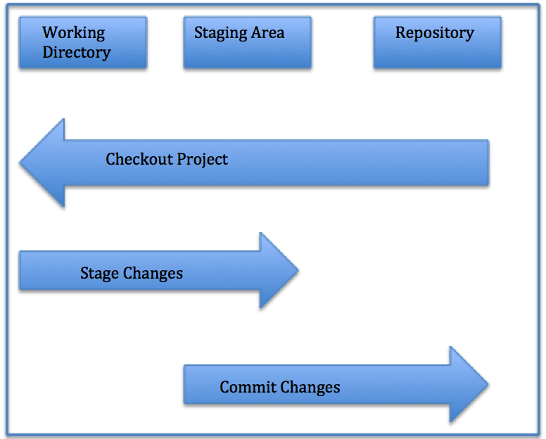
Local Repository Structure
The local Git repository has three components:
Working Directory: The actual files reside here.
Index: The area used for staging
Head: Points to the most recent commit

Slide 27
Add Projects to Git
Projects can be put to Git
  Right-click on project->Team->Share Project-> Git
  Select existing Git repository from the drop-down list and press the Finish button.
  Project is now moved to your Git repository.

Slide 28
Saving Changes
All files in a checked out (or working) copy of a project file are either in a tracked or untracked state.
Tracked
  Files can be modified, unmodified, or staged; they were part of the most recent file snapshot.
Untracked
  Untracked files were not in the last snapshot and do not currently reside in the staging area.
  After cloning a repository, files have tracked status and are unmodified because they have been checked out but not edited.

Slide 29
Git Staging view
Open the Git Staging view
  Window->Show View-> Other-> Git-> Git Staging.
Drag all files into the Staged Changes area
Write a meaningful commit message
Commit the changes
This change is now also stored in to local Git repository.

Slide 30
Git History View
Open the History
  Window-> Show View-> Other->Version Control(Team) -> History
  Can view all changes in repository containing the selected resources
  Will Show all Branches and Tags
  Select a file open this version via the context menu.

Slide 31
GitHUB
GitHub is a is the largest existing host for Git repositories and is used by millions of developers worldwide.
A high percentage of Git repositories reside on GitHub, and this resource is used by many open source projects.
Can set up a free user account.
Done by visiting https://github.com.

Slide 32
Clone an existing repository
To create a copy of an existing Git repository
  Copies all versions of all files for the specified project.
  Automatically checks out or retrieves for editing a copy of the newest version of the project.
  Cloned repository is imported to the existing projects from into workspace.
select File Import…​|Git|Projects from Git
  Select Clone URI in the next dialog.
  Enter the URL to your Git repository which you want to clone.
  Select at least the master branch.

Slide 33
GITHUB - General Workflow
GitHub collaboration workflow revolves around Pull Requests.
  Create a topic branch from master.
  Commit changes for the project.
  Push the topic branch to the GitHub project.
  Open a Pull Request.
  Confer with team and perform additional commits, if applicable.
  The project owner closes or merges the Pull Request.

Slide 34
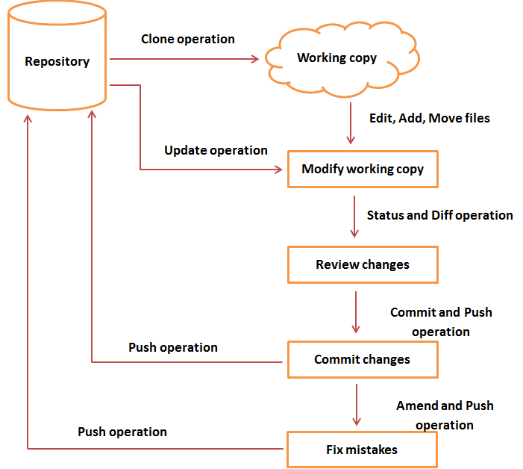
Git General Work flow

Slide 35
Pushing Changes
To push changes to a remote repository.
Pushes changes from the local master branch to the remote repository named origin
For cloned repositories,
  Git will automatically give the name origin  to the server from which you cloned and the name master to your local repository.

Slide 36
Fetching
Fetching entails pulling data you dont have from a remote project.
Cloned Repositories
  git fetch origin
  to pull down any new changes that were pushed to the server since you cloned or last fetched from it.
git fetch solely pulls new data to a local repository;
It does not merge changes with or modify your local work.

Slide 37
Pushing
From the project context menu following operations can be done:
  Pull to pull in changes from your remote Git repository
  Fetch to fetch the current state from the remote repository
  Switch to checkout existing or create new branches
  Push to push changes to your remote Git repository

Slide 38
Branching
Branches of a central repository are created
Collaborators are able to work on a project simultaneously via multiple branches, without affecting this main repository.
A collaborator can create a branch, work on it and save commit snapshots within it,
Can switch between various branches, and merge changes.

Slide 39
Branching
A Git branch is basically a movable pointer that always points to the most recent commit, or snapshot.
Git uses the default local branch name master, which can be changed.
Just because the default name is master does not imply that it is higher in importance or has more functionality than other branches.
The head is a special pointer which indicates which branch you are currently working within.

Slide 40
Creating a New Branch
Creating and switching branches in Eclipse
  Right-click on the project and select Team-> Branch to create new branches or to switch between existing branches.
  Can also switch branches in the History view or the Git repositories view.
  Eclipse supports merging of branches to add the changes committed on one branch into another branch.
  Checkout the branch into which to merge the changes into and select your project and Team Merge to start the merge dialog.

Slide 41
Create a Branch and Checkout
To simultaneously create a new branch and switch to it,
  $ git checkout -b test2
Creates a new branch test2  and switches you to it.
List Branches
    $ git branch
Deleting Branches
  $ git branch -d test

Slide 42
Merging
To merge changes from one branch into your current one
Current branch pointer moves forward to the most recent commit for the branch being merged in
$ git checkout master
$ git merge test
  merges in changes from test branch

Slide 43
Merge Conflicts
When the two files being merged both have changes in identical sections of a file,
Git will not be able to complete the merge cleanly.
These conflicts must be dealt with manually.
Portions of files with unresolved merge conflicts will be labeled unmerged
You can easily locate areas of merge conflict via Git conflict resolution markers,

Slide 44
Merge Conflicts
My name is
<<<<<<< HEAD
Jane
======= Mary >>>>>>>
branch-test Here,
HEAD indicates the branch you checked out before running the merge command.
The content above the ======= resides within this branch,
while everything below it is within the test branch.
git add command on fixed files to mark them as resolved.
$ git status will show the merge resolved

