Slide 1
Arrays

Slide 2
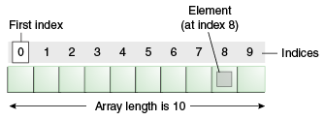
Introduction to Arrays
Array is one variable is used to store a list of data and manipulate
This type of variable is called an array.
It stores multiple data items of the same data type, in a contiguous block of memory, divided into a number of slots.
The new keyword to create an array object.
Need to tell the compiler how many elements will be stored in it.

Slide 3
Creating Arrays
There are three steps to creating an array,
declaring
  int[] k;
  float[] yt;
  String[] names;
allocating
  k = new int[3];
  yt = new float[7];
  names = new String[50];
initializing
  int[ ] k = {1, 2, 3};
  float[ ] yt = {0.0f, 1.2f, 3.4f, -9.87f, 65.4f, 0.0f, 567.9f};

Slide 4
Enhanced For Loop
The enhanced for loop, simplifies looping through an array or a collection.
Instead of having three components, the enhanced for has two.
for(data_type variable : array | collection){}
int [] a = {1,2,3,4};
for(int n : a)
System.out.print(n);.

Slide 5
Array Bounds
All array subscripts begin with 0 and ends with n-1
In order to get the number of elements in an array, can use the length field of an array.
The length field of an array returns the size of the array.
  int list [] = new int[10];
  for (int i = 0; i< list.length; i++)
  {
    System.out.println(list[i]);
    }
There is no array element arr[n]! This will result in an array-index-out-of bounds exception.
Notes:
Special care should be taken while accessing an array element, using the length variable of array objects. In the example shown above list.length gives 10, and if we try to access list[10], we will get an exception.

Slide 6
Array of Objects
  public static void displaybooks(Book[] bks)
  {
  for(int i=0;i<bks.length;i++)
  {
  System.out.println("Book Number :="+bks[i].getBookno());
  System.out.println("Book Name :="+bks[i].getBookname());
  }
  }
  public static void main(String args[])
  {
  Book[] bk = new Book[2];
  Book b1 = new Book(100,"java");
  Book b2= new Book(101,"j2ee");
  bk[0]=b1;
  bk[1]=b2;
  ArrayofObject obj= new ArrayofObject();
  displaybooks(bk);
  }

Slide 7
Copying Arrays
System.arraycopy()
  can be used to efficiently copy data from one array into another:
public static void arraycopy(Object src, int srcPos, Object dest, int destPos, int length)
The two Object arguments
  the array to copy from and the array to copy to.
The three int arguments
  starting position in the source array,
  starting position in the destination array,
  number of array elements to copy.

Slide 8
STRINGS

Slide 9
Strings
Many characters join together to form a string.
  Collection of characters bound by double quotes (“”).
String are created in two ways
  Direct Initialization
    String message1= "Hello World";
    String message2 =“Hello World
No new objects are created.
  When the second line is executed the message2 instance points to the message1 object which was declared before.

Slide 10
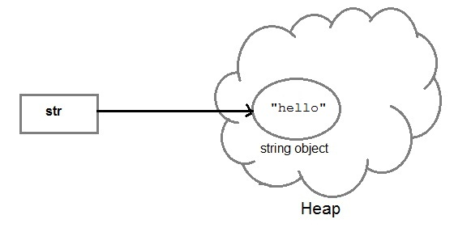
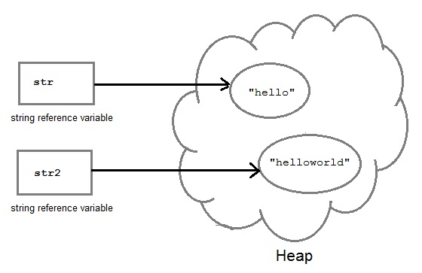
String Creation
String str= "Hello";
String str2=str;

Slide 11
Strings
  String a = "abcd";
  String b = "abcd";
  System.out.println(a == b); // True
  System.out.println(a.equals(b)); // True

Slide 12
Strings
Using constructor
  String myString = new String("Hello World")
A new space is allocated in heap regardless of the object exists in pool or not.
  JVM is forced to create a new string every time its executed
  String c = new String("abcd");
  String d = new String("abcd");
  System.out.println(c == d); // False
  System.out.println(c.equals(d)); // True

Slide 13
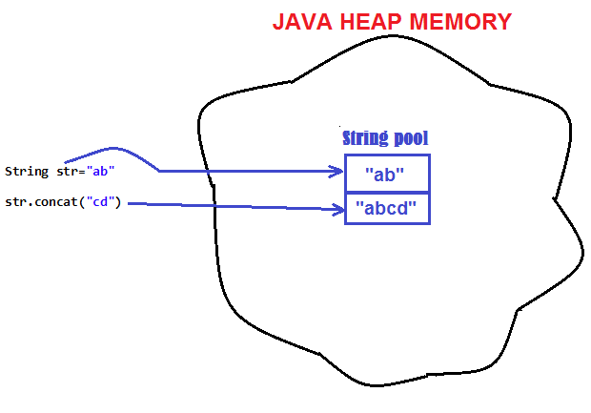
String are Immutable
Java String objects are immutable.
  Unmodifiable or unchangeable.
Once string object is created its data or state can't be changed
  A new string object is created.

Slide 14
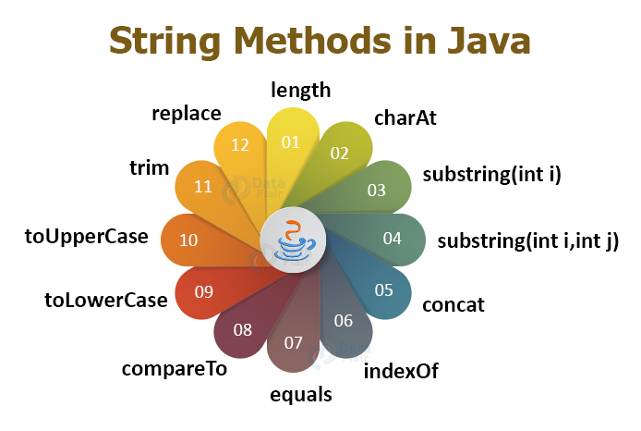

Slide 15
INHERITANCE

Slide 16
Overview
  A class can inherit from another class
    Original class is the “superclass”
    New class is called the “subclass”
Inheritance is a fundamental OO concept
Superclass
Car
Subclasses
SportsCar
Taxi
PoliceCar

Slide 17
Example of Inheritance
  The Car class defines certain methods and variables
  Taxi extends Car, and can:
    Add new variables
    Add new methods
    Override methods of the Car class
Car
Taxi

Slide 18
Specifying Inheritance in Java
  Inheritance is achieved by specifying which superclass the subclass
  “extends”
Taxi inherits all the variables and methods of Car
public class Car {
…
}
public class Taxi extends Car {
…
}

Slide 19
What Does an Object Look Like?
A subclass inherits all the instance variables of its superclass
Car object
public class Car {
String regNum;
int engineSize; …
}
regNum
engineSize
Taxi object
public class Taxi extends Car {
private int cabNum; …
}
regNum
engineSize
cabNum

Slide 20
Default Initialization
  What happens when a subclass object is created?
  If no constructors are defined:
  No-arg constructor is called in superclass
    No-arg constructor called in subclass
Taxi object
regNum
engineSize
Taxi taxi1 = new Taxi();
cabNum

Slide 21
Nondefault Initialization
Specific initialization can be performed as follows:
public class Car {
Car(String r, int e) {
regNum = r;
engineSize = e;
} …
public class Taxi extends Car {
Taxi(String r, int e, int c) {
super(r, e);
cabNum = c;
} …
Use super() to call superclass constructor

Slide 22
Specifying Additional Methods
  The superclass defines methods that are applicable for all kinds of Car
  The subclass can specify additional methods that are specific to Taxis
public class Car {
public int getReg()…
public void changeOwner()…
…
public class Taxi extends Car {
public void renewCabLicense()…
public boolean isBooked()…
…

Slide 23
Overriding Superclass Methods
  A subclass inherits all the methods of its superclass
  The subclass can override a method with a specialized version, if it needs to:
public class Car {
public String details() {
return "Reg:" + getReg();
}
public class Taxi extends Car {
public String details() {
return "Reg:" + getReg() + cabNum;
}

Slide 24
Overriding
When a sub-class defines a
  “method with same method name, argument types, argument order and return type as a method in its super class, its called method overriding. “
Methods declared as final, static and private cannot be overridden.
An overriding method can be declared as final
The method can’t be less accessible
  Public => only public
  Protected => Both Public and Protected
  Default => default, public and protected

Slide 25
Overriding with Compatible Return type
Arguments must be same and return type must be compatible
  class Base
  {
  private int i = 5;
  public Number getNumber()
  {
  return i;
  }
  }
  class Derived extends Base
  {
  @Override
  public Integer getNumber()
  {
  return new Integer(10);
  }
  }

Slide 26
Invoking Superclass Methods
  If a subclass overrides a method, it can still call the original superclass method
  Use super.method()to call a superclass method from the subclass
  Though keyword super is used to refer super class, method call super.super.method() is invalid.
public class Car {
public String details() {
return "Reg:" + getReg();
}
public class Taxi extends Car {
public String details() {
return super.details() + cabNum;
}

Slide 27
super keyword
The keyword super refers to the base class
  super( )
    invokes the base class constructor
    base class constructors are automatically invoked
  super.method( )
    invokes the specified method in the base class
  super.variable
    to access the specified variable in the base class
super must be the first statement in a constructor

Slide 28
Abstract Class
An abstract class is a shared superclass
  Provides a high-level partial implementation of some concept
  Cannot be instantiated
Use the abstract keyword to declare a class as abstract
Vehicle
Vehicle
Abstract superclass
Concrete subclasses
Car
Car
Truck

Slide 29
Defining Abstract Classes in Java
  Use the abstract keyword to declare a method as abstract
    Only provide the method signature
    Class must also be abstract
  Must be implemented by a concrete subclass
    Each concrete subclass can implement the method differently
public abstract class Vehicle {
private String regNum;
public String getRegNum()…
public abstract boolean isRoadWorthy();
}
public class Car
extends Vehicle{
private int numSeats;
public void fitRack()…
public class Truck
extends Vehicle{
private int axles;
public void setLoad()…

Slide 30
The Abstract Class-Super Class
Note
this
  public abstract class BankAccount {
  public abstract void deposit(double amount);
  public abstract void withdraw(double amount);
  public void sayHello() {
  System.out.println("Thanks-Come Again");
  }
  }

Slide 31
Child Class –Its alsoAbstract
  public abstract class Savingaccount extends BankAccount {
  public abstract void getDetails();
  }

Slide 32
The Concrete Class
  public class Supersavings extends Savingaccount {
  private double balance,amount ;
  private String custname;
  private int accno;
  public void deposit(double amt)
  {
  balance+=amt;
  }
  public void withdraw(double amt)
  {
  balance-=amt;
  }
  public void getDetails()
  {
  System.out.println(custname);
  System.out.println(accno);
  System.out.println(amount);
  System.out.println(balance);
  }
  }

Slide 33
Interfaces & Polymorphism

Slide 34
Interfaces
  An interface is like a fully abstract class
    All the methods are public and abstract- Till Java 8
      No instance variables if present they are public static final
  Defines a set of methods that other classes can implement
    A class can implement many interfaces,
      but can extend only one class
      can extend other interfaces and extend multiple interfaces

Slide 35
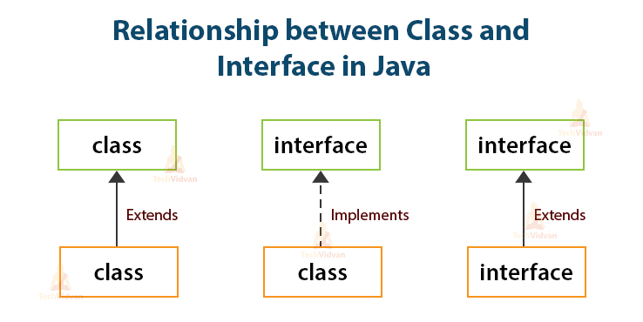

Slide 36



Example of Interfaces
  Interfaces describe an aspect of behavior that different classes can support
    Any class that supports the “Steerable” interface can be steered:
Steerable
Not Steerable

Slide 37
Interface
Interfaces define types in an abstract form
  Allows the specification of a reference type without providing an implementation
  The class that implements the interface decides how to implement
  Use interface keyword instead of class
  public interface Function {
  public double apply(double arg);
  }

Slide 38
Implement the Interface
  public class CurrencyConverter implements Function {
  @Override
  public double apply(double arg) {
  return arg * 45;
  }
  }
  Function usdToInr = new CurrencyConverter();
  System.out.println(usdToInr.apply(100));

Slide 39
Implementing an Interface
public interface Steerable {
int maxTurn = 135;
void turnLeft(int deg);
void turnRight(int deg);
}
public class Car
extends Vehicle
implements Steerable {
public void turnLeft(int deg)
{…}
public void turnRight(int deg)
{…}

Slide 40
Partial Implementation of an Interface
Declare the class as abstract if the class does not implement all the methods of an interface
Implement the methods in the sub class level
Public abstract class Car
extends Vehicle
implements Steerable {
public void turnLeft(int deg)
{…}
}

Slide 41
Using instanceof with Interfaces
  The instanceof operator can be used to check if an object implements an interface
  Downcasting can be used if necessary, to call methods defined in the interface
public void aMethod(Object obj) {
…
if (obj instanceof Steerable)
((Steerable)obj).turnLeft();
}

Slide 42
Extending an Interface
One Interface can extend another Interface
public interface Steerable {
int maxTurn = 135;
void turnLeft(int deg);
void turnRight(int deg);
}
public interface Navigator
extends Steerable {
void calcSpeed(int distance);
}

Slide 43
Polymorphism
This OO Principle allows the programmer to program abstractly
Objects of a subclass can be treated as objects of its superclass
The base class of a hierarchy is usually an abstract class or an Interface
  They define the common behavior (functionality)
Classes and Subclasses inherit this behavior and extend it according to their own properties by overriding the methods of the super class
Subclass objects can be treated as super class objects through references,
  But, super class objects are not subclass objects

Slide 44
Polymorphism
Allows for hierarchies to be highly extensible
New classes can be introduced and can still be processed without changing other parts of the program
Same method can do different things, depending on the class that implements it.
Method invoked is associated with OBJECT and not with reference.
Types of Polymorphism -
  Method Overloading.
  Method Overriding.

Slide 45
Polymorphism
  public interface Conditional {
  public boolean test();
  }

Slide 46
Implementation -One
  public class Professor implements Conditional {
  private String qualification;
  @Override
  public boolean test() {
  return this.qualification.equalsIgnoreCase("phd");
  }
  }

Slide 47
Implementation -Two
  public class Student implements Conditional {
  private double markScored;
  @Override
  public boolean test() {
  return this.markScored>90;
  }
  }

Slide 48
Polymorphism
  public static void print(Conditional poly) {
  System.out.println(poly.test());
  }
  public static void main(String[] args) {
  Student ramesh = new Student(101,"Ramesh",67);
  Professor prof = new Professor(201, "manish", "ece", "phd");
  print(ramesh);
  print(prof);
  }

Slide 49
Substitution of Object References in Method Calls
A subclass object can be passed into any method that expects a superclass object
The method that got invoked, is the version that's present in the object type and NOT the reference type.
public static void main(String[] args) {
Taxi t = new Taxi("ABC123", 2000, 79);
displayDetails(t);
public static void displayDetails(Car c) {
System.out.println(c.details());
}
Notes:
The same object reference (that is, an object reference of the same reference type) is capable of behaving differently at runtime, depending on the object that it points to.

Slide 50
Dynamic Method Dispatch
subclass=
(subclass)superclass
Valid at both Compile ,RunTime
  class First
  {
  public void show()
  {
  System.out.println("ShowFirst");
  }
  }
  class Second extends First
  {
  public void show()
  {
  System.out.println("Show Second");
  }
  }
First fst = new Second();
Second sec = (Second)fst;
sec.show();
First fst2 = new First();
Second sec2 = (Second)fst2;
sec2.show();
subclass=
(subclass)superclass
Valid at Compile time exception at ,RunTime

Slide 51
Dynamic Method Dispatch
Related Through Inheritance
superclass = subclass
  always valid
subclass = superclass
  not valid at compile time, needs a cast
subclass=(subclass)superclass
  valid at compile time, checked at runtime.
  if INVALID then ClassCastException is thrown.
Unrelated Classes – Not Allowed
someClass = someUnrelatedClass
  not valid, won’t compile
somcClass = (someClass)someUnrelatedClass
  not valid, won’t compile

