Slide 1
BUILDING WITH MAVEN

Slide 2
Building with Maven
  Introduction to Maven & its objectives
  Install and setting up Maven
  Maven project structure
  POM.xml description

Slide 3
Project Management Tool
A Java build tool
  “project management and comprehension tool”
    It means - accumulator of knowledge,
An Apache Project
  Mostly sponsored by Sonatype
  Standard and Easy way to build and Publish the projects
  To share JARs across several projects.
  Communication among members of a working team.

Slide 4
Installing Maven
Download Maven :http://maven.apache.org/download.html
Unzip the installation archive
Set the M2_HOME and Path environment variables in the following way:
      M2_HOME=C:\apache-maven-2.2.1
      Path=%M2_HOME%\bin
mvn –version
  Will print out installed version of Maven, indicating successful installation .
  Maven is Bunded with all Popular IDEs

Slide 5
Pom.xml
Stands for Project Object Model
POM is the fundamental unit of work in Maven.
An XML file that contains information about the project and configuration details used by Maven to build the project.
While executing Maven looks for the POM in the current directory.
It reads the POM, gets the needed configuration information, then executes the goal.

Slide 6
POM
The following Details about the project can be configured in POM
  Name and Version
  Artifact Type
  Dependencies
  goals
  Plugins
  Profiles (Alternate build configurations)
Super POM
  Maven's default POM.
  All POMs extend the Super POM
  Configuration is inherited by the POMs

Slide 7
Minimal POM
  <project>
    <modelVersion>4.0.0</modelVersion>
    <groupId>com.mycompany.app</groupId>
    <artifactId>my-app</artifactId>
    <version>1</version>
  </project>

Slide 8
Minimal Pom.xml
Projects are the top-level element in all pom.xml files.
  groupID:
  Arbitrary project grouping identifier (no spaces or colons
  Loosely based on Java package name
artfiactId:
  Arbitrary name of project (no spaces or colons)
  Usually base name of the primary artifact
  Typically files like a JAR or war
  version:
  Version of project
  Format {Major}.{Minor}.{Maintanence}
  Add ‘-SNAPSHOT ‘ to identify in development

Slide 9
Maven Dependency Management
Maven revolutionized Java dependency management
    No more checking libraries into version control
Introduced the Repository concept
    Established Maven Central
Created a module metadata file (POM)
Introduced concept of transitive dependency

Slide 10
Dependencies
Used to store Dependencies and then downloaded
  Via http
Downloaded dependencies are cached in a local repository
  Usually found in ${user.home}/.m2/repository
Maven Central is primary community repo
  http://repo1.maven.org/maven2
  After downloading repository,
  Maven will always look for the artifact in the local repository before looking elsewhere.

Slide 11
Dependencies
  <project>
  ...
  <dependencies>
  <dependency>
  <groupId>javax.servlet</groupId>
  <artifactId>servlet-api</artifactId>
  <version>2.5</version>
  <scope>provided</scope>
  </dependency>
  </dependencies>
  </project>

Slide 12
Resolving Dependency
During the build process dependencies are resolved with dependency management engine.
Specified in <dependencies> elements within a pom.xml file.
They are resolved in the following order:
  Local repository is checked for the dependency.
  A list of remote repositories is checked for the dependency.
  In Case 1 and 2 fail and error is reported

Slide 13
Scopes
Compile
  default scope
  dependencies that are available in all classpaths of a project.
Provided
  Indicates the JDK or a container to provide the dependency at runtime.
  dependency on the Servlet API
Test
  The dependency is not required for normal use
  Available for the test compilation and execution phases.

Slide 14
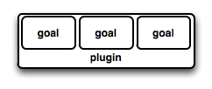
Maven Plugin
Maven is a plugin execution framework
Tasks are done by plugins.
Generally used to :
  create jar file
  create war file
  compile code files
  unit testing of code
Plugin provides a set of goals
mvn [plugin-name]:[goal-name]
mvn compiler:compile

Slide 15
Archetype Pluggin
Maven project templating toolkit.
  original pattern or model from which all other things of the same kind are made.
Provides a quick consistent way with best practices to create a Project
Developers can have a working Maven project to use as a jumping board
A Directory with the artifact Id is Created along with Some Sample Code
mvn archetype: generate

Slide 16
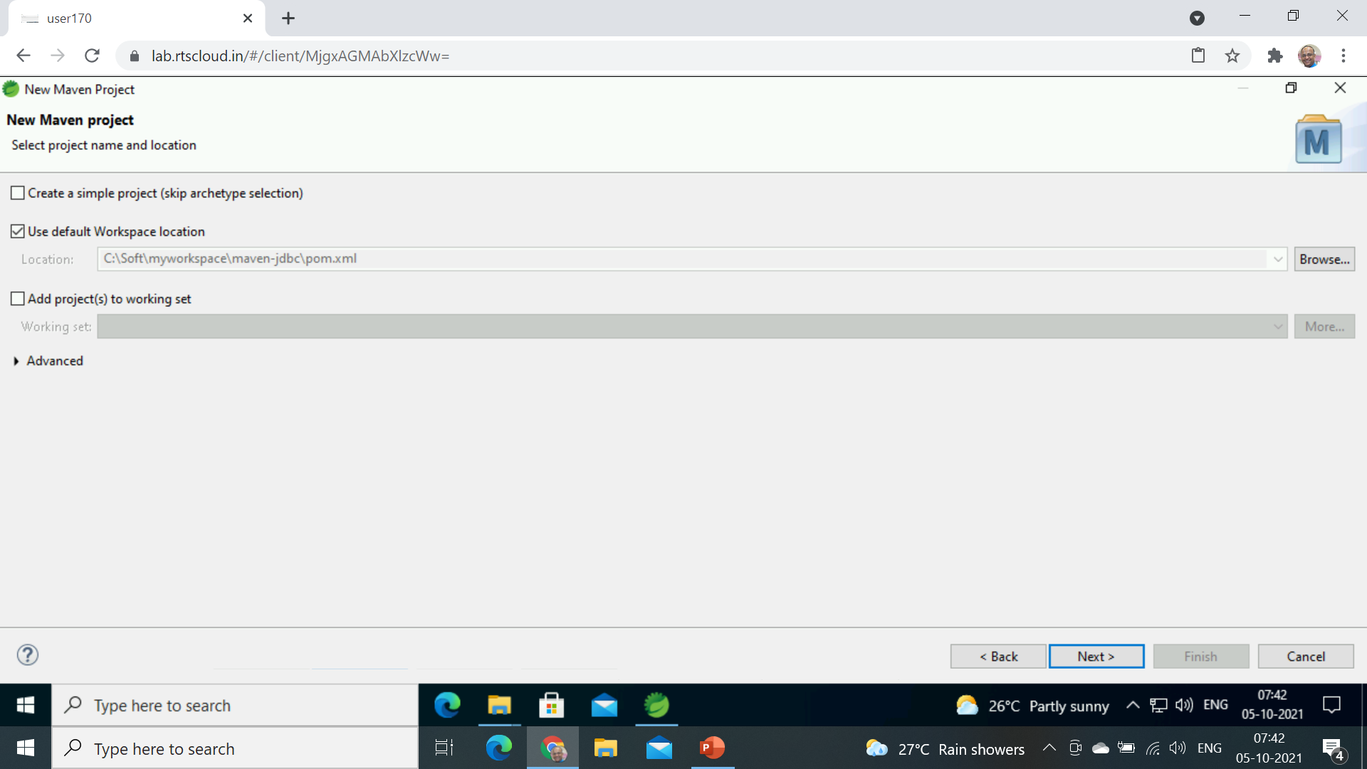
Create Maven Project with Eclise
Select File -> New –Maven Project
Select a Maven Project

Slide 17
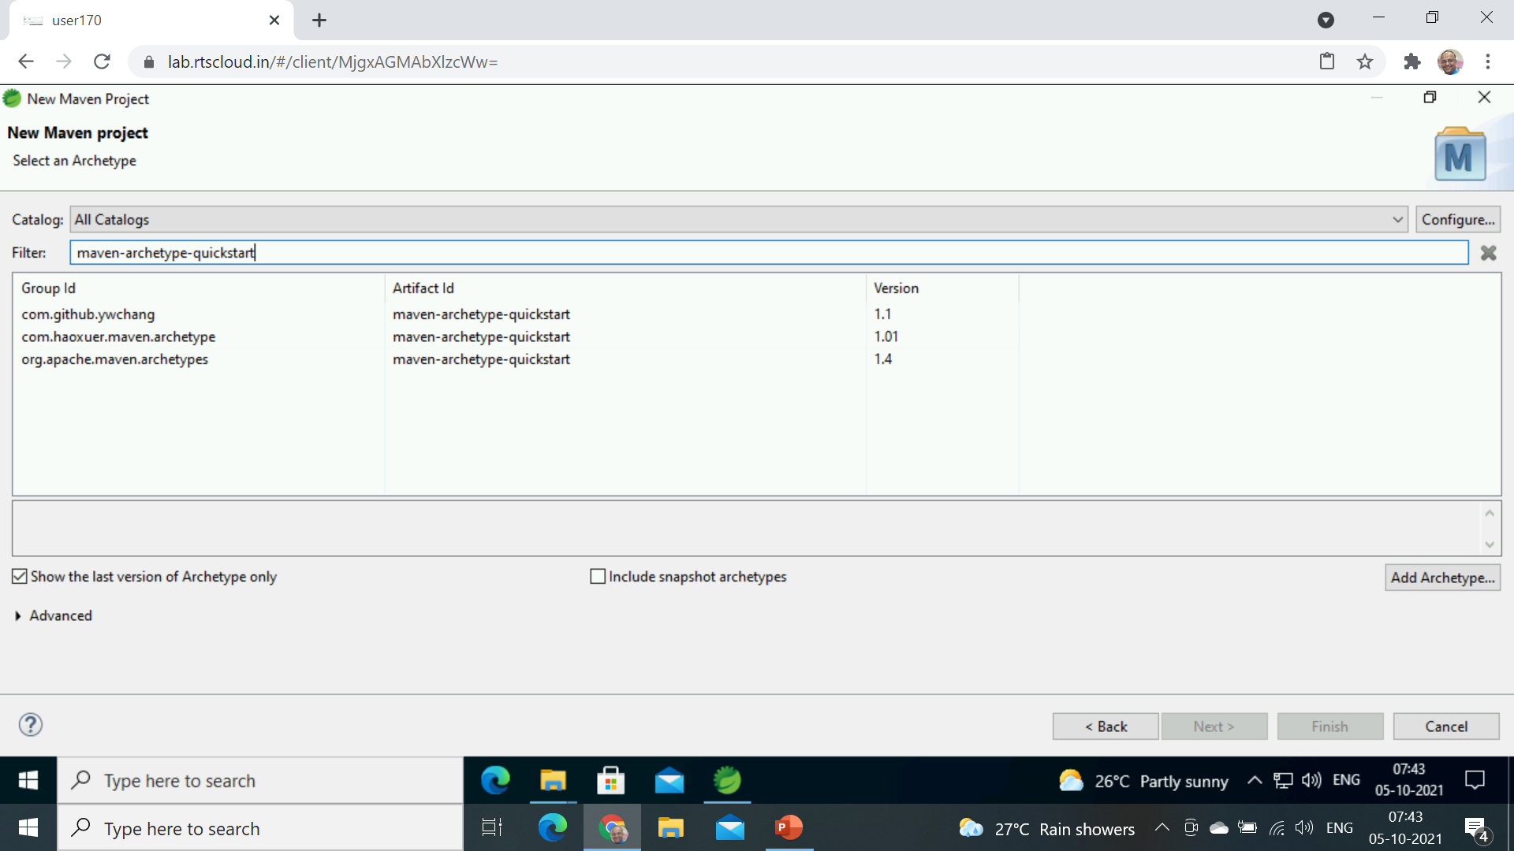
maven-archetype-quickstart

Slide 18
Plugin Goals
A plugin goal represents a specific task to building and managing of a project.
If a build phase has one or more goals bound to it, it will execute all those goals one by one
archetype plugins with Generate Goal will create projects.
  mvn [plugin-name]:[goal-name]
  mvn archetype: generate
  mvn exec:java

Slide 19
Execute Maven Plugin
  <plugin>
  <groupId>org.codehaus.mojo</groupId>
  <artifactId>exec-maven-plugin</artifactId>
  <version>1.5.0</version>
  <executions>
  <execution>
  <goals>
  <goal>java</goal>
  </goals>
  </execution>
  </executions>
  <configuration>
  <mainClass>com.example.demo.App</mainClass>
  </configuration>
  </plugin>

Slide 20
Goals
A goal not bound to any build phase could be executed outside of the build lifecycle by direct invocation.
mvn clean
  Invokes just clean
mvn clean compile
  Clean old builds and compile
mvn package
  A jar file is created inside the project/target directory.

Slide 21
Package
mvn package will execute a series of phases and package to a distributable format, such as a JAR.
  Validate
  generate-sources
  process-sources
  generate-resources
  process-resources
  Compile
java -cp target/my-app-1.0-SNAPSHOT.jar com.mycompany.app.App

Slide 22
Maven Jar Plugin
  <plugin>
  <groupId>org.apache.maven.plugins</groupId>
  <artifactId>maven-jar-plugin</artifactId>
  <version>3.2.0</version>
  <configuration>
  <archive>
  <manifest>
  <mainClass>com.example.demo.App</mainClass>
  </manifest>
  </archive>
  </configuration>
  </plugin>

Slide 23
Variables
Don't repeat yourself.
To assist in ensuring the value is only specified once,
Maven allows variables in the POM.
    <properties>
    <mavenVersion>2.1</mavenVersion>
    </properties>
  <dependency>
    <groupId>org.apache.maven</groupId>
    <artifactId>maven-artifact</artifactId>
    <version>${mavenVersion}</version>
  </dependency>

Slide 24
Maven Eclipse Java Version
  <properties>
  <maven.compiler.target>1.8</maven.compiler.target>
  <maven.compiler.source>1.8</maven.compiler.source>
  </properties>

Slide 25
Packaging
<?xml version="1.0" encoding="UTF-8"?>
<project>
    <groupId>com.mycompany.app</groupId>
    <artifactId>my-app</artifactId>
    <version>1.0-SNAPSHOT</version>
<packaging>jar</packaging>
</project>
Build type identified using the “packaging” element
Tells Maven how to build the project
Example packaging types:
  pom, jar, war, ear, custom
  Default is jar

Slide 26
Add Dependencies
  <dependency>
  <groupId>log4j</groupId>
  <artifactId>log4j</artifactId>
  <version>1.2.17</version>
  </dependency>
  <dependency>
  <groupId>com.oracle.database.jdbc</groupId>
  <artifactId>ojdbc8</artifactId>
  <scope>runtime</scope>
  <version>19.3.0.0</version>
  </dependency>

Slide 27
Assembly Plugin
Apache Maven Assembly Plugin
  Used to aggregate the project output along with its dependencies, modules, site documentation, and other files into a single, runnable package.
single goal
  The only goal in the assembly plugin
  Used to generate the JAR file from the project
  Run with assembly:single.
mvn assembly:single

Slide 28
Maven Assembly Plugin
  <plugin>
  <groupId>org.apache.maven.plugins</groupId>
  <artifactId>maven-assembly-plugin</artifactId>
  <configuration>
  <archive>
  <manifest>
  <mainClass>com.example.demo.Application</mainClass>
  </manifest>
  </archive>
  <descriptorRefs>
  <descriptorRef>jar-with-dependencies</descriptorRef>
  </descriptorRefs>
  </configuration>
  </plugin>

