Slide 1
DOCKER

Slide 2
Docker
Designed to create, deploy, and run applications
  Written in the Go programming language
Packages an application and all its dependencies together in the form of containers.
Application will run on any other machine
  Even if the settings could differ from the machine used for writing and testing the code.
  Takes advantage of several features of the Linux kernel to deliver its functionality.

Slide 3
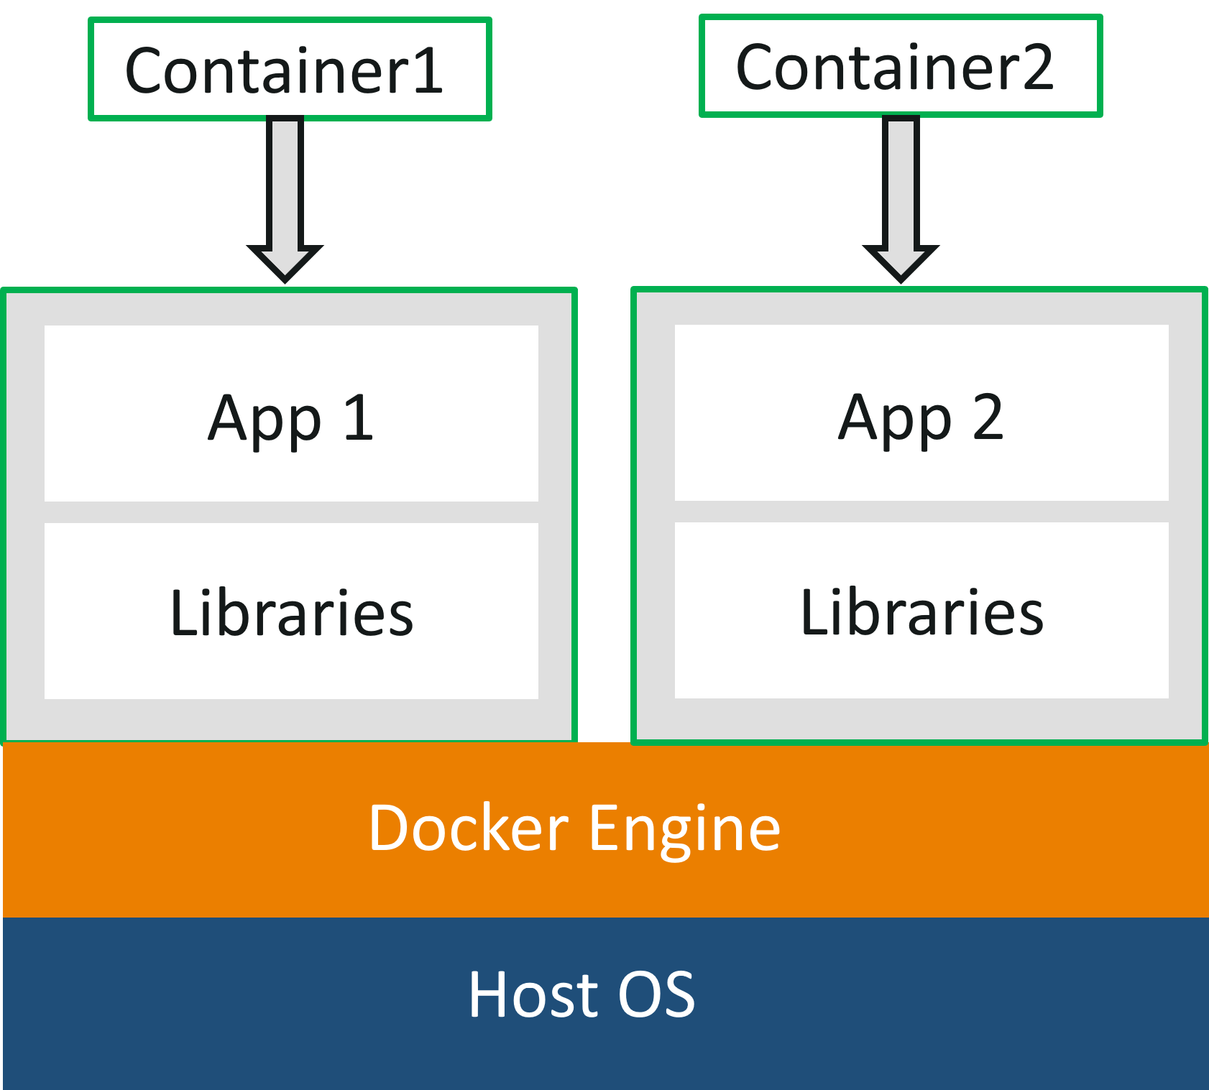
Docker Container

Slide 4
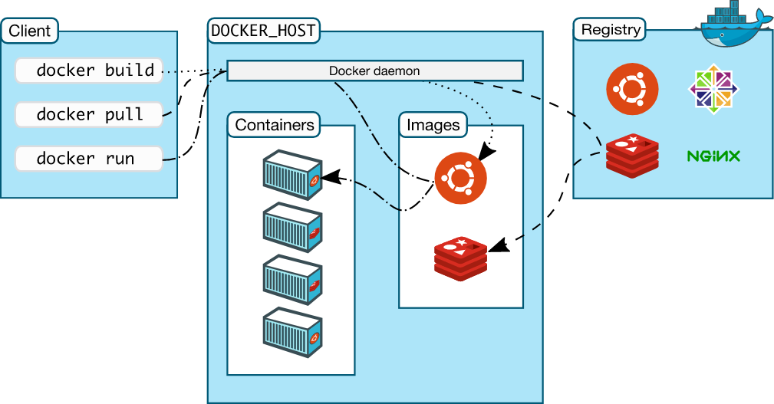
Docker architecture

Slide 5
Docker architecture
The Docker Daemon
  Listens for Docker API requests and manages Docker objects
    Images, containers, networks, and volumes.
  It can also communicate with other daemons to manage Docker services.

Slide 6
Docker architecture
The Docker client
  Users interact with Docker.
  The Docker client can communicate with more than one daemon.
  Docker daemon, does the heavy lifting of building, running, and distributing Docker containers.
  Docker Compose is a special type of Docker client that work with applications consisting of a set of containers.

Slide 7
Docker architecture
Docker Desktop
  Easy-to-install application to build and share containerized applications and microservices.
  Includes the Docker daemon ,the Docker client, Docker Compose, Docker Content Trust, Kubernetes, and Credential Helper.
Docker objects
  Images, Containers, networks, volumes, plugins are different objects.

Slide 8
Docker architecture
Docker registries
  Stores Docker images.
  Docker Hub is a public registry
  Docker is configured to look for images on Docker Hub by default.
  Docker can pull/push/run the required images from configured registry.

Slide 9
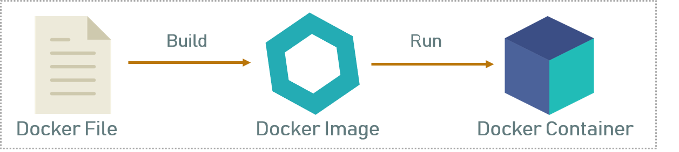
Docker architecture

Slide 10
Dockerfile
A text file without any extension
Used To write the instruction to build new docker image
  Docker reads the instruction and builds images automatically
Will have commands to build image using a simple syntax

Slide 11
Dockerfile
  FROM maven:3.9.6-eclipse-temurin-17 AS build
  WORKDIR /app
  COPY . .
  RUN mvn clean package -DskipTests
  FROM eclipse-temurin:17-jre-jammy
  WORKDIR /app
  COPY --from=build /app/target/*.jar app.jar
  EXPOSE 8080
  ENTRYPOINT ["java", "-jar", "app.jar"]

Slide 12
Multi Stage Dockerfile
A Docker File can use multiple FROM instructions
  Each FROM starts a new stage with a specific purpose
Can have one Dockerfile with multiple configurations
Labeling the Stage
  By adding AS build
  "Everything that happens from this point until the next FROM instruction belongs to a stage named build."
Referencing it Later
  COPY --from=build /app/target/*.jar app.jar

Slide 13
Multistage Build
Build Stage:
  This stage uses a full, often larger, base image like maven:latest or node:lts
  All the tools needed to compile, test, and package required for application.
  A name is assigned to this stage using the AS keyword,
  FROM ... AS builder.
Final Stage:
  This stage starts from a new, minimal base image
  Includes the runtime environment like a JRE for Java applications

Slide 14
Multi Stage Configuration
maven:3.9.6-eclipse-temurin-17
  uses the Temurin JDK to compile
  It’s a Build Stage use image all the tools (Maven + JDK) needed to compile code.
eclipse-temurin:17-jre-jammy
  uses the Temurin JRE to run it.
jammy
  tag indicates that the Java runtime is built on Ubuntu 22.04 (Jammy Jellyfish).
  Uses a slim image with only the JRE and the OS (Jammy) needed to run

Slide 15
Image
Image is a read-only template with instructions for creating a Docker container.
Each instruction in a Dockerfile creates a layer in the image.
  When Dockerfile changes and while rebuilding, only those layers which have changed are rebuilt.
  Makes images lightweight, small, and fast, when compared to other virtualization technologies.
An image may be based on another image, with some additional customization.
Can create custom images with those created by others and published in a registry.

Slide 16
Docker Containers
Runnable instance of an image.
Runs on top of the docker platform.
  Contains only the executable package of the application, libraries and dependent software/servers that are required to run the application.
  They do not have separate OS installations running
  Can create, start, stop, move, or delete a container using the Docker API or CLI.
  Can connect a container to one or more networks, attach storage to it, or even create a new image based on its current state.

Slide 17
Docker Hub
https://hub.docker.com/
A repository that contains the published docker images.
Can create docker image of application and publish it here for later use or someone else to use.
It also has official docker image of many popular application

Slide 18
Build Docker Image
The docker build command builds Docker images from a Dockerfile
  Navigate to directory where DockerFile is present
docker build -tag firstexample:1.0 .
  Can add a tag in the ‘name:tag’ format
  . Used to set the the build context, the current directory
docker run firstexample:1.0
  Used to specify a version of an image to run

Slide 19
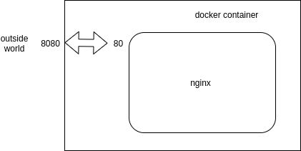
Docker Port Binding
Docker identifies every port the Dockerfile exposes
  Entry with --expose parameter.
Docker does not expose ports by default, you have to configure every exposed port yourself!
Docker ps – a
docker container port *insert containerid*
  80/tcp -> 0.0.0.0:32768

Slide 20
Docker run
docker run -it -p8080:4040 customer-service:1.0
  4040: => from server.port in application.properties
  8080 -> any port which is not in use
Run a command in a new container
  Creates a writeable container layer over the specified image
  Then starts it using the specified command.
-p <port-on-host>:<port-on-container>
  publishes port 4040 in the container to port 8080 on the host.
-it
  Run a container interactively

Slide 21
Pushing to Docker Hub
Can push an image to Docker Hub
Local Image should be named using
  Docker Hub username and the repository name created through Docker Hub on the web.
Can add multiple images to a repository by adding a specific tag
  docs/base:testing
If it’s not specified, the tag defaults to latest.

Slide 22
Pushing Image to DockerHub
Local Images can be named by one of these methods:
  While building
    using docker build -t <hub-user>/<repo-name>[:<tag>]
After Build
  By re-tagging an existing local image
  docker tag <existing-image> <hub-user>/<repo-name>[:<tag>]
docker tag spring-boot vatsank/vatsan-quick-start:1.0
docker login
docker push vatsank/vatsan-quick-start:1.0

Slide 23
DOCKER COMPOSE

Slide 24
Dockerize Dependent Applications
  Comes with an own build-file in YAML format
  It contains details about the services, networks, and volumes for setting up the application.
  Compose to create separate containers, host them and get them to communicate with each other.
  Each container will expose a port for communicating with other containers.
  Used for managing multiple containers.
    To start or stop a composite of services in one command,
    To Merge the logging output of multiple services together

Slide 25
Docker-compose Configuration
services:
  Each object in this key defines a service,
  Like a container.
    Mandatory section
build:
  Specifies the location of our Dockerfile
  “.” represents the directory where the docker-compose.yml file is located.

Slide 26
Docker-compose Commands
image:
  The Name it be given to the image when build-features are used.
  It will be searching for this image in the library or remote-registry
depends_on:
  Used to inform Docker to start a service only, if the listed services have started successfully.
restart:
    always restarts containers that exit with zero ( success ) exit code.
  ports:
    Used to map the container’s ports to the host machine.

Slide 27
docker compose build
Builds images:
  Builds the image for each service that has is defined
  It uses the specified Dockerfile.
Tags images:
  By default, it tags the built images with the format project-service,
  Name of project and service is the name of the service in the docker-compose.yml file.
Caches build layers:
  Docker's build process is optimized to cache layers.
  If there are no changes in Dockerfile or build context, it will reuse cached layers, making the build faster.

Slide 28
Docker volume
Used for persistent data storage by Docker containers.
  To ensure that data, such as a database, is not lost when a container stops, is restarted, or deleted.
It can be safely shared and simultaneously mounted into multiple containers, allowing them to access the same data.
Managed by Docker and stored in a specific location on the host filesystem (typically /var/lib/docker/volumes/ on Linux).
Can have named volumes and anonymous volumes
docker volume create <name>
docker volume ls
docker volume rm <name>
Notes:
Docker volumes provide a mechanism for persistent data storage, independent of the container's lifecycle, while Docker networks enable communication between containers and with external systems.
GeeksforGeeks +1
Docker Volumes
Volumes are the preferred method for persisting data generated by and used by Docker containers. By default, data within a container's filesystem is ephemeral and lost when the container is removed.
Docker Docs +1
Data Persistence: Ensures that data, such as a database, is not lost when a container stops, is restarted, or deleted.
Data Sharing: A single volume can be safely shared and simultaneously mounted into multiple containers, allowing them to access the same data.
Management: Volumes are managed by Docker and stored in a specific location on the host filesystem (typically /var/lib/docker/volumes/ on Linux). They offer better performance than writing data directly to the container's writable layer.
Types: Includes named volumes (explicitly created with a name) and anonymous volumes (assigned a random name by Docker). Bind mounts, while similar, link directly to any specified path on the host system and are often used for development purposes.
Docker Docs +4
Common commands for managing volumes include:
docker volume create <name>: Creates a named volume.
docker volume ls: Lists all volumes.
docker volume rm <name>: Removes a specific volume.
docker volume prune: Removes all unused volumes to free up disk

Slide 29
Docker Networks
To make containers communicate with each other, the host machine, and external networks.
  Containers on the same user-defined network can discover and communicate with each other using their container names as hostnames
Types of Network drivers
  Bridge (default): Creates a private internal network for containers on a single host.
  Host: Removes network isolation, and the container directly shares the host's networking stack.
  Overlay: Enables communication between containers across multiple Docker hosts, essential for Swarm services.
  None: Disables all networking for the container.

Slide 30
Docker-compose multiple Application
  version: '3'
  services:
  student-service:
  build:
  context: ./dockerize-spring-service
  dockerfile: ./Dockerfile
  ports:
  - "8080:6060"
  client-service:
  build:
  context: ./dockerize-spring-service-client
  dockerfile: ./Dockerfile
  ports:
  - 8085:6070
  depends_on:
  - student-service

Slide 31
Environment configurations
Used in the Spring Boot project application.properties file.
Configurations connect and authenticate the API service
  environment:
  SPRING_DATASOURCE_URL=jdbc:postgresql://mypostgres:5432/mydb
  SPRING_DATASOURCE_USERNAME=postgres
  SPRING_DATASOURCE_PASSWORD=password
  SPRING_JPA_HIBERNATE_DDL_AUTO=update

Slide 32
Docker-compose with postgress
  version: '3'
  services:
  myspringapp:
  image: myapplication
  build:
  context: ./
  ports:
  - "8080:8080"
  depends_on:
  - mypostgres

Slide 33
Docker-compose with postgress
  environment:
  - SPRING_DATASOURCE_URL=jdbc:postgresql://mypostgres:5432/mydb
  - SPRING_DATASOURCE_USERNAME=postgres
  - SPRING_DATASOURCE_PASSWORD=password
  - SPRING_JPA_HIBERNATE_DDL_AUTO=update
  mypostgres:
  image: postgres
  ports:
  - "5432:5432"
  environment:
  - POSTGRES_PASSWORD=password
  - POSTGRES_USER=postgres
  - POSTGRES_DB=mydb

Slide 34
Docker-compose Spring Boot App
Add the Spring Boot Module Docker compose support
Can execute as a Spring Boot Application
  services:
  postgres:
  image: 'postgres:latest’
  environment:
  - 'POSTGRES_DB=customer_db’
  - 'POSTGRES_PASSWORD=secret’
  - 'POSTGRES_USER=user’
  ports:
  - '5432’
  volumes:
  - postgres-data:/var/lib/postgresql
  volumes:
  postgres-data:

Slide 35
Docker-compose Commands
docker compose config
docker compose up
  to start up a container
docker compose down
  To take down container
docker compose build
  To rebuild discarding old images with the newer one
docker compose ps:
  This command list all the containers in the current docker-compose file. They can then either be running or stopped.
docker compose build --no-cache
  Ignoring previously cached image layers

Slide 36
SELF STUDY

Slide 37
Google JIB
To containerize Java application need to write a Dockerfile, run a Docker daemon as root, wait for builds to complete, and finally push the image to a remote registry.
Google Jib is an open-source Java containerizer builds containers using the Java tools like maven and gradle
It is a fast and simple container image builder that handles all the steps of packaging application into a container image.
It does not require to write a Dockerfile or have docker installed, and it is directly integrated into Maven and Gradle—just adding the plugin is engugh

Slide 38
Google Jib
Advantages:
  Optimizes image creation by separating dependencies from application classes, resulting in faster build and push times.
  Builds images without a local Docker installation, which is a plus for environments where Docker cannot be installed or is restricted.
  Seamlessly integrates with Maven and Gradle, making it very easy to include in existing Java projects.
Disadvantages:
  Specifically designed for Java applications, which can be a limitation
  Automatically handles the layering of the image, which is efficient but offers less control for fine-tuning.

Slide 39
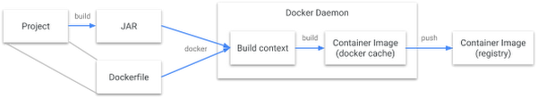
Google JIB Flow

Slide 40
Jib Plugin
  <plugin>
  <groupId>com.google.cloud.tools</groupId>
  <artifactId>jib-maven-plugin</artifactId>
  <version>3.3.1</version>
  <configuration>
  <to>
  <image>vatsank/usingjib:3.0</image>
  </to>

Slide 41
Jib Plugin
  <container>
  <workingDirectory>/app</workingDirectory>
  <environment>
  <SERVER_PORT>6060</SERVER_PORT>
  </environment>
  <ports>
  <port>6060</port>
  </ports>
  <volumes>
  <volume>/app/data</volume>
  </volumes>
  </container>
  </configuration>
  </plugin>

Slide 42
Build Image with Jib
mvn compile jib:dockerBuild
  Used for Development:
  Build an image and run it using docker run,
  Image is placed in local Docker inventory.
mvn compile jib:build
  Used for Production
  Deploy and push image to a container registry like Docker Hub
  Faster for remote deployments because it bypasses the local Docker daemon entirely.

Slide 43
Paketo buildpacks
Cloud Native Buildpack that contributes Spring Boot dependency information and slices an application into multiple layers.
Automatically creates an optimized, production-ready container image from source code with a single command, requiring no Dockerfile.
Docker Desktop installed and running
Spring uses Packeto buildpack and has it integrated with spring boot maven plugin.
spring-boot:build-image

Slide 44
Build Packs
Buildpacks are modular tool to create images without using Dockerfile.
Builder -
  This is itself is an image that builds the image for your application.
Buildpack -
  Does the actual job
  Analysing application code and contributes in image generation.
  Will detect and build the code images.
Stack:
  Stacks provide base image to builders.
  Stacks can define a build image which will be used while building and run image which will be used at running the image.

Slide 45
Build Pack Dependency in pom.xml
  <plugin>
  <groupId>org.springframework.boot</groupId>
  <artifactId>spring-boot-maven-plugin</artifactId>
  <configuration>
  <image>
  <name>example-with-buildpack:1</name>
  <builder>paketobuildpacks/builder-jammy-base:latest</builder>
  <env>
  <BP_JVM_VERSION>17</BP_JVM_VERSION>
  </env>
  </image>

Slide 46
Executions
mvn clean compile jib:dockerBuild
# Create a local folder
mkdir -p $(pwd)/h2_storage
docker run -p 4040:4040 -v $(pwd)/h2_storage:/app/data vatsank/usingjiib:1.0

Slide 47
Buildpack vs Dockerfile
Buildpacks are opinionated and like any opinionated tech it gives us some defaults which helps to build image quickly without another piece of infrastructure code to maintain.
We can get performant, secure images automatically without us need to write anything.
On the other side we lose flexibility and this is where Dockerfile shines.
We have more freedom to chose our base images, run any command etc.
But this flexibility means we are responsible for its correctnes, performance, optimization etc.

Slide 48
Docker-compose Eureka Registry-Client
  version: '3'
  services:
  eureka-service:
  build:
  context: ./eureka-registry
  dockerfile: ./Dockerfile
  ports:
  - "8761:8761"
  environment:
  - eureka.client.serviceUrl.defaultZone= http://eureka-service:8761/eureka
  - eureka.client.fetchRegistry= false
  - eureka.client.registerWithEureka=false

Slide 49
Docker-compose Eureka Registry-Client
  student-service:
  build:
  context: ./dockerize-spring-service
  dockerfile: ./Dockerfile
  ports:
  - 8080:6060
  depends_on:
  - eureka-service
  environment:
  - eureka.client.serviceUrl.defaultZone=http://eureka-service:8761/eureka
  - spring.application.name=student-service

Slide 50
Docker-compose Eureka Registry-Client
  client-service:
  build:
  context: ./dockerize-spring-service-client
  dockerfile: ./Dockerfile
  ports:
  - 8085:6070
  depends_on:
  - student-service
  - eureka-service
  environment:
  - eureka.client.serviceUrl.defaultZone=http://eureka-service:8761/eureka
  - spring.application.name=student-client

Slide 51
Deploying a War File
Create a maven-archetype-webapp project
Add the required Servlets and JSP to the project
Build the project using “mvn package”
Update the Dockerfile
  FROM tomcat:9.0-alpine
  COPY target/webapplication.war /usr/local/tomcat/webapps/
  EXPOSE 8080
  CMD ["catalina.sh", "run"]
  Docker build the image docker build –tag webapp:1.0 .
  Run the container docker run –p8080:8080 webapp:1.0

Slide 52
Pull a Docker Image with Dockerfile
Create a Folder : docker-entrypoint-initdb.d
Create a File : init.sql
    CREATE DATABASE products;
    use products;
    create table electric(id int NOT NULL,product_name varchar(20),PRIMARY KEY(id));
    insert into electric values(101,'tv');
Create file :Dockerfile
    FROM mysql:latest
    ENV MYSQL_ROOT_PASSWORD=root
    COPY ./docker-entrypoint-initdb.d/init.sql /docker-entrypoint-initdb.d/

Slide 53
Azure MsSql and docker-compse
No MSSQL Service:
  Adding an mssql service in Docker would create a second, blank database instance on your local machine that your app isn't configured to use.
No Volumes:
  Volumes are used to persist data stored inside a container.
  Since r data lives on Azure's servers, there is no local data to persist.
Default Network is Sufficient:
  Docker containers can access the public internet (and thus Azure) using the default bridge network automatically.
  Networks are used while trying to connect multiple local containers to each other.

Slide 54
Spring Data JPA
spring.application.name=jpa-azure-mssql
spring.datasource.url=${url}
spring.datasource.username={username}
spring.datasource.password=${password}
spring.jpa.show-sql=true
spring.jpa.properties.hibernate.dialect=org.hibernate.dialect.SQLServerDialect
spring.jpa.hibernate.ddl-auto=update
server.port=4040

Slide 55
docker-compose.yml
  services:
  jpa-azure-mssql-app:
  build: .
  container_name: jpa-azure-mssql-container
  ports:
  - "4040:4040"
  environment:
  - SERVER_PORT=4040
  restart: always

