Slide 1
SPRING CLOUD CIRCUIT BREAKER

Slide 2
Circuit Breaker
Wrap a protected function call in a circuit breaker object
  Circuit Breaker will monitor for failures.
Once the failures reach a certain threshold, the circuit breaker trips,
All further calls to the circuit breaker return with an error, without the protected call being made at all.

Slide 3
Need For Circuit Breaker
In case we have serviceB down, serviceA should still try to recover from this and try to do one of the followings:
Custom fallback:
  Try to get the same data from some other source. If not possible, use its own cache value.
Fail fast:
  If serviceA knows that serviceB is down, there is no point waiting for the timeout and consuming its own resources. It should return ASAP “knowing” that serviceB is down
Don’t crash:
  As we saw in this case, serviceA should not have crashed.
Heal automatic:
  Periodically check if serviceB is working again.
Other APIs should work:
  All other APIs should continue to work.

Slide 4
Spring Cloud Circuit Breaker
Spring Cloud Circuit Breaker
  An abstraction API for adding circuit breakers to your application.
  There are few supported implementations:
Resilience4J
Resilience4J Reactive
Spring Retry

Slide 5
Resilience4j
Fault tolerance library designed for Java 8 and functional programming.
It is lightweight, modular and fast.
  resilience4j-circuitbreaker
  resilience4j-ratelimiter
  resilience4j-bulkhead
  resilience4j-retry
  resilience4j-cache
Fault Tolerance
  The ability of a system to operate properly in case of the failure of some of its components.
  Done at all levels and also in subsystems as a part of the design.

Slide 6
Configuring Circuit Breaker
  public class OrderController {
  private WebClient client;
  private ReactiveResilience4JCircuitBreakerFactory cbFactory;
  private ReactiveCircuitBreaker circuitBreaker;
  public OrderController(
  WebClient client,
  ReactiveResilience4JCircuitBreakerFactory cbFactory) {
  this.client = client
  this.cbFactory = cbFactory;
  this.circuitBreaker = cbFactory.create(“orderService");
  }

Slide 7
Configuring With Web Client
  @GetMapping(path = "/order")
  public Mono<String> slow() {
  return circuitBreaker.run(client.get()
  .uri("lb://ORDER-SERVICE/orders")
  .retrieve()
  .bodyToMono(String.class),
  throwable -> Mono.just("fallback"));
  }
  }

Slide 8
Stages of Circuit Breaker
Circuit Breaker has the following three stages:
  Closed
  Open
  Half-Open

Slide 9
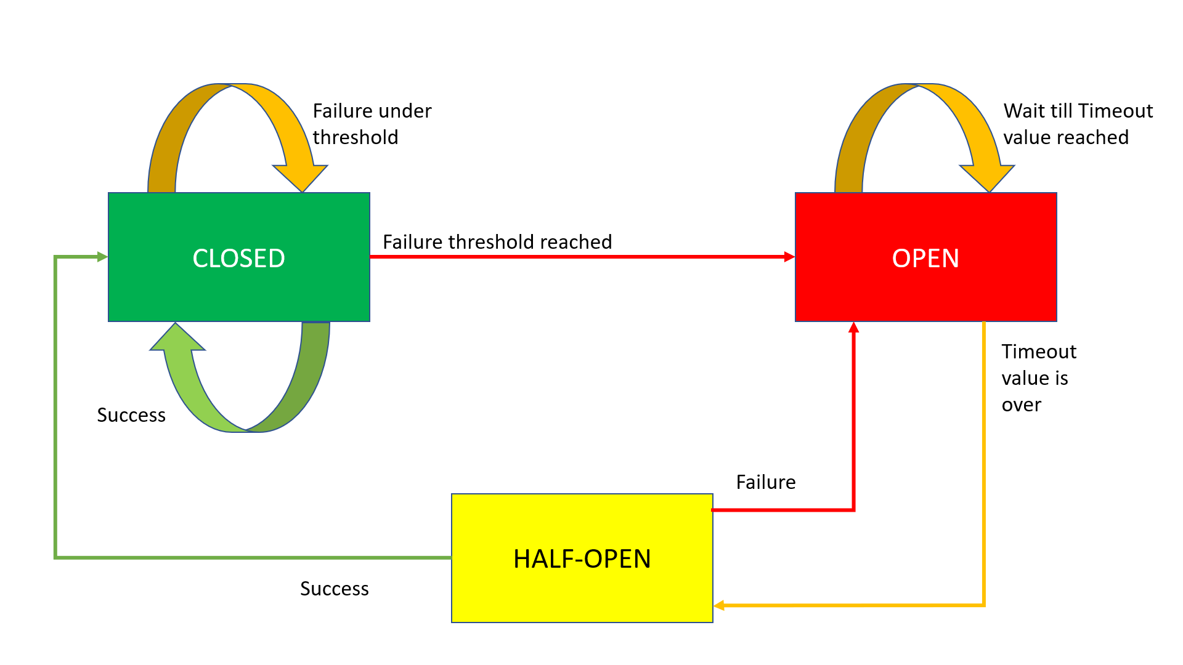
Circuit Breaker Working

Slide 10
Closed State
The Circuit Breaker enters a CLOSED state and waits for Client Requests.
In the CLOSED state, it does the following things:
  It receives Client Requests and makes a call to the Service
  If it succeeds and receives the response from that Service, it will reset the failure count to 0 and send that response back to the end user.
  If it fails to receive the response from that Service, it will increment the failure count by one and check whether that count is greater than the predefined failure threshold
  If the failure count is greater than the failure threshold, then that Circuit Breaker component trips or enters into the OPEN state
  CLOSED state means flow goes as expected,

Slide 11
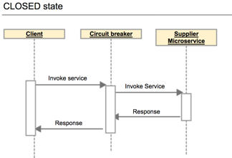
Closed State

Slide 12
OPEN state
In the OPEN state, it does the following things:
  Enters into this state when the failure count is greater than the failure threshold
  It does not make a call to the Service
  If the Client sends any requests to it, it won’t make a call to the Service; it just sends an Exception and waits for some time
  i.e. the Timeout value specified
  Once the Timeout value expires, it will enter into the HALF-OPEN state
OPEN means situation is not good and moving to fallback mode

Slide 13
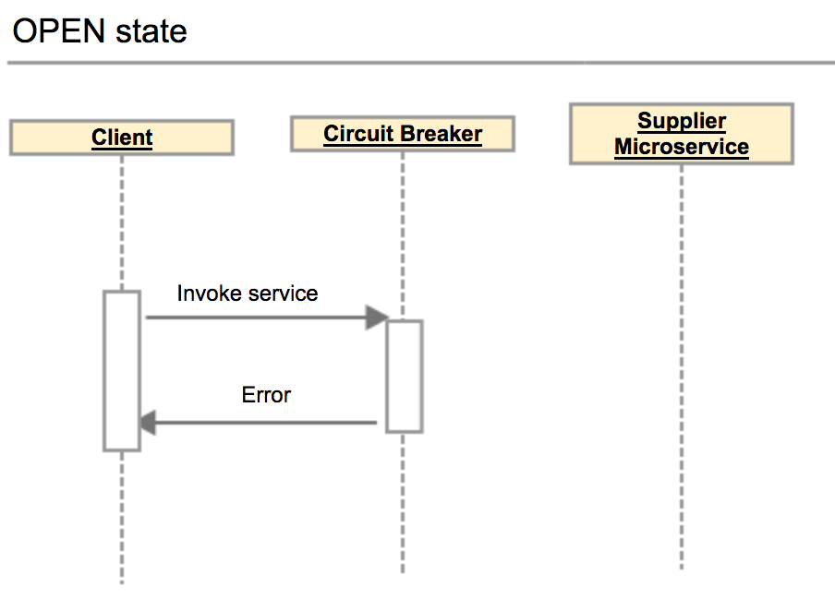
Open State

Slide 14
HALF-OPEN state
In the HALF-OPEN state, it does the following things:
  Enters into this state when it finishes the predefined waiting time.
  It sends the first request to the Service.
  If it receives a success response, then it will enter into the CLOSED state to process further Client Requests. Before picking up the first client request, it will reset the failure count to 0 again.
  If it receives a failure response, then it will re-trip to the OPEN state and wait for a predefined Timeout value to expire.

Slide 15
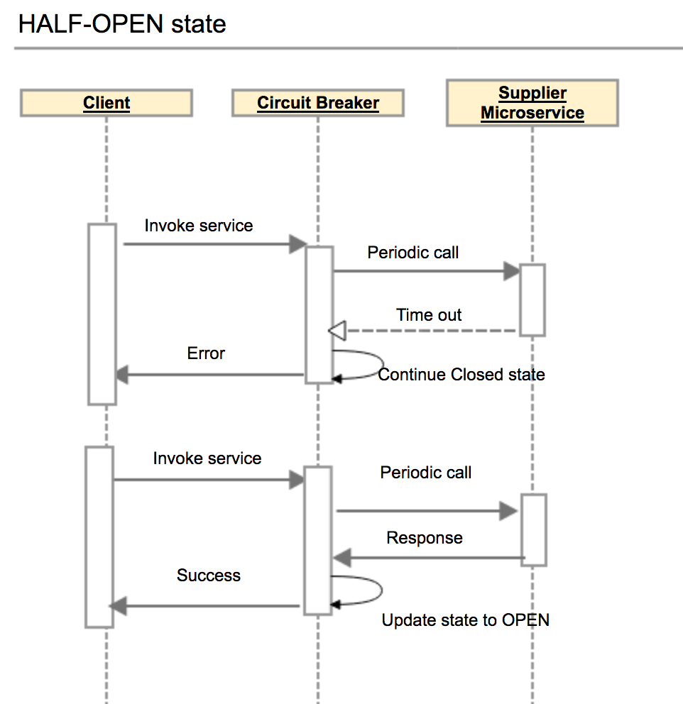
Half Open State

Slide 16
Configuring Circuit Breaker
failureRateThreshold:
  Failure threshold value of 50 which means if the 50 requests are failing in the 100 requests, keep the circuit breaker in CLOSED state.
permittedNumberOfCallsInHalfOpenState
  Default Value : 10
  Configures the number of permitted calls when the CircuitBreaker is half open.

Slide 17
Configuring Circuit Breaker
slidingWindowType : COUNT_BASED
  Used to store and count the results of calls
  Circuit breaker always keeps the total number of invoke equals to slidingWindowSize.
  COUNT_BASED:
    The last slidingWindowSize calls are recorded and aggregated.
  TIME_BASED:
    The calls of the last slidingWindowSize seconds recorded and aggregated
slidingWindowSize
  Default value is100
  Deciding the number of calls to decide when closing a circuit breaker.

Slide 18
Failure rate formula
Count based sliding window
FailureRate = numberOfFailureInvoke / totalNumber X 100%.
Total number =Number of failures invoke + number of successes invoke.
The total number of invoke never exceed the slidingWindowSize .
If the slidingWindowSize is 10 and the number of successes invoke is Nine.
If the 10th invoke is a failure invoke, then circuit breaker will decrease the number of successes invoke by one, and increases the number of failures invoke by one.
Circuit breaker always keeps the total number of invoke equals to slidingWindowSize.

Slide 19
Configuring Circuit Breaker
waitDurationInOpenState:
  The time in millisecond that breaker should wait before transitioning from open to half-open
  Default value is 60000 (1 Minute)
automaticTransitionFromOpenToHalfOpenEnabled
  True: CircuitBreaker will automatically transition from open to half-open state and no call is needed to trigger the transition.
  A thread is created to monitor all the instances of CircuitBreakers to transition them to HALF_OPEN once waitDurationInOpenState passes.
  False : the transition to HALF_OPEN only happens if a call is made, even after waitDurationInOpenState is passed.
  The advantage here is no thread monitors the state of all CircuitBreakers

Slide 20
Configuring Circuit Breaker
minimumNumberOfCalls Default :100
Used for failure rate calculation.
  If minimumNumberOfCalls is 10, then at least 10 calls must be recorded, before the failure rate can be calculated.
  If only 9 calls have been recorded the CircuitBreaker will not transition to open even if all 9 calls have failed.

Slide 21
circuitbreaker
resilience4j:
circuitbreaker:
instances:
orderService:
registerHealthIndicator: true
automaticTransitionFromOpenToHalfOpenEnabled: false
failureRateThreshold: 50
minimumNumberOfCalls: 3
permittedNumberOfCallsInHalfOpenState: 2
slidingWindowSize: 10
waitDurationInOpenState: 5s
slidingWindowType: COUNT_BASED

Slide 22
circuitbreaker
  management:
  endpoints:
  web:
  exposure:
  include:
  - "*"
  endpoint:
  health:
  show-details: always
  circuitbreakers:
  enabled: true
  health:
  circuitbreakers:
  enabled: true

Slide 23
Actuator Endpoints
  http://localhost:6565/actuator/circuitbreakerevents
  http://localhost:8080/actuator/health
  http://localhost:6565/actuator/circuitbreakers
  http://localhost:6565/actuator/metrics/resilience4j.circuitbreaker.calls

Slide 24
SPRING CLOUD GATEWAY

Slide 25
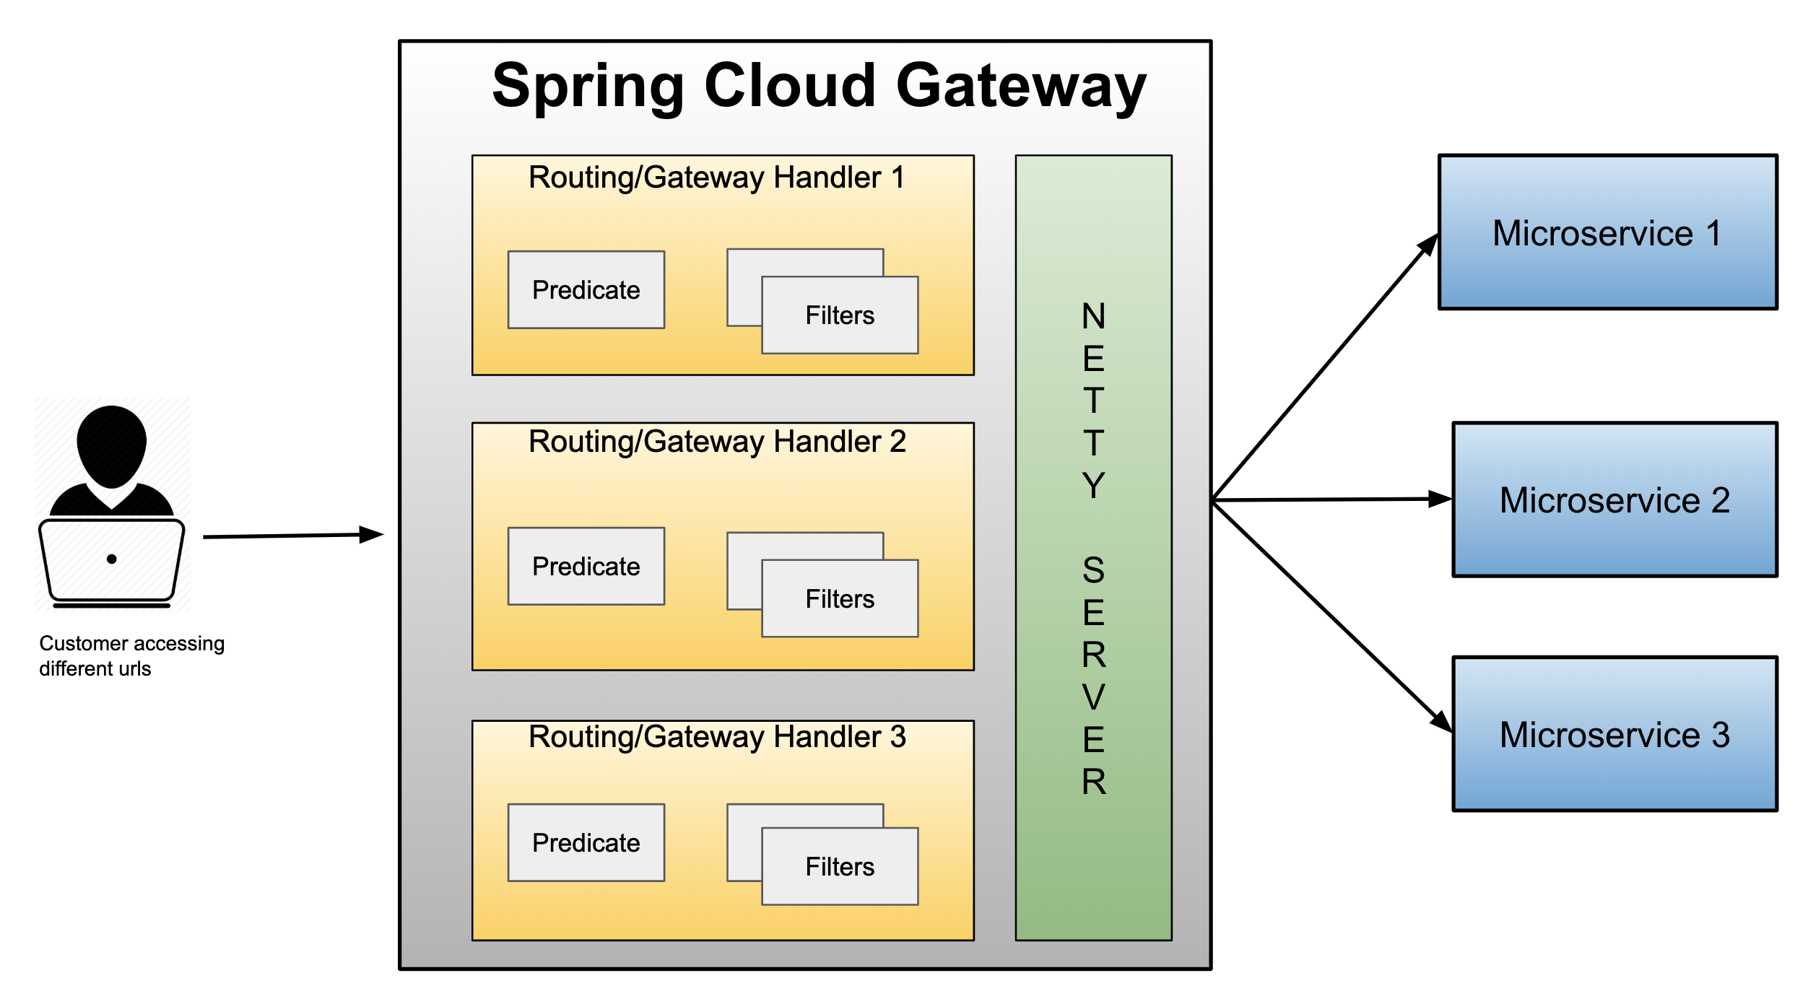
Spring cloud gateway

Slide 26
Gateway
Micro Services require a unified interface to the consumers.
  Services are split into small composable apps
  It shouldn’t be visible to users
  Should have less development effort.
Gateway handles requests to multiple backing services.
  It provides a unified “front door”
  Browser, Mobile Application or other user interface can consume services from multiple hosts
  Can mange the cross-origin resource sharing and authentication

Slide 27
Cloud Gateway
Gateway is an intermediate layer between the users and services.
  Eureka server solved the problem of giving names to services instead of hard coding their IP addresses.
It Maps between a prefix path and a service or more than one service running on different ports
Can Use Eureka server to route the requested service.
Load balances instances
Can filter requests, add authentication, etc.

Slide 28
Spring Cloud Gateway
Provides a simple and effective way to route incoming requests to the appropriate destination using Gateway Handler Mapping.
Uses Netty server to provide non-blocking asynchronous request processing.
Route configuration
Programmatically
  Using Spring RouteLocator.
Properties
  application.yml

Slide 29
Enable Discovery Locator
Can configure routes to the services registered with eureka
Can skip creating API Gateway routes manually.
  spring:
  application:
  name: api-gateway
  cloud:
  gateway:
  discovery:
  locator:
  enabled: true
  lower-case-service-id: true
To access a service with “serviceId” PRODUCT_SERVICE
  http://localhost:8080/product-service/api/v1/items

Slide 30
application.yml
  spring:
  cloud:
  gateway:
  routes:
  - id: review-module
  uri: lb://REVIEW-SERVICE
  predicates:
  - Path=/api/v1/reviews/**
  application:
  name: cloud-gateway
  Invoke the service :
  http://localhost:8080/api/v1/reviews

Slide 31
Actuator Endpoints
Base Path :
  /actuator/gateway
/actuator/gateway/routefilters
  Displays the list of global filters applied to the routes.
/actuator/gateway/routes
  Displays the list of routes defined in the gateway.
/actuator/gateway/routes/{id}
  Displays information about a particular route.

Slide 32
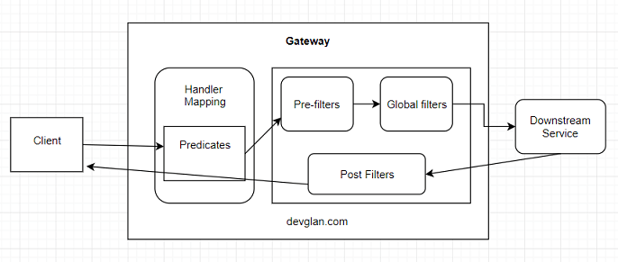
Cloud Gateway Filters

Slide 33
Global Filters
Created by implementing the Interface GlobalFilter with one Method filter()
public Mono<Void> filter(ServerWebExchange exchange, GatewayFilterChain chain)
ServerWebExchange
  Contract for an HTTP request-response interaction.
  Provides access to the HTTP request and response
  Exposes Properties for server-side processing
GatewayFilterChain
  An inteface that allows a WebFilter to delegate to the next in the chain.

Slide 34
Global Filter
  public Mono<Void> filter(ServerWebExchange exchange, GatewayFilterChain chain) {
  boolean result =
  exchange.getRequest().getURI().
  getRawPath().contains("reviews");
  if(result) {
  exchange.getResponse().setStatusCode(HttpStatus.UNAUTHORIZED);
  return exchange.getResponse().setComplete();
  }
  return chain.filter(exchange);
  }

Slide 35
Global Filter – Post Filter
@Bean
public GlobalFilter postGlobalFilter() {
return (exchange, chain) -> {
return chain.filter(exchange)
.then(Mono.fromRunnable(() -> {
log.info("Global Post Filter executed");
}));
};

Slide 36
SPRING SECURITY

Slide 37
Spring Security
Highly customizable authentication and access-control framework.
Focuses on providing both authentication and authorization
“Authentication”
  The process of establishing a user, device or some other system which can perform an action in the application
“Authorization”
  The process of deciding whether a principal is allowed to perform an action within the application.
  authorization is done after authentication process.
  Once the user is authenticated they may have one or more “roles”

Slide 38
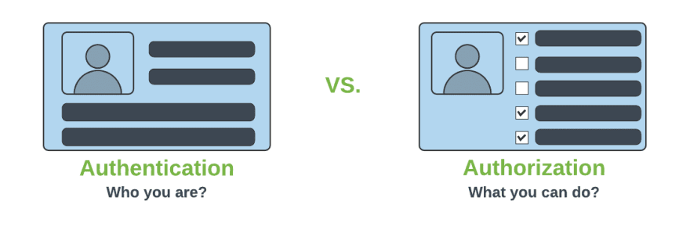
Authentication & Authorization

Slide 39
@EnableWebSecurity
Can be Added to the Class annotated with @Configuration or @SpringApplication
  Can Create a Class of of type WebSecurityConfigurerAdapter
  Spring finds bean with @Configuration and automatically apply Security

Slide 40
WebSecurityConfigurerAdapter
A base class for creating a WebSecurityConfigurer instance.
Can do customization by overriding methods
configure(HttpSecurity)
  Defines the mapping of secured URLs or path that will determine if the user can access specific pages.
configure(AuthenticationManagerBuilder).
  Defines how the security will handle the retrieval of user information commonly in the database.

Slide 41
configure(HttpSecurity)
HttpSecurity
  Provides a Method authoriseRequests()
authorizeRequests()
  To Define custom requirements for URLs
  Can add multiple children to this method.
  The matchers are considered in the order they were declared.
  http.authorizeRequests()
  .antMatchers("/","/*.html","/h2/**")
  .permitAll().

Slide 42
configure(AuthenticationManagerBuilder).
AuthenticationManagerBuilder
  Used to create an Authentication Manager
Authentication Manager
  Used to authenticate the passed Authentication object,
  Allows building in memory authentication
  Can also use LDAP authentication
  Can also use JDBC based authentication,

Slide 43
Method Level Security
Spring Security supports authorization semantics at the method level.
Service layer can be secured by which roles are able to execute a particular method – and test it using dedicated method-level security test support.

Slide 44
Method Level Security
  @Configuration
  @EnableGlobalMethodSecurity(jsr250Enabled = true)
  public class SecurityConfig extends WebSecurityConfigurerAdapter {
  protected void configure(HttpSecurity http) throws Exception {
  // required configurations
  }
  protected void configure(AuthenticationManagerBuilder auth) throws Exception {
  // required configurations
  }
  }

Slide 45
Method Security
@RolesAllowed
  is a standard annotation
  @PermitAll
  public String anonymously() {
  return "Hello, World!"; }
  @RolesAllowed({"ROLE_ADMIN"})
  public String hasRole() {
  return "Hello, World!";
  }

Slide 46
Sql Statements
  CREATE TABLE users( `username` varchar(50) NOT NULL, `password` varchar(200) NOT NULL, `enabled` tinyint(1) NOT NULL, PRIMARY KEY (`username`))
  CREATE TABLE authorities ( `username` varchar(50) NOT NULL, `authority` varchar(50) NOT NULL, KEY `fk_authorities_users` (`username`), CONSTRAINT `fk_authorities_users` FOREIGN KEY (`username`) REFERENCES `users` (`username`))

Slide 47
SQL Statements
  insert into users (username, password,enabled) values ('india','$2a$10$P.9MaemE6x38wnZer4qauO8Dl9pixQEZ27.yEQglTtyjdmJBRtTFS',true);
  insert into authorities (username, authority) values ('india', 'ROLE_USER');
  insert into test.users (username, password, enabled) values ('nepal','$2a10$t4kkrerTgJlcvTj7QresWuBqAsnxVxMxaJ6UzlXCaP/HSdDraO5QC',true);
  insert into authorities (username, authority) values ('nepal', 'ROLE_ADMIN');

Slide 48
Application.properties
  spring.datasource.url=jdbc:mysql://localhost:3306/test
  spring.datasource.username=root
  spring.datasource.password=srivatsan
  spring.datasource.driver-class-name=com.mysql.cj.jdbc.Driver

Slide 49
Pass Word Encoder
  public static void main(String[] args) {
  BCryptPasswordEncoder encoder = new BCryptPasswordEncoder();
  String encoded = encoder.encode("india");
  System.out.println(encoded);
  encoded = encoder.encode("nepal");
  System.out.println(encoded);
  }

Slide 50
Security Config
  @Configuration
  public class SecurityConfiguration extends WebSecurityConfigurerAdapter {
  @Autowired
  private DataSource dataSource;
  @Bean
  public BCryptPasswordEncoder encoder() {
  return new BCryptPasswordEncoder();
  }

Slide 51
Security Config
  @Override
  public void configure(AuthenticationManagerBuilder auth) throws Exception{
  auth.jdbcAuthentication()
  .dataSource(dataSource)
  .usersByUsernameQuery(
  "SELECT username, password, enabled from users where username = ?")
  .authoritiesByUsernameQuery(
  "SELECT u.username, a.authority " +
  "FROM authorities a, users u " +
  "WHERE u.username = ? " +
  "AND u.username = a.username"
  )
  .passwordEncoder(new BCryptPasswordEncoder());
  }

Slide 52
Security Configuration
  @Override
  protected void configure(HttpSecurity http) throws Exception {
  http.authorizeRequests()
  .antMatchers("/api/v1/hospital/**")
  .authenticated().and().httpBasic().and().csrf().disable();
  }

Slide 53
CSRF
  Its a web security vulnerability that allows an attacker to induce users to perform actions that they do not intend to perform.
  It allows an attacker to partly circumvent the same origin policy, which is designed to prevent different websites from interfering with each other.
Should be used for protecting any request that could be processed by a browser by normal users.
If a service is used by non-browser clients, CSRF protection can be disabled

Slide 54
Basic Authentication With WebClient
  @Autowired
  WebClient client;
  @GetMapping(path = "/client")
  public Flux<String> getOrders(){
  return client.get().uri("http://localhost:8080/orders/pending")
  .headers(headers -> headers.setBasicAuth("chennai","chennai"))
  .retrieve()
  .onStatus(HttpStatus::is5xxServerError, clientResponse ->
  Mono.error(new RuntimeException()))
  .bodyToFlux(String.class);
  }

Slide 55
Rest Controller Advice
  @ExceptionHandler(
  value =WebClientResponseException.class)
  public ResponseEntity<String> handleWebClientResponseException(
  WebClientResponseException ex) {
  return ResponseEntity.status(ex.getRawStatusCode())
  .body(ex.getResponseBodyAsString());
  }

Slide 56
SECURITY OAUTH2

Slide 57
OAuth
OAuth is a secure authorization protocol
  Provides authorization flows for web ,desktop and mobile applications.
  Used for authorization of third party application to access the user data without exposing their password.

Slide 58
OAuth2 Roles
Client
  A Third-Party Application
  An application making protected resource requests on behalf of the Resource Owner and with its authorization
Resource Server
  Component that manages users resources.
  It requires a valid access token.
  Client uses the access token to call resources in this server
  Token is added to the HTTP request headers.

Slide 59
OAuth2 Roles
The Authorization Server
  The server that presents the interface where the user approves or denies the request.
  May be the same server as the API server, can also be a separate component.
Resource Owner
  Is the User
  Person who is giving access to some portion of their account.

Slide 60
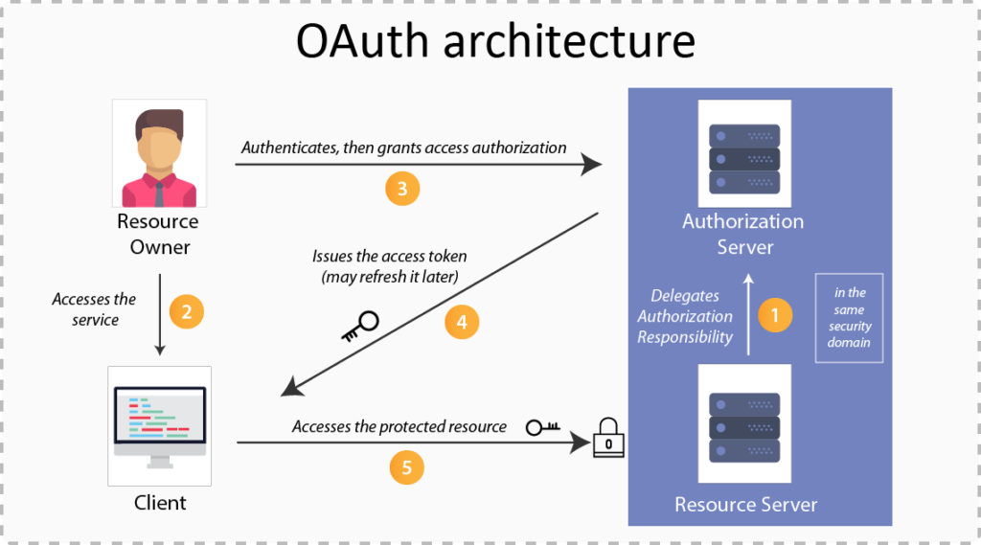

Slide 61
OAuth2 Grant Types
There are Different grant type flows to perform authorizations tasks.
Authorization Code
  Used by confidential and public clients to exchange an authorization code for an access token.
  After the user returns to the client via the redirect URL,
  Application will get the authorization code from the URL
  Use it to request an access token.

Slide 62
OAuth2 Grant Types
Client Credentials
  Used when applications request an access token to access their own resources, not on behalf of a user.
  Refresh Token
  Device Code
    Used in browserless or input-constrained devices
    Previously obtained device code is exchanged for an access token

Slide 63
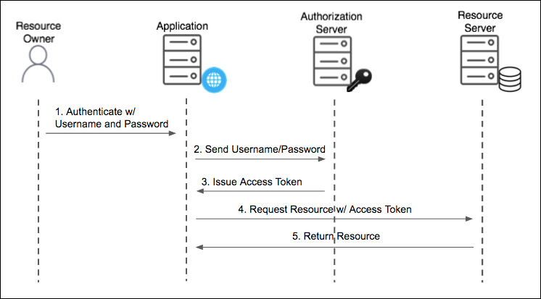
Resource Owner Password Grant Type
Used For Native Mobile and Desktop apps
  Used for highly trusted apps where resource owners share their credentials directly with the app.

Slide 64
Password Grant
Simplest OAuth grants
The application presents a traditional username and password login form to collect the user’s credentials
  Makes a POST request with users' credentials to the server
  Obtains an access token.
The Post request has following parameters
  Grant-type
  userName
  Password
  Client Id
  Client Secret
  Scope

Slide 65
Password Grant Request Parameters
grant_type=password
  To denote the usage of Password grant type
Username
  The user’s username that they entered in the application
Password
  The user’s password that they entered in the application
client_id
  Public identifier of the application that the developer obtained during registration
client_secret (optional)
  If the application is a “confidential client” (not a mobile or JavaScript app), then the secret is included as well.
scope (optional)
  If the application is requesting a token with limited scope

Slide 66
OAuth2 Tokens
Tokens are implementation specific random strings, generated by the authorization server.
Access Token
  Sent with each request, usually valid for about an hour only.
Refresh Token
  It is used to get new access token, not sent with each request, usually lives longer than access token.
  Allows clients to continue to have a valid access token without further interaction with the user.

Slide 67
Access Token
Access token in the same format for all grant types.
  {
  "access_token": "MTQ0NjOkZmQ5OTM5NDE9ZTZjNGZmZjI3",
  "token_type": "bearer",
  "expires_in": 3600,
  "scope": "create"
  }

Slide 68
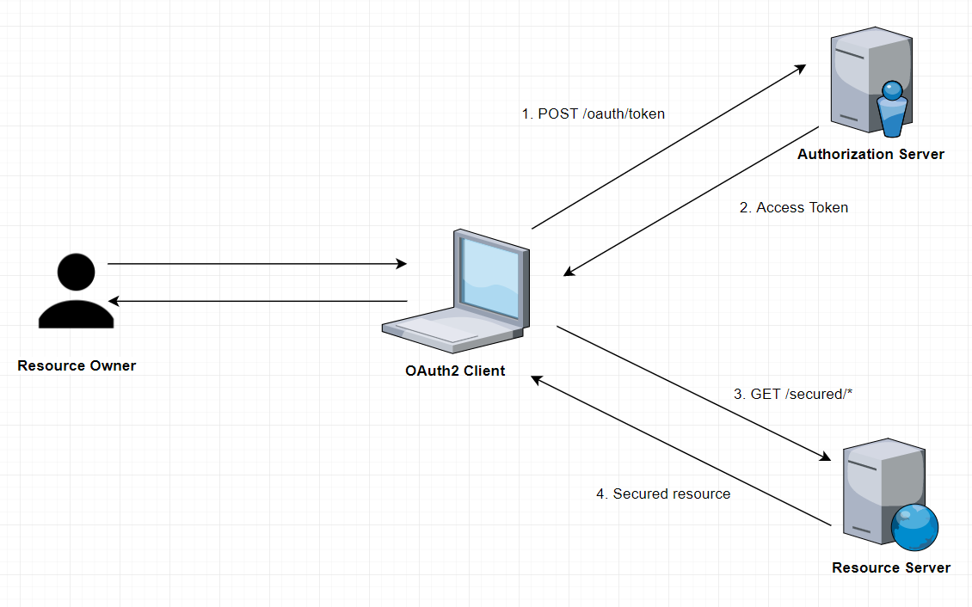
How it Works

Slide 69
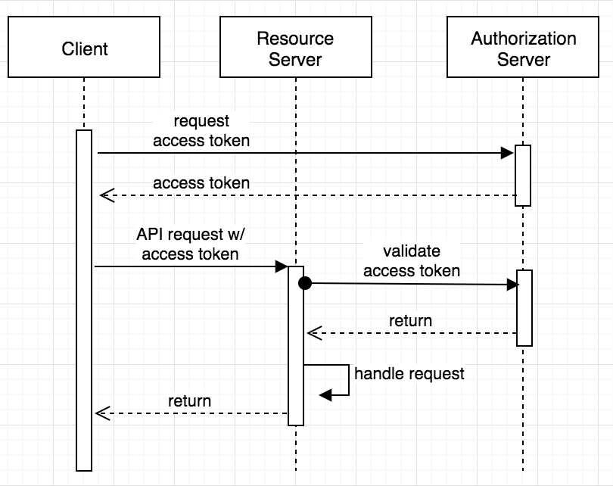
Sequence Diagram

Slide 70
Pom.xml
  <dependency>
    <groupId>org.springframework.cloud</groupId>
    <artifactId>spring-cloud-starter-oauth2</artifactId>
    <version>2.2.5.RELEASE</version>
  </dependency>
  <dependency>
    <groupId>org.springframework.cloud</groupId>
    <artifactId>spring-cloud-starter</artifactId>
  </dependency>

Slide 71
Authentication
AuthenticationManager
  An interface with authenticate() method
Authenticate method does one of the following :
  Return an Authentication with authenticated=true if valid principal.
  Throw an AuthenticationException if there is a invalid principal.
  Return null if it cannot decide.
AuthenticationManagerBuilder
  A helpers to set up authentication
  Can be configured to work with in-memory, JDBC, or LDAP

Slide 72
Endpoints
/oauth/authorize
  The user is responsible for securing the Authorization Endpoint
  Spring Security features are used for this
/oauth/token
  The Token Endpoint will be automatically secured using HTTP Basic authentication on the client's credentials.

Slide 73
Authorization Server
@EnableAuthorizationServer
  Used for enabling an Authorization Server
AuthorizationServerConfigurerAdapter
  Adapter class for AuthorizationServerEndpointsConfigurer
  Configure the properties and enhanced functionality of the Authorization Server endpoints
  @Configuration
  @EnableAuthorizationServer
  public class AuthServerConfiguration extends
  AuthorizationServerConfigurerAdapter {
  }

Slide 74
Checking Tokens
Spring Security OAuth exposes two endpoints for checking tokens
  These are not exposed by default- they are "denyAll()".
/oauth/check_token
/oauth/token_key
To Verify the tokens with this endpoint they are exposed with condition.
  security.tokenKeyAccess("isAuthenticated()")
  .checkTokenAccess("isAuthenticated()"

Slide 75
ClientDetailsServiceConfigurer
.withClient(“client”)
  consumes client_id from request body
.authorizedGrantTypes(grant_types)
  Sets specific grant types
scopes(“read”)
secret(yourClientSecret)
  clients.inMemory().withClient("myclient")
  .authorizedGrantTypes("password")
  .secret(encoder().encode("pass123"))
  .scopes("read","write")
  .redirectUris("http://localhost:4046/flower/login/oauth2/code/myclient");

Slide 76
Redirect URI
The path in the application that the end-user's user-agent is redirected back to after they have authenticated
  location where the authorization server sends the user once the app has been successfully authorized
The default redirect URI template is
{baseUrl}/login/oauth2/code/{registrationId}.
  The registrationId is a unique identifier for the ClientRegistration.

Slide 77
AuthorizationServer
  @Configuration
  @EnableAuthorizationServer
  public class AuthorizationConfig extends
  AuthorizationServerConfigurerAdapter {
  @Autowired
  AuthenticationManager manager;
  @Autowired
  BCryptPasswordEncoder encoder;

Slide 78
AuthorizationServer
  @Override
  public void configure(ClientDetailsServiceConfigurer clients) throws Exception {
  clients.inMemory().withClient("myclient")
  .authorizedGrantTypes("password")
  .scopes("read","write").secret(encoder.encode("pass123"))
  .accessTokenValiditySeconds(3000)
  .refreshTokenValiditySeconds(6000);
  }

Slide 79
Authorization Server
  @Override
  public void configure(AuthorizationServerEndpointsConfigurer endpoints) throws Exception {
  endpoints.authenticationManager(manager);
  }
  @Override
  public void configure(AuthorizationServerSecurityConfigurer security) throws Exception {
  security.checkTokenAccess("permitAll()");
  }
}

Slide 80
WebSecurityConfigurerAdapter
  @Configuration
  public class SecurityConfig extends
  WebSecurityConfigurerAdapter {
  @Autowired
  BCryptPasswordEncoder encoder;

Slide 81
WebSecurityConfigurerAdapter
  @Override
  protected void configure(AuthenticationManagerBuilder builder) throws Exception {
  builder.inMemoryAuthentication().withUser("india")
  .password(encoder.encode("india")).roles("ADMIN")
  .and().withUser("nepal").password(encoder.encode("nepal")).roles("USER");
  }

Slide 82
WebSecurityConfigurerAdapter
    @Override
    protected void configure(HttpSecurity http) throws Exception {
    http.anonymous().disable().csrf().disable()
    .authorizeRequests()
    .antMatchers("/oauth/token").permitAll();
    }

Slide 83
WebSecurityConfigurerAdapter
  @Override
  @Bean
  public AuthenticationManager authenticationManagerBean() throws Exception {
  return super.authenticationManagerBean();
  }
  @Bean
  public BCryptPasswordEncoder encoder() {
  return new BCryptPasswordEncoder();
  }
  }

Slide 84
@EnableResourceServer
Enables application to behave as a Resource Server by configuring an OAuth2AuthenticationProcessingFilter and required components.
The annotation creates a WebSecurityConfigurerAdapter with predefined configuration and order 3, it also takes care of the following
    Access rules
    Paths that are protected by OAuth2 security.
It enables a Spring Security filter that authenticates requests via an incoming OAuth2 token

Slide 85
@EnableResourceServer
  @SpringBootApplication
  @EnableResourceServer
  public class Oauth2ResourceServerApplication {
  public static void main(String[] args) {
  SpringApplication.run(Oauth2ResourceServerApplication.class, args);
  }
  }

Slide 86
Rest Controller
  @RestController
  public class PaymentController {
  @Autowired
  Payment payment;
  @GetMapping("/api/payments/{id}")
  public Payment getPayment(@PathVariable("id") int id) {
  payment.setId(id);
  payment.setAmount(4500);
  payment.setCustomerName("Ramesh");
  return payment;
  }
  }

Slide 87
application.yml
  server:
  port: 9090
  security:
  oauth2:
  resource:
  token-info-uri: http://localhost:4040/oauth/check_token
  client:
  client-id: myclient
  client-secret: pass123

Slide 88
Testing with Postman
Make a post call to the url http://localhost:4046/oauth/token
Select Authorization , and basic authentication
  Add the UserName : myclient
  Add the password : pass123
Select Body form-url-endcoded and key and values ,
  grant_type : password
  Username : india
  Password : india
Will get the Token

Slide 89
Testing with Postman
  Access resource using uri
    Select params tab and add access_token as a parameter
  http://localhost:4040/api/customers/customer/1?access_token=37ec591b-bae9-46ac-8e5a-573e82cb0630
  http://localhost:4040/oauth/check_token?token=29619709-963d-409f-9d0b-917587b3224a

Slide 90
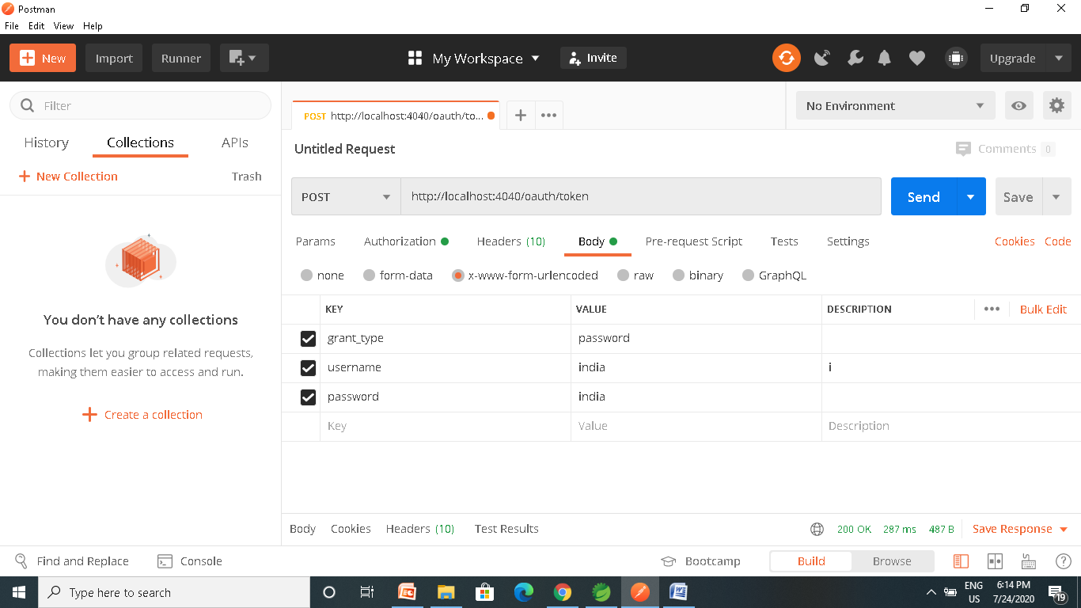
Testing with Postman

Slide 91
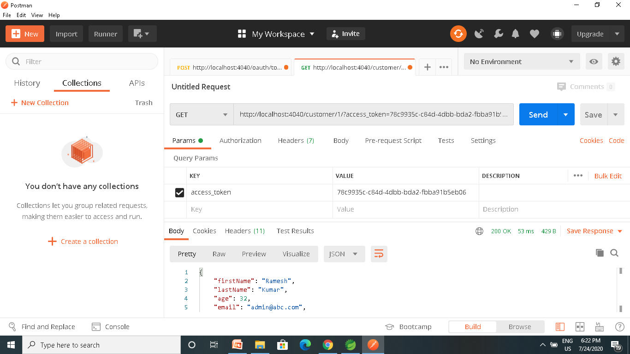

Slide 92
Password Grant Type
Requires that the application collect the user’s password.
  OAuth was created to avoid .
Can be Used for service’s own application to ask the user to enter their password.
It lets the application take advantage OAuth provides around access tokens and token lifetimes.
Instead of storing the user’s password on the device, the application only has to touch the user’s password for as long as it takes to get the access token, then it can store and use the access token instead.

Slide 93
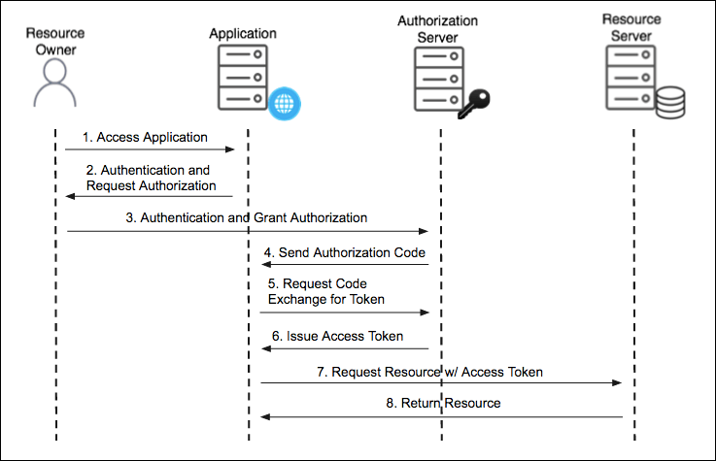
Authorization Code Grant Type

Slide 94
Authorization Code Grant Type
Used by confidential and public clients to exchange an authorization code for an access token.
  After the user returns to the client via the redirect URL, the application will get the authorization code from the URL and use it to request an access token.
The GitHub API uses the OAuth Authorization Code grant type
It needs five piece of information
Client ID
Client Secret
Callback URL
Authorization URL
Access Token URL: :

Slide 95
Authorization Code Grant Type
Social logins using Oauth2 have become an industry standard.
Facebook, LinkedIn and Github are OAuth2 login providers
It has revolutionized the way sites share data
Users can quickly access new applications without having to create a new set of credentials.

Slide 96
Authorization Code Grant Type
Authorization Server
  Client Application can use the authorization code grant to obtain an access token from GitHub
Resource Server
  It uses the access token to ask GitHub for permitted personal details like login ID and name.
  It Decodes the token checking if it gives the app permission to access the user’s details.
  Inserts the user details into the Spring Security context

Slide 97
Using Git Hub
Navigate to https://github.com/settings/developers
create a New OAuth app under the OAuth Apps left menu.
Fill in the Authorization callback URL field to include the redirect URI to your app: http://<your-domain>/login/oauth2/code/github
Click on Register Application
Copy the client ID and client secret to be used Later

Slide 98
OAuth2 Client
  <dependency>
  <groupId>org.springframework.boot</groupId>
  <artifactId>spring-boot-starter-oauth2-client</artifactId>
  <version>2.3.3.RELEASE</version>
  </dependency>

Slide 99
Controller
  @RestController
  public class AppController {
  @GetMapping("/")
  public String home() {
  return "home";
  }
  @GetMapping("/secured")
  public String classified() {
  return "Secured Resource";
  }
  }

Slide 100
Security Config
oauth2Login()
  similar to httpBasic() and formLogin()
  Will be used to display an auto-generated login page for login provider
  public class SecurityConfig extends WebSecurityConfigurerAdapter {
  protected void configure(HttpSecurity http) throws Exception {
  http.authorizeRequests()
  antMatchers("/secured").authenticated().anyRequest()
  .authenticated().and().oauth2Login();
  }
  }

Slide 101
Security Configuration
Client credentials to the application.properties file.
  Properties are prefixed with
    spring.security.oauth2.client.registration
  This is followed by the client name
    spring.security.oauth2.client.registration.github
  The name of the client property follows next
spring.security.oauth2.client.registration.github.client-id=c1c7fb187a46dea59fbe
spring.security.oauth2.client.registration.github.client-secret=53f1d9de1d00d4f00e9ab6bc276e5166c492f45c

Slide 102
SELF STUDY NOTES

Slide 103
Item Controller
  @RestController
  public class ItemController {
  @GetMapping(path = "/item")
  public String getItem() {
  return new String("{'id':101,'name':'tv')");
  }
  }

Slide 104
Circuit Breaker
  @RestController
  public class OrderController {
  private static final String ORDER_SERVICE = "orderService";
  @Autowired
  private RestTemplate restTemplate;
  @Bean
  public RestTemplate getRestTemplate() {
  return new RestTemplate();
  }

Slide 105
Circuit Breaker
  @GetMapping("/order")
  @ResponseStatus(HttpStatus.OK)
  @CircuitBreaker(name=ORDER_SERVICE, fallbackMethod = "orderFallback")
  public ResponseEntity<String> createOrder(){
  String response = restTemplate.getForObject("http://localhost:8081/item", String.class);
  return new ResponseEntity<String>(response, HttpStatus.OK);
  }
  public ResponseEntity<String> orderFallback(Exception e){
  return new ResponseEntity<String>("Item service is down", HttpStatus.OK);
  }
  }

Slide 106
Ordering the Filter
Can Use the Ordered interface to control the multiple filters Order of execution
Can give low value for High precedence by overriding getOrder() Method
  The filter with order as Integer.MIN_VALUE will be executed first in the pre-filter phase and last in post-filter phase .
  Filter with order as Integer.MAX_VALUE will be executed first in the post-filter phase and execute last in the pre-filter phase.

Slide 107
Ordering Filters
  @Component
  public class PreFilter implements GlobalFilter, Ordered {
  @Override
  public int getOrder() {
  return -1;
  }
  }

Slide 108
Gateway Routing
Has Three Main parts
Route:
  The Destination of a particular request.
  It will have destination URI
  It has a condition to be satisfied
  It has one or more filters.
Predicate
  A condition to match like an “if” condition.
  Java 8 Function Predicate
Filter:
  Instances of Spring Framework WebFilter.
  Can modify request or response.
  Spring Provides many WebFilters

Slide 109
Route Locator Builder
Gateway configuration can also be done using java route api
RouteLocatorBuilder
  Used to configure related routing information
  To add predicates and filters
  Provides a Static Method Builder()
    Builder() method is used to construct routes and return a RouteLocator

Slide 110
RouteLocator
RouteLocator
  public interface RouteLocator {
  Flux<Route> getRoutes();
  }
  @Bean
  public RouteLocator gatewayRoutes(RouteLocatorBuilder builder) {
  }

Slide 111
Routing Object
Route
  Defines the routes information such as route assertions, filters, routing addresses, and route priorities.
  When the request arrives, it is processed by the Gateway filter
    And then its forwarded to the proxy service.
  public class Route implements Ordered {
  private final String id;
  private final URI uri;
  private final int order;
  private final AsyncPredicate<ServerWebExchange> predicate;
  private final List<GatewayFilter> gatewayFilters;
  }

Slide 112
Configuring Route Locator
  @Configuration
  public class MyRouteConfig {
  @Bean
  public RouteLocator gatewayRoutes(RouteLocatorBuilder builder) {
return builder.routes()
.route(p -> p.path("/api/v1/reviews/**")
.filters(f -> f.addResponseHeader("Hello", "World"))
.uri("lb://REVIEW-SERVICE") )
.route(p -> p.path("/api/v1/choices/**")
.uri("http://localhost:7575/"))
.build();
  }
  }

Slide 113
Gateway Filter
  @Component
  public class LoggingFilter implements GatewayFilter {
  @Override
  public Mono<Void> filter(ServerWebExchange exchange, GatewayFilterChain chain) {
  ServerHttpRequest request = exchange.getRequest();
  Log.info(request.getPath().toString());
  return chain.filter(exchange);}
  }

Slide 114
Filters With Java Configuration
  @Bean
  public RouteLocator gatewayRoutes(RouteLocatorBuilder builder,LoggingFilter logger) {
  return builder.routes()
  .route(p -> p.path("/api/v1/restaurants/**")
  .filters(f -> f.filter(logger, 0))
  .uri("lb://RESTAURANT-INFO-SERVICE") )
  .route(p -> p.path("/accounts/**")
  .uri("lb://ACCOUNT-SERVICE"))
  .build();
  }

Slide 115
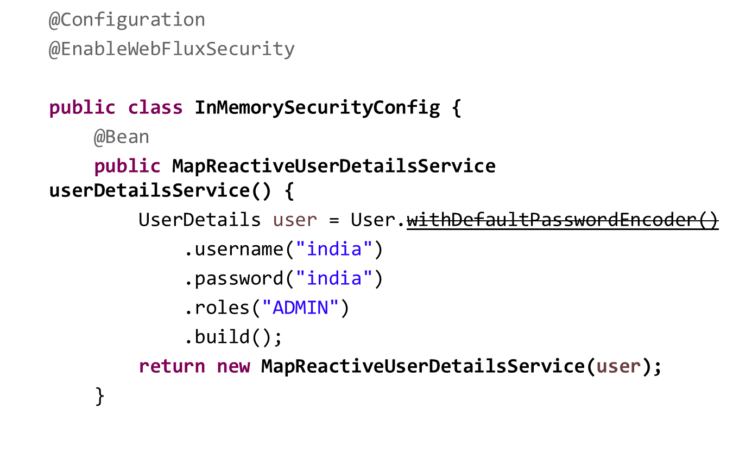
Reactive Security

Slide 116
Reactive Security
  @Bean
  public SecurityWebFilterChain springSecurityFilterChain(ServerHttpSecurity http) {
  http
  .authorizeExchange()
  .anyExchange().authenticated()
  .and()
  .httpBasic();
  return http.build();
  }
  }

Slide 117
Global Filter
  @Component
  public class CustomAuthenticationGlobalFilter implements GlobalFilter {
  public Mono<Void> filter(ServerWebExchange exchange, GatewayFilterChain chain) {
  List<String> authorization = exchange.getRequest().getHeaders().get("Authorization");
  ServerHttpRequest modifiedRequest = exchange.getRequest().mutate().
  header("Authorization", authorization.get(0)).build();
  return chain.filter(exchange.mutate().request(modifiedRequest).build());
  }
  }

Slide 118
Gate Way Filter
GatewayFilter
  Created by extending the abstract class AbstractGatewayFilterFactory
  Using Builder Object can process the request
Pre filter
  Created by processing the request Object before calling chain.filter
Post Filter
  Created by processing the response in while returning chain.filter

Slide 119
Pre Filter
  @Component
  public class MyBasicPreFilter extends AbstractGatewayFilterFactory<MyBasicPreFilter.Config> {
  public static class Config {
  }
  public MyBasicPreFilter() {
  super(Config.class);
  }

Slide 120
PRE Filter
    @Override
    public GatewayFilter apply(Config config) {
    return (exchange, chain) -> {
    ServerHttpRequest request = exchange.getRequest();
    URI requestUrl = exchange.getRequiredAttribute(ServerWebExchangeUtils.GATEWAY_REQUEST_URL_ATTR);
    System.out.println("PRE FILTER =:"+request);
    System.out.println("PRE Filter =:"+ requestUrl);
    return chain.filter(exchange.mutate().build());
    };
    }
    }

Slide 121
Post Filter
  public class MyBasicPostFilter extends AbstractGatewayFilterFactory<MyBasicPostFilter.Config> {
  public static class Config {
  }
  }
  public MyBasicPostFilter() {
  super(Config.class);
  }

Slide 122
Post Filter
  @Override
  public GatewayFilter apply(Config config) {
  return (exchange, chain) -> {
  return chain.filter(exchange)
  .then(Mono.fromRunnable(() -> {
  System.out.println("Post Filter executed");
  }));
  };
  }
  }

Slide 123
Configure Filters
spring:
application:
name: api-gateway
cloud:
gateway:
discovery:
locator:
enabled: true
lower-case-service-id: true
default-filters:
- name: MyBasicPreFilter
- name : MyBasicPostFilter

