Slide 1
SPRING ACTUATOR

Slide 2
Spring Boot Actuator
Exposes REST endpoints that can be consumed to manage and monitor application.
Monitor application health, application bean details, version details, thread dumps, logger details etc
Can restrict these endpoints to be consumed by authorized users only and Spring provides easy way to secure your REST endpoints.

Slide 3
actuator End Point
actuator
  It provides a hypermedia-based discovery page for the other endpoints.
  By default it is sensitive and hence requires username/password for access or may be disabled if web security is not enabled.
Beans
  It displays complete beans configured in the app.
Configprops
  It displays a collated list of all @ConfigurationProperties.

Slide 4
actuator End Point
Health
    It shows application health information
  management.endpoint.health.show-details:=always
Info
  It displays arbitrary application info.
Loggers
  It shows and modifies the configuration of loggers in the application.
metrics:
  It shows metrics information for the current application.
Mappings
  It displays a collated list of all @RequestMapping paths.

Slide 5
Actuator Endpoints
health and info can be accessed
  Other endpoints are disabled by default
management.endpoints.web.exposure.include=*.
  Will enable all of them
  Can also list endpoints which should be enabled
To expose all enabled endpoints except one (for example /loggers), we use:
  management.endpoints.web.exposure.include=*
  management.endpoints.web.exposure.exclude=loggers
  management.security.enabled=false

Slide 6
Info and Health Endpoint
Reads the Information from the pom.xml
  info:
  build:
  artificatId: '@project.artifact@'
  groupId: '@project.groupId@'
  version: '@project.version@'
  java:
  version:@java.version@
  management:
  endpoint:
  health:
  show-details: always

Slide 7
Logger Endpoint
http://localhost:8787/actuator/metrics
http://localhost:8787/actuator/loggers
To Change the Log level make a post request
  http://localhost:8787/actuator/loggers/org.springframework.boot.SpringApplication
  { "configuredLevel": "trace“ }
To reset the logging level back to the original value
  { "configuredLevel": null }

Slide 8
Shut Down End Point
Endpoint is used to shut down the Spring Boot application
Need to enable by adding a property in the application.yml
Done By Making a POST call.
  http://localhost:7070/actuator/shutdown
  management:
  endpoint:
  shutdown:
  enabled: true

Slide 9
Extending Info End Point
  @Component
  public class CustomInfoEndPoint implements InfoContributor {
  @Autowired
  private ConfigurableApplicationContext ctx;
  @Override
  public void contribute(Info.Builder builder) {
  Map<String, Object> details = new HashMap<>();
  details.put("bean-definition-count", ctx.getBeanDefinitionCount());
  details.put("startup-date", ctx.getStartupDate());
  builder.withDetail("context", details);
  }
  }

Slide 10
Custom End Points
Created by Adding one of the following annotations
  @EndPoint
  @WebEndPoint
  @JmxEndPoint
Can Add Methods for Read ,Write and Delete Operations with following annotations
  @ReadOperation
  @WriteOperation
  @DeleteOperation

Slide 11
Custom End Points
  @Component
  @WebEndpoint(id="notes")
  public class ReleaseNoteEndPoint {
  String version10 = new StringBuffer().append("Version 10.0 ").append("\n").append("Add Tour Agent Added").toString();
  @ReadOperation
  public String releaseInfo() {
  return version10;
  }

Slide 12
Custom End Points
  @WriteOperation
  public String addToReleaseInfo(String message) {
  this.version10 = this.version10+"\n"+ message;
  return this.version10;
  }
  }
  By Calling the Post Method with
  http://localhost:6060/actuator/notes
  Need to add Json data to the body request as raw-json

Slide 13
Custom End Point
  Can be created to Use Both Query Parameter and Path Variable
  To create path varable need to annotate each method parameter with @Selector.
  @ReadOperation
  public String helloNameSelector(@Selector String name) {
  return "Hello " + name;
  }
  http://localhost:8080/actuator/helloworld/ramesh'
  To create Query Parameters just pass the argument without any annotation.
  @ReadOperation
  public String helloNameSelector(String name) {
  return "Hello " + name;
  }
  http://localhost:8080/actuator/helloworld?name=Alex'

Slide 14
Auditing Event End Point
Need To register the AuditEventRepository Bean
  Provides information about the application’s audit events.
Accessed with a GET request to /actuator/auditevents
Can also access the details of a particular principal
  http://localhost:6060/actuator/auditevents?principal=nepal
  @Bean
  public AuditEventRepository repo() {
  return new InMemoryAuditEventRepository();
  }

Slide 15
Auditing Event End Point
Enabled with the following entries in application.yml
  management:
  endpoints:
  web:
  exposure:
  include:
  - "*"

Slide 16
ADMINISTRATION SERVER

Slide 17
Spring Boot Administration- Server
Monitoring application by using Actuator Endpoint is slightly difficult.
  Every application has separate actuator endpoints,
  Need to thus making monitoring difficult.
Spring Boot Admin Server
  Used to manage and monitor Microservice application.
  Provides a UI to manage and monitor Actuator endpoints at one place.
Spring Boot Admin Client
  Need to add the Spring Boot Admin starter client dependency
  Applications should have a property to point out the Admin Server URI

Slide 18
@EnableAdminServer
@EnableAdminServer
  Added to the main Spring Boot application class file.
  Make the application as Admin Server to monitor all other microservices.
server:
port: 9494
spring:
application:
name: payment-service
boot:
admin:
client:
url:
- http://localhost:9494

Slide 19
SPRING SECURITY

Slide 20
Spring Security
Highly customizable authentication and access-control framework.
Focuses on providing both authentication and authorization
“Authentication”
  The process of establishing a user, device or some other system which can perform an action in the application
“Authorization”
  The process of deciding whether a principal is allowed to perform an action within the application.
  authorization is done after authentication process.
  Once the user is authenticated they may have one or more “roles”

Slide 21
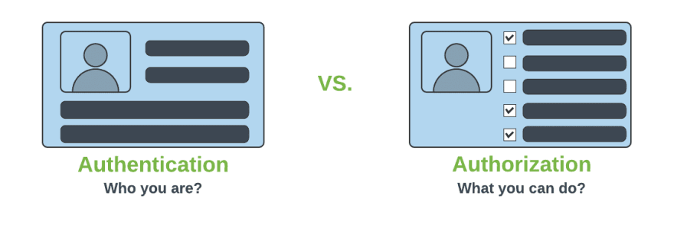
Authentication & Authorization

Slide 22
@EnableWebSecurity
Can be Added to the Class annotated with @Configuration or @SpringApplication
  Can Create a Class of of type WebSecurityConfigurerAdapter
  Spring finds bean with @Configuration and automatically apply Security

Slide 23
Spring Security Modules
  <dependency>
    <groupId>org.springframework.boot</groupId>
    <artifactId>spring-boot-starter-security</artifactId>
  </dependency>
  <dependency>
    <groupId>org.springframework.security</groupId>
    <artifactId>spring-security-test</artifactId>
    <scope>test</scope>
  </dependency>

Slide 24
WebSecurityConfigurerAdapter
A base class for creating a WebSecurityConfigurer instance.
Can do customization by overriding methods
configure(HttpSecurity)
  Defines the mapping of secured URLs or path that will determine if the user can access specific pages.
configure(AuthenticationManagerBuilder).
  Defines how the security will handle the retrieval of user information commonly in the database.

Slide 25
configure(HttpSecurity)
HttpSecurity
  Provides a Method authoriseRequests()
authorizeRequests()
  To Define custom requirements for URLs
  Can add multiple children to this method.
  The matchers are considered in the order they were declared.
  http.authorizeRequests()
  .anyRequest().authenticated()
  .and().httpBasic();

Slide 26
configure(AuthenticationManagerBuilder).
AuthenticationManagerBuilder
  Used to create an Authentication Manager
Authentication Manager
  Used to authenticate the passed Authentication object,
  Allows building in memory authentication
  Can also use LDAP authentication
  Can also use JDBC based authentication,

Slide 27
Form Login
  @Configuration
  public class SecurityConfig extends WebSecurityConfigurerAdapter {
  @Override
  protected void configure(HttpSecurity http) throws Exception {
  http.authorizeRequests().antMatchers("/first").authenticated().and().formLogin();
  }
  @Override
  protected void configure(AuthenticationManagerBuilder auth) throws Exception {
  auth.inMemoryAuthentication().withUser("ramesh").password("{noop}ramesh").roles("USER");
  }

Slide 28
Controller
  @RestController
  public class ProjectController {
  @GetMapping("/first")
  public String getSecuredMessage(Principal user) {
  return "Welcome to Secured Page"+user.getName();
  }
  @GetMapping("/second")
  public String getUnSecuredMessage() {
  return "Welcome to UN-Secured Page";
  }
  }

Slide 29
CSRF
  Its a web security vulnerability that allows an attacker to induce users to perform actions that they do not intend to perform.
  It allows an attacker to partly circumvent the same origin policy, which is designed to prevent different websites from interfering with each other.
Should be used for protecting any request that could be processed by a browser by normal users.
If a service is used by non-browser clients, CSRF protection can be disabled

Slide 30
Sample Security Config
  http.authorizeRequests()
  .antMatchers("/","/*.html","/h2/**")
  .permitAll().
  antMatchers("/first")
  .authenticated().and()
  .httpBasic().and()
  .csrf().
  disable();

Slide 31
Method Level Security
Spring Security supports authorization semantics at the method level.
Service layer can be secured by which roles are able to execute a particular method – and test it using dedicated method-level security test support.

Slide 32
Method Level Security
  @Configuration
  @EnableGlobalMethodSecurity(jsr250Enabled = true)
  public class SecurityConfig extends WebSecurityConfigurerAdapter {
  protected void configure(HttpSecurity http) throws Exception {
  // required configurations
  }
  protected void configure(AuthenticationManagerBuilder auth) throws Exception {
  // required configurations
  }
  }

Slide 33
Method Security
@RolesAllowed
  is a standard annotation
  @PermitAll
  public String anonymously() {
  return "Hello, World!"; }
  @RolesAllowed({"ROLE_ADMIN"})
  public String hasRole() {
  return "Hello, World!";
  }

Slide 34
Basic Authentication With WebClient
  @Autowired
  WebClient client;
  @GetMapping(path = "/client")
  public Flux<String> getOrders(){
  return client.get().uri("http://localhost:8080/orders/pending")
  .headers(headers -> headers.setBasicAuth("chennai","chennai"))
  .retrieve()
  .onStatus(HttpStatus::is5xxServerError, clientResponse ->
  Mono.error(new RuntimeException()))
  .bodyToFlux(String.class);
  }

Slide 35
Rest Controller Advice
  @ExceptionHandler(
  value =WebClientResponseException.class)
  public ResponseEntity<String> handleWebClientResponseException(
  WebClientResponseException ex) {
  return ResponseEntity.status(ex.getRawStatusCode())
  .body(ex.getResponseBodyAsString());
  }

Slide 36
FEIGN CLIENT

Slide 37
Feign
Feign is a declarative web service client.
  A Netflix open-source software library
Declarative client easier than the “RestTemplate”
  Clients are created by defining one or more Java interfaces
  Interfaces, will have method signatures for the rest call
  Interface to be annotated @FeignClient and the actual service to call

Slide 38
@FeignClient
At run time, Feign will automatically provide implementations of the interfaces that are defined with @FeignClient
  Annotation takes the base URL of the service to be called.
For application which are Eureka client
  Will resolve the service in the Eureka service registry.
  @FeignClient(name="SHOW-CUSTOMER-DETAILS")
  @FeignClient(url =http://localhost:6060/api/v1/tours)

Slide 39
@EnableFeignClients
Need to add the starter with artifact id
  spring-cloud-starter-openfeign.
@EnableFeignClients
  When the application starts up, the Feign libraries provide runtime implementations
  @SpringBootApplication
  @EnableDiscoveryClient
  @EnableFeignClients
  public class FeignclientApplication {
  }

Slide 40
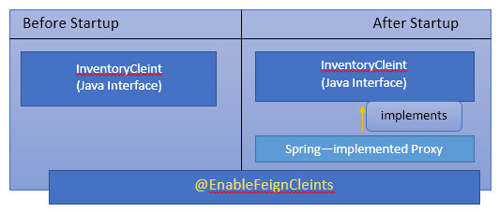
Working of Feign Client

Slide 41
RestTemplate vs FeignClient
Using RestTemplate would require unit testing.
Can Eliminate with Feign because no code to do unit test
In Feign Clients Ribbon is automatically enabled.
  It will automatically load balance between the clients
Eureka
  handles the configuration of the servers that are calling
Ribbon
  handles the load balancing
Feign
  handles the actual code.
  Hystrix
  Handles the Fault Tolerence

Slide 42
Controller
  @RestController
  public class FeignController {
  @Autowired
  private MyClient loadBalancer;
  @GetMapping(value = "/client")
  public List<LoanCustomer> getCustomers() {
  return this.loadBalancer.findAll ();
  }
  }

Slide 43
Configuring Feign Client
  @FeignClient(name="SHOW-CUSTOMER-DETAILS“)
  public interface MyClient {
  @RequestMapping(method = RequestMethod.GET, value = "/customer")
  List<LoanCustomer> findAll();
  }

Slide 44
Security Configuration
  public class ClientConfiguration {
  @Bean
  public BasicAuthRequestInterceptor interceptor() {
  return new BasicAuthRequestInterceptor("guest", "guest");
  }
  }

Slide 45
Rest Controller
  @RestController
  public class FeignController {
  @Autowired
  private MyFeignClient loadBalancer;
  @GetMapping(value = "/client")
  public String getCustomers() {
  return this.loadBalancer.getAll();
  }
  }

Slide 46
Main Application
  @SpringBootApplication
  @EnableFeignClients
  public class SecuredServiceFeignClientApplication {
  public static void main(String[] args) {
  SpringApplication.run(SecuredServiceFeignClientApplication.class, args);
  }
  }

Slide 47
SECURITY USING JDBC

Slide 48
Sql Statements
  CREATE TABLE users( `username` varchar(50) NOT NULL, `password` varchar(200) NOT NULL, `enabled` tinyint(1) NOT NULL, PRIMARY KEY (`username`))
  CREATE TABLE authorities ( `username` varchar(50) NOT NULL, `authority` varchar(50) NOT NULL, KEY `fk_authorities_users` (`username`), CONSTRAINT `fk_authorities_users` FOREIGN KEY (`username`) REFERENCES `users` (`username`))

Slide 49
SQL Statements
  insert into users (username, password,enabled) values ('india','$2a$10$P.9MaemE6x38wnZer4qauO8Dl9pixQEZ27.yEQglTtyjdmJBRtTFS',true);
  insert into authorities (username, authority) values ('india', 'ROLE_USER');
  insert into test.users (username, password, enabled) values ('nepal','$2a10$t4kkrerTgJlcvTj7QresWuBqAsnxVxMxaJ6UzlXCaP/HSdDraO5QC',true);
  insert into authorities (username, authority) values ('nepal', 'ROLE_ADMIN');

Slide 50
Application.properties
  spring.datasource.url=jdbc:mysql://localhost:3306/test
  spring.datasource.username=root
  spring.datasource.password=srivatsan
  spring.datasource.driver-class-name=com.mysql.cj.jdbc.Driver

Slide 51
Pass Word Encoder
  public static void main(String[] args) {
  BCryptPasswordEncoder encoder = new BCryptPasswordEncoder();
  String encoded = encoder.encode("india");
  System.out.println(encoded);
  encoded = encoder.encode("nepal");
  System.out.println(encoded);
  }

Slide 52
Rest Controller
  @RestController
  public class ProjectController {
  @GetMapping("/first")
  public String getSecuredMessage(Principal user) {
  return "Welcome to Secured Page"+user.getName();
  }
  }
  }

Slide 53
Security Config
  @Configuration
  public class SecurityConfiguration extends WebSecurityConfigurerAdapter {
  @Autowired
  private DataSource dataSource;
  @Bean
  public BCryptPasswordEncoder encoder() {
  return new BCryptPasswordEncoder();
  }

Slide 54
Security Config
  @Override
  public void configure(AuthenticationManagerBuilder auth) throws Exception{
  auth.jdbcAuthentication()
  .dataSource(dataSource)
  .usersByUsernameQuery(
  "SELECT username, password, enabled from users where username = ?")
  .authoritiesByUsernameQuery(
  "SELECT u.username, a.authority " +
  "FROM authorities a, users u " +
  "WHERE u.username = ? " +
  "AND u.username = a.username"
  )
  .passwordEncoder(new BCryptPasswordEncoder());
  }

Slide 55
Security Configuration
  @Override
  protected void configure(HttpSecurity http) throws Exception {
  http.authorizeRequests()
  .antMatchers("/api/v1/hospital/**")
  .authenticated().and().httpBasic().and().csrf().disable();
  }

Slide 56
SECURITY OAUTH2

Slide 57
OAuth
OAuth is a secure authorization protocol
  Provides authorization flows for web ,desktop and mobile applications.
  Used for authorization of third party application to access the user data without exposing their password.

Slide 58
OAuth2 Roles
Client
  A Third-Party Application
  An application making protected resource requests on behalf of the Resource Owner and with its authorization
Resource Server
  Component that manages users resources.
  It requires a valid access token.
  Client uses the access token to call resources in this server
  Token is added to the HTTP request headers.

Slide 59
OAuth2 Roles
The Authorization Server
  The server that presents the interface where the user approves or denies the request.
  May be the same server as the API server, can also be a separate component.
Resource Owner
  Is the User
  Person who is giving access to some portion of their account.

Slide 60
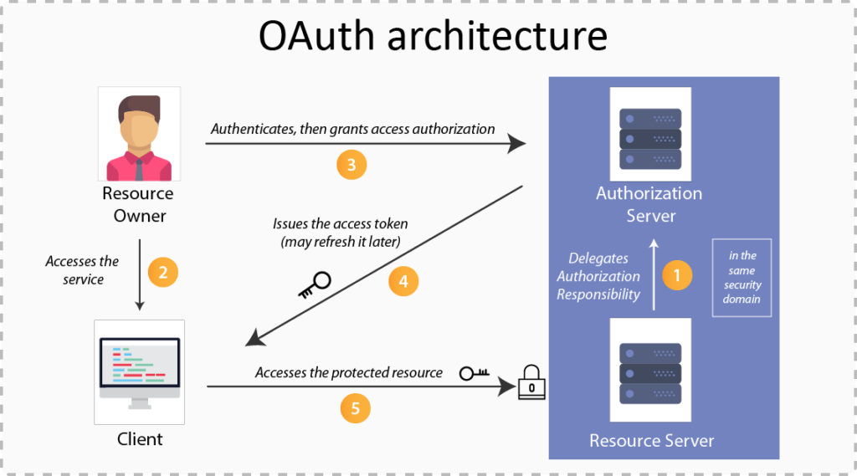

Slide 61
OAuth2 Grant Types
There are Different grant type flows defined and described to perform authorizations tasks.
  Authorization Code
  Client Credentials
  Refresh Token
  Device Code
    Used in browserless or input-constrained devices
    Previously obtained device code is exchanged for an access token

Slide 62
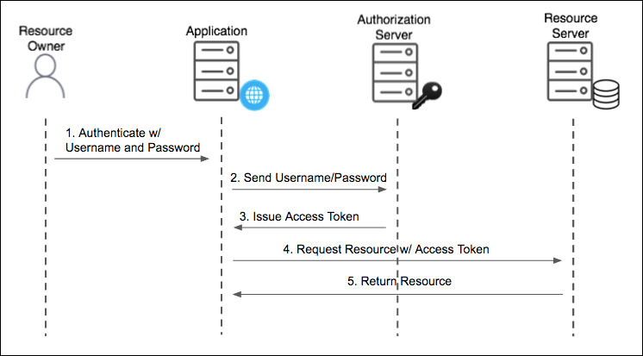
Resource Owner Password Grant Type
Used For Native Mobile and Desktop apps
  Used for highly trusted apps where resource owners share their credentials directly with the app.

Slide 63
Password Grant
Simplest OAuth grants
The application presents a traditional username and password login form to collect the user’s credentials
Uses that data and makes a POST request to the server and gets an access token.
The Post request has following parameters
  Grant-type
  userName
  Password
  Client Id
  Client Secret
  Scope

Slide 64
Password Grant Request Parameters
grant_type=password
  To denote the usage of Password grant type
Username
  The user’s username that they entered in the application
Password
  The user’s password that they entered in the application
client_id
  Public identifier of the application that the developer obtained during registration
client_secret (optional)
  If the application is a “confidential client” (not a mobile or JavaScript app), then the secret is included as well.
scope (optional)
  If the application is requesting a token with limited scope

Slide 65
OAuth2 Tokens
Tokens are implementation specific random strings, generated by the authorization server.
Access Token
  Sent with each request, usually valid for about an hour only.
Refresh Token
  It is used to get new access token, not sent with each request, usually lives longer than access token.
  Allows clients to continue to have a valid access token without further interaction with the user.

Slide 66
Access Token
Access token in the same format for all grant types.
  {
  "access_token": "MTQ0NjOkZmQ5OTM5NDE9ZTZjNGZmZjI3",
  "token_type": "bearer",
  "expires_in": 3600,
  "scope": "create"
  }

Slide 67
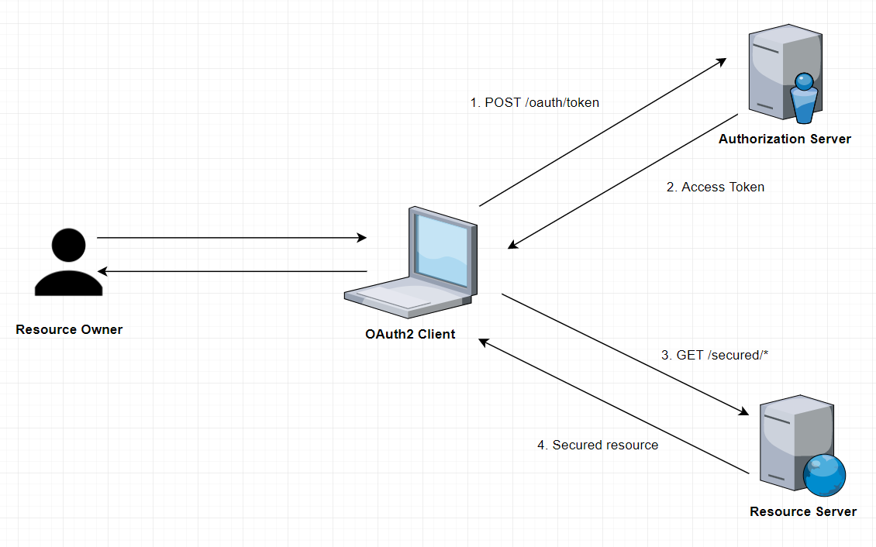
How it Works

Slide 68
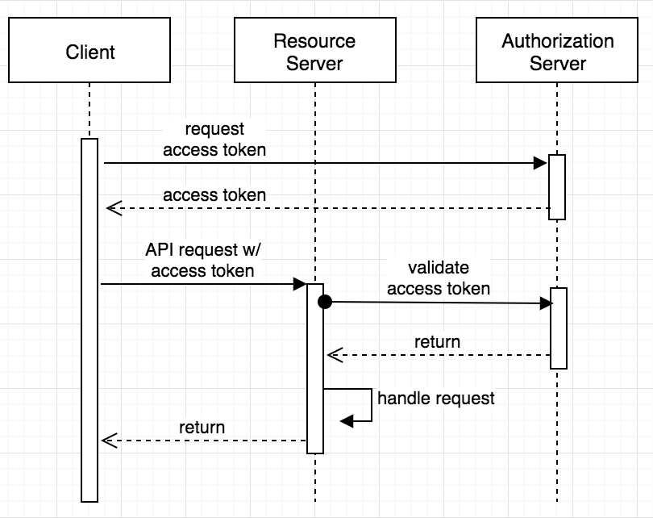
Sequence Diagram

Slide 69
Pom.xml
<dependency>
<groupId>org.springframework.boot</groupId>
<artifactId>spring-boot-starter-oauth2-resource-server</artifactId>
</dependency>
<dependency>
<groupId>org.springframework.boot</groupId>
<artifactId>spring-boot-starter-web</artifactId>
</dependency>
<dependency>
<groupId>org.springframework.cloud</groupId>
<artifactId>spring-cloud-starter-oauth2</artifactId>
</dependency>

Slide 70
Resource
    @RestController
    public class HospitalController {
    @GetMapping(path = "/hospital")
    public String getDetails() {
    return "Malar Hospitals";
    }
    }

Slide 71
@EnableResourceServer
Enables application to behave as a Resource Server by configuring an OAuth2AuthenticationProcessingFilter and required components.
The annotation creates a WebSecurityConfigurerAdapter with predefined configuration and order 3, it also takes care of the following
    Access rules
    Paths that are protected by OAuth2 security.
It enables a Spring Security filter that authenticates requests via an incoming OAuth2 token

Slide 72
Resource Server - Secured
  @SpringBootApplication
  @EnableResourceServer
  public class FlowerHospitalServicePasswordGrantApplication {
  public static void main(String[] args) {
  SpringApplication.run(FlowerHospitalServicePasswordGrantApplication.class, args);
  }
  }

Slide 73
Authentication
AuthenticationManager
  An interface with authenticate() method
Authenticate method does one of the following :
  Return an Authentication with authenticated=true if valid principal.
  Throw an AuthenticationException if there is a invalid principal.
  Return null if it cannot decide.
AuthenticationManagerBuilder
  A helpers to set up authentication
  Can be configured to work with in-memory, JDBC, or LDAP

Slide 74
Endpoints
/oauth/authorize
  The user is responsible for securing the Authorization Endpoint
  Spring Security features are used for this
/oauth/token
  The Token Endpoint will be automatically secured using HTTP Basic authentication on the client's credentials.

Slide 75
WebSecurityConfigurerAdapter
  @Configuration
  public class SecurityConfig extends WebSecurityConfigurerAdapter {
  @Autowired
  private PasswordEncoder encoder;
  @Override
  protected void configure(HttpSecurity http) throws Exception {
  http
  .authorizeRequests()
  .antMatchers("/login").permitAll()
  .antMatchers("/oauth/authorize")
  .authenticated();
  }

Slide 76
WebSecurityConfigurerAdapter
  @Override
  protected void configure(AuthenticationManagerBuilder auth) throws Exception {
  auth.inMemoryAuthentication()
  .withUser("india").password(encoder.encode("india"))
  .roles("USER");
  }
  @Bean
  @Override
  public AuthenticationManager authenticationManagerBean() throws Exception {
  return super.authenticationManagerBean();
  }

Slide 77
Authorization Server
@EnableAuthorizationServer
  Used for enabling an Authorization Server
AuthorizationServerConfigurerAdapter
  Adapter class for AuthorizationServerEndpointsConfigurer
  Configure the properties and enhanced functionality of the Authorization Server endpoints
  @Configuration
  @EnableAuthorizationServer
  public class AuthServerConfiguration extends
  AuthorizationServerConfigurerAdapter {
  }

Slide 78
Checking Tokens
Spring Security OAuth exposes two endpoints for checking tokens
  These are not exposed by default- they are "denyAll()".
/oauth/check_token
/oauth/token_key
To Verify the tokens with this endpoint they are exposed with condition.
  security.tokenKeyAccess("isAuthenticated()")
  .checkTokenAccess("isAuthenticated()"

Slide 79
ClientDetailsServiceConfigurer
.withClient(“client”)
  consumes client_id from request body
.authorizedGrantTypes(grant_types)
  Sets specific grant types
scopes(“read”)
secret(yourClientSecret)
  clients.inMemory().withClient("myclient")
  .authorizedGrantTypes("password")
  .secret(encoder().encode("pass123"))
  .scopes("read","write")
  .redirectUris("http://localhost:4046/flower/login/oauth2/code/myclient");

Slide 80
Redirect URI
The path in the application that the end-user's user-agent is redirected back to after they have authenticated
The default redirect URI template is
{baseUrl}/login/oauth2/code/{registrationId}.
  The registrationId is a unique identifier for the ClientRegistration.

Slide 81
Authorization Server
  @Configuration
  @EnableAuthorizationServer
  public class AuthServerConfiguration extends AuthorizationServerConfigurerAdapter {
  @Autowired
  private AuthenticationManager authenticationManager;
  @Override
  public void configure(AuthorizationServerSecurityConfigurer security) throws Exception {
  security.tokenKeyAccess("isAuthenticated()")
  .checkTokenAccess("isAuthenticated()") ;
  }

Slide 82
Authorization Server
  @Override
  public void configure(ClientDetailsServiceConfigurer clients) throws Exception {
  clients
  .inMemory()
  .withClient("myclient")
  .authorizedGrantTypes("password")
  .secret(encoder().encode("pass123"))
  .scopes("read","write")
  .redirectUris(
  "http://localhost:4046/flower/login/oauth2/code/myclient");
  }

Slide 83
Authorization Server
  @Override
  public void configure(AuthorizationServerEndpointsConfigurer endpoints) throws Exception {
  endpoints.authenticationManager(authenticationManager);
  }
  @Bean
  public BCryptPasswordEncoder encoder() {
  return new BCryptPasswordEncoder();
  }
    }

Slide 84
Testing with Postman
Make a post call to the url http://localhost:4046/oauth/token
Select Authorization , and basic authentication
  Add the UserName : myclient
  Add the password : pass123
Select Body form-url-endcoded and key and values ,
  grant_type : password
  Username : india
  Password : india
Will get the Token

Slide 85
Testing with Postman
  Access resource using uri
    Select params tab and add access_token as a parameter
  http://localhost:4040/api/customers/customer/1?access_token=37ec591b-bae9-46ac-8e5a-573e82cb0630

Slide 86
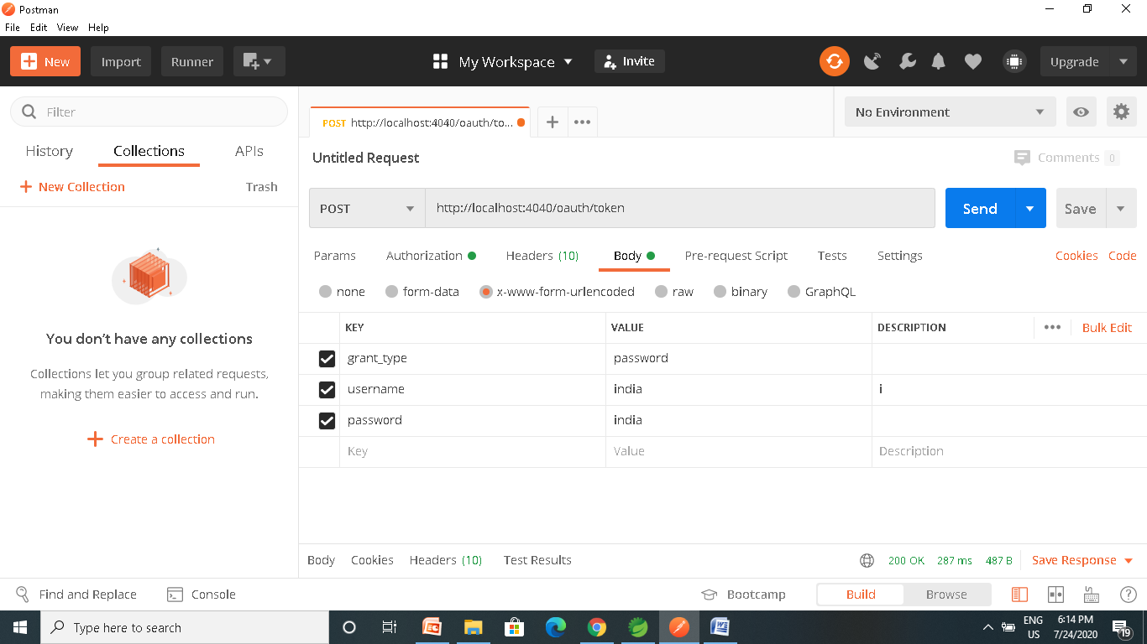
Testing with Postman

Slide 87
Testing with Postman

Slide 88
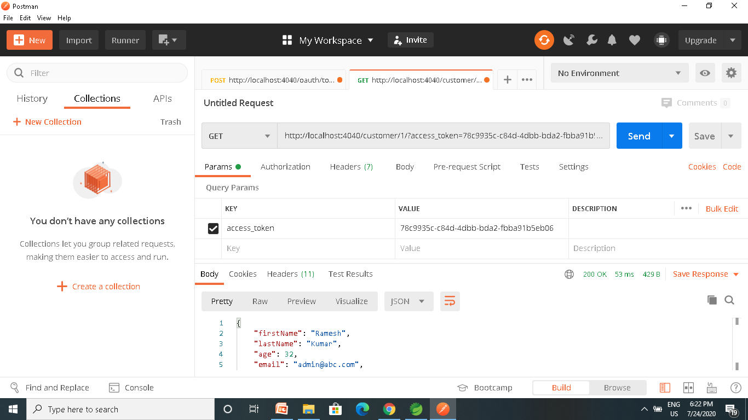

Slide 89
OAuth2RestTemplate
  @Bean
  public OAuth2RestTemplate template() {
  ResourceOwnerPasswordResourceDetails details = new ResourceOwnerPasswordResourceDetails();
  details.setAccessTokenUri("http://localhost:4040/oauth/token");
  details.setClientId("ourclient");
  details.setClientSecret("pass345");
  details.setUsername("india");
  details.setPassword("india");
  details.setGrantType("password");
  OAuth2RestTemplate template = new OAuth2RestTemplate(details);
  return template;
  }

Slide 90
OAuth2Template
  OAuth2RestTemplate template = ctx.getBean(OAuth2RestTemplate.class);
  String resp =
  template.getForObject("http://localhost:4040/api/v1/hospitals/2", String.class);
  System.out.println(resp)

Slide 91
Password Grant Type
Requires that the application collect the user’s password.
  OAuth was created to avoid .
Can be Used for service’s own application to ask the user to enter their password.
It lets the application take advantage OAuth provides around access tokens and token lifetimes.
Instead of storing the user’s password on the device, the application only has to touch the user’s password for as long as it takes to get the access token, then it can store and use the access token instead.

Slide 92
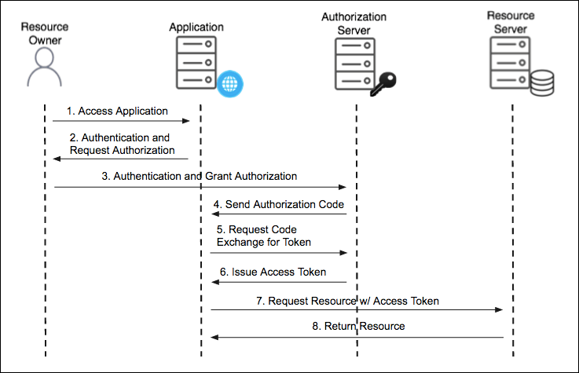
Authorization Code Grant Type

Slide 93
Authorization Code Grant Type
Used by confidential and public clients to exchange an authorization code for an access token.
  After the user returns to the client via the redirect URL, the application will get the authorization code from the URL and use it to request an access token.
The GitHub API uses the OAuth Authorization Code grant type
It needs five piece of information
Client ID
Client Secret
Callback URL
Authorization URL
Access Token URL: :

Slide 94
Authorization Code Grant Type
Social logins using Oauth2 have become an industry standard.
Facebook, LinkedIn and Github are OAuth2 login providers
It has revolutionized the way sites share data
Users can quickly access new applications without having to create a new set of credentials.

Slide 95
Authorization Code Grant Type
Authorization Server
  Client Application can use the authorization code grant to obtain an access token from GitHub
Resource Server
  It uses the access token to ask GitHub for permitted personal details like login ID and name.
  It Decodes the token checking if it gives the app permission to access the user’s details.
  Inserts the user details into the Spring Security context

Slide 96
Using Git Hub
Navigate to https://github.com/settings/developers
create a New OAuth app under the OAuth Apps left menu.
Fill in the Authorization callback URL field to include the redirect URI to your app: http://<your-domain>/login/oauth2/code/github
Click on Register Application
Copy the client ID and client secret to be used Later

Slide 97
OAuth2 Client
  <dependency>
  <groupId>org.springframework.boot</groupId>
  <artifactId>spring-boot-starter-oauth2-client</artifactId>
  <version>2.3.3.RELEASE</version>
  </dependency>

Slide 98
Controller
  @RestController
  public class AppController {
  @GetMapping("/")
  public String home() {
  return "home";
  }
  @GetMapping("/secured")
  public String classified() {
  return "Secured Resource";
  }
  }

Slide 99
Security Config
oauth2Login()
  similar to httpBasic() and formLogin()
  Will be used to display an auto-generated login page for login provider
  public class SecurityConfig extends WebSecurityConfigurerAdapter {
  protected void configure(HttpSecurity http) throws Exception {
  http.authorizeRequests()
  antMatchers("/secured").authenticated().anyRequest()
  .authenticated().and().oauth2Login();
  }
  }

Slide 100
Security Configuration
Client credentials to the application.properties file.
  Properties are prefixed with
    spring.security.oauth2.client.registration
  This is followed by the client name
    spring.security.oauth2.client.registration.github
  The name of the client property follows next
spring.security.oauth2.client.registration.github.client-id=c1c7fb187a46dea59fbe
spring.security.oauth2.client.registration.github.client-secret=53f1d9de1d00d4f00e9ab6bc276e5166c492f45c

Slide 101
SPRING SLEUTH

Slide 102
Sleuth
Capable of enhancing logs
Spring Cloud Sleuth uses Brave as the tracing library
  Adds unique ids to each web request that enters the application.
  Has added support for sharing these ids across thread boundaries.
  Provides trace and span ids
    Can be used to pinpoint exactly when and where application processes a request.
    Making reading logs much easier.
Added through spring boot starter project.
Zipkin Cient Module is also added

Slide 103
Trace and Span
Trace
  A single request or job that is triggered in an application.
  All the various steps in that request, even across application and thread boundaries, will have the same traceId.
Spans
  As sections of a job or request.
  A single trace can be composed of multiple spans each correlating to a specific step or section of the request.

Slide 104
Log Format
This data follows the format
[application name, traceId, spanId, export]
Application name
  Name as set in the properties file
  Used to aggregate logs from multiple instances of the same application.
TraceId
  This is an id that is assigned to a single request, job, or action.
  Each unique user initiated web request will have its own traceId.

Slide 105
Log Format
SpanId
  Tracks a unit of work.
  A request may consists of multiple steps.
  Each step could have its own spanId and be tracked individually.
  By default, any application flow will start with same TraceId and SpanId.
Export
  A boolean property
  To indicate whether or not this log was exported to an aggregator like Zipkin.

Slide 106
Installing Zipkin
Download the latest Zipkin server from maven repository
  https://zipkin.io/pages/quickstart
  Under Java choose latest release
Run the executable jar file using below command.
  java -jar zipkin-server-1.30.3-exec.jar
Zipkin server starts with default configuration.
After Startup , the Web UI is at http://localhost:9411/zipkin/.

Slide 107
Zipkin
Has Four modules
Collector
  Once any component sends the trace data arrives to Zipkin collector daemon
  , it is validated, stored, and indexed for lookups by the Zipkin collector.
Storage
  store and index the lookup data in backend. Cassandra, ElasticSearch and MySQL are supported.
Search
  This module provides a simple JSON API for finding and retrieving traces stored in backend. The primary consumer of this API is the Web UI.
Web UI
  – A very nice UI interface for viewing traces.

Slide 108
Tracer
  @Autowired
  private Tracer tracer;
  public void usingSameSpan() {
  try {
  Thread.sleep(1000L);
  } catch (InterruptedException e) {
  e.printStackTrace();
  }
  log.info("Doing some work");
  }

Slide 109
Continue Span
  All Sleuth related annotations should be applied to an existing span instead of creating a new one.
  @ContinueSpan(log = "method2")
  public void usingSameSpanWithDifferentTag(@SpanTag("tag20") String param) {
  try {
  Thread.sleep(1500L);
  } catch (InterruptedException e) {
  e.printStackTrace();
  }
  log.info("Doing some More work");
  }

Slide 110
New Span
Creates a new span around a public method.
The new span will be either a child of an existing span if a trace is already in progress or a new span will be created if there was no previous trace.
  @NewSpan(name = "secondspan")
  public void createNewSpan() throws InterruptedException {
  log.info("I'm in the original span");
  log.info("I'm in the original span");
  }

Slide 111
SPRING CLOUD GATEWAY

Slide 112
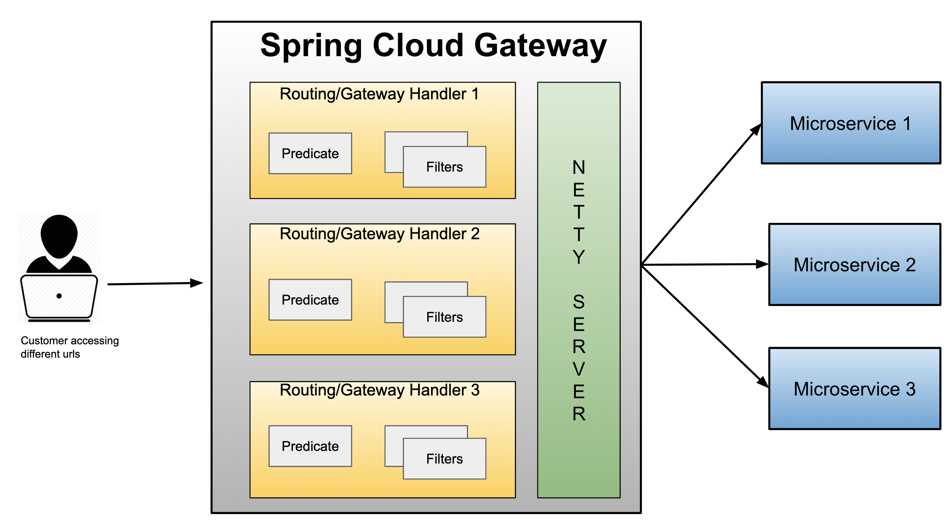
Spring cloud gateway

Slide 113
Gateway
Micro Services require a unified interface to the consumers.
  Services are split into small composable apps
  It shouldn’t be visible to users
  Should have less development effort.
Gateway handles requests to multiple backing services.
  It provides a unified “front door”
  Browser, Mobile Application or other user interface can consume services from multiple hosts
  Can mange the cross-origin resource sharing and authentication

Slide 114
Cloud Gateway
Gateway is an intermediate layer between the users and services.
  Eureka server solved the problem of giving names to services instead of hard coding their IP addresses.
It Maps between a prefix path and a service or more than one service running on different ports
Can Use Eureka server to route the requested service.
Load balances instances
Can filter requests, add authentication, etc.

Slide 115
Spring Cloud Gateway
Provides a simple and effective way to route incoming requests to the appropriate destination using Gateway Handler Mapping.
Uses Netty server to provide non-blocking asynchronous request processing.
Route configuration
Programmatically
  Using Spring RouteLocator.
Properties
  application.yml

Slide 116
Enable Discovery Locator
Can configure routes to the services registered with eureka
Can skip creating API Gateway routes manually.
  spring:
  application:
  name: api-gateway
  cloud:
  gateway:
  discovery:
  locator:
  enabled: true
  lower-case-service-id: true
To access a service with “serviceId” PRODUCT_SERVICE
  http://localhost:8080/product-service/api/v1/items

Slide 117
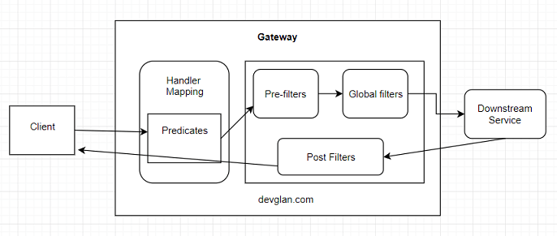
Cloud Gateway Filters

Slide 118
Gate Way Filter
GatewayFilter
  Created by extending the abstract class AbstractGatewayFilterFactory
  Using Builder Object can process the request
Pre filter
  Created by processing the request Object before calling chain.filter
Post Filter
  Created by processing the response in while returning chain.filter

Slide 119
Pre Filter
  @Component
  public class MyBasicPreFilter extends AbstractGatewayFilterFactory<MyBasicPreFilter.Config> {
  public static class Config {
  }
  public MyBasicPreFilter() {
  super(Config.class);
  }

Slide 120
PRE Filter
    @Override
    public GatewayFilter apply(Config config) {
    return (exchange, chain) -> {
    ServerHttpRequest request = exchange.getRequest();
    URI requestUrl = exchange.getRequiredAttribute(ServerWebExchangeUtils.GATEWAY_REQUEST_URL_ATTR);
    System.out.println("PRE FILTER =:"+request);
    System.out.println("PRE Filter =:"+ requestUrl);
    return chain.filter(exchange.mutate().build());
    };
    }
    }

Slide 121
Post Filter
  public class MyBasicPostFilter extends AbstractGatewayFilterFactory<MyBasicPostFilter.Config> {
  public static class Config {
  }
  }
  public MyBasicPostFilter() {
  super(Config.class);
  }

Slide 122
Post Filter
  @Override
  public GatewayFilter apply(Config config) {
  return (exchange, chain) -> {
  return chain.filter(exchange)
  .then(Mono.fromRunnable(() -> {
  System.out.println("Post Filter executed");
  }));
  };
  }
  }

Slide 123
Configure Filters
spring:
application:
name: api-gateway
cloud:
gateway:
discovery:
locator:
enabled: true
lower-case-service-id: true
default-filters:
- name: MyBasicPreFilter
- name : MyBasicPostFilter

Slide 124
Global Filters
Created by implementing the Interface GlobalFilter with one Method filter()
public Mono<Void> filter(ServerWebExchange exchange, GatewayFilterChain chain)
ServerWebExchange
  Contract for an HTTP request-response interaction.
  Provides access to the HTTP request and response
  Exposes Properties for server-side processing
GatewayFilterChain
  An inteface that allows a WebFilter to delegate to the next in the chain.

Slide 125
Global Filters- Pre Filter
  @Component
  public class MyGlobalFilter implements GlobalFilter {
  @Override
  public Mono<Void> filter(ServerWebExchange exchange, GatewayFilterChain chain) {
  String requestPath = exchange.getRequest().getPath().toString();
  System.out.println("Request path = " + requestPath);
  HttpHeaders headers = exchange.getRequest().getHeaders();
  Set<String> headerNames = headers.keySet();
  headerNames.forEach((header) -> {
  System.out.println(header + " " + headers.get(header));
  });
  return chain.filter(exchange);
  }
  }

Slide 126
Global Filter
  public Mono<Void> filter(ServerWebExchange exchange, GatewayFilterChain chain) {
  boolean result =
  exchange.getRequest().getURI().
  getRawPath().contains("reviews");
  if(result) {
  exchange.getResponse().setStatusCode(HttpStatus.UNAUTHORIZED);
  return exchange.getResponse().setComplete();
  }
  return chain.filter(exchange);
  }

Slide 127
Global Filter – Post Filter
@Bean
public GlobalFilter postGlobalFilter() {
return (exchange, chain) -> {
return chain.filter(exchange)
.then(Mono.fromRunnable(() -> {
log.info("Global Post Filter executed");
}));
};

Slide 128
Ordering the Filter
Can Use the Ordered interface to control the multiple filters Order of execution
Can give low value for High precedence by overriding getOrder() Method
  The filter with order as Integer.MIN_VALUE will be executed first in the pre-filter phase and last in post-filter phase .
  Filter with order as Integer.MAX_VALUE will be executed first in the post-filter phase and execute last in the pre-filter phase.

Slide 129
Ordering Filters
  @Component
  public class PreFilter implements GlobalFilter, Ordered {
  @Override
  public int getOrder() {
  return -1;
  }
  }

Slide 130
Gateway Routing
Has Three Main parts
Route:
  The Destination of a particular request.
  It will have destination URI
  It has a condition to be satisfied
  It has one or more filters.
Predicate
  A condition to match like an “if” condition.
  Java 8 Function Predicate
Filter:
  Instances of Spring Framework WebFilter.
  Can modify request or response.
  Spring Provides many WebFilters

Slide 131
Load Balancer Client Filter
ServerWebExchangeUtils.GATEWAY_REQUEST_URL_ATTR.
  Used to look for the URI in the exchange attribute
  If the URL has a lb scheme it'll use the Spring Cloud LoadBalancerClient to resolve the name to an actual host and port.
ServerWebExchangeUtils.GATEWAY_ORIGINAL_REQUEST_URL_ATTR
  The unmodified original URL is placed in this attribute

Slide 132
Actuator Endpoints
Base Path :
  /actuator/gateway
/actuator/gateway/routefilters
  Displays the list of global filters applied to the routes.
/actuator/gateway/routes
  Displays the list of routes defined in the gateway.
/actuator/gateway/routes/{id}
  Displays information about a particular route.

Slide 133
Route Locator Builder
Gateway configuration can also be done using java route api
RouteLocatorBuilder
  Used to configure related routing information
  To add predicates and filters
  Provides a Static Method Builder()
    Builder() method is used to construct routes and return a RouteLocator

Slide 134
RouteLocator
RouteLocator
  public interface RouteLocator {
  Flux<Route> getRoutes();
  }
  @Bean
  public RouteLocator gatewayRoutes(RouteLocatorBuilder builder) {
  }

Slide 135
Routing Object
Route
  Defines the routes information such as route assertions, filters, routing addresses, and route priorities.
  When the request arrives, it is processed by the Gateway filter
    And then its forwarded to the proxy service.
  public class Route implements Ordered {
  private final String id;
  private final URI uri;
  private final int order;
  private final AsyncPredicate<ServerWebExchange> predicate;
  private final List<GatewayFilter> gatewayFilters;
  }

Slide 136
Configuring Route Locator
  @Configuration
  public class MyRouteConfig {
  @Bean
  public RouteLocator gatewayRoutes(RouteLocatorBuilder builder) {
return builder.routes()
.route(p -> p.path("/api/v1/reviews/**")
.filters(f -> f.addResponseHeader("Hello", "World"))
.uri("lb://REVIEW-SERVICE") )
.route(p -> p.path("/api/v1/choices/**")
.uri("http://localhost:7575/"))
.build();
  }
  }

Slide 137
Gateway Filter
  @Component
  public class LoggingFilter implements GatewayFilter {
  @Override
  public Mono<Void> filter(ServerWebExchange exchange, GatewayFilterChain chain) {
  ServerHttpRequest request = exchange.getRequest();
  Log.info(request.getPath().toString());
  return chain.filter(exchange);}
  }

Slide 138
Filters With Java Configuration
  @Bean
  public RouteLocator gatewayRoutes(RouteLocatorBuilder builder,LoggingFilter logger) {
  return builder.routes()
  .route(p -> p.path("/api/v1/restaurants/**")
  .filters(f -> f.filter(logger, 0))
  .uri("lb://RESTAURANT-INFO-SERVICE") )
  .route(p -> p.path("/accounts/**")
  .uri("lb://ACCOUNT-SERVICE"))
  .build();
  }

Slide 139
application.yml
  spring:
  cloud:
  gateway:
  routes:
  - id: review-module
  uri: lb://REVIEW-SERVICE
  predicates:
  - Path=/api/v1/reviews/**
  application:
  name: cloud-gateway
  Invoke the service :
  http://localhost:8080/api/v1/reviews

Slide 140
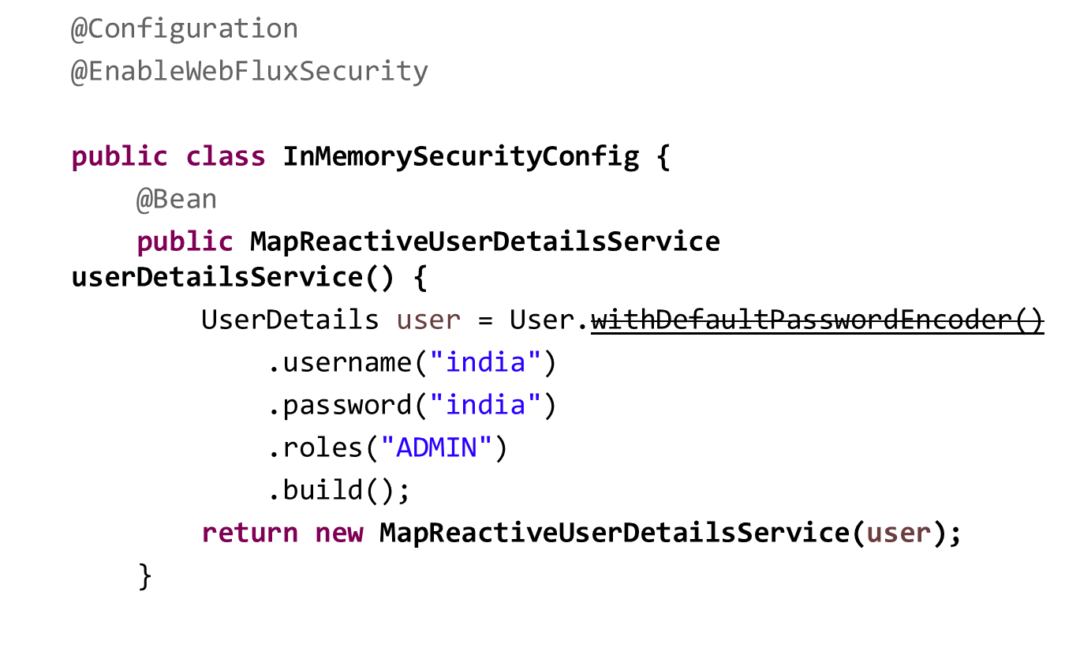
Reactive Security

Slide 141
Reactive Security
  @Bean
  public SecurityWebFilterChain springSecurityFilterChain(ServerHttpSecurity http) {
  http
  .authorizeExchange()
  .anyExchange().authenticated()
  .and()
  .httpBasic();
  return http.build();
  }
  }

Slide 142
Global Filter
  @Component
  public class CustomAuthenticationGlobalFilter implements GlobalFilter {
  public Mono<Void> filter(ServerWebExchange exchange, GatewayFilterChain chain) {
  List<String> authorization = exchange.getRequest().getHeaders().get("Authorization");
  ServerHttpRequest modifiedRequest = exchange.getRequest().mutate().
  header("Authorization", authorization.get(0)).build();
  return chain.filter(exchange.mutate().request(modifiedRequest).build());
  }
  }

Slide 143
SPRING CLOUD CIRCUIT BREAKER

Slide 144
Circuit Breaker
Used to stop the communication to the application may slow down or fail
  It interrupts the current flow after a fault is detected
  When it is is reset (manually or automatically), it can resume its normal operation.
Services will fail fast and have some fallback functionality.
It prevents the failure from cascading and giving the failing service time to recover.

Slide 145
Spring Cloud Circuit Breaker
Spring Cloud Circuit Breaker
  An abstraction API for adding circuit breakers to your application.
  There are few supported implementations:
Resilience4J
Resilience4J Reactive
Spring Retry

Slide 146
Resilience4j
Fault tolerance library designed for Java 8 and functional programming.
It is lightweight, modular and fast.
  resilience4j-circuitbreaker
  resilience4j-ratelimiter
  resilience4j-bulkhead
  resilience4j-retry
  resilience4j-cache
Fault Tolerance
  The ability of a system to operate properly in case of the failure of some of its components.
  Done at all levels and also in subsystems as a part of the design.

Slide 147
Circuit Breaker
Wrap a protected function call in a circuit breaker object
  Circuit Breaker will monitor for failures.
Once the failures reach a certain threshold, the circuit breaker trips,
All further calls to the circuit breaker return with an error, without the protected call being made at all.

Slide 148
Need For Circuit Breaker
In case we have serviceB down, serviceA should still try to recover from this and try to do one of the followings:
Custom fallback:
  Try to get the same data from some other source. If not possible, use its own cache value.
Fail fast:
  If serviceA knows that serviceB is down, there is no point waiting for the timeout and consuming its own resources. It should return ASAP “knowing” that serviceB is down
Don’t crash:
  As we saw in this case, serviceA should not have crashed.
Heal automatic:
  Periodically check if serviceB is working again.
Other APIs should work:
  All other APIs should continue to work.

Slide 149
Dependency
  <dependency>
  <groupId>org.springframework.boot</groupId>
  <artifactId>spring-boot-starter-aop</artifactId>
  </dependency>

Slide 150
Item Controller
  @RestController
  public class ItemController {
  @GetMapping(path = "/item")
  public String getItem() {
  return new String("{'id':101,'name':'tv')");
  }
  }

Slide 151
Circuit Breaker
  @RestController
  public class OrderController {
  private static final String ORDER_SERVICE = "orderService";
  @Autowired
  private RestTemplate restTemplate;
  @Bean
  public RestTemplate getRestTemplate() {
  return new RestTemplate();
  }

Slide 152
Circuit Breaker
  @GetMapping("/order")
  @ResponseStatus(HttpStatus.OK)
  @CircuitBreaker(name=ORDER_SERVICE, fallbackMethod = "orderFallback")
  public ResponseEntity<String> createOrder(){
  String response = restTemplate.getForObject("http://localhost:8081/item", String.class);
  return new ResponseEntity<String>(response, HttpStatus.OK);
  }
  public ResponseEntity<String> orderFallback(Exception e){
  return new ResponseEntity<String>("Item service is down", HttpStatus.OK);
  }
  }

Slide 153
Stages of Circuit Breaker
Circuit Breaker has the following three stages:
  Closed
  Open
  Half-Open

Slide 154
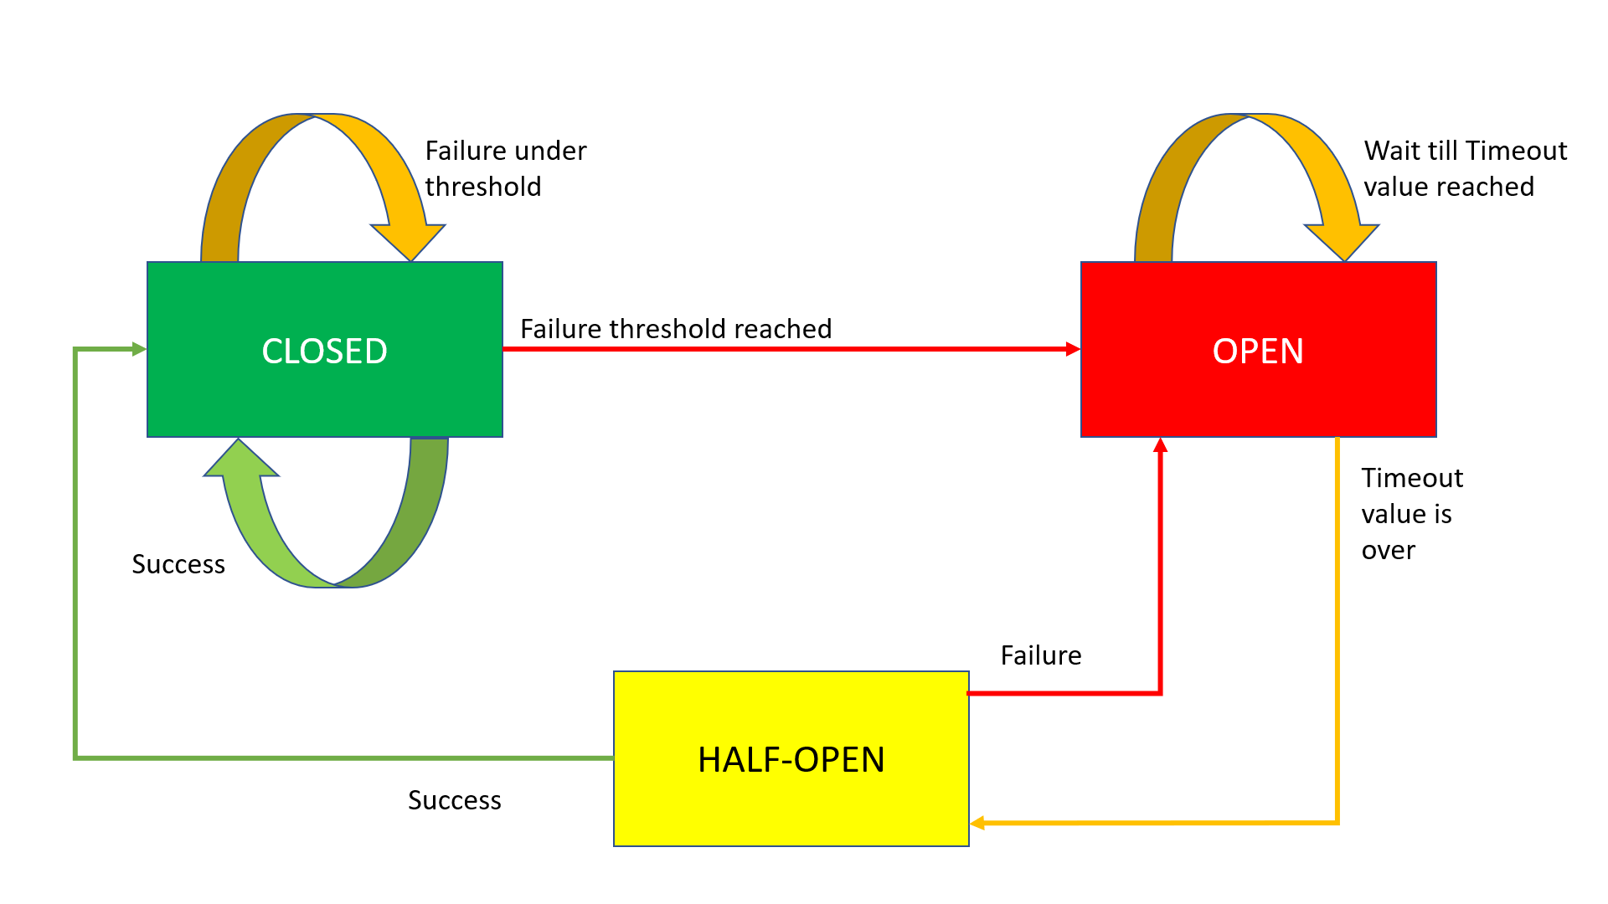
Circuit Breaker Working

Slide 155
Closed State
The Circuit Breaker enters a CLOSED state and waits for Client Requests.
In the CLOSED state, it does the following things:
  It receives Client Requests and makes a call to the Service
  If it succeeds and receives the response from that Service, it will reset the failure count to 0 and send that response back to the end user.
  If it fails to receive the response from that Service, it will increment the failure count by one and check whether that count is greater than the predefined failure threshold
  If the failure count is greater than the failure threshold, then that Circuit Breaker component trips or enters into the OPEN state
  CLOSED state means flow goes as expected,

Slide 156
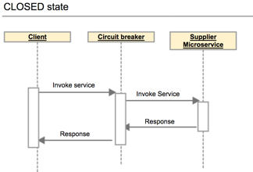
Closed State

Slide 157
OPEN state
In the OPEN state, it does the following things:
  Enters into this state when the failure count is greater than the failure threshold
  It does not make a call to the Service
  If the Client sends any requests to it, it won’t make a call to the Service; it just sends an Exception and waits for some time
  i.e. the Timeout value specified
  Once the Timeout value expires, it will enter into the HALF-OPEN state
OPEN means situation is not good and moving to fallback mode

Slide 158
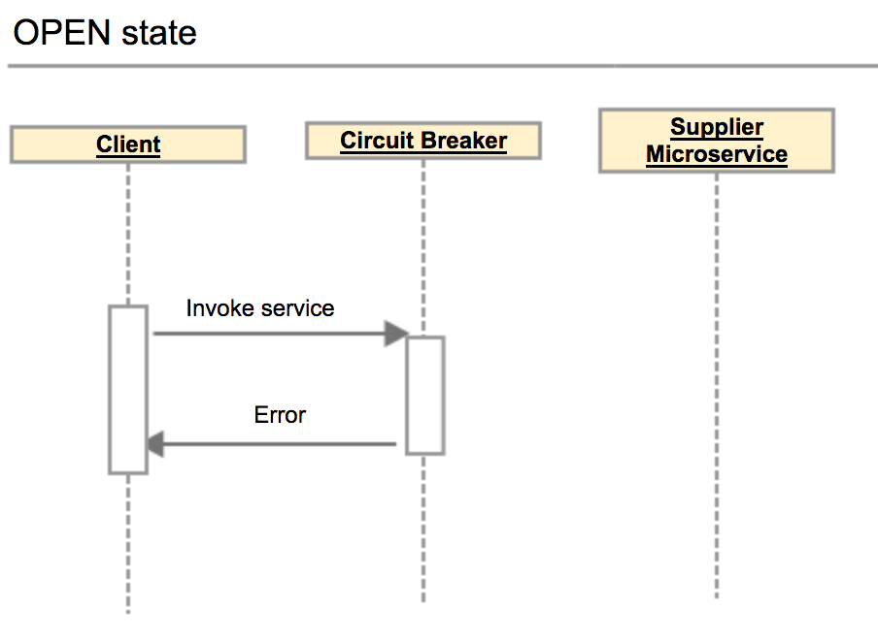
Open State

Slide 159
HALF-OPEN state
In the HALF-OPEN state, it does the following things:
  Enters into this state when it finishes the predefined waiting time.
  It sends the first request to the Service.
  If it receives a success response, then it will enter into the CLOSED state to process further Client Requests. Before picking up the first client request, it will reset the failure count to 0 again.
  If it receives a failure response, then it will re-trip to the OPEN state and wait for a predefined Timeout value to expire.

Slide 160
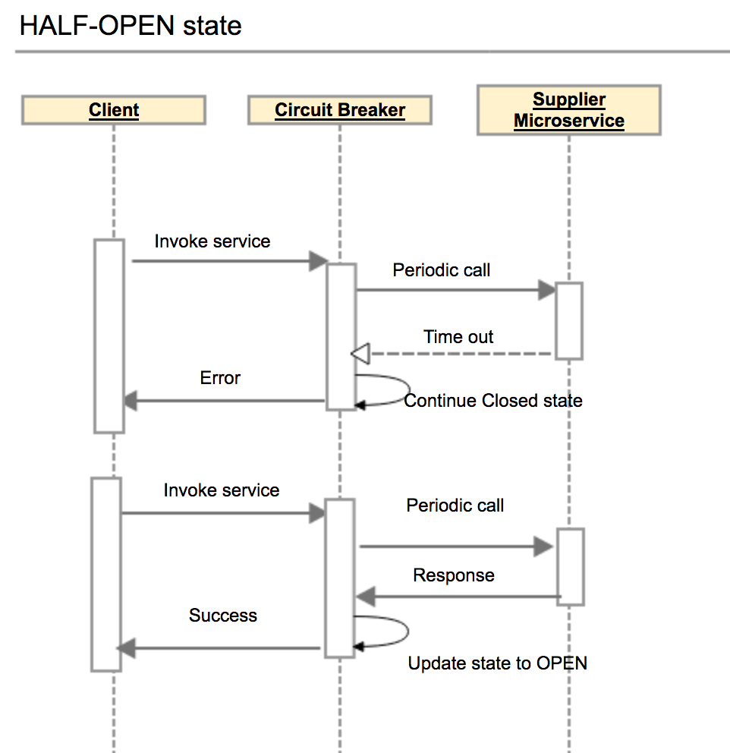
Half Open State

Slide 161
Configuring Circuit Breaker
failureRateThreshold:
  Failure threshold value of 50 which means if the 50 requests are failing in the 100 requests, keep the circuit breaker in CLOSED state.
permittedNumberOfCallsInHalfOpenState
  Default Value : 10
  Configures the number of permitted calls when the CircuitBreaker is half open.

Slide 162
Configuring Circuit Breaker
slidingWindowType : COUNT_BASED
  Used to store and count the results of calls
  Circuit breaker always keeps the total number of invoke equals to slidingWindowSize.
  COUNT_BASED:
    The last slidingWindowSize calls are recorded and aggregated.
  TIME_BASED:
    The calls of the last slidingWindowSize seconds recorded and aggregated
slidingWindowSize
  Default value is100
  Configures the size of the sliding window which is used to record the outcome of calls when the CircuitBreaker is closed.

Slide 163
Failure rate formula
Count based sliding window
FailureRate = numberOfFailureInvoke / totalNumber X 100%.
Total number =Number of failures invoke + number of successes invoke.
The total number of invoke never exceed the slidingWindowSize .
If the slidingWindowSize is 10 and the number of successes invoke is Nine.
If the 10th invoke is a failure invoke, then circuit breaker will decrease the number of successes invoke by one, and increases the number of failures invoke by one.
Circuit breaker always keeps the total number of invoke equals to slidingWindowSize.

Slide 164
Configuring Circuit Breaker
waitDurationInOpenState:
  When the Circuit breaker is in CLOSED state, wait for 10 seconds before sending any more requests to rating service.
automaticTransitionFromOpenToHalfOpenEnabled
  True: CircuitBreaker will automatically transition from open to half-open state and no call is needed to trigger the transition.
  A thread is created to monitor all the instances of CircuitBreakers to transition them to HALF_OPEN once waitDurationInOpenState passes.
  False : the transition to HALF_OPEN only happens if a call is made, even after waitDurationInOpenState is passed.
  The advantage here is no thread monitors the state of all CircuitBreakers

Slide 165
Configuring Circuit Breaker
minimumNumberOfCalls Default :100
Used for failure rate calculation.
  If minimumNumberOfCalls is 10, then at least 10 calls must be recorded, before the failure rate can be calculated.
  If only 9 calls have been recorded the CircuitBreaker will not transition to open even if all 9 calls have failed.
  http://localhost:8080/actuator/health

Slide 166
circuitbreaker
resilience4j:
circuitbreaker:
instances:
orderService:
registerHealthIndicator: true
automaticTransitionFromOpenToHalfOpenEnabled: false
failureRateThreshold: 50
minimumNumberOfCalls: 3
permittedNumberOfCallsInHalfOpenState: 2
slidingWindowSize: 10
waitDurationInOpenState: 5s
slidingWindowType: COUNT_BASED

Slide 167
circuitbreaker
  management:
  health:
  circuitbreakers:
  enabled: true
  endpoints:
  web:
  exposure:
  include:
  - "*"
  endpoint:
  health:
  show-details: always

Slide 168
ELK

Slide 169
Why Log Analysis
In cloud-based environment infrastructures, performance, and isolation is very important.
The performance of virtual machines in the cloud may vary based on the specific loads, environments, and number of active users in the system.
Reliability and node failure can become a significant issue.
Log management helps DevOps engineers, system admin to make better business decisions.
Log analysis via Elastic Stack or similar tools is important.

Slide 170
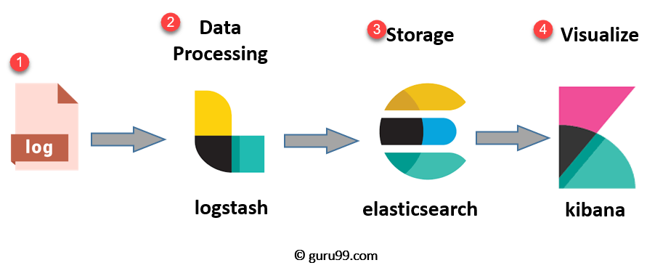
ELK Stack Architecture
Netflix, LinkedIn, Tripware, Medium all are using ELK stack for their business
Used when logs from various Apps of an enterprise converge into a single ELK instance

Slide 171
ELK
Logstash
  Collect logs and events data.
  Parses and transforms data
ElasticSearch
  The transformed data from Logstash is Stored, Search, and indexed.
Kibana
  Uses Elasticsearch DB to Explore, Visualize, and Share
Beats.
  Component for Data collection
This led Elastic to rename ELK as the Elastic Stack.

Slide 172
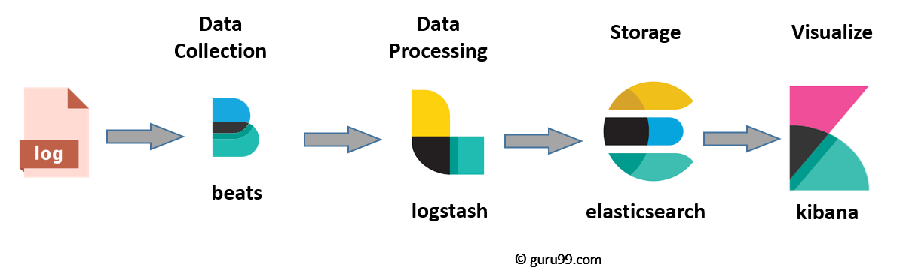
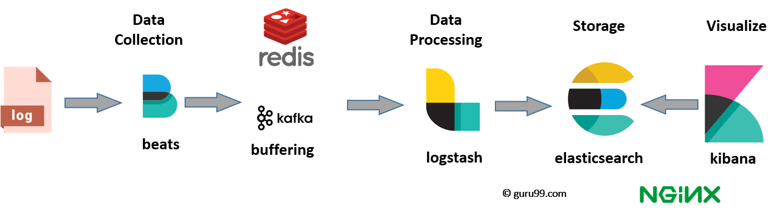
ELK stack el e

Slide 173
Elasticsearch
A NoSQL database.
Based on Lucene search engine
Has built in RESTful APIS.
Simple deployment, maximum reliability, and easy management.
Can do advanced queries and perform detail analysis
Stores all the data centrally.
It is helpful for executing a quick search of the documents.

Slide 174
Features of Elastic search:
Open source search server is written using Java
Used to index any kind of heterogeneous data
Full-Text Search
Sharded, replicated searchable, JSON document store
  Sharding is database partitioning
  Separates very large databases the into smaller, faster, more easily managed parts called data shards
Multi-language & Geolocation support

Slide 175
Elastic Search
A cluster is a collection of nodes which together holds data and provides joined indexing and search capabilities.
Node
  A node is an elasticsearch Instance.
  It is created when an elasticsearch instance begins.

Slide 176
Elastic Search
Index
  An index is a collection of documents which has similar characteristics.
  e.g., customer data, product catalog.
  It is very useful while performing indexing, search, update, and delete operations.
  It allows you to define as many indexes in one single cluster.

Slide 177
Elastic Search
Document
  It is the basic unit of information which can be indexed. It is expressed in JSON (key: value) pair. '{"user": "nullcon"}'. Every single Document is associated with a type and a unique id.
Shard
  Every index can be split into several shards to be able to distribute data.
  The shard is the atomic part of an index, which can be distributed over the cluster if you want to add more nodes.

Slide 178
LOGSTASH

Slide 179
Logstash
  Logstash is the data collection pipeline tool.
  Collects data inputs and feeds into the Elasticsearch.
  Gathers all types of data from the different source and makes it available for further use.
  Used unify data from disparate sources and normalize the data into your desired destinations.
  It allows to cleanse and democratize all your data for analytics and visualization of use cases.

Slide 180
Components of Logstash
Input:
  passing logs to process them into machine understandable format
Filters
  It is a set of conditions to perform a particular action or event
Output
  : Decision maker for processed event or log

Slide 181
Features of Logstash
Events are passed through each phase using internal queues
Allows different inputs for logs
Filtering/parsing for your logs
Advantage of Logstash
  Offers centralize the data processing
  It analyzes a large variety of structured/unstructured data and events
  Offers plugins to connect with various types of input sources and platforms

Slide 182
Kibana
Data visualization which completes the ELK stack.
Can perform advanced data analysis and visualize data in a variety of tables, charts, and maps with Elasticsearch documents
Has dashboard which
  interactive diagrams
  geospatial data
  graphs to visualize complex queries

Slide 183
Search Types
Free text searches
  It is used for searching a specific string
Field-level searches
  It is used for searching for a string within a specific field
Logical statements
  It is used to combine searches into a logical statement.
Proximity searches
  It is used for searching terms within specific character proximity.

Slide 184
Executing KLK Stack
Run the elasticsearch.bat using the command prompt.
  Elasticsearch can then be accessed at localhost:9200
Modify the kibana.yml to point to the elasticsearch instance.
Uncomment the kibana.yml
  elasticsearch.url: "http://localhost:9200"
Run the kibana.bat using the command prompt.
  kibana UI can then be accessed at localhost:5601

Slide 185
Executing ELK Stack
Run logstash using the command
  logstash -f .\..\config\logstash.conf
logstash –f logstash-custom-config.conf
http://localhost:9200/_cat/indices
GET /_cat/indices/<index>
GET /_cat/indices
http://localhost:9200/april-2021.04.25/_search?size=50
http://localhost:9200/april-2021.04.25/_search?pretty

Slide 186
Configuring Logstash
Logstash Configuration file consists of three section: input, filter and output.
Each section contains plugins that do relevant part of the processing
  Should be saved into logstash.conf config file.
Once the config file is in place and Elasticsearch is running, can run Logstash

Slide 187
Logstash-conf file
  input {
  file {
  type => "java"
  path => "C:/elk/*.log"
  codec => multiline {
  pattern => "^%{YEAR}-%{MONTHNUM}-%{MONTHDAY} %{TIME}.*"
  negate => "true"
  what => "previous"
  }
  }
  }

Slide 188
Logstash-conf file
pattern
  That should match what is to be an indicator that the field is part of a multi-line event.
what
  previous or next and indicates the relation to the multi-line event.
negate
  true or false (defaults to false).
  If true, a message not matching the pattern will constitute a match of the multiline filter and the what will be applied.
Any line not starting with a timestamp should be merged with the previous line.

Slide 189
Configurations
  input {
  file {
  path => "/var/log/someapp.log"
  codec => multiline {
  pattern => "^%{TIMESTAMP_ISO8601} "
  negate => true
  what => "previous"
  }
  }
  }
  Any line not starting with a timestamp should be merged with the previous line.

Slide 190
Logstash-conf file
  output {
  stdout {
  codec => rubydebug
  }
  elasticsearch {
  hosts => ["localhost:9200"] } }
  Start logstash using the command prompt
  logstash -f logstash.conf

Slide 191
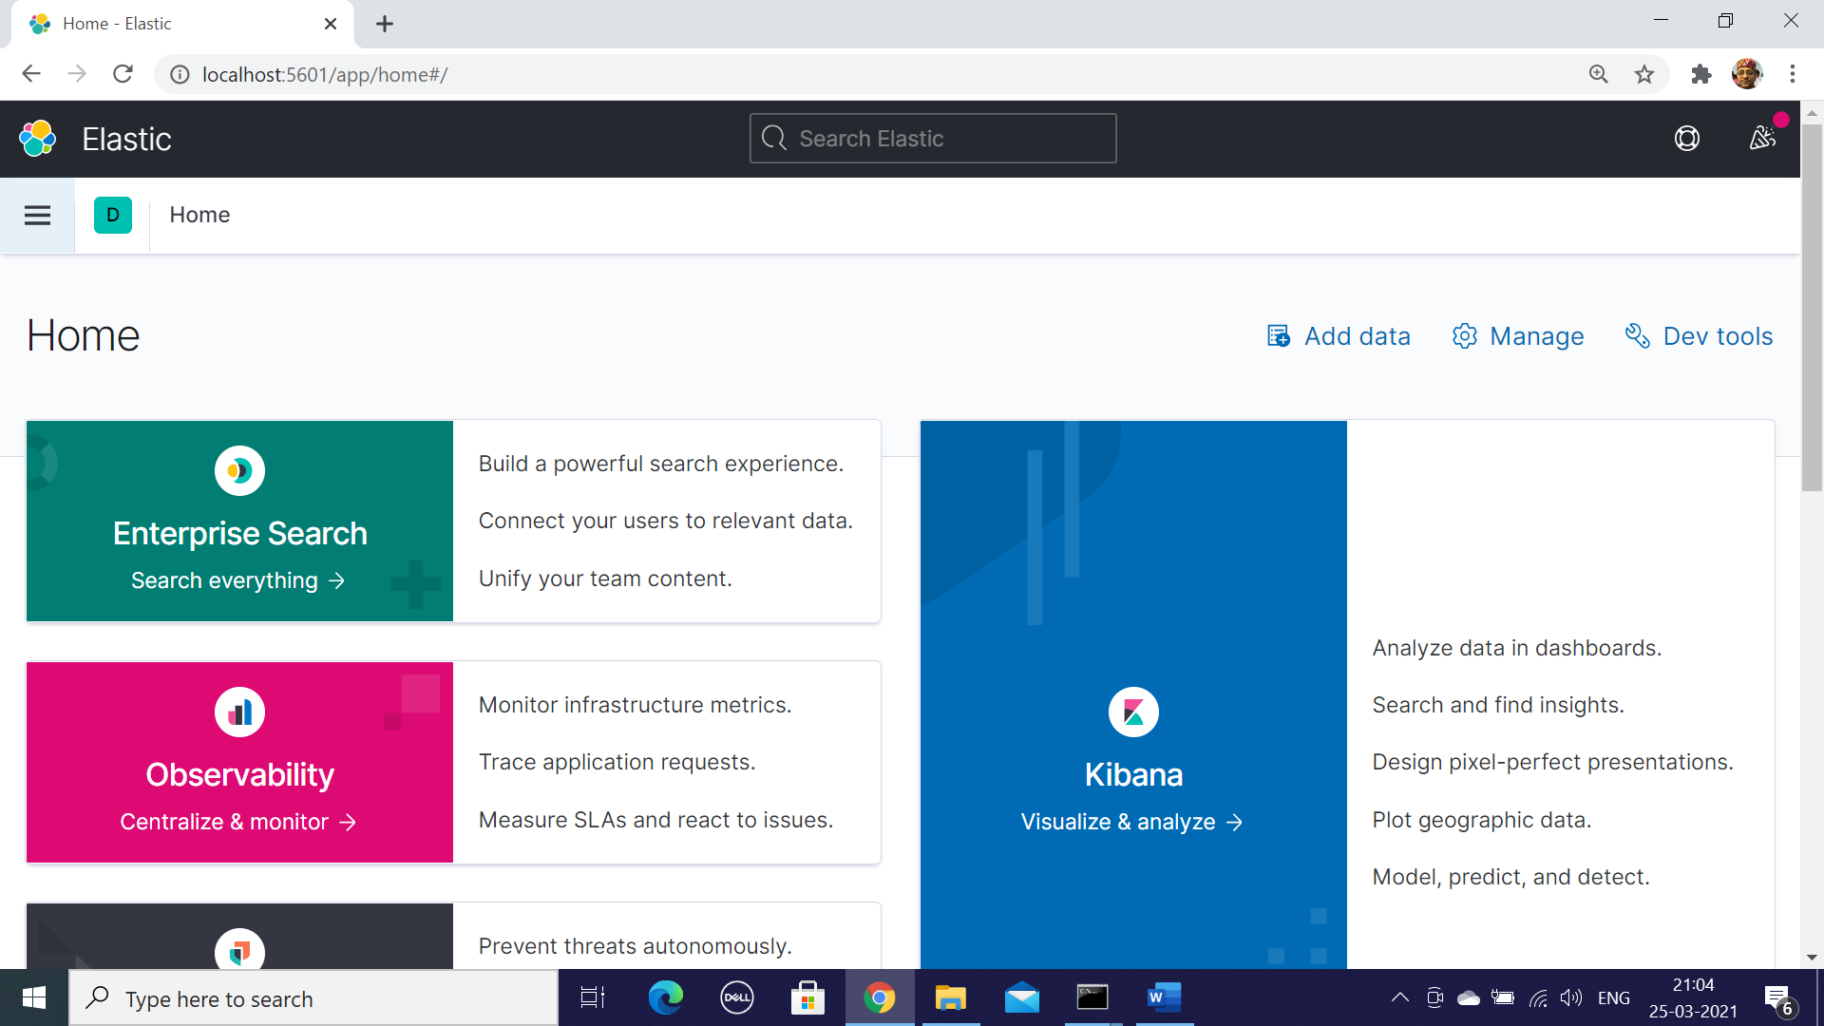
Kibana Welcome Screen

Slide 192
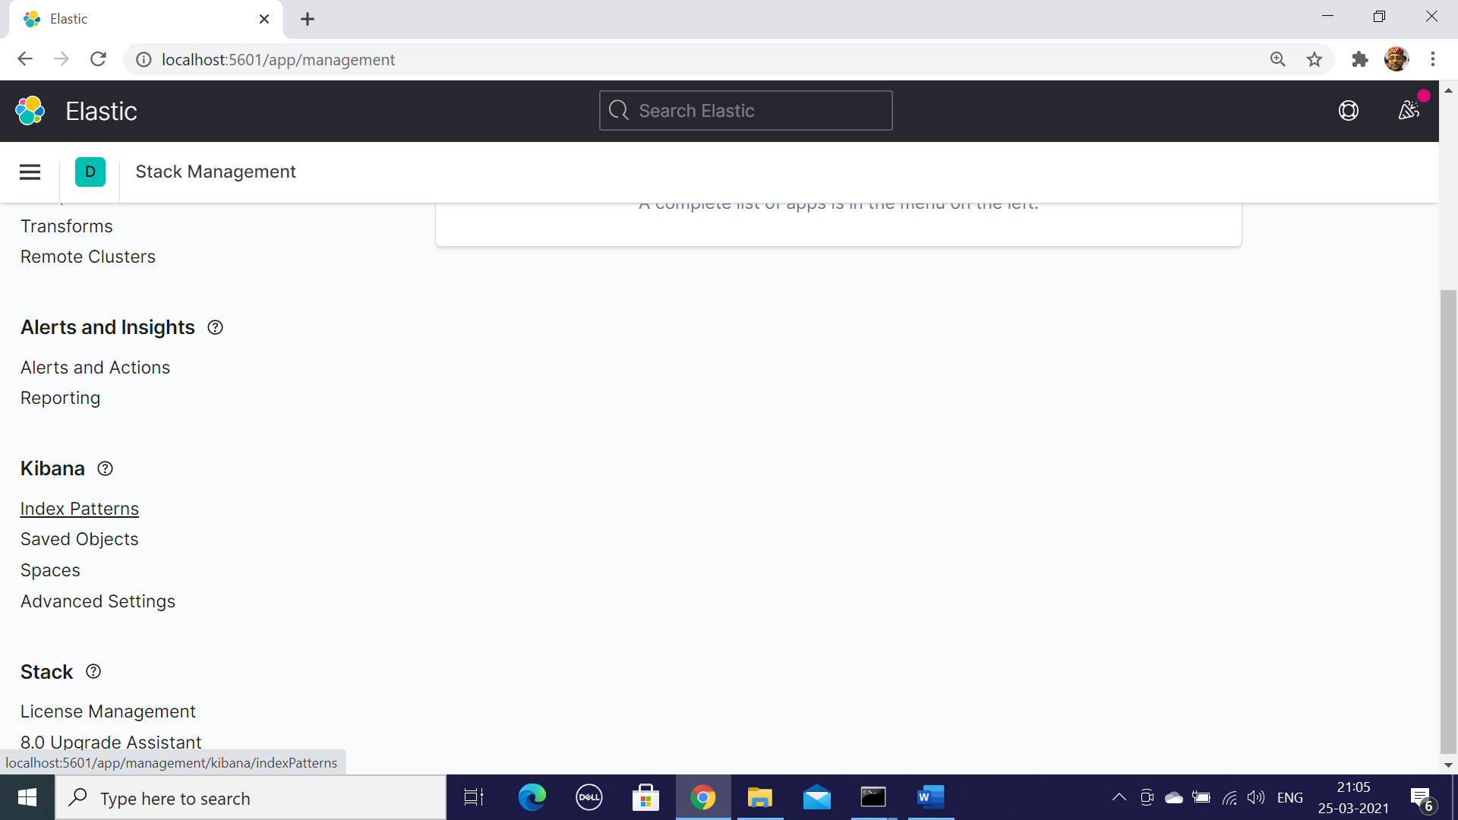
Stack Management – Index Patterns

Slide 193
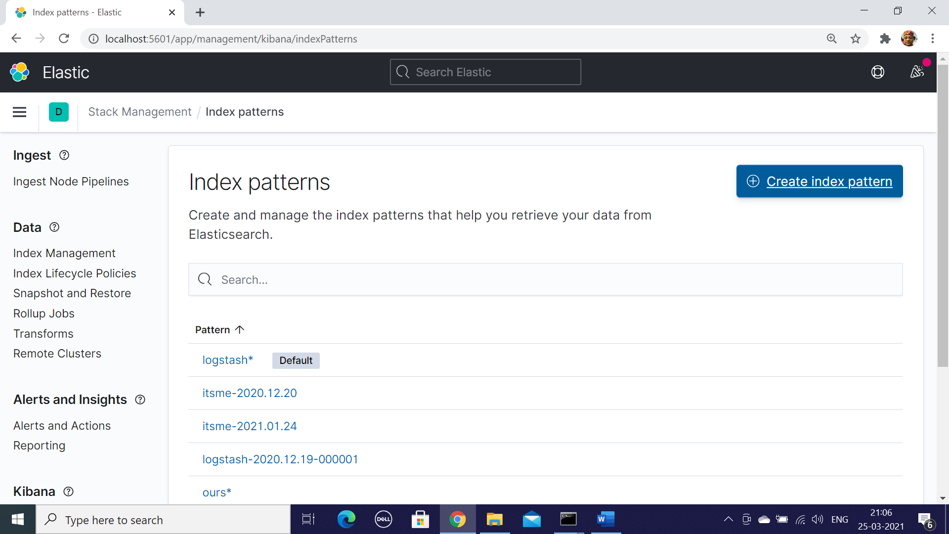
Index Patters

Slide 194
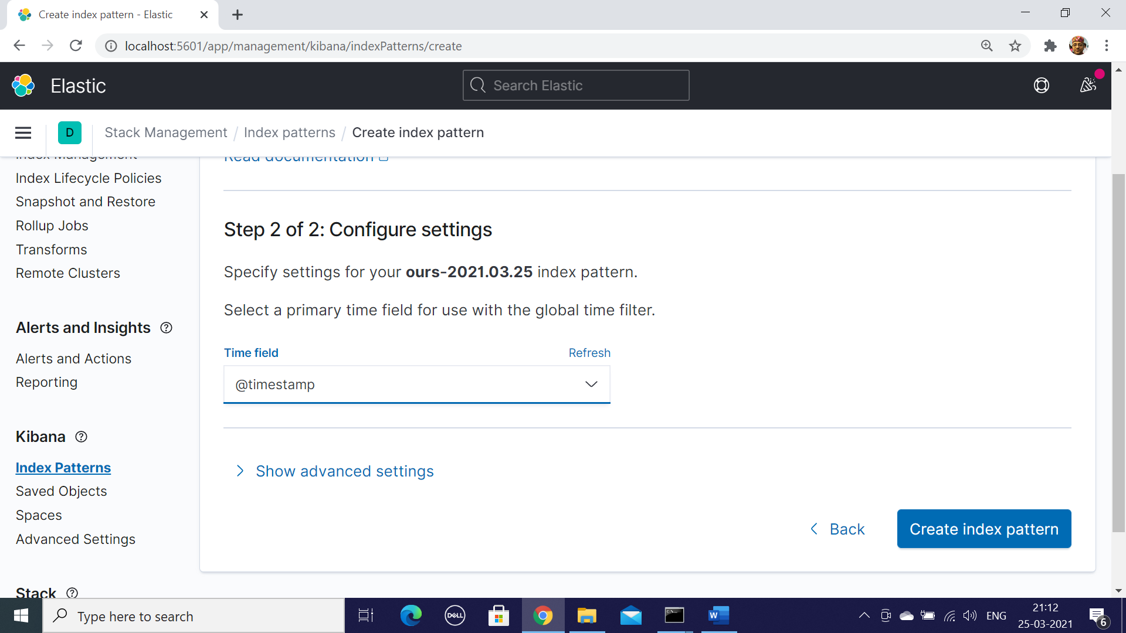
Create Index Pattern

Slide 195
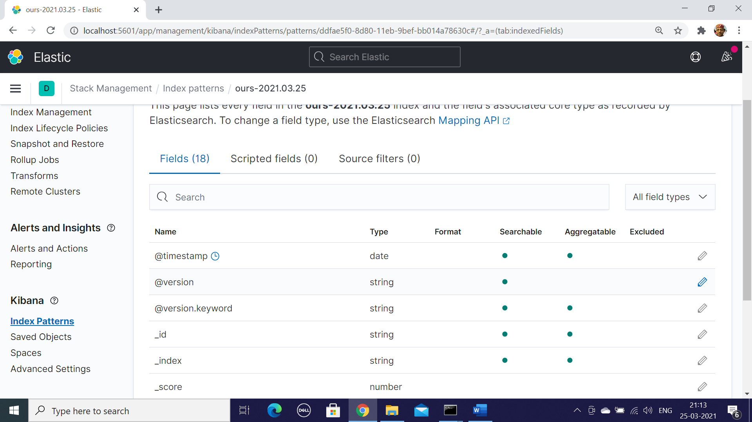
Select Time Stamp

Slide 196
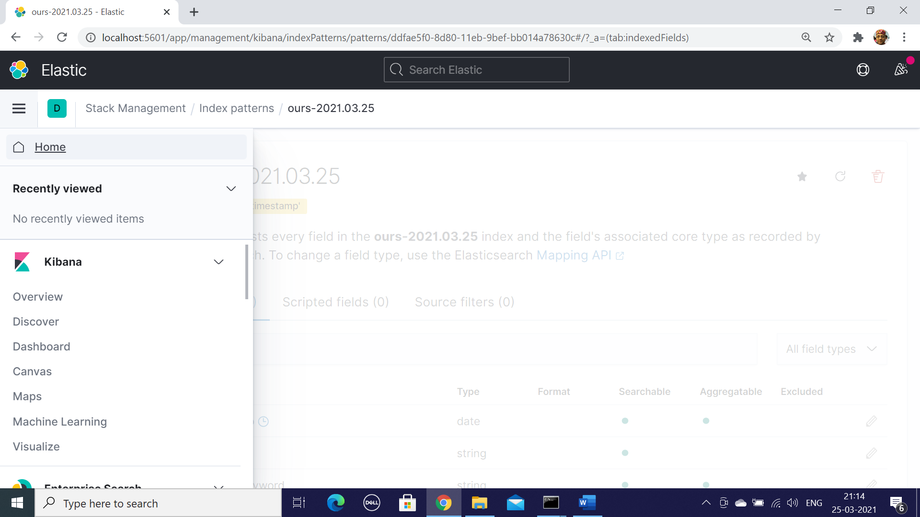
Select Discover

Slide 197
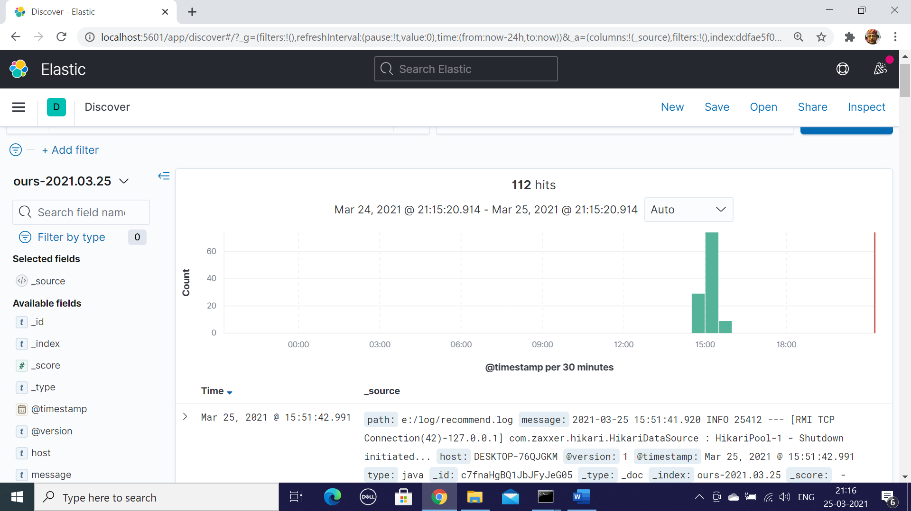
Kibana Dash Board With Visuals

Slide 198
Down Load Links
https://www.elastic.co/downloads/elasticsearch
https://www.elastic.co/downloads/logstash
https://www.elastic.co/downloads/kibana

