Slide 1

INTRODUCTION TO SPRING BOOT

Slide 2

K.Srivatsan - vatsank@gmail.com
IT Trainer Since 1991
Conducting Java Training Since 2004
About 60+ Corporate Clients

Slide 3
Topics
Spring Framework Spring 5.x Overview
Spring Boot Internals
Data Access with Spring Boot
Spring Data REST
Spring Boot with HATEOAS
Documenting REST API with Open API & Swagger
Overview of Project Reactor – Reactive Spring

Slide 4
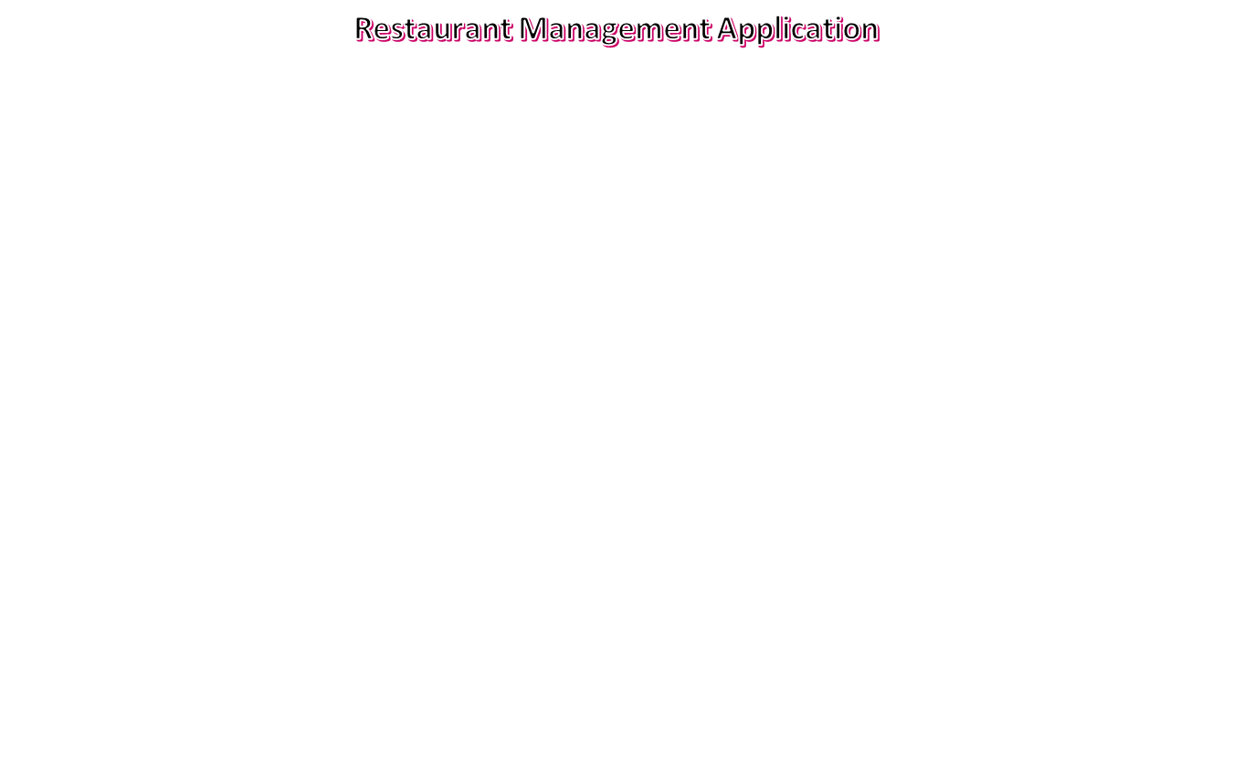
Case Study Design
Client Application
{6060}
Review Service
7070
Restaurant Info Service
7075
Reservation Service
7080
MySql
MySql
MySql

Slide 5
Software Requirement
Java 8.x or above
Eclipse IDE with Spring Tool Suite or Spring Tool Suite
  Configure Spring Tool Suite with Lombok
Spring Distribution 5.X and Boot 2.1
MySQL or Oracle RDBMS
Tomcat Server

Slide 6
Introduction
Spring
  An application development framework and inversion of control container for Java
Spring Boot
  Makes it easy to create stand-alone, production-grade Spring Applications and expose them as services

Slide 7
Spring Framework
Light-weight comprehensive framework for building Java SE and Java EE applications
Java Bean-based configuration management,
Integration with persistence frameworks.
MVC web application framework
Aspect-oriented programming (AOP) framework
Publishing REST API’s

Slide 8
IOC CONTAINER

Slide 9

The Container

Slide 10
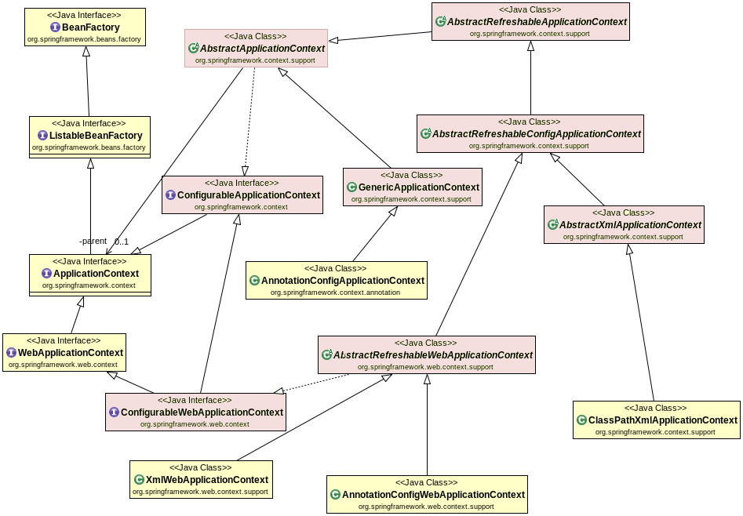
Container Hierarchy

Slide 11
Beans
A bean is an object that is instantiated, assembled, and otherwise managed by a Spring IoC container.
The “beans” are in the form of JavaBeans
  Present in a Named Package
  No Argument constructor
  getter and setter methods for the properties
  Can be controlled for scope, life cycle and callbacks.
Beans are singletons by default
Beans are Eagerly Initialized by default

Slide 12
Dependency Injection
Dependencies between the beans can be Injected by following ways
  Setter Injection
    uses setter method to set the value
  Constructor Injection
    Happens at the time of creating the object itself
  Field Injection (@Autowired at field)
    Uses reflection to set the values of private variables
  @Autowired
  private UserService userService;

Slide 13
Constructor Injection
Dependency can be one of the following
    Injected via a class constructor
    primitive and String-based values
    Dependent object (contained object)
    Collection values
  @Component
  public class UserController {
  private UserService userService;
  public UserController(UserService userService){
  this.userService = userService;
  } }

Slide 14
Setter Injection
Setter Injection
  Injected via setter methods
  Allows flexible initialization
  Requires Java Bean conventions to be followed
    Can add post initialization checking methods
  private UserService userService;
  @Autowired
  public void setUserService(UserService userService){
  this.userService = userService;
  }

Slide 15
REGISTERING BEANS

Slide 16
Configuration Meta Data
Instructs IoC Container to instantiate, configure, and assemble the objects
Can be done in XML format
  Supported from Spring 2.0
Can be done with Annotation
  Supported from Spring 2.5
Can be done with Just Java
  Supported from Spring 3.0

Slide 17
@ Component
@Component
  Spring can scan all the beans through auto scan if the class has this or similar annotation
The Registered Beans can be access by Its name
  The Name is first Character of the Class Name in lowercase
  ‘CustomerService’ to ‘customerService’.
CustomerService cust = (CustomerService)context.getBean("customerService");
@Component(“custService”)
  Can Customize the component name by passing a string value

Slide 18
@Bean
Method-level annotation in Class annotated @Configuration
Added to the public Method of the configuration class
  Methods should not be private or final
Method should return an object that should be registered as a Bean
Supports following attributes
  init-method
  destroy-method
  autowireCandidate
  name

Slide 19
Register Bean
Beans can also be registered with Java Based Configuration
  Done in the Java class with @Configuration Annotation
    This class acts as a source of Bean Definitions
  @Configuration
  public class EmployeeConfig {
  @Bean
  public Employee idOfTheBean(){
  return new Employee();
  }
  @Bean (name=“ram”) // bean Id overridden with name attribute
  public Employee employee(){
  return new Employee();
  }
  }

Slide 20
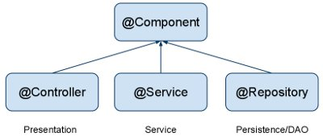
Auto Component Scan Types
@Component
  Indicates a auto scan component.
@Repository
  Indicates DAO component in the persistence layer.
@Service
  Indicates a Service component in the business layer.
@Controller
  Indicates a controller component in the presentation layer.

Slide 21
Auto Wiring of Bean
@Autowired :
  Used to auto wire bean on the setter method, constructor or a field.
  It uses auto wire bean by matching data type.
  @Autowired(required =false)
  Exception will be thrown when matching bean is not found
  required attribute is used to disable this checking
  Will leave the property unset.
@Qualifier
  Used to control which bean should be autowired on a field.
  If there are two similar beans, can specify the bean name to wire

Slide 22
Customer Bean
  @Data
  @NoArgsConstructor
  @AllArgsConstructor
  @FieldDefaults(level = AccessLevel.PRIVATE)
  public class Customer {
  private int customerId;
  private String customerName;
  }

Slide 23
Product Bean
  @Data
  @NoArgsConstructor
  @AllArgsConstructor
  @FieldDefaults(level = AccessLevel.PRIVATE)
  public class Product {
  private int productId;
  private String productName;
  }

Slide 24
Registering The Beans
  @Bean
  public Customer customer() {
  return new Customer(101,"Ramesh");
  }
  @Bean
  public Product tv() {
  return new Product(101,"LED Tv");
  }

Slide 25
Constructor DI
  @Component
  @Data
  public class Invoice {
  private Customer customer;
  private Product product;
  @Autowired
  public Invoice(Customer customer, Product product) {
  super();
  this.customer = customer;
  this.product = product;
  }
  }

Slide 26
Setter DI
  @Autowired
  public void setCustomer(Customer customer) {
  this.customer = customer;
  }
  public Product getProduct() {
  return product;
  }
  @Autowired
  public void setProduct(Product product) {
  this.product = product;
  }
  public Invoice() {
  // TODO Auto-generated constructor stub
  }

Slide 27
Spring Boot
Extension of the Spring framework
  A faster and more efficient development
Eliminates the boilerplate configurations required for setting up a Spring application.
  Opinionated ‘starter’ dependencies to simplify build and application configuration
  Embedded server to avoid complexity in application deployment
  Metrics, Health check, and externalized configuration
  Automatic configuration whenever possible

Slide 28
Spring Initializr
https://start.spring.io/
  A web-based UI tool provided by the Pivotal
  Used to generate the structure of the Spring Boot Project.
  Can configure the list of dependencies
  Package downloaded as Jar or War file
  Import as a Maven Project into STS

Slide 29
Spring Boot Starters
Set of convenient dependency descriptors
Eliminates the need to hunt through sample code
No need to copy-paste loads of dependency descriptors.
Contains lot of the dependencies that are required to get a project up and running
Also has support of managed transitive dependencies.

Slide 30
Creating a Spring Boot Project
In the Eclipse IDE Right-click in the package explorer and select New -> Spring Starter Project
A screen opens with some details which can be changed or can accept the default values for a simple project
The entry point of a Spring Boot application is the class which is annotated with @SpringBootApplication:
Uses this class with public static void main entry-point to launch an embedded web server.

Slide 31
Spring Boot Bootstrap
  @SpringBootApplication
  public class Application {
  public static void main(String[] args) {
  SpringApplication.run(Application.class, args);
  }
  }
Spring Boot can scan all the classes in the same package or sub packages of Main-class for components.
Equivalent to using @Configuration, @EnableAutoConfiguration, and @ComponentScan with their default attributes,

Slide 32
Spring Application
  public static void main(String[] args) {
  ConfigurableApplicationContext ctx = SpringApplication.run(BootIocApplication.class, args);
  Invoice invoice= ctx.getBean(Invoice.class);
  System.out.println(invoice);
  ctx.close();
  }

Slide 33
SPRING APPLICATION

Slide 34
SpringApplication
SpringApplication
  Class to bootstrap a Spring application from a Java main method.
  Creates an appropriate ApplicationContext instance
  Registers a CommandLinePropertySource to expose command line arguments as Spring properties,
  Refreshes the application context, loading all singleton beans, and triggers any CommandLineRunner beans.

Slide 35
SpringApplicationBuilder
A builder for SpringApplication and ApplicationContext instances
  Convenient fluent API and context hierarchy support.
  ConfigurableApplicationContext ctx=new SpringApplicationBuilder(DemoApplication.class)
  .lazyInitialization(false)
  .run(args);

Slide 36
SpringApplicationBuilder
ConfigurableApplicationContext ctx=
new SpringApplicationBuilder(
ApiGateway1Application.class)
.properties("spring.config.name:customapp")
.build().run(args);
ctx.close();
Customapp => refers to customapp.yml

Slide 37
AUTO CONFIGURATION

Slide 38
Auto Configuration
Spring Boot takes an opinionated view of the Spring platform and third-party libraries
  Can get started with minimum effort
  It tries to read “.properties” from various hard-coded locations.
  It also reads the “spring.factories” file
    Part of auto configure-module
    Determines the Auto Configurations it should evaluate.

Slide 39
Auto Configuration
Some Spring Boot Jars contain special JSON meta-data files that the editor looks for
  These files contain information about the known configuration properties.
“spring-boot-autoconfigure-XXX.jar”
  META-INF/spring-configuration-metadata.json”.
  Can find properties like server.port being documented there.

Slide 40
AutoConfigurations
Auto-registered @PropertySources
Spring Boot will automatically register these PropertySources
It has a default set of property locations that it always tries to read
  command line arguments
  application.properties inside .jar file etc.

Slide 41
Auto Configurations
Enhanced Conditional Support
@Conditional
  A low level annotation
Spring Boot has set of additional @Conditional annotations
@ConditionalOnBean(DataSource.class).
  The condition is true only if the user specified a DataSource @Bean in a @Configuration.
@ConditionalOnExpression("someSpELExpression).
  The condition is true if the SpEL expression is true.
@ConditionalOnJava(JavaVersion.EIGHT).
  The condition is true if the current Java version is 8.

Slide 42
Conditional
  public class EmployeeConditional implements Condition {
  @Override
  public boolean matches(ConditionContext context, AnnotatedTypeMetadata metadata) {
  boolean response = true;
  return response;
  }
  }
spring.application.name=Conditional

Slide 43
Defining Conditions
  @Bean
  @Conditional(EmployeeConditional.class)
  public Developer ramesh() {
  return new Developer(102, "Ramesh", "Chennai", "Java",94949);
  }
  @Bean
  @ConditionalOnProperty(name ="spring.application.name",havingValue = "Conditional")
  public Leader suresh() {
  return new Leader(902, "Suresh", "Pune");
  }

Slide 44
YAML

Slide 45
Yaml
YAML is a superset of JSON
A convenient format for specifying hierarchical configuration data.
SnakeYAML
  Jar file added to the class path
  Spring Boot automatically supports YAML as an alternative to properties
  application.properties takes precedence over application.yml
    If both of them are present

Slide 46
YAML
Spring provides two convenient classes that can be used to load YAML documents.
YamlPropertiesFactoryBean
  To load YAML as Properties
YamlMapFactoryBean
  To load YAML as a Map.

Slide 47
Yaml
.yml file is advantageous over .properties file
  Has type safety,
  Hierarchy
  supports list
YAML supports lists as hierarchical properties or inline list
my:
servers:
- dev
- prod
servers: [dev, prod]

Slide 48
ADVANCED BEAN CONFIGURATIONS

Slide 49
Disambiguation options
  @Component
  public class TourAgent {
  private int id;
  private String agentName;
  private long mobileNumber;
  }
  @Bean
  public TourAgent tourAgent() {
  return new TourAgent(1033,"Ram",7484848);
  }

Slide 50
Disambiguation options
  Properties props = new Properties();
  props.put(
  "spring.main.allow-bean-definition-overriding", "true");
  ConfigurableApplicationContext ctx =
  new SpringApplicationBuilder(TourServiceApplication.class)
  .properties(props)
  .build()
  .run(args);

Slide 51
@Primary
Used to give higher preference to a bean, when there are multiple beans of same type.
Used on any class directly or indirectly annotated with @Component or on methods annotated with @Bean
If a bean has @Autowired without any @Qualifier
  Multiple beans of the type exist
  Candidate bean marked @Primary will be chosen
@Qualifier should be used in conjunction with @Autowired always.
@Primary should be used in conjunction with @Bean

Slide 52
@Primary
  @Bean
  @Primary
  public Service myService() {
  return new Service();
  }
  @Bean
  public Service backupService() {
  return new Service();
  }
  getBean(Service.class) will return the primary bean

Slide 53
Life Cycle Methods
  @Component
  public class Invoice {
  @PostConstruct
  public void myInit() { }
  @PreDestroy
  public void myDestroy() { }
  }
  Can be Done with Factory Methods
  @Bean(initMethod=“init",destroyMethod="close")
  public Employee myBean() {
  return new Employee(202,”Ramesh”);
  }

Slide 54
Need for Life Cycle Methods
  public class DeliveryExecutive {
  @Autowired
  private Environment env;
  public DeliveryExecutive{
  env.getActiveProfiles() -> Will throw Null Pointer Exception
  }
  public void init() {
  log.info("Init Method called");
  log.info(env.getActiveProfiles().toString());
  System.out.println(Arrays.asList(env.getDefaultProfiles().toString()));
  }
  }

Slide 55
CONFIGURATION PROPERTIES

Slide 56
@ConfigurationProperties.
Spring Boot supports externalized configuration
  Can access properties defined in properties files.
Custom properties
Spring Properties Editor won’t be aware of these properties.
  Need to make the spring Editor aware of these properties
pom.xml
  <dependency>
    <groupId>org.springframework.boot</groupId>
    <artifactId>spring-boot-configuration-processor</artifactId>
  </dependency>

Slide 57
Custom Property
resources/META-INF/additional-spring-configuration-metadata.json
  File is used to register additional used defined properties
  {"properties": [
  {
  "name": "com.training.custom.propName",
  "type": "java.lang.String",
  "description": "A description for 'com.training.custom.prop-name'"
  }
  ]}

Slide 58
Custom Property in application.yml
  com:
  training:
  custom:
  propName: dev-profile
  server:
  port: 8082

Slide 59
@ConfigurationProperties
@ConfigurationProperties works best with hierarchical properties that all have the same prefix.
Spring will automatically bind any property defined in property file
  Since version 2.2 @ConfigurationProperties classes are detected via classpath scanning.
  @Component or @EnableConfigurationProperties is not required

Slide 60
Define Property in Java Bean
  @FieldDefaults(level = AccessLevel.PRIVATE)
  @NoArgsConstructor
  @Data
  @ConfigurationProperties(prefix = "com.training.custom")
  @Component
  public class Customer {
  int id;
  String name;
  String email;
  private String propName;
  }

Slide 61
Define Property on Factory Method
  @Bean
  @ConfigurationProperties(prefix = "com.training.custom")
  public Customer magesh() {
  return new Customer(101,"magesh","mag@abc.com");
  }

Slide 62
PROFILES

Slide 63
Profiles
A way to segregate parts of application configuration and make it only available in certain environments.
Used to control two things:
  Influence the application properties
  Which beans are loaded into the application context.
@Profile
  Used to Create profiles .
  Can be attached to an @Configuration Class
    Can also be attached to @Bean Factory Method.

Slide 64
Application.yml
  spring:
  config:
  activate:
  on-profile:
  - dev
  server:
  port: 6060
  logging:
  level:
  '[org.springframework.boot]': trace
  --- => (Three Hypens)

Slide 65
Application.yml
  spring:
  config:
  activate:
  on-profile:
  - prod
  server:
  port: 6065
  logging:
  level:
  '[org.springframework.boot]': info

Slide 66
Creating Beans Based on Profiles
  @Bean
  @Profile(value = "dev")
  public Customer ram() {
  return new Customer(101,"Developer Ramesh","ram@abc.com");
  }
  @Bean
  @Profile(value = "prod")
  public Customer shyam() {
  return new Customer(102,"Admin Shyam","shy@abc.com");
  }

Slide 67
SPRING BOOT RUNNERS

Slide 68
Command Line Runner
A Functional Interface
A special bean that execute some logic after the application context is loaded and started.
  They are Created within the same application context
  Can create Multiple CommandLineRunner beans
  It can be ordered using the Ordered interface or @Order annotation.
  Has a run() method that accepts array of String as an argument

Slide 69
Command Line Runner
  @Bean
  public CommandLineRunner commandLineRunner() {
  return (args) -> {
  for(String eachArg:args) {
  System.out.println(" Info"+eachArg);
  }
  } ;
  }

Slide 70
Building Application
mvn package
Can Use the Generated jar to Execute the application.
java -jar target/mymodule-0.0.1-SNAPSHOT.jar
java -jar -Dspring.profiles.active=prod hospital-service.jar

Slide 71
SPRING BEAN SCOPES
Self Study Notes

Slide 72

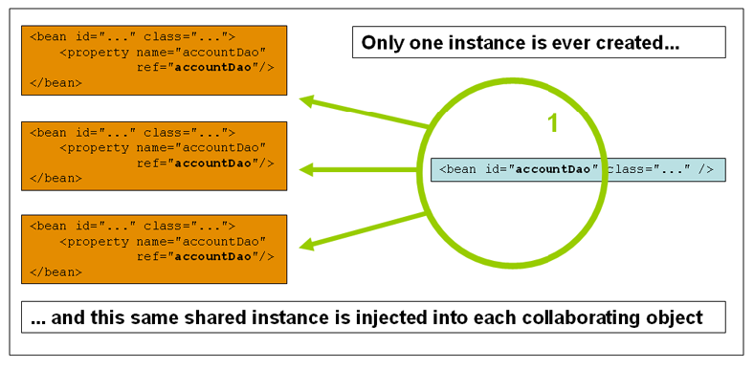
Singleton

Slide 73
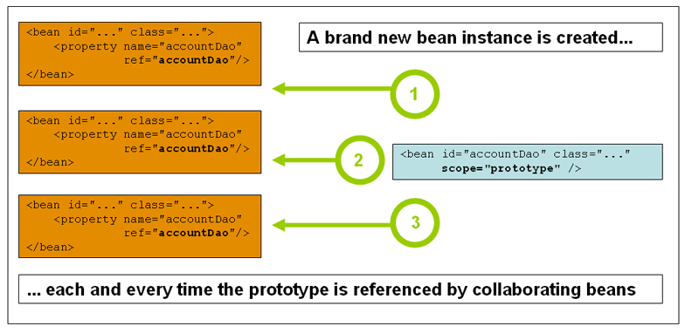
Prototype Scope

Slide 74
Bean Scope
The Bean Scope for Standard Java SE Beans are singleton:
@Scope(scopeName=ConfigurableBeanFactory.SCOPE_SINGLETON)
  Scopes a single bean definition to a single object instance per Spring IoC container, per container and per bean.
  Single instance will be stored in a cache and all subsequent requests and references will result in cached object being returned.
@Scope(value=ConfigurableBeanFactory.SCOPE_PROTOTYPE)

Slide 75
Bean Scope
The Bean Score for Standard Java SE Beans are singleton:
Scopes a single bean definition to a single object instance per Spring IoC container, per container and per bean.
prototype:
  Prototype results in the creation of a new bean instance every time a request for that specific bean is made
  Can change the Scope by
@Scope(value=ConfigurableBeanFactory.SCOPE_PROTOTYPE)

Slide 76
Test the Scopes
  DiscountService service = ctx.getBean(DiscountService.class);
  DiscountNotification protoBean;
  protoBean = service.getDiscount("april");
  log.info("Discount :="+protoBean.showDiscount());
  protoBean = service.getDiscount("may");
  log.info("Discount :="+protoBean.showDiscount());

Slide 77
Lazy Initialization
Beans are created as they are needed rather than during application startup.
  Enabling lazy initialization May improve the startup time of the application
  In a web application, enabling lazy initialization will result in many web-related beans not being initialized until an HTTP request is received.

Slide 78
Lazy Initialization
It can delay the discovery of a problem with the application.
If a misconfigured bean is initialized lazily, a failure will no longer occur during startup and the problem will only become apparent when the bean is initialized.
May reduce the number of beans created when the application is starting

Slide 79
Lazy initialization
Can be enabled programmatically using Spring Application Builder
Can be enabled using property from spring boot 2.2
  spring.main.lazy-initialization=true
Can be enabled by using the @Lazy on the Factory Method

Slide 80
Lazy-initialized beans
  @Bean()
  @Lazy(value=true)
  public Employee myBean() {
  System.out.println("Loading LazyBean bean");
  return new Employee(employee_Id,employee_Name);
  }

Slide 81
Lazy-initialized beans
ApplicationContext implementations eagerly create and configure all singleton beans as part of the initialization process.
A lazy-initialized bean tells the IoC container to create a bean instance when it is first requested, rather than at startup.
  @Bean()
  @Lazy(value=true)
  public Employee myBean() {
  System.out.println("Loading LazyBean bean");
  return new Employee(employee_Id,employee_Name);
  }

