Slide 1
ES6 FEATURES

Slide 2
Need For ES6
JavaScript is everywhere!
Used as the development language everywhere
  IoT devices
  mobile apps
  databases
  front-end and backend web technologies.
JavaScript has profound effects on multiple different technologies.
JavaScript need to meet the expectations of modern web Application Development !

Slide 3
BLOCK SCOPING

Slide 4
Scoping
var declarations in JS
  Difficult to immediately discern which are scoped locally vs. globally.
  Confusion with the working of Hoisting
May end up creating variables on the global Object
Can cause problems for enterprise level applications
Confusing workaround patterns
  IIFE.-workaround to the lack of block scope.

Slide 5
Using let
Allows to scope variables at the block level (the nearest curly brackets).
  function gradeRating(product){
  var grade ="Excellent"
  if(product.rating >3 && product.rating <=4){
  let grade ="Average";
  console.log(grade)
  }
  console.log(grade)
  }
  const tv = new Product(101, "Sony Tv", 'images/sony.jpg', 4.2);
  Output : =>// Excellent

Slide 6
Example
Each iteration creates its own block scope
  for( let i=0;i<=10;i++) {
  console.log(i);
  }
  console.log('Out Side for loop'+i);
  for(var i=0;i<=10;i++) {
  console.log(i);
  }
  console.log('Out Side for loop'+i);

Slide 7
Constant
Const is the new ES6 keyword
  like Java's final
The const declaration creates a read-only reference to a value
  It does not mean the value it holds is immutable,
  Means variable identifier cannot be reassigned.
const PI = 3.141593 PI > 3.0
  const AGE = 13;
  AGE = 20; // Error!

Slide 8
Arrow Functions
Arrow functions are, as the name suggests, functions defined with a new syntax that uses an “arrow” (=>).
  They doesn’t require function keyword, return keyword and curly brackets.
More expressive closure syntax.
  No this, super, arguments
  Cannot be called with new ,throws an error
  No prototype
  No duplicate named parameters

Slide 9
Arrow Functions
There are a variety of syntaxes available in arrow functions.
  var sum = function(num1, num2) {
  return num1 + num2;
  };
  var sum = (num1, num2) => num1 + num2;
  var sum= (num1, num2) => { return num1 + num2; };

Slide 10
Arrow Functions
  genericConverter(funcRef,arg) {
  console.log(funcRef(arg));
  }
  let tempConv = (faren) => {
  return (faren - 32) * (5 / 9)
  }
  genericConverter(tempConv, 45);
  let inrToUsd = (inr) => { return inr * 65 };
  conv.genericConverter(inrToUsd, 650)

Slide 11
Default function parameters
Java Script Functions Parameter passing is special
Functions can handle different numbers of parameters
Parameters of functions default to undefined.
  Can set a default value for the parameter
The check in the function body for undefined is not necessary.
The default argument gets evaluated at call time
  a new object is created each time the function is called.

Slide 12
Default Parameters
  function multiply(a, b = 2) {
  return a*b;
  }
  multiply(5); :output : 10
  function add(a = 1, b = 2) {
  return a + b;
  }
  add(); // 1 + 2 = 3
  add(0); // 0 + 2 = 2
  add(undefined, 0); // 1 + 0 = 1
  add(0, 0); // 0 + 0 = 0

Slide 13
Rest Parameters
Indicated by three dots (...) preceding a named parameter.
  Aggregation of remaining arguments into single parameter of the functions.
  Parameters becomes an Array
  There can be only one rest parameter, and the rest parameter must be last.

Slide 14
Rest Parameter
  var sumAll = function(...numbers) {
  var sum = 0;
  numbers.forEach(number => { sum = sum + number });
  console.log('total' + sum);
  }
  sumAll(1, 2, 3, 4, 5);

Slide 15
Rest With Default Parameter
  function calculateTotal(
  defa =new Invoice(107,"Rakesh",14500),...invoices){
  if(invoices.length ===0){
  invoices =[defa];
  }
  let total = 0;
    invoices.forEach( (eachInvoice)=>{
    total += eachInvoice.amount;
    });
    return total;
  }

Slide 16
Rest With Default Parameter
  var ram = new Invoice(101,"Ramesh",4500);
  var shyam = new Invoice(102,"Shyam",5500);
  var siva = new Invoice(103,"Siva",6500);
  let totalOf2 = calculateTotal(undefined,ram,shyam);
  console.log(totalOf2);
  let totalOf3 = calculateTotal(undefined,ram,shyam,siva);
  console.log(totalOf3);
  let total = calculateTotal();
  console.log(total);

Slide 17
Spread
Has … (three dots) notation.
Creating a New data Structure from existing One
Spreading of elements of an “iterable” collection into both literal elements and individual function parameters.
  function sum(a, b, c) {
  return a + b + c;
  }
  var args = [1, 2, 3];
  console.log(sum(…args)); // 6

Slide 18
Spread
  function sum(a, b, c) {
  return a + b + c;
  }
  var args = [1, 2];
  console.log(sum(…args, 3)); // 6

Slide 19
Spread Example
  let firstList = ['ram','shyam'];
  let secondList = ['gaurav','gautam'];
  let spread = [...firstList,...secondList];
  console.log(spread);
  Output will be
    ['ram', 'shyam‘ 'gaurav', 'gautam' ]
  It WILL NOT BE
    [ [ 'ram', 'shyam' ], [ 'gaurav', 'gautam' ] ]

Slide 20
Spread Example
  const x = null;
  const y = {id: 1, name: 'ram'};
  const z = {...x, ...y};
  console.log(z); => Output : { id: 1, name: 'ram' }
  const x = {age:45};
  const y = {id: 1, name: 'ram'};
  const z = {...x, ...y};
  console.log(z); => { age: 45, id: 1, name: 'ram' }

Slide 21
Spread Example
Supply Default Value
  const y = {id: 1, name: 'ram'};
  const z = {...y, location:'chennai'};
  console.log(z)
  { id: 1, name: 'ram', location: 'chennai' }
  Array of Values
  const scores =[90,45,89];
  const y = {id: 1, name: 'ram'};
  const z = {...y, marks:[...scores]};
  console.log(z);
  { id: 1, name: 'ram', marks: [ 90, 45, 89 ] }

Slide 22
Destructuring
It breaks an array into its elements
  Keeping the original array unchanged.
  Taking an Existing Data Structure and extracting values from it
This process maps the same variable names for values.
let [ firstColor, secondColor ] = [ "red", "green", "blue" ];
  0 1 = 0 1 2
  firstColor = red
  SecondColor = green
  console.log(firstColor); // "red"
  console.log(secondColor); // "green"

Slide 23
Destructuring
Using array destructuring assignment, to swap variables
  let a = 1, b = 2;
  [ a, b ] = [ b, a ];
  console.log(a); // 2
  console.log(b); // 1
The destructuring happens on the temporary array, which has the values of b and a copied into its first and second positions.
The effect is that the variables have swapped values.

Slide 24
Object Destructuring
Uses an object literal on the left side of an assignment operation.
Operates on the named properties that are available in objects.
  var donar = {name: "Ramesh", location: "Chennai", group: "bpos"};
  var {name,group} = donar;
  var {name,group} = = {name: "Ramesh", location:
  "Chennai", group: "bpos"}; ;
  console.log(name);
  console.log(group);

Slide 25
De structuring
Using a new Variable Name
  var donar = {name: "Ramesh", location: "Chennai", group: "bpos"};
  var {name: donarName, group: bloodGroup} = donar;
  console.log(donarName);
  console.log(bloodGroup);

Slide 26
Using Default Values
Default values can also be used in object de structuring
  var donar = {name: "Ramesh", location: "Chennai", group: "bpos"};
  var {name,group,lastDonated='12-10-2018'} = donar;
  console.log(name);
  console.log(group);
  console.log(lastDonated) // 12-10-2018

Slide 27
Rest in Object De structuring
The rest syntax can also be used to pick up property keys that are not already picked up by the destructuring pattern.
  keys and their values are copied onto a new object.
  var donar = {name: "Ramesh", location: "Chennai", group: "bpos"};
  var {name,...otherDetails} = donar;
  console.log(name);
  console.log(otherDetails); //{ location: 'Chennai', group: 'bpos' }

Slide 28
Destructuring and Spread
Destructuring is used to create variables from array items or object properties.
Spread is used to unpack iterables such as arrays, objects, and function calls.
Rest parameter will create an array from an indefinite number of values.

Slide 29
REACT MATERIAL UI

Slide 30
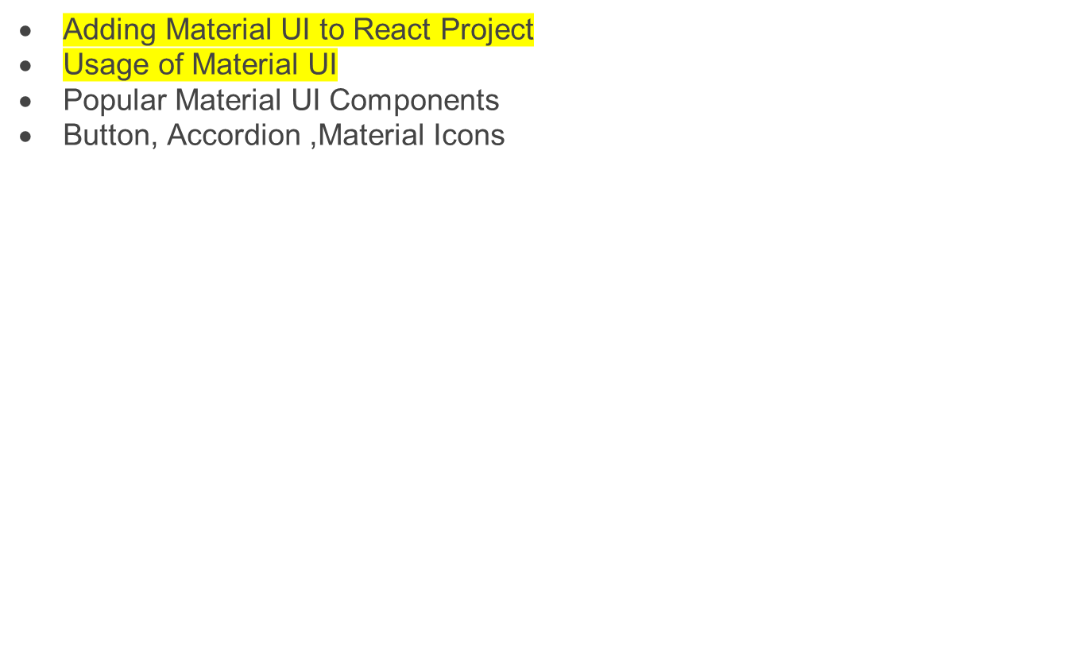

Slide 31
Introduction
Material UI is an open-source React component library that implements Google's Material Design.
It includes a comprehensive collection of prebuilt components that are ready for use in production right out of the box.
It has a suite of customization options that make it easy to implement Custom design system on top of our components.

Slide 32
Advantages of Material UI
Ship faster:
  Over 2,500 open-source contributors have poured countless hours into these components.
  Focus on your core business logic instead of reinventing the wheel—we've got your UI covered.
Beautiful by default:
  we're meticulous about our implementation of Material Design, ensuring that every Material UI component meets the highest standards of form and function, but diverge from the official spec where necessary to provide multiple great options.
Customizability:
  the library includes an extensive set of intuitive customizability features. The templates in our store demonstrate how far you can go with customization.

Slide 33
Cross-team collaboration: Material UI's intuitive developer experience reduces the barrier to entry for back-end developers and less technical designers, empowering teams to collaborate more effectively. The design kits streamline your workflow and boost consistency between designers and developers.
Trusted by thousands of organizations: Material UI has the largest UI community in the React ecosystem. It's almost as old as React itself—its history stretches back to 2014—and we're in this for the long haul. You can count on the community's support for years to come (e.g. Stack Overflow).
Material UI is comprehensive in that it comes packaged with default styles

Slide 34
All components and hooks are exported as Client Components with the "use client" directive.
Run one of the following commands to add Material UI to your project:
npm install @mui/material @emotion/react @emotion/styled
With styled-components
Material UI uses Emotion as its default styling engine. If you want to use styled-components instead, run one of the following commands:
npm install @mui/material @mui/styled-engine-sc styled-components

Slide 35
Visit the Styled engine guide for more information about how to configure styled-components.
Icons
To use the font Icon component or the prebuilt SVG Material Icons (such as those found in the icon demos), you must first install the Material Icons font. You can do so with npm, or with the Google Web Fonts CDN.
npm install @mui/icons-material

Slide 36
Google Web Fonts
To install the Material Icons font in your project using the Google Web Fonts CDN, add the following code snippet inside your project's <head /> tag:
To use the font Icon component, you must first add the Material Icons font. Here are some instructions on how to do so. For instance, via Google Web Fonts:
<link
rel="stylesheet"
href="https://fonts.googleapis.com/icon?family=Material+Icons"
/>

Slide 37
Quickstart
The following code snippet demonstrates a simple app that uses the Material UI Button component:
import * as React from 'react';
import Button from '@mui/material/Button';
export default function MyApp() {
return (
<div>
<Button variant="contained">Hello World</Button>
</div>
);
}

Slide 38
Globals
Since Material UI components are built to function in isolation, they don't require any kind of globally scoped styles. For a better user experience and developer experience, we recommend adding the following globals to your app.
Responsive meta tag
Material UI is a mobile-first component library—we write code for mobile devices first, and then scale up the components as necessary using CSS media queries.
To ensure proper rendering and touch zooming for all devices, add the responsive viewport meta tag to your <head> element:
<meta name="viewport" content="initial-scale=1, width=device-width" />

Slide 39
CssBaseline
Material UI provides an optional CssBaseline component. It fixes some inconsistencies across browsers and devices while providing resets that are better tailored to fit Material UI than alternative global style sheets like normalize.css.
Default font
Material UI uses the Roboto font by default. See Installation—Roboto font for complete details.

Slide 40
React Templates
Browse our collection of free React templates to get started building your app with Material UI, including a React dashboard, React admin panel, and more.
Our curated collection of Material UI templates includes dashboards, sign-in and sign-up pages, a blog, a checkout flow, and more.
The templates can be combined with one of the example projects to form a complete starter.
Sections of each layout are clearly defined either by comments or use of separate files, making it simple to extract parts of a page (such as a "hero unit", or footer, for example) for reuse in other pages. For multi-part examples, a table in the README at the linked source code location describes the purpose of each file.

