Slide 1

APACHE GROOVY

Slide 2
Groovy Script
Object oriented and Java syntax compatible programming language built for the Java platform.
Dynamic language has many features which are similar to Python, Ruby, Smalltalk, and Pero.
Groovy source code gets compiled into Java Bytecode so it can run on any platform that has JRE is installed.
it is designed as a companion, not a replacement for Java.

Slide 3
Need for Groovy
Groovy is an agile and dynamic language
Seamlessly integrates with all existing Java objects and libraries
Feels easy and natural to Java developers
More concise and meaningful code compares to Java
Can use it as much or as little as you like with Java apps

Slide 4
Features of Groovy
List, map, range, regular expression literals
Multimethod and metaprogramming
Groovy classes and scripts are usually stored in .groovy files
Scripts contain Groovy statements without any class declaration.
It can be compiled and fully integrated with traditional Java application.
Supports closures, dynamic typing, metaobject protocol
Support for static and dynamic typing & operator overloading

Slide 5
Install Groovy
Seps to install Groovy on eclipse
Select Eclipse help
Select Eclipse Marketplace.
Type Groovy in Find section
Select Groovy DevelomentTools xxxSnapshot
Follow the next few steps and restart eclipse

Slide 6
First Example
  class Example {
    static void main(String[] args) {
    println("Hello World")
    }
  }
There is no need for semicolons
System.out.println is reduced to println

Slide 7
Groovy Variables
Groovy supports Dynamic Typing.
Variables are defined using the keyword “def,”
The type of a variable does not need to be declared in advance.
  Compiler figures out the variable type at runtime and you can even the variable type.
  def age = 34
  println age.getClass()
  def name = “Ramesh"
  println name.getClass()

Slide 8
In Groovy, we can also use ${Variable _name} and $Variable_name instead of using the '+' operator. Using $Variable_name is known as interpolation. It can be used only when the string is defined inside the double quotes.
Example 3:
package com.app
class GroovyStringExample3 {
static void main(args)
{
String s1 = "Javatpoint"
println "This is tutorial on Groovy at ${s1} "
println "This is tutorial on Groovy at $s1 "
}
}

Slide 9
Groovy-Loops
1.upto(14) {println "$it"}
  $it is a closure that gives the value of the current loop.
0.step(14,2){println "$it"}

Slide 10
Example
  def names = ["Ramesh", "Siva", "Mani"]
  names.add("Vivek")
  println names
  println(names.contains("Siva"))
  println(names.get(2))
  println(names.pop())

Slide 11
Groovy Maps
A Map Groovy is a collection of Key Value Pairs
  def detail = [firstName:'Siva', lastName:'reddy']
  print detail.get("firstName")

Slide 12
Groovy Vs. Java
Default access specifier is public.
Getters and setters are automatically generated for class members.
Allows variable substitution using double quotation marks with strings.
Typing information is optional.
Groovy it’s not required to end with a semicolon.
Default access modifier is a package,
Need to define getters and setters method for fields
Does not support variable substitution.
Typing information is mandatory
Every statement ends with a semicolon.

Slide 13
Sql Example
  Add groovy-sql.3.0.13.jar and mysqlconnector jars
  static void main(String[] args) {
  def sql = Sql.newInstance('jdbc:mysql://localhost:3306/test', 'root',
  'srivatsan', 'com.mysql.cj.jdbc.Driver')
  sql.eachRow('select * from product_sep_2022') {
  tp ->
  println([tp.id,tp.product_name,tp.rate_per_unit])
  }
  sql.close()
  }

Slide 14
Pojo Class
  class Product {
  int id;
  String productName;
  double ratePerUnit;
  Product(){
  }
  Product( id, productName, ratePerUnit) {
  super();
  this.id = id;
  this.productName = productName;
  this.ratePerUnit = ratePerUnit;
  }
  @Override
  public String toString() {
  return "Product [id=" + id + ", productName=" + productName + ", ratePerUnit=" + ratePerUnit + "]";
  }
  }

Slide 15
Select Statement
  sql.eachRow('select * from product_sep_2022') {
  tp ->
  Product obj = new Product(id:tp.id,productName:tp.product_name,ratePerUnit:tp.rate_per_unit)
  println(obj)
  }

Slide 16
CHEF

Slide 17
Introduction
Chef is an automation tool
  It provides a way to define infrastructure as a source (IaaS)
  Automating infrastructure rather than using a manual process.
Chef is used for continuous deployment (CD)
  Can production code ready with each change to the codebase.
  Changes to the code can be delivered to the customer immediately
Creates cookbooks to deploy application code to the server

Slide 18
Chef architecture
Chef works on a three-tier client-server model
  Working units like cookbooks are developed under the workstation; using CLI,
Can deploy the cookbooks to the Chef server and all the nodes present in architecture.
Knife :
  Workstation to sever and server to machines communications are created by knife.
  Knife is command line tool that upload a cookbook to the sever .
Chef-server :
  Chef-server is middle-man between workstation and machines .
  This sever may be hosted locally or remote.

Slide 19
Chef Components
Workstation :
  Workstation are personal computer or virtual server where configuration code is created,tested or changed.
  Used by the devops engineer
Recipe :
  Code written by the devops engineer in workstations is called as Recipes.
Cookbook :
  The collection of recipes called as a cookbook.

Slide 20
Chef Components
Machine /Nodes :
  Nodes are the systems that require configurations.
Chef client
  Fetches the current state of node and then chef-client communicate with the chef-sever .
  If there is new configuration is avaiable .withe the help of knife it will take it and install it on node.

Slide 21
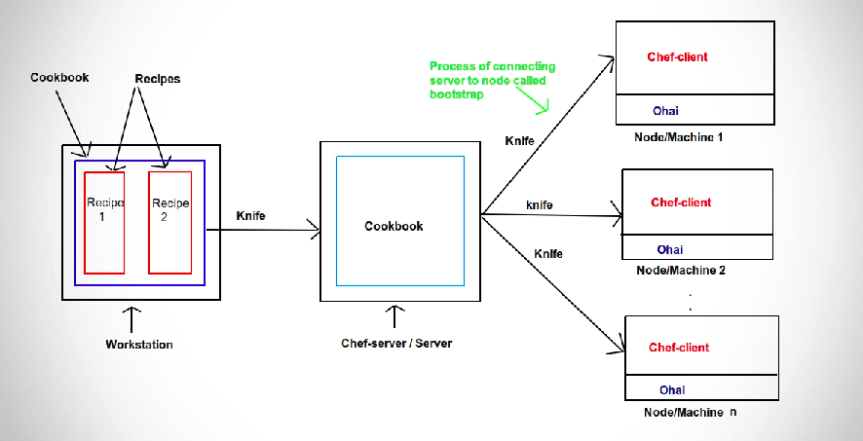
Chef Components

Slide 22
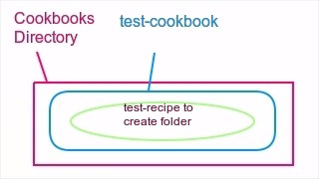
Cook Book

Slide 23
Creating a Simple Cook Book
Make a directory cookbooks.
Inside the cookbooks directory Create a one cookbook
  ‘chef generate cookbook test-cookbook’
In the test-cookbook folder and generate one recipe
  chef generate recipe test-recipe.
Edit the test-recipe.rb ’
  file ‘/myfile.txt’ do
  content ‘ welcome to chef ’
  action :create
  end
chef-client -zr “recipe[test-cookbook::test-recipe]” .
-z flag : chef-client should run in local mode
  Not connected to any chef server
-r recipe

