Slide 1

REST WebService
Roy Thomas Fielding

Slide 2
REST WebServices
An architectural style based on web-standards and the HTTP protocol.
First described by Roy Fielding in 2000.
Fast becoming defacto web services and almost replaced SOAP based web services
Increasingly important on JEE and other web development
  Easy to implement, its scalable, high performance,

Slide 3
REST Overview
Resource Oriented Architecture
  Data and functionality are considered resources
  Accessed using Uniform Resource Identifiers (URIs), typically links on the Web.
A resource is accessed via a common interface based on the HTTP standard methods.
A REST server provides access to the resources and a REST client which accesses and modify the REST resources.

Slide 4
Lightweight Web Services
REST is a lightweight alternative to Web Services and RPC.
REST services is:
  Platform-independent
  Language-independent
  Runs on top of HTTP Protocol
  Used in the Presence of firewalls too.
REST does not offer
  built-in security features
  encryption
  session management
These feature can be added by building on top of HTTP:

Slide 5
Resource Oriented Architectures
Involve loose-coupling between client and server, due to:
  Late binding to resource data
Successful use revolves around the cache-ability of resource data
  HTTP cache-control headers are used to specify resource to be cached.
Best for “linking and referring” across organization boundaries
Interaction are Stateless , new request should carry all the information required to complete
Must not rely on previous interactions with the same client.

Slide 6
Web Application & REST Service
An API that adheres to the principles of REST does not require the client to know anything about the structure of the API.
Server needs to provide whatever information the client needs to interact with the service.
The server specifies the location of the resource, and the required fields.
The browser doesn't know in advance where to submit the information, and it doesn't know in advance what to submit.

Slide 7
"Representational State Transfer? "
Resource
Client
http://www.boeing.com/aircraft/747
Fuel requirements
Maintenance schedule
...
Boeing747.html
  The Client references a Web resource using a URL.
  A representation of the resource is returned
  The representation places the client in a new state.
  When the client selects a hyperlink it accesses another resource.
  The client application transfers state with each resource representation.

Slide 8
The REST way of Designing the Web Services
HTTP GET request
URL 1
Parts
List
Response
(HTML/XML doc)
HTTP response
HTTP GET request
URL 2
Part
Data
Response
(HTML/XML doc)
Web Server
HTTP response
HTTP POST
PO
(HTML/XML)
URL 3
PO
URL to submitted PO
HTTP response

Slide 9
Examples of REST Web Services
Popular Real Life Example of REST Web services
Twitter API
Amazon.com
National Digital Forecast Database (NDFD)
Yahoo Weather Services
http://www.thomas-bayer.com/sqlrest/CUSTOMER/
http://www.thomas-bayer.com/sqlrest/CUSTOMER/2

Slide 10
JAX-RI - Implementation
To simplify development of RESTful Web services JAX-RS API has been designed.
Jersey RESTful Web Services framework is open source, production quality, framework for developing RESTful Web Services
Provides it’s own API that extend the JAX-RS toolkit with additional features and utilities to further simplify RESTful service and client development.
Download the Reference Implementation
  https://jersey.github.io/download.html

Slide 11
REST Request Methods
GET - Requests a specific representation of a resource
PUT - Creates or updates a resource with the supplied representation
DELETE - Deletes the specified resource
POST - Submits data to be processed by the identified resource

Slide 12
Root Resource
Root resource classes are POJOs annotated with @Path
  Can also have one method annotated with @Path
The annotation's value is a relative URI path.
Resource methods
  Methods of a resource class annotated with a resource method designator.
  Method designator with annotation such as @GET, @PUT, @POST, @DELETE

Slide 13
Main Class
  Its Auto Generated bin maven Project
  public class Main {
  public static HttpServer startServer() {
  ResourceConfig rc = new ResourceConfig().packages("com.example.demo.rs_demo");
  GrizzlyHttpServerFactory.createHttpServer(URI.create(BASE_URI), rc);
  }
  public static void main(String[] args) throws IOException {
  HttpServer server = startServer();
  System.in.read();
  server.stop();
  }
  }

Slide 14
Root Resource
  import jakarta.ws.rs.GET;
  import jakarta.ws.rs.Path;
  import jakarta.ws.rs.Produces;
  import jakarta.ws.rs.core.MediaType;
  @Path("myresource")
  public class MyResource {
  @GET
  @Produces(MediaType.TEXT_PLAIN)
  public String getIt() {
  return "Got it!";
  }
  }

Slide 15
Response Builder
Used to build Response instances that contain metadata instead of or in addition to an entity.
Obtained via static methods of the Response class,
public abstract Response build()
  Create a Response instance from the current ResponseBuilder.
  The builder is reset to a blank state equivalent to calling the ok method.

Slide 16
Send a JSON Response
import javax.json.Json;
import javax.json.JsonObject;
  @GET
  @Path("/quick")
  @Produces(MediaType.APPLICATION_JSON)
  public String getMessage(){
  JsonObject map = Json.createObjectBuilder().add("ram",40).build();
  return map.toString();
  }

Slide 17
@PathParam
Annotation is used to access Value of the variable on request method as a parameter
Binds the value of a path segment to a resource method parameter.
Used to inject values from the URL into a method parameter.
getCustomerById(@PathParam("customerId") int id)
Its invoked as
http://localhost:2020/RestExample/webapi/customer/101

Slide 18
Multiple @PathParam Annotation
  @GET
  @Path("{year}/{month}/{day}")
  public Response getDate(
  @PathParam("year") int year,
  @PathParam("month") int month,
  @PathParam("day") int day) {
  String date = year + "/" + month + "/" + day;
  return Response.status(200)
  .entity("getDate is called, year/month/day : " + date)
  .build();
  }

Slide 19
@QueryParam
Query parameters are extracted from the request URI
  Any java language types may be used as query parameters.
  Can also use Default Value annotation to avoid a null pointer exception if no query parameter is passed.
  @GET
  @Path("login/{zip}")
  public String login(@QueryParam("zip") String zip) {
  return "Id is " +id; }
  public String login( @DefaultValue("11111")
  @QueryParam("zip") String zip) {
  }

Slide 20
Difference between queryParam and PathPram
@QueryParam
  is used to access key/value pairs in the query string of the URI (the part after the ?).
  http://example.com?q=searchterm,
  use @QueryParam("q") to get the value of q.
@PathParam
  is used to match a part of the URI as a parameter.
  http://example.com/books/{bookid},
  use @PathParam("bookid") to get the id of a book.

Slide 21
@Produces Annotation
@Produces(MediaType.TEXT_PLAIN[, more-types])
  Used to specify the MIME media types or representations a resource can produce and send back to the client.
  Can be Applied Both at the Class and Method Level
Class level
  All the methods in a resource can produce the specified MIME types by default.
Method Level
  Overrides any @Produces annotations applied at the class level.
406 Not Acceptable
  Returned when methods matching MIME type is not found in a client request,

Slide 22
Server Response
A server response in REST is often an XML file; for example,
XML
  XML is easy to expand (clients should ignore unfamiliar fields) and is type-safe;
CSV (comma-separated values)
  CSV is more compact;
JSON (JavaScript Object Notation).
  Easy to parse in JavaScript clients and in other languages, too).
HTML
  Response is a human-readable document;

Slide 23
The @Consumes Annotation
@Consumes(type[, more-types])
  used to specify which MIME media types of representations a resource can accept, or consume, from the client.
Class level
  All the response methods accept the specified MIME types by default.
Method level
  overrides @Consumes annotations applied at the class level.
HTTP 415 (“Unsupported Media Type”) .
  Returned when methods can not respond to the requested MIME type

Slide 24
Java Object as JSON Response
  @GET
  @Path("{customerId}")
  @Produces(MediaType.APPLICATION_JSON)
  public Response getCustomerById(@PathParam("customerId") int id) {
  Customer cust=null;
  try {
  cust = dao.findById(id);
  } catch (SQLException e) {
  e.printStackTrace();
  }
  return Response.status(200).entity(cust).build();
  }

Slide 25
Post Request with JSON
  @POST
  @Consumes(MediaType.APPLICATION_JSON)
  @Produces(MediaType.APPLICATION_JSON)
  public Response addCustomer(Customer cust){
  int rowAdded=0;
  Customer addedCustomer = null;
  try {
  rowAdded = dao.add(cust);
  } catch (SQLException e) {
  e.printStackTrace();
  }
  if(rowAdded ==1) {
  addedCustomer = cust;
  }
  return Response.status(201).entity(addedCustomer).build();
  }

Slide 26
Delete Request
  @DELETE
  @Consumes(MediaType.APPLICATION_JSON)
  public Response removeCustomer(Customer cust){
  int rowDeleted=0;
  Customer deletedCustomer = null;
  try {
  rowDeleted =dao.remove(cust.getCustomerId());
  } catch (SQLException e) {
  e.printStackTrace();
  }
  if(rowDeleted ==1) {
  deletedCustomer = cust;
  }
  return Response.status(201).entity(deletedCustomer).build();
  }

Slide 27
Put Method
  @Path("updateItem/")
  @PUT
  public String update(@QueryParam("itemCode") int itemCode ){
  System.out.println("item Code"+itemCode);
  String message="One Item with Id "+"value"+itemCode+"updated";
  return message;
  }

Slide 28
  @Provider
  public class ElementNotFoundException {
  private String message ;
  private String errorCode;
  public ElementNotFoundException(String message,String errorCode) {
  super();
  this.message = message;
  this.errorCode=errorCode;
  }
  public String getMessage() {
  return message;
  }
  public void setMessage(String message) {
  this.message = message;
  }
  public String getErrorCode() {
  return errorCode;
  }
  public void setErrorCode(String errorCode) {
  this.errorCode = errorCode;
  }
  }

Slide 29
return this.service.findById(key).orElseThrow(()->
new WebApplicationException(
Response.ok(new ElementNotFoundException("Element Not Found","ERR-603"))
.build()));

Slide 30
DEVELOPING CLIENT FOR JAX-RS APPLICATION

Slide 31
Jax-RS Client Module
Client Builder
  Main entry point to the client API used to bootstrap Client instances.
Client
  Client is the main entry point to the fluent API used to build and execute client requests in order to consume
  Object that Manage the client-side communication infrastructure.
  Client client = ClientBuilder.newClient();

Slide 32
Web Target
Obtained through the reference of the Client
  Its represents a resource target identified by the resource URI.
Client Object contains overloaded target(...) methods
  These methods are used for creation of WebTarget instance.
  Takes the uri of the target web resource passed as a String
  WebTarget webTarget =
  client.target("http://localhost:8080/user")
  .path("guest");

Slide 33
Invoking HTTP Request
InvocationBuilder
  Used to start building a new HTTP request invocation
  Created using one of the request(...) methods that are available on WebTarget.
  It can define the media type of the requested resource.
  Takes the request specific parameters.
  Can also setup headers
  Invocation.Builder invocationBuilder = webTarget.request(MediaType.APPLICATION_JSON);
  Response response = invocationBuilder.get();

Slide 34
Get From REST API
  Client client = ClientBuilder.newClient();
  WebTarget webTarget = client.target("http://localhost:8080/user").path("guest");
  Invocation.Builder invocationBuilder = webTarget.request(MediaType.APPLICATION_JSON);
  Response response = invocationBuilder.get();
  User user = response.readEntity(User.class);
  System.out.println(user);

Slide 35
Posting To Rest API
  Client client = ClientBuilder.newClient();
  WebTarget webTarget = client.target("http://localhost:8080/users").path(“guest");
  Invocation.Builder invocationBuilder = webTarget.request(MediaType.APPLICATION_JSON);
  User user = new User(1, "Darshan");
  Response response = invocationBuilder.post(Entity.entity(user, MediaType.APPLICATION_JSON));
  System.out.println(response.getStatus());
  System.out.println(response.readEntity(String.class));

Slide 36
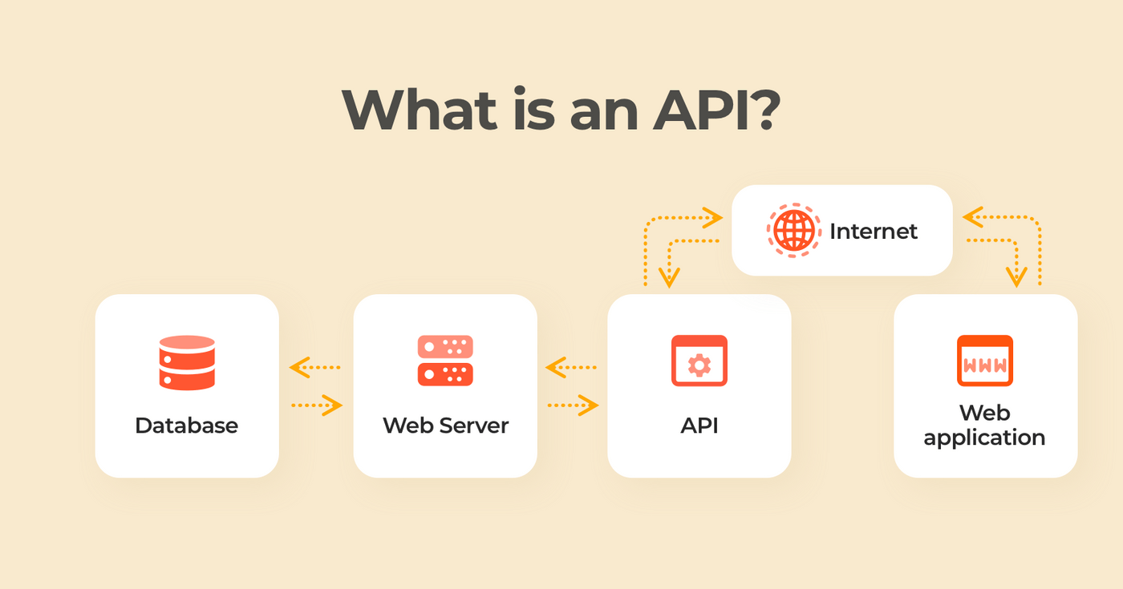
API

Slide 37
REST SERVICE USING SPRING DATA JPA

Slide 38
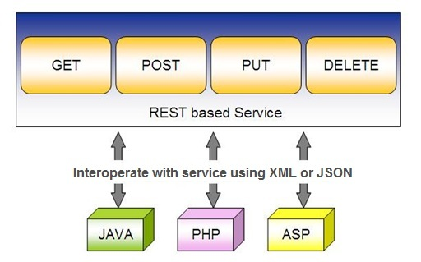
Spring RESTful Services
REST does not require the client to know anything about the structure of the API.
Server needs to provide whatever information the client needs to interact with the service.

Slide 39
Using appropriate Request Methods
GET :
  Should not update anything.
  Should be idempotent (same result in multiple calls).
  Possible Return Codes 200 (OK) + 404 (NOT FOUND) +400 (BAD REQUEST)
POST :
  Should create new resource.
  Ideally return JSON with link to newly created resource.
  Same return codes as get possible.
  In addition : Return code 201 (CREATED) is possible.

Slide 40
Using appropriate Request Methods
PUT :
  Update a known resource. ex: update client details.
  Possible Return Codes : 200(OK)
DELETE :
  Used to delete a resource.
  Possible Return Codes : 200(OK) or a 204 - no content

Slide 41
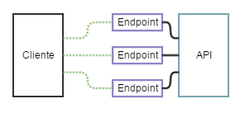
API and Endpoint

Slide 42
SPRING DATA REST WITH JPA

Slide 43
Spring RESTful Services
A RESTful architecture may expose multiple representations of a resource.
From Spring 4 @RestController annotation is added to controller
  A combination of @Controller and @ResponseBody
A Rest Controller method returns a domain object instead of a view.

Slide 44
REST Stereotypes
@RestController
  An implicit @ResponseBody is being added to the methods.
  Allows Spring to render the returned HttpEntity and its payload, directly to the response.
@GetMapping
  To map HTTP GET requests onto specific handler methods.
  Composed annotation for @RequestMapping(method = RequestMethod.GET).

Slide 45
REST Stereotypes
@PathVariable
  Indicates that the Method parameter should be bound to a URI template variable.
  @GetMapping("/members/{id}")
  public String getById(@PathVariable String id) { }
@PostMapping
  Combined shortcut for @RequestMapping(method = RequestMethod.POST).
  @PostMapping("/members“)
  public void addMember(@RequestBody Member member) { }

Slide 46
SAMPLE CODE-DEMO

Slide 47
Entity
  @Entity
  @Table(name = "demo_invoice")
  @Data
  @AllArgsConstructor
  @NoArgsConstructor
  @FieldDefaults(level = AccessLevel.PRIVATE)
  public class Invoice {
  @Id
  long id;
  String customerName;
  @DateTimeFormat(iso = DateTimeFormat.ISO.DATE)
  LocalDate invoiceDate;
  double amount;
  }

Slide 48
Repository
  @Repository
  public interface InvoiceRepository extends JpaRepository<Invoice, Long>{
  }

Slide 49
Service
  @Service
  public class InvoiceService {
  @Autowired
  private InvoiceRepository repo ;
  public List<Invoice> findAll(){
  return repo.findAll();
  }
  public Invoice findById(int id) {
  Optional<Invoice> optInvoice=repo.findById(id);
  return optInvoice.orElseThrow(() -> new
  RunTimeException(“Invoice not found"));
  }

Slide 50
Controller
  @RestController
  public class InvoiceController {
  @Autowired
  private InvoiceService service ;
  @GetMapping(path = "/api/v1/invoices")
  public List<Invoice> findAll() {
  List<Invoice> details = service.findAll();
  return details;
  }

Slide 51
@RequestBody
Used to map the HttpRequest body to a transfer or domain object
  Spring automatically deserializes the JSON into a Java type
  The type of @RequestBody annotation must correspond to the JSON sent from client-side
HttpMessageConverter
  Internally Used by Spring to perform Serialization/deserialization
@Valid
  To perform automatic validation by adding to method argument

Slide 52
Post and Put Mapping
  @PostMapping(path = "/api/v1/invoices")
  public Invoice add(@RequestBody Invoice entity
  ,HttpServletResponse response) {
  response.setStatus(201);
  return this.service.add(entity);
  }
@ResponseStatus(HttpStatus.CREATED)
  @PostMapping(path = "/api/v1/invoices")
  public Invoice add(@RequestBody Invoice entity) {
  return this.service.add(entity);
  }

Slide 53
ResponseEntity
Represents Complete HTTP response, gives more flexibility
  May be required in some special cases
  Can be used to send Status Code,Response Body,Location to the resource which was altered
  @GetMapping(path = "/api/v1/invoices")
  public ResponseEntity<Invoice> getInvoices() {
  HttpHeaders responseHeaders = new HttpHeaders();
  return ResponseEntity.ok().headers(responseHeaders).body(dao.findAll());
  }

Slide 54
Put Mapping
@PutMapping(path = "/api/v1/invoice")
  public Invoice update(@RequestBody Invoice entity) {
  return this.service.add(entity);
  }
  @PatchMapping(path = "/api/v1/invoice")
  public ResponseEntity<String> updateAmount() {
  return ResponseEntity.status(HttpStatus.CREATED)
  .body("Updated Amount:="+this.service.updateAmount());
  }

Slide 55
Remove Method in Service
  public Invoice remove(Invoice entity) {
  Optional<Invoice> optional = Optional.empty();
  if(this.repository.existsById(entity.getId())) {
  this.repository.delete(entity);
  optional = Optional.of(entity);
  }
return optional;
}

Slide 56
Delete Mapping in Controller
  @DeleteMapping(path = "/api/v1/invoice")
  public ResponseEntity<Invoice> remove(@RequestBody Invoice entity) {
  Invoice invoice = this.service.removeInvoice(entity).orElseThrow(()-> new RuntimeException("Element NOT FOUND"));
  return ResponseEntity.ok().body(invoice);
  }

Slide 57
@RestControllerAdvice
Used for Exception handling in Rest API’s
Used to handle exceptions across the whole application
Like an interceptor of exceptions thrown by methods annotated with @RequestMapping or one of the shortcuts.
It’s a combination of @ContollerAdvice and @ResponseBody.
@ExceptionHandler
  Annotation for handling exceptions in specific handler classes and/or handler methods.

Slide 58
@RestControllerAdvice
  @RestControllerAdvice
  public class ErrorHandler {
  @ExceptionHandler(value = Exception.class)
  public ErrorDetails handleAllExceptions(Exception ex, WebRequest request){
  return new ErrorDetails(LocalDateTime.now(),
  ex.getMessage(), request.getDescription(false));
  }
  }
  request.getDescription(false):
  Whether to include client-specific information like session id and user name

Slide 59
application.yml
  spring:
  datasource:
  url: jdbc:mysql://localhost:3306/test
  username: root
  password: srivatsan
  driver-class-name: com.mysql.cj.jdbc.Driver
  jpa:
  show-sql: true
  hibernate:
  ddl-auto: update
  naming:
  physical-strategy: org.hibernate.boot.model.naming.PhysicalNamingStrategyStandardImpl

Slide 60
application.yml
  logging:
  level:
  org.hibernate.sql: debug
  org.hibernate.type.descriptor.sql.BasicBinder: trace

