Slide 1

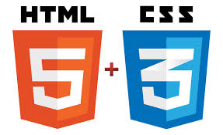
Tim Berners-Lee

Slide 2
UI Developer
Responsible to translate creative software design concepts and ideas into reality using front end technology
The task of a user experience designer is to design and create a software interfaces by prioritizing Users and business requirements over technology limitations and constraints.
  screens ,keyboards, sounds,
Knowledge Required
  HTML5
  JavaScript
  CSS/SCSS
  Ajax
  Advance Developers can hava React/Angular/Typescript

Slide 3
UX Designer
The user experience is how a user interacts with and experiences ease of use, and efficiency.
The sequence of actions they take as they interact with the interface
The thoughts and feelings that arise as they try to accomplish their task
The impressions they take away from the interaction
Create prototypes and wireframes.
  Conduct usability testing
Knowledge Required
  PhotoShop
  Wireframe Tools
  Animation Tools
  Creative Background

Slide 4
Modern UI Technologies
HTML
Javascript / Typescript
CSS
WebPack and Bundling
Ajax and Async Programming

Slide 5
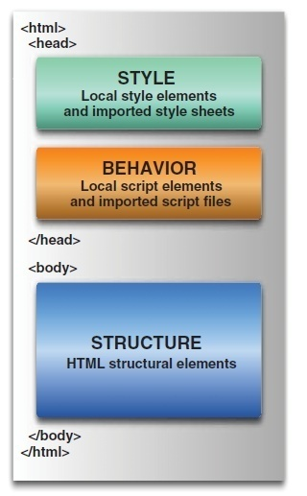
Web page

Slide 6
What is HTML
Hypertext Markup Language.
Based on the Standard Generalized Markup Language (SGML)
Defines a set of common styles for web pages:
  headings, paragraphs, lists, and tables.
  defines character styles such as boldface
These styles are indicated inside HTML documents using tags.
  <h1>Hello World</h1>
HTML element encompasses opening tag, closing tag, content

Slide 7
Evolution of HTML
Tim Berners-Lee made major contribution in Creating HTML in 1989
He Founded the W3C , refined and updated HTML with HTML4 in 1997.,
Growing need for richer Web content
  audio, video and interactivity ,Plug-in applications such as Flash
Web Hypertext Application Technology Working Group (WHATWG) in 2004,
  Created with the involvement of Apple, the Mozilla Foundation and Opera
In 2006 WHATWG developed the new standard named HTML5
  released in 2008, web browsers have increasingly incorporated the new standard

Slide 8
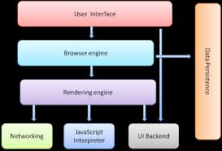
Browser Structure

Slide 9

Rendering Engine
By default, display only HTML, XML and image.
Beyond above things, we need extension/Add-on/Plug-ins
Also called as Layout Engine
Rendering Engine
  Chrome and Opera : Blink
  Chrome (iPhone) & Safari : WebKit
  Firefox : Gecko
  IE : Trident

Slide 10
What is HTML5?
Latest standard for HTML.
Designed to replace both HTML 4, XHTML, HTML DOM Level 2.
Designed to deliver rich content without the need for additional plugins.
Animation to graphics, music to movies, and can also be used to build complicated web applications.
Cross-platform.
It is designed to work with PC, or a Tablet, a Smartphone, or a Smart TV.

Slide 11
Page Simplification
HTML5 has made some simplifications to the page:
The new doctype is simply: <!DOCTYPE HTML>.
  The doctype is specified to ensure that browsers render the page in standards mode; the statement is case-insensitive.
The character set is simply declared with:
<meta charset="UTF-8">.
  This tells the browser to use the UTF-8 character encoding, ensuring that the browser won't display characters as gibberish.
The type attribute is no longer required on <style> and <script> tags.
  The default types are CSS and ECMAScript, respectively.

Slide 12
Structuring HTML
HTML defines page's overall structure
  <html>
  <head>
  <body>
These tags don't affect what the page looks like when it's displayed;
Helps the tools that interpret or filter HTML files.

Slide 13
Meta Tags
Charset:
  Instruction to the browser to use the UTF-8 character encoding
  Method of converting typed characters into machine-readable code.
View Port :
  Added to Ensure rendering and Touch Zooming

Slide 14
Meta Tags
http-equiv:
  Used to simulate an HTTP response header
    <meta http-equiv="refresh" content="300">
    <meta http-equiv="X-UA-Compatible" content="IE=edge">
X-UA-Compatible
  To choose the version of Internet Explorer the page should be rendered as IE7,IE8 or Edge
Initial-Scale
  The initial zoom level for the page when its opened in browser

Slide 15
Basic HTML
<!DOCTYPE html>
<html lang="en">
<head>
<meta charset="UTF-8">
<meta http-equiv="X-UA-Compatible" content="IE=edge">
<meta name="viewport" content="width=device-width, initial- scale=1.0">
<title>Document</title>
</head>
  <body>
  <header>
  <h1> HTML 5 and CSS 3</h1>
  </header>
  </body>
  </html>

Slide 16
HTML Global Attributes
Global attributes may be specified on all HTML elements
Class
  Specifies one or more classnames for an element (refers to a class in a style sheet)
Id
  Specifies a unique id for an element
Style
  Specifies an inline CSS style for an element
Accesskey
  specifies a shortcut key to activate/focus an element
Tabindex
  Specifies the tabbing order of an element
Title
  Specifies extra information about an element

Slide 17
<link>
TO link document to other resources.
The destination of the link(s) is given by the href attribute
The types of link indicated (the relationships) are given by the value of the rel attribute
The possible supported tokens are icon, stylesheet.
  Should only include the tokens from this list that the user agent implements the processing model for.

Slide 18
Headings
Headings are used to add titles to sections of a page
. HTML defines six levels of headings.
  <h1>Installing Your Safety Lock</h1>
The numbers indicate heading levels (H1 through H6).
They're displayed in larger or bolder text, are centered or underlined, or are capitalized so that they stand out from regular text.

Slide 19
Paragraphs
<p> tag was used to indicate the end of a paragraph and not the beginning.
Multiple <P>'s do not create blank lines
Use <BR> for blank line
Fully-specified text uses <P> and </P> ,but </P> is optional

Slide 20
List Tags- Unordered List
List tags begin and end the entire list.
Creates a list with bullets next to the list items.
The <li> tag, followed by text, then closed with </li> tag.
  <ul type=“disc”>
  <li>I am item one</li>
  <li>I am item two</li>
  </ul>
Type attribute: disc, circle, square
  <ol type="I">
  <li>Roman I</li>
  <li>Roman II</li>
  </ol>
Type Attribue : “1” , “A”,”a”,”I”

Slide 21
Comments
Comments in HTML pages to describe the page itself or to provide some kind of indication of the status of the page.
Text in comments is ignored when the HTML file is parsed;
Comments don't ever show up on screen
  <!-- This is a comment -->

Slide 22
Creating Links
<a href="http://www.someplace.com">Display Text</a>
“a” stands for anchor, and the href="" is asking for a location to link to. The </a> is the closing tag.
The text between the tags is what will show up on your Web page as a link.
"local url".
  Any file for which the to create a local url link , the file should be in the same directory as the page you are editing.
  <a href="linking.htm">Linking to Other Pages</a>

Slide 23
Horizontal Rules & Line Break
The <hr> tag, which has no closing tag in HTML and no text associated with it, creates a horizontal line on the page.
Rule lines are used to visually separate sections of a web pagejust before headings,
  To separate body text from a list of items.
Line Break
The <br> tag breaks a line of text at the point where it appears.
When a web browser encounters a <br> tag, it restarts the text after the tag at the left margin

Slide 24
Physical Character Style
    <H1>Physical Character Styles</H1>
    <B>Bold</B><BR>
    <I>Italic</I><BR>
    <U>Underlined</U><BR>
    Subscripts: f<SUB>0</SUB> + f<SUB>1</SUB><BR>
    Superscripts: x<SUP>2</SUP> + y<SUP>2</SUP><BR>
    <SMALL>Smaller</SMALL><BR>
    <BIG>Bigger</BIG><BR>
    <STRIKE>Strike Through</STRIKE><BR>

Slide 25
Inline Images in HTML: The <img> Tag
Inline images are placed in HTML documents using the <img> tag.
Adding Alternative Text to Images
When client cannot present then there is graceful degradation
  Providing an alternative version or making the user aware of shortcomings of a product as a safety measure to ensure that the product is usable
<img src="myimage.gif" alt=“picture of a cat" />

Slide 26
Images and Links
Image can serve as a link
Add an <img> tag inside a link tag (<a>), that image serves as a link itself:
<a href="index.html"><img src="uparrow.gif" alt="Up" /></a>
Both an image and text in the link tag, they become links to the same page:
<a href="index.html">
  <img src="uparrow.gif" alt="Up" />Up to Index</a>
  <a href="mailTo:admin@abc.com">Contact Admin</a>

Slide 27
<A> Anchors (HyperLinks)
Link to an absolute URL:
  If you get spam, contact
  <A HREF="htttp:www.microsoft.com“>Microsoft </A> to report the problem.
Link to a relative URL:
  See these <A HREF="#references"> references </A>
  concerning our fine products.
Link to a section within a URL:
  Amazon provided a <A HREF="www.amazon.com/#reference">
  reference for our company. </A>

Slide 28
Naming a Section
You can link to another part of the same web page by adding an id attribute to almost any HTML tag, and then link to it by adding a pound sign (#) at the beginning of where the destination url goes
Clicking on the link will take you to the HTML element with that id.
<p id="part16">
Part 16
HTML Made Easy
</p>
<a href=“#part16”>software Required</a>

Slide 29
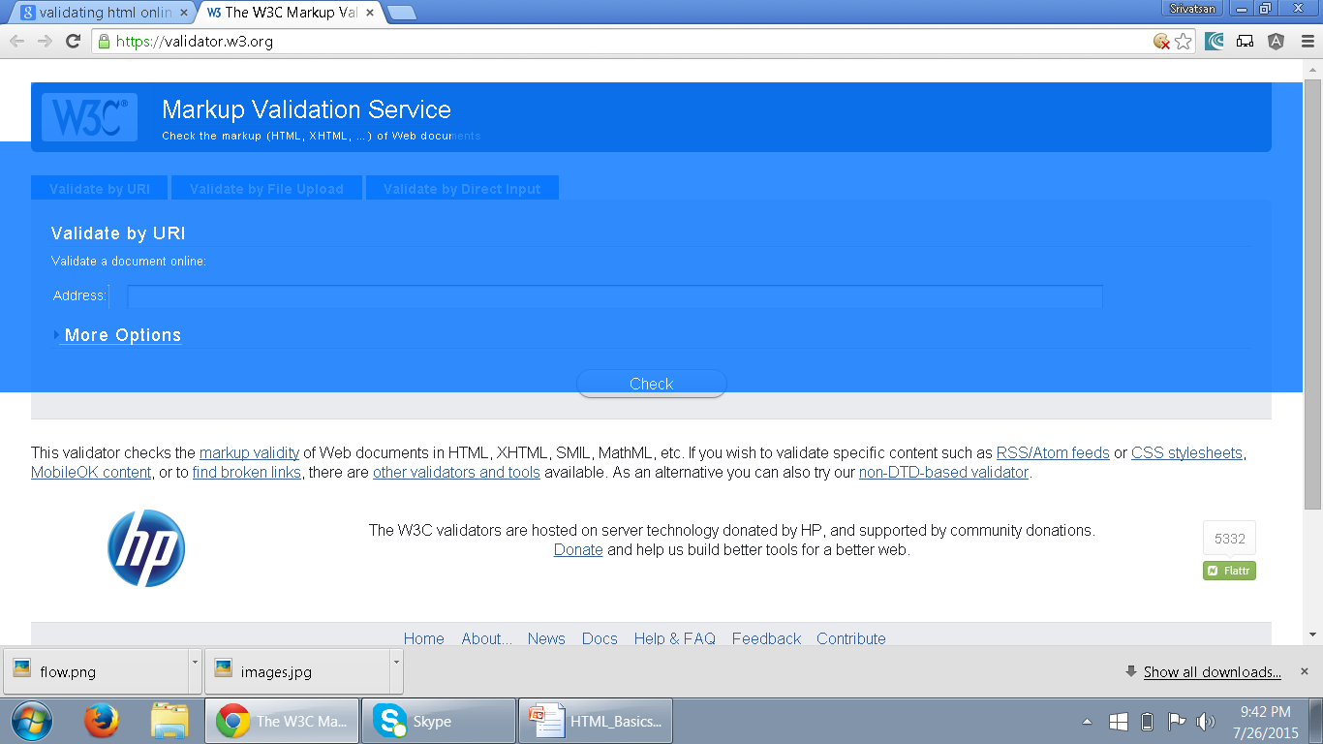
Validating HTML
The validator service checks the markup validity of Web documents in HTML, XHTML, SMIL, MathML, etc
https://validator.w3.org/
.

Slide 30
Cascading StyleSheets (CSS)
The Goal of HTML was to create content for a web page.
  CSS is a W3C Specification
From HTML 4.0
  Only CSS is used for all formatting
  It can also be added from a separate external .css file.

Slide 31
CSS Usage
Specify point size and font of text;
Set margins within a web page;
Create a distinctive style for individual web pages or sets of web pages;
Format style to one element of a web page or to a numerous pages;
Control color of different elements of a web page;

Slide 32
Style Rule
A Style Rule is composed of two parts: a selector and a declaration.
TH {color: red;}.
The Selector indicates the element to which the rule is applied.
The Declaration determines the property values of a selector.
  Property specifies a characteristic
    color, font-family, position
  Value expresses specification of a property
    RED for color, 12 pt for font-size
    {color: red;}
Selector
Declaration
Value
Property

Slide 33
External Style Sheet
Can also expressed in an external Style Sheet
    Used to apply styles to number of pages
External Style Sheet has a .css extension.
<link rel="stylesheet" type="text/css" href=“my_style.css" />
href:
  URL Specifies the location of the linked document
rel
  Specifies the relationship between the current document and the linked document
  Author,Icon,external,Help,search,sidebar,stylesheet

Slide 34
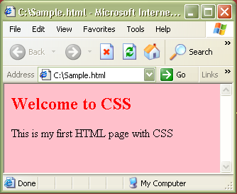
CSS – External StyleSheet Example
<html>
<link rel="stylesheet" type="text/css" href=“my_style.css" />
<h2> Welcome to CSS </h2>
<body> This is my first HTML page with CSS </body>
</html>
Sample.html
Path to the .css file
h2 {color:red}
body {background-color:pink}
my_style.css
Output:

Slide 35
CSS – Internal StyleSheet
Included in the head section of HTML page
    <style> tag is used to hold the values for formatting
Can contain <type> attribute with a value “text/css”
Style that can be applied to a page that needs a unique format.

Slide 36
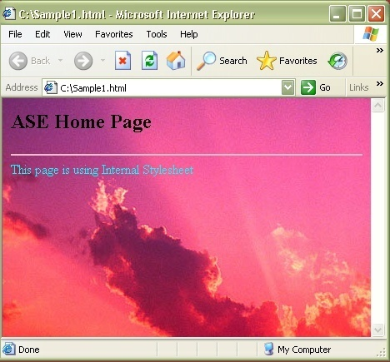
CSS – Internal StyleSheet Example
<html>
<head>
<style type="text/css">
hr{color:pink}
body {background- image:url(‘images\Sunset.jpg')}
</style>
</head>
<hr>
<body>
<h2> Home Page</h2>
<p>This page is using Internal Stylesheet</p>
</body>
</html>

Slide 37
CSS – Inline StyleSheet
    style attribute is used in the relevant tag.
    style attribute can contain any CSS property.
    <html>
    <p style="color:blue">This is a example of inline stylesheet</p>
    </html>

Slide 38
Working with Tables

Slide 39
Head and Body
<thead>
  Can semantically indicate that the first row was the header of the table.
  must appear after any <caption> element
  Must appear before any <tbody>, <tfoot> and <tr> element
<tfoot>
  defines a set of rows summarizing the columns of the table.
  Can be used as a child of a <table> element, after any <caption>, and <thead>
  Can be used before any <tbody> and <tr> elements.
.

Slide 40
<table> - Element
To tabulate data in columns and rows as in a spreadsheet
Used for displaying tabular data.
Its inappropriate to use tables for layout.
  <table>
  <tr>
  <th>Name</th>
  <th>ID</th>
  </tr>
  <tr>
  <td>Ramesh</td>
  <td>10000</td>
  </tr>
  </table>

Slide 41
Table
Elements used to create data within each row
<th>...</th>
  Used for heading cells.
  Browsers center the contents
  text is rendered in the boldface.
<td>...</td>
  Used to render table data.

Slide 42
Basic Styling With CSS
Width
  Can be applied to individual cells <th> or <td>
  width attribute in cells can be pixel or a percentage
  Useful when multiple columns of identical widths, regardless of their contents
border-collapse
  To specify whether a table's borders are separated
  cells can have distinct borders from each other
  Adjacent cells can share borders.
  border-collapse: collapse;
  border-collapse: separate;

Slide 43
Padding
Padding :
  sets the padding area on all four sides of an element.
  A shorthand that sets all individual paddings at once:
  padding-top, padding-right, padding-bottom, and padding-left.
  Can be used to defines the amount of space between the edges of the cells and the content inside a cell.
one value : Same padding to all four sides.
two values : top and bottom, left and right.
three values : top, left and right, bottom.
four values : top, right, bottom, and left

Slide 44
Basic Styling With CSS
border
  A shorthand property for setting following property values
  Any value that is not specified is set to its corresponding initial value.
  border-width,
  border-style,
  border-color.
border: 1px;
border: 2px dotted;
border: medium dashed green;

Slide 45
Basic Styling
  table{
  border: 2px solid blue;
  border-collapse:collapse;
  }
  th,tr,td{
  border: 2px solid blue;
  }
  td{
  padding:0px 10px 0px 10px;
  width: 30px;
  }

Slide 46
colSpan and rowSpan
Create a cell that spans multiple rows or columns
  Can be added to both <th> or <td>
The data within that cell then fills the entire width or length of the combined cells
rowspan
  similar to colspan,
  it will span across rows rather than columns.

Slide 47
Table Example
  <table>
  <caption>Conference Schedule</caption>
  <thead>
  <tr>
    <th>Item Number</th>
    <th>Item Name</th>
    <th>Quantity</th>
    <th>Rate</th>
    <th>Amount</th>
  </tr>
  </thead>

Slide 48
Table Example
  <tbody>
  <tr>
    <td>101</td>
    <td>Cake</td>
    <td>1</td>
    <td>200</td>
    <td>200</td>
  </tr>
  </tbody>
  <tfoot>
        <tr>
        <td colspan="4">Total</td>
        <td>200</td>
        </tr>
  </tfoot>
  </table>

Slide 49
Basic Styling
  table{
  border: 2px solid blue;
  border-collapse: collapse;
  margin: auto;
  }
  thead {
  background-color: grey;
  }
  tfoot {
  background-color: lightgray;
  }
  caption{
  font-style: 'Arial';
  }
  tr,td {
  border: 2px solid blue;
  text-align: center;
  }

Slide 50
Semantic markup
HTML is oriented towards design
  element in it should have well-structured content.
Semantic markup :
  self-describing and uses the correct HTML elements for the correct job.
  <div id="heading" style="font-size:300%; padding: 10px;">
  My heading
  </div>
Its not heading in terms of meaning or purpose.

Slide 51
Advantage of Semantic Markup
Search engine optimization
  keywords in headings have more weight,
Accessibility
  screen readers use heading elements as navigational signposts
Development
  it is a lot trickier to target elements with styles and scripts when you don't use proper semantic elements
Lightweight
  removing all those nested <divs> and other spaghetti code.
This makes file sizes smaller and coding easier.

Slide 52
Structural Elements
Elements that are replacements for the common ad hoc semantics applied using class and id attributes
Header
  Header content for a page or a section of page
Footer
  footer content for a page or a section of the page
Section
  A section in a web page
Article
  Independent article content
Aside
  Related content or pull quotes
nav
  Navigational aids

Slide 53
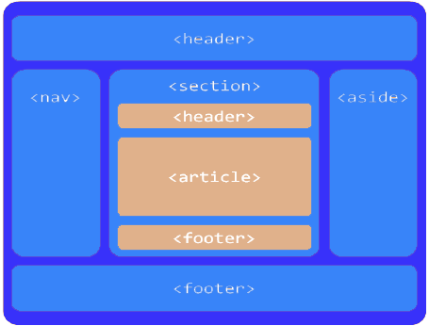
Page Layout

Slide 54
Example
  <div id="main">
  <div id="primary">
  <article>
  </article>
  </div>
  <div id="content">
  <article>
  <aside></aside>
  </article>
  </div>
  </div>

Slide 55
<nav> Element
The nav element stands for Navigation.
  “A section of a page that links to other pages or to parts within the page: a section with navigation links.”
Usage is not limited to only the primary navigation, typically at the top of the web page.
Can also be used on any part of the page that also acts as a navigator,

Slide 56
Example
  <body>
  <div id="wrapper">
  <header>
  <h1>HTML5 Document Structure Example</h1>
  <nav id="navigation">
  <ul id="nav-list">
  </ul>
  </nav>
  </header>

Slide 57
HTML
FORM HANDLING

Slide 58
New Global Attributes
Contenteditable
  Whether the contents of the element is editable or not
  Values can be true or false
draggable
  whether the element is draggable.
  Values can be true or false
hidden
  Specifies that the element represents an element that is not yet, or is no longer, relevant.
  Value can be "hidden" or empty string
spellcheck
    Elements contents are subject to spell checking and grammar checking.
  Values can be true or false

Slide 59
Using the <form> Tag
To accept input from a user, input fields are placed inside a <form> tag.
Its purpose is to indicate where and how the user's input should be sent.
The two most used attributes of the <form> tag are
  Action
  method.
Both of these attributes are optional.
  <form action="someaction" method="get or post">
  </form>
Action specifies the URL to which the form is submitted.

Slide 60
Creating Form Controls with the <input> Tag
Text Boxes
  These tags allows the user to enter a single line of text.
  <input type="text" name=“userName" size="25" maxlength="60" />
The type=" "
  specifies the type of input we want from the user, the type is "text".
The name=" "
  attribute is name of the line of text to be recognized when the form is submitted

Slide 61
label
Defines a label for an <input> element.
Usability improvement for mouse users, because if the user clicks on the text within the <label> element, it toggles the control.
The for attribute of the <label> tag should be equal to the id attribute of the related element to bind them together.
  <label for="email">EMAIL-ID</label>
  <input type="email" value="" name="emailid" size="30" placeholder="Enter a valid email address“ id=“email”>

Slide 62
Creating Password Controls
The password field used when data entered is masked
  <input type="password" name="userpassword" size="8" maxlength="8" />
Text Area
  used to create text area where lines of text could be inserted
  <textarea name="comments" rows="5" cols="30"></textarea>

Slide 63
Radio Buttons and Check Box
Little button for user to click on :
  <label>Pizza</label>
  <input type="radio" name="foodchoice" value="pizza" />
The name=" "
  To name the section of choices.,If its group all the button share the same value
The value=" “
  To assign the value of the individual button when it is selected.
  This is going to be the text sent back as the user's choice

Slide 64
Checkboxes
  <label>Pizza</label>
    <input type="checkbox" name="foodchoice" value="pizza" />
A little square is displayed instead of small circle
type="checkbox"
  tells the browser to display the little box.
name=" "
  allows to give the section of choices a name,
value=" "
  allows to give the individual checkbox its value

Slide 65
Drop-Down Menus
They are created with the <select> tag:
  <select name="bestcolor">
  <option selected="selected">blue</option>
  <option>red</option>
  <option>black</option>
  <option>green</option>
  <option>polka dots!</option>
  </select>
<option selected="selected">
  To specify which option will be displayed as the default value on the screen.
<option>
  To add another choice to the list.

Slide 66
Creating Submit Buttons
Submit buttons are used to indicate that the user is finished filling out the form.
Submit button is displayed with the text “Submit Query. “
value attribute used enter custom label,
  <input type="submit" value="Send Form Data" />
Creating Reset Buttons
Reset buttons set all the form controls to their default values.
  <input type="reset" value="Clear Form" />

Slide 67
Creating Generic Buttons
<input type="button" name="verify" value="verify" onclick="verifydata()" />
Button can be created such a way it runs a function when clicked
Label for the Button is provided with the value attribute
Unlike Submit buttons, regular buttons don't submit the form when they're clicked.

Slide 68
Search
Provides a search field—a one-line text input control for entering one or more search terms.
The difference is primarily stylistic:
Browsers have added the ability to clear the input with the click of a mouse, by providing an x icon once text is entered into the field.

Slide 69
Email Addresses and Telephone Number
Used for specifying one or more email addresses.
  It supports the Boolean multiple attribute, allowing for multiple, comma-separated email addresses.
  <label for=“email">Email </label>
  <input type="email" id="email" name="email“ multiple=“multiple”>
  <label for="telNo">Telephone number (xxx-xxx-xxxx) </label>
  <input id="telNo" name="telNo" type="tel" required
  pattern="[0-9]{3}-[0-9]{3}-[0-9]{4}">

Slide 70
Dates and Times
There are several new date and time input types,
  date, datetime, datetime-local, month, time, and week.
  <input type=“date” name=“birthdate” >
date
  This comprises the date (year, month, and day), but no time
month
  Only includes the year and month; January 2015.

Slide 71
The required Attribute
The Boolean required attribute tells the browser to submit the form if the field in question is filled out correctly.
The focus will move to the first invalid form element.
Default error messages are shown on the page
<input type="text" title="First Name should not be blank" name="firstName“ required="required“ />

Slide 72
Place Holder Attribute
To show a short hint inside the form element, space permitting,
Text disappears when the field gains focus, and reappears on blur if no data was entered
  <label for="url">My website is located at:</label>
  <input type="text" id="url" name="url“
  placeholder="http://example.com">
  </li>
Can also be Styled with CSS
input::-webkit-input-placeholder { color: #ccc; }

Slide 73
The disabled Attribute
Can be used with any form control except the output element
If set on a fieldset apply to all the contained form elements
They aren’t submitted along with the form to the server side
<button disabled="disabled">Register</button>

Slide 74
The readonly Attribute
Similar to the disabled attribute: it makes it impossible for the user to edit the form field.
Unlike disabled, however, the field can receive focus, and its value is submitted with the form.
Used to let the user know that we are collecting this data without allowing them to change it:
  <label for="about">Article Title</label>
  <input type="text" name="about" id="about" readonly=“readOnly”/>

Slide 75
formaction
Similar to action attribute of <form> element.
used to send the data through the URL,
overrides the action attribute of the form element.
Can be used with submit and image
  <input type="submit“
  formaction="demo_admin.php"
  value="submit as Admin“>
<input type="submit" formmethod="post" formaction="demo_post.php">

Slide 76
CSS and CSS3

Slide 77
Style Classes
Created to control which elements of a given type should use a style rule.
  In the style sheet, the selector defines the class name, which is preceded by a period.
  In the HTML, the tag includes the class attribute and specifies the value of the class name
A class name should be descriptive of the purpose (such as nav, news, footer, and so on) rather than being descriptive of the presentation (such as redText).
a.anchorStyle { text-decoration : none }
<a class="anchorStyle" href="somepage.html">Link text</a>

Slide 78
Style Classes
Style classes can also be “generic,” i.e. not tied to a specific element type.
  .mytag {
  font-size: 23px;
  background: gray;
  }
  .urtag
  {
  font-size: 32px;
  background: fuchsia;
  }

Slide 79
Using the CSS
  <head>
  <link href="MyFirstCss.css" type="text/css" rel="stylesheet">
  </head>
  <body>
  <div class="mytag">
  <p> Using Div Tag in CSS</p>
  <div class="urtag">
  <p> Using Second Tag in the list</p>
  </div>
  </div>

Slide 80
Cascading Rule
If two equally specific rules can apply to the same element, the one that comes last in the style sheet is used.
Thus, in the example below, a:hover must follow a:link and a:visited in order to have effect, since a link can be both visited (or not) and hovering.
The order of the first two doesn’t matter since they are mutually exclusive.
a:link { color : red }
a:visited { color : green }
a:hover { color : yellow }

Slide 81
Css class definition
<div class="general-div">some stuff</div>
<div class="general-div special">some stuff</div>
<div class="general-div">some stuff</div>
<div class="extra-div">some stuff</div>
<div class="extra-div special">some stuff</div>
.general-div {width: 300px; height: 300px; border: 1px solid #000;}
.extra-div {width: 200px; height: 200px; border: 1px solid #666;}
.general-div.special {background-color: red;}
.extra-div.special {background-color: blue;}
.general-div with .special class to have red background,
extra-div with .special class to have a blue background.

Slide 82
Block-Level Elements
A block level element in HTML create a “block” or “box”.
Browsers typically display the block-level element with a new line.
Block level elements may contain inline elements and other block-level elements.
The block level elements create “larger” structure than inline elements.

Slide 83
List of Block-Level Elements
<address> Contact information | <figcaption> (HTML5) Figure caption | <ol> Ordered list
<article>(HTML5) Article content | <figure>(HTML5) Groups media content with a caption | <output>(HTML5) Form output
<aside>(HTML5) Aside content | <footer>(HTML5) Section or page footer | <p> Paragraph
<audio>(HTML5) Audio player | <form> Input form | <pre> Preformatted text
<blockquote> Long (“block”) quotation | <h1><h2><h3><h4><h5><h6> Heading levels 1 - 6 | <section>(HTML5) Section of the page
<canvas>(HTML5) Drawing canvas | <header>(HTML5) Section or page header. | <table> Table.
<dd> Definition description | <hgroup>(HTML5) Groups header information | <tfoot> Table footer
<div> Document division | <hr> Horizontal rule (dividing line) | <ul> Unordered list
<dl> Definition list | <fieldset> Field set label | <video>(HTML5) Video player

Slide 84


Inline Elements
.norm {
color:red;
}
.big {
color:blue;
font-weight:bold;
}
.italicText {
color:green;
font-style:italic;
}
#row1 {
padding:10px;
border:solid 1px #000;
}
<div id="row1" >
<span class="norm">This is small text and </span>
<span class="big">this is big</span>
<span class="italicText"> I am Italic</span>
</div>

Slide 85
CSS Display properties
Display
  The display property configures how and if an element is displayed.
An element configured with:
  display:none ;
    will not be displayed
    and does not occupy any space
    used when configuring styles to print a web page
  display:block ;
    will be rendered as a block element – a line break above and below (even if it is actually an inline element, such as an anchor tag).
  display:inline;
    The element will be rendered as an inline element – no line break above and below (even if it is actually a block element – such as a <li>).

Slide 86
Changing How an Element is Displayed
Changing an inline element to a block element, or vice versa, can be useful for making the page look a specific way, and still follow web standards.
The following example displays <li> elements as inline elements:
Example
li {
display: inline;
}
Example
span {
display: block;
}

Slide 87
COMMENTS IN CSS
<style>
/*
p {
font-family: sans-serif;
font-size: 15pt;
}
*/
</style>

Slide 88
SELECTORS

Slide 89
CSS Selectors
Selectors are at the heart of CSS.
CSS allowed the matching of elements by type, class, and/or id.
CSS2.1 added pseudo-elements, pseudo-classes, and combinators.
With CSS3, we can target almost any element on the page with a wide range of selectors.

Slide 90
Universal Selector
* {
margin: 0;
padding: 0;
}
The star symbol will target every single element on the page.
Used to zero out the margins and padding.
It adds too much weight on the browser

Slide 91
Select by Id
#container {
width: 960px;
margin: auto;
}
Prefixing the hash symbol to a selector allows us to target by id.
Most common usage
id selectors are rigid and don't allow for reuse.
Can use a pseudo-class.

Slide 92
Class Selector
.error {
color: red;
}
This is a class selector.
The difference between ids and classes is that, with the latter, you can target multiple elements.
Use classes when you want your styling to apply to a group of elements.

Slide 93
Selector Grouping
Can be grouped using a comma (,) separator.
Any element that matches either of the selectors in the group:
td, th { ⋮ declarations }
  Similar to the logical OR operator,
  but it’s important to remember that each selector in a group is autonomous.
#foo td, th { ⋮ declarations }
#foo td { ⋮ declarations } th { ⋮ declarations }

Slide 94
Compound Selectors
Compound selectors are more specific than simple selectors.
For instance, if a style sheet defines both
p { color : red }
div p { color : blue }
Then for a <p> tag that is inside a <div> element, the second rule would apply.

Slide 95
Attribute Selector
a[title] {
color: green;
}
Select the anchor tags that have a title attribute.
a[href=“Welcome.html”] {
color: green;
}
a[href $="html"]{
margin: 20px 20px;
}
* appear somewhere in the attribute's value.
^ for Beginning of the String
$ is used for end of the String

Slide 96
Attribute selectors
Attribute selectors selects elements based upon the attributes present in the HTML Tags and their value.
  IMG[src="small.gif"] {
  border: 1px solid #000;
  }
  will work for
  <img src=“small.gif” />

Slide 97
Adjacent Selector
ul + p {
color: red;
}
This is referred to as an adjacent selector.
It will select only the element that is immediately preceded by the former element.
In this case, only the first paragraph after each ul will have red text.

Slide 98
CSS-Pseudo classes
Pseudo classes are used to include special effects to some selectors.
Syntax : selector:pseudo-class {property:value}
For example: a:link {color:#00FF00}
CSS classes can be used with pseudo-classes.
Syntax: selector.class:pseudo-class {property:value}
For example: a.red:visited {color:#FF0000}
<a class="red" href=“c:\css_syntax.html">CSS Syntax</a>

Slide 99
CSS-Pseudo classes
Some of the pseudo classes are
  :active Adds a style to an activated element
  :first-child Adds a style to the first element that is the included in another element
  :focus Adds a style to an element that has keyboard input focus
  :hover Adds a style to an element when mouse moves over it
  :lang Adds a style to an element with the specific lang attribute
  :link Adds a style to an unvisited link
  :visited Adds a style to a visited link

Slide 100
Pseudo Class
A user interface element that has been checked
  input[type=radio]:checked+label {
  border: 1px solid blue;
  }
div:hover {
background: #e3e3e3;
}

Slide 101
CSS3 Psuedo Classes
:nth-child(N)
matches elements on the basis of their positions within a parent element’s list of child elements
:nth-last-child(N)
matches elements on the basis of their positions within a parent element’s list of child elements
:nth-of-type(N)
matches elements on the basis of their positions within a parent element’s list of child elements of the same type
:nth-last-of-type(N)
matches elements on the basis of their positions within a parent element’s list of child elements of the same type

Slide 102
pseudo Element
CSS classes can also be used with pseudo-elements:
selector.class::pseudo-element {
property:value;
}
:first-letter
represents the first character of the first line of text within an element
:first-line
represents the first formatted line of text
:before
specifies content to be inserted before another element
:after
specifies content to be inserted after another element
::selection
represents a part of the document that’s been highlighted by the user

Slide 103
pseudo Element
P::first-line {
font-weight: bold;
font-size: 1.2em;
}
We can use pseudo elements (designated by ::) to style fragments
Used to target first line, or the first letter.
Applied to block level elements in order to take effect.
P::first-letter {
float: left;
font-size: 2em;
padding-right: 2px;
}

Slide 104
Box Model
Every block element in CSS is effectively inside a box, and can have margins, padding and borders applied to it.
Box widths can be specified in absolute values (e.g. px) or in relative values,
The root (or top-most) element’s containing box is effectively the browser window.
The main idea is that every element’s layout is composed of:
  the actual element’s content area.
  a border around the element.
  a padding between the content and the border (inside the border)
  a margin between the border and other content (outside the border)

Slide 105
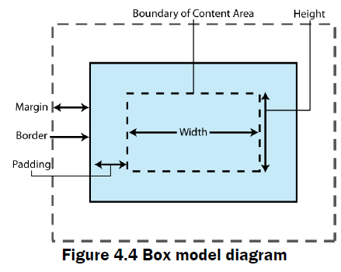

Slide 106
Margins & Padding
Padding
  Defines the space around elements inside the border;
  i.e between the border and the content itself
  cannot have negative values
  DO NOT affect the position of background elements
  Can be defined independently on top, right, bottom and left, or all-at-once using CSS shorthand

Slide 107
CSS Margins
You can set following margin properties of an element:
  The margin-bottom property specify the bottom margin of an element.
  The margin-top property specify the top margin of an element.
  The margin-left property specify the left margin of an element.
  The margin-right property specify the right margin of an element.
  The margin shorthand property for setting margin properties in one declaration.

Slide 108
margin
<div style=“margin: 20px;”>
This is a paragraph with a specified margin from all sides.</div>
<div style=“margin-top: 10px;”>
This is a paragraph with a specified top margin.</div>

Slide 109
Margin property
<style>
p {margin: 15px; }
all four margins will be 15px
p {margin: 10px 5px; }
top and bottom margin will be 10px, left and right
will be 2% of the total width of doc.
p {margin: 10px 8px 20px 15px; }
top margin will be 10px, right margin will be 2%, bottom
margin will be -10px, left margin will be set by the browser
</style>

Slide 110
CSS Padding
Padding property allows you to specify how much space should appear between the content of an element and its border :
  The padding-bottom property specify the bottom padding of an element.
  The padding-top property specify the top padding of an element.
  The padding-left property specify the left padding of an element.
  The padding-right property specify the right padding of an element.
  The padding shorthand property serves as the preceding properties.

Slide 111
padding
<p style=“padding-bottom: 15px; border-width: 1px solid black;”>
This is a paragraph with a specified bottom padding.</p>
<p style=“padding-top: 15px; border-width: 1px solid black;”>
This is a paragraph with a specified top padding.</p>
<p style=“padding: 15px; border-width: 1px solid black;”>
This is a paragraph with a specified right padding.</p>

Slide 112
You can individually change the width of the bottom, top, left and right borders of an element. Using the following properties:
  border-bottom-width changes the width of bottom border.
  border-top-width changes the width of top border.
  border-left-width changes the width of left border.
  border-right-width changes the width of right border.

Slide 113
border-width
<style>
p.example1 {
border-style: solid;
border-bottom-width: 6pt;
border-top-width: 6pt;
border-left-width: 4pt;
border-right-width: 4pt;
}
</style>
<p class=“example1”>
This example is showing all borders in different widths.
</p>
Output:
Possible values:
any color with valid format
This example is showing all borders in different widths.

Slide 114
border
<p style=“border: 4px solid red;”>
This example is showing shorthand property for border.</p>
Output:

Slide 115
TWITTER BOOTSTRAP

Slide 116
What is Twitter Bootstrap?
Bootstrap is a powerful mobile first front-end framework for faster and easier web development. It uses HTML, CSS and JavaScript.
"Mobile First", meaning that almost everything has been redesigned to start from a lower screen size and scale up
Developed by Mark Otto and Jacob Thornton at Twitter.
  Released as an open source product in August 2011 on GitHub.
Browser Support:
It is supported by all popular browsers.

Slide 117
Motivation for Bootstrap
Easy to get started:
With just the knowledge of HTML and CSS anyone can get started with Bootstrap. Also the Bootstrap official site has a good documentation.
Responsive design:
Bootstrap's responsive CSS adjusts to Desktops, Tablets and Mobiles.
Provides a clean and uniform solution for building an interface for developers.

Slide 118
Boot Strap Modules
Scaffolding:
  A Basic structure with Grid System, link styles, background.
CSS:
  A global CSS settings,
  fundamental HTML elements styled and enhanced with extensible classes, and an advanced grid system.
Components:
  Contains over a dozen reusable components
  built to provide iconography, dropdowns, navigation, alerts, popovers, and much more.
JavaScript Plugins:
  Bootstrap contains over a dozen custom jQuery plugins.
  You can easily include them all, or one by one.

Slide 119
Containers
A containing element can be used to wrap and place grid system.
There are two containers to choose
They are not nestable by default.
  Because of padding and fixed widths
.container
  Gives a Fixed width for the container for each breakpoint
  Used for a responsive fixed width container.
  <div class="container"> …</div>
.container-fluid
  Full width container, spanning the entire width of Viewport.
  Constantly resize even to the smallest changes in browser width.
  <div class="container-fluid"> ... </div>

Slide 120
Boot Strap Grid System
  Includes a responsive, mobile first fluid grid system
  Scales up to 12 columns as the device or view port size increases.
  Starts by targeting smaller screens like mobile devices, tablets, and then “expands” components and grids for larger screens such as laptops, desktops.

Slide 121
Different Width Grids
There are four Grid Systems with the width of the viewport
Extra small devices ~ Phones (< 768px)
Small devices ~ Tablets (>= 768px)
Medium devices ~ Desktops (>= 992px)
Large devices ~ Desktops (>= 1200px)
Each viewports have a class to address it
col-xs- ~ Extra small devices
col-sm- ~ Small devices
col-md- ~ Medium devices
col-lg- ~ Large devices

Slide 122
Grid System
Rows must be placed within a .container class for proper alignment and padding.
  rows are used to create horizontal groups of columns.
Grid columns are created by specifying the number of twelve available columns to span.
Content should be placed within columns, and only columns may be immediate children of rows.
Predefined grid classes like .row and .col-*-* are available
Columns create gutters via padding.

Slide 123
Mobile First
  <div class="container-fluid">
  <div class="row">
  <div class="col-sm-12 col-md-6 col-lg-4">
  <p>Column One </p>
  </div>
  <div class="col-sm-12 col-md-6 col-lg-4">
  <p>Column Two</p>
  </div>
  <div class="col-sm-12 col-md-6 col-lg-4">
  <p>Column Three</p>
  </div>
  </div>
  </div>

Slide 124
Un Equal Grid
  <div class="row">
  <div class="col-md-3">
  <p class="box">FIRST</p></div>
  <div class="col-md-6">
  <p class="box">Second</p></div>
  <div class="col-md-3">
  <p class="box">Third</p></div>
  </div>

Slide 125
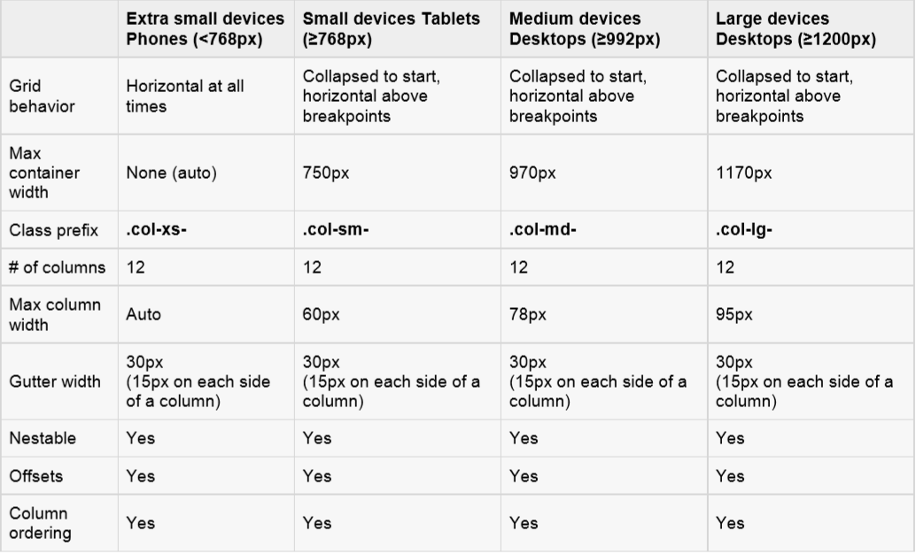
Grid Options
Bootstrap grid system in multiple devices:

Slide 126
LIST ITEMS

Slide 127
List Items
  Supports ordered lists, unordered lists, and definition lists.
.list-group
  The classes is added to the <ul>.
  render complex and customized content in lists.
.list-group-item
  This class is added to <li>
.badge
  Added to list group item
  It will be automatically positioned on the right.

Slide 128
List Item
  <ul class = "list-group">
  <li class = "list-group-item">Pre-Paid</li>
  <li class = "list-group-item">
  <span class = "badge">New</span>
  BroadBand
  </li>
  <li class = "list-group-item">
  <span class = "badge">Free for 3 Month</span>
  HD Set Top Box
  </li>
  </ul>

Slide 129
List Item
  .list-inline
  This class is used to place all list items on a single line
  <ol class="list-inline">
  <li><a href="">Home</a></li>
  <li><a href="">Contact</a></li>
  <li><a href="">Clients</a></li>
  <li><a href="">Download</a></li>
  </ol>

Slide 130
TABLES

Slide 131
Tables
Basic Table( .table)
  Table with just some light padding and horizontal dividers
  <table class="table"> </table>
Striped Table (.table-striped)
  Adds stripes on rows within the <tbody>
  <table class="table table-striped"> </table>
Bordedred Table (.table-bordered)
  Adds borders surrounding every element and rounded corners around the entire table
  <table class="table table-bordered">

Slide 132
Tables
HOVER TABLE (.table-hover)
  A light gray background will be added to rows while the cursor hovers over them
  <table class="table table-hover">
RESPONSIVE TABLES: (.table-responsive)
  Table scroll horizontally up to small devices (under 768px).
  When viewing on anything larger than 768px wide, will not see any difference in these tables.
  <table class=“table table-responsive">
Condensed or Compact Table(.table-condensed)
  Made more compact and save the space by cutting the cell padding in half.

Slide 133
FORMS

Slide 134
Form Layout
Has the following form layouts:
  Vertical (default) form
  Inline form
  Horizontal form
VERTICAL OR BASIC FORM:
  Add a role form to the parent <form> element.
  Wrap labels and controls in a <div> with class .form-group.
  Used for optimum spacing.
  Add a class of .form-control to all textual <input>, <textarea>, and <select> elements.
  <form role="form">
  <div class="form-group">
  <label for="name">Name</label>
  <input type="text" class="form-control" id="name" >
  </div>
  </form>

Slide 135
Inline Form
  To create a form where all of the elements are inline, left aligned and labels are alongside
<form class="form-inline" role="form">
<div class="form-group">
<label class="sr-only" for="name">Name</label>
<input type="text" class="form-control" id="name" placeholder="Enter Name">
</div>
</form>

Slide 136
HORIZONTAL FORM
Use Bootstrap's predefined grid classes to align labels and form controls.
Add the class .control-label to the <label> element.
Can set the width of the label by setting it's "col-md-" or "_sm"
<form class="form-horizontal" role="form">
<div class="form-group">
<label for="firstname" class="col-sm-2 control-label">First Name</label>
<div class="col-sm-10">
<input type="text" class="form-control” id="firstname” >
</div>
</div>
</form

Slide 137
Form-select
.form-select
  To trigger the custom styles.
  Custom styles are limited to the <select>’s initial appearance
  Cannot modify the <option>s due to browser limitations.
    <select class="form-select">
    <option value="1">One</option>
  </select>

Slide 138
Form-check
Can Style checkboxes and radios with “.form-check”
Structurally, our <input>s and <label>s are sibling elements as
  <div class="form-check">
  <input class="form-check-input" type="checkbox" value="" id=“check1">
  <label class="form-check-label" for=“check1">
  Default checkbox
  </label>
  </div>

Slide 139
Prefix and Suffix To Controls
Can add text and icons or buttons before or after any text-based input
.input-group-addon
  Wrap the text or icon within a <span> element
.input-group
  The Class is applies to a <div> wrapped with both the <span> and text-based <input>
  It does not support <select> or <textarea> elements
  Can add .input-group-lg or .input-group-sm to make it larger or smaller.
.form-control-static
  To place a plain text next to a form label within a form used on a <p> Element.

Slide 140
BUTTONS

Slide 141
Buttons
Different classes for styling the buttons and its different states.
Button styles can be applied to any element.
But Mostly applied to the <a>, <input>, and <button> elements

Slide 142
Button
btn btn-default
  Default gray button with gradient
.btn btn-primary
  Provides extra visual weight to indicate primary action button in a set of buttons
.btn btn-info
  Can be used as an alternative to the default button
.btn btn-success , .btn btn-warning , .btn btn-danger
  Indicates a successful,caution,or potentially negative action
.btn btn-link
  Deemphasize a button by making it look like a link while maintaining button behavior

Slide 143
Changing the Sizes of Buttons
Buttons can scaled up or down.
You can make buttons larger or smaller through adding an extra class .btn-lg, .btn-sm, or .btn-xs.
<button type="button" class="btn btn-default btn-lg">Large button</button>
Create block level buttons (buttons that covers the full width of the parent elements) by adding an extra class .btn-block.
<button type="button" class="btn btn-primary btn-lg btn-block">Block level button</button>

Slide 144
Creating Buttons
<button type="button" class="btn btn-primary btn-lg disabled" disabled="disabled">Primary button</button>
To create a button groups and apply the class .btn-group on it
  <div class="btn-group">
    <button type="button" class="btn btn-primary">Left</button>
    <button type="button" class="btn btn-primary">Middle</button>
    <button type="button" class="btn btn-primary">Right</button>
  </div>
.btn-group-vertical.
  Button groups appear vertically stacked

Slide 145
Button Group
Height Sizing of Button Groups
  Apply relative sizing classes on button group rather than on Button
  .btn-group-lg, .btn-group-sm or .btn-group-xs
Creating Justified Button Groups
  You can also make a group of buttons stretch at the same size to span the entire width of its parent by applying an extra class
  .btn-group-justified
Creating Single Toggle Button
  Change the normal state of a button to a push state and vice versa on a single button
  <button type="button" class="btn btn-primary"
data-toggle="button">Single Toggle Button</button>

Slide 146
Button Group
  <div class="btn-group">
  <button type="button" class="btn btn-default">Action</button>
  <button type="button" data-toggle="dropdown" class="btn btn-default dropdown-toggle">
  <span class="caret"></span>
  </button>
  <ul class="dropdown-menu">
    <li><a href="#">Action</a></li>
    <li><a href="#">Another action</a></li>
    <li class="divider"></li>
    <li><a href="#">Separated link</a></li>
  </ul>
  </div>

