Slide 1

SPRING BOOT BATCH PROCESSING

Slide 2
Batch Job
A Batch job consists of one or more steps.
Each step is responsible of completing one logical task.
  Every step reads input data, processes the input data, and writes the processed data to the configured output.
If the batch job has more than one step, the output of a step is often used as an input of the next step.

Slide 3
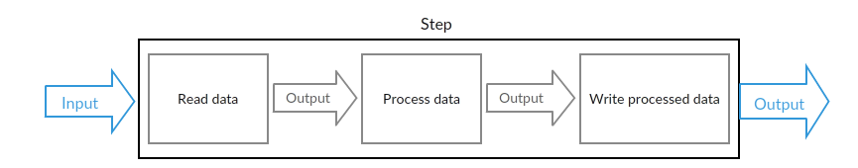
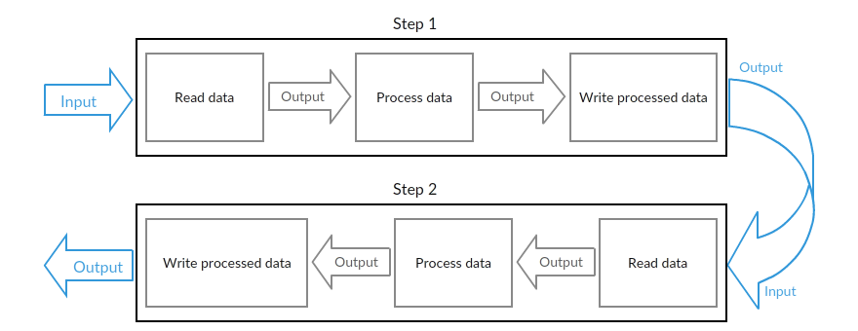
Batch Jobs

Slide 4
Job
  Made up of several Steps, usually encapsulates a Batch Operation.
  Each Step usually has one ItemReader, ItemProcessor, and ItemWriter.
  A JobLauncher executes a job, and metadata about configured and executed jobs are saved in a JobRepository.

Slide 5
Step
The Step represents an independent logical task
  Each step belongs to one job.
ItemReader:
  reads the input data and provides the found items one by one.
ItemProcessor
  transforms items into a form that's understood by the ItemWriter one item at a time.
ItemWriter
  writes an information of an item to the output one item at a time.

Slide 6
Features of Batch Proceesing
Efficiency
  Process jobs when computing or other resources are readily available.
  Non-urgent tasks can be scheduled as batch processes, while time-sensitive tasks can be prioritized.
  Batch systems can also run in the background to alleviate processor strain.
Improved Data Quality:
  Reduces the likelihood of errors by automating most or all components of a processing job and minimizing user interaction.
  Precision and accuracy are improved.

Slide 7
Spring Batch
A lightweight, comprehensive batch framework
  Helps in development of robust batch applications
  Provides reusable functions that are essential in processing large volumes of records
  Can also do following :
    logging/tracing,
    transaction management,
    Job processing statistics,
    job restart,
    Resource management.

Slide 8
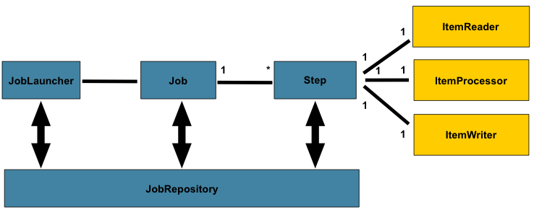
Spring Batch Procesing

Slide 9
Configure Spring Boot Batch
A database is required to store batch-related information.
Spring boot batch dependencies will provide all required classes for batch execution.
Application.properties
  spring.batch.initialize-schema=ALWAYS

Slide 10
@EnableBatchProcessing
Aannotation adds many critical beans that support jobs
It also autowires a couple factories needed
  @Configuration
  @EnableBatchProcessing
  public class BatchConfig {
  }

Slide 11
Batch Configurations
JobBuilderFactory
  Used to generates a batch task.
StepBuilderFactory
  Used to Generates a batch step.

Slide 12
Item Reader
The ItemReader interface is used to define the reader class.
This class should include the data reading code.
FlatFileItemReader
  A sub type of ItemReader that reads lines from input Resource
  Line is defined by the setRecordSeparatorPolicy and mapped to item using LineMapper

Slide 13
FlatFileItemReader
  @Bean
  public FlatFileItemReader<Payment> reader() {
  FlatFileItemReader<Payment> reader= new FlatFileItemReader<>();
  reader.setResource(new ClassPathResource("/payments.csv"));
  reader.setLinesToSkip(1);
  reader.setLineMapper(lineMapper());
  return reader;
  }

Slide 14
Line Mapper
Interface for mapping lines (strings) to domain objects
  Read from a file to domain objects on a per line basis.
Implementations of this interface perform the actual work
  Parsing a line without having to deal with how the line was obtained.

Slide 15
Line Mapper
  @Bean
  public DefaultLineMapper<Payment> lineMapper(){
  DelimitedLineTokenizer tokenizer = new DelimitedLineTokenizer();
  tokenizer.setNames( "txnId", "customerName", "details","amount" );
  BeanWrapperFieldSetMapper<Payment> mapper = new BeanWrapperFieldSetMapper<>();
  mapper.setTargetType(Payment.class);
  DefaultLineMapper<Payment> lineMapper = new DefaultLineMapper<>();
  lineMapper.setLineTokenizer(tokenizer);
  lineMapper.setFieldSetMapper(mapper);
  return lineMapper;
  }

Slide 16
ItemWriter
The ItemWriter interface is used to define the writer class.
  Contains the code for writing the data after it has been processed.
  @Bean
  public ItemWriter<Payment> writer(PaymentRepository repo){
  return payments -> {
  repo.saveAll(payments);
  };
  }

Slide 17
Processor
Contains the data processing code.
Done by invoking the process method.
  @Bean
  public ItemProcessor<Payment, Payment> processor(){
  return payment -> {
  Double discount = payment.getAmount()*0.10;
  payment.setAmount(payment.getAmount()-discount);
  return payment;
  };
  }

Slide 18
Job
Domain object representing a job.
JobBuilderFactory
  Convenient factory which sets the JobRepository automatically.
  @Bean
  public Job jobOne(JobBuilderFactory jbf,Step stepOne) {
  return jbf.get("paymentsJob")
  .start(stepOne)
  .build();
  }

Slide 19
Step
Step:
  Interface representing the configuration of a step.
Chunk
  Build a step that processes items in chunks with the size provided
  @Bean
  public Step stepOne(StepBuilderFactory sbf,PaymentRepository repo) {
  return sbf.get("stepOne")
  .<Payment,Payment>chunk(2)
  .reader(reader())
  .processor(processor())
  .writer(writer(repo))
  .build() ;
  }

Slide 20
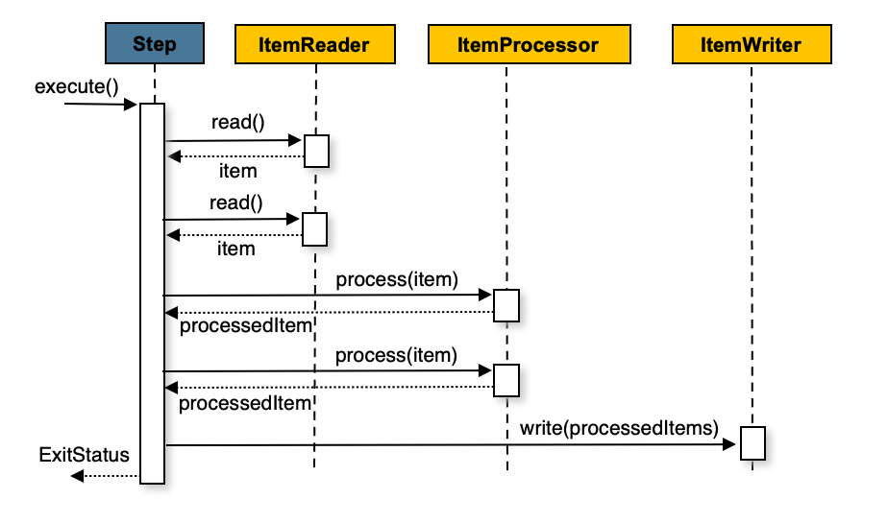
Batch Processing

Slide 21
Payment
  @Table(name = "payment_batch")
  @Entity
  public class Payment {
  @Id
  @Column(name = "txn_id")
  private int txnId;
  private String details ;
  @Column(name = "customer_name")
  String customerName;
  private double amount;
  }

Slide 22
Job Launcher
  JobLauncher jobLauncher = ctx.getBean(JobLauncher.class);
  Job jobOne = ctx.getBean(Job.class);
  JobParameters jobParameters =
  new JobParametersBuilder()
  .addLong("time", System.currentTimeMillis())
  .toJobParameters();
  try {
  jobLauncher.run(jobOne, jobParameters);
  } catch (Exception e) {
  e.printStackTrace();
  }
  System.out.println("Job Execution completed!");

