Slide 1
SPRING BOOT MVC

Slide 2
Spring MVC
Web application framework that takes advantage of design principles of Spring framework
Flexible and extensible via component’s
Simplified form handling through its parameter binding
Can do validation and error handling

Slide 3
MVC Architecture
Controller
  Designed around a DispatcherServlet
Model
  Can use any object as a command or form object.
  Data binding is highly flexible.
View
  View resolution is extremely flexible.
  View name resolution is configurable
  Can use properties file to configure views

Slide 4
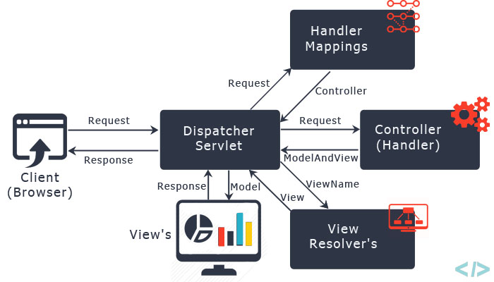
The requesting processing workflow

Slide 5
@RequestMapping
Used to map URLs onto a class or a particular method.
Class-level annotation maps a specific request path or pattern to a controller
Method-level annotations are used to narrow the primary mapping
  HTTP "GET"/"POST“ methods.

Slide 6
@RequestMapping
  @Controller
  @RequestMapping("/api")
  public class SecondController {
  @RequestMapping(value=“/hello” method = RequestMethod.GET)
  public String greet()
  {
  return “Hello User";
  }
  }
  http://localhost:8080/api/hello

Slide 7
Model
A map object used to store attribute value pairs
It's created before invoking a handler method if the method has an argument type Model.
  Stores attribute values to render dynamic views such as JSP.
addAttribute(String name, Object obj)
  Used to map attribute names to object as attribute vales.
  public String init(Model model) {
  model.addAttribute("majHeading", "Jeevan Blood Bank");
  return "index";
  }

Slide 8
Controller
  @Controller
  public class WelcomeController {
  @RequestMapping("/welcome")
  public String showLoginPage() {
  return "welcome";
  }
  }

Slide 9
View Resolver
InternalResourceViewResolver
  Used to map the logical view names to view files
  spring.mvc.view.prefix=/WEB-INF/pages/
  spring.mvc.view.suffix=.jsp

Slide 10
Welcome.jsp
  src/main/webapp/WEB-INF/pages
  <%@ page language="java" contentType="text/html; charset=ISO-8859-1"
  pageEncoding="ISO-8859-1"%>
  <!DOCTYPE html>
  <html>
  <head>
  <meta charset="ISO-8859-1">
  </head>
  <body>
  <h2>MVC Configured Successfully</h2>
  </body>
  </html>

Slide 11
Dependency Required
Update the pom.xml with following Dependencies
The Entries can be picked from the Effective Pom.
  <dependency>
  <groupId>org.apache.tomcat.embed</groupId>
  <artifactId>tomcat-embed-jasper</artifactId>
  </dependency>
  <dependency>
  <groupId>javax.servlet</groupId>
  <artifactId>jstl</artifactId>
  </dependency>

Slide 12
ModelAndView object
Encapsulates both model and view that is to be used to render model
Model is represented as a java.util.Map
Objects can be added to without name:
  addObject(String, Object) – added with explicit name
  addObject(Object) – added using name generation (Convention over Configuration)
View is represented by String or View object
Analogous to Struts Action

Slide 13
Controller
  @Controller
  public class FirstController {
  @RequestMapping("/first")
  public ModelAndView execute()
  {
  String message = "Welcome to Spring!";
  return new ModelAndView("Success", “msg",message);
  }
  }

Slide 14
@RequestParam
Use to bind request parameters to a method parameter in the controller.
  @RequestMapping ("/find")
  public String get ( @RequestParam ("custId") int id, Model model) {
  Customer cust =dao.findByCustomerId(id);
  System.out.println("Inside GET Method"+ cust);
  model.addAttribute("foundCustomer",cust);
  return "Display";
  }
Can also do return new ModelAndView("redirect:RedirectPage.htm");

Slide 15
@ModelAttribute
When Used as method parameter, maps a model attribute to the specific, annotated method parameter
The controller gets a reference to the object holding the data entered in the form.
When used at method level provides reference data for the model
The @ModelAttribute annotated methods are executed before the chosen @RequestMapping annotated handler method.
This helps in pre-populating the implicit model with specific attributes,

Slide 16
Model
  @Data
  @AllArgsConstructor
  @NoArgsConstructor
  @ToString
  public class TripDetail {
  private long tripId;
  private String destination;
  private double amount;
  }

Slide 17
Controller
  @Controller
  public class TripController {
  @Autowired
  TripDetail detail;
  @GetMapping("/")
  public String init() {
  return "index";
  }

Slide 18
Controller
    @GetMapping("/addTrip")
    public String initForm(Model model) {
    model.addAttribute("command",detail);
    return "addTripDetails";
    }
    @PostMapping("/addTrip")
    public String onSubmit(@ModelAttribute("data") TripDetail details) {
    System.out.println(details);
    return "success";
    }
    }

Slide 19
Using Spring's form tag library
Spring's form tag library gives the tags access to the command object and reference data of the controller
The form tag library comes bundled in spring-webmvc.jar.
The library descriptor is called spring-form.tld.
<%@ taglib prefix="form" uri="http://www.springframework.org/tags/form" %>
A Form tag puts the command object in the PageContext

Slide 20
View
  <form:form action="/addTrip" method="post">
  <form:input path="tripId"/>
  <form:input path="destination"/>
  <form:input path="amount"/>
  <input type="submit" value="Add">
  </form:form>

Slide 21
REST SERVICE USING SPRING DATA JPA

Slide 22
REST Overview
REpresentational State Transfer
An architectural style of creating API's
  Makes it easier for systems to communicate with each other.
The implementation of the client and server can be done independently without each knowing about the other.
Different clients hit the same REST endpoints, perform the same actions, and receive the same responses.

Slide 23
REST Overview
Resource Oriented Architecture
  Data and functionality are considered resources
  Accessed using Uniform Resource Identifiers (URIs)
  Accessed Using HTTP standard methods.

Slide 24
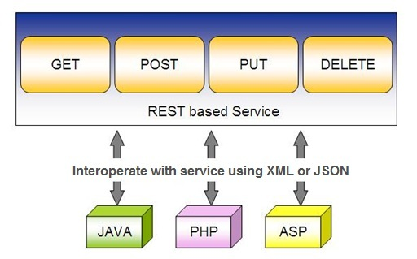
Spring RESTful Services
REST does not require the client to know anything about the structure of the API.
Server needs to provide whatever information the client needs to interact with the service.

Slide 25
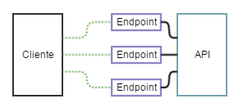
API and Endpoint

Slide 26
SPRING DATA REST WITH JPA

Slide 27
Spring RESTful Services
A RESTful architecture may expose multiple representations of a resource.
From Spring 4 @RestController annotation is added to controller
  A combination of @Controller and @ResponseBody
A Rest Controller method returns a domain object instead of a view.

Slide 28
REST Stereotypes
@RestController
  An implicit @ResponseBody is being added to the methods.
  Allows Spring to render the returned HttpEntity and its payload, directly to the response.
@GetMapping
  To map HTTP GET requests onto specific handler methods.
  Composed annotation for @RequestMapping(method = RequestMethod.GET).

Slide 29
REST Stereotypes
@PathVariable
  Indicates that the Method parameter should be bound to a URI template variable.
  @GetMapping("/members/{id}")
  public String getById(@PathVariable String id) { }
@PostMapping
  Combined shortcut for @RequestMapping(method = RequestMethod.POST).
  @PostMapping("/members“)
  public void addMember(@RequestBody Member member) { }

Slide 30
@Repository
CrudRepository
  Extends Repository
  provides CRUD functions
JpaRepository
  Provides Methods such as flushing the persistence context and delete records in a batch
  Querying methods return List's instead of Iterable's

Slide 31
CrudRepository Interface
Extends Repository Interface and has the following Methods
  <S extends T> S save(S entity)
  <S extends T> Iterable<S> saveAll(Iterable<S> entities);
  Optional<T> findById(ID primaryKey)
  Iterable<T> findAll()
  void delete(T entity)
  long count()
  boolean existsById(ID id);

Slide 32
JpaRepository
Extends PagingAndSortingRepository
Can also optionally extend QueryByExampleExecutor
  List<T> findAllById(Iterable<ID> ids);
  <S extends T> S saveAndFlush(S entity);
  void deleteInBatch(Iterable<T> entities);
  void deleteAllInBatch();
  T getOne(ID id);
  void flush();

Slide 33
Creating Spring Data Application
  Create a repository interface and extend one of the repository interfaces provided by Spring Data.
  If required add custom query methods to the created repository interface
  Inject the repository interface to another component and use the implementation that is provided automatically by Spring.
Need NOT create an implementation class
  Spring will automatically create its implementation class at runtime.
The Repository class will be auto detected if suitably placed in the scan path

Slide 34
SAMPLE CODE-DEMO

Slide 35
Entity
  @Entity
  @Table(name = "demo_invoice")
  @Data
  @AllArgsConstructor
  @NoArgsConstructor
  @FieldDefaults(level = AccessLevel.PRIVATE)
  public class Invoice {
  @Id
  long id;
  String customerName;
  @DateTimeFormat(iso = DateTimeFormat.ISO.DATE)
  LocalDate invoiceDate;
  double amount;
  }

Slide 36
Repository
  @Repository
  public interface InvoiceRepository extends JpaRepository<Invoice, Long>{
  }

Slide 37
Service
  @Service
  public class InvoiceService {
  @Autowired
  private InvoiceRepository repo ;
  public List<Invoice> findAll(){
  return repo.findAll();
  }
  public Invoice findById(int id) {
  Optional<Invoice> optInvoice=repo.findById(id);
  return optInvoice.orElseThrow(() -> new
  RunTimeException(“Invoice not found"));
  }

Slide 38
Controller
  @RestController
  public class InvoiceController {
  @Autowired
  private InvoiceService service ;
  @GetMapping(path = "/api/v1/invoices")
  public List<Invoice> findAll() {
  List<Invoice> details = service.findAll();
  return details;
  }

Slide 39
@RequestBody
Used to map the HttpRequest body to a transfer or domain object
  Spring automatically deserializes the JSON into a Java type
  The type of @RequestBody annotation must correspond to the JSON sent from client-side
HttpMessageConverter
  Internally Used by Spring to perform Serialization/deserialization
@Valid
  To perform automatic validation by adding to method argument

Slide 40
Post and Put Mapping
  @PostMapping(path = "/api/v1/invoices")
  public Invoice add(@RequestBody Invoice entity
  ,HttpServletResponse response) {
  response.setStatus(201);
  return this.service.add(entity);
  }
@ResponseStatus(HttpStatus.CREATED)
  @PostMapping(path = "/api/v1/invoices")
  public Invoice add(@RequestBody Invoice entity) {
  return this.service.add(entity);
  }

Slide 41
ResponseEntity
Represents Complete HTTP response, gives more flexibility
  May be required in some special cases
  Can be used to send Status Code,Response Body,Location to the resource which was altered
  @GetMapping(path = "/api/v1/invoices")
  public ResponseEntity<Invoice> getInvoices() {
  HttpHeaders responseHeaders = new HttpHeaders();
  return ResponseEntity.ok().headers(responseHeaders).body(dao.findAll());
  }
  HttpStatus status = e != null ? HttpStatus.OK : HttpStatus.NOT_FOUND;
  return new ResponseEntity<Mono<Employee>>(e, status);

Slide 42
Put Mapping
@PutMapping(path = "/api/v1/invoice")
  public Invoice update(@RequestBody Invoice entity) {
  return this.service.add(entity);
  }
  @PatchMapping(path = "/api/v1/invoice")
  public ResponseEntity<String> updateAmount() {
  return ResponseEntity.status(HttpStatus.CREATED)
  .body("Updated Amount:="+this.service.updateAmount());
  }

Slide 43
Remove Method in Service
  public Invoice remove(Invoice entity) {
  Optional<Invoice> optional = Optional.empty();
  if(this.repository.existsById(entity.getId())) {
  this.repository.delete(entity);
  optional = Optional.of(entity);
  }
return optional;
}

Slide 44
Delete Mapping in Controller
  @DeleteMapping(path = "/api/v1/invoice")
  public ResponseEntity<Invoice> remove(@RequestBody Invoice entity) {
  Invoice invoice = this.service.removeInvoice(entity).orElseThrow(()-> new RuntimeException("Element NOT FOUND"));
  return ResponseEntity.ok().body(invoice);
  }

Slide 45
application.yml
  spring:
  datasource:
  url: jdbc:mysql://localhost:3306/test
  username: root
  password: srivatsan
  driver-class-name: com.mysql.cj.jdbc.Driver
  jpa:
  show-sql: true
  hibernate:
  ddl-auto: update
  naming:
  physical-strategy: org.hibernate.boot.model.naming.PhysicalNamingStrategyStandardImpl

Slide 46
application.yml
  application:
  name: invoice-service
  logging:
  level:
  org.hibernate.sql: debug
  org.hibernate.type.descriptor.sql.BasicBinder: trace
  management:
  endpoints:
  web:
  exposure:
  include:
  - "*"

