Slide 1
Exception handling

Slide 2
Exception Handling
An exception is a problem that arises during the execution of a program.
When an Exception occurs the normal flow of the program is disrupted and the program terminates abnormally, which is not recommended
  Exceptions are to be handled.

Slide 3
Exception Handling
java.lang.Object
java.lang.Throwable
java.lang.Error
java.lang.Exception
java.io.IOException
java.lang.RuntimeException
Notes:
The class Object is the root of the class hierarchy. Every class has Object as a superclass. All objects, including arrays, implement the methods of this class.
The Throwable class is the superclass of all errors and exceptions in the Java language. Only objects that are instances of this class (or of one of its subclasses) are thrown by the Java Virtual Machine or can be thrown by the Java throw statement. Similarly, only this class or one of its subclasses can be the argument type in a catch clause.
An Error is a subclass of Throwable that indicates serious problems that a reasonable application should not try to catch. Most such errors are abnormal conditions. The ThreadDeath error, though a "normal" condition, is also a subclass of Error because most applications should not try to catch it.
The class Exception and its subclasses are a form of Throwable that indicates conditions that a reasonable application might want to catch.
RuntimeException is the superclass of those exceptions that can be thrown during the normal operation of the Java Virtual Machine. A method is not required to declare in its throws clause any subclasses of RuntimeException that might be thrown during the execution of the method but not caught.
IOException signals that an I/O exception of some sort has occurred. This class is the general class of exceptions produced by failed or interrupted I/O operations.

Slide 4
Exceptions
checked exceptions
  Conditions that can readily occur in a correct program
  Includes all subtypes of Exception
  Excluding classes that extend Runtime Exception.
  Subject to the handle or declare rule
unchecked exceptions
  Problems that reflect program bugs
  Probable bugs are represented by the RuntimeException class.
  Compiler doesn’t enforce the handle or declare rule.
Error
  Fatal situations are represented by the Error class.

Slide 5
Handle or Declare Rule
Handle the exception by using the try-catch-finally block.
  try{
  // some code
  } catch(Exception e){
  }
Declare that the code causes an exception by using the throws clause.
  void trouble() throws IOException { ... }
  void trouble() throws IOException, MyException { ... }
Other Principles
  You do not need to declare runtime exceptions or errors.
  You can choose to handle runtime exceptions

Slide 6
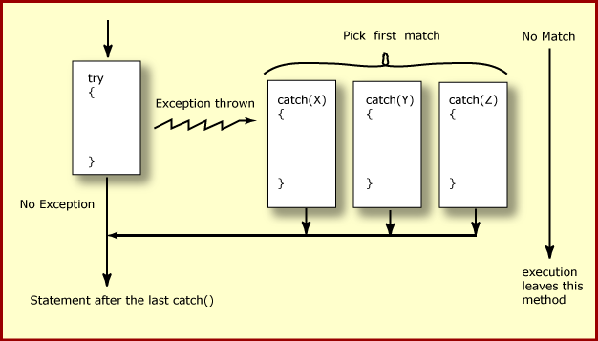
How try catch Work

Slide 7
Exception Handling
  try {
  Object value = "twenty";
  Integer number = (Integer) value;
  }
  catch ( ClassCastException ex ) {
  ex.printStackTrace();
  }
  System.err.println("Good-bye" );
  }

Slide 8
Nested Try Catch
  try {
  Object value = "twenty";
  Integer number = (Integer) value;
    try {
    String mark ="50";
    Integer.parseInt(mark);
    } catch (NumberFormatException e) {
    e.printStackTrace();
    }
  }
  catch ( ClassCastException ex ) {
  ex.printStackTrace();
  }

Slide 9
Catching Exception –Multiple Catch
  try {
  Object value = "twenty";
  Integer number = (Integer) value;
  String mark ="50";
  Integer.parseInt(mark);
  }
  catch ( ClassCastException ex ) {
  ex.printStackTrace();
  }
  catch (NumberFormatException e) {
  e.printStackTrace();
  }

Slide 10
Effective Exception Hierarchy
The exception classes are arranged in a hierarchy.
Catches for specific exceptions should always be written prior to the generic handler.
A generic handler for Exception would cover any missing situation.
  try
  {
  }
  catch (NumberFormatException e) {
  }
  catch (Exception ex2) {
  }
  try
  {
  }
  catch (Exception e1) {
  }
  catch(NumberFormatException e2) {
  }

Slide 11
Multiple Catch
  try {
  Object value = "twenty";
  Integer number = (Integer) value;
  String mark ="50";
  Integer.parseInt(mark);
  }
  catch ( ClassCastException| NumberFormatException ex ) {
  ex.printStackTrace();
  }

Slide 12
Multiple Catch
  try {
  } catch (RangeCheckException | RuntimeException e) {
  }
  try {
  } catch (RangeCheckException | Exception e) {
  }

Slide 13
Finally block
Its optional and will always be invoked,
  whether an exception in the corresponding try is thrown or not,
  whether a thrown exception is caught or not.
finally-will-always-be-called except if the JVM shuts down.
  When the try or catch blocks may call System.exit();
Finally Block is always executed despite of different scenarios:
  Forced exit occurs using a return, a continue or a break statement
  Normal completion
  Caught exception thrown
  Exception was thrown and caught in the method
  Uncaught exception thrown
  Exception thrown was not specified in any catch block in the method

Slide 14
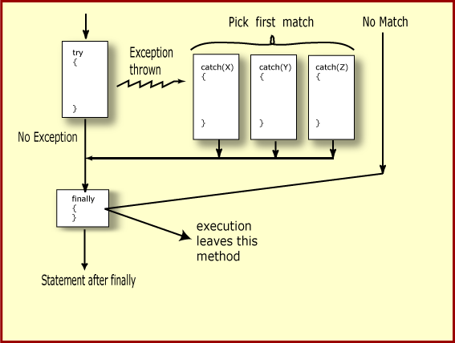
Finally Block

Slide 15
Finally Block
  public static String tryblkWithReturn(String data ) {
  try {
  int no = Integer.parseInt(data);
  }
  catch (NumberFormatException e) {
  System.out.println("Entering Catch Block");
  return "Hello";
  }
  finally {
  System.out.println("Inside finally");
  }
  System.out.println("I am back");
  return "Hi";
  }

Slide 16
Finally Block
  public static String tryblkWithNewException(String data ) throws Exception {
  try {
  int no = Integer.parseInt(data);
  }
  catch (NumberFormatException e) {
  System.out.println("Entering Catch Block");
  throw new Exception();
  }
  finally {
  System.out.println("Inside finally");
  }
  System.out.println("I am back");
  return "Hi“;
  }

Slide 17
Throws Clause
A method is required to either catch or list all exceptions it might throw
  Except for Error or RuntimeException, or their subclasses
If a method may cause an exception to occur but does not catch it, then it must say so using the throws keyword
Applies to checked exceptions only
  <type> <methodName> (<parameterList>) throws <exceptionList>
  {
  <methodBody>
}

Slide 18
The try-with-resources Statement
A try statement that declares one or more resources.
A resource is an object that must be closed after the program is finished with it.
Ensures the resource is closed at the end of the statement.
Any object that implements java.lang.AutoCloseable, and java.io.Closeable, can be used as a resource.

Slide 19
The try-with-resources Statement
  System.out.print("Enter an integer: ");
  try(Scanner scan = new Scanner( System.in )) {
  int num = scan.nextInt();
  System.out.println("square" + num + "is" + num*num );
  }
  catch ( InputMismatchException ex ) {
    System.err.println("You entered bad data." );
    System.err.println("Run the program again." );
  }
  System.out.println("Good-bye" );
  }

Slide 20
Throwing Exceptions
The throw Keyword
Java allows you to throw exceptions (generate exceptions)
  throw <exception object>
An exception you throw is an object
  You have to create an exception object in the same way you create any other object
Example:
  throw new ArithmeticException(“testing...”);

Slide 21
Re-throw Exception
Exception of the Catch Parameter type is the one that is rethrown
To intercept all exceptions and rethrow them
  Can catch with super class Exception
  Declare method as throwing an Exception.
"imprecise rethrow“
  Throwing a general Exception type (instead of specific ones)

Slide 22
Re-Throw Exception
Java 7, can be more precise about the exception types being rethrown from a method.
This leads to improved checking for rethrown exceptions.
Can handle them a lot better at the calling side

Slide 23
Re-throw Exceptions
  public static void myExample() throws ParseException,IOException {
  try {
  new SimpleDateFormat("yyyyMMdd").parse("date");
  new FileReader("Abc.txt").read();
  } catch (Exception e) {
  throw e;
  }
  }

Slide 24
Method Overriding and Exceptions
The overriding method can throw:
  No exceptions
  One or more of the exceptions thrown by the overridden method
  One or more subclasses of the exceptions thrown by the overridden method
The overriding method cannot throw:
  Additional exceptions not thrown by the overridden method
  Superclasses of the exceptions thrown by the overridden method

Slide 25
Overriding –When Method Has Exceptions
Any exceptions declared in overriding method must be of the same type as those thrown by the super class, or a subclass of that type.
  class MyBase {
  public void method1() throws Exception
  { }
  public void method2() throws RuntimeException
  { }
  }
  class Sub extends MyBase
  {
  public void method1() throws Throwable {
  }
  public void method2() throws ArithmeticException {
  }
  }
This is compile Time Exception
This is Allowed

Slide 26
User Defined Exception
User Defined Exception must be a child of Throwable.
To write a checked exception that is automatically enforced by the Handle or Declare Rule, need to extend the Exception class.
To write a runtime exception, need to extend the RuntimeException class.

Slide 27
Exception Handling
  Scanner scan = new Scanner( System.in );
  int num ;
  System.out.print("Enter an integer: ");
  try {
  num = scan.nextInt();
  System.out.println("The square of " + num + " is " + num*num );
  }
  catch ( InputMismatchException ex ) {
    System.err.println("You entered bad data." );
    System.err.println("Run the program again." );
  }
  System.err.println("Good-bye" );
  scan.close();
  }

Slide 28
Files & IO

Slide 29
Overview
At its lowest level, all Java I/O involves a stream of bytes either entering or leaving memory
Packaged classes exist to make it easy for a program to read and write larger units of data.
Low-level stream class object are used to handle byte I/O
High-level stream class object will allow the program to read and write primitive data values and objects

Slide 30


File Classes
  Java views the data in files as a stream of bytes.
  A stream of bytes from which data are read is called an input stream.
  A stream of bytes to which data are written is called an output stream.
  Java provides classes for connecting to and manipulating data in a stream.
  The classes are defined in the package java.io and are organized in a large complex hierarchy.

Slide 31
File Class
This is an abstract representation file and directory pathnames
  Not used to read and write data
  Used for searching and deleting of files, creating directories and working with path and making directories
  has methods for getting file/directory info.
  cannot be used to read or write to a file.
To make a File object, there are three commonly used constructors File
  File file1 = new File("C:\\Data\\myFile.dat");
  public File(String directory, String filename)

Slide 32
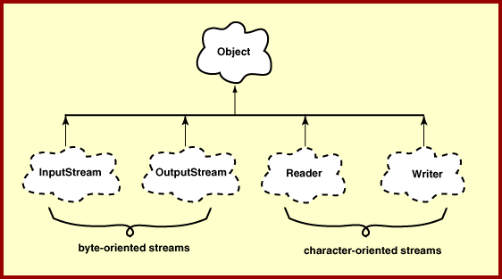
Hirearchy of IO Package

Slide 33
FileWriter
Used to write character to files
The Write method() of this classes is used to write characters
Wrapped by BufferedWriter to improve the performance
FileWriter(File file)
FileWriter(File file, boolean append)
All constructors and methods throw IOException

Slide 34
Print Writer
PrintWriter wraps the FileWriter
Has flexible and powerful methods to write data to files
format(),printf() and append() are used to work with data
print() or println() take a single parameter of any data type

Slide 35
FileReader
Used to read characters from files
The read() method of this class is used to read characters
These are wrapped by BufferedReader to improve the performance
Constructors:
FileReader(File file) throws FileNotFoundException
FileReader(String fileName) throws FileNotFoundException

Slide 36
Buffering
BufferedReader
  Buffers give a temporary holding place to group until it reaches final place.
  It helps in efficent reading of files
  Reads a large amount of data from a file at once and keep that data in buffer
  Minimizes the number of times of file access.
  Provides a readLine() method , which reads a line of characters from the file
  BufferedReader in =
    new BufferedReader(new FileReader(“file.txt"));
BufferedWriter
  Provides a newLine() method , which that creates line separators automatically

Slide 37
Write To File
  public boolean writeToTextFile(Professor prof,File file) {
  boolean result = false;
  try (PrintWriter writer = new PrintWriter(new FileWriter(file,true))){
  writer.println(prof);
  result =true;
  } catch (IOException e) {
  e.printStackTrace();
  }
  return result;
  }

Slide 38
Read From File
  public Professor[] readFromTextFile(File file) {
  Professor[] list = new Professor[4];
  String line =null;
  try(BufferedReader reader = new BufferedReader(new FileReader(file))){
  int i = 0;

Slide 39
Read From File
    while( (line = reader.readLine())!=null) {
    String[] values = line.split(",");
    Professor prof = new Professor(Integer.parseInt(values[0]),
    values[1],values[2], values[3]);
    list[i]= prof;
    i++;
    }
    }catch(IOException e) {
    e.printStackTrace();
    }
    return list;
    }

