Slide 1
HSBC -Grads -2021
Day -1

Slide 2

K.Srivatsan - vatsank@gmail.com
IT Trainer Since 1991
Conducting Java Training Since 2004
About 60+ Corporate Clients

Slide 3
Topics
Concepts of OOPs
Java Programming Language Basics
Inheritance,Packages,Polymorphism
Exception Handling, Introduction to IO
Collections with Generics,SQL,
JDBC,Factory pattern
HTML,CSS,Java Script
Spring Core
Spring Mvc,Boot
Spring Micro services

Slide 4
Object Oriented Programming
A Method of organizing software in the form of objects that contain both data and the behavior of these objects.
  Programs are divided into Objects (abstracted into class)
  Data, is given the priority.
  Data and functions are packed into a single unit
  Objects communicate through functions or methods

Slide 5
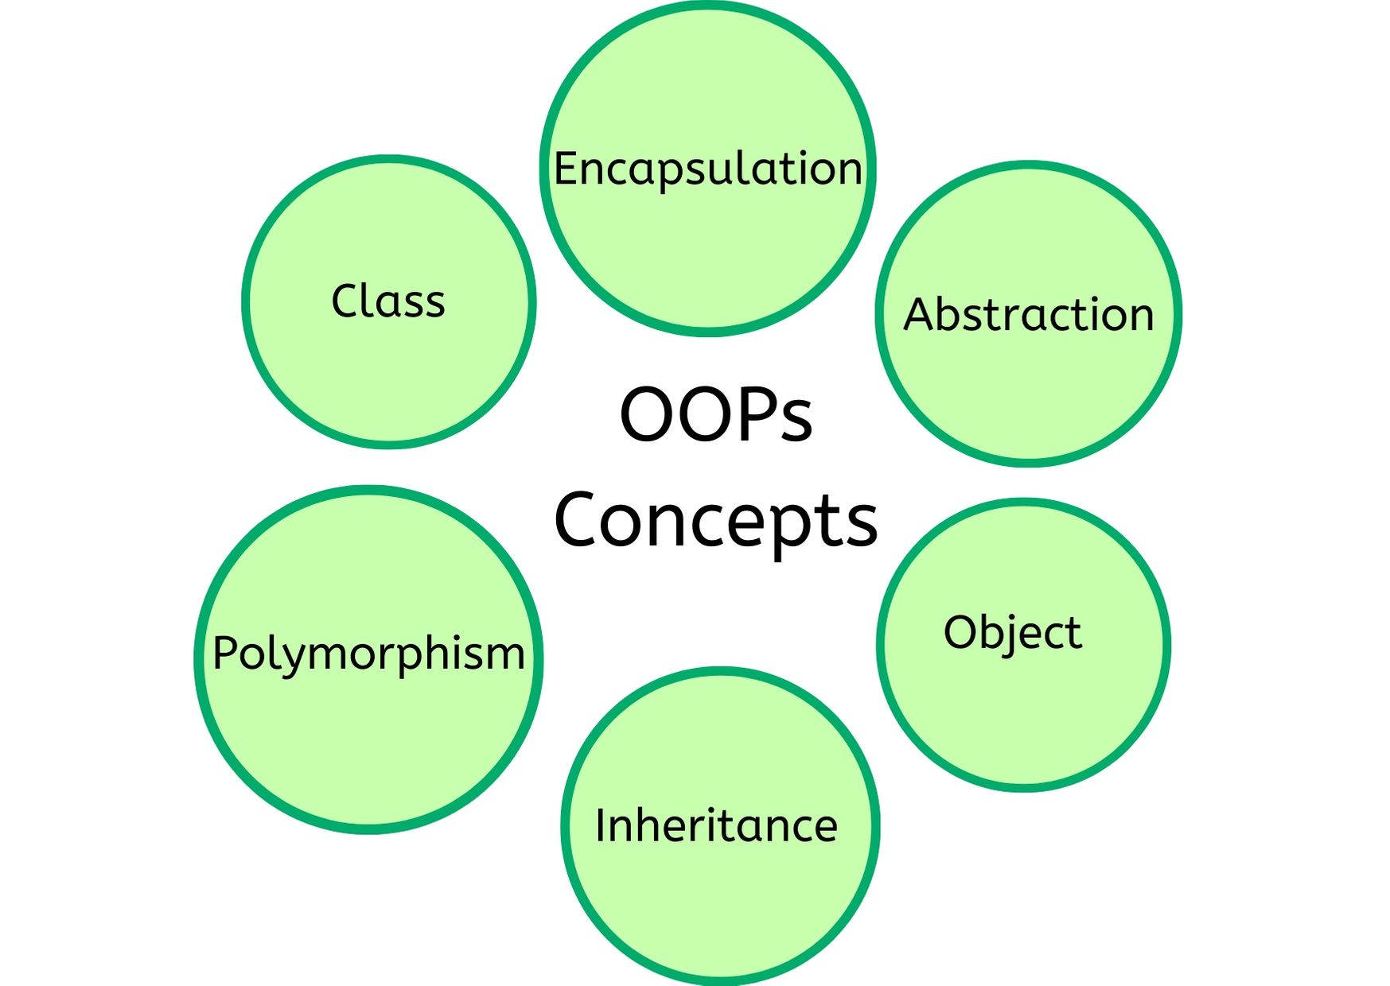
OOPS Concepts

Slide 6
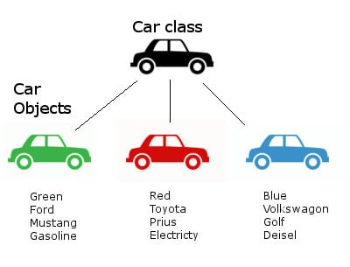
Class and Objects

Slide 7

Objects
An object is something (a thing or a concept) that has a well-defined role in the application domain
It has an identity, state and behavior and is something to which actions are directed
Its state encompasses its properties (attributes and relationships) and their values
Its behavior is how it acts and reacts

Slide 8
Objects
Software objects model real-world objects or abstract concepts
  E.g. dog, bicycle, queue
Real-world objects have states and behaviors
  Dogs' states: name, color, breed, hungry
  Dogs' behaviors: barking, fetching, sleeping
How do software objects implement real-world objects?
  Use variables/data to implement states
  Use methods/functions to implement behaviors
An object is a software bundle of variables and related methods

Slide 9
Objects
Creating an object from a class is called instantiation
An object is a concrete instance of a particular class
Objects have state
  Set of values associated to their attributes
Example:
  Class: Account
  Objects: Ivan's account, Peter's account

Slide 10
Message
All communication between objects is done via messages
Objects in programs are dynamic. They do things or have things done to them.
The actions that are associated with an object can be used to send messages to the objects and to retrieve information from objects.
A message is the passing of information or data from one object to another.
Argument is a data value that specializes the content of a message in some way.

Slide 11
Interfaces
Messages define the interface to the object
  Everything an object can do is represented by its message interface
The interfaces provide abstractions
  You shouldn't have to know anything about what is in the implementation in order to use it (black box)
An interface is a set of operations (methods) that given object can perform

Slide 12
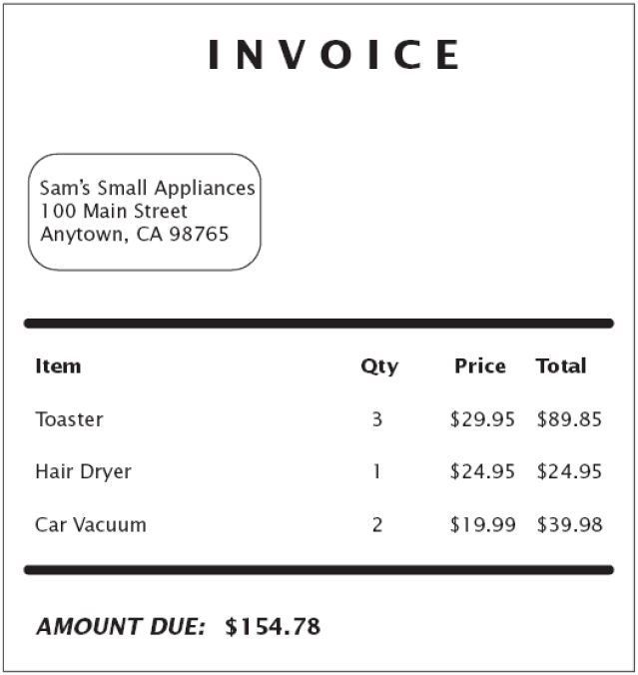
Example: Invoice

Slide 13
Example: Invoice
Classes that come to mind: Invoice, LineItem, and Customer
Good idea to keep a list of candidate classes
Brainstorm, simply put all ideas for classes onto the list
You can cross not useful ones later

Slide 14
Finding Classes
Keep the following points in mind:
  Class represents set of objects with the same behavior
    Entities with multiple occurrences in problem
    description are good candidates for objects
    Find out what they have in common
    Design classes to capture commonalities
  Represent some entities as objects, others as primitive types
    Should we make a class Address or use a String?
  Not all classes can be discovered in analysis phase
  Some classes may already exist

Slide 15
Preparing Data Dictionary
Isolated word have many interpretations, so prepare a data dictionary for all modeling entities
Describe the scope of the class within the current problem, including assumptions or restrictions on its membership or use
The data dictionary also describes associations, attributes, and operation

Slide 16
Example for Data Dictionary-ATM NetWork
Account : a single account in a bank against which transactions can be applied. Account may be of various types, at least checking or savings. A customer can hold more than one account.
Bank : A financial institution that holds accounts for customers and that issues cash cards authorizing access to accounts over the ATM network.
ATM : …
Bank ,Computer : …
Cash, Card : …
Cashier : ... etc.

Slide 17
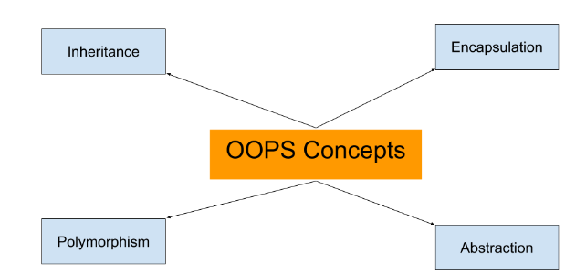
OOPS Concepts

Slide 18
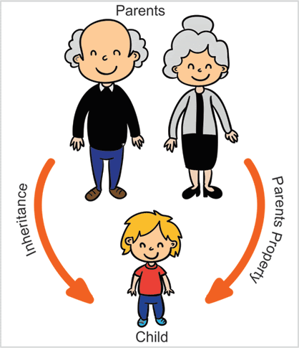
Inheritance
Inheritance -Passes "Knowledge" Down
  A class can inherit from another class and take advantage of the attributes and methods defined by the superclass.
Inheritance implements the “is a” relationship between objects

Slide 19
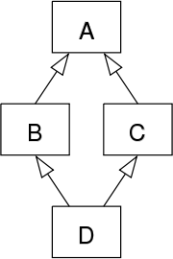
Diamond Problem
When an object of class D, any calls to method definitions in class A will be ambiguous – because it’s not sure whether to call the version of the method
derived from class B or class C.

Slide 20
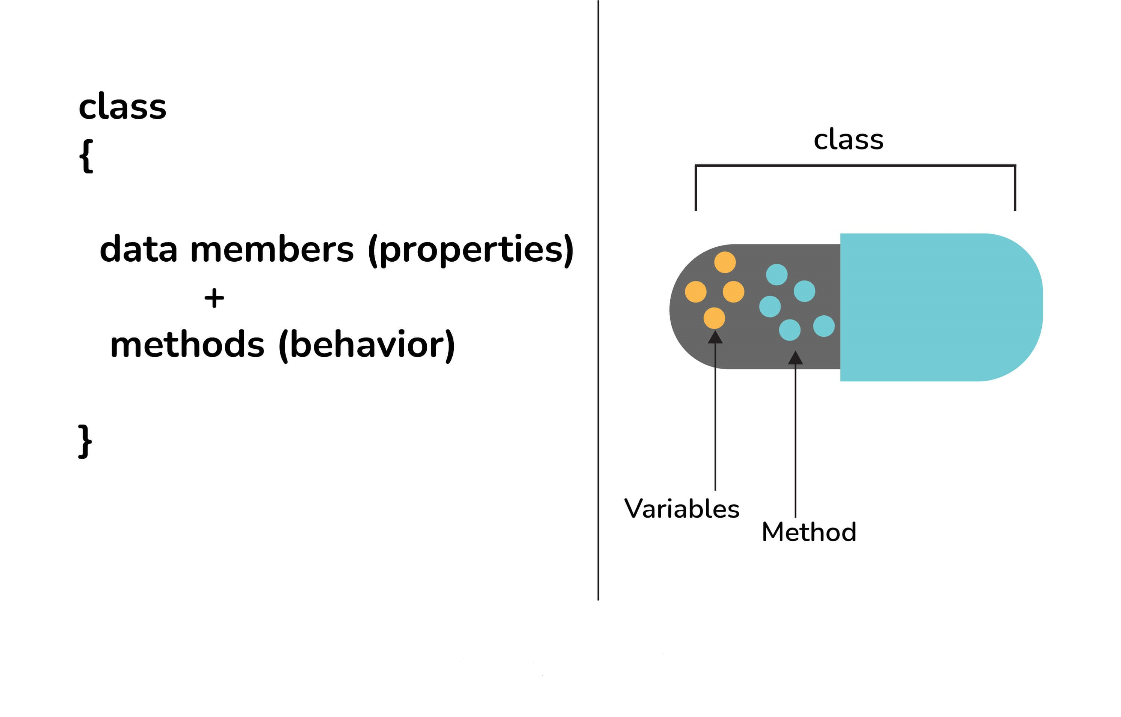
Encapsulation
Encapsulation - Enforces Modularity
  Encapsulating the data and behavior into a single object is of primary importance in OO development.
  A single object contains both its data and behaviors and can hide what it wants from other objects.

Slide 21
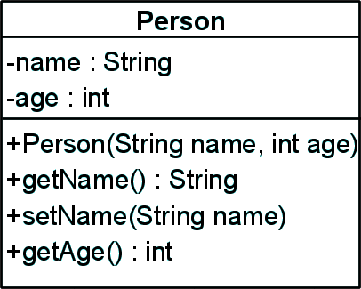
Encapsulation – Example
Data Fields are private
Constructors and accessor methods are defined
Notes:
(c) 2006 National Academy for Software Development - http://academy.devbg.org
(c) 2006 National Academy for Software Development - http://academy.devbg.org

Slide 22
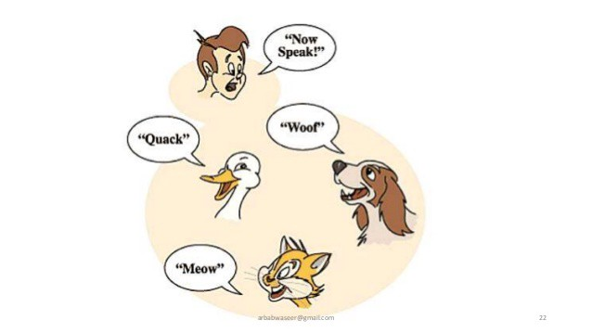
Polymorphism
Polymorphism -Takes any Shape
  Polymorphism means that similar objects can respond to the same message in different manners.

Slide 23

Abstraction
"show" only essential attributes and "hides" unnecessary information.
  Selecting data from a larger pool to show only relevant details of the object to the user.
It helps in reducing programming complexity and efforts.
  Focusing on what the information object must contain

Slide 24
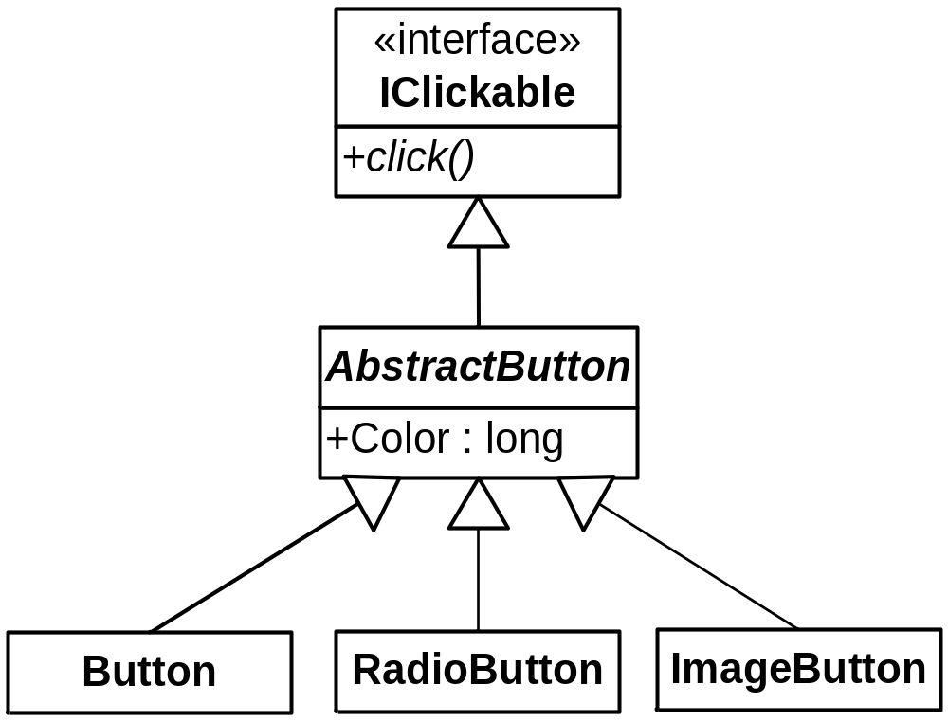
Abstraction in Java
In Java abstraction is achieved by use of
  Abstract classes
  Interfaces
Notes:
(c) 2006 National Academy for Software Development - http://academy.devbg.org
(c) 2006 National Academy for Software Development - http://academy.devbg.org

Slide 25
Encapsulation vs Data Abstraction
Encapsulation is data hiding
Encapsulation groups together data and methods that act upon the data
Abstraction is hiding implementation
Data abstraction deals with exposing the interface to the user and hiding the details of implementation.

Slide 26
The Relationship
aggregation is a special kind of an association and
composition is a special kind of an aggregation.
(Association->Aggregation->Composition)
If you are not even sure whether the relationship is best described as Association or Composition or Aggregation, then model it as an Association.

Slide 27
Aggregation
a restrictive form of “part-of” association
When object of one class has an (*has*) object of another,
Life or existence of the aggregated objects are independent of each other
  final class Car {
  private Engine engine;
  void setEngine(Engine engine) {
  this.engine = engine;
  }
  void move() {
  if (engine != null)
  engine.work();
  } }

Slide 28
Composition
A stricter form of aggregation
Life or existence of the composite object is dependent on the existence of container object,
Existence of composite object is not meaningful without its container object.
  final class Car {
  private final Engine engine;
  Car(EngineSpecs specs) {
  engine = new Engine(specs);
  }
  void move() {
  engine.work();
  }
  }

Slide 29
Aggregation vs Inheritance
Both associations describe trees (hierarchies)
  Aggregation tree describes “a-part-of “relationships (also called and-relationship)
  Inheritance tree describes "kind-of" relationships (also called or-relationship)
Aggregation relates instances (involves two or more different objects)
Inheritance relates classes (a way to structure the description of a single object)

Slide 30
CLASS DIAGRAM

Slide 31
Class Diagrams
the most widely used diagram of UML
models the static design view of a system
also useful in modelling business objects
used to specify the structure, interfaces and relationships between classes that underlie the system architecture.
primary diagram for generating codes from UML models

Slide 32
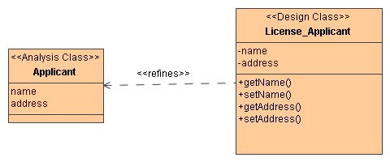
Class Notation
Basic notation: a solid-outline rectangle with three compartments separated by horizontal lines.
Three compartments:
  top compartment holds the class name and other general properties of the class
  middle compartment holds a list of attributes
  bottom compartment holds a list of operations

Slide 33
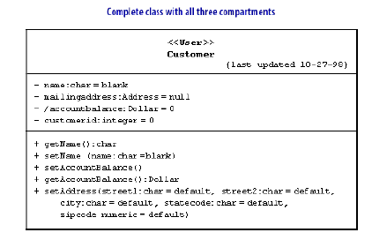
Class Diagram

Slide 34
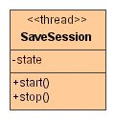
Stereotypes for Classes
Attribute or operation lists in a class may be organized into groups with stereotypes.
A number of stereotypes of classes and data types:
thread
event
entity
process
utility
Metaclass
Powerclass
enumeration, etc.

Slide 35
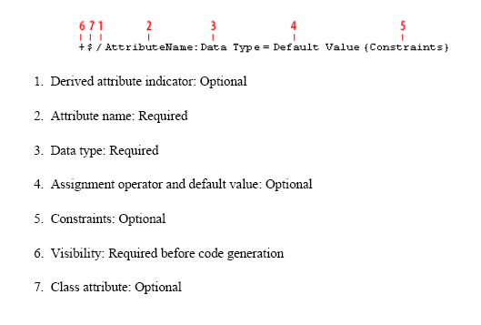
Attribute Syntax

Slide 36
Adding Visibility
scope of access allowed to a member of a class
applies to attributes and operations
UML visibility maps to OO visibilities:
  private scope: within a class (-)
  package scope: within a package (~)
  public scope: within a system (+)
  protected scope: within an inheritance tree (#)

Slide 37
Identifying Classes
Disparate Attributes and operations on a class :
  Split class so that each is part is coherent
Difficulty in generalizing cleanly :
  one class may be playing two roles, spilt it up and page par may then fit cleanly
Duplication associations with same and purpose :
  generalize to create the missing super class that unites them
Missing Access Path:
  Add New Associations so that you can answer the queries
Lack of attributes ,operations and associations on a class

Slide 38
Candidates for classes
Tangible things referred to by common nouns in requirements spec
  I.e., cookie, factory, triangle
Events with associated information (i.e., flight, game).
Abstract data stores (i.e., buffer, tree, hash table)
Note: verbs can also be classes!
  Parsing -> Parser, Scanner as a subclass of String

Slide 39
Candidates for classes
Can anything be a class? What isn't a class?
  Proper nouns are instances of classes, not classes
  Classes have content: store state information and perform operations
  If it doesn’t store state and perform multiple operations, keep it simple
  Classes with just one or two routines (probably not worth classifying)
  Redundant classes: merge synonyms, reuse classes in libraries

Slide 40
Iterating Class Model
A class model can be created itratively
It can become correct after a single pass,
different parts of a model are often at different stages of completions

Slide 41
Relationships
Generalization
A relationship between a general thing (called “parent” or “superclass”) and a more specific kind of that thing (called the “child” or “subclass”), such that the latter can substitute the former.
Realization
A semantic relationship between two things wherein one specifies the behavior to be carried out, and the other carries out the behavior.
(arrow-head points to the superclass)
(arrow-head points to the thing being realized)

Slide 42
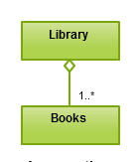
Aggregation
Special form of association representing has-a or part-whole relationship.
Distinguishes the whole (aggregate class) from its parts (component class).
No relationship in the lifetime of the aggregate and the components (can exist separately).

Slide 43
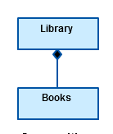
A Composition Example
Stronger form of aggregation
Implies exclusive ownership of the component class by the aggregate class
The lifetime of the components is entirely included in the lifetime of the aggregate (a component can not exist without its aggregate).

Slide 44


Inheritance
Superclass
Person
+Name: String
+Address: String
Subclass
Subclass
Employee
Student
+Company: String
+Salary: double
+School: String
Notes:
(c) 2006 National Academy for Software Development - http://academy.devbg.org
(c) 2006 National Academy for Software Development - http://academy.devbg.org

Slide 45
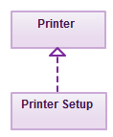
Realization
Denotes the implementation of the functionality defined in one class by another class.
To show the relationship in UML, a broken line with an unfilled solid arrowhead is drawn from the class that defines the functionality of the class that implements the function.

Slide 46
Class Diagrams
Multiplicity
Customer
1
Simple
Aggregation
Class
Abstract
Class
Rental Invoice
Rental Item
1..*
1
0..1
Composition
Simple
Association
Generalization
DVD Movie
VHS Movie
Video Game
Checkout Screen

Slide 47


OOP with Java

Slide 48
Objective
Describe the key features of Java technology
Write, compile, and run a simple Java application
Describe the function of the Java Virtual Machine
Define garbage collection

Slide 49
History of Java
Conceived as Programming language for embedded systems like microwave ovens, televisions etc
One of the first projects developed using Java
    personal hand-held remote control named Star 7.
The original language was called Oak
It was developed in the year 1991 at Sun Microsystems
Notes:
Java was conceived by a team of engineers in Sun Microsystems in 1991 as a part of a research project, which was led by James Gosling and Patrick Naughton. It took 18 months to develop the first working version. This language was initially called “Oak” but was renamed as “Java” in 1995.
Modeled after C++, the Java language was designed to be small, simple, and portable across platforms and operating systems, both at the source and at the binary level, which means that Java programs (applets and applications) can run on any machine that has the Java virtual machine installed.

Slide 50
Primary Goals of Java
Provides an easy-to-use language by:
  Avoiding many pitfalls of other languages
  Being object-oriented
  Enabling users to create streamlined and clear code
Provides an interpreted environment for:
  Improved speed of development
  Code portability
  Enables users to run more than one thread of activity
  Loads classes dynamically; that is, at the time they are actually needed
  Supports changing programs dynamically during runtime by loading classes from disparate sources

Slide 51
Features of Java
Features that fulfill the goals:
  The Java Virtual Machine (JVM)
  Garbage collection
  The Java Runtime Environment (JRE)
  JVM tool interface

Slide 52
The Java Virtual Machine
Executes instructions that a Java compiler generates.
A runtime environment, embedded in web browsers, servers, and operating systems
Imaginary machine that is implemented by emulating software on a real machine
Reads compiled byte codes that are platform-independent
Bytecode
  a special machine language that can be understood by the JVM independent of any particular computer hardware,
  Java Runtime Environment (JRE) is an implementation of the JVM”.
  “JVM becomes an instance of JRE at runtime”.
    A runtime instance of JVM will born when .class file starts its execution

Slide 53
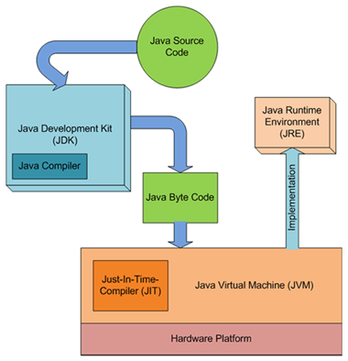
JDK,JVM and JRE

Slide 54
JVM Tasks
Loads code
  Loads all classes necessary for the execution of a program
  Maintains classes of the local file system in separate namespaces
Verifies code (Bytecode Verifier)
  The code adheres to the JVM specification.
  The code does not violate system integrity.
  The parameter types for all operational code are correct.
  No illegal data conversions have occurred.

Slide 55
Class Loader
Bootstrap Class Loader
  Responsible for loading classes from bootstrap classpath
  JAVA_HOME/jre/lib directory.
  Highest priority will be given to this loader.
Extension Class Loader
  This loader is child of Boorstrap class loader.
  It loads classes from JAVA_HOME/jre/lib/ext
  Can be specified by the java.ext.dirs system property.
Application Class Loader
  This loader is child of Extension class loader
  Responsible for loading classes from application level classpath.
  It uses Environment Variable which is mapped to java.class.path.

Slide 56
Garbage Collection
Garbage collector is responsible for cleaning the memory.
In other languages, de-allocation is the programmer’s responsibility.
A system-level thread to track memory allocation.
Garbage collection has the following characteristics:
  Checks for and frees memory no longer needed
  Is done automatically
  Can vary dramatically across JVM implementations
Can request JVM to run garbage collection by calling System.gc()

Slide 57
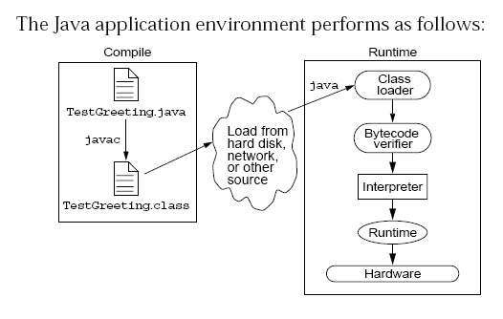
Java Run Time Environment

Slide 58
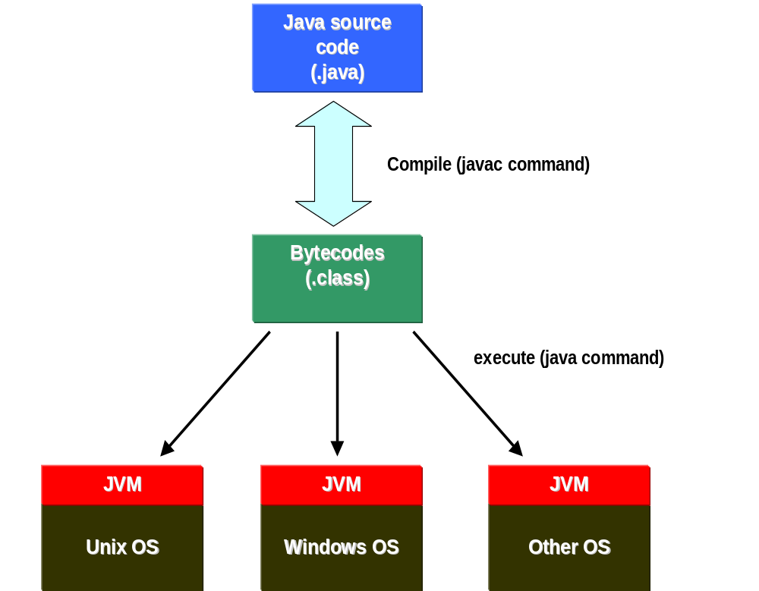

Slide 59
Integrated Development Environments
An IDE is the high-productivity tool
Used to edit, compile, and test programs, manage projects, debugging, building GUI interfaces, etc.
IDE provides extensive programming support for editing and project management,
The Popular IDE’s
  Eclipse
  NetBeans
  JDeveloper

Slide 60
Java language syntax

Slide 61
Objectives
Identify the basic parts of a Java program
Differentiate among Java literals, primitive data types,
variable types ,identifiers and operators
Develop a simple valid Java program using the concepts learned in this chapter

Slide 62
Program structure
A program in Java consists of one or more class definitions
One of these classes must define a method main(), which is where the program starts running
Java programs should always end with the .java extension.
There can be More than one Class Definition in a class ,but only one public class
Source Filenames should match the name of the public class.

Slide 63
Source File Layout
Basic syntax of a Java source file is:
[<package_declaration>]
<import_declaration>*
<class_declaration>+

Slide 64
Software Packages
Packages help manage large software systems.
Packages can contain classes and sub-packages.
package <top_pkg_name>[.<sub_pkg_name>]*;
Specify the package declaration at the beginning of the source file.
Only one package declaration per source file.
If no package is declared, then the class is placed into the default package.
Package names must be hierarchical and separated by dots.

Slide 65
The import Statement
import <pkg_name>[.<sub_pkg_name>]*.<class_name>;
import <pkg_name>[.<sub_pkg_name>]*.*;
import java.util.List;
import java.io.*;
import shipping.gui.reportscreens.*;
The import statement does the following:
  Precedes all class declarations
  Tells the compiler where to find classes

Slide 66
Example 1.1
  package com.training;
  public class Greetings {
  public String getMessage() {
  return "Welcome to Java Programming";
  }
  }

Slide 67
Example 1.1 (contd)
  package com.training;
  public class TestGreetings {
  public static void main(String[] args) {
  Greetings grtObj = new Greetings();
  System.out.println(grtObj.getMessage());
  }
  }

Slide 68
The System Class
Its part of the java.lang package
The classes in this package are available without the need for an import statement
This class contains several useful class fields and methods.
It can’t be Instantiated
It also Provides facilities for
  Standard Input
  Standard Output
  Error Output Streams
  Access to externally defined properties

Slide 69
Classes as Blueprints for Objects
In manufacturing, a blueprint describes a device from which many physical devices are constructed.
In software, a class is a description of an object:
  A class describes the data that each object includes.
  A class describes the behaviors that each object exhibits.
In Java technology, classes support three key features OOP
  Encapsulation
  Inheritance
  Polymorphism

Slide 70
Declaring Java Technology Classes
Basic syntax of a Java class:
  <modifier>* class <class_name> {
  <attribute_declaration>*
  <constructor_declaration>*
  <method_declaration>*
  }
Define an attribute:
<modifier>* <type> <name> [ = <initial_value>];

Slide 71
Declaring Methods
Basic syntax of a method:
<modifier>* <return_type> <name> ( <argument>* ) {
<statement>*
}
  public int getWeight() {
  return weight;
  }
  public void setWeight(int newWeight) {
  if ( newWeight > 0 ) {
  weight = newWeight;
  }
  }

Slide 72
Accessing Object Members
The dot notation is: <object>.<member>
  used to access object members, including attributes and methods.
d.setWeight(42);
d.weight = 42; // only permissible if weight is public

Slide 73
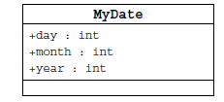
Information Hiding
Client code has direct access to internal data
(d refers to a MyDate object):
d.day = 32; // invalid day
d.month = 2; d.day = 30; // plausible but wrong
d.day = d.day + 1; // no check for wrap around

Slide 74
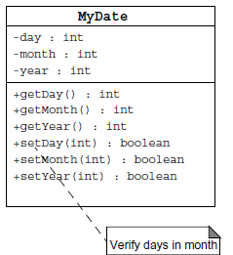
Encapsulation
Hides the implementation details of a class
Forces the user to use an interface to access data
Makes the code more maintainable

Slide 75
Classes
Top-level classes can be declared as
  public
    a public class is globally accessible.
    a single source file can have only one public class or interface
  abstract
    an abstract class cannot be instantiated
  final
    a final class cannot be subclassed
  Default
    With any Modifier
They can’t be declared as protected and private

Slide 76
Constructors
Have no return type
Have the same name as the class
If we don't’ put a constructor the compiler puts a default one
  The default constructor has the same access modifier as the class.
  The default constructor has no arguments.
  The default constructor is always a no-arg constructor, but a no-arg constructor is not necessarily the default constructor
  The default constructor includes a no-arg call to the super constructor (super()).
They are not inherited and hence they are not overridden
It can be Overloaded
It can have any of the Four Access Modifies
It cannot be synchronized
It can have throws clause

Slide 77
Instantiation with new
It is the process by which individual objects are created.
  Class objectReference = new Constructor();
Declaration
  Employee empObj;
Instantiation
  empObj = new Employee()
Declaration and Instantiation
  Employee empObj = new Employee()
  new operator allocates memory for an object.

Slide 78
Constructor Overloading
One constructor can call another overloaded constructor of the same class by using this keyword.
this() is used to call a constructor from another overloaded constructor in the same class
The call to this() can be used only in a constructor ,and must be the first statement in a constructor
A constructor can call its super class constructor by using the super keyword.
A constructor can have a call to super() or this() but never both

Slide 79
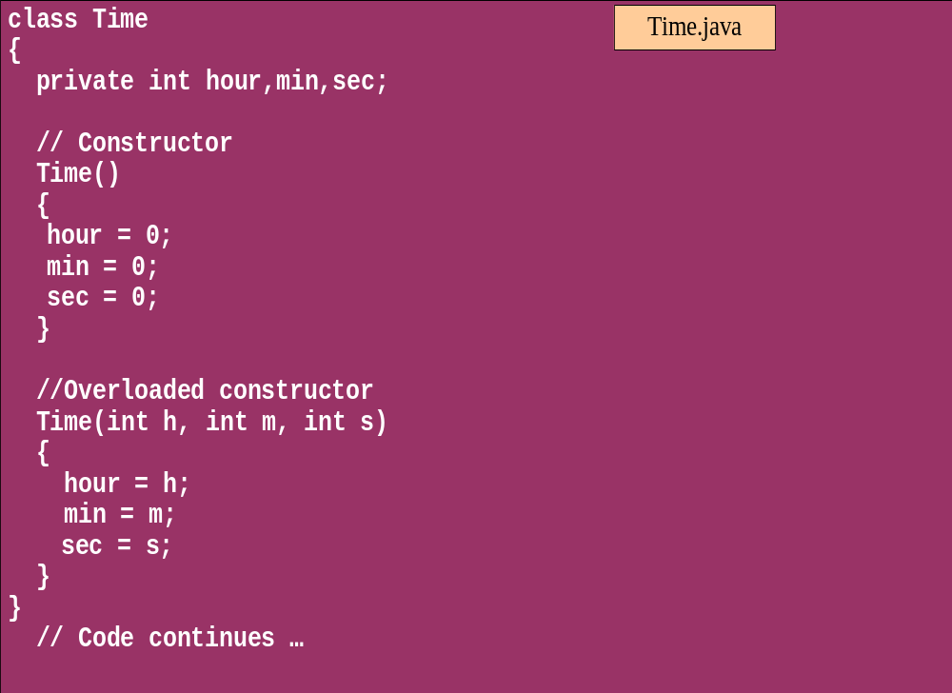
Overloaded Constructor

Slide 80
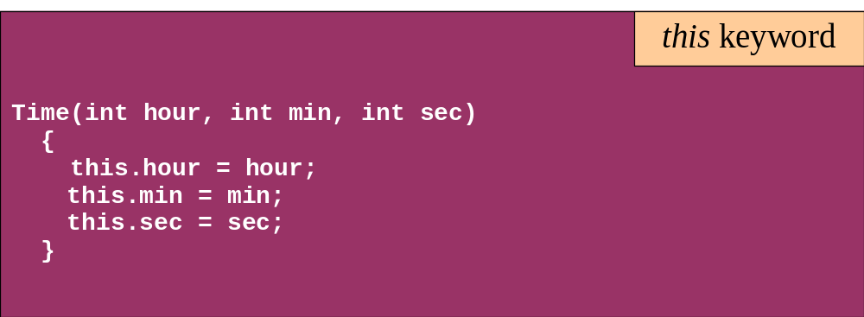
this keyword
Is a reference to the object from which the method was invoked

Slide 81
Comments
Java supports three forms of comments
  // single line comments
  /* multi
    line
    comment
    */
  /** a
    * Javadoc
    * comment
    */

Slide 82
Variables and Methods
A variable, which corresponds to an attribute, is a named memory location that can store a certain type of value.
Variable is a kind of special container that can only hold objects of a certain type.
Primitive type Variable
    Basic, built-in types that are part of the Java language
    Two basic categories
      boolean
      Numeric
        Integral - byte, short, int, long, char
        Floating point - float, double

Slide 83
Instance Variables and Methods
Variables and methods can be associated either with objects or their classes
An instance variable and instance method belongs to an object.
They can have any one of the four access levels
  Three access modifies – private, public , protected
They have a default value
A class variable (or class method) is a variable (or method) that is associated with the class itself.

Slide 84
Example for Variables
  public class VariableTypes {
  private int inst_empid;
  private static String cls_empName
  public void getData() { }
  public static void getSalary() { }
  public void showData(int a)
  {
  int localVariable ;
  }
  }
Instance Variable
Class Variable
Parameter Variable
Local Variable

Slide 85
Identifiers
Identifiers are used to name variables, methods, classes and interfaces
Identifiers
  start with an alphabetic character
  can contain letters, digits, or “_”
  are unlimited in length
Examples
  answer, total, last_total, relativePoint, gridElement, person, place, stack, queue

Slide 86
Local Variable needs to Be Initialized
  public class LocalVariable {
  private String name;
  public void display()
  {
  int age;
  System.out.println("Age"+age);
  System.out.println("Name"+name);
  }
Age Should be Initialized before Use

Slide 87
Instance Variable have Default Values
class Values
{
private int a;
private float b;
private String c;
public void display()
{
System.out.println("integer"+a);
System.out.println("float"+b);
System.out.println("String"+c);
}
public class DefaultVales {
public static void main(String[] args) {
Values v = new Values();
v.display();
}
}

Slide 88
Assignment of reference variables
int x = 7;
int y = x;
String s = “Hello”;
String t = s;
x
y
s
t
7
7
0x01234
0x01234
Hello

Slide 89
Pass-by-Value
The Java programming language only passes arguments by value for primitive data types.
When an object instance is passed as an argument to a method, the value of the argument is a reference to the object
The contents of the object can be changed in the called method, but the object reference is never changed
For primitives, you pass a copy of the actual value.
For references to objects, you pass a copy of the reference
You never pass the object. All objects are stored on the heap.
Notes:
The Java programming language only passes arguments by value.
When an object instance is passed as an argument to a method, the value of the argument is a reference to the object.
The contents of the object can be changed in the called method, but the object reference is never changed .

Slide 90

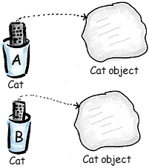
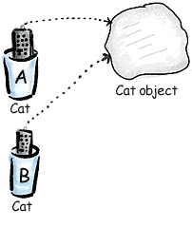
Pass By Value

Slide 91
Casting Primitive Types
Casting creates a new value and allows it to be treated as a different type than its source
JVM can implicitly promote from a narrower type to a wider type
To change to a narrow type explicit casting is required
Byte -> short -> int -> long -> float -> double

Slide 92
Casting Primitive Types
  public class PrimCasting {
  public static void main (String [] args){
  int x = 99;
  double y = 5.77;
  x = (int)y; //Casting
  System.out.println("x = "+ x);
  double y1 = x; //No Casting
  int i =42;
  byte bt;
  bt= (byte)i;
  System.out.println("The Short number"+ bt);
  }
  }

Slide 93
Wrapper Classes
Primitives have no associated methods
Wrapper Classes are used encapsulate primitives
They also provide some static utility methods to work on them
Primitive Type | Wrapper class
-boolean | Boolean
-byte | Byte
-char | Character
-double | Double
-float | Float
-int | Integer
-long | Long
short | Short

Slide 94
Wrapping Primitives
Wrapping a value
  int i = 288
  Integer iwrap = new Integer(i);
unWrapping a value
  int unwrapped = iwrap.intValue();
Methods In Wrapper Class
  parseXxx()
  xxxValue()
  valueOf()

Slide 95
Wrapper Class Method
Convert String to Numbers
public class ParsingStrings
{
public static void main(String args[])
{
int ino=Integer.parseInt(args[0]);
floatfno = Float.parseFloat(args[1]);
double dno = Double.parseDouble(args[2]);
Long lno = Long.parseLong(args[3]);
System.out.println("Integer value" +ino );
String strIno = Integer.toString(ino);
System.out.Println(“String Value”+strIno);
}
}

Slide 96
Auto Boxing
Java 5.0 provided autoboxing
Integer n = new Integer(123) Int m = n.intValue() m++; n=new Integer(m); System.out.println(n); | Integer n = new Integer(123); n++; System.out.println(n);

Slide 97
Auto Boxing
public class ABoxing {
  public void show(int a, float b)
  {
  System.out.println("Integer"+a*2);
  System.out.println("Float"+b*2);
  }
  public static void main(String[] args) {
  ABoxing abObj =new ABoxing ();
  Integer a = 10;
  Float b =20f;
  abObj.show(a,b);
  }
  }

Slide 98
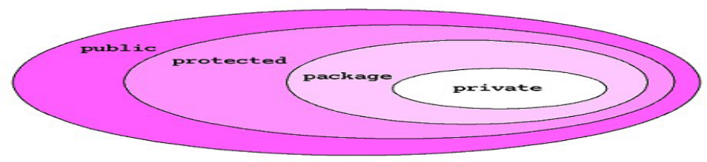
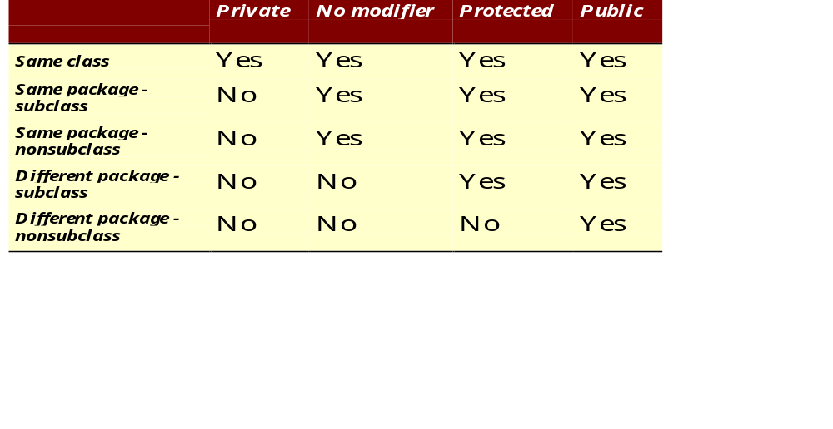
The 4 Access Levels and 3 Modifiers

Slide 99
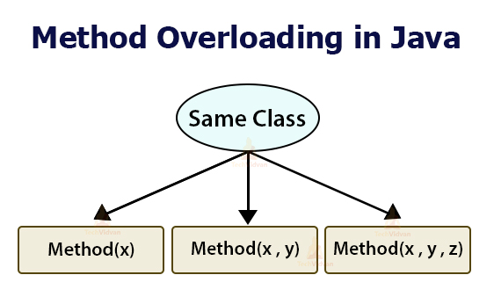

Slide 100
Method Overloading
If two (or more) methods of a class have the same name but different signatures, then the method name is said to be overloaded.
The signature of a method consists of the name of the method and the number and types of formal parameters in particular order.
Method overloading is method name overloading.
Several methods that implement similar behavior but for different data types.
They are independent methods of a class and can call each other just like any other method.
A method can be overloaded in the same class or in a subclass.

Slide 101
Overloading Methods
Overloaded methods MUST change the argument list.
Overloaded methods CAN change the return type.
Overloaded methods CAN change the access modifier.
Overloaded methods CAN declare new or broader checked exceptions.

Slide 102
Overloading and AutoBoxing
public class Overloading {
public Integer add(Integer a , Integer b)
{
Integer c = a+b;
return c+100;
}
public int add(int a , int b)
{
return a+b;
}

Slide 103
Application
  public static void main(String[] args) {
  Overloading olObj = new Overloading();
  System.out.println(olObj.add(45, 55));
  }
  Output will be 100 and Not 200

Slide 104
Static Variables and Methods
A static method belongs to a class and not to its instance objects and hence they are shared between Objects
Static Methods can not be overridden
They can only call other static methods
They can access only static variables and not instance Variables
They cannot refer to this or super
Instance variable : 1 per instance and Static variable : 1 per class
Static final variables are constants
main( ) is defined to be a static method so as to be invoked directly

Slide 105
Static Method access only static
  public class StatClass {
  private int id;
  private static String name;
  private void instMethod()
  {
  staticMethod();
  System.out.println(id);
  System.out.println(name);
  }
  private static void staticMethod()
  {
  System.out.println(id);
  System.out.println(name);
  instMethod();
  }
  }
Can Access Static from Instance Method
Cannot Access Instance Variable From Static
Cannot Access Instance Method From Static

Slide 106
Static Import
  import java.util.*;
  import static java.lang.System.out;
  import static java.lang.System.in;
  public class StaticImport {
  public static void main(String[] args) {
  Scanner kb = new Scanner(in);
  out.print("Enter an integer ");
  int x = kb.nextInt();
  out.print("Enter a double ");
  double d = kb.nextDouble();
  out.println("The sum is " + (x+d));
  }
  }

Slide 107
java.util.Scanner Class
A simple text scanner which can parse primitive types and strings using regular expressions.
A Scanner breaks its input into tokens using a delimiter pattern, which by default matches whitespace.
The resulting tokens may then be converted into values of different types using the various next methods.
  Scanner sc = new Scanner(System.in);
  int i = sc.nextInt();
  sc.close();

Slide 108
java.util.Scanner Class
  Scanner sc = new Scanner(System.in);
  System.out.println("Enter The Number");
  int number = sc.nextInt();
  System.out.println("Enter the Name");
  String name = sc.next();
  System.out.println(number + ":"+name);

Slide 109
java.util.Scanner Class
  public static void main(String[] args) {
  String line="Java,is,in,OOP,Language";
  Scanner sc1 = new Scanner(line);
  sc1.useDelimiter(",");
  while (sc1.hasNext())
  {
  System.out.println(sc1.next());
  }
  }

