Slide 1
SPRING REST CLIENT-REST TEMPLATE

Slide 2
Consuming REST with REST Template
REST web service can be comsumed programmatically.
Spring convenient template class is called RestTemplate.
  one-line that can bind the data to custom domain types.
It leverages the same marshallers that the server uses.
Can use JAXB marshaller,as well as JSON marshaller

Slide 3
Rest Template
Rest Template is used to create applications that consume REST
Its Autowired to the controller class.
exchange()
  Returns ResponseEntity containing an object mapped from the response body
  Can Communicate with any HTTP Method
  Takes the following arguments
    URL,
    HttpMethod,
    Return type for Exchange() method.

Slide 4
Rest Template
  getForObject(url, java.lang.Class<T>)
    Retrieve an Entity by doing a GET on the specified URL.
    Class<T> is the response class Type
    retrieves an entity.
getForEntity(url, java.lang.Class<T>)
  Retrieve a representation by doing a GET on the URL
  Class<T> is the response class Type
  It returns ResponseEntity<?>

Slide 5
Rest Template -Exchange
  HttpHeaders headers = new HttpHeaders();
  headers.setAccept(Arrays.asList(MediaType.APPLICATION_JSON));
  HttpEntity <String> entity = new HttpEntity<String>(headers);
  restTemplate.exchange(" http://localhost:8080/products",
  HttpMethod.GET, entity, String.class).getBody();

Slide 6
Template Exchange
ParameterizedTypeReference<T>
  Used to enable capturing and passing a generic Type.
  Uses Jackson Library for producing a List of Objects instead of an Array
  Done by creating an annoymous subclass
  template.exchange(
  "http://localhost:8080/api/v1/products",
  HttpMethod.GET, null,
  new ParameterizedTypeReference<List<Product>>() {}
  ).getBody();

Slide 7
getForObject
  @Autowired
  RestTemplate restTemplate;
  String obj =
  restTemplate.getForObject("http://localhost:4040/person/all", String.class);
  System.out.println(obj);

Slide 8
PostForObject
Used to create a new Resource
postForObject()
  Returns the Resource itself.
RestTemplate restTemplate = new RestTemplate();
HttpEntity<Book> request = new HttpEntity<>(new Book(“Java"));
Book bk = restTemplate.postForObject(url, request,Book.class);

Slide 9


Slide 10
INTRODUCTION TO MICRO SERVICES

Slide 11
Monolith Application
A monolithic application is a single-tiered software application
  Has user interface and data access code combined into a single program from a single platform.
Its characteristics
  Doesn’t have Module but Modularized using object-based approach to be distributed across multiple computers
  Deployed together as a single deployment unit- EAR or WAR.
  Long Release Cycles
  Large Teams

Slide 12
Challenges to Monolith
  Large codebases become mess over the time
  Multiple teams working on single codebase become tedious
  Difficulty in Adapting to Device Explosion
  Scaling up certain parts of the application
  Technology updates/rewrites become complex and expensive tasks

Slide 13
Micro Services
An engineering approach focused on decomposing applications with well-defined interfaces - service contracts such as a JSON schema or WSDL
  Deployed independently as services and operated by small teams who own the entire lifecycle of the service.
  Each service handles a specific business domain (logging, auth, orders, customers)
  Each Service provides the implementation for user interface, business logic, and connection to database.
  Each Service can be scaled up Individually

Slide 14
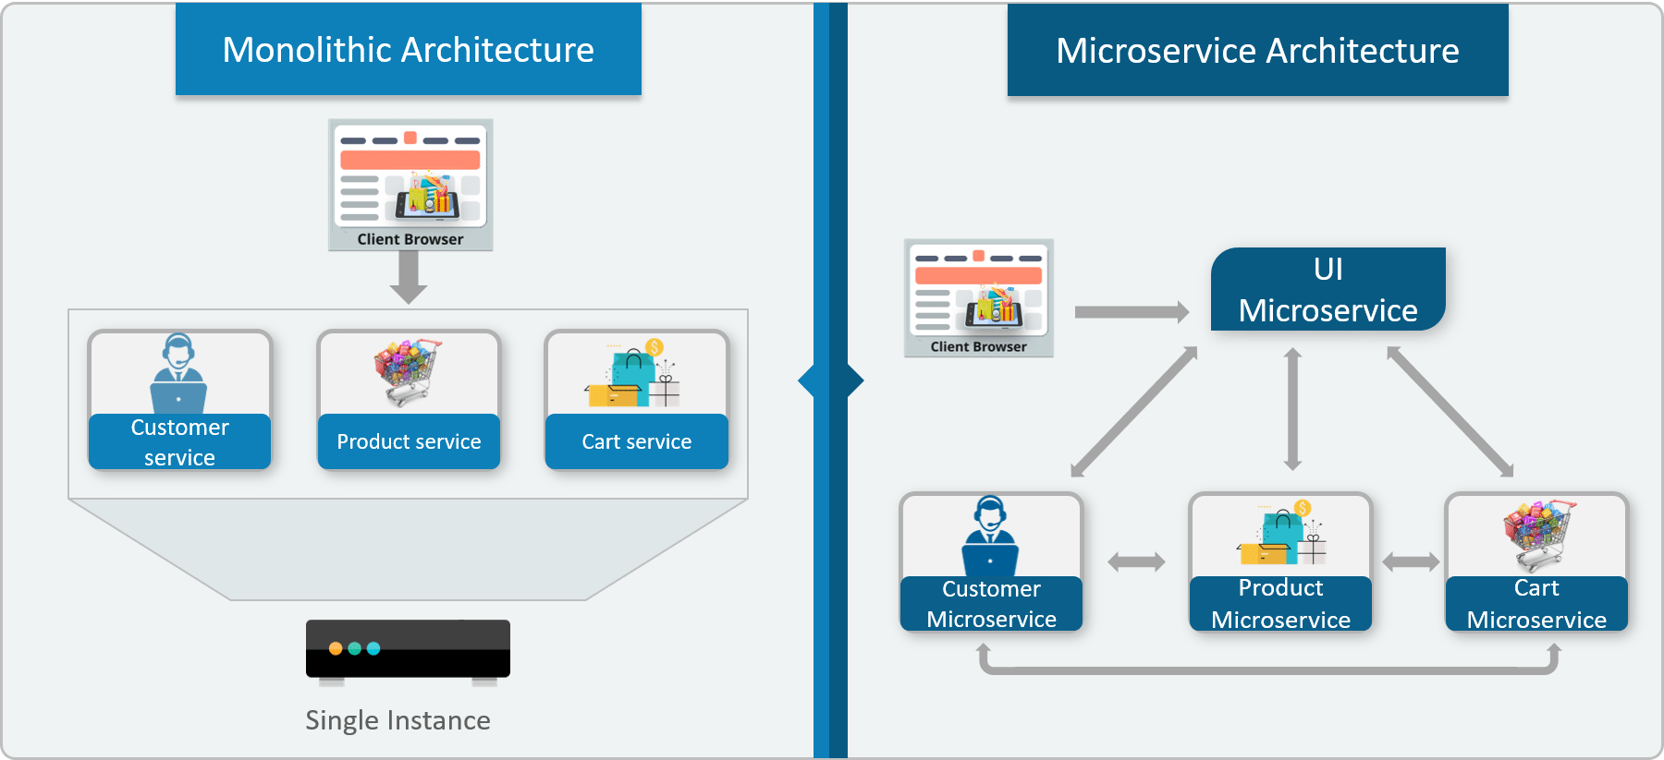

Monolithic vs Micro Service

Slide 15
Characteristics of Micro Service
Single-function
  Each and every service has a specific function, or responsibility.
  A service can do many tasks, but all of them are relevant to a single function.
Well-defined interfaces
  Services must provide an interface that defines to communicate with it.
  Defines a list of methods, and their inputs and outputs.
  JSON Schema or WSDL files

Slide 16
Characteristics of Micro Service
Independent
  Services doesn’t know about each other implementation.
  They can get tested, deployed, and maintained independently.
  Services may be implemented using different language stacks, and communicate with different databases.
    They can work together to complete a required operation.

Slide 17
Characteristics of Micro Service
Small Teams
  Split the work up and team across the services.
  Each team focuses on a specific service, they don’t need to know about internal workings of other teams.
  Teams can work efficiently, communicate easily,
  Each service can be deployed rapidly as soon as it’s ready.
Entire Lifecycle
  The team is responsible for the entire lifecycle of the service; from coding, testing, staging, deploying, debugging, maintaining.
  No separate team for coding, deployment. Etc

Slide 18
Characteristics of Micro Service
Minimizing Communication
  Only essential cross-team communication should be through the interface that each service provides.
  They all need to agree on the external interface, so that communication between services is clearly defined.
Cloud Enabled
  Dynamic Scaling

Slide 19
When Not to use Micro Services
Complexity is a key factor
  "...don't even consider microservices unless you have a system that's too complex to manage as a monolith...“ –Martin Fowler
If complexity isn't problem, microservices aren't the solution.
Micro service architecture also brings with it significant overhead
  Design
  Interoperability of services
  Management
  Use of system resources.

Slide 20
Challenges with Micro service
Development has some inherent complexities
Quick Setup needed
  Should be able to create micro services quickly.
Automation
  Smaller component build ,deployment, monitoring etc should automated
Visibility :
  Should be able to monitor and identify problems automatically.
  Need great visibility around all the components.
Debugging
  Centralized Logging and Dashboards are essential to debug problems.

Slide 21
Challenges with Micro service
Configuration Management
  Need to maintain configurations for hundreds of components across environments.
  Should Have Configuration Management solution
Dynamic Scale Up and Scale Down
  Applications should be easily scaled up and down
Pack of Cards :
  If a Service at the bottom of the call chain fails, it can have knock on effects on all other services.
  Services should be fault tolerant by Design.
Consistency
  Should have some decentralized governance around the languages, platforms, technology and tools used for implementing/deploying/monitoring

Slide 22
Solutions to Challenges
Spring Boot
  Enable building production ready applications quickly
  Provide non-functional features
  embedded servers (easy deployment with containers)
  metrics (monitoring)
  health checks (monitoring)
  externalized configuration

Slide 23
Solutions to Challenges
Spring Cloud
  Cloud solutions – From Spring and Open Sourced
Dynamic Scale Up and Down.
  Using a combination of Naming Server (Eureka)
  Client Side Load Balancing
  Feign (Easier REST Clients)
Visibility and Monitoring
  Zipkin Distributed Tracing
  API Gateway
Configuration Management
  Spring Cloud Config Server
Fault Tolerance
  Cloud Circuit Breaker

Slide 24
SPRING CLOUD EUREKA

Slide 25
Service Register and Discovery
Application is decomposed into Many Microservices.
  Each deployed in different servers and different ports.
Services may need to communicate with each other to execute some tasks
  Using ip address and port number has many limitations on invoking the services

Slide 26
Service Register and Discovery
“Service Registration“.
  Services are registered in a centralized location with an identifier and server details.
“Service Discovery”
  Microservice should be able to look up the list of registered services from the centralized location
Implementations of Service Registration and Discovery Server
  Netflix Eureka
  Consul
  Zookeeper

Slide 27
Netflix Eureka Server
Micro services will register with Eureka server
Services provide the following details
  host name, ip address, port, and health indicators etc…
serviceId.
  The Unique Id given to the registered Services
    Also Used to by other services for access

Slide 28
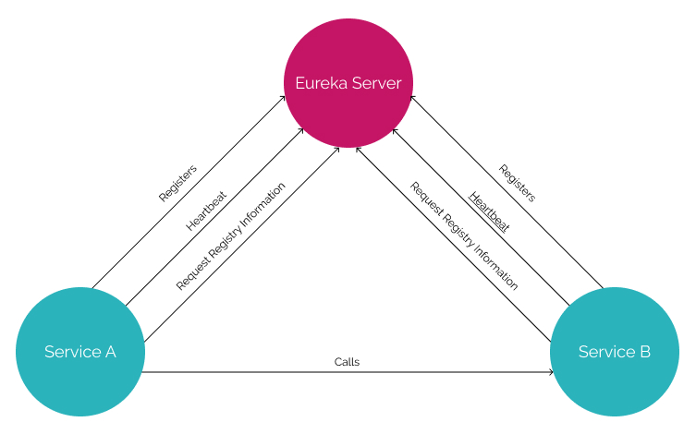
Service Registry

Slide 29
Service Registry
Handles only Registration
  Not communication between the two servers
  Communication is directly between the two services
Cache
  If Eureka is down, the client uses a cached copy of the remote service's address
  Can handle temporary network failures.

Slide 30
Netflix Eureka Server
@EnableEurekaServer
  Added to the main Spring Boot Application configuration class
  Used to Notify the Spring Container that this application is a registration service by Netflix technology
  It also activates Eureka Server related configurations
  @EnableEurekaServer
  @SpringBootApplication
  public class EurekaServerApplication {
  public static void main(String[] args) {
  SpringApplication.run(EurekaServerApplication.class, args);
  }
  }

Slide 31
Server Config Properties
  server:
  port: 8761
  spring:
  application:
  name: eureka-server-registry
  eureka:
  client:
  fetch-registry: false
  register-with-eureka: false
  service-url:
  defaultZone: http://localhost:8761/eureka

Slide 32
Configuration Properties
fetch-registry=false (default: true)
  A Eureka instance is also a Eureka client
  It can fetch the registry containing the details of other instances.
  “false” means it will not be fetching the registry information
register-with-eureka=false (default: true)
  Should this server register itself as a client;
  “false” means it prevents itself from acting as a client.

Slide 33
Configuration Properties
eureka.client.serviceUrl.defaultZone
  In a standalone mode
    points to the local server address.
    Switch off the client-side behavior
    Does not keep trying and failing to reach its peers.

Slide 34
EUREKA DISCOVERY CLIENT

Slide 35
Discovery From Eureka Server
EurekaClientConfigBean
    Implementation of EurekaClientConfig.
    Properties are prefixed by eureka.client.
Discovery clients
  Clients can look up and fetch information of other services
  Can communicate without IP addresses and port numbers

Slide 36
Discovery Clients
@EnableDiscoveryClient
  Added in the main spring boot configuration class
  Works with any Discovery Client implementations
  Example : Eureka, Consul, Zookeeper
@EnableEurekaClient
  Works only with Eureka

Slide 37
Discovery Client Service
  @SpringBootApplication
  @EnableEurekaClient
  public class BloodDonarServiceApplication {
  public static void main(String[] args) {
  SpringApplication.run(BloodDonarServiceApplication.class, args);
  }
  }

Slide 38
application.yml
  spring:
  application:
  name: product-service
  server:
  port: 5454
  eureka:
  client:
  service-url:
  defaultZone: http://localhost:8761/eureka

Slide 39
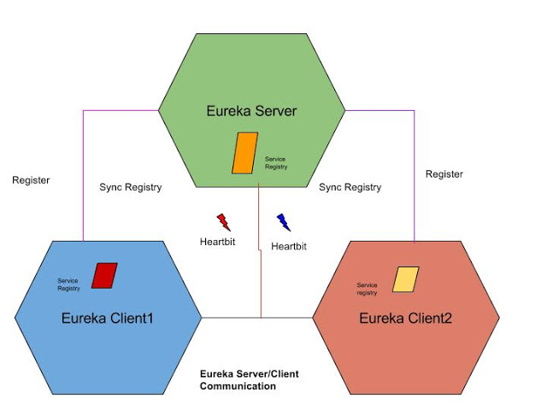
Eureka Working

Slide 40
@LoadBalanced
  Eliminates direct use of Ribbon
  Ribbon automatically integrates with RestTemplate
    Makes RestTemplate ribbon aware.
  Also helps to use "logical identifiers" for the URLs passed to restTemplate.
    logical identifiers are name of a service.
  @Bean
  @LoadBalanced
  public RestTemplate template() {
  return new RestTemplate();
  }

Slide 41
Rest Client - Application
  @SpringBootApplication
  @EnableDiscoveryClient
  public class PaymentServiceApplication {
  public static void main(String[] args) {
  SpringApplication.run(PaymentServiceApplication.class, args);
  }
  @Bean
  @LoadBalanced
  public RestTemplate template() {
  return new RestTemplate();
  }
  }

Slide 42
Rest Client - Controller
  @RestController
  @Slf4j
  public class PaymentController {
  @Autowired
  private RestTemplate template;
  String baseURL = "http://CUSTOMER-SERVICE/";
  @GetMapping(path = "/api/v1/client/customers")
  public String getCustomerDetails() {
  String reqURL = baseURL+"api/v1/customers";
  return this.template.getForObject(reqURL, String.class);
  }
  }

