Slide 1
Flow Control

Slide 2
Control Structures
To change the ordering of the statements in a program
Two types of Control Structures
decision control structures ,
  allows us to select specific sections of code to be executed
    if -- else , if – else if
    switch -- case
repetition control structures
  allows us to execute specific sections of the code a number of times
    while
    do -- while
    for

Slide 3
Decision Control Structures
Types:
  if-statement
  if-else-statement
  If-else if-statement
If Specifies that a statement or block of code will be executed if and only if a certain boolean statement is true.
      if( boolean_expression )
      statement;
    or
      if( boolean_expression ){
      statement1;
      statement2;
      }
boolean_expression : can be an expression or variable.

Slide 4
if-else statement
if( boolean_exp ){
Statement(s)
}
else {
Statement(s)
}
  if(boolean_exp1 )
  statement1;
  else if(boolean_exp2)
  statement2;
  else
  statement3;
For Comparison == used instead =
= being an assignment operator
equals Method Should Be Used for Objects comparison

Slide 5
switch-statement
Allows branching on multiple outcomes.
switch expression is an integer ,character expression or variable
case_selector1, case_selector2 and unique integer or character constants.
If none of the cases are satisfied, the optional default block if present is executed.
    switch( switch_expression ){
    case case_selector1:
    Statement(s);
    break;
    case case_selector2:
    Statement(s);
    break;
    default:
    statement1;
    }

Slide 6
switch-statement
When a switch is encountered,
  evaluates the switch_expression,
  jumps to the case whose selector matches the value of the expression.
  executes the statements in order from that point on until a break statement is encountered
  break statement stops executing statements in the subsequent cases, it will be last statement in a case.
  Used to make decisions based only on a single integer or character value.
  The value provided to each case statement must be unique

Slide 7
switch-statement
  public double CalculateDiscount(int pCode)
  {
  double discountPercentage=0.0d;
  switch(pCode)
  {
  case 1:
  discountPercentage=0.10d;
  break;
  case 2:
  discountPercentage=0.15d;
  break;
  case 3:
  discountPercentage=0.20d;
  break;
  default:
  discountPercentage=0.0;
  }
  return discountPercentage;
  }

Slide 8
Switch-Case in a Method
Can have Either Return or Break if present inside a Method, but should provide a default Value
    public String switchExample(int key) {
    switch (key) {
    case 1:
    return "Good Morning";
    case 2:
    return "Good AfterNoon";
    case 3:
    return "Good Evening";
    default:
    return "Good Night";
    }

Slide 9
Switch-Case Java 7.0
From In Java SE 7 and later, can use a String object in the switch statement's expression.
The String in the switch expression is compared with the expressions associated with each case label as if the String.equals method were being used.
Will Throw a Null pointer Expression if the expression is NULL
  String color = "red";
  switch (color) {
  case "red":
  System.out.println("Color is Red");
  break;
  default:
  System.out.println("Color not found");
  }

Slide 10
Repetition Control Structures
while-loop
  The statements inside the while loop are executed as long as the Boolean expression evaluates to true
do-while loop
  statements inside a do-while loop are executed several times as long as the condition is satisfied, the statements inside a do-while loop are executed at least once
Watch this
  while(boolean_expression){
  statement1;
  statement2;
  }
do{
statement1;
statement2;
}while(boolean_expression);

Slide 11
Arrays

Slide 12
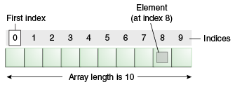
Introduction to Arrays
Array is one variable is used to store a list of data and manipulate
This type of variable is called an array.
It stores multiple data items of the same data type, in a contiguous block of memory, divided into a number of slots.
The new keyword to create an array object.
Need to tell the compiler how many elements will be stored in it.

Slide 13
Creating Arrays
There are three steps to creating an array,
declaring
  int[] k;
  float[] yt;
  String[] names;
allocating
  k = new int[3];
  yt = new float[7];
  names = new String[50];
initializing
  int[ ] k = {1, 2, 3};
  float[ ] yt = {0.0f, 1.2f, 3.4f, -9.87f, 65.4f, 0.0f, 567.9f};

Slide 14
Enhanced For Loop
The enhanced for loop, simplifies looping through an array or a collection.
Instead of having three components, the enhanced for has two.
for(data_type variable : array | collection){}
int [] a = {1,2,3,4};
for(int n : a)
System.out.print(n);.

Slide 15
Array Bounds
All array subscripts begin with 0 and ends with n-1
In order to get the number of elements in an array, can use the length field of an array.
The length field of an array returns the size of the array.
  int list [] = new int[10];
  for (int i = 0; i< list.length; i++)
  {
    System.out.println(list[i]);
    }
There is no array element arr[n]! This will result in an array-index-out-of bounds exception.
Notes:
Special care should be taken while accessing an array element, using the length variable of array objects. In the example shown above list.length gives 10, and if we try to access list[10], we will get an exception.

Slide 16
Array of Objects
  public static void displaybooks(Book[] bks)
  {
  for(int i=0;i<bks.length;i++)
  {
  System.out.println("Book Number :="+bks[i].getBookno());
  System.out.println("Book Name :="+bks[i].getBookname());
  }
  }
  public static void main(String args[])
  {
  Book[] bk = new Book[2];
  Book b1 = new Book(100,"java");
  Book b2= new Book(101,"j2ee");
  bk[0]=b1;
  bk[1]=b2;
  ArrayofObject obj= new ArrayofObject();
  displaybooks(bk);
  }

Slide 17
Copying Arrays
System.arraycopy()
  can be used to efficiently copy data from one array into another:
public static void arraycopy(Object src, int srcPos, Object dest, int destPos, int length)
The two Object arguments
  the array to copy from and the array to copy to.
The three int arguments
  starting position in the source array,
  starting position in the destination array,
  number of array elements to copy.

Slide 18
STRINGS

Slide 19
Strings
Many characters join together to form a string.
  Collection of characters bound by double quotes (“”).
String are created in two ways
  Direct Initialization
    String message1= "Hello World";
    String message2 =“Hello World
No new objects are created.
  When the second line is executed the message2 instance points to the message1 object which was declared before.

Slide 20
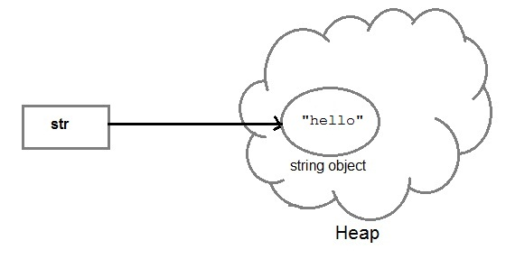
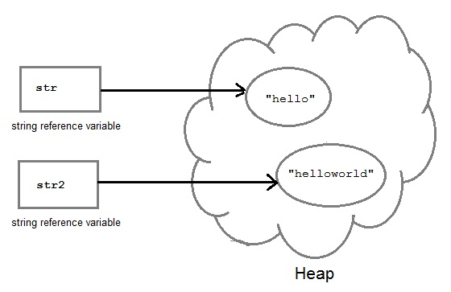
String Creation
String str= "Hello";
String str2=str;

Slide 21
Strings
  String a = "abcd";
  String b = "abcd";
  System.out.println(a == b); // True
  System.out.println(a.equals(b)); // True

Slide 22
Strings
Using constructor
  String myString = new String("Hello World")
A new space is allocated in heap regardless of the object exists in pool or not.
  JVM is forced to create a new string every time its executed
  String c = new String("abcd");
  String d = new String("abcd");
  System.out.println(c == d); // False
  System.out.println(c.equals(d)); // True

Slide 23
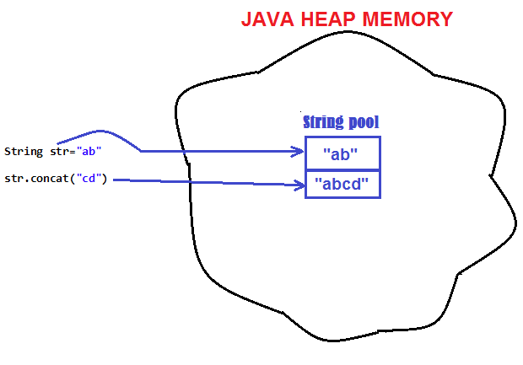
String are Immutable
Java String objects are immutable.
  Unmodifiable or unchangeable.
Once string object is created its data or state can't be changed
  A new string object is created.

Slide 24
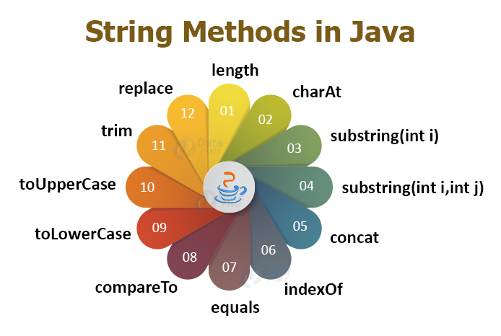

Slide 25
INHERITANCE

Slide 26
Overview
  A class can inherit from another class
    Original class is the “superclass”
    New class is called the “subclass”
Inheritance is a fundamental OO concept
Superclass
Car
Subclasses
SportsCar
Taxi
PoliceCar

Slide 27
Example of Inheritance
  The Car class defines certain methods and variables
  Taxi extends Car, and can:
    Add new variables
    Add new methods
    Override methods of the Car class
Car
Taxi

Slide 28
Specifying Inheritance in Java
  Inheritance is achieved by specifying which superclass the subclass
  “extends”
Taxi inherits all the variables and methods of Car
public class Car {
…
}
public class Taxi extends Car {
…
}

Slide 29
What Does an Object Look Like?
A subclass inherits all the instance variables of its superclass
Car object
public class Car {
String regNum;
int engineSize; …
}
regNum
engineSize
Taxi object
public class Taxi extends Car {
private int cabNum; …
}
regNum
engineSize
cabNum

Slide 30
Default Initialization
  What happens when a subclass object is created?
  If no constructors are defined:
  No-arg constructor is called in superclass
    No-arg constructor called in subclass
Taxi object
regNum
engineSize
Taxi taxi1 = new Taxi();
cabNum

Slide 31
Nondefault Initialization
Specific initialization can be performed as follows:
public class Car {
Car(String r, int e) {
regNum = r;
engineSize = e;
} …
public class Taxi extends Car {
Taxi(String r, int e, int c) {
super(r, e);
cabNum = c;
} …
Use super() to call superclass constructor

Slide 32
Specifying Additional Methods
  The superclass defines methods that are applicable for all kinds of Car
  The subclass can specify additional methods that are specific to Taxis
public class Car {
public int getReg()…
public void changeOwner()…
…
public class Taxi extends Car {
public void renewCabLicense()…
public boolean isBooked()…
…

Slide 33
Overriding Superclass Methods
  A subclass inherits all the methods of its superclass
  The subclass can override a method with a specialized version, if it needs to:
public class Car {
public String details() {
return "Reg:" + getReg();
}
public class Taxi extends Car {
public String details() {
return "Reg:" + getReg() + cabNum;
}

Slide 34
Overriding
When a sub-class defines a
  “method with same method name, argument types, argument order and return type as a method in its super class, its called method overriding. “
Methods declared as final, static and private cannot be overridden.
An overriding method can be declared as final
The method can’t be less accessible
  Public => only public
  Protected => Both Public and Protected
  Default => default, public and protected

Slide 35
Overriding with Compatible Return type
Arguments must be same and return type must be compatible
  class Base
  {
  private int i = 5;
  public Number getNumber()
  {
  return i;
  }
  }
  class Derived extends Base
  {
  @Override
  public Integer getNumber()
  {
  return new Integer(10);
  }
  }

Slide 36
Invoking Superclass Methods
  If a subclass overrides a method, it can still call the original superclass method
  Use super.method()to call a superclass method from the subclass
  Though keyword super is used to refer super class, method call super.super.method() is invalid.
public class Car {
public String details() {
return "Reg:" + getReg();
}
public class Taxi extends Car {
public String details() {
return super.details() + cabNum;
}

Slide 37
super keyword
The keyword super refers to the base class
  super( )
    invokes the base class constructor
    base class constructors are automatically invoked
  super.method( )
    invokes the specified method in the base class
  super.variable
    to access the specified variable in the base class
super must be the first statement in a constructor

