Slide 1
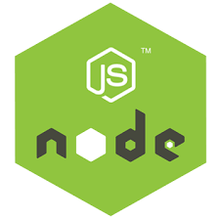

Slide 2
Introduction
Developed by Ryan Dahl in 2009
Writing JavaScript applications outside web browsers.
It is Open source, cross-platform runtime environment
Built on Google Chrome's JavaScript Engine (V8 Engine).
An event driven, non-blocking (asynchronous) I/O
  Cross-platform runtime environment for building highly scalable server-side applications

Slide 3
Introduction
Client-side JS makes heavy use of the DOM,with no access to files/databases
Server-side JS deals mostly in files/databases,
Provides a rich library of various JavaScript modules which simplifies the development of web applications
Node.js = Runtime Environment + JavaScript Library

Slide 4
NodeJs
Uses JavaScript to build entire server side application.
Can be used to build different types of applications
  command line application,
  web application,
  real-time chat application,
  REST API server etc.
  Creating an HTTP server , TCP server
  Online games
  MVC Applications

Slide 5
Installation
Download From : http://nodejs.org/#download
Check the Application Running
  Type “node” and enter
  Type ‘Hello From Node JS’
  The text gets printed shows node is installed correctly
Create a JS File
From the Command Prompt node xxx.js

Slide 6
Development Environment
Can be setup in Windows, Mac, Linux and Solaris.
The following tools/SDK help developing a Node.js application
  Node.js
  IDE (Integrated Development Environment) or TextEditor
  NPM (Node Package Manager)

Slide 7
NodeJS Console
Has virtual environment called REPL
  Read-Evaluate-Print-Loop.
started by invoking node on console
> "10 + 20"
> "Hello" + "World"
> var x = 10, y = 20;
> x + y
>function add(a, b){ return a+b; }
>add(4,5)
>console.log(‘\033c’);

Slide 8
Node.js Module:
Module are organized with single or multiple JavaScript files
  Reused throughout the Node.js application.
Node.js includes three types of modules:
  Core Modules
  Local Modules
  Third Party Modules

Slide 9
Core Module
Include bare minimum functionalities of Node.js.
Compiled into its binary distribution and load automatically when Node.js process starts.
  Need to import the core module to use it in application.
http :
  http module includes classes, methods and events to create Node.js http server.
Path
  path module includes methods to deal with file paths.
fs
  fs module includes classes, methods, and events to work with file I/O.
Util
  util module includes utility functions useful for programmers.

Slide 10
Creating Modules
Modules are loaded once, and after that they are cached by Node.
Unlike the browser, Node does not have a window global object, but instead has two others: globals and process.
  Should avoid adding properties on the two.
exports to expose a function, object or variable as a module in Node.js.

Slide 11
package.json
Any project that's using Node.js will need to have a package.json file.
Includes the packages and applications it depends
Metadata like the project's name, description, and author.
Structured in the JSON format

Slide 12
Initialize a Project
npm init or npm init --yes
A step-by-step tool to scaffold project.
  Will prompt for input a few aspects of the project in the following order:
  The project's name,
  The project's initial version,
  The project's description,
  The project's entry point (meaning the project's main file),
  The project's test command (to trigger testing with something like Standard)
  The project's git repository (where the project source can be found)
  The project's keywords (basically, tags related to the project)
  The project's license (this defaults to ISC - most open-source Node.js projects are MIT)

Slide 13
Package.json
A JSON File and not a Object Literal
  Has a name and version fields. Required entries,
  package.json
  {
  "name": "file_upload", "version": "0.0.1", "dependencies": {
  "express": "^4.8.6",
  "ejs": "^1.0.0",“
  mysql": "^2.4.3"
  }}

Slide 14
Creating Application
Modify the package.json
{
"type": "module"
}

Slide 15
Module – Payment.js
  var bankModule={};
  bankModule.simpleInterest=function(){
  return "SimpleInterest CalculationInvoked";
  }
  bankModule.compoundInterest=function(){
  return "CompoundIntrestcalculation Invoked";
  }
  export default bankModule

Slide 16
Application
  import bankModule from './Bank.js'
  console.log(bankModule.simpleInterest())

Slide 17
Node.js Ecosystem
Node.js heavily relies on modules,
  require keyword loaded the local modules.
Libraries in Node.js are called packages and they can be installed by typing
  npm install “package_name”;
NPM (Node Package Manager) comes bundled with Node.js installation.
Modules can be installed globally or locally to a directory of Node application

Slide 18
Node Package Manager
NPM command line tool installs, updates or uninstalls packages
An online repository for open-source Node.js packages.
It has useful modules and many deveopers publishes to it
Popular package
  AngularJS, jQuery, Gulp, Bower etc.
Official website: https://www.npmjs.com

Slide 19
Npm install
Npm always installs the latest version
Can install specific version by defining it in package.json file in the local directory
-g or --global
  to install the package globally rather than locally.
  npm root –g : will show the path of global node modules
-f or --
  force npm to fetch remote resources even if a local copy exists on disk.

Slide 20
NPM Operations
Two Modes :
  global and local.
  Global mode : Performs operations which affect all the Node.js applications on the computer
  Local mode : Performs operations for the particular local directory which affects an application in that directory only.
C:\>npm install <package name>
npm install -g typescript
Global packages into <User>/local/lib/node_modulesfolder.
C:\MyNodeProj> npm install -g expressUpdate

Slide 21
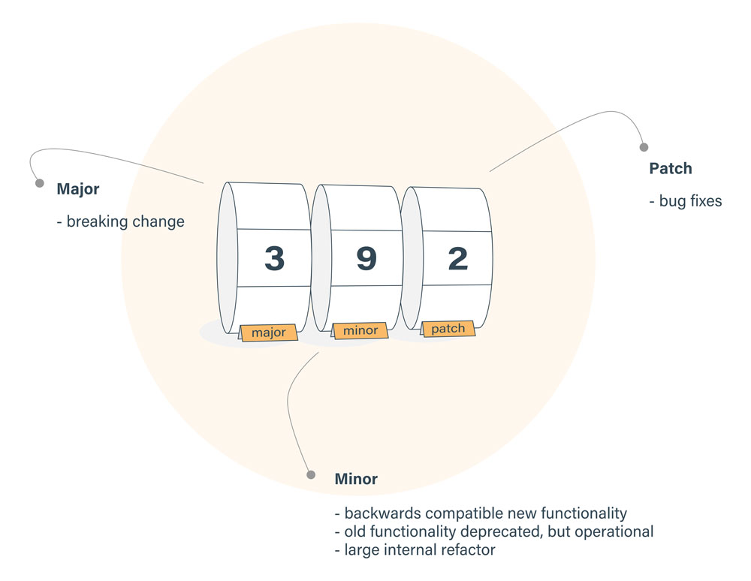
(^) Packages.json
Locks down the major version number,
  Leaves the minor and patch versions to be more flexible.
^2.2.3
  Any version that is greater than or equal to 2.2.3 and also less than 3.0.0.

Slide 22
(~) Packages.json
~2.3.1,
  Fixes both the major and minor version numbers
    Matching any patch number
  All versions greater than or equal to 2.3.1 and less than 2.4.0
1.*
  '*' would equate to any version
  Allow versions greater than or equal to 1.0.0 and less than 2.0.0.

Slide 23
Npm Install
Install takes optional flags which save or update the package version in package.json
-S, --save:
  Package will appear dependencies.
-D, --save-dev:
  Package will appear development Dependencies.
-O, --save-optional:
  Package will appear in optional Dependencies.

Slide 24
Http Server
  import http from 'http';
  const server = http.createServer((req, res) => {
  res.writeHead(200, { 'Content-Type': 'application/json' });
  res.end(JSON.stringify({
  data: 'Hello World!',
  }));
  });
  server.listen(3000);

Slide 25
REST CALLS WITH NODEJS

Slide 26
REST with JSON Server
Mock Web service Instead of Real Web Service
JSON Server
  A Node Module that can be used to create demo rest json webservice
  Done with a simple JSON file with sample data.
Installing JSON Server
    $ npm install -g json-server
  Starting JSON Server
    json-server --watch db.json

Slide 27
Creating a Mock DB
  Create a File : db.json
  {
    "invoices": [
      {
      "id": 1,
      "name": "Ramesh",
      "amount": "10000"
      },
      {
      "id":2,
      "name": "Suresh",
      "amount": "5000"
      }
    ]
    }
    http://localhost:3000/medBuddy/102
    http://localhost:3000/medBuddy?description=Tests

Slide 28
Node Frequently Used Commands
Install package globally and Locally
  npm install express –g // npm install express
Uninstall package globally and Locally
  npm uninstall express –g // npm uninstall express
List global and Local packages.
  npm ls –g // npm ls -l
  npm list -g --depth=0
Update global and Local packages.
  npm update –g // npm update
Search package
  npm search express

Slide 29
ES6 FEATURES

Slide 30
Need For ES6
JavaScript is everywhere!
Used as the development language everywhere
  IoT devices
  mobile apps
  databases
  front-end and backend web technologies.
JavaScript has profound effects on multiple different technologies.
JavaScript need to meet the expectations of modern web Application Development !

Slide 31
BLOCK SCOPING

Slide 32
Scoping
var declarations in JS
  Difficult to immediately discern which are scoped locally vs. globally.
  Confusion with the working of Hoisting
May end up creating variables on the global Object
Can cause problems for enterprise level applications
Confusing workaround patterns
  IIFE.-workaround to the lack of block scope.

Slide 33
Using let
Allows to scope variables at the block level (the nearest curly brackets).
  function gradeRating(product){
  var grade ="Excellent"
  if(product.rating >3 && product.rating <=4){
  let grade ="Average";
  console.log(grade)
  }
  console.log(grade)
  }
  const tv = new Product(101, "Sony Tv", 'images/sony.jpg', 4.2);
  Output : =>// Excellent

Slide 34
Example
Each iteration creates its own block scope
  for( let i=0;i<=10;i++) {
  console.log(i);
  }
  console.log('Out Side for loop'+i);
  for(var i=0;i<=10;i++) {
  console.log(i);
  }
  console.log('Out Side for loop'+i);

Slide 35
Constant
Const is the new ES6 keyword
  like Java's final
The const declaration creates a read-only reference to a value
  It does not mean the value it holds is immutable,
  Means variable identifier cannot be reassigned.
const PI = 3.141593 PI > 3.0
  const AGE = 13;
  AGE = 20; // Error!

Slide 36
Arrow Functions
Arrow functions are, as the name suggests, functions defined with a new syntax that uses an “arrow” (=>).
  They doesn’t require function keyword, return keyword and curly brackets.
More expressive closure syntax.
  No this, super, arguments
  Cannot be called with new ,throws an error
  No prototype
  No duplicate named parameters

Slide 37
Arrow Functions
There are a variety of syntaxes available in arrow functions.
  var sum = function(num1, num2) {
  return num1 + num2;
  };
  var sum = (num1, num2) => num1 + num2;
  var sum= (num1, num2) => { return num1 + num2; };

Slide 38
Arrow Functions
  genericConverter(funcRef,arg) {
  console.log(funcRef(arg));
  }
  let tempConv = (faren) => {
  return (faren - 32) * (5 / 9)
  }
  genericConverter(tempConv, 45);
  let inrToUsd = (inr) => { return inr * 65 };
  conv.genericConverter(inrToUsd, 650)

Slide 39
Default function parameters
Java Script Functions Parameter passing is special
Functions can handle different numbers of parameters
Parameters of functions default to undefined.
  Can set a default value for the parameter
The check in the function body for undefined is not necessary.
The default argument gets evaluated at call time
  a new object is created each time the function is called.

Slide 40
Default Parameters
  function multiply(a, b = 2) {
  return a*b;
  }
  multiply(5); :output : 10
  function add(a = 1, b = 2) {
  return a + b;
  }
  add(); // 1 + 2 = 3
  add(0); // 0 + 2 = 2
  add(undefined, 0); // 1 + 0 = 1
  add(0, 0); // 0 + 0 = 0

Slide 41
Rest Parameters
Indicated by three dots (...) preceding a named parameter.
  Aggregation of remaining arguments into single parameter of the functions.
  Parameters becomes an Array
  There can be only one rest parameter, and the rest parameter must be last.

Slide 42
Rest Parameter
  var sumAll = function(...numbers) {
  var sum = 0;
  numbers.forEach(number => { sum = sum + number });
  console.log('total' + sum);
  }
  sumAll(1, 2, 3, 4, 5);

Slide 43
Spread
Has … (three dots) notation.
Creating a New data Structure from existing One
Spreading of elements of an “iterable” collection into both literal elements and individual function parameters.
  function sum(a, b, c) {
  return a + b + c;
  }
  var args = [1, 2, 3];
  console.log(sum(…args)); // 6

Slide 44
Spread
  function sum(a, b, c) {
  return a + b + c;
  }
  var args = [1, 2];
  console.log(sum(…args, 3)); // 6

Slide 45
Spread Example
  let firstList = ['ram','shyam'];
  let secondList = ['gaurav','gautam'];
  let spread = [...firstList,...secondList];
  console.log(spread);
  Output will be
    ['ram', 'shyam‘ 'gaurav', 'gautam' ]
  It WILL NOT BE
    [ [ 'ram', 'shyam' ], [ 'gaurav', 'gautam' ] ]

Slide 46
Spread Example
  const key ='city'
  const value ='chennai'
  const combine = {[key]:value}
  console.log(combine) // {‘city’:’Chennai’}
  const x = {age:45};
  const y = {id: 1, name: 'ram'};
  const z = {...x, ...y};
  console.log(z); => { age: 45, id: 1, name: 'ram’ }

Slide 47
Spread Example
Supply Default Value
  const y = {id: 1, name: 'ram'};
  const z = {...y, location:'chennai'};
  console.log(z)
  { id: 1, name: 'ram', location: 'chennai' }
  Array of Values
  const scores =[90,45,89];
  const y = {id: 1, name: 'ram'};
  const z = {...y, marks:[...scores]};
  console.log(z);
  { id: 1, name: 'ram', marks: [ 90, 45, 89 ] }

Slide 48
Destructuring
It breaks an array into its elements
  Keeping the original array unchanged.
  Taking an Existing Data Structure and extracting values from it
This process maps the same variable names for values.
let [ firstColor, secondColor ] = [ "red", "green", "blue" ];
  0 1 = 0 1 2
  firstColor = red
  SecondColor = green
  console.log(firstColor); // "red"
  console.log(secondColor); // "green"

Slide 49
Destructuring
Using array destructuring assignment, to swap variables
  let a = 1, b = 2;
  [ a, b ] = [ b, a ];
  console.log(a); // 2
  console.log(b); // 1
The destructuring happens on the temporary array, which has the values of b and a copied into its first and second positions.
The effect is that the variables have swapped values.

Slide 50
Object Destructuring
Uses an object literal on the left side of an assignment operation.
Operates on the named properties that are available in objects.
  var donar = {name: "Ramesh", location: "Chennai", group: "bpos"};
  var {name,group} = donar;
  var {name,group} = = {name: "Ramesh", location:
  "Chennai", group: "bpos"}; ;
  console.log(name);
  console.log(group);

Slide 51
De structuring
Using a new Variable Name
  var donar = {name: "Ramesh", location: "Chennai", group: "bpos"};
  var {name: donarName, group: bloodGroup} = donar;
  console.log(donarName);
  console.log(bloodGroup);

Slide 52
Using Default Values
Default values can also be used in object de structuring
  var donar = {name: "Ramesh", location: "Chennai", group: "bpos"};
  var {name,group,lastDonated='12-10-2018'} = donar;
  console.log(name);
  console.log(group);
  console.log(lastDonated) // 12-10-2018

Slide 53
Rest in Object De structuring
The rest syntax can also be used to pick up property keys that are not already picked up by the destructuring pattern.
  keys and their values are copied onto a new object.
  var donar = {name: "Ramesh", location: "Chennai", group: "bpos"};
  var {name,...otherDetails} = donar;
  console.log(name);
  console.log(otherDetails); //{ location: 'Chennai', group: 'bpos' }

Slide 54
Destructuring and Spread
Destructuring is used to create variables from array items or object properties.
Spread is used to unpack iterables such as arrays, objects, and function calls.
Rest parameter will create an array from an indefinite number of values.

Slide 55
Example
  export default function useCountry(country){
  return [country,(country)=> 'mera'+country+'mahan']
  }
  const [country,setCountry] = useCountry(‘bharath’);
  console.log(country)
  console.log(setCountry('bharath'))

