Slide 1

INTRODUCTION TO SPRING BOOT

Slide 2
Introduction
Spring
  An application development framework and inversion of control container for Java
Spring Boot
  Makes it easy to create stand-alone, production-grade Spring Applications and expose them as services

Slide 3
REGISTERING BEANS

Slide 4
@ Component
@Component
  Spring can scan all the beans through auto scan if the class has this or similar annotation
The Registered Beans can be access by Its name
  The Name is first Character of the Class Name in lowercase
  ‘CustomerService’ to ‘customerService’.
CustomerService cust = (CustomerService)context.getBean("customerService");
@Component(“custService”)
  Can Customize the component name by passing a string value

Slide 5
@Bean
Method-level annotation in Class annotated @Configuration
Added to the public Method of the configuration class
  Methods should not be private or final
Method should return an object that should be registered as a Bean
Supports following attributes
  init-method
  destroy-method
  autowireCandidate
  name

Slide 6
Register Bean
Beans can also be registered with Java Based Configuration
  Done in the Java class with @Configuration Annotation
    This class acts as a source of Bean Definitions
  @Configuration
  public class EmployeeConfig {
  @Bean
  public Employee idOfTheBean(){
  return new Employee();
  }
  @Bean (name=“ram”) // bean Id overridden with name attribute
  public Employee employee(){
  return new Employee();
  }
  }

Slide 7
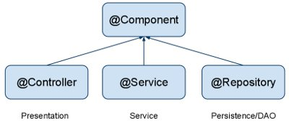
Auto Component Scan Types
@Component
  Indicates a auto scan component.
@Repository
  Indicates DAO component in the persistence layer.
@Service
  Indicates a Service component in the business layer.
@Controller
  Indicates a controller component in the presentation layer.

Slide 8
Spring Boot
Extension of the Spring framework
  A faster and more efficient development
Eliminates the boilerplate configurations required for setting up a Spring application.
  Opinionated ‘starter’ dependencies to simplify build and application configuration
  Embedded server to avoid complexity in application deployment
  Metrics, Health check, and externalized configuration
  Automatic configuration whenever possible

Slide 9
Spring Initializr
https://start.spring.io/
  A web-based UI tool provided by the Pivotal
  Used to generate the structure of the Spring Boot Project.
  Can configure the list of dependencies
  Package downloaded as Jar or War file
  Import as a Maven Project into STS

Slide 10
Spring Boot Starters
Set of convenient dependency descriptors
Eliminates the need to hunt through sample code
No need to copy-paste loads of dependency descriptors.
Contains lot of the dependencies that are required to get a project up and running
Also has support of managed transitive dependencies.

Slide 11
Creating a Spring Boot Project
In the Eclipse IDE Right-click in the package explorer and select New -> Spring Starter Project
A screen opens with some details which can be changed or can accept the default values for a simple project
The entry point of a Spring Boot application is the class which is annotated with @SpringBootApplication:
Uses this class with public static void main entry-point to launch an embedded web server.

Slide 12
Spring Boot Bootstrap
  @SpringBootApplication
  public class Application {
  public static void main(String[] args) {
  SpringApplication.run(Application.class, args);
  }
  }
Spring Boot can scan all the classes in the same package or sub packages of Main-class for components.
Equivalent to using @Configuration, @EnableAutoConfiguration, and @ComponentScan with their default attributes,

Slide 13
Spring Application
  public static void main(String[] args) {
  ConfigurableApplicationContext ctx = SpringApplication.run(BootIocApplication.class, args);
  Invoice invoice= ctx.getBean(Invoice.class);
  System.out.println(invoice);
  ctx.close();
  }

Slide 14
AUTO CONFIGURATION

Slide 15
Auto Configuration
Spring Boot takes an opinionated view of the Spring platform and third-party libraries
  Can get started with minimum effort
  It tries to read “.properties” from various hard-coded locations.
  It also reads the “spring.factories” file
    Part of auto configure-module
    Determines the Auto Configurations it should evaluate.

Slide 16
Auto Configuration
Some Spring Boot Jars contain special JSON meta-data files that the editor looks for
  These files contain information about the known configuration properties.
“spring-boot-autoconfigure-XXX.jar”
  META-INF/spring-configuration-metadata.json”.
  Can find properties like server.port being documented there.

Slide 17
AutoConfigurations
Auto-registered @PropertySources
Spring Boot will automatically register these PropertySources
It has a default set of property locations that it always tries to read
  command line arguments
  application.properties inside .jar file etc.

Slide 18
ADVANCED BEAN CONFIGURATIONS

Slide 19
Disambiguation options
  @Component
  public class TourAgent {
  private int id;
  private String agentName;
  private long mobileNumber;
  }
  @Bean
  public TourAgent tourAgent() {
  return new TourAgent(1033,"Ram",7484848);
  }

Slide 20
Disambiguation options
  Properties props = new Properties();
  props.put(
  "spring.main.allow-bean-definition-overriding", "true");
  ConfigurableApplicationContext ctx =
  new SpringApplicationBuilder(TourServiceApplication.class)
  .properties(props)
  .build()
  .run(args);

Slide 21
@Primary
Used to give higher preference to a bean, when there are multiple beans of same type.
Used on any class directly or indirectly annotated with @Component or on methods annotated with @Bean
If a bean has @Autowired without any @Qualifier
  Multiple beans of the type exist
  Candidate bean marked @Primary will be chosen
@Qualifier should be used in conjunction with @Autowired always.
@Primary should be used in conjunction with @Bean

Slide 22
@Primary
  @Bean
  @Primary
  public Service myService() {
  return new Service();
  }
  @Bean
  public Service backupService() {
  return new Service();
  }
  getBean(Service.class) will return the primary bean

Slide 23
Lazy Initialization
Beans are created as they are needed rather than during application startup.
  Enabling lazy initialization May improve the startup time of the application
  In a web application, enabling lazy initialization will result in many web-related beans not being initialized until an HTTP request is received.

Slide 24
Lazy Initialization
It can delay the discovery of a problem with the application.
If a misconfigured bean is initialized lazily, a failure will no longer occur during startup and the problem will only become apparent when the bean is initialized.
May reduce the number of beans created when the application is starting

Slide 25
Lazy initialization
Can be enabled programmatically using Spring Application Builder
Can be enabled using property from spring boot 2.2
  spring.main.lazy-initialization=true
Can be enabled by using the @Lazy on the Factory Method

Slide 26
Lazy-initialized beans
  @Bean()
  @Lazy(value=true)
  public Employee myBean() {
  System.out.println("Loading LazyBean bean");
  return new Employee(employee_Id,employee_Name);
  }

Slide 27
Lazy-initialized beans
ApplicationContext implementations eagerly create and configure all singleton beans as part of the initialization process.
A lazy-initialized bean tells the IoC container to create a bean instance when it is first requested, rather than at startup.
  @Bean()
  @Lazy(value=true)
  public Employee myBean() {
  System.out.println("Loading LazyBean bean");
  return new Employee(employee_Id,employee_Name);
  }

Slide 28
Life Cycle Methods
  @Component
  public class Invoice {
  @PostConstruct
  public void myInit()
  {
  System.out.println("Inside init Method");
  }
  @PreDestroy
  public void myDestroy()
  {
  System.out.println("Inside Destroy Method");
  }
  }

Slide 29
Life Cycle Java Based Configuration
  public class Employee {
  public void start() { // Initialization Work }
  public void close() {
  // Destruction Work
  }
  }
  @Bean(initMethod="start",destroyMethod="close")
  public Employee myBean() {
  return new Employee(employee_Id,employee_Name);
  }

Slide 30
Life Cycle Methods
  public class DeliveryExecutive {
  @Autowired
  private Environment env;
  public DeliveryExecutive{
  env.getActiveProfiles() -> Will throw Null Pointer Exception
  }
  public void init() {
  log.info("Init Method called");
  log.info(env.getActiveProfiles().toString());
  System.out.println(Arrays.asList(env.getDefaultProfiles().toString()));
  }
  }

Slide 31
SPRING BEAN SCOPES

Slide 32

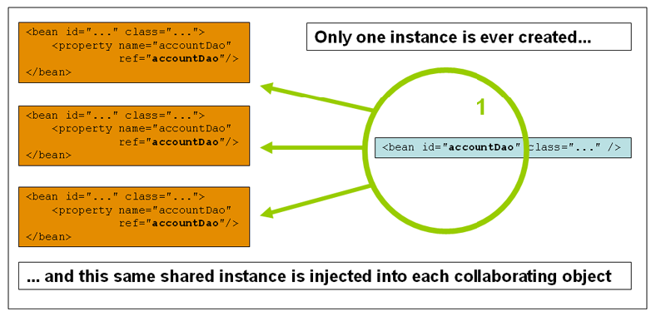
Singleton

Slide 33
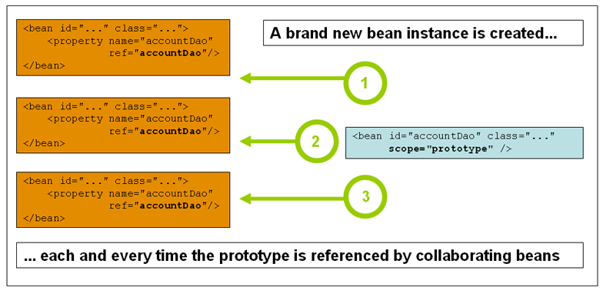
Prototype Scope

Slide 34
Bean Scope
The Bean Scope for Standard Java SE Beans are singleton:
@Scope(scopeName=ConfigurableBeanFactory.SCOPE_SINGLETON)
  Scopes a single bean definition to a single object instance per Spring IoC container, per container and per bean.
  Single instance will be stored in a cache and all subsequent requests and references will result in cached object being returned.
@Scope(value=ConfigurableBeanFactory.SCOPE_PROTOTYPE)

Slide 35
Bean Scope
The Bean Score for Standard Java SE Beans are singleton:
Scopes a single bean definition to a single object instance per Spring IoC container, per container and per bean.
prototype:
  Prototype results in the creation of a new bean instance every time a request for that specific bean is made
  Can change the Scope by
@Scope(value=ConfigurableBeanFactory.SCOPE_PROTOTYPE)

Slide 36
Test the Scopes
  DiscountService service = ctx.getBean(DiscountService.class);
  DiscountNotification protoBean;
  protoBean = service.getDiscount("april");
  log.info("Discount :="+protoBean.showDiscount());
  protoBean = service.getDiscount("may");
  log.info("Discount :="+protoBean.showDiscount());

Slide 37
JDBC

Slide 38
Working With SQL
Has extensive support for working with SQL databases
  Direct JDBC access using JdbcTemplate
Has a functionality for creating Repository implementations
  From interfaces using conventions to generate queries from method names.

Slide 39
Spring JDBC
Spring Task
  Connection Management
  Statement Management
  ResultSet Management
  Transaction Management
  Exception Handling
Developer Task
  SQL
  Row Data Retrieval
  Parameter Setting

Slide 40
Spring JDBC – Template pattern
Defines the skeleton of an algorithm in an operation, deferring some steps to subclasses.
Template Method lets subclasses redefine certain steps of an algorithm without letting them to change the algorithms structure.
In Spring JDBC development, it’s always recommended to use JdbcTemplate

Slide 41
Spring JDBC Template
Has many helpful methods for performing CRUD operations
execute(String sql)
  To Issue a single SQL execute, typically a DDL statement.
queryForList(String sql, Object[] args)
  Query given SQL to create a prepared statement from SQL and a list of arguments to bind to the query, expecting a result list.
update(String sql)
  Issue a single SQL update operation (such as an insert, update or delete statement).

Slide 42
Configuring a Data Source
Configurations are controlled by external configuration properties
Defined application.properties:
  spring.datasource.url=jdbc:mysql://localhost:3306/test
  spring.datasource.username=root
  spring.datasource.password=Srivatsan

Slide 43
Entity Class & DAO Interface
  @Data
  @NoArgsConstructor
  public class Customer {
  private long id;
  private String first_name;
  private String last_name;
  }

Slide 44
Dao Interface
  public interface Crud<T> {
    public int add(T t);
    public List<T> findAll();
    public T findById(int id);
    public int update(T t);
    public int remove(int id);
      }

Slide 45
@Repository
A repository is a mechanism for encapsulating storage, retrieval, and search behavior which emulates a collection of objects.
@Repository
  Indicates that the decorated class is a repository.
  A specialization of the @Component annotation
  Will be auto detected through classp ath scanning.

Slide 46
DAO Implementation
  @Repository
  public class ProductDAOImpl implements Crud<Product> {
  private JdbcTemplate template;
  @Autowired
  public ProductRepository(JdbcTemplate template) {
  super();
  this.template = template;
  }

Slide 47
Add
  @Override
  public int add(Product t) {
  String sql ="insert into product_2022 values(?,?,?)";
  return template.update(sql,
  t.getProductId(),t.getProductName(),t.getRatePerUnit());
  }

Slide 48
Find All
  public List<Product> findAll() {
  String sql = "select * from product_2022";
  RowMapper<Product> mapper = (rs,rowNumber) ->{
  Product product = new Product();
  product.setProductId(rs.getInt(1));
  product.setProductName(rs.getString(2));
  product.setRatePerUnit(rs.getDouble(3));
  return product;
  };
  return template.query(sql,mapper);
  }

Slide 49
Bean Property Row Mapper
BeanPropertyRowMapper implements RowMapper
  Converts a row into a new instance of the specified mapped target class.
  Class must be a top-level class and it must have a default or no-arg constructor.
  Column values are mapped based on matching the column name as obtained from result set meta-data to public setters for the corresponding properties.
  The names are matched either directly or by transforming a name separating the parts with underscores to the same name using "camel" case.

Slide 50
Find All
  public List<Product> findAll() {
  String sql = "select * from product_2022";
  return template.query(sql,
  BeanPropertyRowMapper.newInstance(Product.class));
  }

Slide 51
Find By Id
  @Override
  public Product findById(int id) {
  String sql = "select * from product_2022 where productId=?";
  return template.queryForObject(sql,
  BeanPropertyRowMapper.newInstance(Product.class),id);
  }

Slide 52
Update
  @Override
  public int update(Product t) {
  String sql = "update product set productName=?,ratePerUnit=? where id=?";
  return template.update(sql,
  t.getProductName(),t.getRatePerUnit(),t.getProductId());
  }

Slide 53
Detele
  @Override
  public int remove(int id) {
  String sql = "delete from product where productId =?";
  return template.update(sql,id);
  }

Slide 54
SPRING BOOT MVC

Slide 55
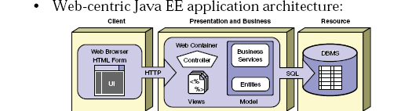
SPRING BOOT MVC

Slide 56
Client calls a program
server returns the Response
Client
(Browser)
WEB
server
html
dB

Slide 57
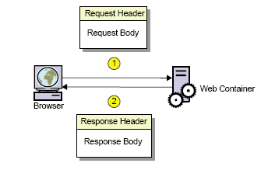
Request and Response

Slide 58
Spring MVC
Web application framework that takes advantage of design principles of Spring framework
Flexible and extensible via component’s
Simplified form handling through its parameter binding
Can do validation and error handling

Slide 59
MVC Architecture
Controller
  Designed around a DispatcherServlet
Model
  Can use any object as a command or form object.
  Data binding is highly flexible.
View
  View resolution is extremely flexible.
  View name resolution is configurable
  Can use properties file to configure views

Slide 60
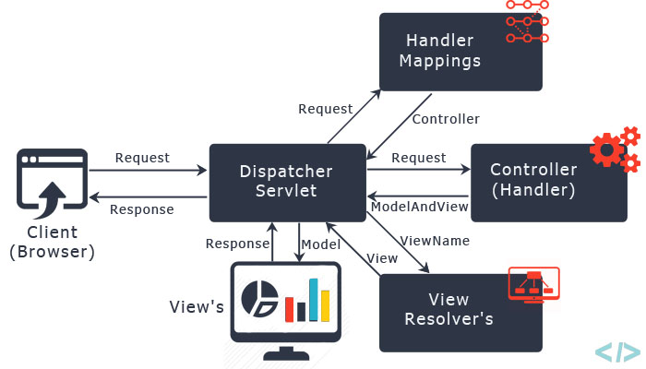
The requesting processing workflow

Slide 61
@RequestMapping
Used to map URLs onto a class or a particular method.
Class-level annotation maps a specific request path or pattern to a controller
Method-level annotations are used to narrow the primary mapping
  HTTP "GET"/"POST“ methods.

Slide 62
Controller
  @Controller
  @RequestMapping("/mvc")
  public class WelcomeController {
  @RequestMapping(value = "/greet",method = RequestMethod.GET)
  @ResponseBody
  public String getMessage() {
  return "<h1 style='text-align:center'>Welcome to Spring MVC</h1>";
  }
  }

