Slide 1
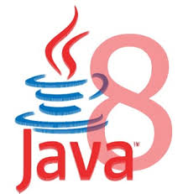

Slide 2
Java 8 – Significant New Features
Java SE 8 is a revolutionary release of the development platform
Lambda expression
  Adds functional processing capability to Java.
Method references
  Using functions as parameter.
  Referencing functions by their names instead of invoking them directly
Default method
  Interfaces to have default method implementation.
Date Time API
  Improved date time API.

Slide 3
FUNCTIONAL INTERFACES

Slide 4
Functional interface
An interface with only one method.
@FunctionalInterface
  Used to enforce the intent of the interface
  Existing interfaces are annotated with @FunctionalInterface
    Adding another method to the interface definition, will not be functional and compilation process will fail.
Used with lambda expressions.

Slide 5
Built-in Functional Interfaces
Earlier Versions of Java has several functional interfaces
  Prominent because of Lambda expressions
Existing functional interfaces
  Comparator
  Callable
  Runnable
  ActionListener
Collections API has been rewritten and new Stream API uses a lot of functional interfaces.
java.util.function
  Consumer, Supplier, Function and Predicate.

Slide 6

LAMBDAS

Slide 7
Functional vs Object Oriented Programming
Functional Programming
  Composing functions rather than objects.
Functions are first class.
  Passed around, dynamically created, stored in data structures
Use pure functions.
  A pure function is a function with no side effects.
  An increase in modularity which makes code easier to test, reuse, parallelize, generalize, and reason about.

Slide 8
Functional Programming
Java always remained Object first language.
Functions are not important for Java.
  cannot live on their own in Java world.
JavaScript is one of the best example of an FP language.
There is no way of passing a method as argument or returning a method body
invList.forEach((inv)->{System.out.println(inv);});
Lambda expression adds that missing link of functional programming to Java.

Slide 9
Benefits of Lambda Expression
Fewer Lines of Code
  It reduced amount of code.
Sequential and Parallel Execution
  Support by passing behavior in methods
Higher Efficiency
  Utilizing Multicore CPU’s using Streams
Streams API
  Handling Collection of data much efficiently

Slide 10
Where to use Lambda expressions
Lambda expressions can be used where there is a target type.
The following are the target type in Java
  Variable declarations and assignments
  Return statements
  Method or constructor arguments

Slide 11
Lambda Expressions
Lambda Expressions are:
Anonymous
  It doesn’t have an explicit name like a method
Function
  Not associated with a particular class like a method
  Has a list of parameters, a body, a return type, and list of exceptions that can be thrown.
Passed around
  Can be passed as argument to a method or stored in a variable.
Concise
  No need to write a lot of boilerplate like anonymous classes.

Slide 12
Lambda Expressions
A lambda expression is composed of three parts.
  Argument List (int x, int y)
  Arrow Token ->
  Body x + y

Slide 13
Lambda – Argument List
Can have zero, one or more parameters.
  (int x, int y)
Parameters can be explicitly declared or it can be inferred
  (int a) is same as just (a)
Parameters are separated by commas.
  (a, b) or (int a, int b) or (String a, int b, float c)
Empty parentheses to represent an empty set
  () -> 42
It is not mandatory to use parentheses.
  a -> return a*a

Slide 14
Lambda Expression - Body
  The body of the lambda expressions can contain zero, one or more statements.
Lambdas may return a value.
The type of the return value will be inferred by compiler.
  Body is evaluated like a method body
  return statement returns control to the caller of the anonymous method.
The return statement is not required if the lambda body is just a one-liner.
If the return is an expression curly braces are required

Slide 15
Lambda with Built-in Functional Interface
    public static void main(String[] args) {
    Thread t1 =new Thread( () -> {
      for(int i=0;i<10;i++)
      {
      System.out.println("Hello World");
      }
    }
    );
  t1.start();
  }
    }

Slide 16
Functional Interfaces and Lambda
  public interface GenericFunction<T> {
  public void showValues(List<T> t);
  }
  GenericFunction<Invoice> funcRef = (list) -> {
  list.forEach(
  (eachElement)->System.out.println(eachElement));
  };
  funcRef.showValues(getCustomers());

Slide 17
Scope in Lambda
Lambdas are allowed to capture static and instance variables
  But they are effectively final.
  Can also be explicitly declared final
Effectively Final.
  A n effectively final variable is one whose value does not change after it is first assigned.

Slide 18
Effectively Final
  @FunctionalInterface
  public interface EFConverter<T,R> {
  public R convertToString(T from);
  }
  int num = 1;
  EFConverter<Integer, String> stringConverter =
  (from) -> String.valueOf(from + num);
  String result = stringConverter.convertToString(new Integer(45));
  // num++;
  System.out.println(result.length());

Slide 19
Restrictions on local variables
Instance variables are stored on the heap, whereas local variables live on the stack.
Lambdas have access to Local Variable from Threads ,
  Thread could try to access the variable after the thread that allocated the variable had de allocated it.
Java implements access to a free local variable as access to a copy of it rather than access to the original variable.
If the local variable is assigned only once – the problem cease to exist

Slide 20
When NOT to Use Lambda
Lambdas may not be considered for the following criteria
Size
  The larger a lambda gets, the more difficult it makes it to follow the logic surrounding it.
Repetition
  It's better to create a named function for repeated logic, although it's okay to repeat very simple lambdas that are spread apart.
Nesting
  Nested lambdas are really, really hard to read.
Software is easily changed. Write both ways and see which is easier to read.

Slide 21
BUILT-IN FUNCTIONAL INTERFACES

Slide 22
Need for Built In Functional Interfaces
Lambda expressions must correspond to one functional interface.
Java 8 also has new functional interfaces covering the most common scenarios usages.
  Each developer need not define functional interface of types which are already in this package.
  They are Defined with Generic types and are re-usable for specific use cases.

Slide 23
Built-in Functional Interfaces
Located inside the java.util.function package.
  Predicate<T>
  Consumer<T>
  Function<T, R>
  Supplier<T>
  UnaryOperator<T>
Where T and R represent generic types
  T represents a parameter type
  R the return type.

Slide 24
Built-in Functional Interfaces
It also provides specializations for primitive type (int, long, double, and boolean )
  IntPredicate
  LongConsumer
  BooleanSupplier
There are also versions, which take two parameters
  BiPredicate<L, R>
  BiConsumer<T, U>
  BiFunction<T, U, R>
  BinaryOperator<T>
T and U represent parameter types
R the return type

Slide 25
Predicate<T>
A predicate is a function that receives a value and evaluates it.
  It has a method test(T obj) to evaluate and return a Boolean value.
  It also has some default Methods
@FunctionalInterface
public interface Predicate<T> {
boolean test(T t);
// Other default and static methods
}

Slide 26
Predicate<T>
Using Anonymous Class
Predicate<String> startsWithA = new Predicate<String>() {
public boolean test(String t) {
return t.startsWith("A");
} };
boolean result = startsWithA.test("Anand");
Using Lambda Expression
  Predicate<String> testWithLambda = (name)->name.startsWith("A");
  System.out.println(testWithLambda.test("Anand"));

Slide 27
Predicate<T>
  public void usingPredicate(){
  List<String> countries =
  Arrays.asList("India","Nepal","srilanka","SouthAfrica","Indonesia");
  Predicate<String> pref = (country)->country.startsWith("I");
  countries.forEach((eachCountry)->{
  if(pref.test(eachCountry)) {
    System.out.println(eachCountry);
    }
  });
  }

Slide 28
Predicate<T> Default Methods
negate()
  returns a predicate that represents the logical negation of the predicate.
Predicate<String> predicate = (s) -> s.length() > 0;
  System.out.println(predicate.test("Ramesh"));
  System.out.println(predicate.negate().test("Ramesh"));

Slide 29
Predicate<T> Methods
Can combine predicates
Predicate<String> startsWithA = t -> t.startsWith("A");
Predicate<String> endsWithA = t -> t.endsWith("A");
boolean result = startsWithA.and(endsWithA).test("Hi");
static <T> Predicate<T> isEqual(Object targetRef)
  Returns a Predicate that tests if two arguments are equal according to Objects.equals(Object, Object).

Slide 30
Function<T,R>
Represents a function that accepts one argument and produces a result
Object of a particular type is the input, an operation is performed on it and object of another type is returned as output,
  Can be used without the need to define a new functional interface every time.
R apply(T t)
  Applies this function to the given argument (T t)
  Returns the function result

Slide 31
Function<T,R>
  Function<Integer, String> function = (t) -> {
  if (t % 2 == 0) {
  return t+ " is even number";
  }
  else {
  return t+ " is odd number";
  }
  };
  System.out.println(function.apply(5));
  System.out.println(function.apply(8));

Slide 32
Comparator<T>
Comparator<T>
  Compares its two arguments for order.
  int compareTo(T o1, T o2)
    Returns a negative integer, zero, or a positive integer as the first argument is less than, equal to, or greater than the second.
  ArrayList<Invoice> invList =new ArrayList<Invoice>();
  invList.add(new Invoice(101,"Ramesh",4500));
  invList.add(new Invoice(201,"Rakesh",4500));
  Collections.sort(invList,(inv1, inv2)->{
  return inv1.getInvoiceNumber().compareTo(inv2.getInvoiceNumber());
  });

Slide 33
Supplier<T>
Represents a supplier of results.
It does not take any arguments.
Used for lazy generation of values.
T get():
  Does not accept any argument
  Returns newly generated values, T, in the stream.
  No requirement that new or distinct results be returned each time the supplier is invoked.

Slide 34
Supplier<T>
  public void usingSupplier(){
  Supplier<Invoice> invSupplier = ()->{
  return new Invoice(200,"Rakesh",7888);
  };
  Invoice inv = invSupplier.get();
  System.out.println(inv);
  }

Slide 35
Supplier<T>
  @FunctionalInterface
  public interface InvoiceSupplier {
  Invoice supplyInvoice(long number,String name, double amount);
  }
InvoiceSupplier supplier = Invoice::new;
Invoice inv2 = supplier.supplyInvoice(987, "Mukesh", 874);
System.out.println("Constructor Reference"+ inv2);

Slide 36
Supplier interface:
Primitive specializations of the Supplier interface:
  IntSupplier having one abstract method getAsInt()
  LongSupplier having one abstract method getAsLong()
  DoubleSupplier having one abstract method getAsDouble()
  BooleanSupplier having one abstract method getAsBoolean()
  IntSupplier rollNumber = ()-> {return 45;};
  int number = rollNumber.getAsInt();
  System.out.println(number);

Slide 37
Consumer<T>
Represents an operation that accepts a single input and returns no result
It has one Method void accept(T t)
  Performs operation on the given argument (T t)
Lambda passed to the List.forEach method implements Consumer
  public static void printNames(String name){
  System.out.println(name);
  }
  public void usingConsumer(){
  Consumer<String> consumer = Example::printNames;
  consumer.accept("Ramesh");
  consumer.accept("Suresh");
  consumer.accept("Maghesh");
  }

Slide 38
DEFAULT METHODS IN INTERFACES

Slide 39
Need for default Methods
When a interface has one or multiple implementations
Adding one or more methods to the interface
  All the implementations will be forced to implement them too.
  If not the design will break down.
Default interface methods allows to add new methods to an interface that are automatically available in the implementations.
  Thus, there’s no need to modify the implementing classes.
Backward compatibility is neatly preserved without having to refactor the implementers.

Slide 40
Default Method
Default methods are implicitly public
They are declared with the default keyword
They provide an implementation.
Default methods in interfaces helps to incrementally provide additional functionality to a given type without breaking down the implementing classes.
Can be used to provide additional functionality around an existing abstract method:

Slide 41
METHOD REFERENCES

Slide 42
Method References
Used to store a reference on the function
  But don't want to invoke it right away.
Lambda expressions are for passing parameter to an instance method
Points to existing methods by their names.
  Described using :: (double colon) symbol.
When Used With Lambdas expressions, creates a compact and concise code.

Slide 43
Method References
List names = new ArrayList();
  names.add("Mahesh");
  names.add("Suresh");
names.forEach((e)->System.out.println(e));
  Passes parameter as an argument to the println method
names.forEach(System.out::println);
  Can replace the pass-through lambda with a method reference.
  A method reference names the method to which the parameter is passed

Slide 44
Method References
Common Parts are removed to Change Lambda to a Method reference
  The parameter
  The argument
  Dot is replaced with a colon on the method call.
  String[] nameList =
  { "Ramesh", "anand", "Suresh", "Anand", "Magesh" };
  Arrays.sort(nameList, String::compareToIgnoreCase);
  for(String name:nameList) {
  System.out.println(name);
  }

Slide 45
STREAMS

Slide 46
Streams
An Interface defined in java.util.stream package.
Streams are a sequence of elements from a source that supports aggregate operations.
  filter, map, reduce, find, match, sort.
  Operations can be executed in series or in parallel.
The source can be a Collection, IO Operation or Arrays
Java collections has methods that return Stream.
  These Methods are added as default methods.

Slide 47
Characteristics of Streams
Not related to InputStreams, OutputStreams, etc.
These are NOT data structures
  Wrappers around Collection that carry values from a source through a pipeline of operations.
More powerful, faster and more memory efficient than Lists
Designed for lambdas
Employ lazy evaluation
Streams are parallelizable

Slide 48
Collections vs Streams
Collections are in-memory data structures which hold elements within it.
  Each element in the collection is computed before it actually becomes a part of that collection.
  On the other hand Streams are fixed data structures which computes the elements on-demand basis.
Streams are lazily constructed Collections, where the values are computed when user demands for it.
Collections are eagerly computed values

Slide 49
Streams
The Streams also support Pipelining and Internal Iterations.
Streams operations returns Streams only.
  Helps creating chain of various stream operations.
  This is called as pipelining.
The pipelined operations looks similar to a sql query.
In Java, we traditionally use for loops or iterators to iterate through the collections.
  These iterations are called as external iterations and they are clearly visible in the code.
Java 8 Stream uses internal Iterations which are not visible in the code

Slide 50
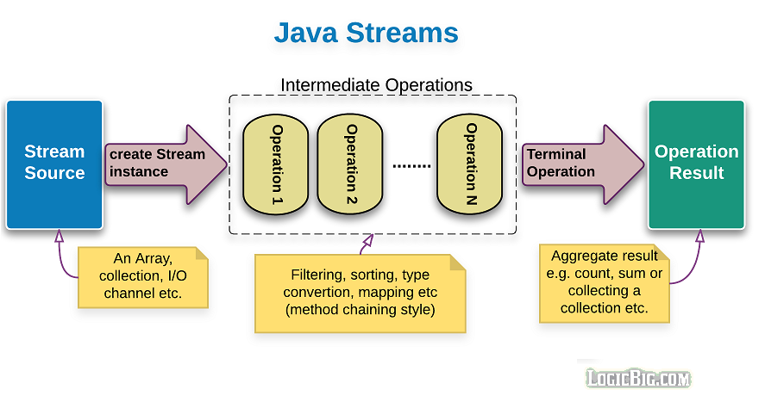
Structure of Java 8 Stream Operations
The three important components to make it work.
  A source
  one or more intermediate operations
  A terminal operation.
The three are pipelined in a sequence to make a stream work.

Slide 51
Intermediate operations
  intermediate operations are lazy.
    They will not be invoked until the terminal operation is invoked.
    Streams become accessible when intermediate operations were called.
  Return streams and can create pipeline of operations.
    map, filter, and limit

Slide 52
Terminal Operations
Streams end with a terminal operation.
They produce a result or side effect, marking the end of a stream.
Examples:
  forEach,
  collect,
  count,
  min, max

Slide 53
Filter()
Takes predicate as an argument
Applies to the whole stream and returns a filtered stream
  Containing elements which match the Predicate.
  List<Customer> filteredList= customerList.stream().filter((Customer cust ) -> cust.getCustomerId() >200).collect(toList());
  System.out.println("After applying filter method");
  filteredList.forEach(System.out::println);

Slide 54
collect()
A terminal operation
It accepts an argument of the type Collector
Predefined collectors for most common operations.
Collectors.toList()
  Used for collecting all Stream elements into a List instance.
Collectors.toSet()
  Used for collecting all Stream elements into a Set instance.

Slide 55
Map()
Takes an instance of Function <T, R> as parameter
Converts the type of elements in the stream from the current type T to the new type R.
Returns as output a stream of type R or Stream<R>
  List<Customer> customerList = HandleCustomers.getCustomers();
  List<Long> phoneBook = customerList.stream().
  map((eachCust)->eachCust.getPhoneNumber()).collect(toList());
  phoneBook.forEach(System.out::println);

Slide 56
Max , Min ,Count
count()
  returns the count of elements of a stream.
max()
  returns the maximum element of a stream according to the provided Comparator.
min()
  returns the minimum element of a stream according to the provided Comparator.

Slide 57
Min
  List<Product> catalog = new ArrayList<>();
  Comparator<Product> priceComparator = Comparator.comparing(Product::getRatePerUnit);
  String itemType="TV";
  Optional<Product> minresult = catalog.stream().
  filter((Product prod ) -> prod.getProductName().equalsIgnoreCase(itemType)).
  min(priceComparator);
  double leastPriced=0;
  if(minresult.isPresent())
  {
  leastPriced= minresult.get().getRatePerUnit();
  }

Slide 58
Max
  Optional<Product> maxresult= catalog.stream().
  filter((Product prod ) -> prod.getProductName().equalsIgnoreCase(itemType)).
  max(priceComparator);
  double highPriced=0;
  if(maxresult.isPresent())
  {
  highPriced= maxresult.get().getRatePerUnit();
  }
  System.out.println("Highest Priced :="+itemType + highPriced);

Slide 59
Count()
  long countresult= catalog.stream().
  filter((Product prod ) -> prod.getProductName().equalsIgnoreCase(itemType)).count();
  System.out.println(countresult);

Slide 60
collect()
Collectors.toCollection()
  To use a custom implementation
  List<String> result = givenList.stream()
  .collect(toCollection(LinkedList::new))
Collectors.toMap()
  Used to collect Stream elements into a Map instance.
  Map<Long, String> map = customerList.stream()
  .collect(Collectors.toMap(Customer::getPhoneNumber, Customer::getCustomerName));
  map.forEach((x, y) -> System.out.println("Key: " + x +", value: "+ y));

Slide 61
MODULE SYSTEM

Slide 62
What is a module
A Module is a group of closely related packages and resources along with a module descriptor file.
  Helps in organizing code
  it’s a “package of Java Packages”
  Abstraction that allows to make code more reusable
  Used to determine what code is publicly accessible outside of the module.

Slide 63
Module System
Core highlight of from Java 9
Module system has a “java.base” Module.
  It’s known as Base Module.
  Every application gets java.base
  packages java.lang, io, math, net, nio, util, security, text, time
  Separate Modules exisit for other packges
Modules are split into some major groups:

Slide 64
Module
Application is a combination of multiple modules
A module represent a specific business capability.
They are self-sufficient for that capability, and should expose only interfaces to use the module functionality.
A Module may be dependent on other modules, which it should declare explicitly to complete its tasks

Slide 65
Packaging Modules
A module can be packaged as a jar file that has a module-info.class file at the root.
To use a module, Need to include the jar file into modulepath instead of the classpath.
A modular jar file added to classpath is normal jar file and module-info.class file will be ignored.

Slide 66
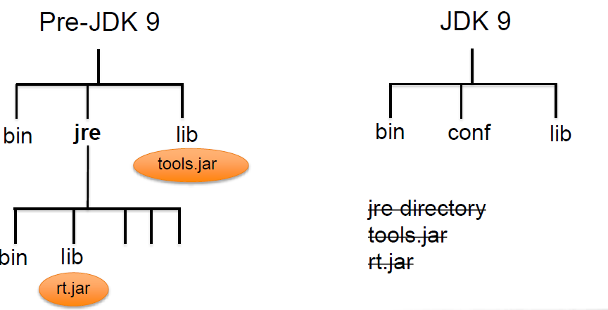
JDK / JRE File Structure

Slide 67
Modular JDK
JDK modules always run in module mode
Classpath sees whole JDK
Modules specify which JDK modules they need
Changes JDK structure
  no more rt.jar
  packaged as .jmod files
  no more boot classpath
  no more extension classpath
Creating a module
What modules does it depend on
  depends on java.base by default
What packages does it export
  nothing exported by default

Slide 68
Resources
Each module is responsible for its resources, like media or configuration files.
In Earlier versions all resources are put into the root level of project and manually managed
  resources belonged to different parts of the application.
Modules, can ship required images and XML files
  Making projects much easier to manage.

Slide 69
Module Naming Rules
Similar to naming packages
  dots are allowed, dashes are not
  Can use project-style (my.module)
  Can use Reverse-DNS (com.training.mymodule).
Module names should follow package names
The module name should be the root package:
  com.training
Module Name
com.greetings.hello
  com.greetings.hello // file system Naming
  Package Name
  com.greetings.hello
  com/greetings/hello // file system naming

Slide 70
Distribution
Can be distributed one of two ways: as a JAR file or as an “exploded” compiled project.
Can create multi-module projects comprised of a “main application” and several library modules.
Can have only one module per JAR file.
Need to make sure to bundle each module in project as a separate jar.

Slide 71
Module Descriptor –module-info.java
A module includes a descriptor file
Name
  The name of the module
Dependencies
  A list of other modules that this module depends on
Public Packages
  A list of all packages to be accessible from outside the module

Slide 72
module-info.java.
  Module Descriptor file contains Module Directive with following information
    Requires
    Exports
  Module declaration begins with the keyword module
  Followed by a unique module name and a module body enclosed in braces
  Body can also be empty
  module modulename {
  }

Slide 73
Requires
requires modulename;
  specifies that the module depends on another module
  required module is needed at compile and run time.
    Modules in JDK are searched then module in module path
    Throws an error if it doesn't find the module.
  module com.training.base {
  requires java.sql;
}

Slide 74
Exports
  By default, a module doesn’t expose any of its API to other modules.
  directive to expose all public members and their nested public and protected types
  The strong encapsulation ,Code is significantly more secure,
  Need to explicitly open the API to make it usable.
  module my.module {
  exports com.my.package.name;
  }
Calling requires my.module, will have access to the public types in com.my.package.name package,

