Slide 1

Spring
Aspect Oriented Programming

Slide 2
Aspect Oriented Programming
Programming technique that promotes separation of concerns within a software system
  Not a replacement for Object Oriented Programming.
  A way of organizing Program Structure
Cross Cutting Concerns
  Transaction management
  Security
  Auditing
  Event handling

Slide 3
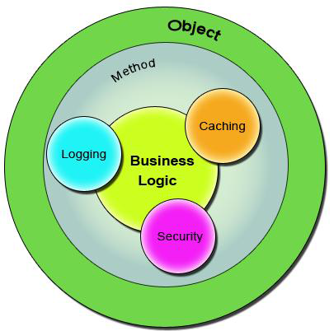
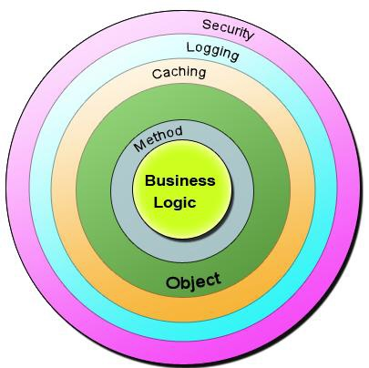
Cross Cutting Concerns

Slide 4
Sample Code
  public class Account {
  public long deposit(long depositAmount){
  newAmount = existingAccount + depositAccount;
  currentAmount = newAmount;
  return currentAmount;
  }
  public long withdraw(long withdrawalAmount){
  if (withdrawalAmount <= currentAmount){
  currentAmount = currentAmount – withdrawalAmount;
  }
  return currentAmount;
  }
  }

Slide 5
Aspect
  An Aspect is a functionality or a feature that cross-cuts over objects.
  Advice is the code that implements the Aspect.
  Aspect defines the functionality in a more abstract manner.
Advice provides a Concrete code Implementation for the Aspect.
  Logging and Transaction Management are the aspects.
  public void deposit(){
  // Transaction Management
  // Logging
  // Checking for the Privileged User
  // Actual Deposit Logic comes here
  }

Slide 6
Joint Point
Join Points defines the various Execution Points where an Aspect can be applied.
  Represents a method execution.
  public void someBusinessOperation(BusinessData data){
  //Method Start - > Possible aspect code here like logging.
  try{
  // Original Business Logic here.
  } catch(Exception exception) {
  // Exception -> Aspect code here when some exception is raised. }
  finally{
  // Finally -> Aspect code at this point too.
  }
  // Method End -> Aspect code here in the end of a method.
  }

Slide 7
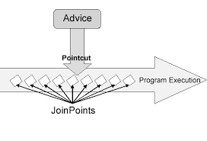
Pointcut
A Pointcut will exactly tell on which Join Points the Aspects will be applied.

Slide 8
Advices
  Before advice :@Before
  Executes before a join point,
  Does not have the ability to prevent execution flow proceeding to the join point (unless it throws an exception).
After returning advice : @AfterReturning
  Executed after a join point completes normally:
After throwing advice : @AfterThrowing
  Executed if a method exits by throwing an exception.
  After advice :@After
  Executed when normal or exceptional return by which a join point exits
  Around advice : @Around
  Advice that surrounds a join point

Slide 9
Around Advice
Represented by org.aopalliance.intercept.MethodInterceptor.
Provides finer control whether the target method has to be called or not.
Around Advice can even change the return type, thereby returning a brand new object of other type if needed.
Can be used to check arguments and execute rather than having it in the actual method implementation.

Slide 10
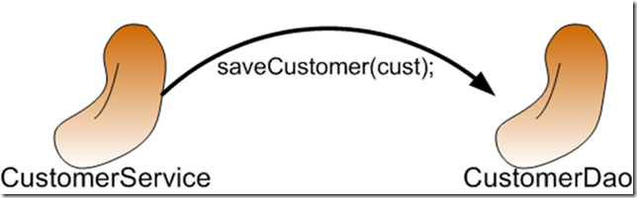
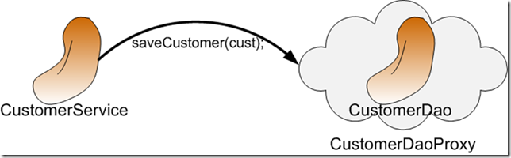
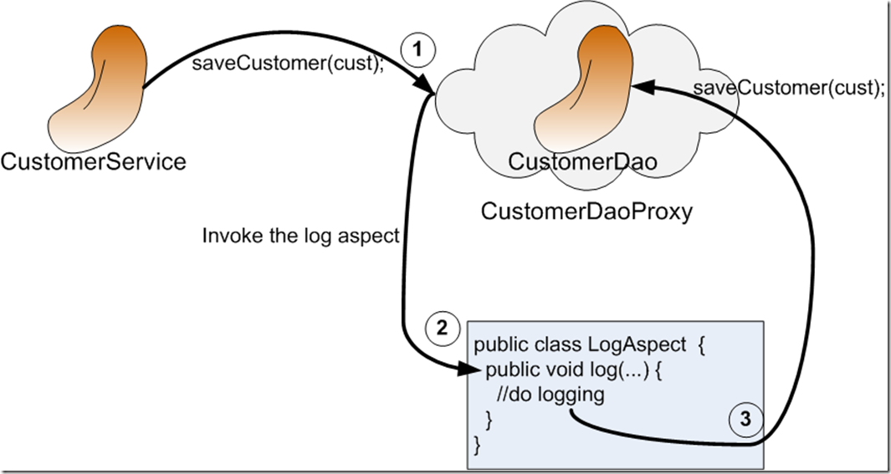
AOP Proxy Mechanism

Slide 11
Dependency
  <dependency>
  <groupId>org.springframework.boot</groupId>
  <artifactId>spring-boot-starter-aop</artifactId> </dependency>

Slide 12
Format of an execution expression
execution(
  modifiers-pattern
  returning-type-pattern
  declaring-type-pattern
  name-pattern(param-pattern)
  throws-pattern
)
execution(public * *(..)) or within(com.xyz.service.*)
execution – for matching method execution join points

Slide 13
Declaring a pointcut
execution(public * *(..))
the execution of any public method:
execution(* set*(..)) -
the execution of any methods beginning with "set":
execution(* com.xyz.service.AccountService.*(..))
the execution of any method defined by the named interface:
execution(* com.xyz.service.*.*(..))
the execution of any method defined in the service package:

Slide 14
Logging Aspect
  @Aspect
  @Component
  public class AroundAspect {
  private final Logger log = LoggerFactory.getLogger(this.getClass());
  @Around("execution(* com.example.demo.services.DemoService.*(..))")
  public Object logging(ProceedingJoinPoint pjp) throws Throwable{
  log.info("Before ");
  Object obj = pjp.proceed();
  log.info("After ");
  return obj;
  }
  }

Slide 15
REST

Slide 16
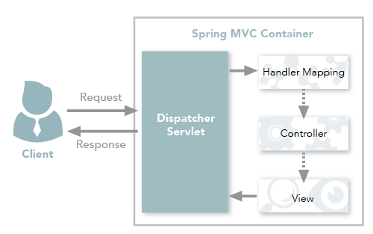
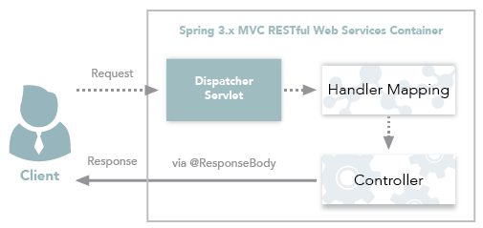
Spring MVC and Spring REST

Slide 17
REST Overview
REpresentational State Transfer
An architectural style of creating API's
  Makes it easier for systems to communicate with each other.
The implementation of the client and server can be done independently without each knowing about the other.
Different clients hit the same REST endpoints, perform the same actions, and receive the same responses.

Slide 18
REST Overview
Resource Oriented Architecture
  Data and functionality are considered resources
  Accessed using Uniform Resource Identifiers (URIs)
  Accessed Using HTTP standard methods.

Slide 19
Lightweight Web Services
REST is a lightweight alternative to Web Services and RPC.
REST services is:
  Platform-independent
  Language-independent
  Runs on top of HTTP Protocol
  Used in the Presence of firewalls too.
REST does not offer
  built-in security features
  encryption
  session management
These feature can be added by building on top of HTTP:

Slide 20
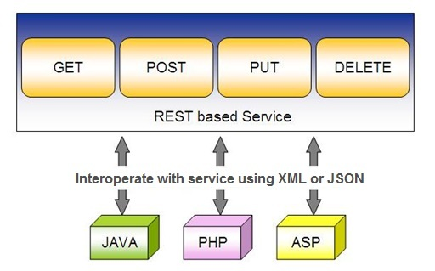
Spring RESTful Services
REST does not require the client to know anything about the structure of the API.
Server needs to provide whatever information the client needs to interact with the service.

Slide 21
Using appropriate Request Methods
GET :
  Should not update anything.
  Should be idempotent (same result in multiple calls).
  Possible Return Codes 200 (OK) + 404 (NOT FOUND) +400 (BAD REQUEST)
POST :
  Should create new resource.
  Ideally return JSON with link to newly created resource.
  Same return codes as get possible.
  In addition : Return code 201 (CREATED) is possible.

Slide 22
Using appropriate Request Methods
PUT :
  Update a known resource. ex: update client details.
  Possible Return Codes : 200(OK)
DELETE :
  Used to delete a resource.
  Possible Return Codes : 200(OK) or a 204 - no content

Slide 23
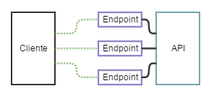
API and Endpoint

Slide 24
API and Endpoint
REST API
  API accessed using the HTTP protocol at a predefined set of URLs.
  URLs represent various resources
  Resource can be returned as JSON, HTML, audio files, or images.
  https://developers.facebook.com/docs/graph-api/
Endpoint:
  The part that comes after the Base URL.
  /invoices
  /invoices/5

Slide 25
SPRING DATA REST WITH JPA

Slide 26
Spring RESTful Services
A RESTful architecture may expose multiple representations of a resource.
From Spring 4 @RestController annotation is added to controller
  A combination of @Controller and @ResponseBody
A Rest Controller method returns a domain object instead of a view.

Slide 27
REST Stereotypes
@RestController
  An implicit @ResponseBody is being added to the methods.
  Allows Spring to render the returned HttpEntity and its payload, directly to the response.
@GetMapping
  To map HTTP GET requests onto specific handler methods.
  Composed annotation for @RequestMapping(method = RequestMethod.GET).

Slide 28
REST Stereotypes
@PathVariable
  Indicates that the Method parameter should be bound to a URI template variable.
  @GetMapping("/members/{id}")
  public String getById(@PathVariable String id) { }
@PostMapping
  Combined shortcut for @RequestMapping(method = RequestMethod.POST).
  @PostMapping("/members“)
  public void addMember(@RequestBody Member member) { }

Slide 29
@RequestBody
Used to map the HttpRequest body to a transfer or domain object
  Spring automatically deserializes the JSON into a Java type
  The type of @RequestBody annotation must correspond to the JSON sent from client-side
HttpMessageConverter
  Internally Used by Spring to perform Serialization/deserialization
@Valid
  To perform automatic validation by adding to method argument

Slide 30
ResponseEntity
Represents Complete HTTP response, gives more flexibility
  May be required in some special cases
  Can be used to send Status Code,Response Body,Location to the resource which was altered
  @GetMapping(path = "/api/v1/invoices")
  public ResponseEntity<Invoice> getInvoices() {
  HttpHeaders responseHeaders = new HttpHeaders();
  return ResponseEntity.ok().headers(responseHeaders).body(dao.findAll());
  }

Slide 31
Put Mapping
@PutMapping(path = "/api/v1/invoice")
  public Invoice update(@RequestBody Invoice entity) {
  return this.service.add(entity);
  }
  @PatchMapping(path = "/api/v1/invoice")
  public ResponseEntity<String> updateAmount() {
  return ResponseEntity.status(HttpStatus.CREATED)
  .body("Updated Amount:="+this.service.updateAmount());
  }

Slide 32
Remove Method in Service
  public Invoice remove(Invoice entity) {
  Optional<Invoice> optional = Optional.empty();
  if(this.repository.existsById(entity.getId())) {
  this.repository.delete(entity);
  optional = Optional.of(entity);
  }
return optional;
}

Slide 33
Delete Mapping in Controller
  @DeleteMapping(path = "/api/v1/invoice")
  public ResponseEntity<Invoice> remove(@RequestBody Invoice entity) {
  Invoice invoice = this.service.removeInvoice(entity).orElseThrow(()-> new RuntimeException("Element NOT FOUND"));
  return ResponseEntity.ok().body(invoice);
  }

Slide 34
@RestControllerAdvice
Used for Exception handling in Rest API’s
Used to handle exceptions across the whole application
Like an interceptor of exceptions thrown by methods annotated with @RequestMapping or one of the shortcuts.
It’s a combination of @ContollerAdvice and @ResponseBody.
@ExceptionHandler
  Annotation for handling exceptions in specific handler classes and/or handler methods.

Slide 35
@RestControllerAdvice
  @RestControllerAdvice
  public class ErrorHandler {
  @ExceptionHandler(value = Exception.class)
  public ErrorDetails handleAllExceptions(Exception ex, WebRequest request){
  return new ErrorDetails(LocalDateTime.now(),
  ex.getMessage(), request.getDescription(false));
  }
  }
  request.getDescription(false):
  Whether to include client-specific information like session id and user name

Slide 36
SPRING REST CLIENT-REST TEMPLATE

Slide 37
Consuming REST with REST Template
REST web service can be comsumed programmatically.
Spring convenient template class is called RestTemplate.
  one-line that can bind the data to custom domain types.
It leverages the same marshallers that the server uses.
Can use JAXB marshaller,as well as JSON marshaller

Slide 38
Rest Template
  getForObject(url, java.lang.Class<T>)
    Retrieve a representation by doing a GET on the specified URL.
    Class<T> is the response class Type
getForEntity(url, java.lang.Class<T>)
  Retrieve a representation by doing a GET on the URL
  Class<T> is the response class Type

Slide 39
getForObject
  @Autowired
  RestTemplate restTemplate;
  String obj =
  restTemplate.getForObject("http://localhost:4040/person/all", String.class);
  System.out.println(obj);

Slide 40
PostForObject
Used to create a new Resource
postForObject()
  Returns the Resource itself.
RestTemplate restTemplate = new RestTemplate();
HttpEntity<Book> request = new HttpEntity<>(new Book(“Java"));
Book bk = restTemplate.postForObject(url, request,Book.class);

Slide 41
INTRODUCTION TO MICRO SERVICES

Slide 42
Micro Services
Problems with Monolithic Application
What is Microservices
Advantages and disadvantages
When not to use Microservice
Use case for MicroServices

Slide 43
Monolith Application
A monolithic application is a single-tiered software application
  Has user interface and data access code combined into a single program from a single platform.
Its characteristics
  Doesn’t have Module but Modularized using object-based approach to be distributed across multiple computers
  Deployed together as a single deployment unit- EAR or WAR.
  Long Release Cycles
  Large Teams

Slide 44
Challenges to Monolith
  Large codebases become mess over the time
  Multiple teams working on single codebase become tedious
  Difficulty in Adapting to Device Explosion
  Scaling up certain parts of the application
  Technology updates/rewrites become complex and expensive tasks

Slide 45
Micro Services
An engineering approach focused on decomposing applications with well-defined interfaces - service contracts such as a JSON schema or WSDL
  Deployed independently as services and operated by small teams who own the entire lifecycle of the service.
  Each service handles a specific business domain (logging, auth, orders, customers)
  Each Service provides the implementation for user interface, business logic, and connection to database.
  Each Service can be scaled up Individually

Slide 46
Micro Service
  class UserApp() {
  User getUser() {
  // 1. auth user
  // 2. get user data
  // 3. log user actions
  }
  }
  class UserApp() {
  void authUser(User user) { ... }
  User getUserData() { ... }
  void logUserActions() { ... }
  }

Slide 47
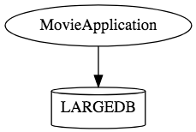
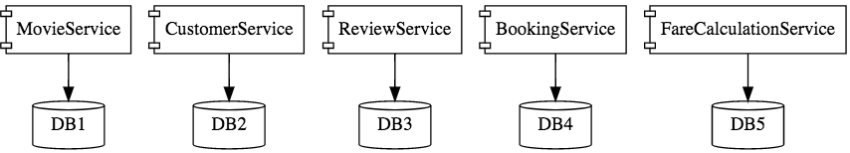
Micro Services

Slide 48
When Not to use Micro Services
Complexity is a key factor
  "...don't even consider microservices unless you have a system that's too complex to manage as a monolith...“ –Martin Fowler
If complexity isn't problem, microservices aren't the solution.
Micro service architecture also brings with it significant overhead
  Design
  Interoperability of services
  Management
  Use of system resources.

Slide 49
Challenges with Micro service
Development has some inherent complexities
Quick Setup needed
  Should be able to create micro services quickly.
Automation
  Smaller component build ,deployment, monitoring etc should automated
Visibility :
  Should be able to monitor and identify problems automatically.
  Need great visibility around all the components.
Debugging
  Centralized Logging and Dashboards are essential to debug problems.

Slide 50
Challenges with Micro service
Configuration Management
  Need to maintain configurations for hundreds of components across environments.
  Should Have Configuration Management solution
Dynamic Scale Up and Scale Down
  Applications should be easily scaled up and down
Pack of Cards :
  If a Service at the bottom of the call chain fails, it can have knock on effects on all other services.
  Services should be fault tolerant by Design.
Consistency
  Should have some decentralized governance around the languages, platforms, technology and tools used for implementing/deploying/monitoring

Slide 51
SPRING CLOUD EUREKA

Slide 52
Service Register and Discovery
Application is decomposed into Many Microservices.
  Each deployed in different servers and different ports.
Services may need to communicate with each other to execute some tasks
  Using ip address and port number has many limitations on invoking the services

Slide 53
Service Register and Discovery
“Service Registration“.
  Services are registered in a centralized location with an identifier and server details.
“Service Discovery”
  Microservice should be able to look up the list of registered services from the centralized location
Implementations of Service Registration and Discovery Server
  Netflix Eureka
  Consul
  Zookeeper

Slide 54
Netflix Eureka Server
Micro services will register with Eureka server
Services provide the following details
  host name, ip address, port, and health indicators etc…
serviceId.
  The Unique Id given to the registered Services
    Also Used to by other services for access

Slide 55
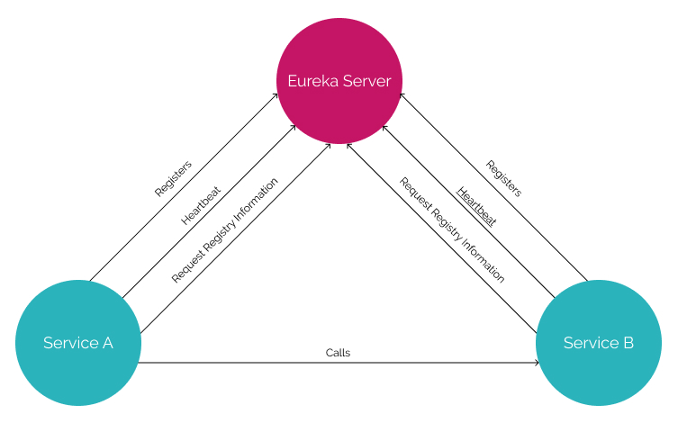
Service Registry

Slide 56
Service Registry
Handles only Registration
  Not communication between the two servers
  Communication is directly between the two services
Cache
  If Eureka is down, the client uses a cached copy of the remote service's address
  Can handle temporary network failures.

Slide 57
Netflix Eureka Server
@EnableEurekaServer
  Added to the main Spring Boot Application configuration class
  Used to Notify the Spring Container that this application is a registration service by Netflix technology
  It also activates Eureka Server related configurations
  @EnableEurekaServer
  @SpringBootApplication
  public class EurekaServerApplication {
  public static void main(String[] args) {
  SpringApplication.run(EurekaServerApplication.class, args);
  }
  }

Slide 58
Server Config Properties
  server:
  port: 8761
  spring:
  application:
  name: eureka-server-registry
  eureka:
  client:
  fetch-registry: false
  register-with-eureka: false
  service-url:
  defaultZone: http://localhost:8761/eureka

Slide 59
Configuration Properties
fetch-registry=false (default: true)
  A Eureka instance is also a Eureka client
  It can fetch the registry containing the details of other instances.
  “false” means it will not be fetching the registry information
register-with-eureka=false (default: true)
  Should this server register itself as a client;
  “false” means it prevents itself from acting as a client.

Slide 60
Configuration Properties
eureka.client.serviceUrl.defaultZone
  In a standalone mode
    points to the local server address.
    Switch off the client-side behavior
    Does not keep trying and failing to reach its peers.

Slide 61
EUREKA DISCOVERY CLIENT

Slide 62
Discovery From Eureka Server
EurekaClientConfigBean
    Implementation of EurekaClientConfig.
    Properties are prefixed by eureka.client.
Discovery clients
  Clients can look up and fetch information of other services
  Can communicate without IP addresses and port numbers

Slide 63
Discovery Clients
@EnableDiscoveryClient
  Added in the main spring boot configuration class
  Works with any Discovery Client implementations
  Example : Eureka, Consul, Zookeeper
@EnableEurekaClient
  Works only with Eureka

Slide 64
Discovery Client Service
  @SpringBootApplication
  @EnableEurekaClient
  public class BloodDonarServiceApplication {
  public static void main(String[] args) {
  SpringApplication.run(BloodDonarServiceApplication.class, args);
  }
  }

Slide 65
application.yml
  spring:
  application:
  name: product-service
  server:
  port: 5454
  eureka:
  client:
  service-url:
  defaultZone: http://localhost:8761/eureka

Slide 66
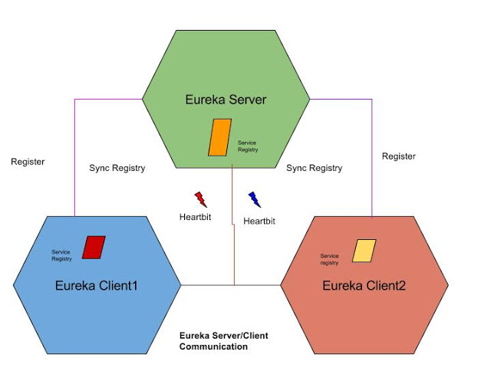
Eureka Working

Slide 67
LOAD BALANCING

Slide 68
Load Balancing
The process of distributing network traffic across multiple servers.
  Ensures no single server bears too much demand.
  Spreads the work evenly
  Improves application responsiveness.
  Increases availability of applications and websites for users.
When the number of users is large, a service is created multiple replicas.
  Each replica runs on a different computer.

Slide 69
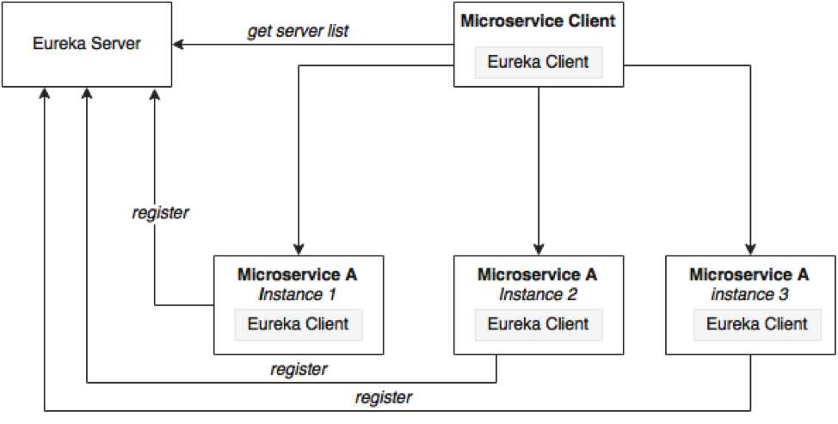
Load Balancing

Slide 70
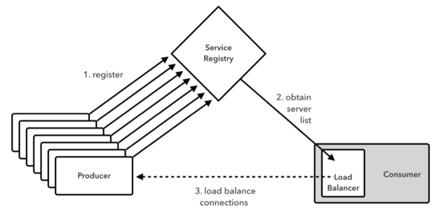
Working of Load Balancer

Slide 71
Load Balancing on Server Side
Load Balancers are components placed at the Server Side.
When the requests come from the Client, they will go to the load balancer, and the load balancer will designate a Server for the request.
It may use algorithm like random designation.
Most load balancers are hardware, integrated with software to control load balancing.
Need a separate server to host the load balancer instance which has the impact on cost and maintenance.

Slide 72
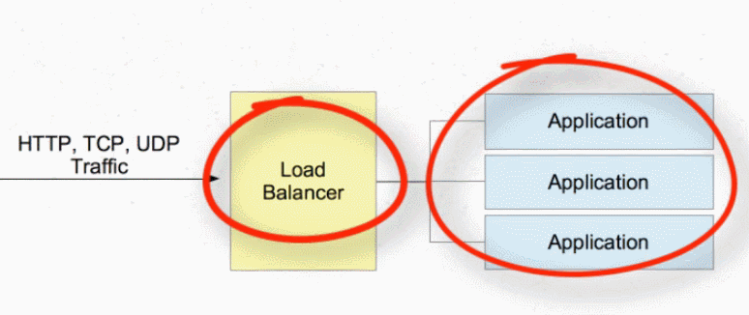
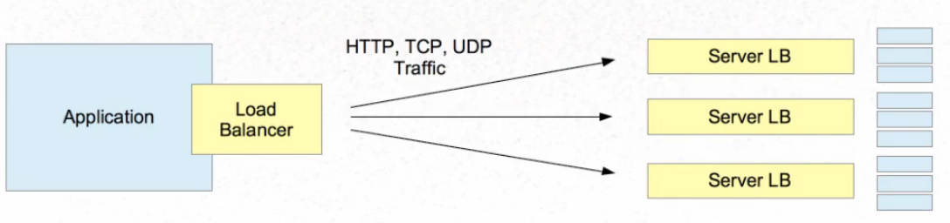
Server Side and Client Side

Slide 73
@LoadBalanced
  Eliminates direct use of Ribbon
  Ribbon automatically integrates with RestTemplate
    Makes RestTemplate ribbon aware.
  Also helps to use "logical identifiers" for the URLs passed to restTemplate.
    logical identifiers are name of a service.
  @Bean
  @LoadBalanced
  public RestTemplate template() {
  return new RestTemplate();
  }

Slide 74
Rest Client - Application
  @SpringBootApplication
  @EnableDiscoveryClient
  public class PaymentServiceApplication {
  public static void main(String[] args) {
  SpringApplication.run(PaymentServiceApplication.class, args);
  }
  @Bean
  @LoadBalanced
  public RestTemplate template() {
  return new RestTemplate();
  }
  }

Slide 75
Rest Client - Controller
  @RestController
  @Slf4j
  public class PaymentController {
  @Autowired
  private RestTemplate template;
  String baseURL = "http://CUSTOMER-SERVICE/";
  @GetMapping(path = "/api/v1/client/customers")
  public String getCustomerDetails() {
  String reqURL = baseURL+"api/v1/customers";
  return this.template.getForObject(reqURL, String.class);
  }
  }

Slide 76
HTTP Client
Hypertext Transfer Protocol
  Used to transmit data on the World Wide Web.
  Used to request and transmit a wide variety of data,
    HTML documents, images, videos, and other media.
  Client send a request to a server and get the response back from the server.

Slide 77
HttpClient
HTTPClient library was introduced in Java 11
  Need for other libraries like Apache Http Client is eliminated
HttpClient is immutable, and can be used to send multiple requests.
Provides a lot of useful and self-describing methods
Supports both HTTP/1.1 and HTTP/2
Default use is HTTP/2,
  if the request sent to the servers does not support HTTP/2
  Will automatically downgraded to HTTP/1.1.

Slide 78
Using HTTP Client
Create a HttpClient instance.
Create an HttpRequest instance
  HttpRequest.newBuilder()
Send a request by using send() method
Get the response as a HttpResponse class object
  HttpClient httpClient = HttpClient.newBuilder().build();

Slide 79
HttpRequest
  String url ="http://localhost:8080/api/v1/students";
  HttpRequest req= HttpRequest
  .newBuilder(URI.create(url))
  .GET()
  .build();

Slide 80
Handle Response
  Response body and headers of the response can be obtained
  HttpClient httpClient = HttpClient.newHttpClient();
  HttpResponse response = httpClient.send(req,BodyHandlers.ofString());
  response.headers().map().entrySet().forEach(System.out::println);
  System.out.println(response.statusCode());
  System.out.println(response.body());

Slide 81
Async Request
  String url ="http://localhost:8080/api/v1/restaurants";
  HttpClient httpClient = HttpClient.newHttpClient();
  HttpRequest req= HttpRequest
  .newBuilder(URI.create(url))
  .GET()
  .build();
  httpClient.sendAsync(req,BodyHandlers.ofString())
  .thenApply(HttpResponse::body)
  .thenAccept(System.out::println)
  .join();

